Slide 1
Acidosis and alkalosis
Acid-base disorders are very common clinical problems.
PH 7.35-7.45
Acidemia is a pH <7.35, and
alkalemia is a pH >7.45.
Acidosis and alkalosis are used to describe how the pH changes.
The primary causes of acid-base disturbances are abnormalities in the respiratory system and in the metabolic or renal system.

Slide 2
DISORDERS OF ACID-BASE BALANCE
The pH of the arterial plasma is normally 7.40, (pH 7.36-7.44) corresponding to a H⁺ concentration of 40 nmol/l. An increase in H⁺ concentration corresponds to a decrease in pH.
this parameter is under tight homeostatic regulation, such that the H⁺ concentration does not vary outside the range 36-44 nmol/l (pH 7.44-7.36) under normal circumstances.
IN acidosis there is anaccumulation of acid or loss of abase causing afall in Ph . The converse accure in alkalosis .
Abnormal acid-base balance occurs in a wide range of diseases variety of physiological mechanisms act to prevent wide swings in the pH of the ECF.
The first is the action of blood and tissue buffers, of which the most important is the carbonic acid/bicarbonate buffer system. This involves the reaction of H⁺ ions with bicarbonate to form carbonic acid, which, under the influence of the enzyme carbonic anhydrase (c.a.), dissociates to form CO₂ and water, as follows:
CO2+H2O---H2CO3----H2+HCO3
This buffer system is important because bicarbonate is present in relatively high concentration in the ECF (21-28 mmol/l), and two of its key components are under physiological control: the CO₂ by the lungs, and the bicarbonate, by the kidneys.

Slide 3
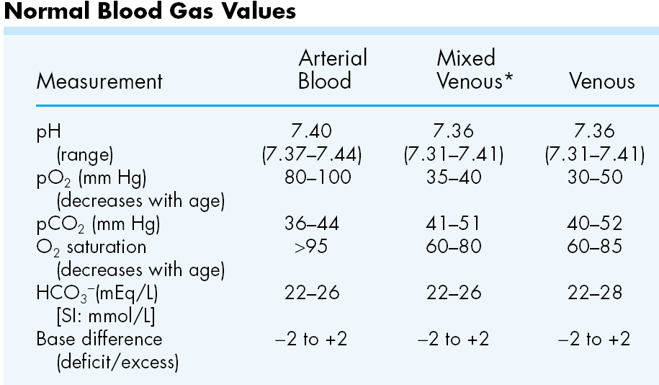

Slide 4
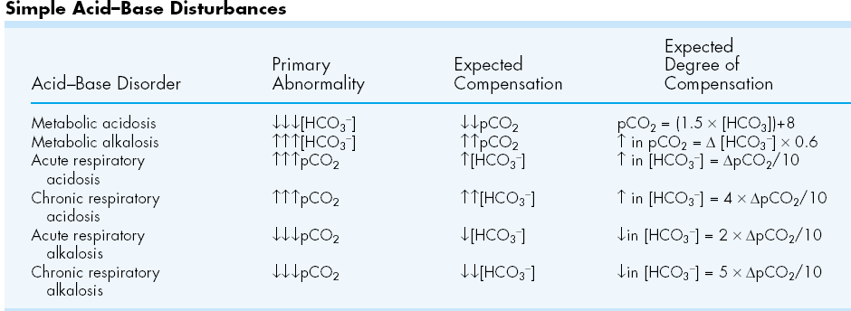

Slide 5
Metabolic acidosis :decrease HCO3<24mmol ,decrease CO2<5.33kpa ,PH>40
Metabolic alkalosis
increase HCO3>24mmol ,increase CO2>5.33kpa ,PH<40
Respiratory acidosis: increase HCO3>24mmol ,increase CO2>5.33kpa ,PH>40
Respiratory alkalosis: increase HCO3<24mmol ,decrease CO2<5.33kpa ,PH<40

Slide 7
ACIDOSIS 1-METABOLIC ACIDOSIS
Metabolic acidosis occurs when an acid other than carbonic acid (due to CO₂ retention) accumulates in the body, resulting in a fall in the plasma bicarbonate.
The pH fall which would otherwise occur is blunted by hyperventilation, resulting in a reduced PCO₂. If the kidneys are intact (i.e. not the cause of the initial disturbance), renal excretion of acid can be gradually increased over days to weeks, raising the plasma bicarbonate and hence the pH towards normal in the new steady state

Slide 8
Causes
Base loss(Bicarbonate losses )
Extra renal = ( Small bowel drainage Diarrhea )
Renal = renal tubular acidosis ( Urinary loss of HCO₃ in proximal RTA
Carbonic anhydrase inhibitors Primary hyperparathyroidism
Failure of bicarbonate regeneration
Distal renal tubular acidosis (impaired tubular acid secretion )
Aldosterone deficiency (Addison's disease
Aldosterone insensitivity ( Interstitial renal disease, Aldosterone antagonists)
Ureteroileostomy (ileal bladder)
Acidifying salts ( Ammonium chloride , Lysine or arginine hydrochloride )
Diabetes mellitus
Reduced excretion of acids ( Renal failure: Accumulation of organic acids
Overproduction of acids
Ketoacidosis
1- Diabetic(Accumulation of ketones¹ with hyperglycaemia)
2-Alcoholic
3-Starvation (Accumulation of ketones without hyperglycaemia)
Lactic acidosis( Tissue hypoxia (e.g. shock) or liver disease)
Toxin ingestion ( Methanol Ethylene glycol Salicylates)

Slide 9
Clinical features
Rapid deep breathing ?stimulation of respiratory centre by reduction in PH of blood &to eleminat acid substance
The urin strongly acidic

Slide 10
Management
The first step in management of metabolic acidosis is identifying and correcting the cause when possible . This may involve control of diarrhoea, treatment of diabetes, correction of shock, cessation of drug administration, or dialysis to remove toxins. Since metabolic acidosis is frequently associated with sodium and water depletion, resuscitation with appropriate intravenous fluids will often be needed.
Use of intravenous bicarbonate in this setting is controversial. Because rapid correction of acidosis has some inherent risks (e.g. induction of hypokalaemia or reduced plasma ionised calcium), use of bicarbonate infusions is best reserved for situations where the underlying disorder cannot be readily corrected and where the acidosis is severe (H⁺ > 70 nmol/l, pH < 7.15) and associated with evidence of tissue dysfunction. The acidosis associated with RTA can sometimes be controlled by treating the underlying cause . Usually, however, supplements of sodium and potassium bicarbonate are necessary to achieve the target of a plasma bicarbonate level above 18 mmol/l with normokalaemia in types 1 and 2 RTA, while diuretics or corticosteroids (as appropriate) may be effective in reversing the underlying disturbance in type 4 RTA.

Slide 11
RESPIRATORY ACIDOSIS acondition
where the PCO2 is above the normal range is caused by:
1-impairment in the rate of alveolar ventilation.
2-a sudden depression of the medullary respiratory center (narcotic overdose),
3-paralysis of the respiratory muscles(M.G,G.B ,toxines ,anasthesia
4-airway obstruction.(infection ,allergy ,tumoures ,F.B….
5-Chronic respiratory acidosis in chronic airway disease (emphysema), with extreme kyphoscoliosis, and with extreme obesity (pickwickian syndrome).
The serum bicarbonate concentration is increased, the magnitude of which depends on the acuity and the severity of the respiratory disorder. Acute increases in the Pco₂ result in somnolence, confusion, and, ultimately, carbon dioxide narcosis. Asterixis may be present. Because carbon dioxide is a cerebral vasodilator, the blood vessels in the optic fundi are often dilated, engorged, and tortuous. Frank papilledema may be present in patients with severe hypercapnic states.
treatment
1-The only practical therapy of acute respiratory acidosis involves treatment of the underlying disorder
2-O2 and
3- ventilatory support. I
n patients with chronic hypercapnia who develop an acute increase in the Pco₂, attention should be directed toward identifying factors that may have aggravated the chronic disorder. Alkalinizing salts should be avoided in patients with chronic

Slide 12
METABOLIC ALKALOSIS
Aetiology and clinical assessment Metabolic alkalosis is characterised by an increase in the plasma bicarbonate concentration and the plasma pH .
There is a compensatory rise in PCO₂ due to hypoventilation. CAUSES
1-Hypovolaemic metabolic alkalosis
is the most common pattern, such as sustained vomiting where acid-rich fluid is lost directly from the body.
during treatment with most diuretic drugs (other than carbonic anhydrase inhibitors and potassium-sparing drugs), since the diuretic action involves increased acid loss into the urine.
2- Normovolaemic (or hypervolaemic) metabolic alkalosis
occurs in settings where both bicarbonate retention and volume expansion occur simultaneously. Classical causes include corticosteroid excess states such as primary hyperaldosteronism (Conn's syndrome, Cushing's syndrome and corticosteroid therapy. Occasionally, overuse of antacid salts for treatment of dyspepsia can produce a similar pattern.

Slide 13
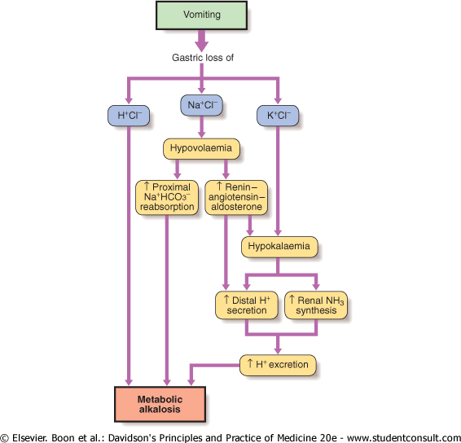

Slide 14
. Clinically, apart from manifestations of the underlying cause, there may be few symptoms or signs related to alkalosis itself. When the rise in systemic pH is abrupt, plasma ionised calcium falls and signs of increased neuromuscular irritability such as tetany may develop

Slide 15
Management In metabolic alkalosis associated with hypovolaemia,
treatment involves provision of adequate intravenous fluid, specifically isotonic sodium chloride, which interrupts the volume-conserving mechanisms and allows the kidney to excrete the excess alkali in the urine.
Replacement of potassium helps correct the hypokalaemia and its consequences in the kidney. In metabolic alkalosis associated with normal or increased volume, treatment should focus on correcting the underlying cause, specifically the removal or blockade of excess mineralocorticoid activity. The approach depends on the underlying endocrinological diagnosis .

Slide 16
RESPIRATORY ALKALOSIS
occurs when hyperventilation reduces the arterial Pco₂₍₃₁₋₄₂₎ and consequently increases the arterial pH. Acute respiratory alkalosis is most commonly a result of the
hyperventilation syndrome. It may also occur in
damage to the respiratory centers
,hysterical
acute salicylism,
in fever and
septic states
association with various pulmonary processes (pneumonia, pulmonary emboli, or congestive heart failure).
iatrogenically by injudicious mechanical ventilatory support.
Chronic hyperventilation occurs in the acclimatization response to high altitudes (a low ambient oxygen tension),
in advanced liver disease,
and in pregnancy
. Acute hyperventilation is characterized by lightheadedness, paresthesias, circumoral numbness, and tingling of the extremities. Tetany occurs in severe cases. When anxiety provokes hyperventilation, air rebreathing with a paper bag generally terminates the acute attack

Slide 17
Disturbance | Blood H⁺ | Primary change | Compensatory response | Predicted compensation
Metabolic acidosis | > 40¹ | HCO₃ < 24 mmol/l | PCO₂< 5.33 kPa² | P CO₂ fall in kPa = 0.16 ×HCO₃ fall in mmol/l
Metabolic alkalosis | < 40¹ | HCO₃> 24 mmol/l | PCO₂> 5.33 kPa²,³ | PCO₂ rise in kPa = 0.08 ×HCO₃ rise in mmol/l
Respiratory acidosis | > 40¹ | PCO₂> 5.33 kPa² | HCO₃> 24 mmol/l | Acute:HCO₃ rise in mmol/l = 0.75 ×PCO₂rise in kPa Chronic: HCO₃ rise in mmol/l = 2.62×P CO₂ rise in kPa
Respiratory alkalosis | < 40¹ | PCO₂< 5.33 kPa² | HCO₃< 24 mmol/l | Acute:HCO₃ fall in mmol/l = 1.50 ×CO₂fall in kPa Chronic: HCO₃ fall in mmol/l = 3.75×P CO₂ fall in kPa

