Slide 1

Bio Lab
Genetic engineering
2nd semester

Slide 2
Genetic engineering
Process of inserting new genetic information into existing cells in order to modify a specific organism for the purpose of changing its characteristics (alters the genetic structure of an organism by either removing or introducing DNA).
Or it refers to the direct manipulation of DNA to alter an organism’s characteristics (phenotype) in a particular way. This may mean changing one (A-T or C-G), deleting a whole region of DNA, or introducing an additional copy of a gene.

Slide 3
Also called genetic modification or genetic manipulation, is the direct manipulation of an organism's genes using biotechnology. It is a set of technologies used to change the genetic makeup of cells, including the transfer of genes within and across species boundaries to produce improved or novel organisms.
Genetic engineering is used by scientists to any organism, from a virus to a sheep.

Slide 4
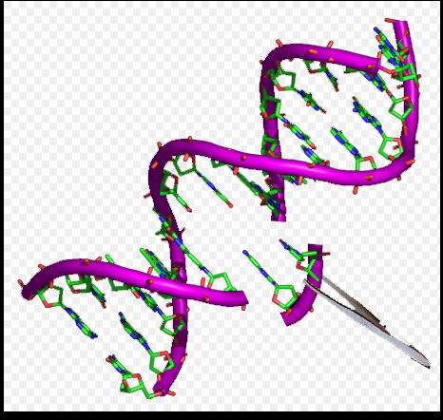
New DNA is obtained by either isolating and copying the genetic material of interest using recombinant DNA methods or by artificially synthesizing the DNA.

Slide 5
*The first recombinant DNA molecule was made by Paul Berg in 1972 by combining DNA from the monkey virus SV40 with the lambda virus.
*Genetic engineering involves the direct manipulation of one or more genes. Most often, a gene from another species is added to an organism's genome to give it a desired phenotype.
*An organism that is generated through genetic engineering is considered to be genetically modified(GM) and the resulting entity is a genetically modified organism (GMO). The first GMO was a bacterium in 1973.

Slide 6
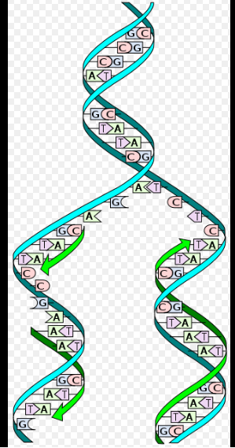

Slide 7
*Genetic engineering has been applied in numerous fields including research(Micro organisms &proteins), medicine(human insulin, growth hormone, enzymes, drugs,vaccines & heart disease, diabetes, arthritis, ..), industrial(Genetically modified food) biotechnology(GM animal ,GM bacteria,..) and agriculture(GM crops).
In research GM organisms are used to study gene function and expression through loss of function, gain of function, tracking and expression experiments.

Slide 8
Inserting DNA into the host genome
There are a number of techniques used to insert genetic material into the host genome. Some bacteria can naturally take up foreign DNA.
This ability can be induced in other bacteria via stress (e.g. thermal or electric shock), which increases the cell membrane's permeability to DNA; up-taken DNA can either integrate with the genome or exist as extrachromosomal DNA. DNA is generally inserted into animal cells using microinjection, where it can be injected through the cell's nuclear envelope directly into the nucleus, or through the use of viral vectors.

Slide 9
*In animals it is necessary to ensure that the inserted DNA is present in the embryonic stem cells, Bacteria consist of a single cell and reproduce clonally so regeneration is not necessary, But in plants the DNA is often inserted using Agrobacterium-mediated recombination Selectable markers are used to easily differentiate transformed from untransformed cells.
These markers are usually present in the transgenic organism.
*Further testing using PCR, Southern hybridization, and DNA sequencing is conducted to confirm that an organism contains the new gene.

Slide 10
Recombinant Technology
-Basically it is the potential genetic engineering field by using PCR or microorganisms.
-Genes are Isolated ,Modified &Inserted into an organism they are made up by recombinant technology through:
–Cutting DNA and recombine their pieces
–Amplify modified pieces.

Slide 11
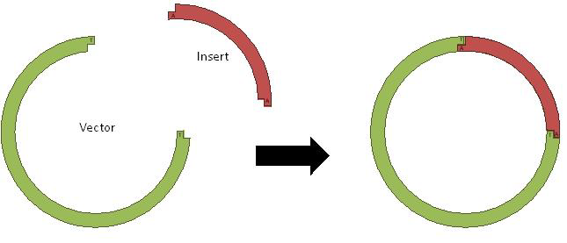
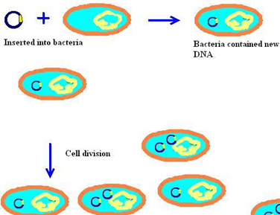

Slide 12
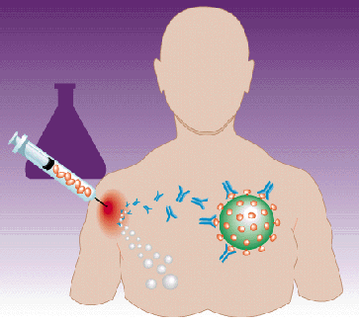
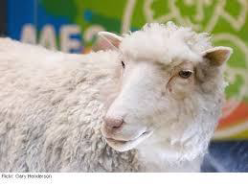
Applications
Engineered Proteins (Hormons-Insulin, and blood-clotting factors &Vaccines by using bacteria)
Produce Drugs,foods,enzymes.
Cleaning Up the Environment(Microorganisms can break down organic wastes and cycle materials.
Basic Researchs(genetic processes).
Engineered Mammals(mice, Cattle& chicken)

Slide 13
THANK YOU

