Slide 1
Intracerebral Hemorrhage

Slide 2
Intracerebral hemorrhage
accounts for 8-13% of all strokes and results from a wide spectrum of disorders, is more likely to result in death than ischemic stroke.
Intracerebral hemorrhage and accompanying edema may disrupt or compress adjacent brain tissue, leading to neurological dysfunction. Substantial displacement of brain parenchyma may cause elevation of intracranial pressure (ICP) and potentially fatal herniation syndromes.

Slide 3
Asian countries have a higher incidence of intracerebral hemorrhage than other regions of the world possibly due to environmental factors (eg, a diet rich in fish oils) and/or genetic factors.
Incidence of intracerebral hemorrhage increases in individuals older than 55 years and doubles with each decade until age 80 years.

Slide 4
Hypertensive hemorrhage:
Hypertension is the most common cause (Over 50%) of nontraumatic (spontaneous) intracerebral Hg.
1.chronic hypertension: chronic HT. appears to promote structural changes in the walls of the penetrating arteries ,predisposing to formation of a microaneurysms (Charcot-Bouchard)in those arteries ,and now there is a general agreement that massive cerebral Hg follow the rupture of those aneurysms.
2.acute hypertension: many patients with intracerebral Hg ,has no history of chronic HT.,and lack such sings of hypertensive end-organ disease as LVH,retinopathy or nephropathy. It has been therefore suggested that a sudden elevation of Bd. pressure may cause intracerebral Hg.
Acute elevation of Bd. may also precipitate Hg. in chronically hypertensive patients with Charcot-Bouchard aneurysms.

Slide 5
Other Causes Of Intracerebral Hemorrhage
Trauma :Usually closed-head trauma. Most common locations are frontal and temporal poles .
Vascular Malformations : Can be divided into arteriovenous malformations (AVMs) and aneurysms ;bleeding from AVMs which are located within the brain parenchyma ,typically causes intracerebral Hg ,whereas bleeding from aneurysms ,which are situated on the surface vessels ,produce subarachnoid Hg.However blood from AVMs can extend into the subarachnoid space ,and aneurysms in some locations can bleed into the brain itself.
Hemorrhage into cerebral infarcts: Some cases of cerebral infarction ,especially when embolic in origin ,are accompanied by Hg into the infarct.

Slide 6
Amphetamine or Cocaine Abuse : Typically occurs within minute to hours after the drug is administered .Most such Hgs are located in the subcortical white matter and may be related to either acute elevation of blood pressure or drug induced arteritis.
Hemorrhage into Tumors: Primary or metastatic brain tumors is an occasional cause of intracerebral Hg .
Anticoagulation: Patients receiving heparin or warfarin are at increased risk for developing intracerebral hemorrhage.
Coagulopathy: Intracerebral Hg is a complication of both clotting factors and platelets disorders, such as hemophilia and ITP.

Slide 7
Clinical features
intracerebral Hg occurs without warning mostly when the patient is awake, headache is present in 50% and may be severe and vomiting is common.
Bd.pressuer is elevated after the Hg. has occurred. Thus, normal or low Bd.pressure in patient with stroke make the diagnosis of hypertensive Hg unlikely.
supratentorial hemorrhage
Contralateral hemiplegia, hemisensory loss, aphasia, neglect, gaze abnormalities, and hemianopia.
Infratentorial hemorrhages manifest
cranial nerve abnormalities, ataxia, nystagmus, cerebellar signs.
Approximately 10% of patients with ICH in the lobar areas also experience seizures at onset or in the first 24 hours after symptom onset.

Slide 8
Predilection sites for intracerebral hemorrhage include the following:
basal ganglia (40-50%),
lobar regions (20-50%),
thalamus (10-15%),
pons (5-12%),
cerebellum (5-10%),
other brainstem sites (1-5%).
Intraventricular hemorrhage occurs in one third of intracerebral hemorrhage cases from extension of thalamic ganglionic bleeding into the ventricular space. Isolated intraventricular hemorrhage frequently arise from subependymal structures including the AVMs, and cavernous angiomas.

Slide 9
Clinical features according to site of hg:
Deep cerebral Hg: The most common sites of intracerebral Hg are the putamen and the thalamus, which are separated by the posterior limb of the internal capsule. Pressure on these fibers from lateral(putaminal) or medial(thalamic) hematoma produces; a cotralateral sensorimotor deficit, homonymous hemianopia and aphasia if hematoma exert pressure on the cortical language areas.
Lobar Hg: In the subcortical white mater underlying frontal,parietal,temporal and occipital lobes. Symptoms and sings are vary according to the location.
Pontine Hg: Coma occurs within seconds to minute and usually lead to death within 48 hours .Other clinical features include; pinpoint pupils, hyperthermia, quadriplegia and patient may exhibits decerebrate posture.
Cerebellar Hg:The distinctive features of crebellar Hg (headache, vomiting and inability to walk or stand) begin suddenly and the clinical picture is indistinguishable from that of pontine Hg.

Slide 10
Brain Imaging
Brain CT scan can demonstrate very early hemorrhage, and Because of its speed and wide availability, noncontrast head CT is the imaging modality of choice in patients with acute stroke.
Laboratory Studies:
Complete blood count (CBC) with platelets:
Prothrombin time (PT)/activated partial thromboplastin time (aPTT): Identify a coagulopathy.
Serum chemistries including electrolytes.
Screening for hematologic, infectious, and vasculitic etiologies.
ECG frequently identifies cerebrum-induced dysrhythmia or cardiac injury.

Slide 11
Consider further diagnostic workup CT angiography (CTA), MR angiography (MRA), and digital subtraction angiography (DSA) for:
young patients,
patients with lobar hemorrhage,
patients without a history of hypertension,
and patients without a clear cause of hemorrhage who are surgical candidates.

Slide 12
management
Medical care
Frequent monitoring of vital signs and cardiac status are needed as patients often deteriorate in the first 24 hours.
Blood pressure reduction is controversial ,but it seems reasonable to reduce the pressure to a levels of about 180/100 mmhg (slowly and carefully and with nonvasodilating IV drugs such as labetalol, or esmolol).
Stuporous or comatose patients generally are treated for elevated ICP, with tracheal intubation and hyperventilation, mannitol administration, and elevation of the head of the bed while surgical consultation is obtained.

Slide 13
Maintain euvolemia, using normotonic rather than hypotonic fluids, to maintain brain perfusion without exacerbating brain edema.
Avoid hyperthermia.
Correct any identifiable coagulopathy with fresh frozen plasma, vitamin K, protamine, or platelet transfusions.
Initiate fosphenytoin or other anticonvulsant definitely for seizure activity or lobar hemorrhage, and optionally in other patients.
Facilitate transfer to the operating room or ICU.

Slide 14
If the patient develops signs of brain herniation, repeat CT scans can determine whether new bleeding has occurred or there is obstructive hydrocephalus.
Patients who survive that acute phase should be evaluated for the etiology of the bleed. This may require a cerebral arteriogram to diagnose aneurysm or AVMs and MRI to identify a hemorrhagic tumor.
Rehabilitation of surviving patients aims at improving limb strength, gait, and speech.

Slide 15
Surgical Care
Consider surgery in the following situations:
cerebellar hemorrhage greater than 3 cm,
for patients with intracerebral hemorrhage associated with a structural vascular lesion,
and young patients with lobar hemorrhage.
Surgical approaches include the following:
Craniotomy and clot evacuation under direct visual guidance
Stereotactic aspiration with thrombolytic agents
Endoscopic evacuation

Slide 16
Complications
Neurological deficits or death
Seizures
Hydrocephalus
Spasticity
Urinary complications
Aspiration pneumonia
Neuropathic pain
Deep venous thrombosis
Pulmonary emboli
Cerebral herniation

Slide 17
Prognosis
Intracerebral hemorrhage has a 30-day mortality rate of 44%. Pontine or other brainstem intracerebral hemorrhage has a mortality rate of 75% at 24 hours.
Neurologic sequelae are typically less severe and infrequent compared with a similar-sized ischemic stroke because neuronal tissue was compressed by the hemorrhage and less destroyed.

Slide 18
Factors that affect the prognosis include the following:
Early reduction in the level of consciousness carries an ominous prognosis.
The size and location of intracerebral hemorrhage provide useful prognostic information.
Larger hematomas have a worse outcome.
Lobar hemorrhage has a better outcome than deep hemorrhage.
Significant volume of intraventricular blood is a poor prognostic indicator.
The presence of hydrocephalus is associated with a poor outcome.

Slide 19
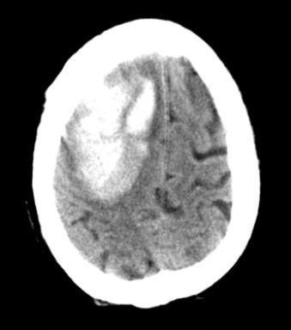

Slide 20
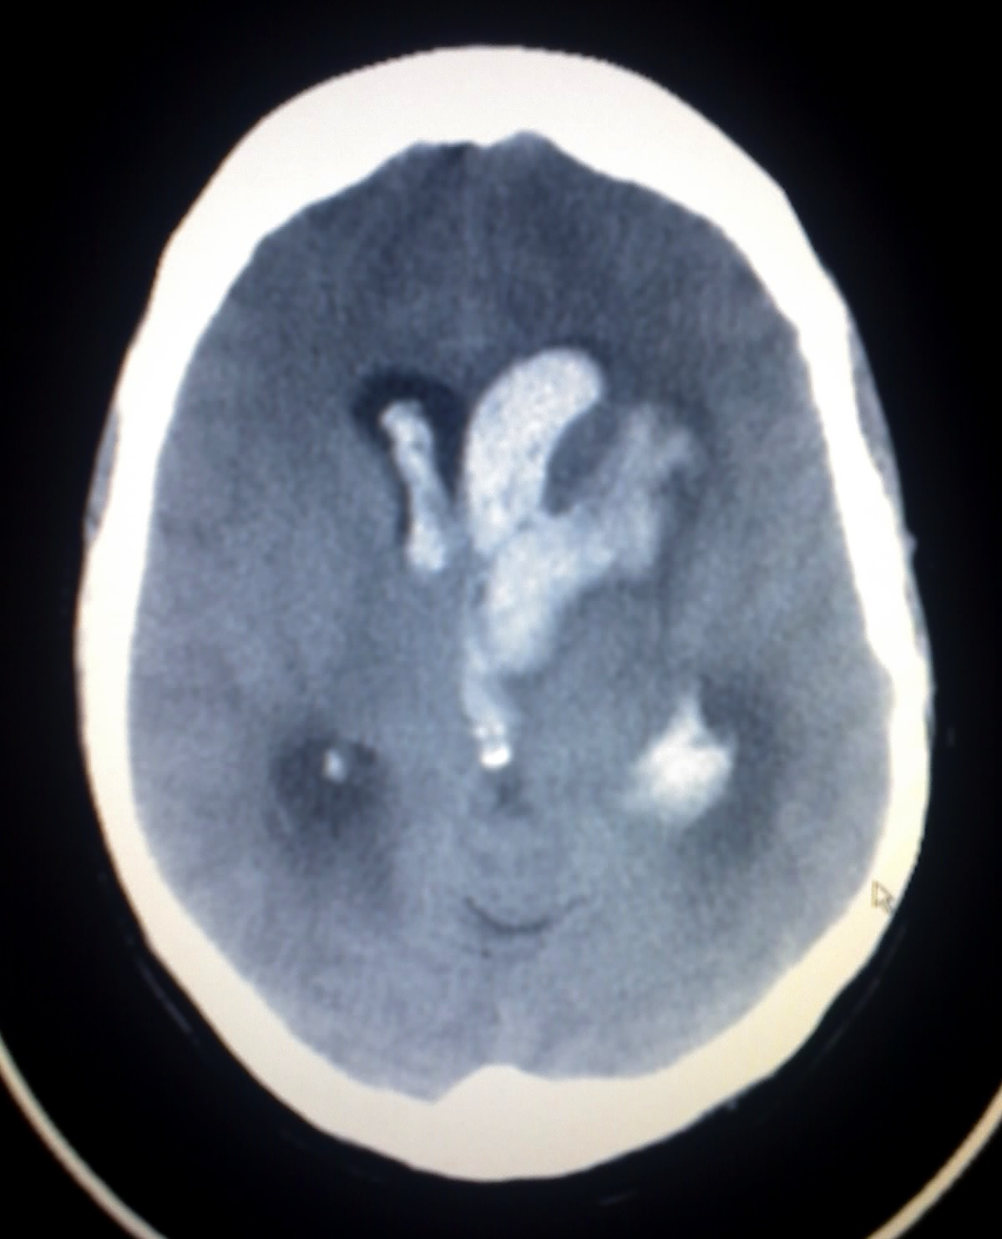

Slide 21
