Slide 1
.
Microbiology
First cores of general microbiology
2021-2022
Third class
Dr. Luma T. Ahmed

Slide 2
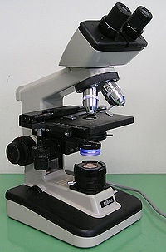
Microbiology
Microbiology is the science dealing with all microorganisms
Microorganisms are creatures that are not directly visible to the unaided eye (naked eye). All these creatures are living in nature. Part of these is living in a saprophytic form on soil, water, vegetation and so on. Some of these saprophytic microorganisms may invade the body of human or animal causing important diseases ( Parasitism).
Another part of these creatures are living in or on the human or animal body (normal flora). This type of relationship called mutualism which confers benefits to both partners. Some of these normally existing microorganisms become harmful to the host and this relationship called parasitism during which the host provides the primary benefits to the parasite.
.

Slide 3
Eukaryotes and prokaryotes
A major biological division separates the microorganisms into eukaryotes and prokaryotes.
Eukaryotes (Protists):
Organisms that containing a membrane-bound nucleus. Other membrane bound organelles e.g. mitochondria, microfilaments that forming a complex intracellular structures unlike that found in prokaryotes. The agents of motility are flagella or cilia do not resemble the flagella of prokaryotes. The genetic transfer among eukaryotes depends upon fusion of haploid gametes to form diploid cell containing complete set of genes derived from each gamete. The classification of eukaryotes frequently based on morphological properties. Eukaryotes include the following groups of microorganisms; protozoa, fungi, slime molds and algae.

Slide 4
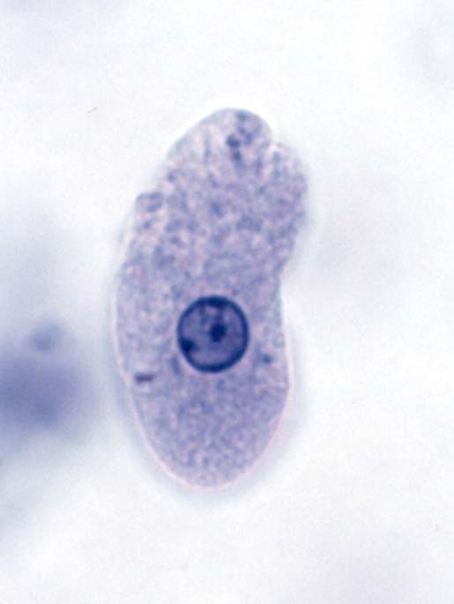
Eukaryotes
Protozoa:
are unicellular non-photosynthetic protists. They include:
Flagellated protozoa, such as Giardia lambelia that causing chronic diarrhea in human. Ciliated protozoa, such as Balantidium coli, Amoeboid protozoa such as Entamoeba histolytica that causing amoebic dysentery in human, and sporozoa such as Plasmodium causing malaria in human.
Fungi: are non-photosynthetic protists growing as a mass of branching filaments (hyphae). This mass is multinucleated of continuous cytoplasm. The mycelia form called mold and those does not forming mycelia called yeast.
Algae: all organisms that produce O2 as a product of photosynthesis, all algae contain chlorophyll in their chloroplast. Algae may be unicellular or multicellular.

Slide 5
Eukaryotes
Slime molds: They are characterized by the presence of an amoeboid multinucleated mass called plasmodium as a stage in their life cycle. The plasmodium of the slime mold is analogous to mycelia in fungi. The growth of slime molds depend on nutrients provided bacteria or plant cells. The reproduction is through plasmodia.
Prokaryotes
Are primarily distinguished by their relatively small size and the absence of nuclear membrane, DNA is not physically separated from the cytoplasm. There are no membrane-bound cytoplasmic organelles. The DNA in almost all bacteria is circular. Prokaryotes include the following groups of microorganisms: bacteria, mycoplasma, Chlamydia and rickettsia.

Slide 6
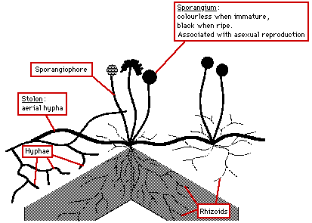

Slide 7
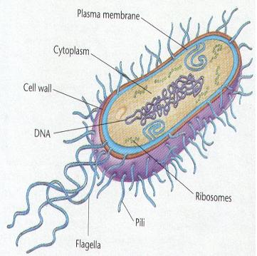
Prokaryotes
Bacteria: are small unicellular microorganisms, widely distributed in the nature either as free living, normal flora on or in human or animal body (like enteric bacteria in human intestine) or as a parasites infect human or animals causing important diseases. Bacterial cells consist of nucleoid (analogous to nucleus in eukaryotes) in the cytoplasm which is surrounded by cell envelop. Classification of bacteria may depend on structural, physiologic, biochemical or genetic criteria, of these are:
1. Spore formation: spores are specialized cell structure that may allow survival of bacteria in unsuitable environments.
2. Fermentation of carbohydrate.
3. Gram staining: is an effective criterion that divide bacteria into gram positive and gram negative bacteria.
4. Genetic criteria.

Slide 8
Bacteria
Bacteria have different ways for generating metabolic energy.
1. Photosynthesis: Photosynthesis is similar to respiration. in photosynthesis the reductant & oxidant are created photochemically by light energy absorbed by pigments in the membrane.
2. Respiration: Is a chemical reduction of an oxidant (electron acceptor)by a reductant (electron donor) The reductant may be organic or inorganic. Oxygen (O2) often employed as an oxidant.
3. Fermentation: Fermentation is characterized by substrate phosphorylation (an enzymatic process in which a pyrophosphate bond is donated directly to ADP by a phosphorylated metabolic intermediate . The formation of ATP in fermentation is not coupled to the transfer of electrons. For example the fermentation of glucose (C₆H₁₂O₆) yields a net gain of two pyrophosphate bonds in ATP & produces two molecules of lactic acid (C₃H₆O₃).

Slide 9
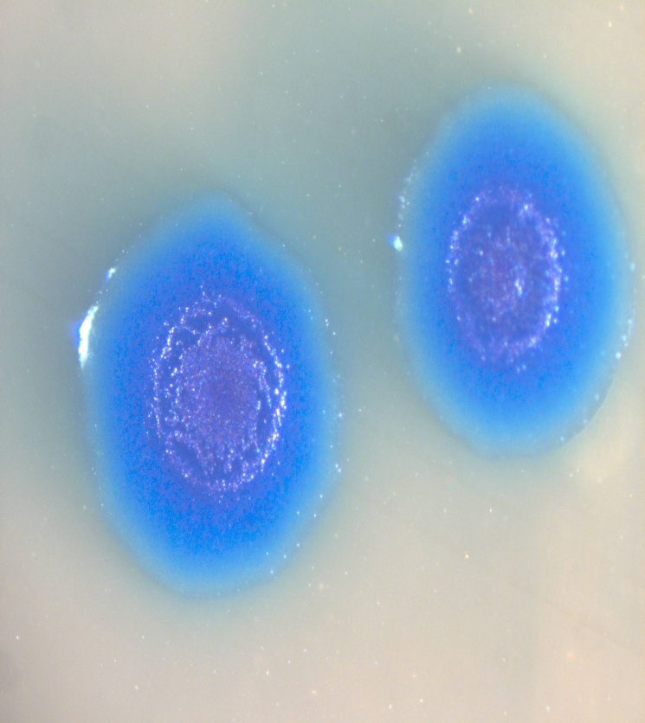
Bacteria
Mycoplasma: are parasitic prokaryotes that have lost their ability to form cell wall and adapted to live in their environment.
Chlamydia & rickettsia: are obligatory intracellular parasites and are extremely small & depend on the host for their essential metabolites.

Slide 10
Viruses
However, the bellow organisms do not meet the above criteria;
Viruses:
are the smallest microorganisms that cannot seen by light microscope unless we use the electron microscope. The virus particle consists of nucleic acid, either DNA or RNA enclosed in a protein coat called capsid. The capsid protein protect the nucleic acid and facilitate attachment and penetration of the host cell. Viruses lack the cell organelles that required for viral replication and energy production, therefore all viruses are obligatory intracellular parasites. Different viruses infect a wide range of human, plants & animals and even algae, bacteria & protozoa.

Slide 11
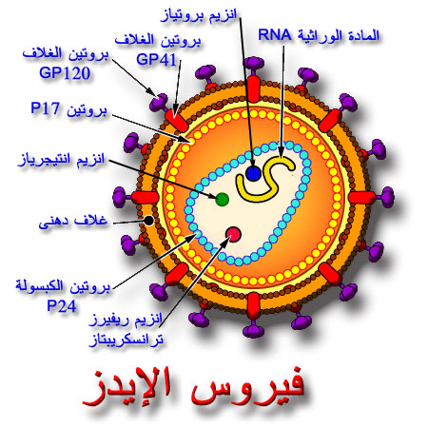

Slide 12
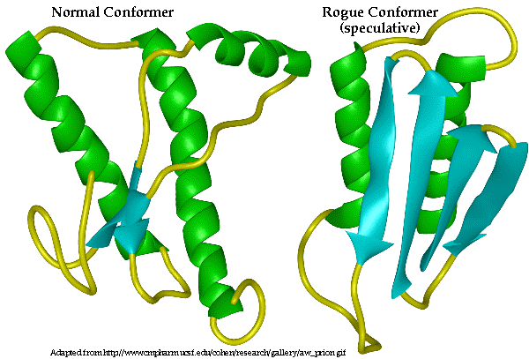
Viroids
& prion
Viroid:
Small single-stranded covalently closed circular RNA molecules existing as highly base-pair rod-like structures with no capsid. A number of transmissible plant diseases caused by viroid. It replicated by DNA-depended RNA polymerase of the plant host.
Prion:
These are unconventional transmissible protein material devoid from any amount of nucleic acid. It is the causative agents of Bovine spongiform encephalopathy (Mad cow) and Creutzfeldt-Jakob disease in human.

Slide 13
Prokaryotic cell organelles
1.The nucleoid:
The prokaryotic nucleoid, the equivalent of eukaryotic nucleus. The nuclear membrane & mitotic apparatus are absent. The nuclear region is filled with DNA fibrils. Bacterial DNA consist of a single continuous circular molecule (single haploid chromosome). The number of nucleoids & hence the number of chromosomes depend on the growth conditions (rapidly growing bacteria contain more nucleoids than slowly growing bacteria). The DNA is associated at one end with an invagination of the cytoplasmic membrane called mesosome. This attachment thought to play a role in the separation of the two sister chromosomes following chromosomal replication.

Slide 14
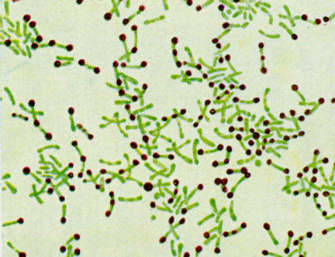
Cytoplasmic structures
2.Cytoplasmic structures:
Prokaryotic cell lack plastids such as mitochondria & chloroplasts; the electron transport systems are localized instead in the cytoplasmic membrane.
Bacteria often store or reserve materials in the form of insoluble granules called the inclusion bodies always function in the storage of energy or as reservoir of structural building blocks.
Many bacteria accumulate granules of polyphosphate, which are reserves of inorganic phosphate (polyphosphate granules) that can be used in the synthesis of nucleic acid & phospholipid synthesis called metachromatic granules ( e.g. corynebacterium).
Certain specialized bacteria contain protein-bound vesicles, these include carboxysomes, which contain carboxylase the key enzyme of CO2 fixation. Magnetosomes (membrane bound granules of iron compounds) that allow bacteria to exhibit magneto taxis ( migration or orientation of bacterial cell with respect to earth's magnetic field.

Slide 15
The cell envelope
The layer surround the prokaryotic cell are referred collectively as cell envelope. The structure & composition of cell envelope is differing between G positive & G negative bacteria.
G positive cell envelope:
It composed of, the cytoplasmic membrane, a thick peptidoglycan layer (15-80 nm in diameter); some bacteria have an outer layer either capsule or S-layer.
G negative cell envelope:
This is a highly complex, multilayer structure. The cytoplasmic membrane is called the inner membrane surrounded by single sheet of peptidoglycan ( 2 nm in diameter) to which is anchored a complex layer called outer membrane. The outmost capsule or S-layer may also be present. The space between the inner & outer membrane is called periplasmic space.
The cytoplasmic membrane:
The bacterial cytoplasmic membrane also called the cell membrane composed of phospholipids & proteins (200 different kinds). Proteins accounts for a proximately 70% of the membrane mass.

Slide 16
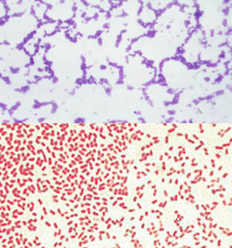

Slide 17
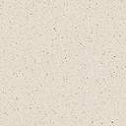
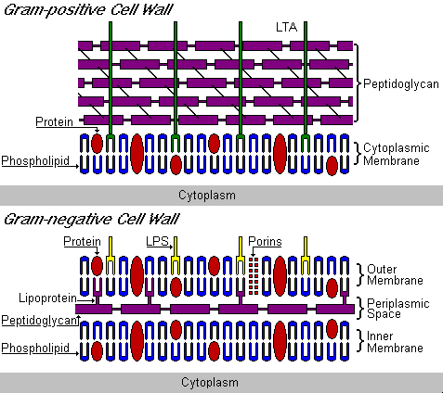
Comparison between G+ & G- cell membrane

Slide 18
Functions of cytoplasmic membrane
Convoluted invaginations of the cytoplasmic membrane from specialized structure called mesosomes. These are of two types; septal mesosomes, which function in the formation of cross-walls during cell division, and lateral mesosomes. The bacterial chromosomes (DNA) is attached to a septal mesosomes.
Functions of cytoplasmic membrane:
At least 50% of the cytoplasmic membrane must be in the semi-fluid state to ensure cell growth. At low temperature, this is achieved by greatly increased synthesis & incorporation of unsaturated fatty acids into the phospholipid of cell membrane.
1. Permeability & transport:
The cytoplasmic membrane forms a hydrophobic barrier impermeable to most hydrophilic molecules. However, several mechanisms (transport system) exist that enable the cell to transport nutrients into & waste products out of the cell. There are 3 general transport mechanisms involved in membrane transport.
Passive transport :
Passive transport is a movement of biochemicals and other or molecular substances across cell membranes without need of cellular energy. The rate of passive transport depends on the permeability of the cell membrane, which, in turn, depends on the organization

Slide 19
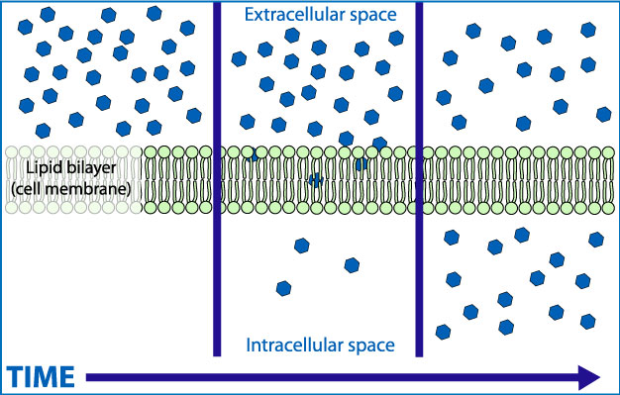

Slide 20
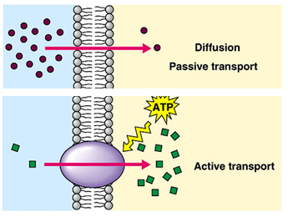
Functions of cytoplasmic membrane
and characteristics of the membrane lipids and proteins. Furthermore, passive transport has neither selectivity nor speed. The 4 main kinds of passive transport are diffusion, facilitated diffusion, filtration and osmosis.
2. Active transport:
Active transport is the movement of molecules across a cell membrane in the direction against the concentration gradient. Unlike passive transport, active transport uses cellular energy to move molecules against a gradient, polar repulsion, or other resistance. Active transport is usually associated with accumulating high concentrations of molecules that the cell needs, such as ions, glucose and amino acids.
3. group translocation:
Group translocation, also known as the phosphotransferase system, is a distinct method used

Slide 21
Functions of cytoplasmic membrane
by bacteria for sugar uptake where the source of energy is from phosphoenolpyruvate. It is known as multicomponent system that always involves enzymes of the plasma membrane and those in the cytoplasm. An example of this transport is found in E. coli cells. The phosphotransferase system is involved in transporting many sugars into bacteria, including glucose, mannose, fructose and cellobiose. The phosphoryl group on PEP is transferred to the glucose sugar for example forming glucose-6-phosphate, therefore providing a one-way concentration gradient of glucose across the membrane.
2. Electron transport & oxidative phosphorylation:
The cytochromes & other enzymes & components of the respiratory chain are located in the cytoplasmic membrane.
3. Excretion of hydrolytic exoenzymes & pathogenicity proteins:
All microorganisms that relay on macromolecular organic polymers as a source of nutrients e.g. sugar, proteins & lipid excrete hydrolytic enzymes

Slide 22
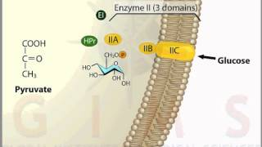

Slide 23
Functions of cytoplasmic membrane:
that degrade the polymers to subunits small enough to penetrate the cytoplasmic membrane.
4. Biosynthetic functions:
The cytoplasmic membrane is the site of the carrier lipid on which the subunits of the cell wall are assembled as well as of the enzymes of the cell wall biosynthesis. some proteins of DNA replicating complex are present at discrete sites in the membrane, presumably in the septal mesosomes to which the DNA is attached.
5. Chemotactic systems:
Attractants & repellents bind to specific receptors the bacterial membrane. These are at least 20 different chemoreceptors in the membrane of E. coli, some of which also function as first step in the transport process.
Cell wall:
The layers of the envelope laying between the cytoplasmic membrane & the capsule are collectively called the cell wall. The difference between the G positive & G negative bacteria has been shown to reside I the cell wall. In G positive bacteria the cell wall composed mainly of peptidoglycan & teichoic acid. In G negative bacteria it is composed of peptidoglycan & outer membrane.

Slide 24
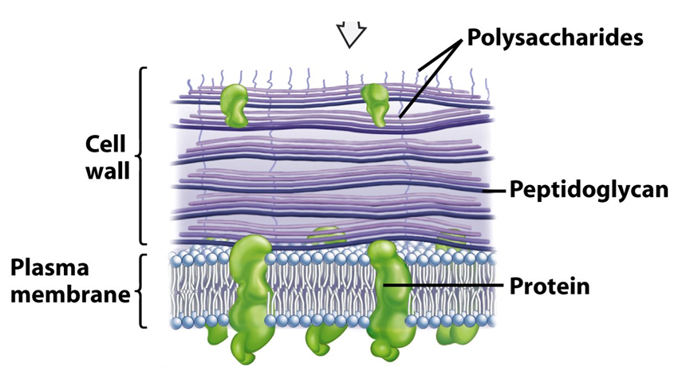

Slide 25
Cell wall
Function of the cell wall;
1. osmotic protection; the internal osmotic pressure of most bacteria range from 5 to 20 nm as a result of solute concentration via active transport. This pressure would be sufficient to burst the cell, but this is not occur due to the presence of cell wall.
2. It plays an important role in cell division.
3. serving as a primer for its own biosynthesis.
4.It is the site of major antigenic determinants of the cell surface.
5. In G negative, it is responsible for the non-specific endotoxin.
Special components of G + cell wall:
1. teichoic & teichuronic acids:
These are water-soluble polymers found within the cell wall of Gram-positive bacteria. There are two types of teichoic acids; wall teichoic acid & membrane teichoic acid. Some positive species lack wall teichoic acid, but all appear to contain membrane teichoic acid. The main function of teichoic acids is to provide rigidity to the cell-wall by attracting cations such as magnesium and sodium. Teichoic acids also assist in regulation of cell growth by limiting the ability of autolysins to break the bond between the N-acetyl glucosamine and the N-acetylmuramic acid.

Slide 26
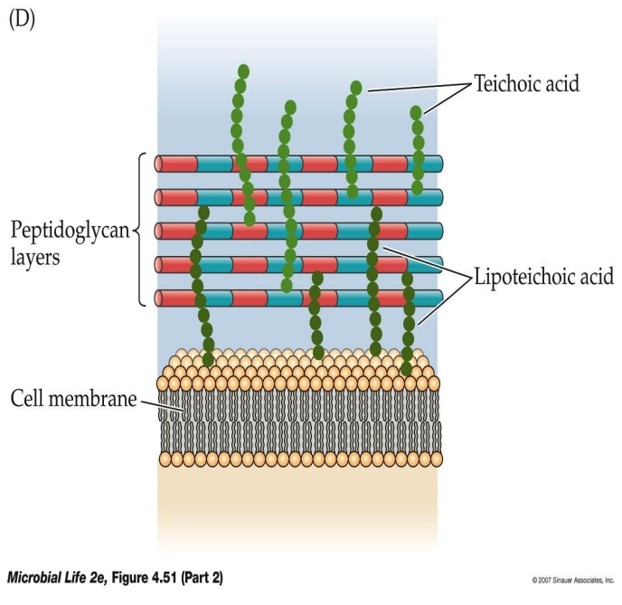

Slide 27
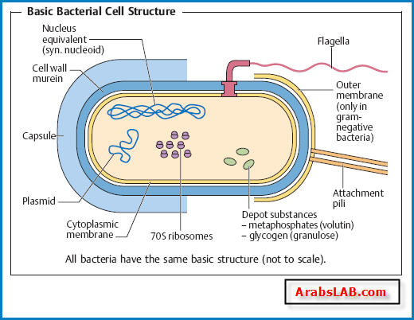
Basic Bacterial structure

Slide 28
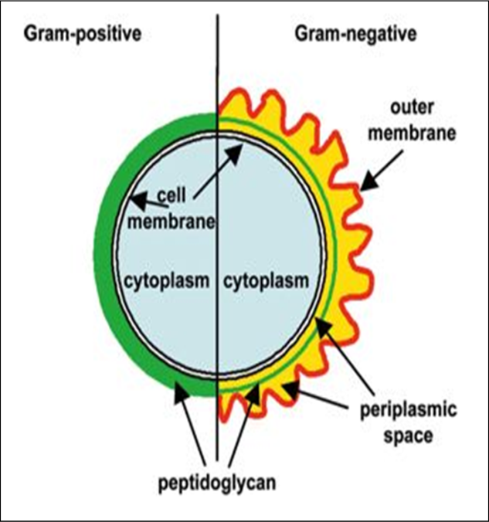
Special components of G + & G - cell wall
Lipoteichoic acids also act as receptor molecules for some Gram-positive bacteriophage. Evidence suggests teichoic acid may act as a bacteriophage receptor.
2. polysaccharides:
These include certain neutral sugars e.g. mannose, arabinose & galactose which exists as subunits of polysaccharide in the cell wall.
Special components of G negative cell wall:
1. lipoprotein:
Its function is to stabilize the outer membrane & anchor it to the peptidoglycan layer.
2.outer membrane:
3.Lipopolysacharride:
LPS which is extremely toxic to animals called the endotoxin. The toxicity is associated with lipid A. the polysacharride represent the major surface antigen called O antigen.
The perplasmic place:
It constitute approximately 10-20% of the cell volume.

Slide 29
Capsule & glycocalyx & flagella
Capsule is a condensed, well-defined layer of extracellular polymer closely surrounding the bacterial cell formed when grow in natural environment. These polymers usually polysaccharide with one exception, the capsule of B. anthracis is poly D-glutamic acid. The capsule contribute to the invasiveness of pathogenic bacteria by resist phagocytosis.
The glycocalyx is a loss meshwork of fibrils extending outward from the cell. It play a role in the adherence of bacteria to surfaces in the environment.
Flagella (flagellum):
Bacterial flagella are thread-like extensions composed entirely of protein. It is the organ of locomotion. Three types of arrangement are recognized:
Monotrichous: single polar flagellum (V.cholerae)
Lophotrichous: multiplepolar flagellae
Peritrichous: the flagellae distributed over the entire cell (E. coli).
Amphitrichous: bacteria have a single flagellum on each of two opposite ends

Slide 30
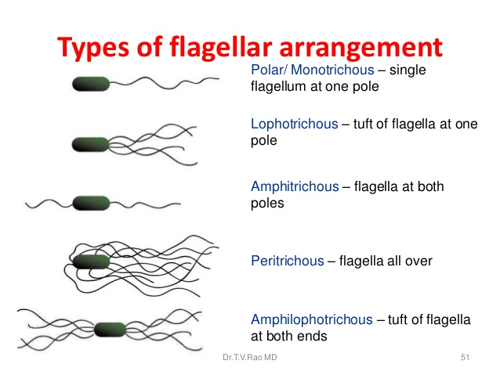

Slide 31
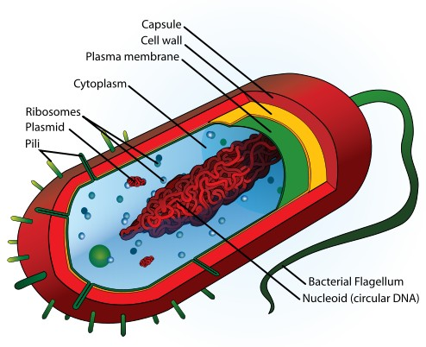
Pilli & endospores
Pilli (fimbria):
Many G negative bacteria possess rigid surface appendages called pilli (hair) or fimbriae (fingers). They are shorter & finer than flagella, & composed of structural protein subunits called pillin. It is responsible for the attachment of bacteria. Two types of pilli are exist:
Ordinary pilli: which play a role in the adherence of symbiotic or pathogenic bacteria to host cell, & considered as a virulence factor.
Sex pilli: which responsible for the attachment of donor & recipient cells in bacterial conjugation.
Endospore:
The spore is a resting cell that is highly resistant to desiccation, heat & chemical agents that is formed under unsuitable environmental conditions by a process called sporulation.
Germination:
The return of the spore to its vegetative bacteria called germination. It occurs in three stages; activation, initiation & outgrowth.

