Slide 1
Lec 5 pancreas & gallbladder
Dr.Thura Abbas Fadhel
M.B.Ch.B F.I.C.MS Path

Slide 2
Gallbladder & extrahepatic bile ducts
Cholelithiasis
Also called gallstones
Types -80% of gallstones cholesterol stones
-20% pigment stones composed of bilirubin calcium salts
Gallstones impact at neck just proximal to cystic duct

Slide 3
Risk factors: increasing age
Fat,
fertile [multiple pregnancies]
forty
female
obesity
rapid weight loss
Complications: 1 - 2% have acute or chronic cholecystitis, choledocholithiasis, cholangitis, empyema, gallstone ileus, acute pancreatitis

Slide 4
Microscopic (histologic) description Minimal / mild lymphocytic mucosal inflammation, fibrosis, thickening of muscularis propria ,cholesterolosis, focal epithelial metaplasia .
Acute cholecystitis
Either gallstone associated (acute calculous cholecystitis) or not (acute acalculous cholecystitis) 10% perforate without treatment Gross description Enlarged, distended gallbladder Congested vessels , serosal and mucosal exudate, thickened wall with edema and hemorrhage Ulcers with blood clot, pus and bile

Slide 5
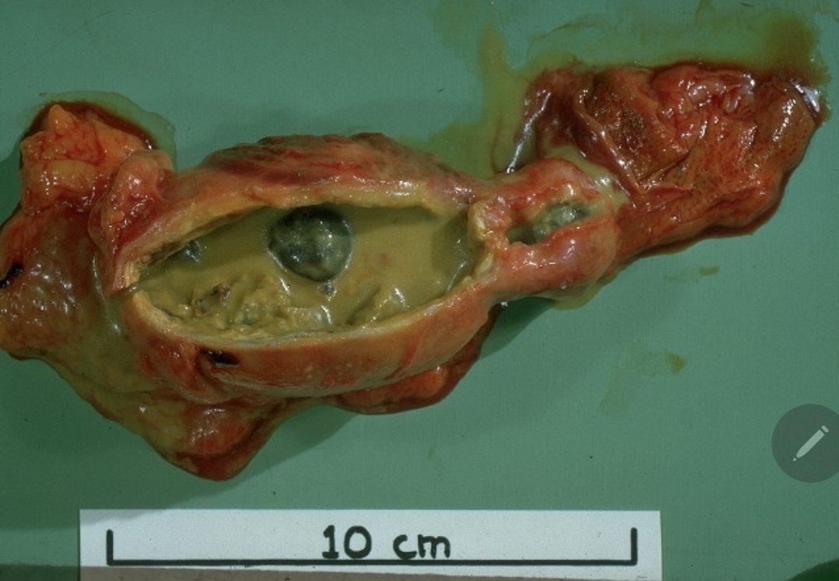
Microscopic description Initially edema, congestion, hemorrhage, fibrin deposition in and around muscular layer Later mucosal and mural necrosis with neutrophils

Slide 6
Chronic cholecystitis
The most common disease of the gallbladder, typically secondary to cholelithiasis Variety of histologic findings, including variable amounts of mononuclear cell predominant inflammation, mucosal changes including metaplasia, muscular hypertrophy and transmural fibrosis
Gross description Nearly normal to thickened gallbladder Gallbladder may appear shrunken due to marked fibrosis

Slide 7
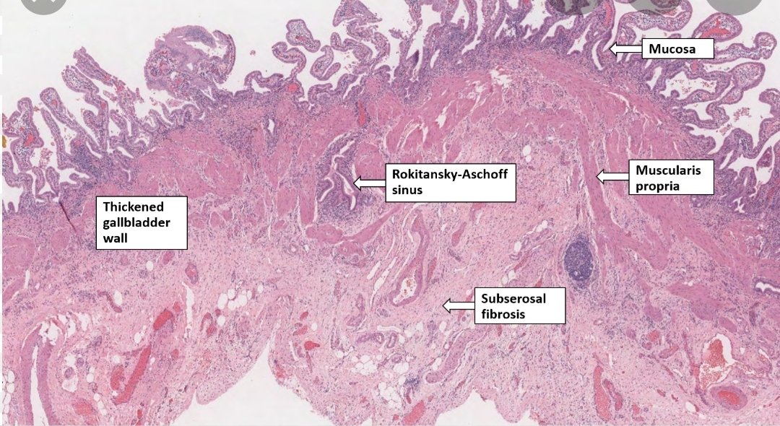

Slide 8
Gallbladder carcinoma
Aggressive cancer, with an overall 5 year survival rate of < 10%
Commonly occurs in the sixth and seventh decades F:M = 3:1
Risk factors : Cholelithiasis (major risk factor) Chronic cholecystitis, Obesity Infections (esp. Salmonella and Opisthorchis viverrini) Primary sclerosing cholangitis congenitak anomaly of pancreatobiliary system.

Slide 9
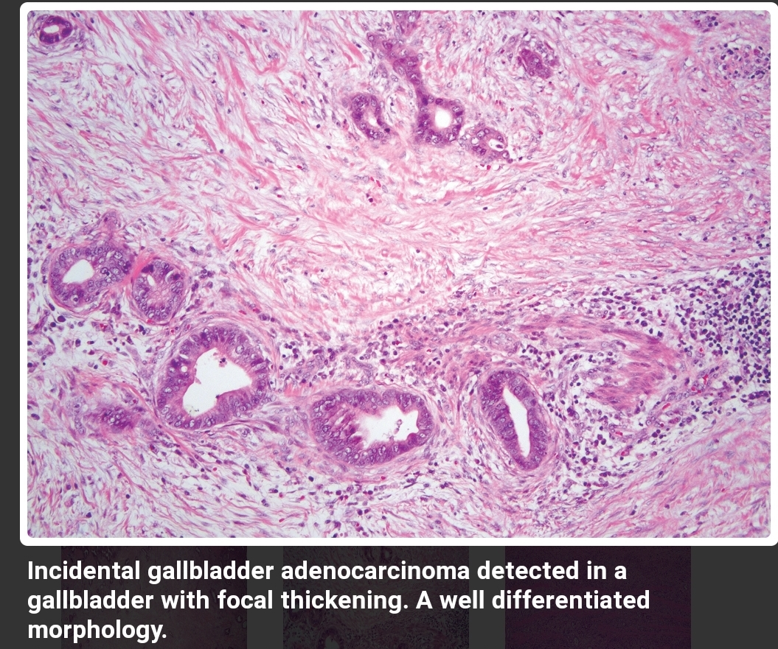
Gross description Frank tumors may have one or more of the following features: Thickened and indurated gallbladder wall Exophytic or polypoid mass .

Slide 10
Extrahepatic bile duct nonneoplastic
Choledocholithiasis is the presence of stones within the biliary tree. Almost all these stones are derived from the gallbladder.
Cholangitis refers to acute mostly bacterial inflammation of the wall of bile ducts. Most cases are due to obstruction bile flow, mostly by choledocholithiasis.

Slide 11
Primary sclerosing cholangitis
Chronic cholestatic disorder of unknown origin (possibly autoimmune) involving entire biliary tract from ampulla of Vater to small intrahepatic bile ducts or gallbladder
Mor common in males
Ass with ulcerative colitis
Also associated with other autoimmune dis.

Slide 12
Primary biliary cholangitis
Primary biliary cholangitis (PBC) is a chronic, progressive cholestatic liver disease with granulomatous destruction of interlobular bile ducts, leading to fibrosis and ultimately cirrhosis Typically occurs in middle aged women;
Labs include elevated alkaline phosphatase, elevated IgM and the classic antimitochondrial antibody (AMA)

Slide 13
Cholangiocarcinomas
are adenocarcinomas arising from in bile ducts within and outside of the liver.
The prognosis of cholangiocarcinomas is poor because they are generally asymptomatic until late, and most patients have unresectable tumors
• • These adenocarcinomas are generally well-differentiated with an abundant fibrous stroma
• Mean survival time is around 12 months.

Slide 14
Pancreas
Acute pancreatitis
Acute onset of abdominal pain due to enzymatic necrosis and inflammation of pancreas
Due to autodigestion by inappropriately activated enzymes
Complications: sterile pancreatic abscess, pancreatic pseudocyst, infected pancreatic necrosis, large vessel thrombi in nearby vessels, distant fat necrosis Unexpected deaths may occur in early phase of disease

Slide 15
Causes implicated include 1. Gallstones and excessive alcohol intake; these are the main offenders. 2. Non-gallstone obstruction of the pancreatic ducts e.g. by periampullary tumors 3. Medications as with thiazide & frusemide diuretics 4. Trauma, both blunt and iatrogenic during surgery or endoscopy 5. Others such as metabolic disorders, ischemia and infections as with mumps.
In up to 20% of patients there is no identifiable cause (idiopathic pancreatitis).

Slide 16
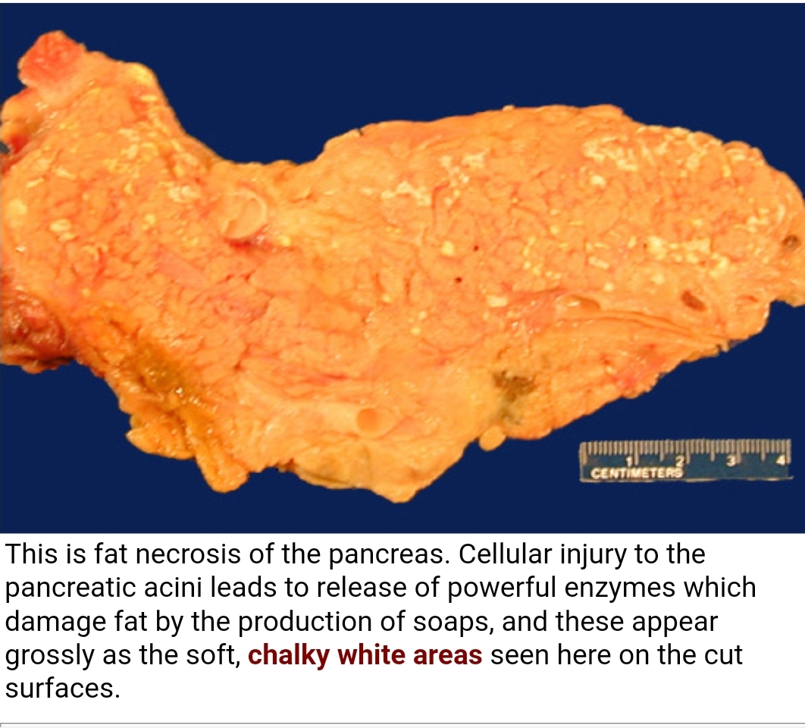

Slide 17
Chronic pancreatitis
Repeated attacks of pancreatic inflammation with loss of pancreatic parenchyma and replacement with fibrosis, variable pain and symptoms of pancreatic insufficiency (malabsorption, diabetes)
Risk factors
alcohol, overeating, opiates, drugs, hypercalcemia, hyperparathyroidism, hyperlipoproteinemia, pancreas divisum , pancreatic neoplasm, cystic fibrosis; cigarette smoking; idiopathic .

Slide 18
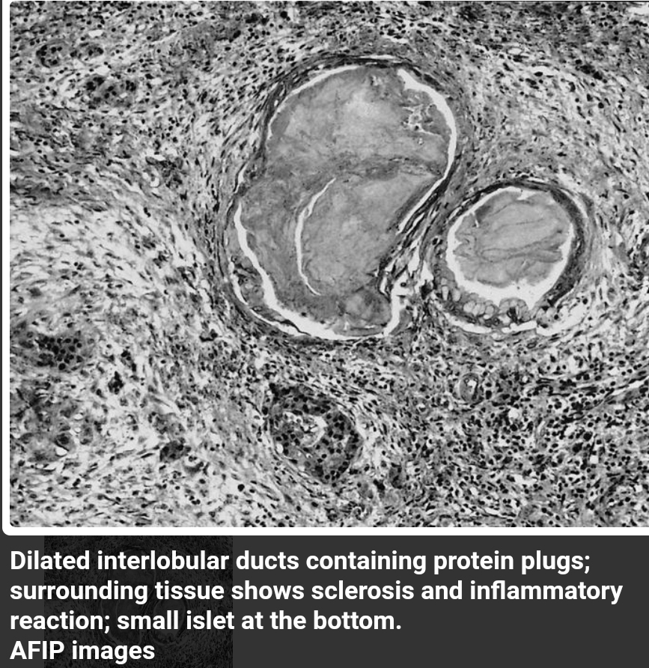
Microscopic Loss of acini and ductal tissue ,
fibrosis,
Chronic inflammation
Dilated ducts with concretions

Slide 19
PANCREATIC NEOPLASMS Cystic Neoplasm Some of these are entirely benign (e.g., serous cystadenoma); others, such as mucinous cystic neoplasm, can be benign but frequently have malignant potential.
Pancreatic Carcinoma has a very poor prognosis in that the 5-year survival rate is less than 5%. Pathogenesis: like all cancers, it arises as a consequence of inherited and acquired mutations in cancer-associated genes.

Slide 20
There is a progressive accumulation of genetic changes in pancreatic epithelium as it proceeds from non-neoplastic, to noninvasive lesions to invasive carcinoma. The more common molecular alterations in pancreatic carcinogenesis affect K-RAS (oncogene)
Risk factors
elderly (60 and 80 years).
Smoking has the strongest environmental influence. Chronic pancreatitis
diabetes mellitus
Familial clustering of pancreatic cancer

Slide 21
Microscopical features • Most carcinomas are ductal adenocarcinomas . • It is highly invasive;
• Perineural and lymphatic invasions are commonly seen. Endoscopic ultrasonography and CT, are helpful in diagnosis and in performing guided percutaneous needle biopsy.

Slide 22
Neuroendocrine neoplasms SSS
Can be either well differentiated tumors or poorly differentiated carcinomas Neoplasms which express neuroendocrine markers (synaptophysin, chromogranin A, NCAM / CD56 or protein gene product (PGP)) Functional tumors are associated with elevated serum hormone levels and are associated with a clinical hormonal syndrome (see clinical features below) Nonfunctional tumors are not associated with a clinical hormonal syndrome but may still be associated with elevated serum hormone levels or tissue hormone expression on immunohistochemistry

Slide 23
Insulinoma: Most common functioning pancreatic neuroendocrine tumor Insulin secretion Benign in 90% Gastrinoma: Second most common functioning pancreatic neuroendocrine tumor Gastrin secretion
Glucagonoma: 4Ds: diabetes, dermatitis (necrolytic migratory erythema), deep vein thrombosis, depression

Slide 24
VIPoma: watery diarrhea, hypokalemia, achlorhydria / hypochlorhydria
Somatostatinoma: Diabetes mellitus, diarrhea or steatorrhea, anemia, malabsorption, cholelithiasis

