Slide 1
Lec.1 Pathological terms
Dr. Thura Abbas Fadhel

Slide 2
Pathology: The study of disease.
Gross pathology refers to macroscopic manifestations of disease in organs, tissues, and body cavities.
Fixation is considered as physiochemical process where cells or tissues are fixed chemically. Fixatives perform various functions such as prevention of autolysis and tissue putrefaction.

Slide 3
A biopsy is a medical procedure that involves taking a small sample of tissue so that it can be examined under a microscope.
excisional biopsy A surgical procedure in which an entire lump or suspicious area is removed for diagnosis. The tissue is then examined under a microscope.
incisional biopsy A surgical procedure in which a portion of a lump or suspicious area is removed for diagnosis. The tissue is then examined under a microscope to check for signs of disease.

Slide 4
A frozen section examination is a specific type of biopsy procedure that allows a surgeon to establish a rapid diagnosis of a suspicious mass during surgery. The technical name for this procedure is cryosection.
core needle biopsy obtains a cylinder of tissue about 1/16th of an inch in diameter. The needle is wider than that used for fine-needle aspiration (another form of needle biopsy), but since a core needle biopsy gathers more material, it means more information is derived.

Slide 5
Immunohistochemistry (IHC) uses antibodies to detect the location of proteins and other antigens in tissue sections
Sentinel lymph node The sentinel lymph node is the first lymph node or group of nodes draining a cancer.

Slide 6
Cytology is the study of individual cells of the body, as opposed to histology which is the study of whole human tissue itself.
Fine needle aspiration is a type of biopsy procedure. In fine needle aspiration, a thin needle is inserted into an area of abnormal-appearing tissue or body fluid.

Slide 7
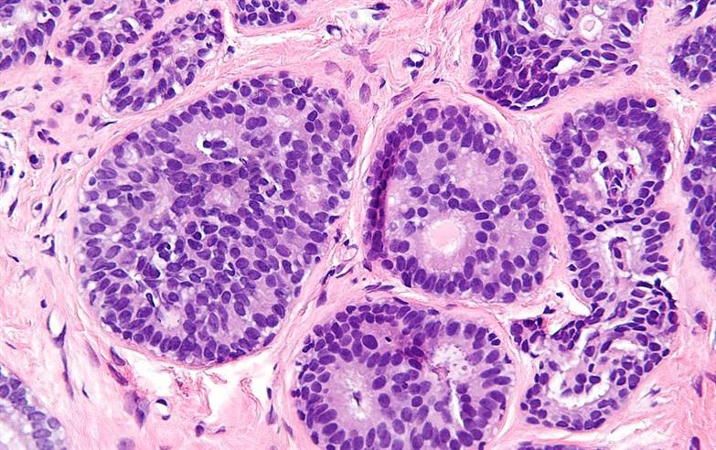
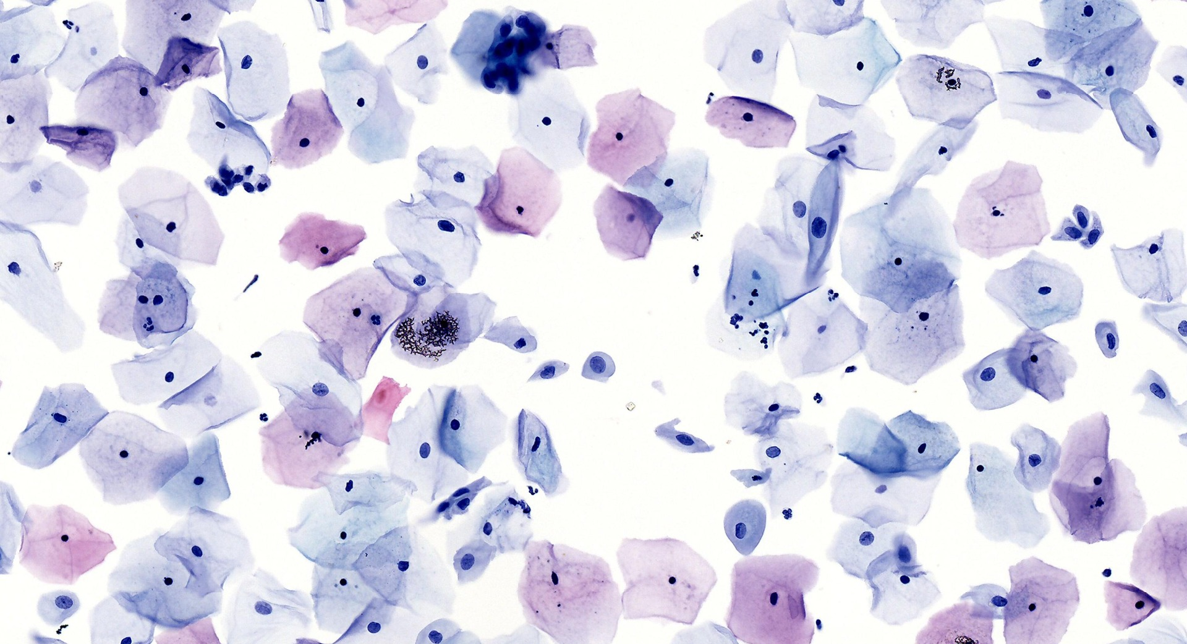

Slide 8
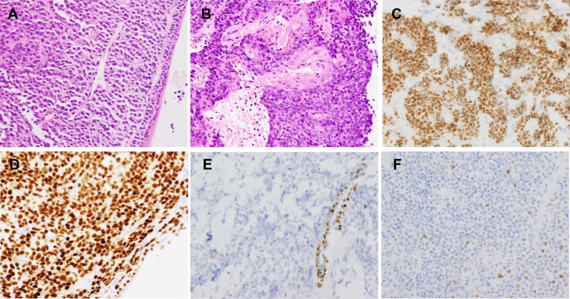

Slide 9
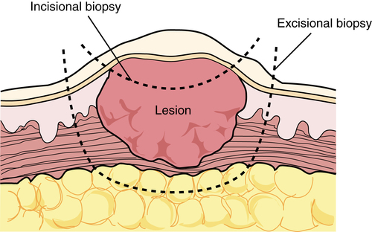

Slide 10
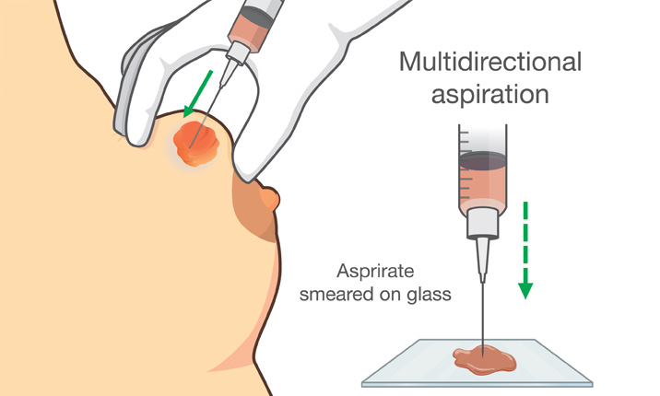

Slide 11
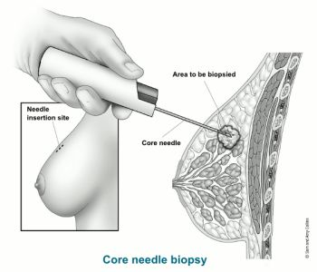

Slide 12
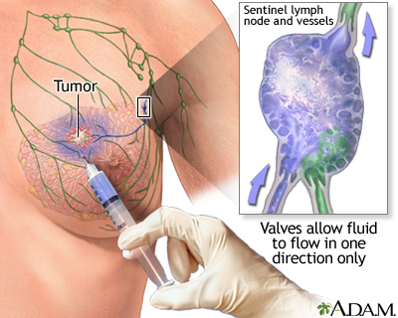

Slide 13
