Slide 1
Parkinson's Disease and Related Disorders

Slide 2
Parkinson's disease (PD)
2nd commonest neurodegenerative disease, affecting 5 million persons in the world.
It affects men and women of all races, all occupations, and all countries.
age of onset is about 60 years and the frequency increases with aging.
The prevalence will dramatically increase in future decades.

Slide 4
Pathology
the hallmarks of PD
degeneration of dopaminergic neurons in the substantia nigra
reduced striatal dopamine.
intracytoplasmic inclusions ( Lewy bodies) .

Slide 5
Pathology
neuronal degeneration with inclusion body formation can also affect
cholinergic neurons of the nucleus basalis of Meynert (NBM),
norepinephrine neurons of the locus coeruleus (LC),
serotonin neurons in the raphe nuclei.
neurons of the olfactory system, cerebral hemispheres, spinal cord, and peripheral autonomic nervous system.
"nondopaminergic" pathology = nondopaminergic clinical features.

Slide 6
Etiology
Sporadic (unknown cause) 85–90%.
older patients (>50 years).
environmental factors
risk with exposure to pesticides, rural living, and drinking well water.
risk with cigarette smoking and caffeine.
genetic factors younger patients.

Slide 7
Clinical Features

Slide 8
Tremor
is the most common initial symptom (85% of patients).
usually asymmetric, resting tremor and slow (3–5 Hz).
It is typically distal with pronation–supination tremor of the forearm or a pill‐rolling tremor of the finger.
It may affect chin, lip, or tongue, but head and neck are rarely affected.
As with other tremors, the amplitude increases with stress and resolves during sleep.

Slide 9
Bradykinesia
(slowness of movement)
Symptoms may include:
subjective sense of weakness.
loss of dexterity "message not getting to the limb“.
fatigability, when performing repeated actions.

Slide 10
Facial bradykinesia
decreased blink rate and facial expression (masked face).
monotonal Speech.
Drooling (especially night time drooling).

Slide 11
Truncal bradykinesia
slowness or difficulty in rising from a chair or turning in bed
small steps gait with reduced arm swinging.
Freezing, more prominent as patients attempt to navigate doorways or narrow areas and can result in patients getting trapped behind furniture.

Slide 12
In the upper extremities:
small, effortful handwriting (micrographia)
difficulty using the hand for fine activities (using a key).
In the lower extremities:
scuffing of foot on the ground(Shuffling gait),

Slide 13
Rigidity
an increase in resistance to passive movement about a joint (hypertonia).
smooth (lead pipe) or oscillating (cogwheeling).
Postural instability
imbalance and loss of righting reflexes.
poorly amenable to treatment and a common source of disability in late disease.

Slide 14
nonmotor symptoms
commonly precede motor signs
substantial reduction in olfactory function (smell)
rapid eye movement (REM) behavior disorder (RBD).
loss of normal atonia during REM sleep.
patients “act out their dreams” and may kick, hit, talk, or cry out in their sleep.

Slide 16
Diagnosis &Differential Diagnosis
Parkinsonism = bradykinesia with rigidity and/or tremor.
PD is the most common disease in parkinsonsm group (75% ).
Old criteria: 2 of 3 (tremor, rigidity, bradykinesia) = 24% error rate.
U.K. brain bank criteria
parkinsonism associated with rest tremor, asymmetry, and a good response to levodopa = accurate in 99% of cases.

Slide 17
Parkinson's Disease Genetic Sporadic Dementia with Lewy bodies | Atypical Parkinsonisms Multiple-system atrophy Cerebellar type (MSA-c) Parkinson type (MSA-p) Progressive supranuclear palsy Corticobasal ganglionic degeneration Frontotemporal dementia | Secondary Parkinsonism Drug-induced Tumor Infection Vascular Normal-pressure hydrocephalus Trauma Liver failure Toxins (e.g., carbon monoxide, manganese, MPTP, cyanide, hexane, methanol, carbon disulfide) | Other Neurodegenerative Disorders Wilson's disease Huntington's disease Neurodegeneration with brain iron accumulation SCA 3 (spinocerebellar ataxia) Fragile X–associated ataxia-tremor-parkinsonism Prion disease Dystonia-parkinsonism (DYT3) Alzheimer's disease with parkinsonism

Slide 18
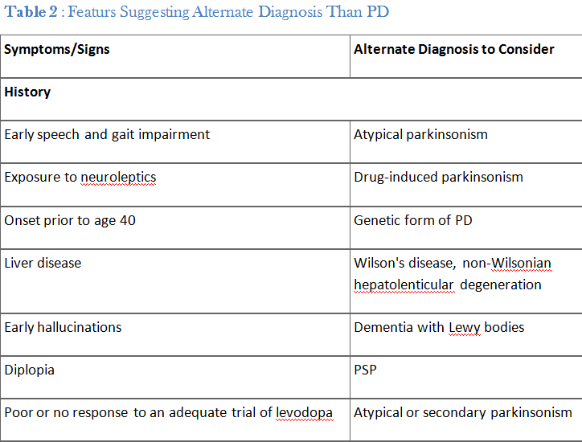

Slide 19
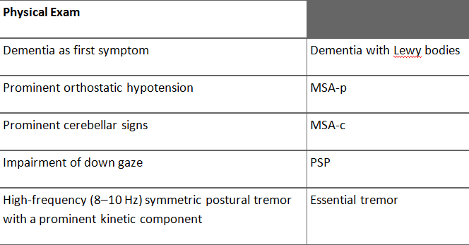

Slide 20
Magnetic Resonance Imaging (MRI)
When clinical presentation does not allow a high degree of diagnostic certainty
lack tremor
acute or stepwise progression
younger than 55 years.
useful to exclude:
strokes
Tumors
multi-infarct state
hydrocephalus
Wilson disease.

Slide 21
Treatment

Slide 22
Levodopa (precursor of dopamine)
administered in combination with a peripheral decarboxylase inhibitor (carbidopa or benserazide)
most effective symptomatic treatment, almost all patients experience improvement.
failure to respond should cause the diagnosis to be questioned

Slide 23
Acute dopaminergic side effects
(nausea, vomiting, and orthostatic hypotension)
avoided by:
gradual titration.
additional doses of a peripheral decarboxylase inhibitor (e.g., carbidopa)
a peripheral dopamine-blocking agent such as domperidone.

Slide 24
Dopamine Agonists
ergot derivatives: bromocriptine, pergolide & cabergoline
(cardiac valvular damage)
non-ergot dopamine agonists: pramipexole, ropinirole & rotigotine.
have modest effect on parkinsonism.
They are longer acting, so less prone to induce dyskinesia.
For this reason, many physicians initiate therapy with a dopamine agonist.
On the other hand, they can be used as adjuncts to levodopa to enhance motor function and reduce "off" time in fluctuating patients.

Slide 25
Acute side effects of dopamine agonists include:
nausea, vomiting, and orthostatic hypotension.
Hallucinations and cognitive impairment.
Sedation with sudden unintended episodes of falling asleep.
Impulse-control disorders: pathologic gambling, hypersexuality, and compulsive eating and shopping.

Slide 26
MAO-B Inhibitors Selegiline & rasagiline
block central dopamine metabolism and increase synaptic concentrations of the neurotransmitter.
provide modest antiparkinsonian benefits when used as monotherapy in early disease.
reduced "off" time when used as an adjunct to levodopa in patients with motor fluctuations.
has a disease-modifying effects, and significantly delayed the time until the emergence of disability, necessitating the introduction of levodopa in untreated PD patients.

Slide 27
COMT Inhibitors tolcapone & entacapone.
When levodopa is administered with a decarboxylase inhibitor, it is primarily metabolized by catechol-O-methyltransferase (COMT).
Inhibitors of COMT increase the elimination half-life of levodopa and enhance its brain availability.
Combining levodopa with a COMT inhibitor reduces "off" time and prolongs "on" time in fluctuating patients.

Slide 28
Other Medical Therapies
Anticholinergic Drugs trihexyphenidyl & benztropine.
Their major clinical effect is on tremor.
Their use is limited particularly in the elderly, due to their side effects (urinary dysfunction, glaucoma, and cognitive impairment).
Amantadine
in early disease it has mild symptomatic effects.
widely used as an antidyskinesia agent in patients with advanced PD.
Indeed, it is the only oral agent that reduce dyskinesia while improving parkinsonian features.
Side effects include livido reticularis, weight gain, and impaired cognitive function.

