Slide 1
Bio Lab RNAs & Gene Expression 2nd semester

Slide 2
What is RNA ?
It is ribonucleic acid, it consists of nucleotides containing sugar ribose, phosphate molecule & 4 nitrogen bases adenine(A), uracil (U), cytocine(C) and Guanine(G)
Its structure is single strand
It has many types coded & non coded.

Slide 3
Types of RNA: 1-mRNA: coding messenger RNA that carries genetic information from DNA in the nucleus to the ribosome in the cytoplasm & translate to protein. 2-rRNA: noncoding ribosomal RNA. 3-tRNA: noncoding transfer RNA 4-small RNAs that important in gene expression that code for mRNA & rRNA

Slide 4
Transcription & Translation
Transcription : the process after DNA replication ,it is a segment of DNA become a template for the production of mRNA molecule, it is in the nucleus.
Translation: the process occurs in the cytoplasm at the ribosomes, the tRNA molecules bring Amino acids to ribosomes to synthesis polypeptid & mRNA come from nucleus & bind to the ribosomes, tRNA binds with A.A and their anticodons bind mRNA codons

Slide 5
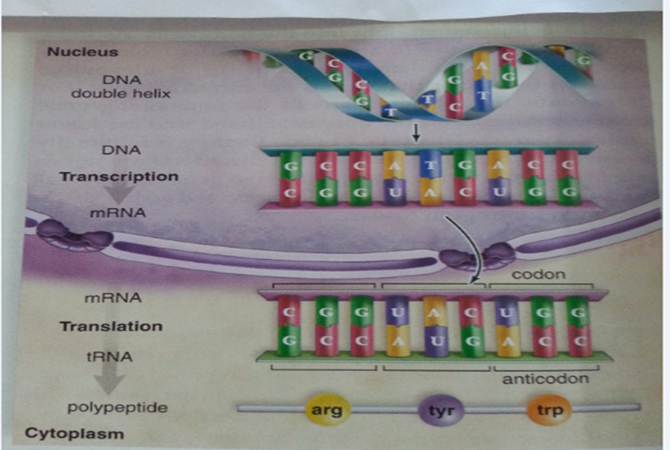

Slide 6
Gene Expression
Gene expression is the process by which information from a gene is used in the synthesis of a functional gene product. These products are often proteins.
The process of gene expression is used by all known life ,eukaryotes (including multicellular organisms), prokaryotes(bacteria and archaea), and utilized by viruses to generate the macromolecular machinery for life.

Slide 8
In genetics, gene expression is the most fundamental level at which the genotype gives rise to the phenotype, i.e. observable trait(in this cat)

Slide 9
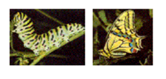
The genetic code stored in DNA is "interpreted“ by gene expression, and the properties of the expression give rise to the organism's phenotype. Such phenotypes are often expressed by the synthesis of proteins that control the organism's shape, or that act as enzymes catalysing specific metabolic pathways characterising the organism. Ex.( colors of butter fly)

Slide 10
How do scientists measure gene expression?
Gene expression is dynamic, and the same gene may act in different ways under different circumstances. For example, imagine that two organisms have similar genotypes but different phenotypes. What is the cause of this variation in phenotype? Could the difference stem from differing regulation of gene expression? Could temperature affect expression of the organism's DNA ? Might some other factor be responsible? To go about answering these types of questions, researchers often use many laboratory techniques such as serial analysis of gene expression (SAGE), these techniques make it possible to identify which genes are turned on and which are turned off within cells. Also, this information can be used to help determine what circumstances trigger expression of various genes.

Slide 11
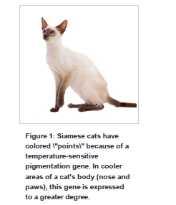

Slide 12
Regulation of gene expression refers to the control of the amount and timing of appearance of the functional product of a gene. Control of expression is vital to allow a cell to produce the gene products it needs when it needs them, this gives cells the flexibility to adapt to a variable environment, example of where gene expression is important like: *Control of insulin expression so it gives a signal for blood glucose regulation. *A large number of methods have been developed for analyzing gene expression like PCR technique.

Slide 13
THANK YOU

