Slide 1
Respiratory system
Dr.thura Abbas Al-Taee

Slide 2
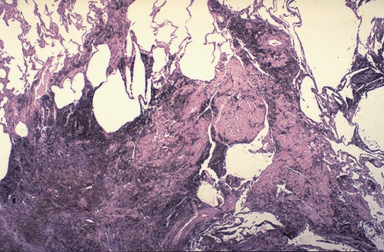
Anthracotic pigment ordinarily is not fibrogenic, but in massive amounts (as in "black lung disease" in coal miners) a fibrogenic response can be elicited to produce the "coal worker's pneumoconiosis" seen here

Slide 3
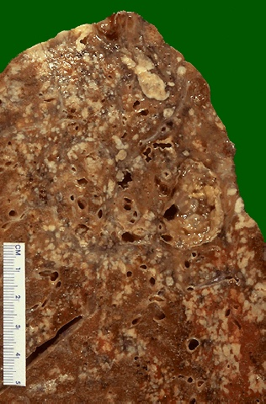
the granulomas have areas of caseous necrosis. This is very extensive granulomatous disease. This pattern of multiple caseating granulomas primarily in the upper lobes is most characteristic of secondary (reactivation) tuberculosis.

Slide 4
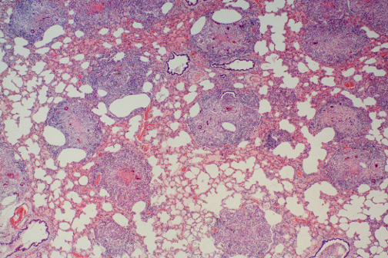
At low magnification, this photomicrograph reveals multiple granulomas. Granulomatous disease by chest radiograph can appear as reticulonodular densities.

Slide 5
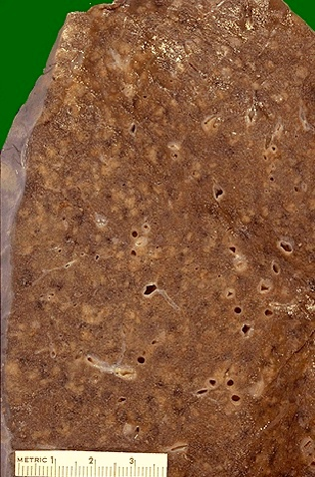
When the immune response is poor or is overwhelmed by an extensive infection, then it is possible to see the gross pattern of granulomatous disease seen here. This is a "miliary" pattern of granulomas because there are a multitude of small tan granulomas, about 2 to 4 mm in size, scattered throughout the lung parenchyma. The miliary pattern gets its name from the resemblence of the granulomas to millet seeds

Slide 6
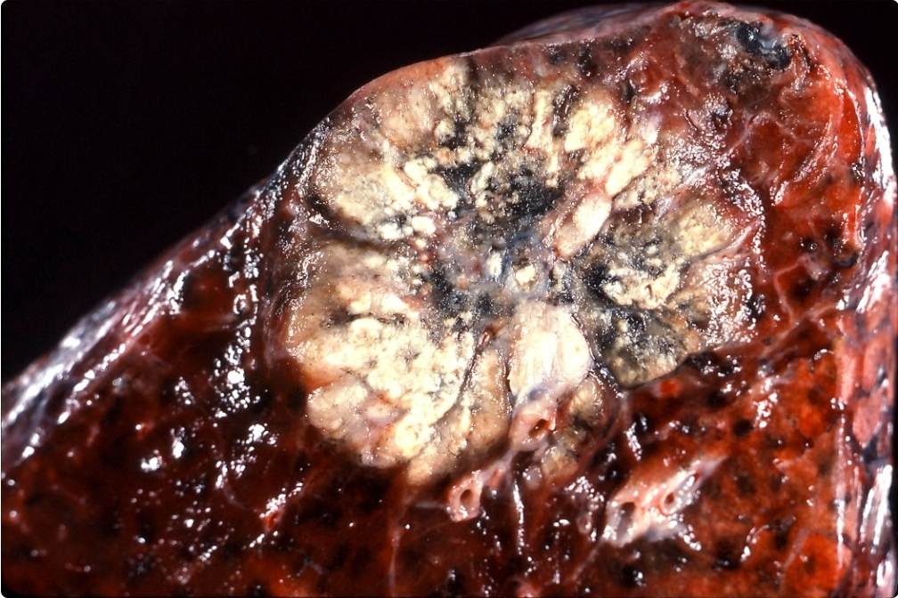
This peripherally located adenocarcinoma contains a large area of mostly central scarring with anthracotic pigmentation

Slide 7
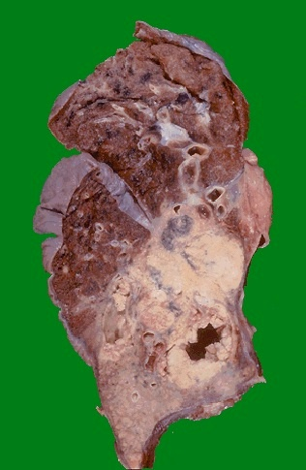
This is a larger squamous cell carcinoma in which a portion of the tumor demonstrates central cavitation, probably because the tumor outgrew its blood supply. Squamous cell carcinomas are one of the more common primary malignancies of lung and are most often seen in smokers.

Slide 8
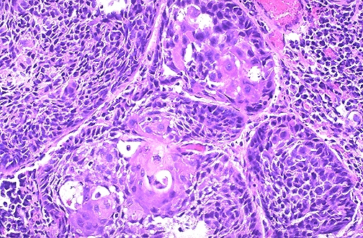
This is the microscopic appearance of squamous cell carcinoma with nests of polygonal cells with pink cytoplasm and distinct cell borders. The nuclei are hyperchromatic and angular.

Slide 9
