Slide 1
Obstructive pulmonary diseases
ASTHMA

Slide 2
Asthma is a chronic inammatory disorder of the airways, in which many cells and cellular elements play a role. Chronic inammation is associ- ated with airway hyper-responsiveness that leads to recurrent episodes of wheezing, breathlessness, chest tightness and coughing, particularly at night and in the early morning. These episodes are usually associated with widespread but variable airow obstruction within the lung that is often reversible, either spontaneously or with treatment

Slide 3
The prevalence of asthma increased steadily over the latter part of last century. As asthma affects all age groups, it is one of the most common and important long-term respiratory conditions in terms of global years lived with disability

Slide 4
PathophysiologyAirway hyper-reactivity (AHR) – the tendency for airways to narrow exces- sively in response to triggers that have little or no effect in normal individ- uals – is integral to the diagnosis of asthma and appears to be related, although not exclusively, to airway inammation (Fig. 17.17). Other fac- tors likely to be important in the behaviour of airway smooth muscle include the degree of airway narrowing and neurogenic mechanisms.The relationship between atopy (the propensity to produce IgE) and asthma is well established and in many individuals there is a clear rela- tionship between sensitisation and allergen exposure, as demonstrated by skin-prick reactivity or elevated serum-specic IgE. Common exam- ples of allergens include house dust mites, pets, insect pests and fungi. Inhalation of an allergen into the airway is followed by early and late- phase bronchoconstrictor responses (Fig. 17.18). Allergic mechanisms are also implicated in some cases of occupational asthma.

Slide 5
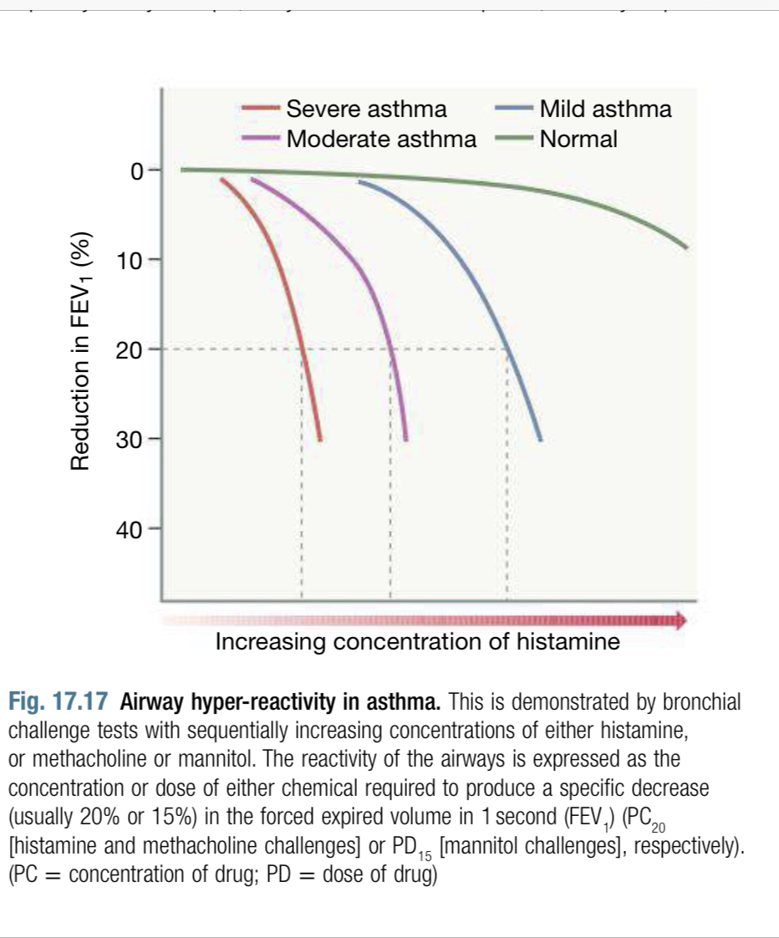

Slide 6
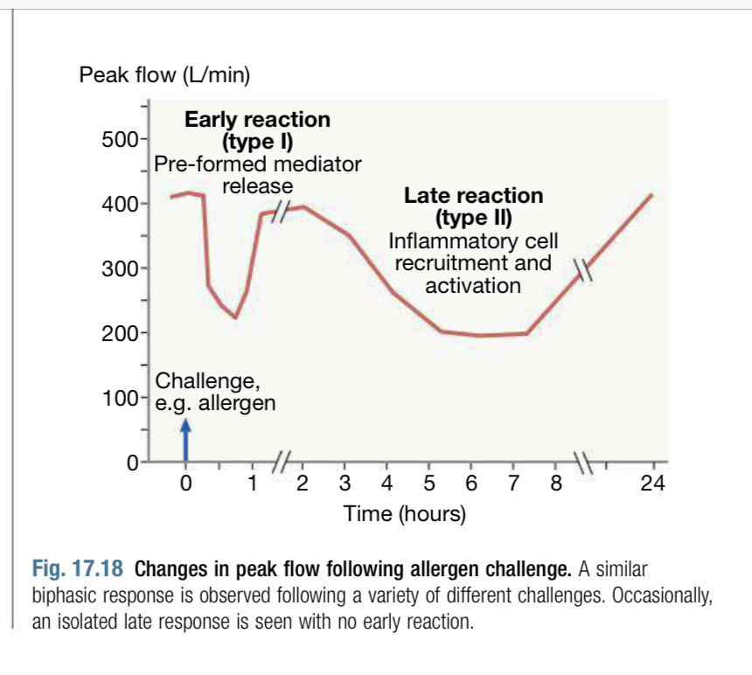

Slide 7
In cases of NSAID-induced asthma, the ingestion of salicylates results in inhibition of the cyclo-oxygenase enzymes, preferentially shunting the metabolism of arachidonic acid through the lipoxygenase pathway with resultant production of the asthmogenic cysteinyl leukotrienes. In exercise-induced asthma, hyperventilation results in water loss from the pericellular lining uid of the respiratory mucosa, which, in turn, triggers mediator release. Heat loss from the respiratory mucosa may also be important

Slide 8
In persistent asthma, a chronic and complex inammatory response ensues, characterised by an inux of numerous inammatory cells, the transformation and participation of airway structural cells, and the secretion of an array of cytokines, chemokines and growth factors. Examination of the inammatory cell prole in induced sputum samples demonstrates that, although asthma is predominantly characterised by airway eosinophilia, neutrophilic inammation predominates in some patients while in others scant inammation is observed (‘pauci-granu- locytic’ asthma).With increasing severity and chronicity of the disease, remodelling of the airway may occur, leading to brosis of the airway wall, xed narrow- ing of the airway and a reduced response to bronchodilator medication.

Slide 9
Clinical featuresTypical symptoms include recurrent episodes of wheezing, chest tight- ness, breathlessness and cough. Asthma is commonly mistaken for a cold or a persistent chest infection (e.g. longer than 10 days). Classical precipitants include exercise, particularly in cold weather, exposure to airborne allergens or pollutants, and viral upper respiratory tract infec- tions. Wheeze apart, there is often very little to nd on examination. An inspection for nasal polyps and eczema should be performed. Rarely, a vasculitic rash may suggest eosinophilic granulomatosis with polyangiitis (EGPA, formerly known as Churg–Strauss syndrome).Patients with mild intermittent asthma are usually asymptomatic between exacerbations. Individuals with persistent asthma report ongo- ing breathlessness and wheeze but these are variable, with symptoms uctuating over the course of one day, or from day to day or month to month.1

Slide 10
Asthma characteristically displays a diurnal pattern, with symptoms and lung function being worse in the early morning. Particularly when poorly controlled, symptoms such as cough and wheeze disturb sleep. Cough may be the dominant symptom in some patients, and the lack of wheeze or breathlessness may lead to a delay in reaching the diagnosis of so-called ‘cough-variant asthma’.Some patients with asthma have a similar inammatory response in the upper airway. Careful enquiry should be made as to a history of sinusitis, sinus headache, a blocked or runny nose and loss of sense of smell.Although the aetiology of asthma is often elusive, an attempt should be made to identify any agents that may contribute to the appearance or aggravation of the condition. Particular enquiry should be made about potential allergens, such as exposure to pets or other animals, pest infes- tation, exposure to moulds following water damage to a home or build- ing, and any potential occupational agents.

Slide 11
In some circumstances, asthma is triggered by prescription drugs. Beta-adrenoceptor antagonists (β-blockers), even when administered topically as eye drops, may induce bronchospasm, as may aspirin and other non-steroidal anti-inammatory drugs (NSAIDs). The classical NSAID-induced asthma patient is female and presents in middle age with asthma, rhinosinusitis and nasal polyps. Aspirin-sensitive patients may also report symptoms following alcohol and foods containing sali- cylates. Other medications implicated include the oral contraceptive pill, cholinergic agents and prostaglandin F2α. Betel nuts contain arecoline, which is structurally similar to methacholine and can aggravate asthma. An important minority of patients develop a particularly severe form of asthma and this appears to be more common in women. Allergic triggers are less important and airway neutrophilia predominates.

Slide 12
DiagnosisThe diagnosis of asthma is predominantly clinical and is based on the combination of history, lung function and ‘other’ tests, which allows high, intermediate or low probability of asthma to emerge. The approach may vary from patient to patient and may need to be re-evaluated following the introduction of treatment.Supportive evidence is provided by the demonstration of variable air- ow obstruction, preferably by using spirometry (Box 17.19) to measure FEV1 and FVC. This identies the obstructive defect, denes its sever- ity, and provides a baseline for bronchodilator reversibility (Fig. 17.19). If spirometry is not available, a peak ow meter may be used. Symptomatic patients should be instructed to record peak ow readings after rising in the morning and before retiring in the evening. A diurnal variation in PEF of more than 20% (the lowest values typically being recorded in the morning) is considered diagnostic and the magnitude of variability provides some indication of disease severity (Fig. 17.20).It is not uncommon for patients whose symptoms are suggestive of asthma to have normal lung function. In these circumstances, the demonstration of AHR by challenge tests may be useful to conrm the diagnosis (see Fig. 17.17). AHR has a high negative predictive value but positive results may be seen in other conditions such as COPD, bronchi- ectasis and cystic brosis. Exercise tests are useful when symptoms are predominantly related to exercise (Fig. 17.21). Measurement of exhaled nitric oxide (FeNO) is a useful test for glucocorticoid-naïve patients as a measure of eosinophilic airways inammation. An elevated FeNO value (adults >50ppb; children >35ppb) supports the diagnosis of asthma and suggests that the patient’s symptoms are highly likely to respond to glucocorticoids.The diagnosis may be supported by the presence of peripheral blood eosinophilia or atopy demonstrated by skin-prick tests or measurement of total and allergen-specic IgE. X-ray appearances are often normal, but lobar collapse may be seen if mucus occludes a large bronchus and, if accompanied by the presence of itting inltrates, may suggest that asthma has been complicated by allergic bronchopulmonary aspergillosis.

Slide 13
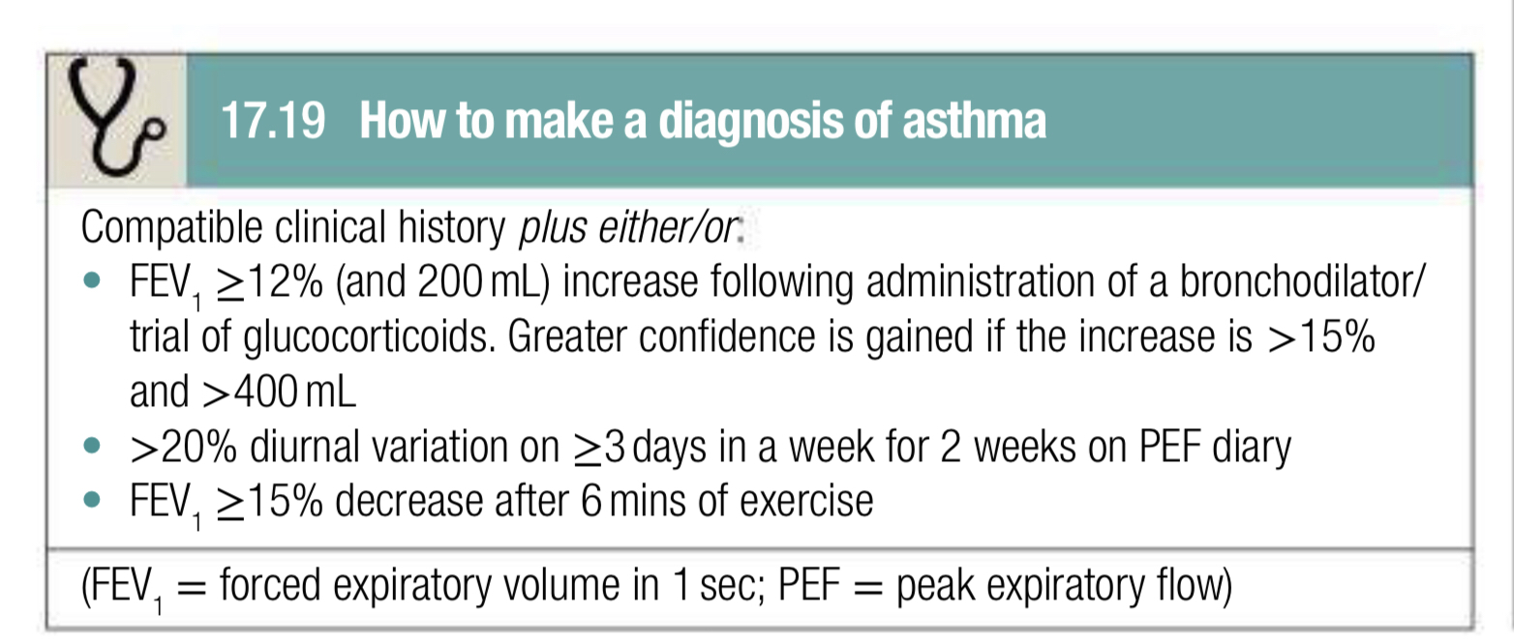

Slide 14
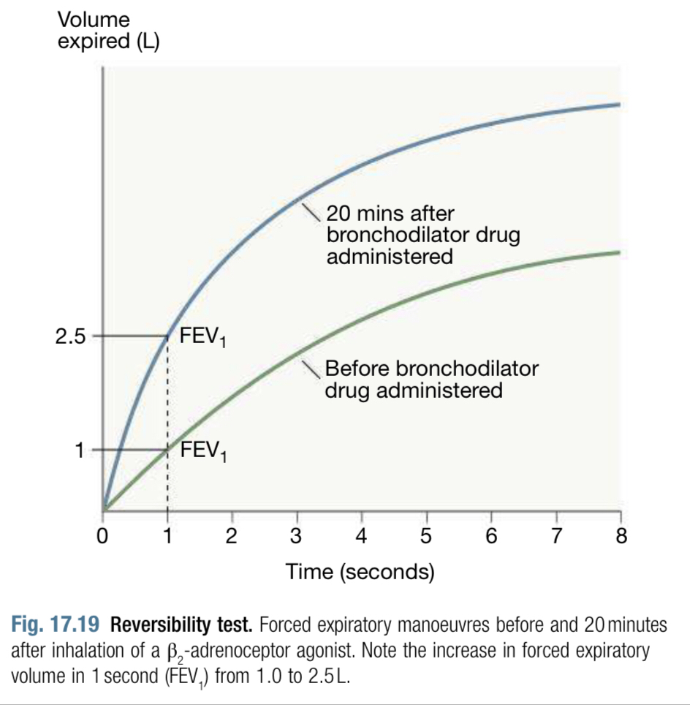

Slide 15
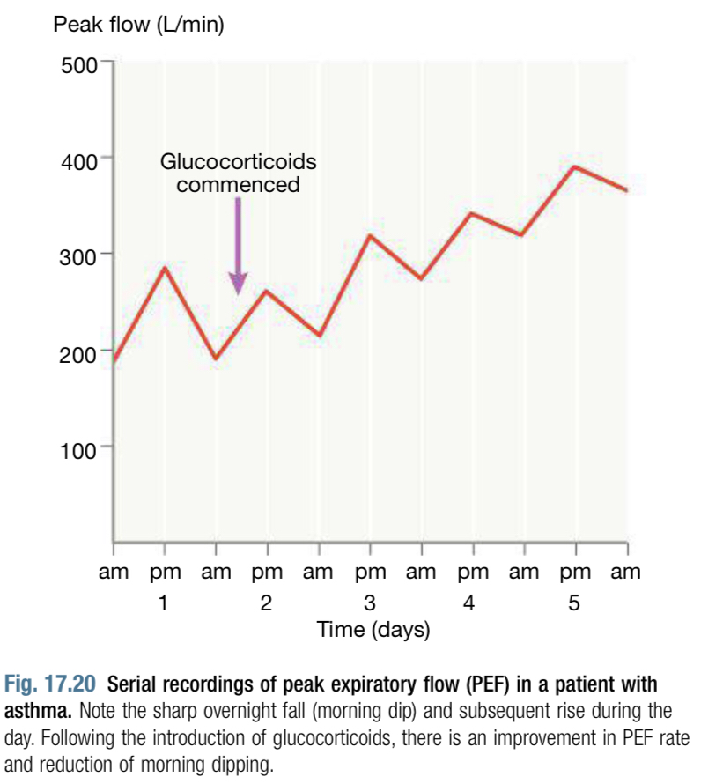

Slide 16
ManagementSetting goalsAsthma is a chronic condition but may be controlled with appropriate treatment in the majority of patients. The goal of treatment should be to obtain and maintain complete control (Box 17.20) but aims may be mod- ied according to the circumstances and the patient. Unfortunately, sur- veys consistently demonstrate that the majority of individuals with asthma report suboptimal control, perhaps reecting the poor expectations ofpatients and their clinicians. Pregnancy raises some issues in asthmamanagement, which are shown in Box 17.21 Self-managementPatients should be encouraged to take responsibility for managing their own disease. A key aspect of self-management is education, ensuring that the patient understands the relationship between symptoms and inammation, key symptoms such as nocturnal waking and the indica- tions for medication. The patient must also be able to use the prescribed inhalers and understand the importance of concordance with therapy. Written action plans can be helpful in developing self-management skills and they can be guided by symptoms or PEF.

Slide 17
Avoidance of aggravating factorsThis is particularly important in the management of occupational asthma but may also be relevant in atopic patients, for whom removing or reduc- ing exposure to relevant antigens may effect improvement. House dust mite exposure may be reduced by replacing carpets with oorboards and using mite-impermeable bedding, but these measures have not demonstrated major improvements in asthma control. Many patients are sensitised to several ubiquitous aeroallergens, making avoidance strat- egies impracticable. Measures to reduce fungal exposure may be appli- cable in specic circumstances and medications known to precipitate or aggravate asthma should be avoided. Smoking cessation (p.90) is particularly important, as smoking not only encourages sensitisation but also induces a relative glucocorticoid resistance in the airway.

Slide 18
The stepwise approach to the management of asthmaPrior to any step up in a patient’s asthma therapy they should be reviewed to ensure that aggravating factors have been addressed, concordance assessed and inhaler technique checked.Once asthma control is established, the dose of inhaled (or oral) glucocorticoid should be titrated to the lowest dose at which effective

Slide 19
control is maintained. Decreasing the dose of glucocorticoid by around 25%–50% every 3 months is a reasonable strategy for most patients.The stepwise approach is summarized in Figure 17.22 Step 1: Regular preventerThe initial therapy for a patient diagnosed with asthma would be a low- dose inhaled glucocorticoid (ICS). For adults, a starting dose equiva- lent to beclometasone dipropionate (BDP) 400 μg per day is reasonable, although higher doses may be required in smokers.A variety of different inhaled devices are available and the choice of device should be guided by patient preference and competence in its use. The metered-dose inhaler remains the most widely prescribed (Fig. 17.23).Step 2: Initial add-on therapyIf the asthma remains poorly controlled despite regular preventer therapy, the next step should be addition of a long-acting beta agonist (LABA). This should be done via a combination ICS/LABA inhaler to prevent inad- vertent administration of LABA monotherapy and risk of asthma death.Combination ICS/LABA inhalers containing the fast-acting LABA for- moterol can be used as a maintenance and reliever (MART) inhaler allow- ing for auto-titration of therapy in response to symptoms.

Slide 20
Step 3: Additional add-on therapiesIf asthma control remains poor despite initial add-on therapy, the patient should have a detailed asthma review. There are a number of options to consider at this stage:
 If there has been no response to the LABA, then it should be stopped and an increase of the ICS to a medium dose (800 μg) considered. If there is benet from the LABA, but control is poor then the ICS should be increased to a medium dose, alternatively trial of a leuko- triene antagonist (LTRA) or a slow-release theophylline preparation should be considered.

Slide 21
Step 4: High-dose therapiesIn adults, the dose of inhaled glucocorticoid should be trialled up to a high dose (2000μg BDP) (or equivalent) daily. Trials of LTRA, long-act- ing antimuscarinic agents (LAMA), theophyllines or a slow-release oral β2-agonist may be considered. If the trial of add-on therapy is ineffective, it should be discontinued.

Slide 22
Step 5: Continuous or frequent use of oral glucocorticoidsAt this stage, oral prednisolone (usually administered as a single daily dose in the morning) should be prescribed at the lowest dose necessary to control symptoms and the patients should be referred for specialist severe asthma assessment. Patients who are on long-term glucocorti- coid tablets (>3 months) or are receiving more than three or four courses per year will be at risk of systemic side-effects (p. 684). The risk of osteo- porosis in this group can be reduced by giving bisphosphonates. These patients should be considered for biologic therapy to minimise long-term harm from oral glucocorticoids.Omalizumab (anti-IgE) therapy may be considered for those patients with severe IgE-driven atopic asthma. Benralizumab (anti-IL5r), mepoli- zumab (anti-IL5), reslizumab (anti-IL5) or dupiliumab (anti-IL4/13) could be considered for patients with eosinophilic forms of asthma.

Slide 23
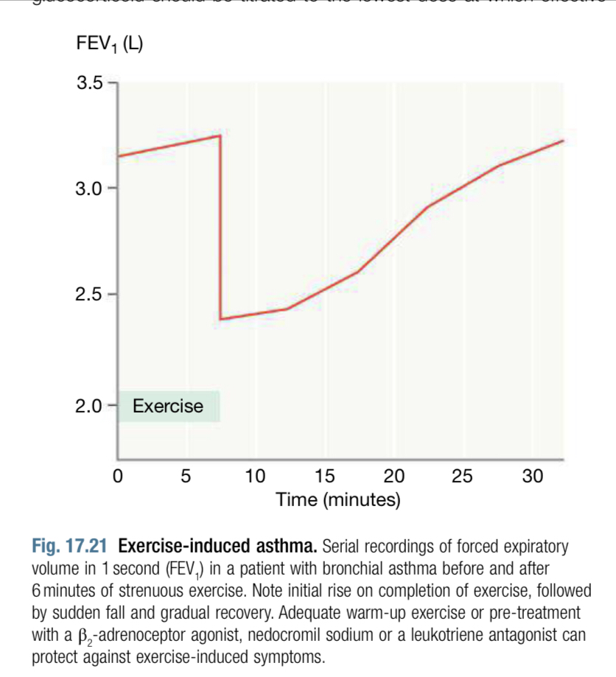

Slide 24
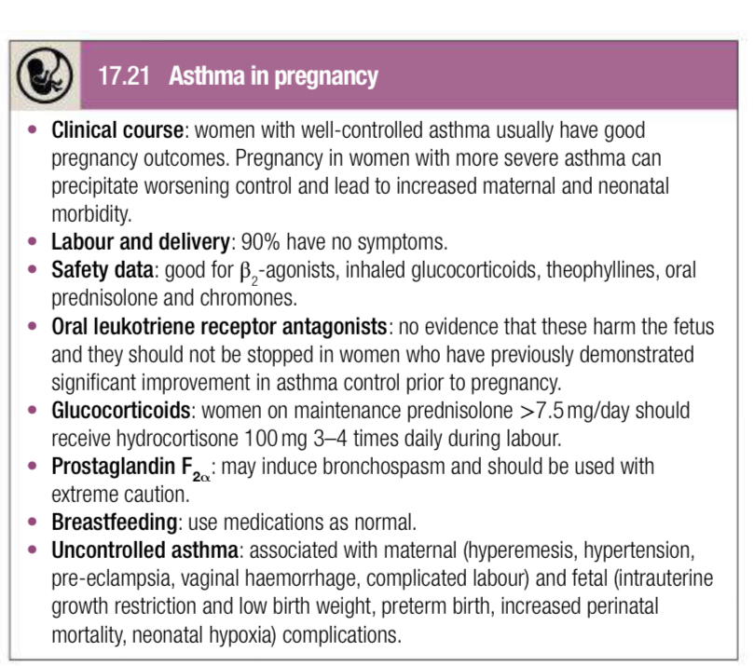

Slide 25
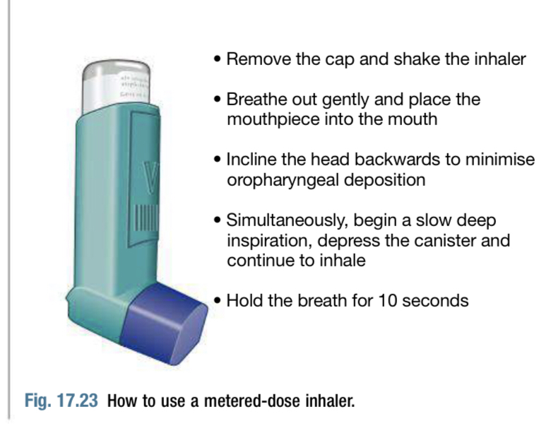

Slide 26
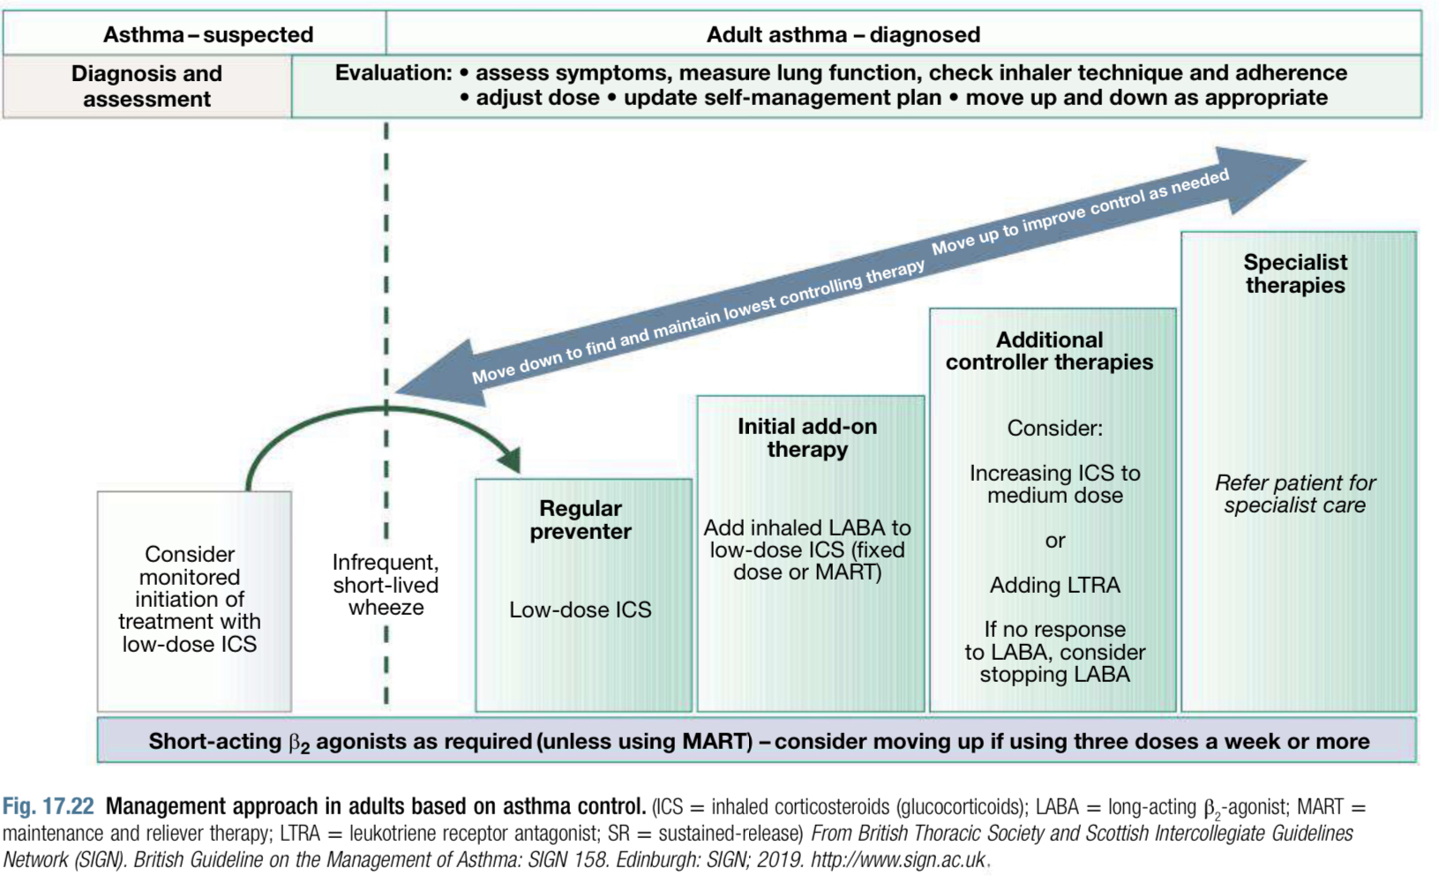

Slide 27
Exacerbations of asthmaThe course of asthma may be punctuated by exacerbations with increased symptoms, deterioration in lung function, and an increase in airway inammation. Exacerbations are most commonly precipitated by viral infections but moulds, pollens (particularly following thunderstorms) and air pollution are also implicated. Most attacks are characterised by
a gradual deterioration over several hours to days but some appear to occur with little or no warning: so-called brittle asthma. An important minority of patients appear to have a blunted perception of airway nar- rowing and fail to appreciate the early signs of deterioration

Slide 28
Management of mild to moderate exacerbationsDoubling the dose of inhaled glucocorticoids does not prevent an impending exacerbation. Short courses of at least 5 days of ‘rescue’ glu- cocorticoids (prednisolone 40–50 mg/day) are therefore often required to regain control. Tapering of the glucocorticoid dose to withdraw treatment is not necessary, unless it has been given for more than 3 weeks.Indications for ‘rescue’ courses include:symptoms and PEF progressively worsening day by day, with a fall of PEF below 75% of the patient's personal best recordingonset or worsening of sleep disturbance by asthmapersistence of morning symptoms until midday  progressively diminishing response to an inhaled bronchodilator symptoms that are sufciently severe to require treatment with nebu-lised bronchodilators

Slide 29
Management of acute severe asthmaBox 17.22 highlights the immediate assessment requirements in acute asthma. Measurement of PEF is mandatory, unless the patient is too ill to cooperate, and is most easily interpreted when expressed as a percent- age of the predicted normal or of the previous best value obtained on optimal treatment (Fig. 17.24). Arterial blood gas analysis is essential for those patients with life-threatening or near-fatal asthma to determine the PaCO2, a normal or elevated level being particularly dangerous. A chest X-ray is not immediately necessary, unless pneumothorax is suspected.Treatment includes the following measure

Slide 30
 Oxygen. Controlled supplemental oxygen should be administered to maintain SaO2 94%–98%. The presence of a high PaCO2 should not be taken as an indication to reduce oxygen concentration but as a warning sign of a severe or life-threatening attack. Failure to achieve appropriate oxygenation is an indication for assisted ventilation. High doses of inhaled bronchodilators. Short-acting β2-agonistsare the agent of choice. They can be administered either via mul- tiple doses of a metered-dose inhaler via a spacer device, or via a nebuliser driven by oxygen. Ipratropium bromide provides further bronchodilator therapy and should be added to if there is a failure to respond to salbutamol or in life-threatening attacks. Systemic glucocorticoids. These reduce the inammatory response, reduce mortality, subsequent hospital admission and requirement for bronchodilators. They should be administered to all patients with an acute severe attack. They can usually be administered orallyas prednisolone but intravenous hydrocortisone may be used in patients who are vomiting or unable to swallow.

Slide 31
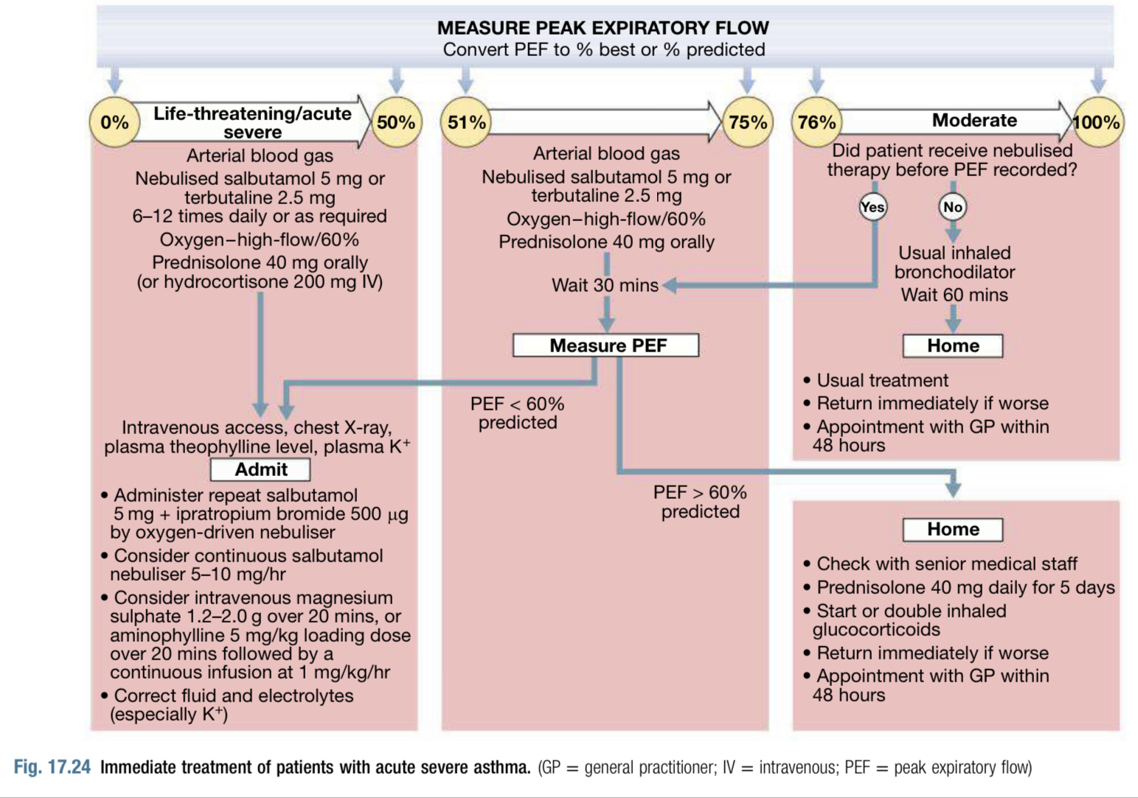

Slide 32
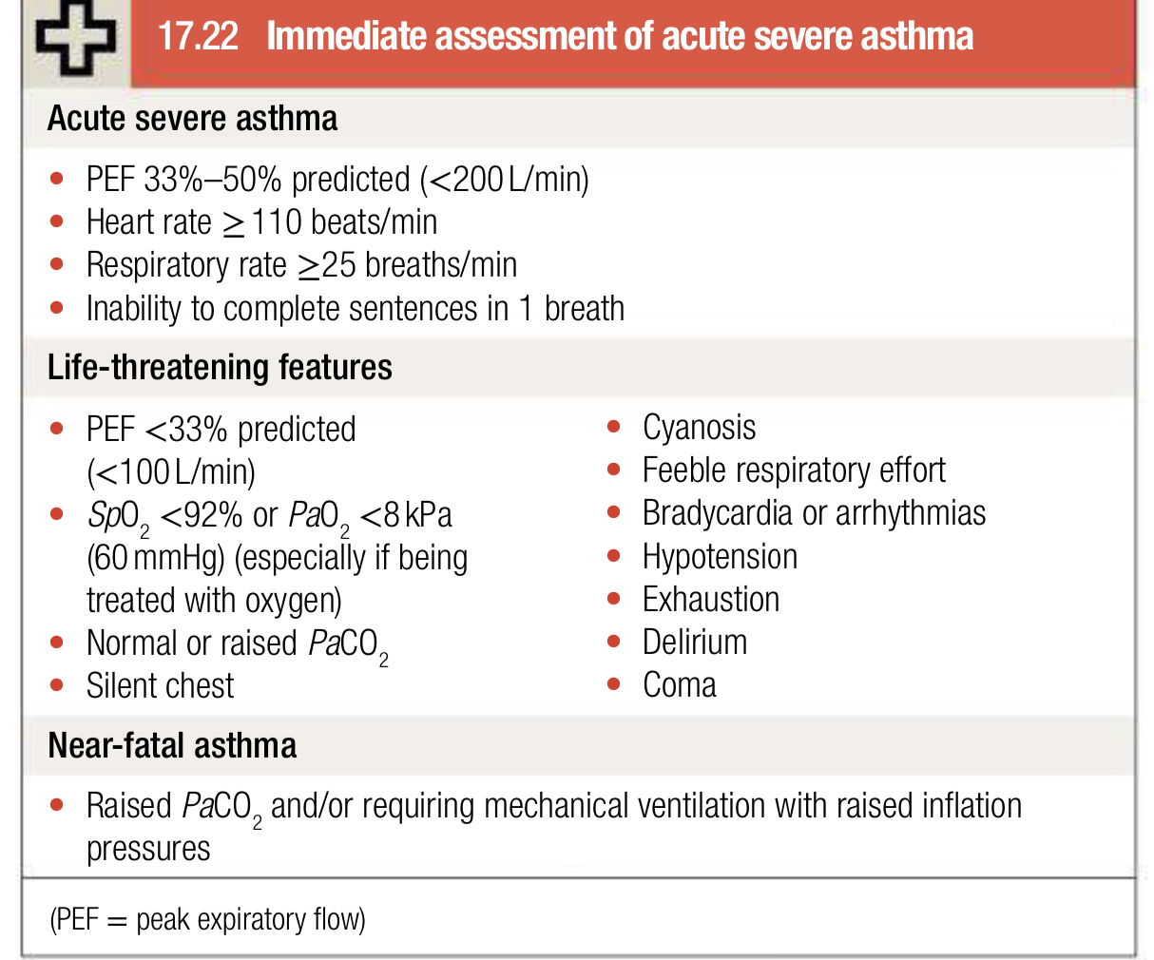

Slide 33
There is no evidence base for the use of intravenous uids but many patients are dehydrated due to high insensible water loss and may ben- et. Potassium supplements may be necessary to counteract hypokal- aemia caused by repeated doses of beta-agonists.If patients fail to improve, a number of further options may be consid- ered, including intravenous magnesium for patients with life-threatening or near-fatal attacks and intravenous aminophylline, although cardiac and therapeutic drug level monitoring is recommended.PEF should be recorded 15–30minutes after starting therapy and thereafter according to response every 4–6 hours and pulse oximetry should be monitored to ensure that SaO2 94%–98% is maintained.

