Slide 1
Clinical slides
Brain CT scan

Slide 2
CT scan is:
Fast
Cheap
Available
( Easy in Interpretation)

Slide 4
Blood Can Be Very Bad
B = Blood
C = cisterns
B = Brain
V = Ventricles
B = Bone

Slide 5
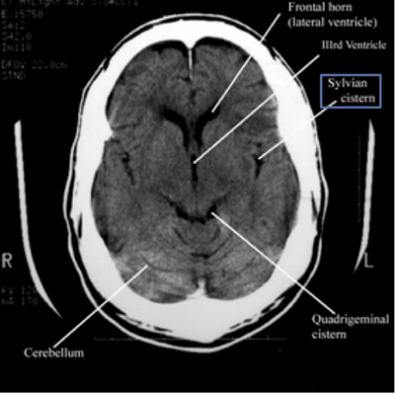
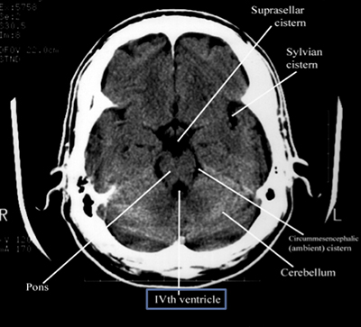

Slide 6
Color depend on the density.
High density appear white, the most dense structure is the skull bone, and mentioned as hyperdense.
Low density structure appear dark, the least dense structures are the air in the sinuses and the CSF, and mentioned as hypodense.
Other brain tissues are mostly gray and mentioned as isodense.

Slide 8
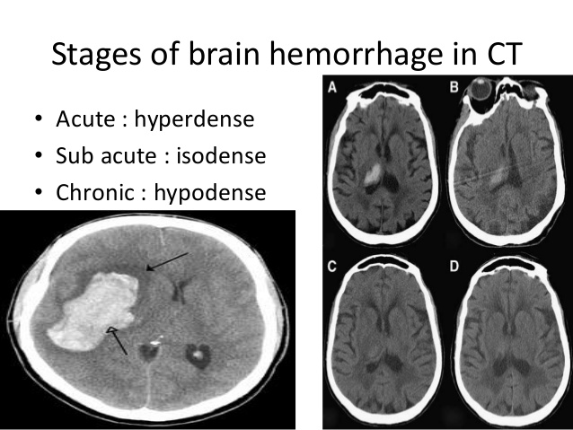
Bleeding increase density so it appear hyperdense
Acute blood is hyper dense
Subacute is isodense
Chronic is hypodense

Slide 9
Intracranial hemorrhage:
Intracerebral hg.
Intraventricular hg.
Subarachnoid hg.
Subdural hematoma.
Epidural (extradural) hematoma

Slide 10
What is the most common cause of spontaneous intracerebral Hg.?

Slide 11
Which is the commonest site of hypertensive Hg.?

Slide 12
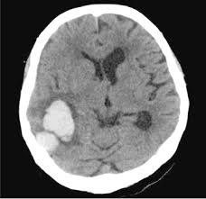
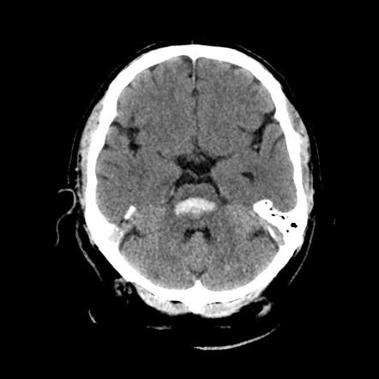
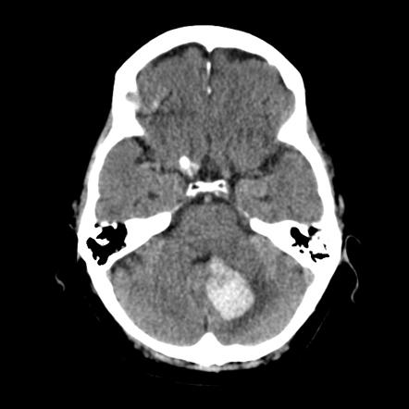
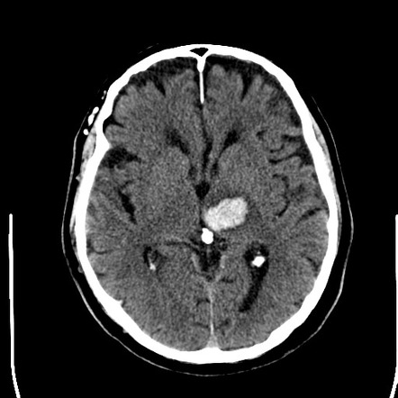
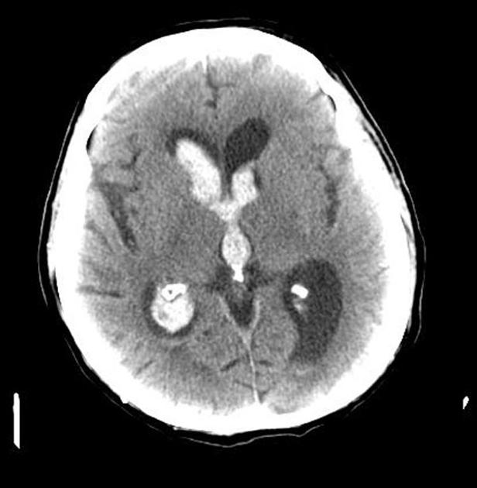
Intracerebral hemorrhage

Slide 13
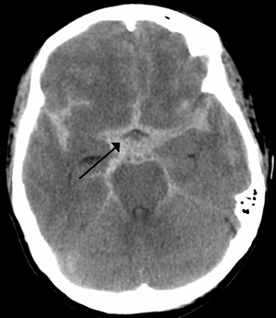
Subarachnoid Hemorrhage (SAH)
SAH appears as a hyperdensity, that fills the normally dark, CSF-filled subarachnoid spaces around the brain.
The normally black subarachnoid cisterns and sulci may appear white in acute hemorrhage.
These findings are most evident in the largest subarachnoid spaces, such as the suprasellar cistern and Sylvian fissures.

Slide 14
What is the most common cause of spontaneous SAH ?
What are the complications of SAH ?

Slide 15
Subdural Hematoma
a type of bleeding usually associated with a trauma, in which the blood is collected between the dura mater and the arachnoid mater.
It usually results from tears in bridging veins that cross the subdural space.
It occurs not only in severe head injury but also in minor trauma particularly those who are elderly or receiving anticoagulants, and may also be spontaneous.

Slide 16
Clinical features of SDH
Loss of consciousness or fluctuating levels of consciousness
Headache
Difficulty with gait or balance
Cognitive dysfunction or memory loss
Personality change
Motor deficit (eg, hemiparesis)
Aphasia
Seizures
Nausea or vomiting

Slide 17
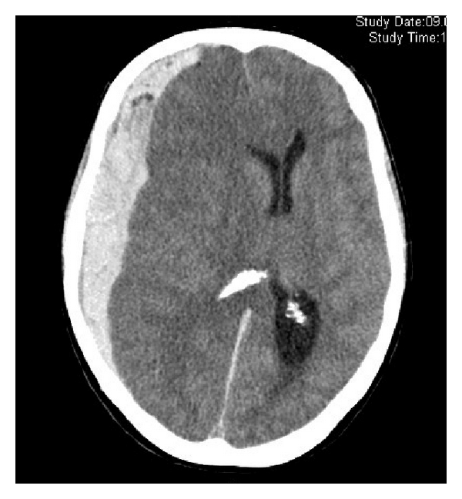
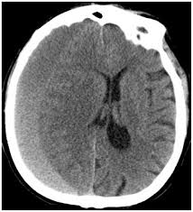
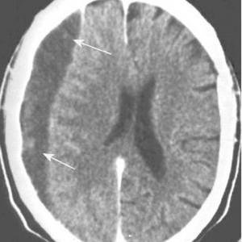
Acute 0-3 Subacute 3-14 Chronic

Slide 18
Epidural hematoma
bleeding occurs between dura mater and the skull.
Often there is loss of consciousness following a head injury, a brief regaining of consciousness( lucid period), and then loss of consciousness again.
Other symptoms may include headache, confusion, vomiting, and an inability to move parts of the body.
The cause is typically head injury that results in fracture of the temporal bone and bleeding from the middle meningeal artery.
Occasionally it can occur as a result of a bleeding disorder or blood vessel malformation.

Slide 20
Differentiate between SDH and EDH

Slide 22
Ischemic stroke
Ischemia = necrotic tissue so it appear as hypodense

Slide 23
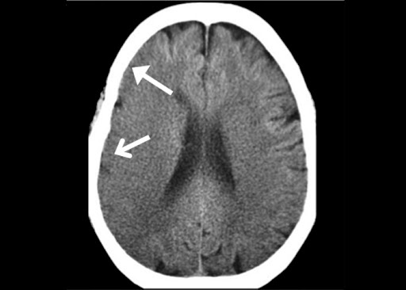
Early findings (within 6 hours) include:
loss of gray-white differentiation corresponding to increased water content from early cytotoxic edema.

Slide 24
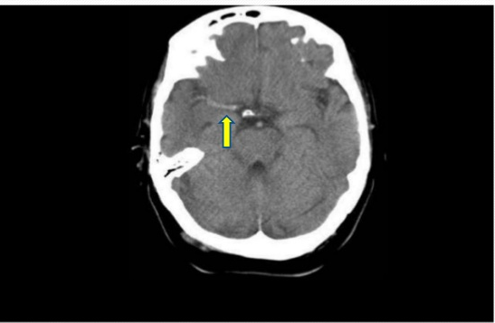
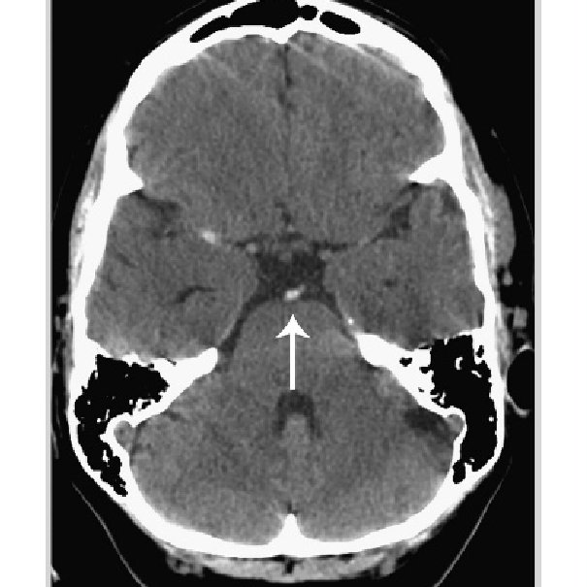
dense vessel sign or dot sign; these are believed to represent acute thrombus or embolus and has been described in the MCA and basilar artery,

Slide 25
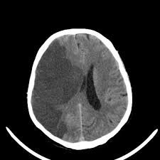
After approximately 12-24 hours, a more well-defined area of hypodensity, which may have associated mass effect with sulcal or ventricular effacement, may be seen.

Slide 26
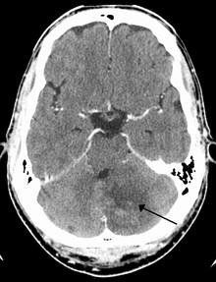
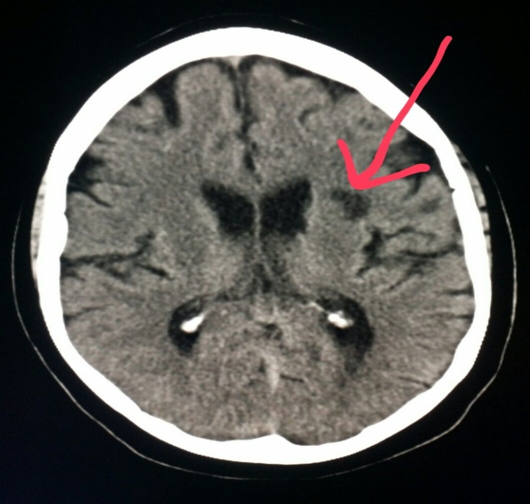
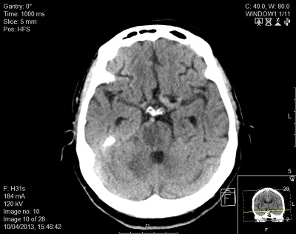
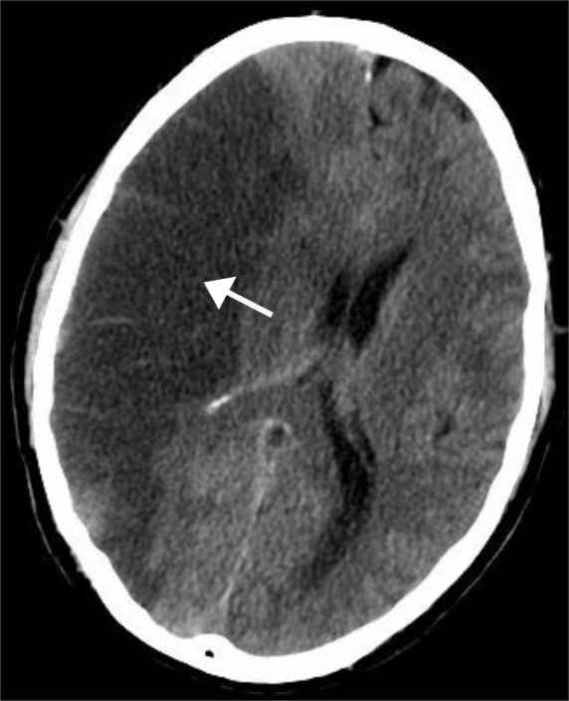
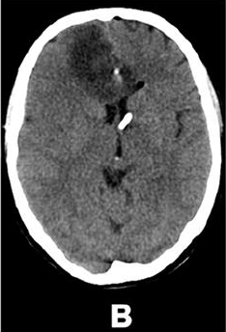

Slide 27
Normal Pressure Hydrocephalus
(Non-obstractive hydrocephalus or communicating hydrocephalus)
is a brain disorder in which excess CSF accumulates in the brain’s ventricles.
is called "normal pressure" because despite the excess fluid, CSF pressure as measured during a spinal tap is often normal.
As brain ventricles enlarge with the excess CSF, they can disrupt and damage nearby brain tissue, leading to a classic triad of symptoms:
difficulty walking (gait apraxia), problems with thinking and reasoning (reversible dementia), and loss of bladder control (incontinence).

Slide 28
Causes and risk factors
In some cases, normal pressure hydrocephalus is caused by other brain disorders such as head injury, hemorrhage, infection or inflammation. But in most cases, the cause remains unknown.
Diagnosis
MRI or CT is needed to demonstrate enlarged ventricles and no macroscopic obstruction to cerebrospinal fluid flow.
Management
CSF shunting is the first-line treatment

Slide 29
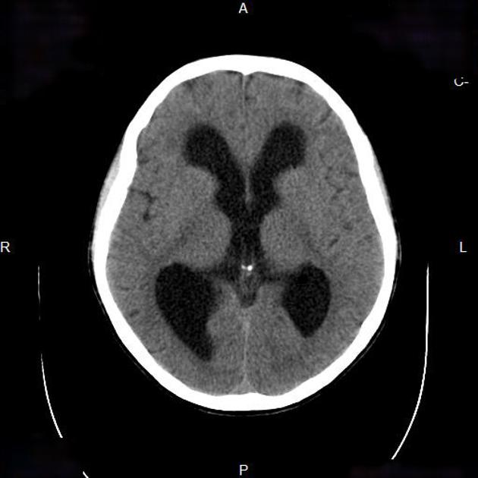

Slide 30
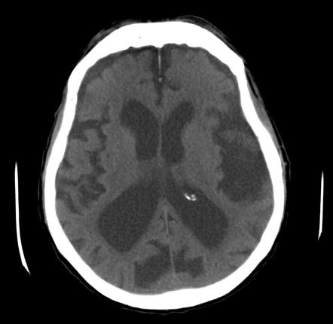
Brain atrophy

Slide 31
Obstructive Hydrocephalus
(Non-communicating hydrocephalus)
results secondary to obstruction along the CSF pathway between the lateral ventricles and the fourth ventricular outlet.
The CT and MRI appearances are identical to those of communicating hydrocephalus, with the exception that in obstructive hydrocephalus not all ventricles are enlarged.
The ventricles are dilated proximal but not distal to the obstruction. For example, in aqueduct obstruction, the fourth ventricle remains normal as the third and lateral ventricles enlarge.
The cause of obstructive hydrocephalus can often be identified on CT or MRI.

Slide 32
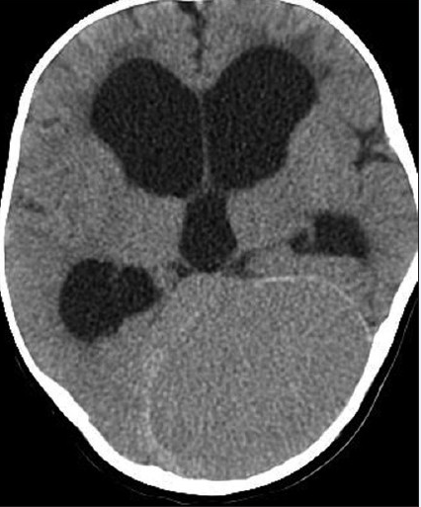
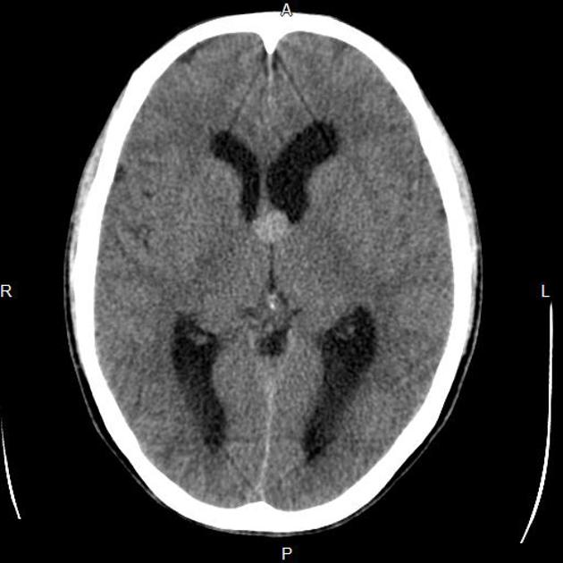

Slide 33
Thank you for your attention
any question?

