Slide 1
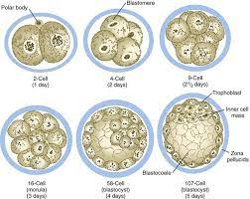
Cleavage and Implantation
Presented By
Ass.lec. Applied Embryology

Slide 2
Objectives
At the end of the lecture you should know about:
Describe of the cleavage.
Blastocyst formation .
Normal and abnormal implantation.
The stem cells.

Slide 5
Cleavage
Cleavage is series of repeated mitotic divisions (without cell growth) of the zygote resulting in rapid increase in the number of cells (embryonic cells).
These embryonic cells are called blastomeres .
Blastomeres become smaller with each successive cleavage division.

Slide 6
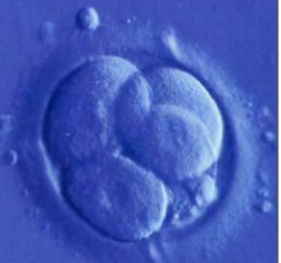
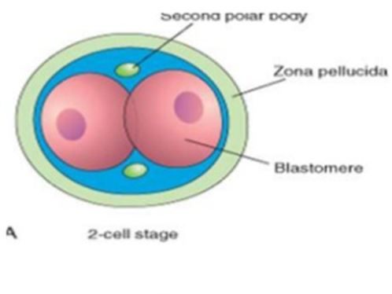
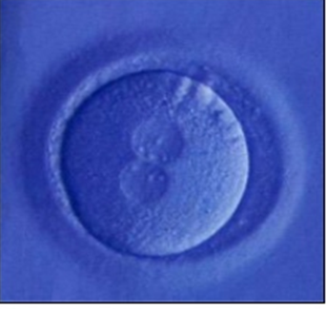
Cleavage
Cleavage normally occurs as the zygote passes along the uterine tube toward the uterus.
Division of the zygote into blastomeres begins approximately 30 hours after fertilization (day 2).
The 1st cleavage is the division of the zygote into a two-cell stage

Slide 7
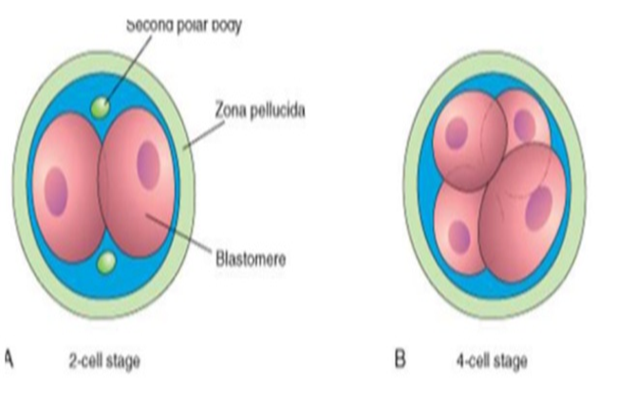
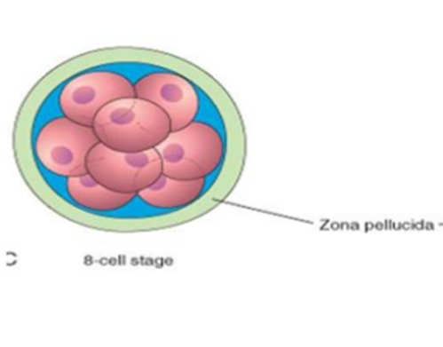
Cleavage
The 2nd cleavage is from the two-cell stage into a four-cell stage.
The 3rd cleavage is from the fourth-cell stage into an eight-cell stage.
After the 8th- cell stage the blastomeres change their shape and form a compact ball of cell.

Slide 8
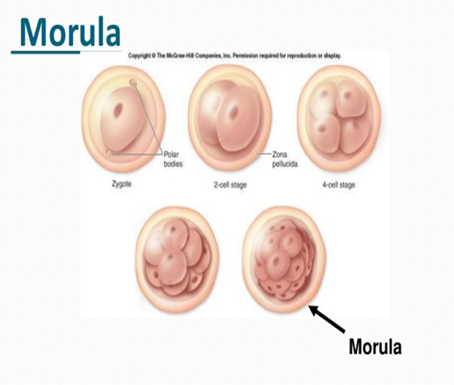
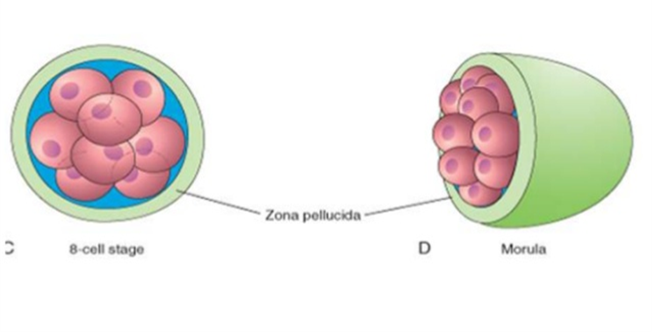
Cleavage
On the 3rd day after fertilization, The cell of the compacted divided to form 16 blastomeres forming a mass cell is called a morula.

Slide 10
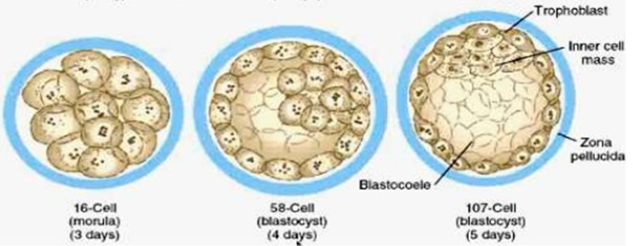
Implantation
.The morula enters the uterine cavity 4 days after fertilization.
The morula showed a cavity Fluid begins to penetrate through the zona pellucida into the intracellular spaces of inner cell mass.
Intracellular spaces form A single cavity is called Blastocele.
The morula form the blastocyst.

Slide 11
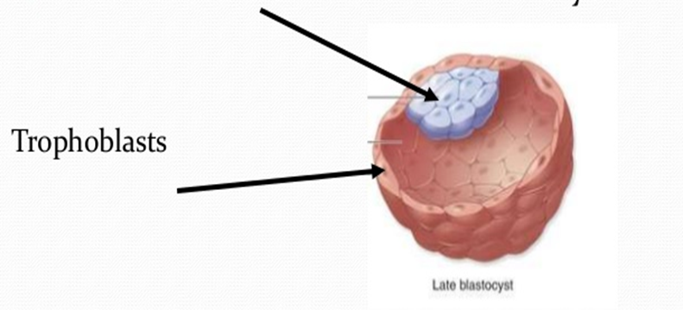
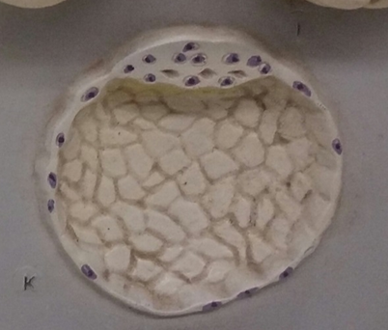
Implantation
The fluid in the blastocyst cavity separates blastomeres into 2 parts:
Outer cell mass (Trophoblast): form the epithelial wall of a blastocyst, will form the placenta.
Inner cell mass: form embryoblast which gives rise to the embryo.
The blastocyst enlarged to rupture the surrounding zona pellucida, and the outer trophoblast cells penetrate the uterine mucosa.

Slide 12
Implantation
The wall of the uterus is composed of three layers:
Perimetrium: (outer layer) the peritoneal covering lining the outside wall.
Myometrium: (middle layer) thick layer of smooth muscle.
Endometrium or mucosa: (inner layer) lining with simple epithelium that descends into a lamina propria (C.T) to form numerous uterine gland.

Slide 14
Implantation
The blastocyst attached to the mucosa of the body of the uterus, adjacent embryo pole (called implantation) on the ^{6th} day after fertilization.
Implantation occurs normally in the anterior or posterior walls of the body of the uterus.

Slide 15
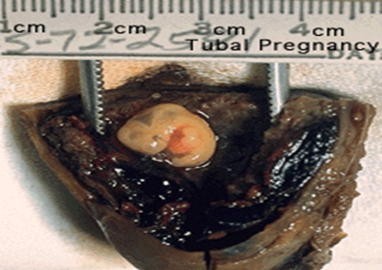
Abnormal Implantation
Ectopic pregnancy
It mean implantation outside the uterus.
80% of ectopic pregnancies occurs in ampulla of uterine tube.
Most common are in ampulla and isthmus.
Abnormal implantation sites or Ectopic Pregnancy occurs if implantation is in uterine tube or outside the uterus.
sites - external surface of uterus, ovary, bowel, gastrointestinal tract, mesentery, peritoneal wall
If not spontaneous then, embryo has to be removed surgically

Slide 16
Ectopic implantation

Slide 17
Stem Cell
Embryonic stem cells: are derived from the inner cell mass of the embryo. Because these cells are pluripotent and can form any cell or tissue type, they have the potential for curing a different of diseases as diabetes, Parkinson’s disease.
ES cells may be obtained from embryos after in vitro fertilization, a process called reproductive cloning.

Slide 18
Reproductive cloning

Slide 19
Stem Cell
. Adult Stem Cells:
Adult tissues contain stem cells that also may prove valuable in treating diseases. These cells are restricted in their ability to form different cell types and, therefore, are multipotent, not pluripotent, although scientists are finding methods to circumvent this disadvantage.

