Slide 1
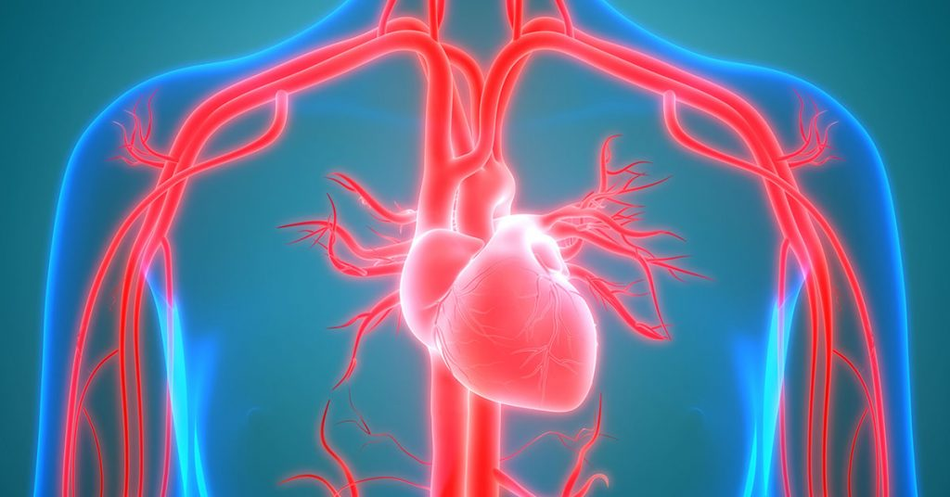
Cardiovascular System I
By: Assistant lecturer Reham Saad

Slide 2
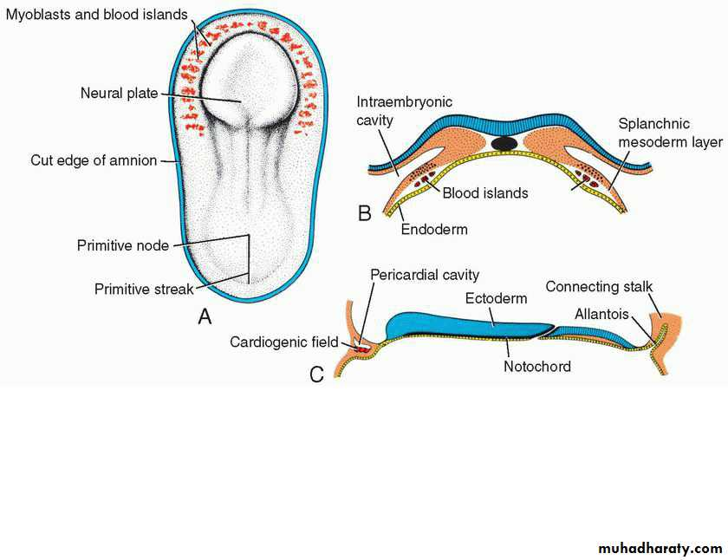
Establishment of the Cardiogenic Field
The vascular system appears in the middle of the third week.
Cardiac progenitor cells lie in the epiblast, immediately lateral to the primitive streak.
Cells destined to form cranial segments of the heart, the outflow tract, migrate first, and cells forming more caudal portions, right ventricle, left ventricle, and sinus venosus, respectively, migrate in sequential order.
The cells proceed toward the cranium and position themselves rostral to the buccopharyngeal (oropharyngeal) membrane and neural folds.
The cells reside in the splanchnic layer of the lateral plate mesoderm, they are induced by the underlying pharyngeal endoderm to form cardiac myoblasts.
A. Dorsal view of a late presomite embryo (approximately 18 days) after removal of the amnion. Prospective myoblasts and hemangioblasts reside in the splanchnic mesoderm in front of the neural plate and on each side of the embryo. B. Transverse section to show the position of the blood islands in the splanchnic mesoderm layer. C. Cephalocaudal section through a similarstaged embryo showing the position of the

Slide 3
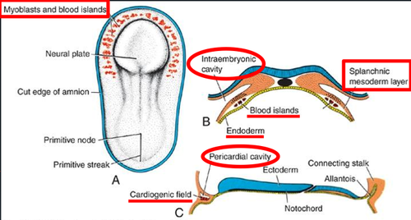
Establishment of the Cardiogenic Field
Blood islands also appear in this mesoderm, where they will form blood cells and vessels by the process of vasculogenesis.
With time, the islands unite and form a horseshoe-shaped endothelial-lined tube surrounded by myoblasts.
This region is known as the cardiogenic field; the intraembryonic cavity over it later develops into the pericardial cavity.
In addition to the cardiogenic region, other blood islands appear bilaterally, parallel and close to the midline of the embryonic shield.
These islands form a pair of longitudinal vessels, the dorsal aortae.
A. Dorsal view of a late presomite embryo (approximately 18 days) after removal of the amnion. Prospective myoblasts and hemangioblasts reside in the splanchnic mesoderm in front of the neural plate and on each side of the embryo. B. Transverse section to show the position of the blood islands in the splanchnic mesoderm layer. C. Cephalocaudal section through a similarstaged embryo showing the position of the

Slide 4
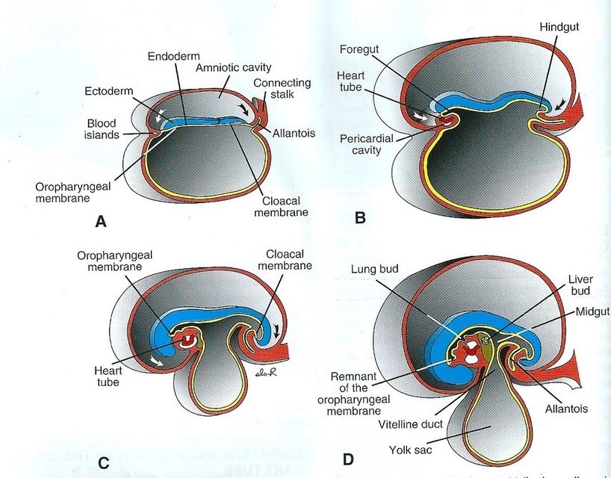
Formation and position of the heart tube:
Initially, the central portion of the cardiogenic area is anterior to the buccopharyngeal membrane and the neural plate.
With closure of the neural tube and formation of the brain vesicles, however, the central nervous system grows cephalad so rapidly that it extends over the central cardiogenic area and the future pericardial cavity.
As a result of growth of the brain and cephalic folding of the embryo, the buccopharyngeal membrane is pulled forward, while the heart and pericardial cavity move first to the cervical region and finally to the thorax.
As the embryo folds cephalocaudally, it also folds laterally.

Slide 5
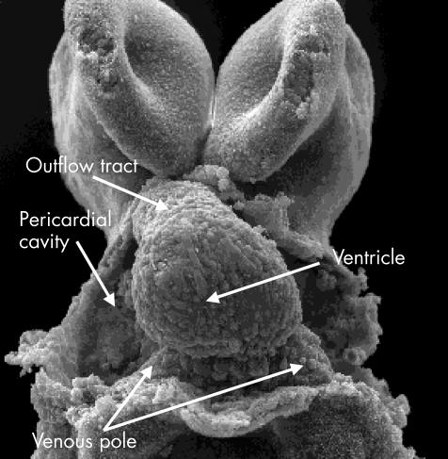
Formation and position of the heart tube:
As a result, the crescent part of the horseshoe-shaped area expands to form the future outflow tract and ventricular regions.
Thus, the heart becomes a continuous expanded tube consisting of an inner endothelial lining and an outer myocardial layer.
It receives venous drainage at its caudal pole and begins to pump blood out of the first aortic arch into the dorsal aorta at its cranial pole.
The developing heart tube bulges more and more into the pericardial cavity.
Initially, the tube remains attached to the dorsal side of the pericardial cavity by a fold of mesodermal tissue, the dorsal mesocardium.
No ventral mesocardium is ever formed.

Slide 6
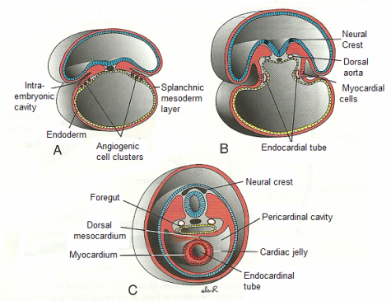
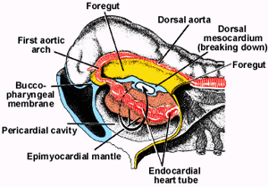
Formation and position of the heart tube:
The dorsal mesocardium disappears, creating the transverse pericardial sinus, which connects both sides of the pericardial cavity.
The heart is now suspended in the cavity by blood vessels at its cranial and caudal poles.
During these events, the myocardium thickens and secretes a thick layer of extracellular matrix, rich in hyaluronic acid, that separates it from the endothelium.
In addition, mesothelial cells from the region of the sinus venosus migrate over the heart to form the epicardium.

Slide 7
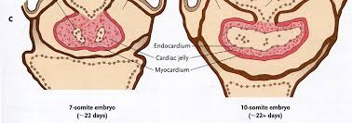
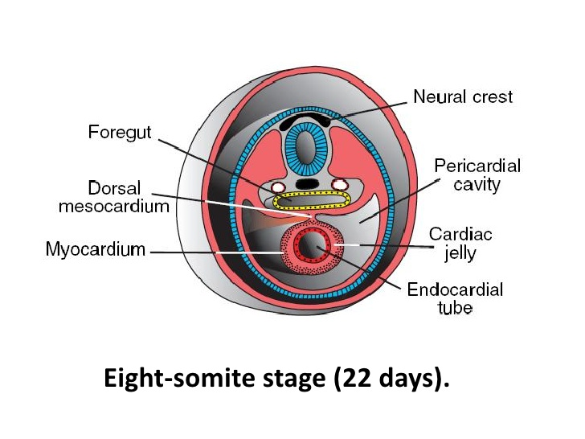
Formation and position of the heart tube:
Thus the heart tube consists of three layers:
The endocardium, forming the internal endothelial lining of the heart;
The myocardium, forming the muscular wall;
The epicardium or visceral pericardium, covering the outside of the tube.
This outer layer is responsible for formation of the coronary arteries, including their endothelial lining and smooth muscle.

Slide 8
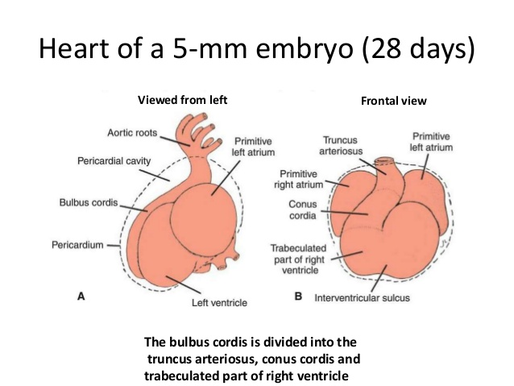
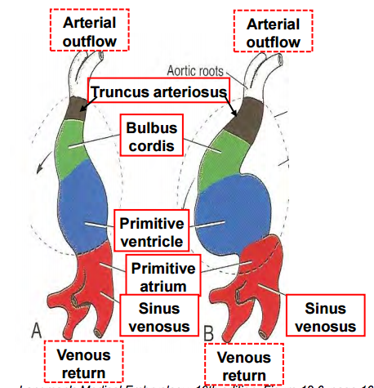
Formation of the heart Loop
The heart tube has four parts from anterior to posterior:
the bulbus cordis.
the ventricle.
the atrium.
the sinus venosus.
These four parts bend forming the heart loop.
The bulboventricular part is located inside the pericardial cavity,
the initially paired atrial and sinus parts are located inside the mesenchyme of the septum transversum, after bending the four parts of the heart loop become completely inside the pericardial cavity.

Slide 9
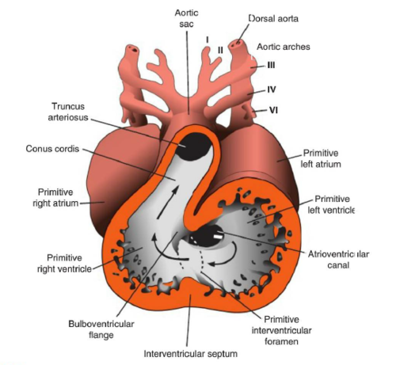
Derivatives of the heart tube:
bulbus cordis:
proximal third form the trabeculated part of the Rt ventricle,
middle third (the conus cordis) forms the outflow of both ventricles,
distal third (the truncus arteriosus) forms the root of the aorta and pulmonary arteries.
the ventricle:
it forms the trabeculated Lt ventricle,
the sulcus between the bulbus cordis and the ventricle forms the primary interventricular foramen.
The sulcus between the ventricle and the atrium forms the atrioventricular canal.
the atrium:
forms the common atrium, which the primordium of the trabeculated part of the Rt and Lt atria.
sinus venosus:
it consists of a transverse part and the Lt and Rt sinus horns, each horn has 3 veins:
1. vitelline vein (omphalomesenteric vein). 2.umbilical vein. 3.common cardinal vein.

Slide 10
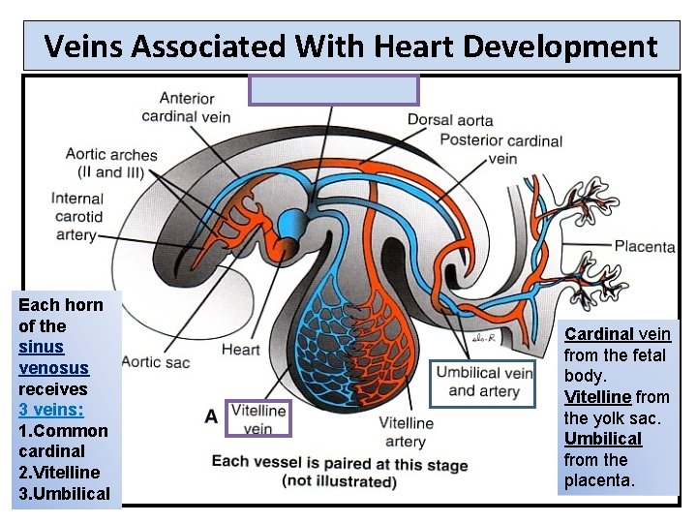

Slide 11
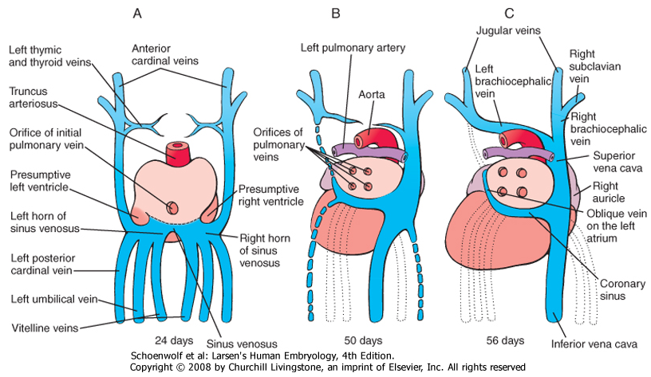
Development of the Sinus Venosus
In the middle of the 4th week, the sinus venosus receives venous blood from the right and left sinus horns.
Each horn receives blood from three important veins:
the vitelline or omphalomesenteric vein,
the umbilical vein,
the common cardinal vein.
At first communication between the sinus and the atrium is wide.
Soon, however, the entrance of the sinus shifts to the right.
This shift is caused primarily by left-to-right shunts of blood, which occur in the venous system during the 4th and 5th weeks of development.

Slide 12
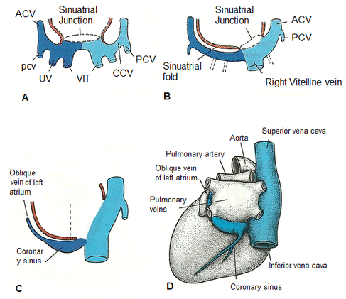
The fate of the Lt sinus horn:
After disappearance of the Lt umbilical and Lt vitelline and the Lt common cardinal veins, the Lt horn degenerate forming the coronary sinus and the oblique vein of the Lt atrium.

Slide 13
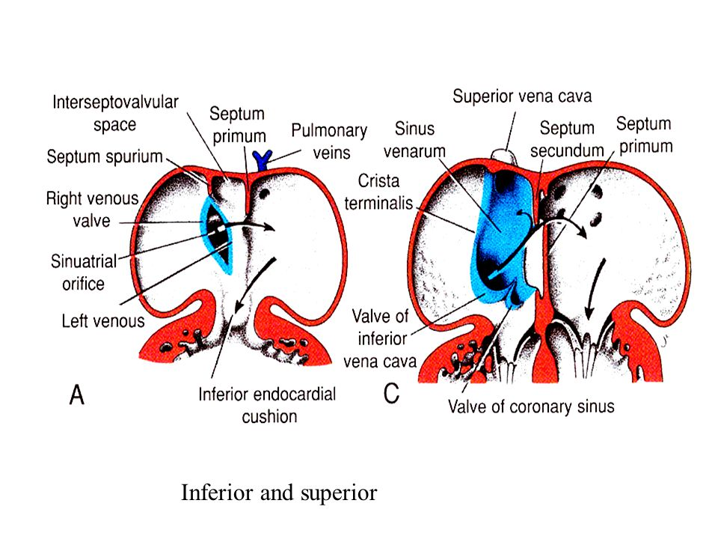
The fate of the Rt sinus horn:
It forms the smooth part of the Rt atrium (the sinus venarum), the orifice of the Rt horn into the Rt atrium has 2 valves.
These valves fused dorsally forming a ridge, known as the septum spurium.
The Lt valve and the septum spurium fused with the developing interatrial septum.
The upper part of the Rt valve disappears, while the lower part of the Rt valve forms the valve of inferior vena cava (IVC) and the valve of the coronary sinus.

Slide 14
The Rt horn form posterior smooth part of Rt atrium.
Rt common cardinal vein form lower part of superior of vena cava.
The Rt vitelline vein form part of inferior vena cava.
The body of sinus venosus and Lt horn form coronary sinus.
The Lt common cardinal vein form oblique vein of Lt atrium.

Slide 15
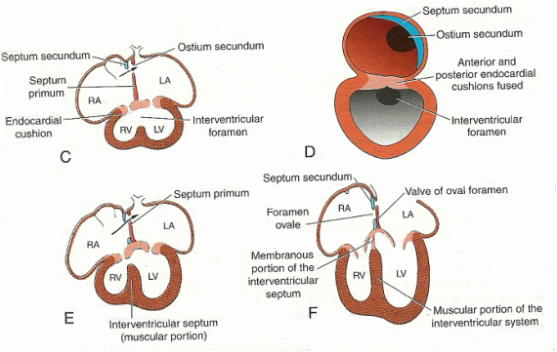
Formation of the heart septa
Septation in the common atrium
In the 4th week, a sickle shaped septum primum projects from the roof of the common atrium.
This septum grows toward the atrioventricular canal that has thickenings in its walls called the endocardial cushions.
These endocardial cushions grow towards each other and fuse together to form AV septum (septum intermedium) that divides the AV canal into right and left AV canals
These cushions grow toward the septum primum to close the opening between them (the ostium primum).
Just before closure of the ostium primum, perforations appear in the septum primum to form the ostium secundum that keeps the Rt to Lt flow of blood between the atria.
Then after, the septum secundum is formed on the Rt side of the septum primum.
This septum fuses with the left valve of Rt sinus horn and with the septum spurium.

Slide 16
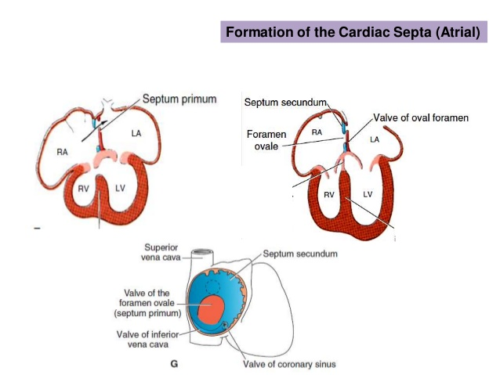
Formation of the heart septa
Septation in the common atrium
The development of the septum secundum stops resulting in an incomplete covering over the ostium secundum, the opening left is called the oval foramen.
The floor of this foramen is the remains of the septum primum that act as a valve for the oval foramen.
After birth, the increased pressure inside the left atrium accompanied by beginning of the pulmonary circulation results in closure of the oval foramen.
Notes:
During cardiac septum, the bud of the pulmonary vein projects from the Lt atrium and grows toward the developing lungs. This bud incorporates into the Lt atrial wall forming the smooth part of the Lt atrium.

Slide 17
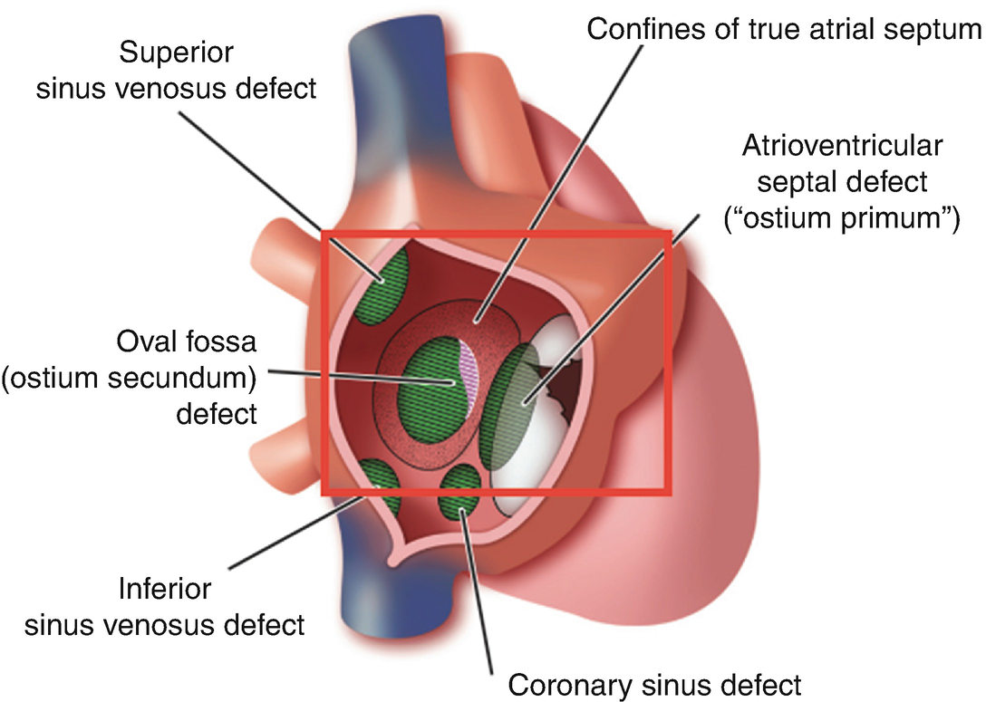
Anomalies of the interatrial Septation:
There are many types of defected atrial Septation with Rt to Lt shunt of blood:
Ostium secundum defect:
either by a large ostium secundum formation, or small septum secundum.
Ostium primum defect:
by abnormal endocardial cushions closing the ostium primum.

Slide 18
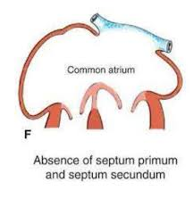
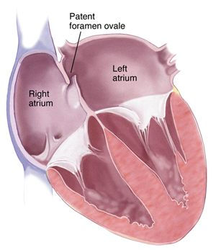
Anomalies of the interatrial Septation:
There are many types of defected atrial Septation with Rt to Lt shunt of blood:
Common atrium or triloculare biventriculare: causes by complete absence of the atrial septum
Premature closure of the oval foramen (before birth): leading to increased pressure and hypertrophy of the Rt atrium and ventricle, with atrophy of the left atrium and ventricle. It causes death shortly after birth.

Slide 19
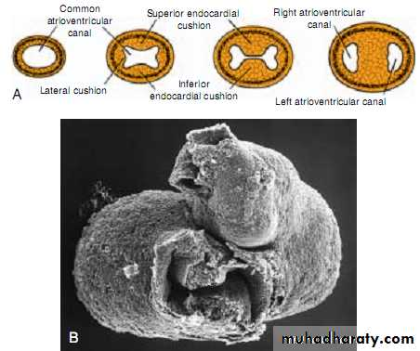
Formation of the heart septa
Septation of the atrioventricular canal:
At early stages (end 4th weeks), the canal connects the common atrium and the Lt ventricle primordium only.
Later on, the canal is enlarged on the Rt side to be connected with the Rt ventricle.
After the 4th week, in addition to the anterior and posterior endocardial cushion, the two lateral atrioventricular cushions appear on the right and left border of the canal
These cushions fused with each other to from the Rt and Lt atrioventricular orifices.
The mesenchymal proliferation developing around these orifices are hollowed by the blood flow forming the bicusps (or mitral) valves form in the left atrioventricular canal, and three, constituting the tricuspid valves, from on the right side.

Slide 20
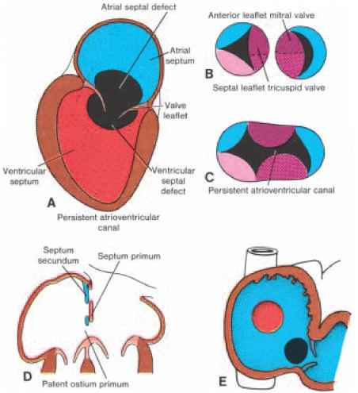
Anomalies of atrioventricular Septation
Persistent atrioventricular canal: by failure of fusion of the endocardial cushions that is associated with defected atrial and ventricular Septation.
Ostium primum defect: endocardial cushions in the atrioventricular canal partially fused. The result is a defect in the atrial septum, but the interventricular septum is closed, is usually combined with a cleft in anterior leaflet of the tricuspid valve.

Slide 21
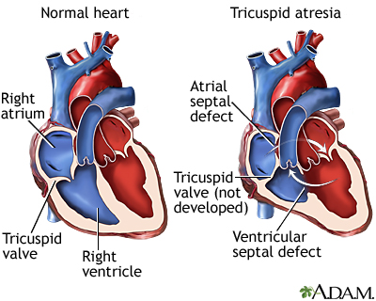
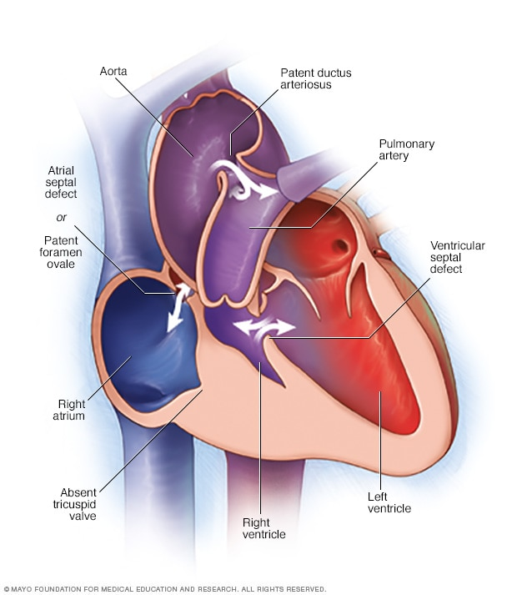
Anomalies of atrioventricular Septation
Tricuspid Artesia: associated with opened oval foramen and defected ventricular septum, with hypertrophy of the Lt ventricle and atrophy of the Right ventricle.

Slide 22
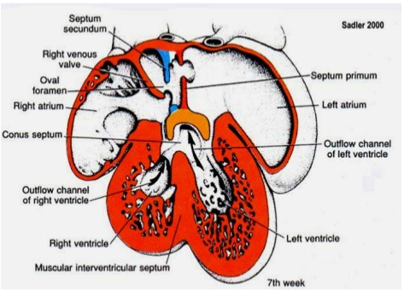
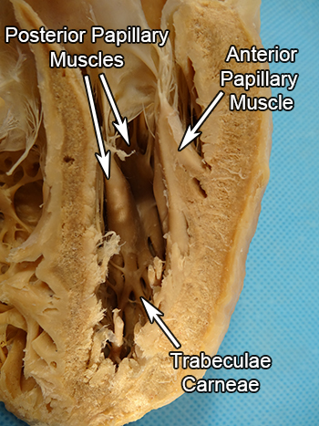
Formation of the heart septa
Septum formation in the Ventricles
After the 4th week, the lateral walls of both ventricles grow on the outside and absorbed from the inside forming the Trabeculae carneae (are rounded or irregular muscular columns which project from the inner surface of the right and left ventricle of the heart ) and papillary muscles.
The medial walls of both of the ventricles fail to grow and thus become opposed and fused with each other forming the muscular interventricular septum.

Slide 23
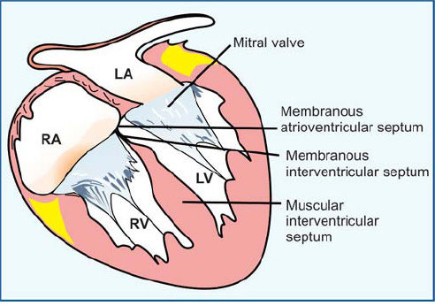
Formation of the heart septa
Septum formation in the Ventricles
The opening between the upper free end of this septum and the endocardial cushions is closed by the membranous interventricular septum that is derived from the inferior cushion.
In addition, the conus and truncus swellings will contribute to the interventricular septum.

Slide 24
Anomalies of the ventricular Septation:
Defected muscular and membranous interventricular Septation.
Persistent atrioventricular canal.
Tricuspid atresia.
Tetralogy of fallot.
Transposition of the great vessels.

Slide 25
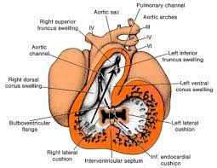
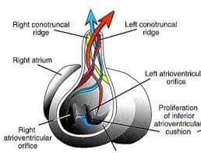
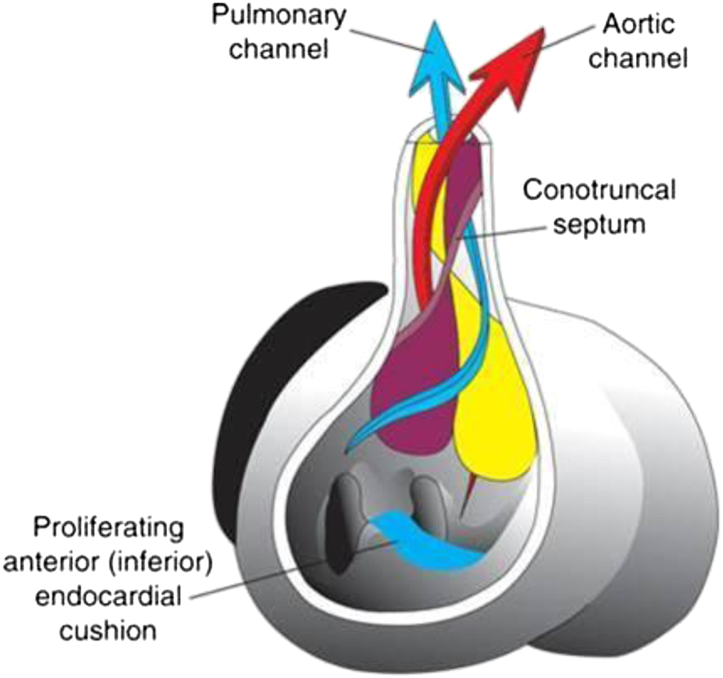
Formation of the heart septa
Septation of the truncus arteriosus and conus cordis:
During the 5th week, two swellings develop in the truncus arteriosus as a Rt superior and Lt inferior swellings.
Similar swellings appear in the conus cordis as Rt dorsal and Lt ventral wall of the conus cordis.
These four swellings grow toward each other in a spiral way to separate the aorta from the pulmonary artery by a spiral septum.
after complete fusion , the conotruncal ridge form the aorticopulmonary septum divided the truncus into an aortic and a pulmonary channel.

Slide 26
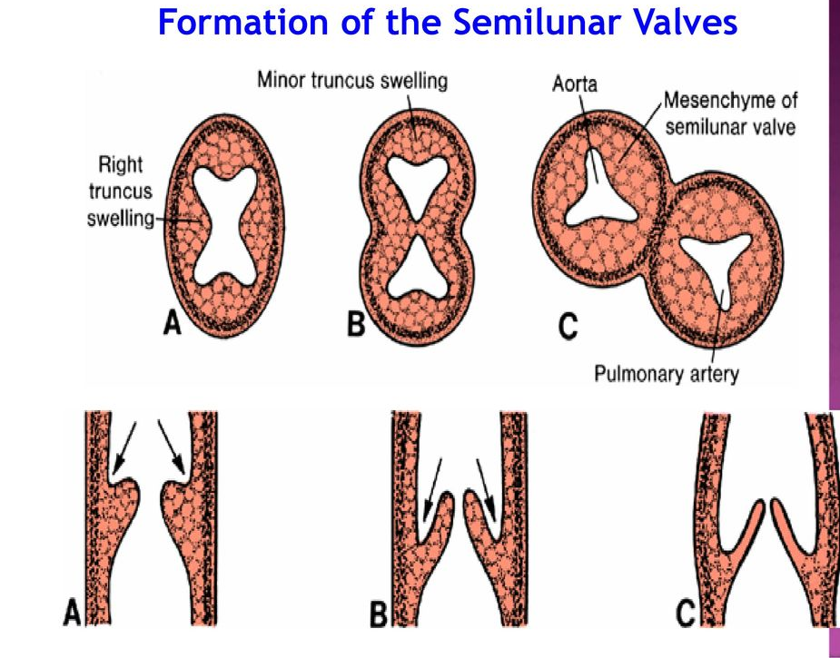
Septation of the truncus arteriosus and conus cordis:
When partitioning of the truncus has almost been complete, primordia of the semilunar valves become visible as a small tubercles on the main truncus swelling.
One of each pair is assigned to the pulmonary and aortic channel.
A third tubercle appear in both channel opposite the fused truncus swelling .

Slide 27
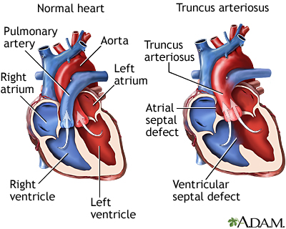
Anomalies of the truncoconal Septation:
Persistent truncus arteriosus: by absence of the truncoconal swellings, associated with interventricular septal defect.

Slide 28
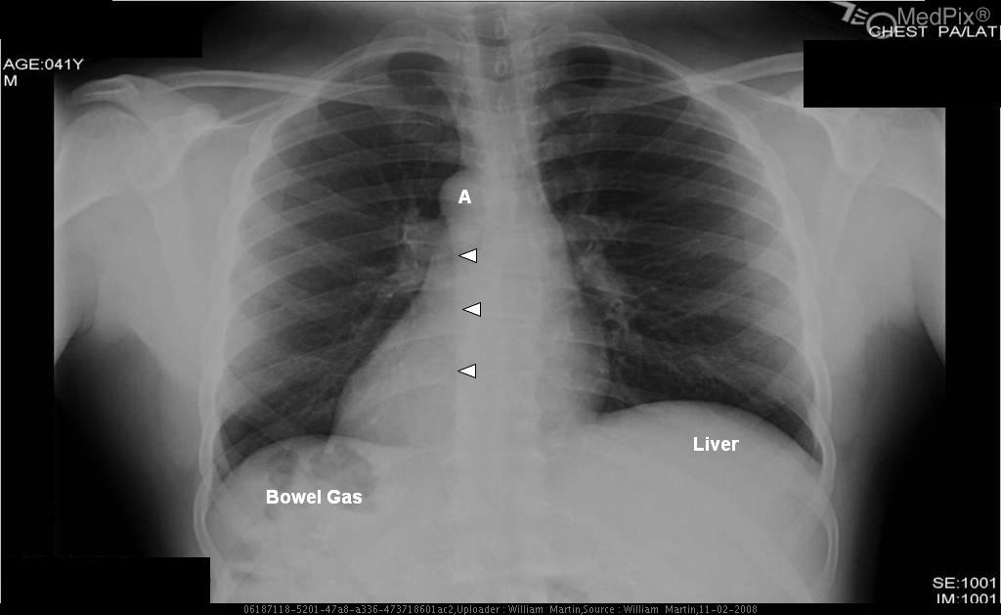
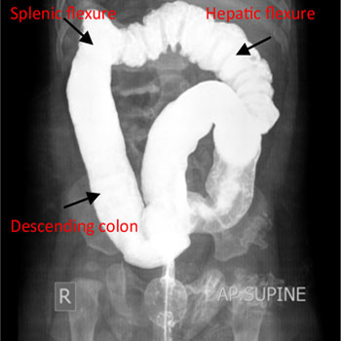
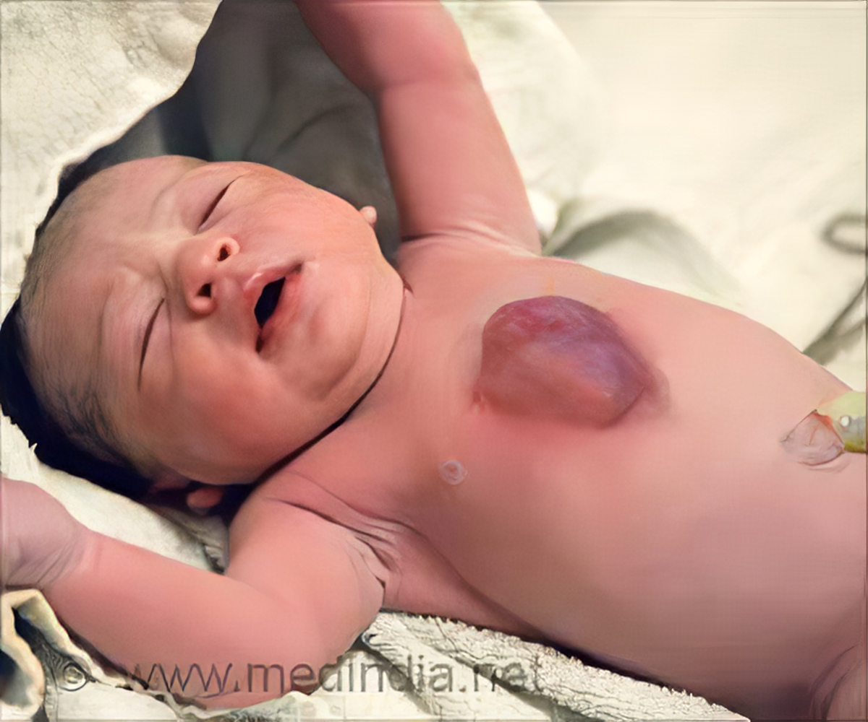
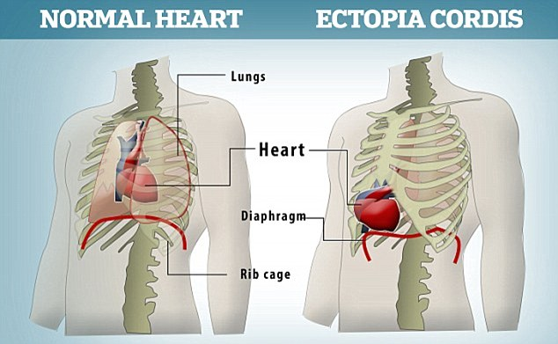
Anomalies of the cardiac position:
Dextrocardia: the heart lies on the Rt side of the thorax instead of the left, is caused because the heart loops to the left in stead of the right; associated with or with out situs inversus (abnormal transposition of abdominal viscera).
Ectopia cordis: the heart lies on the surface of the chest.

