Slide 1
Skull & Cranium
Diyala university
College of Medicine
Department of Anatomy and Histology
Anatomy Lab
Second semester\ second stage

Slide 28
Mandible
Largest and strongest bone of the face.
Forms the lower jaw and holds the lower teeth in place.
Landmarks
Body: curved horizontal portion of the mandible
Rami: two upward projections of bone that are perpendicular to the body of the mandible.
Angle of the mandible: angle formed where the body meets the ramus

Slide 29
Condylar process: a condyle on the posterior portion of the ramus that articulates with the mandibular fossa of the temporal bone.
Coronoid process: a sharp projection of bone on the anterior portion of the ramus that acts as a point of muscle attachment.
Alveolar process: arch of bone containing the lower teeth
Mental foramen: small hole on the side of the body for blood vessels and nerves.

Slide 30
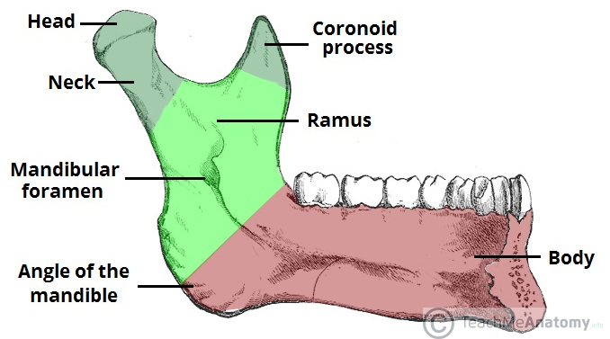

Slide 31
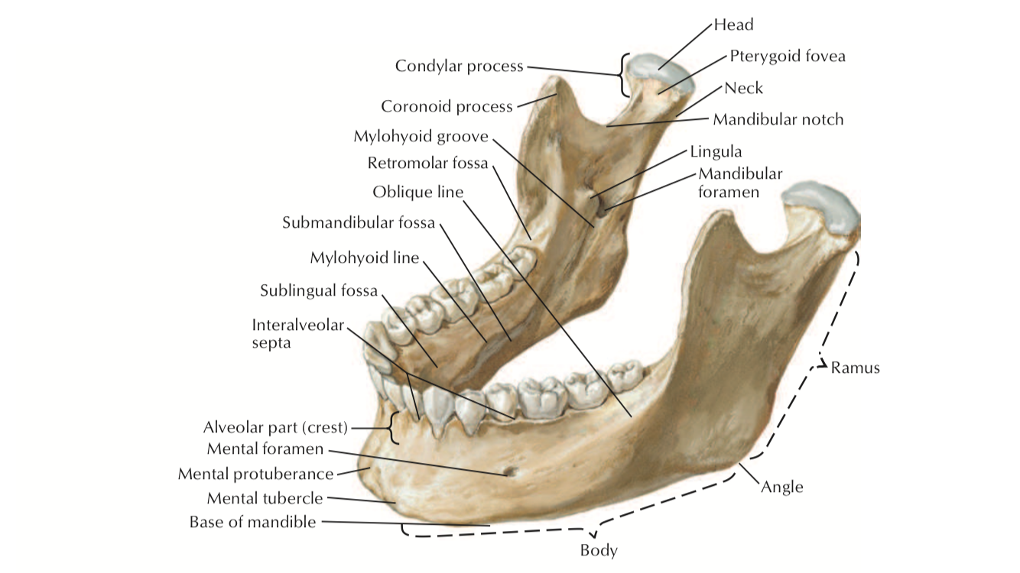

Slide 32
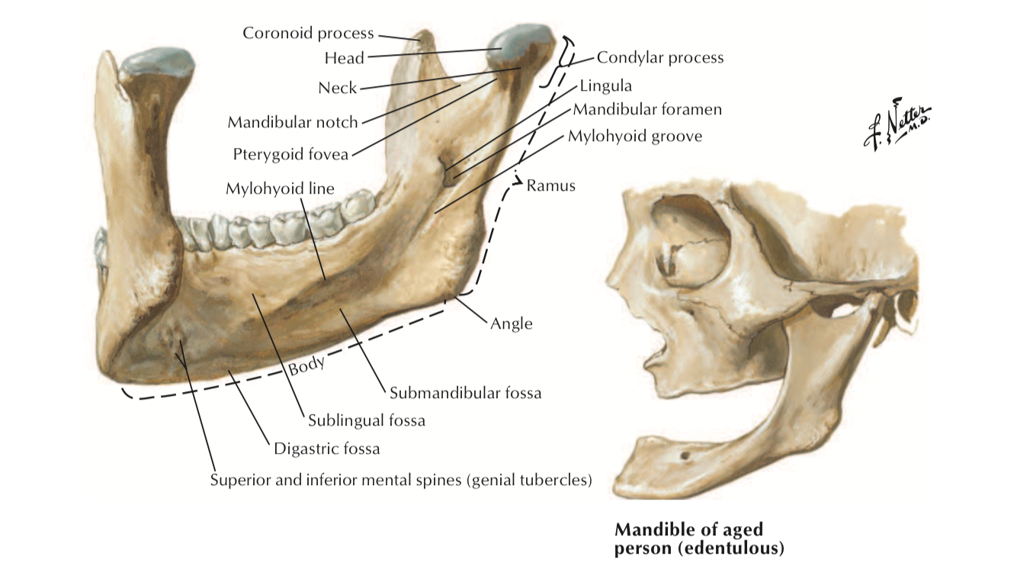

Slide 33
THANK YOU

