Slide 1
Pelvic Wall and Pelvic Diaphragm
Presented by
Msc. Dr. Reham Saad kadhum

Slide 2
The Pelvis
The bony pelvis is composed of four bones: the two hip bones, which form the lateral and anterior walls,
The sacrum and the coccyx, which are part of the vertebral column and form the back wall .
The two hip bones articulate with each other anteriorly at the symphysis pubis and posteriorly with the sacrum at the sacroiliac joints. The bony pelvis thus forms a strong basin-shaped structure that contains and protects the lower parts of the intestinal and urinary tracts and the internal organs of reproduction.

Slide 4
Orientation of the Pelvis
The front of the symphysis pubis and the anterior superior iliac spines should lie in the same vertical plane.
This means that the pelvic surface of the symphysis pubis faces upward and backward and the anterior surface of the sacrum is directed forward and downward.

Slide 6
The pelvis is divided into two parts by the pelvic brim, which is formed by the sacral promontory (anterior and upper margin of the first sacral vertebra) behind,
The iliopectineal lines (a line that runs downward and forward around the inner surface of the ileum) laterally, and the symphysis pubis (joint between bodies of pubic . bones) anteriorly.
Above the brim is the false pelvis, which forms part of the abdominal cavity. Below the brim is the true pelvis.

Slide 7
False Pelvis
The false pelvis is of little clinical importance. It is bounded behind by the lumbar vertebrae, laterally by the iliac fossae and the iliacus muscles, and in front by the lower part of the anterior abdominal wall.
True Pelvis
Knowledge of the shape and dimensions of the female pelvis is of great importance for obstetrics, because it is the bony canal through which the child passes during birth. The true pelvis has an inlet, an outlet, and a cavity .

Slide 8
The pelvic inlet, or pelvic brim is bounded posteriorly by the sacral promontory, laterally by the iliopectineal lines, and anteriorly by the symphysis pubis
■■ The pelvic outlet is bounded posteriorly by the coccyx, laterally by the ischial tuberosities, and anteriorly by the pubic arch
The pelvic outlet has three wide notches.
Anteriorly, the pubic arch is between the ischiopubic rami, and laterally are the sciatic notches.
The pelvic cavity lies between the inlet and the outlet.
It is a short, curved canal, with a shallow anterior wall and a much deeper posterior wall .

Slide 9
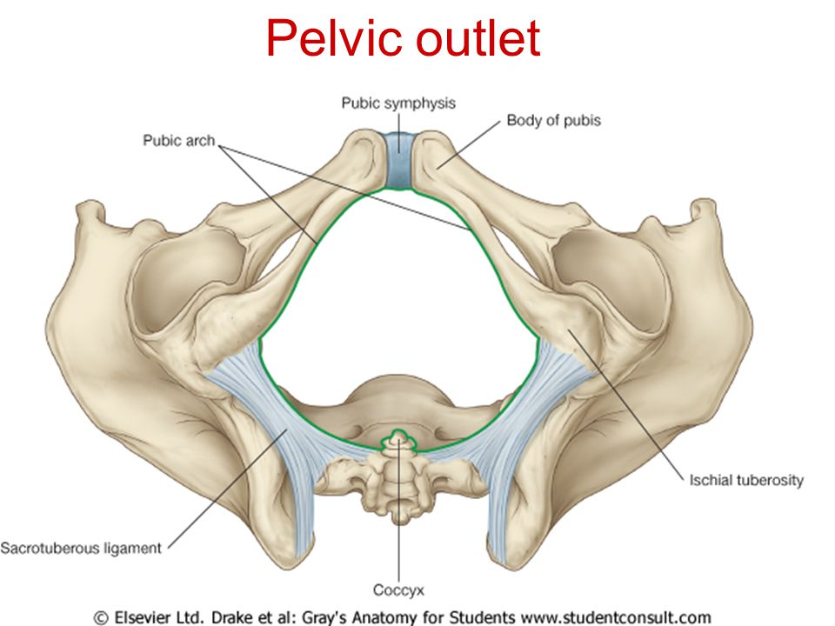

Slide 11
The sciatic notches are divided by the sacrotuberous and sacrospinous ligaments into the greater and lesser sciatic foramina . From an obstetric standpoint, because the sacrotuberous ligaments are strong and relatively inflexible, they should be considered to form part of the perimeter of the pelvic outlet.
Thus, the outlet is diamond shaped, with the ischiopubic rami and the symphysis pubis forming the boundaries in front and the sacrotuberous ligaments and the coccyx forming the boundaries behind.

Slide 12
Structure of the Pelvic Walls
The walls of the pelvis are formed by bones and ligaments that are partly lined with muscles covered with fascia and parietal peritoneum.
The pelvis has anterior, posterior, and lateral walls and an inferior wall or floor

Slide 13
Anterior Pelvic Wall
The anterior pelvic wall is the shallowest wall and is formed by the bodies of the pubic bones, the pubic rami, and the symphysis pubis .

Slide 14
Posterior Pelvic Wall
The posterior pelvic wall is extensive and is formed by the sacrum and coccyx and by the piriformis muscles and their covering of parietal pelvic fascia.

Slide 15
Sacrum
The sacrum consists of five rudimentary vertebrae fused together to form a single wedge-shaped bone with a forward concavity.
The upper border or base of the bone articulates with the fifth lumbar vertebra.
The narrow inferior border articulates with the coccyx bone .
Laterally, the sacrum articulates with the two iliac bones to form the sacroiliac joints
The anterior and upper margins of the first sacral vertebra bulge forward as the posterior margin of the pelvic inlet—the sacral promontory which is an important obstetric landmark used when measuring the size of the pelvis.
The vertebral foramina together form the sacral canal.
The laminae of the 5th sacral vertebra, and sometimes those of the 4th, fail to meet in the midline, forming the sacral hiatus . The sacral canal contains the anterior and posterior roots of the lumbar, sacral, and coccygeal spinal nerves; the filum terminale; and fibrofatty material. It also contains the lower part of the subarachnoid space down as far as the lower border of the 2nd sacral vertebra
The anterior and posterior surfaces of the sacrum possess on each side four foramina for the passage of the anterior and posterior rami of the upper four sacral nerves

Slide 18
The sacrum is usually wider in proportion to its length in the female than in the male.
The sacrum is tilted forward so that it forms an angle with the fifth lumbar vertebra, called the lumbosacral angle.
Coccyx
The coccyx consists of four vertebrae fused together to form a small triangular bone, which articulates at its base with the lower end of the sacrum
The coccygeal vertebrae consist of bodies only, but the first vertebra possesses a rudimentary transverse process and cornua. The cornua are the remains of the pedicles and superior articular processes and project upward to articulate with the sacral cornua

Slide 19
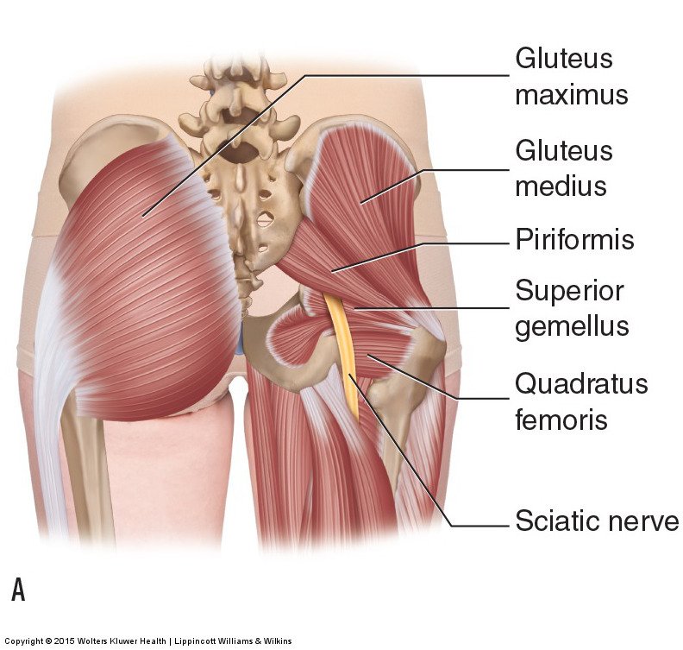
Piriformis Muscle
The piriformis muscle arises from the
front of the lateral mass of the sacrum
and leaves the pelvis to enter the
gluteal region by passing laterally
through the greater sciatic foramen .
It is inserted into the upper border of
the greater trochanter of the femur.
■■ Action: It is a lateral rotator of the
femur at the hip joint.
■■ Nerve supply: It receives branches
from the sacral plexus.

Slide 20
Lateral Pelvic Wall
The lateral pelvic wall is formed by part of the hip bone below the pelvic inlet, the obturator membrane, the sacrotuberous and sacrospinous ligaments, and the obturator internus muscle and its covering fascia .
Hip bone ( discussed in last year ) .

Slide 21
Obturator Membrane
The obturator membrane is a fibrous sheet that almost completely closes the obturator foramen, leaving a small gap, the obturator canal, for the passage of the obturator nerve and vessels as they leave the pelvis to enter the thigh
Sacrotuberous Ligament
The sacrotuberous ligament is strong and extends from the lateral part of the sacrum and coccyx and the posterior inferior iliac spine to the ischial tuberosity .
Sacrospinous Ligament
The sacrospinous ligament is strong and triangle shaped. It is attached by its base to the lateral part of the sacrum and coccyx and by its apex to the spine of the ischium .
The sacrotuberous and sacrospinous ligaments prevent the lower end of the sacrum and the coccyx from being rotated upward at the sacroiliac joint by the weight of the body .

Slide 23
Obturator Internus Muscle
The obturator internus muscle arises from the pelvic surface of the obturator membrane and the adjoining part of the hip bone
The muscle fibers converge to a tendon, which leaves the pelvis through the lesser sciatic foramen and is inserted into the greater trochanter of the femur.
■■ Action: It laterally rotates the femur at the hip joint.
■■ Nerve supply: The nerve to the obturator internus, a branch from the sacral plexus

Slide 25
Thanks

