Slide 1
Ectopic pregnancy
Dr.Inaam Faisal

Slide 2
Introduction:
The blastocyst normally implants in the endometrial lining of the uterine cavity. Implantation anywhere else is considered an ectopic pregnancy. It is derived from the Greek ektopos—out of place .
Incidence:-
According to the American College of Obstetricians and Gynecologists (2008), 2 % of all first-trimester pregnancies in the United States are ectopic, and these account for 6 % of all pregnancy-related deaths.

Slide 3
Incidence and aetiology
One in 80 pregnancies are ectopic. They account for 9–13% of maternal deaths in the Western world and 10–30% in low resource countries.
The incidence of a heterotopic pregnancy (one pregnancy is intrauterine & other is extrauterine ) in the general population is low (1:25,000–30,000), but significantly higher after in-vitro fertilization (IVF) treatment (1%) due to the transfer of two blastocysts.

Slide 4
Classification
Nearly 95 % of ectopic pregnancies are implanted in the various segments of the fallopian tubes .Of these, most are ampullary implantations. The remaining 5 % implant in the ovary, peritoneal cavity, or within the cervix.

Slide 5
Tubal Pregnancy
The fertilized ovum may lodge in any portion of the oviduct, giving rise to ampullary, isthmic, and interstitial tubal pregnancies). In rare instances, the fertilized ovum may implant in the fimbriated extremity. The ampulla is the most frequent site, followed by the isthmus. Interstitial pregnancy accounts for only About 2%.From these primary types, secondary forms of tubo-abdominal, tubo-ovarian, and pregnancies occasionally develop.

Slide 6
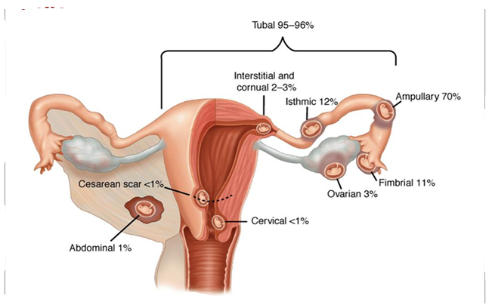

Slide 7
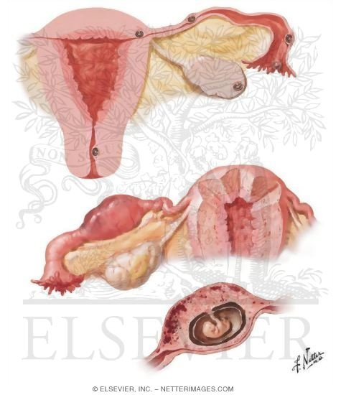

Slide 8
Risk Factors
1-previous ectopic pregnancy 3-13%
2-Tubal corrective surgery 4%
3-Tubal sterilization 9%
4-Intrauterine device 1-4%
5-Documented tubal pathology 3.8–21%
6-Infertility 2.5–3%
7-Assisted reproductive technolog y 2–8%
8-Previous genital infection 2–4 %
Chlamydia 2%
Salpingitis 1.5–6.2%

Slide 9
9-Smoking 1.7–4%
10-Multiple sexual partners 1.6–3.5%
11-Prior cesarean delivery 1–2.1%
12-Maternal age (peak 25 to 34 years).
Recurrence rate is about 10-15%

Slide 10
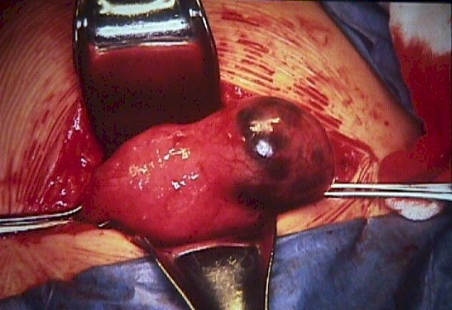

Slide 11
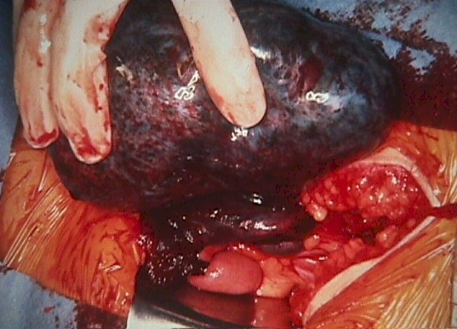

Slide 12
Pathophysiology:
In theory, any mechanical or functional factors that prevent or interfere with the passage of the fertilized egg to the uterine cavity may be etiological factor for an ectopic pregnancy. In general the main cause is a low grade infection- chronic PID.
In an ectopic pregnancy, the uterine endometrium usually responds to the hormonal changes of pregnancy & undergoes focal decidual

Slide 13
Natural history of untreated tubal pregnancy:
The most common outcomes of established tubal pregnancies include the following:
Tubal rupture.
Pregnancy resorption.
Tubal abortion into the peritoneal cavity.
Clinical presentation:
Acute presentation (tubal rupture):
Acute abdominal pain referred to the shoulder tip.
Cardiovascular collapse.
Normal temperature.
Uterus slightly enlarged & there is a tender mass to one side.
Positive cervical excitation.

Slide 14
b. Subacute presentation:
Give rise to diagnostic confusion.
Abdominal pain which can be localized to one iliac fossa.
Delayed menstruation.
Episodes of vaginal bleeding.
There may be referred pain to shoulder.
Abdominal & pelvic examination reveal sign of peritoneal irritation less marked than in an acute situation.
c. Asymptomatic (silent presentation).
:discovered during assessment of early pregnancy or while investigating for other complain

Slide 15
Diagnosis:
Symptoms of ectopic pregnancy tend to have a poor positive predictive value to help discriminate between intra & extra uterine pregnancy. They may present as acute/ subacute or silent presentation.
Signs: often have no specific signs:
Rapid heart rate, low BP may be noticed.
peritonism (due to intra abdominal blood if ruptured).
Gynecological examination:
speculum or bimanual examination must be performed in an environment where facilities for resuscitation are available because may provoke tubal rupture.

Slide 16
uterus usually normal size.
cervical excitation & tenderness occasionally.
adnexial tenderness.
adnexial mass.
Investigation:
Ultrasound: transvaginal U/S : gestational sac of an intra uterine pregnancy should be detectable when serum B-hCG level exceeds 1000IU/L.
The presence or absence of an intra uterine gestational sac is the principle point of distinction between intra uterine and tubal pregnancy.
Morphology of ectopic pregnancy can be classified by U/S into 5 categories:
Gestational sac with a live embryo.
Sac with an embryo but no heart rate.
Sac containing yolk sac.
Empty gestational sac.
Solid tubal swelling

Slide 17
The presence of fluid in the pouch of Douglas is a non specific sign of ectopic pregnancy. In 10 to 20% of ectopic pregnancy a pseudo gestational sac is seen as a small, central located endometrial fluid collection surrounded by a single echogenic rim of endometrial tissue undergoing decidual reaction.
II. Biochemical measurements:
Serum hCG:
Healthy normally developing pregnancies generally can be detected by a normal rate of increase of maternal serum B-hCG levels.

Slide 18
Normal pregnancies show doubling of hCG levels every 48 hours in the first few weeks of pregnancy & sub optimal rise is suspicious of an ectopic pregnancy i.e. a prolonged hCG doubling time is an indicator of an abnormal pregnancy.
2. Serum progesterone:
Serum progesterone levels will respond quickly to any decrease in hCG production.
Serum progsterone <20 nmol/L reflects fast decreasing hCG levels and can be used to diagnose spontaneous resolving pregnancies.
Progesterone level >60 nmol/L indicate normal increase in hCG level but those between 20 & 60 nmol/L are strongly associated with abnormal pregnancy

Slide 19
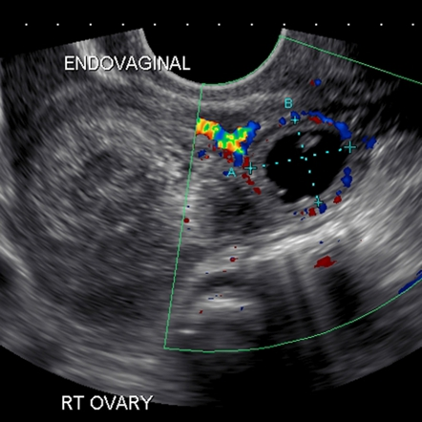

Slide 20
Culdocentesis
This simple technique was used commonly in the past to identify hemoperitoneum. The cervix is pulled toward the symphysis with a tenaculum, and a long 16- or 18-gauge needle is inserted through the posterior vaginal fornix into the cul-de-sac. If present, fluid can be aspirated, however, failure to do so is interpreted only as unsatisfactory entry into the cul-de-sac and does not exclude an ectopic pregnancy, either ruptured or unruptured. Fluid containing fragments of old clots, or bloody fluid that does not clot, is compatible with the diagnosis of hemoperitoneum resulting from an ectopic pregnancy. If the blood subsequently clots, it may have been obtained from an adjacent blood vessel rather than from a bleeding ectopic pregnancy

Slide 21
Multimodality Diagnosis:
Ectopic pregnancies are identified with the combined use of clinical findings along with serum analyte testing and transvaginal sonography. A number of algorithms have been proposed, but most include five key components:
Transvaginal sonography
Serum hCG level both the initial level and the pattern of subsequent rise or decline
Serum progesterone level
Uterine curettage
Laparoscopy and occasionally, laparotomy.

Slide 22
Management
In many cases, early diagnosis allows definitive surgical or medical management of unruptured ectopic pregnancy—sometimes even before the onset of symptoms. In either case, treatment before rupture is associated with less morbidity and mortality and a better prognosis for fertility. D-negative women with an ectopic pregnancy who are not sensitized to D-antigen should be given anti-D immunoglobulin
Surgical Management
Laparoscopy is the preferred surgical treatment for ectopic pregnancy unless the woman is hemodynamically unstable.

Slide 23
The standard surgical treatment approach is laparoscopy. Laparotomy is reserved for severely compromised patients or where there are no endoscopic facilities. The operation of choice is removal of the Fallopian tube and the EP within (salpingectomy), or in some cases a small opening can be made over the site of the EP and the EP extracted via this opening ( salpingostomy). Salpingostomy is recommended only if the contralateral tube is absent or visibly damaged, and it is associated with a higher rate of subsequent EP. Pregnancy rates subsequently remain high if the contralateral tube is normal because the oocyte can be picked up by the ipsilateral or contralateral tube.

Slide 24
Tubal surgery is considered conservative when there is tubal salvage. Examples include salpingostomy, salpingotomy, and fimbrial expression of the ectopic pregnancy.
Radical surgery is defined by salpingectomy. Conservative surgery may increase the rate of subsequent uterine pregnancy but is associated with higher rates of persistently functioning trophoblast .
Salpingostomy
This procedure is used to remove a small pregnancy that is usually less than 2 cm in length and located in the distal third of the fallopian tube .A 10- to 15-mm linear incision is made with unipolar needle cautery on the antimesenteric border over the pregnancy. The products usually will extrude from the incision and can be carefully removed or flushed out using high-pressure irrigation that more thoroughly removes the trophoblastic tissue

Slide 25
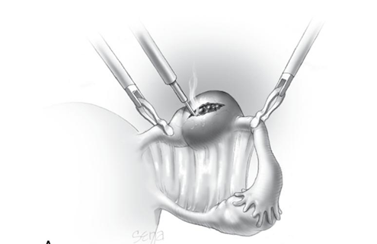
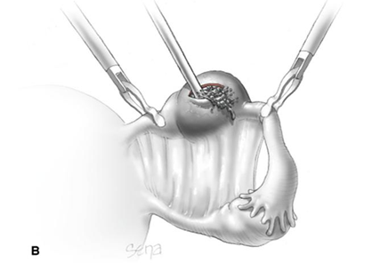

Slide 26
.Small bleeding sites are controlled with needlepoint electrocoagulation or laser, and the incision is left unsutured to heal by secondary intention,it is used if other tube is not healhty or absent
Salpingotomy
Seldom performed today, salpingotomy is essentially the same procedure as salpingostomy except that the incision is closed with delayed-absorbable suture.
Salpingectomy
Tubal resection may be used for both ruptured and unruptured ectopic pregnancies. When removing the oviduct, it is advisable to excise a wedge of the outer third (or less) of the interstitial portion of the tube. This so-called cornual resection is done in an effort to minimize the rare recurrence of pregnancy in the tubal stump. Even with cornual resection, however, a subsequent interstitial pregnancy is not always prevented

Slide 27
Medical management Intramuscular methotrexate is a treatment option for patients with minimal symptoms, an adnexal mass <40 mm in diameter and a current serum hCG concentration under 3,000 IU/l.

Slide 28
Methotrexate is a folic acid antagonist that inhibits deoxyribonucleic acid (DNA) synthesis, particularly affecting trophoblastic cells. The dose of methotrexate is calculated based on the patient’s body surface area and is 50 mg/m2. After methotrexate treatment serum hCG is usually routinely measured on days 4, 7 and 11, then weekly thereafter until undetectable (levels need to fall by 15% between day 4 and 7, and continue to fall with treatment). Medical treatment should therefore only be offered if facilities are present for regular follow up visits.

Slide 29
The few contraindications to medical treatment include:
chronic liver, renal or haematological disorder;
active infection;
immunodeficiency; and
breastfeeding.
Fetal cardiac activity. this is a relative contraindication to medical therapy

Slide 30
There are also known side-effects such as stomatitis, conjunctivitis, gastrointestinal upset and photosensitive skin reaction, and about two-thirds of patients will suffer from non-specific abdominal pain. It is important to advise women to avoid sexual intercourse during treatment and to avoid conceiving for 3 months after methotrexate treatment because of the risk of teratogenicity. It is also important to advise them to avoid alcohol and prolonged exposure to sunlight during treatment.

Slide 31
Patient Selection
The best candidate for medical therapy is the woman who is asymptomatic, motivated, and compliant. With medical therapy, some classical predictors of success include:
Initial serum hCG level.
Ectopic pregnancy size .. A 93% success rate with single dose methottexate when the ectopic mass was < 3.5 cm ,

Slide 32
Expectant Management
In select cases, it is reasonable to observe very early tubal pregnancies . Expectant management is based on the assumption that a significant proportion of all Eps will resolve without any treatment. Expectant management is indicated women with these criteria:
Tubal ectopic pregnancies only
Decreasing serial hCG levels
Diameter of the ectopic mass not <or=3.5 cm
No evidence of intra-abdominal bleeding or rupture by transvaginal sonography.
So,. This option is suitable for patients who are haemodynamically stable and asymptomatic (and remain so). The patient requires serial hCG measurements until levels are undetectable.
With expectant management, subsequent rates of tubal patency and intrauterine pregnancy are comparable with surgery and medical management .

Slide 33
Increasing Ectopic Pregnancy Rates
A number of reasons at least partially explain the increased rate of ectopic pregnancies in the United States and many European countries. Some of these include:
1-Increasing prevalence of sexually transmitted infections, especially those caused by Chlamydia trachomatis
2-Identification through earlier diagnosis of some ectopic pregnancies otherwise destined to resorb spontaneously
3-Popularity of contraception that predisposes pregnancy failures to be ectopic
4-Tubal sterilization techniques that with contraceptive failure increase the likelihood of ectopic pregnancy
5-Assisted reproductive technology
6-Tubal surgery, including salpingotomy for tubal pregnancy and tuboplasty for infertility

Slide 34
Differential diagnosis of ectopic pregnancy:
Gynecologic problems:
Threatened or incomplete abortion.
Ruptured corpus luteum cyst.
Acute PID.
Adnexal torsion.
Degenerating leiomyoma (especially in pregnancy).
Non- gynecologic problems:
Acute appendicitis.
Pyelonephritis.
Pancreatitis.

Slide 35
THANK YOU

