Slide 1
Large for gestational age (LGA) Small for gestational age(SGA) Hypoglycemia

Slide 2
SGA describes an infant whose birth wt is statistically less than the 10th centile or 2 SD below the mean BWt for gestational age
IUGR represents a deviation from expected growth patterns. The ↓ fetal growth associated with IUGR is an adaptation to unfavorable I.U conditions that result in permanent alterations in metabolism , growth&development
IUGR most frequently occurs with a variety of maternal conditions that are associated with preterm delivery

Slide 3
Etiologies for IUGR & SGA at Birth Maternal Factors Age (young & advanced) Cigarette smoking Genetics (short stature, wt) Illnesses during pregnancy (PET, severe DM, ch.HT ,CTD) Infections (intrauterine(TORCHS ) Lack of good ANC ,Oligohydramnios Poor nutrition &Race (Black) Fetal Factors Chromosomal abnormality &nonchromosomal syndrome Congenital infections IEM &Multiple gestations Maternal Medications Antimetabolites (MTX) Heavy metals (Hg, Pb) Hydantoin Narcotics (morphine, methadone) Steroids (prednisone) Substance & illicit drug use (alcohol, cocaine) &Warfarin Placental &Uterine Abnormalities Abruptio placentae ,Abnormal implantation ,Abnormal placental vessels : Chorioangioma ,Circumvallate placenta, Fetal vessel thrombosis ,Ischemic villous necrosis Multiple gestations ,True knots in umbilical cord &Villitis (congenital infection)

Slide 4
SGA appear smaller than normal with decreased s.c fat. More severely affected infants may present with a "wasted appearance" with asymmetric findings including larger heads for the size of the body (CNS sparing), widened AF , small abdomen, thin arms & legs, dry &redundant skin, ↓ M. mass, & thin (often meconium-stained) umbilical cord. Gestational age is often difficult to assess when based on physical appearance & perceived advanced neurologic maturity. Physical examination should detail the presence of dysmorphic features, abnormal extremities, or gross anomalies that might suggest underlying congenital malformations, chromosomal defects, or exposure to teratogens

Slide 5
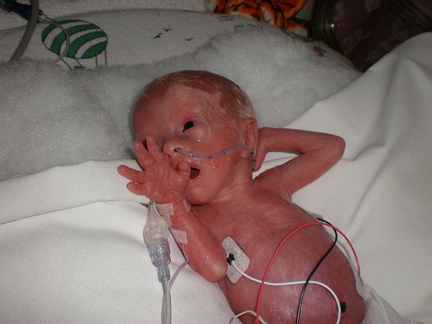

Slide 6
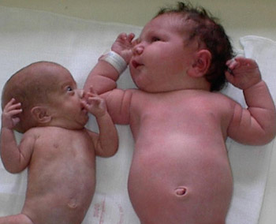

Slide 7
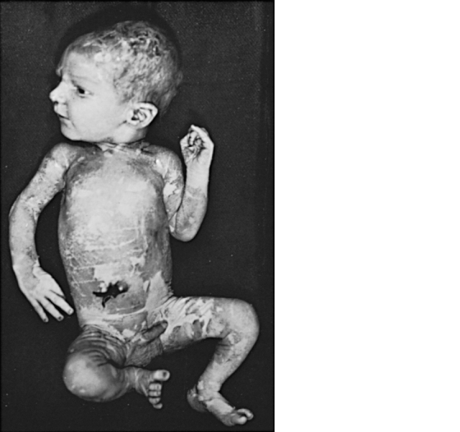
Infant with IUGR as a result of placental insufficiency. Note the long, thin appearance with peeling, parchment-like dry skin, alert expression, meconium staining of the skin, & long nails

Slide 8
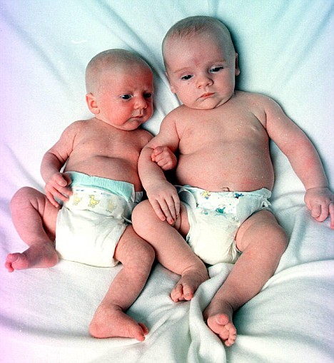

Slide 9
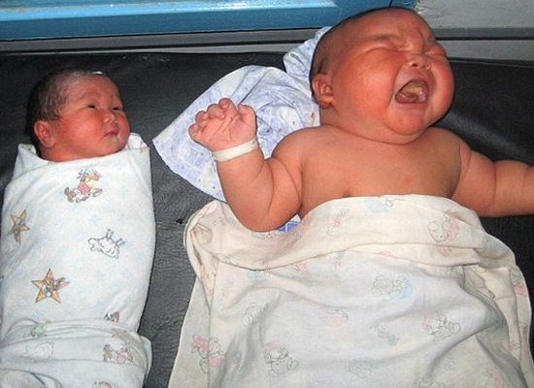

Slide 10
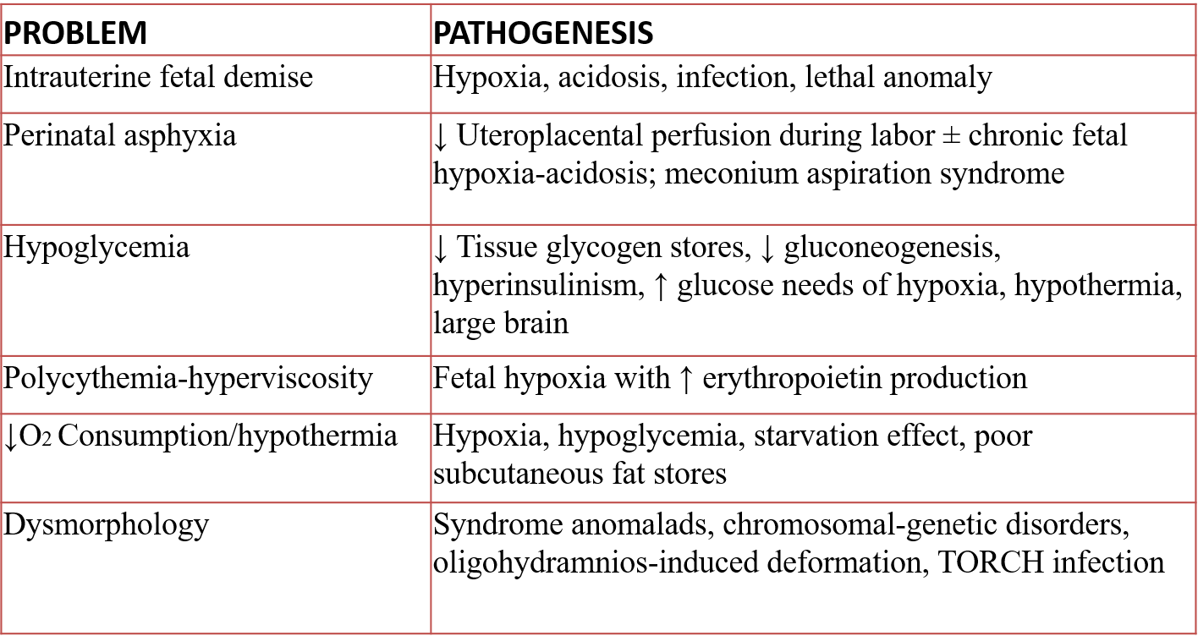
Problems of IUGR (SGA) Infants

Slide 11
Infants with severe IUGR or SGA, esp. in conjunction with fetal distress, may have problems at birth that include resp. acidosis, metabolic acidosis, asphyxia, hypoxemia, hypotension, hypoglycemia, polycythemia, meconium aspiration syndrome, & PPHN
Management of IUGR & SGA infants is usually symptomatic & supportive
MR of infants severely affected are 5 - 20 times the MR of infants who are appropriate for gestational age

Slide 12
Infants born at a weight > the 90th centile for their age are considered large for gestational age (LGA). Among the risks associated with being LGA are all the risks of the infant of a diabetic mother & risks associated with postmaturity
The problems associated with being LGA are:
1- Birth asphyxia from a difficult delivery
2-Birth trauma, especially from shoulder dystocia at delivery (difficulty delivering the shoulders from impaction behind maternal symphysis pubis)
3-Hypoglycemia due to hyperinsulinism
4-Polycythemia.

Slide 13
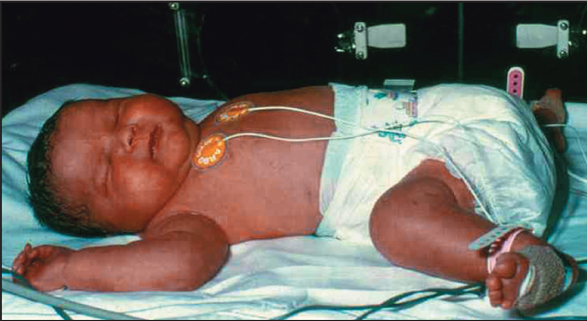
Infant of a diabetic mother showing macrosomia & plethora. Born vaginally at 36 /52 gestation, she weighed 5.5 kg & suffered a right-sided brachial plexus injury.

Slide 14
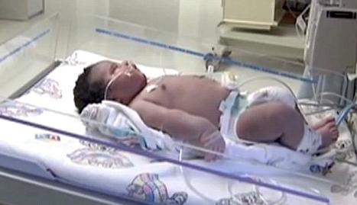

Slide 15
Fetal problems associated with maternal diabetes
Congenital malformations. there is a 6% risk , a 3 fold increase. The range of anomalies is similar to that for the general population, apart from an ↑ incidence of cardiac malformations, sacral agenesis (caudal regression syndrome) & hypoplastic left colon. Studies show that good diabetic control periconceptionally ↓ the risk of congenital malformations. (IUGR). There is a 3 fold increase in growth restriction in mothers with long-standing microvascular disease. Macrosomia . Maternal hyperglycemia causes fetal hyperglycemia as glucose crosses the placenta. As insulin does not cross the placenta, the fetus responds with ↑ secretion of insulin which promotes growth by ↑ both cell no.& size. ~ 25% of such infants have a birth wt >4 kg compared with 8% of non-diabetics. Neonatal problems include: Hypoglycemia.. (RDS). More common as lung maturation is delayed. Hypertrophic CMP . Hypertrophy of the cardiac septum occurs in some infants. It regresses over several wks but may cause HF from ↓ LV function. Polycythemia (venous hematocrit >0.65). Makes the infant look plethoric. Treatment with partial exchange transfusion to reduce the hemocrit & normalise viscosity may be required

Slide 16
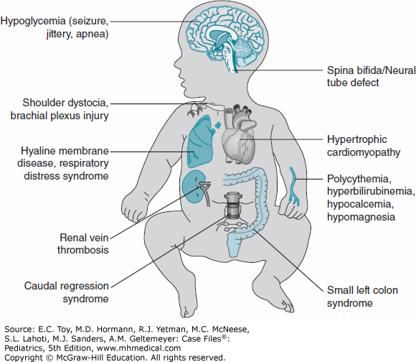

Slide 18
Fetal problems associated with maternal diabetes
Congenital malformations. there is a 6% risk , a 3 fold increase. The range of anomalies is similar to that for the general population, apart from an ↑ incidence of cardiac malformations, sacral agenesis (caudal regression syndrome) & hypoplastic left colon. Studies show that good diabetic control periconceptionally ↓ the risk of congenital malformations. (IUGR). There is a 3 fold increase in growth restriction in mothers with long-standing microvascular disease. Macrosomia . Maternal hyperglycemia causes fetal hyperglycemia as glucose crosses the placenta. As insulin does not cross the placenta, the fetus responds with ↑ secretion of insulin which promotes growth by ↑ both cell no.& size. ~ 25% of such infants have a birth wt >4 kg compared with 8% of non-diabetics. Neonatal problems include: Hypoglycemia.. (RDS). More common as lung maturation is delayed. Hypertrophic CMP . Hypertrophy of the cardiac septum occurs in some infants. It regresses over several wks but may cause HF from ↓ LV function. Polycythemia (venous hematocrit >0.65). Makes the infant look plethoric. Treatment with partial exchange transfusion to reduce the hemocrit & normalise viscosity may be required

Slide 19
Hypoglycemia:
BG levels decline after birth until 1–3 hr of age, when levels spontaneously ↑in normal infants.
In healthy term infants, RBG values are rarely <35 mg/dL between 1 -3 hr of life, <40 mg/dL from 3 - 24 hr, & <45 mg/dL (2.5 mmol/L) after 24 hr.
Both premature & term infants are at risk for serious neurodevelopmental deficits from equally low glucose levels.
This risk is related to the depth & duration of the hypoglycemia

Slide 20
Physiology
Glucose provides 60-70% of energy to fetus and newborn.
Fetal glucose is approximately 2/3 of maternal
levels.(Trans placental facilitated diffusion)
Why prone to develop hypoglycemia:-
1.Umblical cord cutting at birth.
2. Inadequate storage of glycogen.
3. Immature adaptive mechanisms.
4. Prone to long term neurological damage.

Slide 21
Hypoglycemia is likely to occur in the first 24 hrs of life in babies who had IUGR, who are preterm, born to mothers with DM , are LGA , hypothermic, polycythemic or ill for any reason. Growth-restricted & preterm infants have poor glycogen stores, whereas the infants of a DM mother have sufficient glycogen stores, but hyperplasia of the islet cells in the pancreas causes high insulin levels

Slide 22
The incidence of symptomatic hypoglycemia is highest in SGA infants . The incidence of symptomatic hypoglycemia probably varies between 1 -3 / 1,000 live births & affects ~ 5–15% of growth-restricted infants. The onset of symptoms varies from a few hrs to a wk after birth. Symptoms include: jitteriness or tremors, apathy, episodes of cyanosis, convulsions, intermittent apneic spells or tachypnea, weak or high-pitched cry, limpness or lethargy, difficulty feeding, & eye rolling. Episodes of sweating, sudden pallor, hypothermia, & cardiac arrest & failure also occur. Frequently, a clustering of episodic symptoms may be noted. Because these CF may result from various causes, so measurement of blood glucose levels is important ,whether they disappear with the administration of sufficient glucose , if they do not, other diagnoses must be considered.

Slide 23
When symptoms other than seizures are present, an i.v (2 mL/kg) of 10% glucose is effective in elevating the blood glucose conc.. In the presence of convulsions, 4 mL/kg of 10% glucose as a bolus injection is indicated. Then , a glucose infusion should be given at 8 mg/kg/min. If hypoglycemia recurs, the infusion rate & conc. should be increased until 15–20% glucose is used. If an i.v infusions of 20% glucose are inadequate to eliminate symptoms & maintain BG , glucagon or hydrocortisone can be given. if no response hyperinsulinemia is probably present & diazoxide should be administered. If the diazoxide is unsuccessful, octreotide may be useful; infants with severe persistent hyperinsulinemic hypoglycemia may eventually need to undergo subtotal pancreatectomy . The serum glucose level should be measured every 2 hr after initiating therapy until several determinations are >40 mg/dL. Subsequently, every 4–6 hr & the treatment gradually reduced & finally discontinued when BG value has been in the normal range & the baby asymptomatic for 24–48 hr. Treatment is usually necessary for a few days to a wk, rarely for several wks. Infants at increased risk for hypoglycemia should have their BG measured within 1 hr of birth, every 1–2 hr for the 1st 6–8 hr, & then every 4–6 hr until 24 hr of life. Normoglycemic high-risk infants feeding started at 1–3 hr of age & continued at 2–3 hr intervals for 24–48 hr.

Slide 24
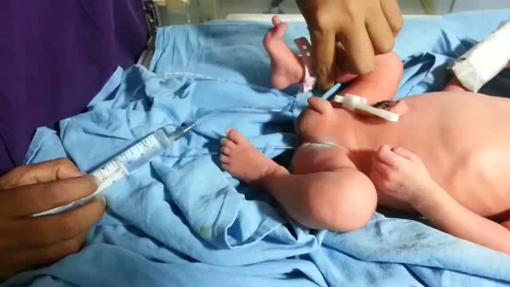

Slide 25
HYPOCALCEMIA
DEFINITION:
Hypocalcemia is defined as total serum calcium of less than 7 mg/dL (1.75 mmol/L) or ionized calcium less than 4 mg/dL (1 mmol/L)
In very low BW infants the ionized calcium levels of 0.8 to 1mmol/L are common & not usually associated with clinical symptoms

Slide 26
TYPES OF NEONATAL HYPOCALCEMIA
The early onset hypocalcemia:
presents within 72 h requires treatment with Ca supplementation for at least 72 hr.
late onset hypocalcemia:
usually presents after 7 days & requires longer term therapy.

Slide 27
CAUSES OF EARLY ONSET HYPOCALCEMIA
Prematurity
Preeclampsia
Infant of Diabetic mother
Peri-natal stress/ asphyxia
Maternal intake of anticonvulsants
(phenobarbitone, phenytoin sodium)
Maternal hyperparathyroidism
Iatrogenic (alkalosis, use of blood products, diuretics, phototherapy, lipid infusions etc

Slide 28
CLINICAL FEATURES
Asymptomatic
Symptomatic:
a) Neuromuscular irritability , Myoclonic jerks
Jitteriness, Exaggerated startle Seizures
b)Cardiac involvement :Tachycardia, prolonged QT Interval, decreased contractility,
c)Other symptoms like
apnea, cyanosis,tachypnea,laryngospasm are noted

Slide 29
Diagnosis
Lab. : measuring total or ionized serum Ca+2
Ionized calcium is preferred mode for measuring hypocalcemia
ECG: QoTc>0.22 seconds or QTc>0.45 sec
QoT is measured from origin of q to origin of t wave
QT is measured from origin of q wave to end of t wave

Slide 30
Management of EOH

Slide 32
Side effects of calcium:
Bradycardia
Arrythmias
Skin & subcutaneous tissue necrosis may occur due to
extravasation
Hepatic necrosis may occur if tip of UVC lies in branch
of portal vein

Slide 33
LATE ONSET NEONATAL HYPOCALCEMIA
presents at the end of the 1st wk of life. It is usually symptomatic in the form of neonatal tetany or seizures.
This is usually caused by high phosphate intake (iatrogenic).

Slide 34
CAUSES OF LATE ONSET HYPOCALCEMIA
Increased phosphate load
Cow milk, renal insufficiency
Hypomagnesemia
Vitamin D deficiency
Maternal vitamin D deficiency
Malabsorption
Renal insufficiency
Hepato-biliary disease
PTH resistance
Transient neonatal pseudo-hypoparathyroidism

Slide 35
Hypoparathyroidism
Primary
Hypoplasia, aplasia of parathyroid glands - (Di George’s
syndrome), CATCH 22 syndrome ,activating mutations of calcium
sensing receptor
Secondary
Maternal hyperparathyroidism
Metabolic Syndromes
Kenny-caffey syndrome
Long-chain fatty A . acyl CoA dehydrogenase deficiency
Kearns-sayre syndrome

Slide 36
Iatrogenic
Citrated blood products, Lipid infusions, Bicarbonate therapy
Diuretics, Glucocorticosteriods Phosphate therapy ,
Alkalosis
Phototherapy ??

Slide 38
Learning Objectives:
1-Definitions LGA SGA Hypocalcemia ,Hypoglycemia IUGR
2- Identify the Causes & risk factors for these problems
3-What are the Problems encountered
4- Describe clinical presentations of these problems
5-Outline management.
6-Conduct an ongoing program to monitor the progress of such children.
7-Appropriately utilize hospitalization, consultation with other health professionals & community resources

