Slide 1
Acid Base Balance

Slide 2
WATER INTAKE AND OUTPUT
Intake | Output
Liquids 1600 | Urine 1500
Food 700 | Sweat (and insensible water loss) 500
Metabolic water 200 | Exhaled air (water vapor) 300
 | Feces 200

Slide 3
Characteristics of water physiology from infancy to adolescence

Slide 4
Body water content
Water is the major component of human body. It represents 60% of an adult’s body weight.
Due to difference in body composition, children have higher body water content relative to body mass than adults.
Water represents 75% of the body mass in infants in first 6 months of life . Then it ↓ rapidly between 6 months & 2 years and at a slower rate during childhood.
It reaches an adult level by the age of puberty (>12 years).
It is also after 12 years old that gender differences appear: water as a % of total body weight ↓ at a faster rate in girls, due to the fact that, women have a higher % of body fat than men

Slide 5
Main water losses in children
Under normal conditions, body water is mostly lost through urine and skin, & to a lesser extent, from lungs and faeces.
Urinary water losses
In children, average urinary volume 600 - 1300 mL/d & ↑ with age to progressively reach adult values.
Skin and lung water losses
Body surface area to body mass ratio is different between children & adults.
It is twice as high in young children (1-2 years old) as in adults.
The difference levels out by adolescence, when children have almost reached their adult size.
This explains why until adolescence, children lose more water relative to body mass from the skin at rest and under thermoneutral conditions compared to adults.

Slide 6
Body water balance regulation
A- Regulation by kidneys
Kidneys are able to reabsorb or eliminate water depending on body needs. To achieve this function, they are influenced by several hormones, antidiuretic hormone (ADH), aldosterone and natriuretic factors (peptide).
In children, renal function reaches maturity at about 2 years old, with comparable glomerular filtration rate & urine concentrating & diluting capacity to adults.
However, voiding volume and frequency are only fully mature by adolescence

Slide 7
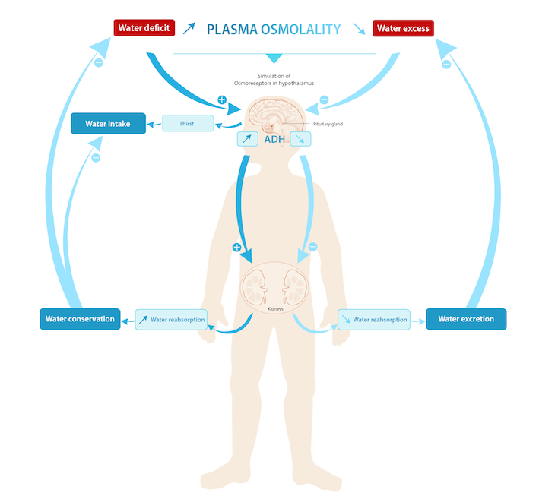

Slide 8
B- Thirst mechanism
When water losses exceed water intake, the body enters a state of hypohydration.
Besides the kidneys, thirst also plays a role in restoring water balance by stimulating the desire to drink.
Thirst is a sensation influenced by both physiological (cellular tonicity, extracellular volume, stomach distension, ADH blood volume...) and behavioral factors (meals, preferences, availability of beverage...).
However, as for adults, thirst and voluntary drinking do not always guarantee adequate hydration.
Indeed, some trials have reported that, when dehydrated and left to their own choice, children and adolescents do not drink enough to ensure the complete replacement of water loss.

Slide 9
C- Thermoregulation
Water plays an essential role in the body’s process of temperature control. Evaporation of sweat from skin is an effective cooling system & represents the main route of heat loss in adult.
In contrast to adults, children lose more heat from convection (dry heat loss) than evaporation. This can be explained by two major physiological differences.
Children have a larger body surface area to body mass ratio and dry heat exchange depends on surface area.
Immature sweating mechanisms.Until puberty, children have lower sweating rates than adults, especially boys compared to men.
Despite these differences, equivalent thermoregulation outcomes in children and adults exercising in the heat have been observed when adequately hydrated. However, limited data suggest that body temperature rises more quickly in children than in adults.
Thus, pre-pubertal children lose less water than adults during exercise and/or in the heat but their body temperature regulation may be more sensitive to dehydration than adults.

Slide 10
To date, there is no significant evidence that children would be at different risk of dehydration or hyperthermia than adults during physical activity under heat
In adequately hydrated children, no increased risk of exertional heat-illness has been observed compared to adults (

Slide 11
ELECTROLYTES
They are chemicals that dissolve in water & dissociate into ions.
Cations are positive ions such as Na+ & K+.
Anions are negative ions such as Cl_ & HCO3 _.
By creating osmotic pressure, electrolytes regulate osmosis of water between compartments.
INTAKE, OUTPUT, AND REGULATION
Intake— electrolytes are part of food & beverages.
Output— urine, sweat, feces.
Regulation; through;
Aldosterone — Na+ & K+;
ANP — Na+;
PTH & calcitonin —Ca+2 & HPO₄ ⁻².

Slide 12
ACID–BASE BALANCE
Normal pH Ranges;
blood: 7.35 - 7.45; tissue fluid: similar to blood.
ICF: 6.8 - 7.0;
Normal pH of body fluids is maintained by;
Buffer systems (Bicarbonate , phosphate, & protein) respond within fraction of second.
Respiration. Respond within 1- 3 min.
Kidneys respond within several hours – days.

Slide 13
BUFFER SYSTEMS
Each consists of a weak acid & a weak base; react with strong acids or bases to change them to substances that do not greatly affect pH.
React within a fraction of a second, but have the least capacity to prevent pH changes, because a limited number of molecules of these buffers are present in body fluids.
Its types:
Bicarbonate buffer system
Phosphate buffer system.
Protein buffer system

Slide 14
Bicarbonate Buffer System
Important in both blood & tissue fluid; base to acid ratio is 20 to 1.
The two components of this buffer system are
Carbonic acid (H2CO3), a weak acid.
Sodium bicarbonate (NaHCO3), a weak base.
If a potential pH change is created by a strong acid, the following reaction takes place:
HCl + NaHCO3 → NaCl + H2CO3
(strong acid) (weak acid)
If a potential pH change is created by a strong base, the following reaction takes place:
NaOH + H2CO3 → H2O + NaHCO3
(strong base) (weak base)

Slide 15
RESPIRATORY MECHANISMS
It affects pH because it regulates amount of CO2 present in body fluids.
Resp. system may be the cause or may correct pH imbalance (from other causes).

Slide 16
Respiratory acidosis
Causes;↓ rate or efficiency of respiration(eg asthma, & pneumonia)→excess CO2 → excess H+ ions formation→ lower pH of body fluids:
CO2 + H2O → H2CO3 → H⁺ + HCO3.
Compensation; Kidneys excrete H+ ions & reabsorb Na+ ions & HCO3- ions.
Respiratory alkalosis (less common)
Causes ↑rate of respiration (eg; anxiety, high altitude) →↑ amount of CO2 exhaled. Because there are fewer CO2 molecules in body fluids→ fewer H+ ions are formed, & pH tends to rise.
Compensation; Kidneys retain H+ ions & excrete Na+ ions & HCO3- ions

Slide 17
Respiratory Compensation for Metabolic pH Changes
Metabolic acidosis or alkalosis are changes in pH caused by other than a respiratory disorders.
Respiratory mechanism does not have the capacity to fully compensate an ongoing metabolic pH imbalance (In such cases, respiratory compensation is 50 - 75% effective).

Slide 18
Metabolic acidosis
Causes; e.g kidney disease, uncontrolled DM, excessive diarrhea or vomiting.
Compensation; excess H+ ions in body fluids→ stimulates respiratory centers in medulla→↑ rate of respiration to exhale more CO2 → ↓ H+ ion formation.
Metabolic alkalosis is not common,
Causes; eg overuse of antacid medications or vomiting of stomach contents only.
Compensation; As pH begins to rise→ breathing slows & ↓ amount of CO2 exhaled (CO2 retained within body)→ ↑ H+ ions formation.

Slide 19
RENAL MECHANISMS
Kidneys regulate pH of ECF by excreting or conserving H+ ions & by reabsorbing Na+ ions & HCO3- ions.
Although renal mechanisms have the greatest capacity to buffer
E.g ketoacidosis in untreated diabetes mellitus ( metabolic acidosis).
As ketones (acid) accumulate in blood,
capacity of ECF buffer systems is quickly exhausted.
Breathing rate then ↑, & more CO2 is exhaled to ↓ H+ ion formation. There is a limit to how much respiratory rate can ↑,
Renal buffering mechanisms will then become effective.

Slide 20
EFFECTS OF pH CHANGES
Acidosis is most detrimental to CNS, causing ↓ impulse transmission at synapses. A person in acidosis becomes confused & disoriented, then lapses into a coma.
Alkalosis affects both CNS & PNS.↑ synaptic transmission, even without stimuli. It is first indicated by irritability & muscle twitches & Progress to muscle spasms & convulsions.

Slide 21
FUNCTIONS OF THE KIDNEYS

Slide 22
Excretion of metabolic waste products, foreign chemicals, drugs, & Hs.
Regulation of Arterial blood Pressure; kidneys contribute in:
long-term regulation by excreting variable amounts of Na+ &water.
short-term regulation by secreting vasoactive substances, such as renin.
Rennin angiotensin mechanism: Sequence;
↓BP stimulates juxtaglomerular cells in kidneys to secrete renin.
Renin splits plasma protein angiotensinogen(synthesized by liver)to angiotensin I.
Angiotensin I is converted to angiotensin II by an enzyme found in lung & vascular endothelium.
Angiotensin II→ vasoconstriction & stimulates adrenal cortex to secrete aldosterone.
Secretion of erythropoietin —H is secreted whenever ↓blood O2 level (hypoxia).
It stimulates red bone marrow to ↑ the rate of RBC production.
Synthetic erythropoietin is available for hemodialysis patients, cancer patients & AIDS patients with severe anemia.
Activation of vitamin D —This vit. exists in several forms that are converted to calcitriol (D2) by kidney. D2 is active form of vit.D that ↑ intestinal absorption of Ca⁺²& phosphate.
Regulation of acid–base balance.
Gluconeogenesis ; kidney synthesize glucose from a.a during prolong fasting.

Slide 23
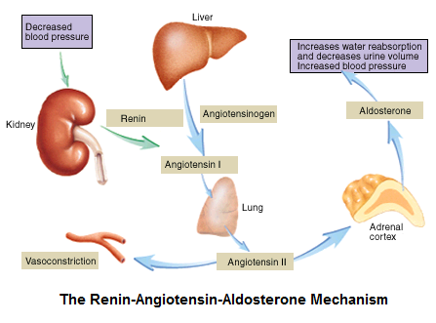

Slide 24
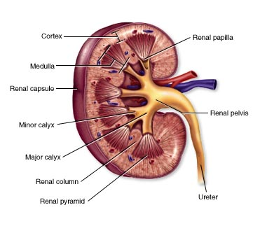
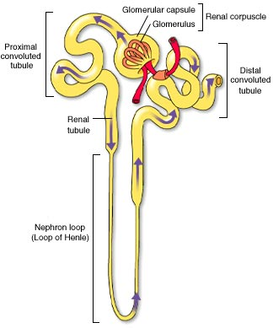
Kidney Nephron
It is structural & functional unit of kidney where urine is formed.
Each kidney contains 1 million nephrons.
Each nephron has two major portions: a renal corpuscle & a renal tubule.

Slide 25
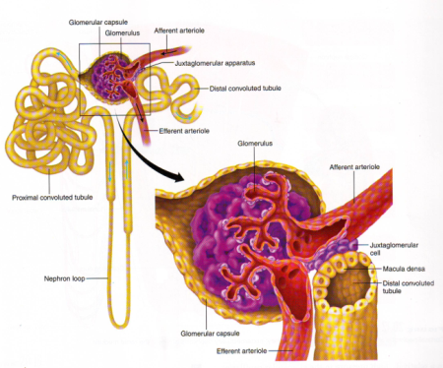
Juxtaglomerular complex
consists of;
1) Macula densa cells:
Specialized epithelial cells in initial portion of DCT that comes in close contact with afferent & efferent arterioles.
Contain Golgi apparatus.
2)Juxtaglomerular cells in walls of afferent & efferent arterioles adjacent to macula densa.

Slide 26
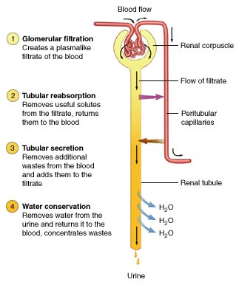
FORMATION OF URINE
Although about 45 gallons of filtrate is produced daily, most of water is reabsorbed (importance ?).
Conservation of water is largely due to long loop of nephron, which establishes a concentration gradient in kidney tissue.
Water can leave collecting duct by osmosis & return to bloodstream in the surrounding peritubular capillaries.

Slide 27
URINATION REFLEX (micturition or voiding).
This reflex is a spinal cord reflex over which voluntary control may be exerted.
Stimulus for reflex is stretching of detrusor muscle of bladder.
Bladder can hold 800 mL of urine, but reflex is activated long before maximum is reached.
When urine volume reaches 200 - 400 mL, stretching generate sensory impulses to→ sacral spinal cord→ Motor impulses return along parasymp. nerves to detrusor m.→ contraction.
At the same time, internal urethral sphincter relaxes.
If external urethral sphincter is voluntarily relaxed, urine flows into urethra, & bladder is emptied.
If bladder continues to fill & be stretched, voluntary control is no longer possible.

Slide 28
