Slide 1
The Physiology of the Gastrointestinal Tract (GIT)
General Objectives
To describe the structural organization of the GIT (alimentary canal and accessory glands) & the different layers of the GIT.
To describe the functions of the various parts of the GIT (secretion, digestion, absorption & motility).
To describe the composition of different GI secretions and their functions.
To describe the regulatory mechanisms (nervous & hormonal) of GI function.

Slide 2
Functions of the GIT
Ingestion
Motility: mixing & propulsion
Secretion
Digestion
Absorption
Excretion

Slide 3
Organization of the GIT
The alimentary canal: mouth, pharynx, esophagus, stomach, small intestine, large intestine, rectum & anal canal.
Associated glands: salivary glands, pancreas, liver & gall bladder.

Slide 4
Delay of
3 seconds

Slide 5
Sphincters

Slide 6
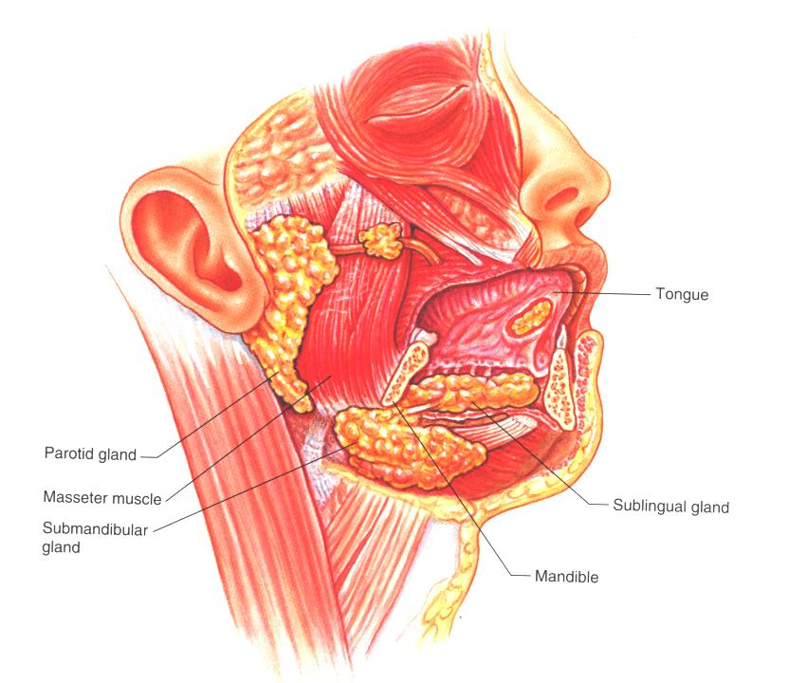

Slide 7
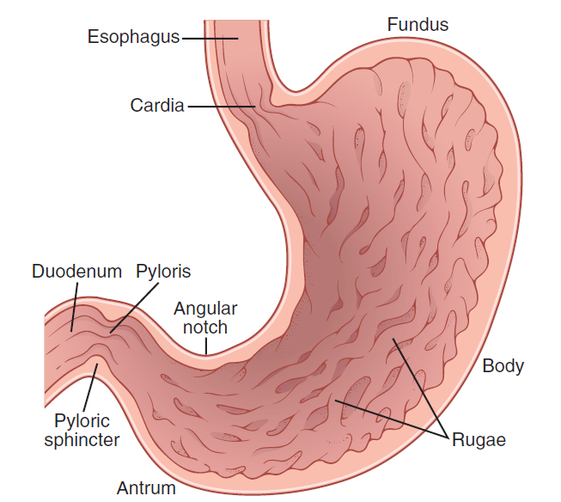
Physiological anatomy of the stomach

Slide 8
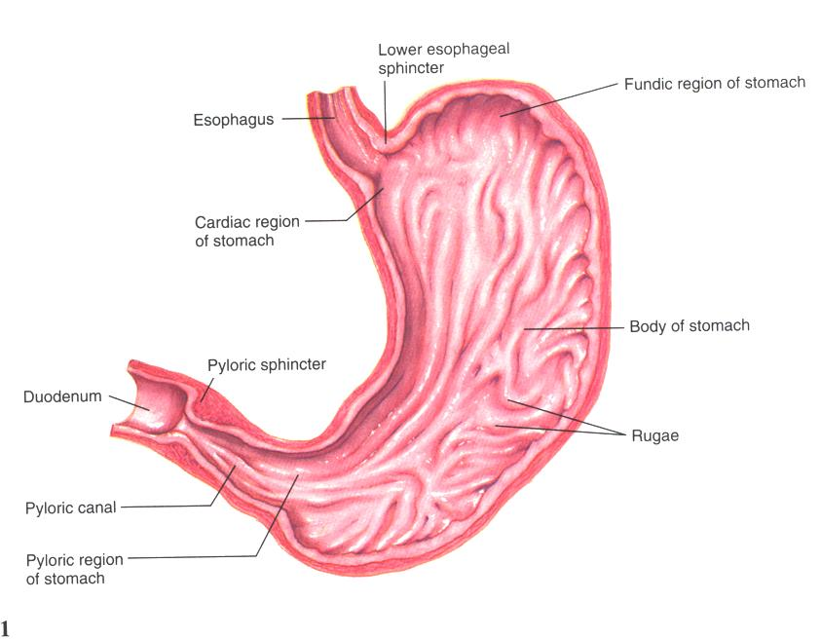

Slide 9
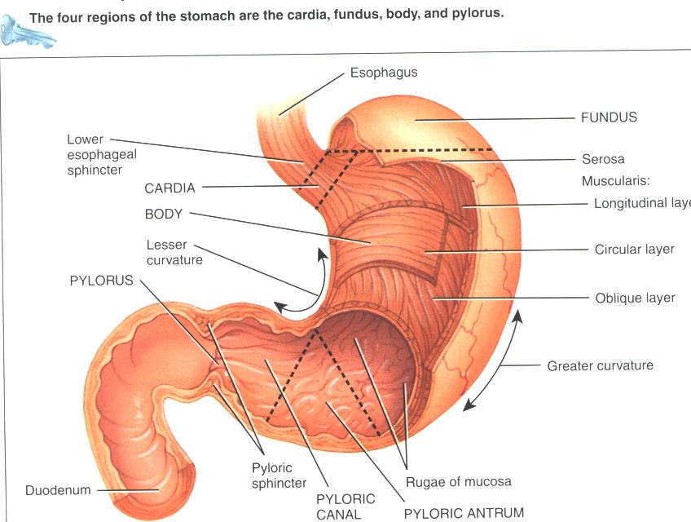

Slide 10
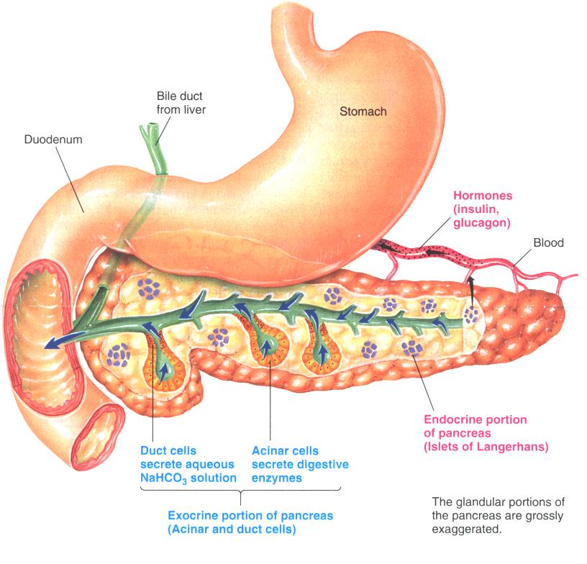

Slide 11
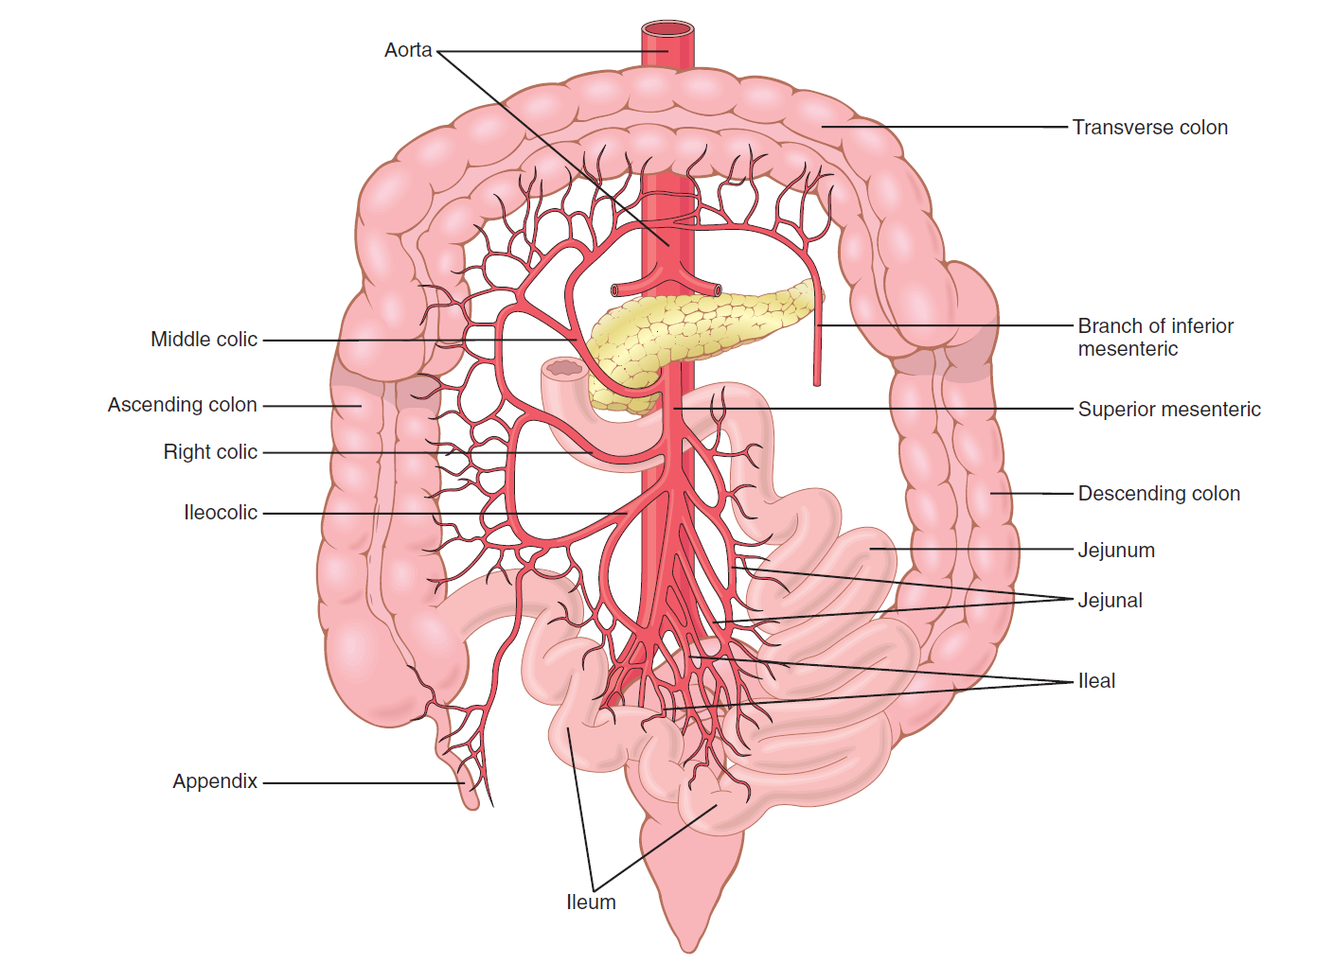
Arterial blood supply to the intestines through the mesenteric web.

Slide 12
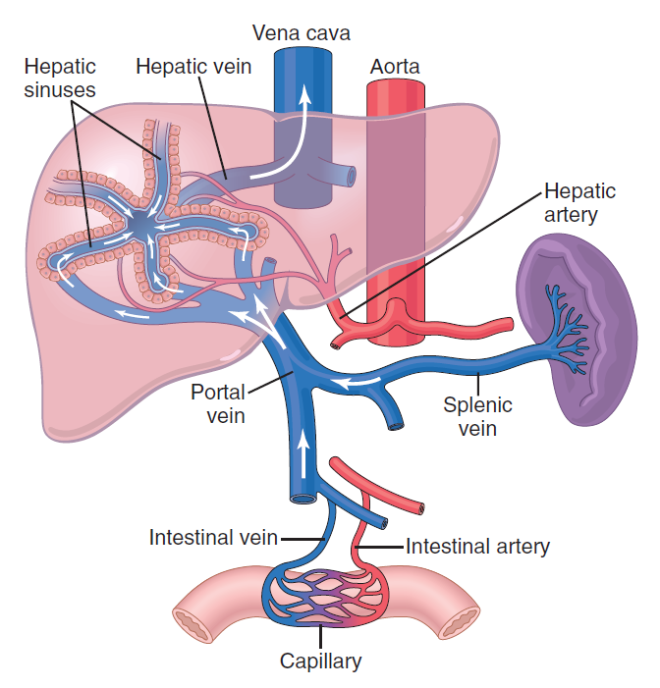
Splanchnic circulation

Slide 13
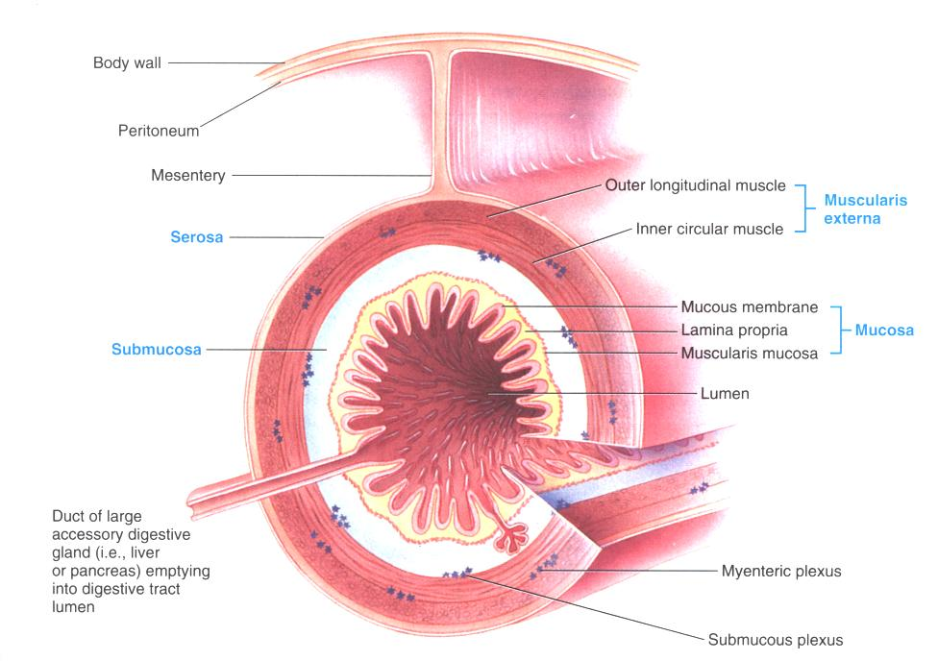

Slide 14
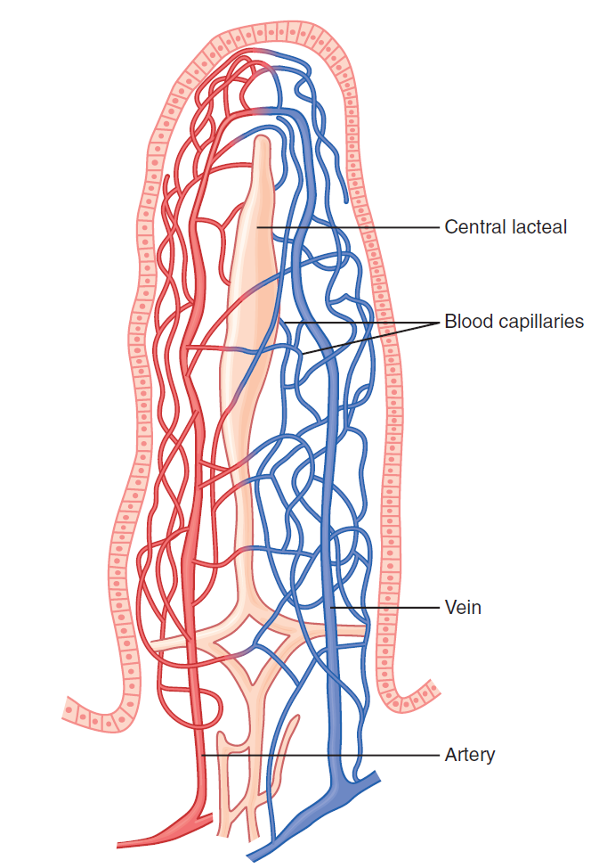
Microvasculature of the villus, showing a countercurrent arrangement of blood flow in the arterioles and venules

Slide 15
Mucosa
This layer is concerned with secretion of both the digestive juices and certain hormones as well as the absorption of the various nutrients.
It contains blood capillaries, lymph vessels and a layer of smooth muscle called the muscularis mucosa.

Slide 16
Submucosa
This is a dense connective tissue layer that contains larger blood and lymph vessels as well as a network of neurons called submucous or Meissner’s plexus.

Slide 17
Muscularis externa: an outer longitudinal layer and inner circular layer of smooth muscle. In between myenteric or Aurbach’s plexus.
Serosa: an outer fibrous coating

Slide 18
Control of GI functions (secretions & motility)
Nervous
Hormonal

Slide 19
Nervous supply to the Gut
Extrinsic (autonomic)
Sympathetic (decreases motor & secretory activity, contraction of sphincters)
Parasympathetic
(stimulatory)
Intrinsic
Submucous or Meissner’s plexus (controls secretory function)
myenteric or Auerbach’s plexus (controls motor activity)

Slide 20
Hormonal control of GIT function
1. Gastrin (from the stomach): stimulates gastric motility and secretion.
2. CCK (from small intestines) stimulates pancreatic enzyme secretion, and gall bladder contraction. Inhibits gastric emptying.
3. Secretin (from small intestines): stimulates pancreatic and biliary bicarbonate secretion.

Slide 21
Important actions of GI hormones
Action Gastrin CCK Secretin GIP
Acid secretion S I I
Pancreatic HCO₃⁻ secretion S S
Pancreatic enzyme secretion S
Bile HCO₃⁻ S
Gallbladder contraction S
Gastric emptying I
Mucosal growth S
Pancreatic growth S S
S = stimulates; I = inhibits

Slide 22
Additional GI hormones
Hormones are produced by enteroendocrine cells in the GI tract in stomach, small and large intestine
increases intestinal motility
increases intestinal motility
increases intestinal motility
neurotransmitter for intestinal smooth muscle
stimulates secretion of water and ions
decreases intestinal motility
increases blood flow to ileum
Motilin
Serotonin
Substance P
Vasoactive intestinal peptide
(VIP)
Neurotensin
16

Slide 23
Additional GI hormones (cont.)
Glucagon
Entero-glucagon
Glicentin
(glucagon-like substance)
Somatostatin
Urogastrone
(Epidermal Growth Factor)
Histamine
stimulate hepatic glycogenolysis
stimulates hepatic glycogenolysis
local inhibition of other endocrine cells
(e.g. G-cells)
inhibits secretion of HCl
increases epithelial growth
increases secretion of HCl

Slide 24
Types of movements in the GIT
Propulsive: move bolus forward.
Segmentation: mixing in the small intestine.

Slide 25
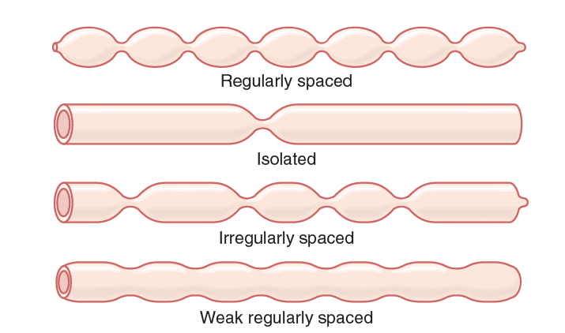
Segmentation movements of the small intestine

Slide 26
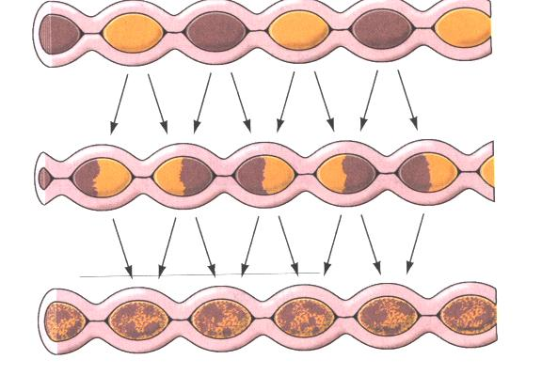

Slide 27
Gastrointestinal paracrine mediators
Paracrine agonists released by:
- paracrine cells
- GI immune system
- antibodies
- inflammatory mediators (prostaglandins, leukotrienes, cytokines, histamine, others)
Lymph node
4
Villus
Epithelium
Lamina propria
Muscularis mucosae
Submucosa
Circular muscle
Longitudinal
muscle
Serosa
Myenteric plexus
Submucosal plexus
Gland in submucosa
Muscularis externa
3

Slide 28
GI immune system
- half of the mass of immune cells in the body are in the GI tract
- antibody secretion to specific food antigens
- immunologic defense against pathogenic microorganisms

Slide 29
Pancreatic Hormones
Pancreatic hormones: insulin
glucagon
somatostatin
produced and secreted (endocrine pancreatic secretion) by the islets of Langerhans
essential for the regulation of metabolism

Slide 30
Regulation of GI function
Autonomous
Neural regulation
smooth muscle
function
extrinsic NS (CNS)
pacemaker activity
intrinsic NS
electrical coupling
GI hormones
Paracrine
mediators
humoral regulation
> high degree of integration
> high degree of autonomy

Slide 31
Example: acid secretion by gastric parietal cell....
cholinergic
nerve terminals
G-cells
+ gastric motility
enhances mixing of food
and disgestive juices
H⁺

Slide 32
MOTILITY
muscular contractions that mix and move the
contents of the gastro-intestinal tract to the appropriate sites of digestion and absorption

Slide 33
Patterns of GI motility
Type of contraction Organ/structure
• Tonic
contractions upper and lower esophageal sphincters
pyloric valve
sphincter of Oddi
ileocecal valve
internal anal sphincter
• Propulsive
peristalsis esophagus
lower 2 thirds of stomach
small intestine
rectum

Slide 34
Patterns of GI motility (cont)
Type of contraction Organ/structure
• Reverse
peristalsis
(antipropulsion) proximal colon
• Mass
movements ascending, transverse and descending colon
• Nonpropulsive
segmentation small intestine
• Haustration ascending, transverse and descending colon

Slide 35
Patterns of GI motility (cont)
• Migrating
motor complex =
migrating myoelectric
complex fasting/empty small intestine

Slide 36
Esophagus
Tubular conduit (about 20 cm long) for food transport from mouth to stomach.
Structural and regulatory aspects:
• Upper third of the esophagus: circular and longitudinal muscle layers are striated;
innervation via cranial nerve.
• Middle third: coexistence of skeletal and smooth muscle.
Primary innervation from vagus nerve;
nerve input from neurons of myenteric plexus
• Lower third: smooth muscle, enteric nerve system (input from vagus nerve to
enteric nerve system).

Slide 37
Esophagus
Function:
  swallowing or deglutition, which is the process of moving food from the mouth through the esophagus into the stomach
  No digestion or absorption
  Secretions: mucus

Slide 38
Swallowing
Swallowing can be initiated voluntarily but then it is under reflex control.
Swallowing reflex:
Receptors: touch receptors in pharynx.
Afferent: sensory impulses from receptors.
Centre: swallowing centre in brain stem.
Efferent: parasympathetic nerves to muscles of pharynx and esophagus.

Slide 39
Mechanism of Swallowing
3 stages:
  Oral or Voluntary: bolus of food is passed into the pharynx by upward and backward movement of tongue against palate. This stimulates the touch receptors that initiate the swallowing reflex.
  Pharyngeal: involuntary passage of bolus through the pharynx into esophagus. Respiratory passageways are closed & respiration is inhibited (protective reflexes).
  Esophageal: involuntary passage of bolus from esophagus to stomach by peristaltic movements of esophagus.

Slide 40
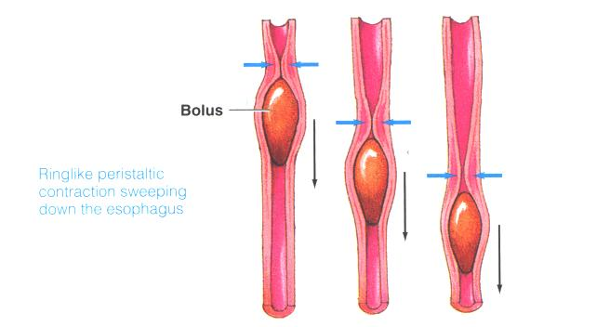

Slide 41
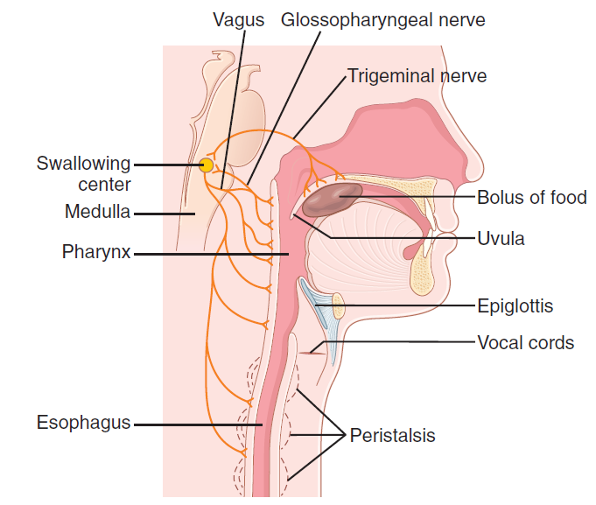
Swallowing mechanism

Slide 42
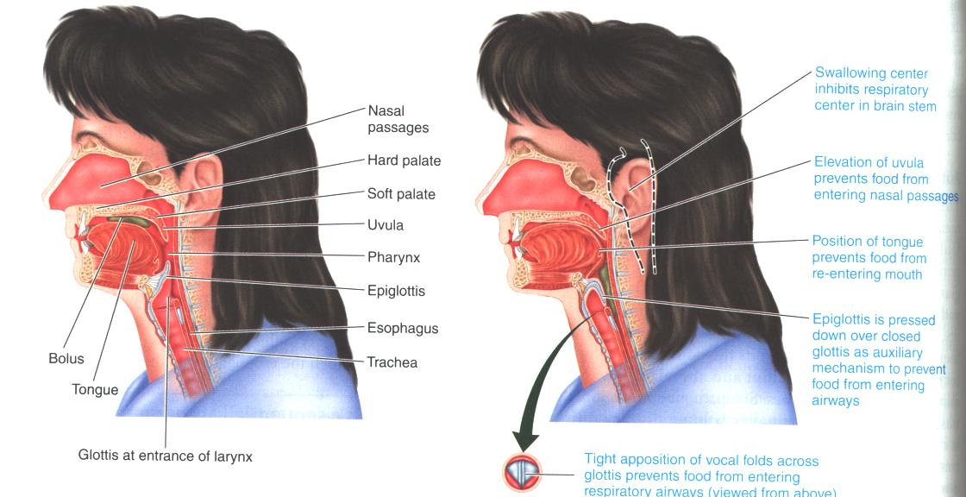

Slide 43
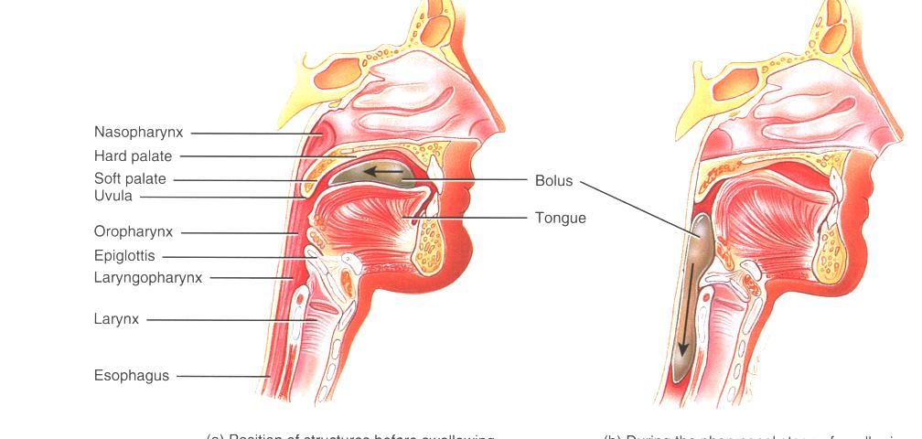

Slide 44
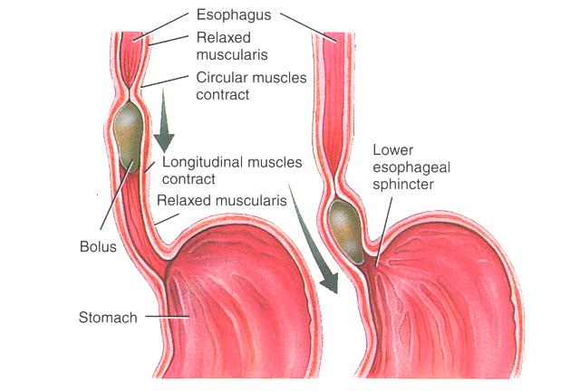

Slide 45
Protective reflexes during pharyngeal phase of swallowing:
Elevation of the soft palate: closes posterior nasal openings, thus preventing food reflux into the nasal cavities.
Elevation of the larynx against the epiglottis: closes the superior laryngeal orifice (glottis), thus preventing food entrance into the trachea.
Approximation of the vocal cords: This also closes the glottis, but its role is much more important than that of the epiglottis.
d) Temporary apnea: stoppage of breathing for few seconds which also prevents food entrance into the trachea.

Slide 46
II- Mouth, Salivary glands & Esophagus
Learning Objectives
Name the salivary glands.
Describe the salivary secretion: volume, pH and composition.
Describe the different functions of saliva.
Describe the regulation of salivary secretions.
Name functions of esophagus.
Describe the mechanism of swallowing.

Slide 47
The Salivary glands
3 paired salivary glands made of ducts and acini that make between 1-1.5 liters/day with a pH of 6-7
Parotid glands
Submandibular or submaxillary glands
Sublingual glands

Slide 48
Composition of Saliva
Mostly water 99.5%
Ionic content: low in Na⁺ and Cl⁻, high in K⁺ and HCO₃⁻
Enzymes: lingual lipase and α-amylase (ptyalin).
Mucins
Lysozymes: proteolytic enzyme
Immunoglobulin A (IgA)

Slide 49
Functions of saliva
Digestive functions:
Amylase breaks down starch, and lingual lipase breaks down triglycerides (active in the stomach).
It dissolves food materials so it can be sensed by taste buds.
Lubrication:
Keeps mouth moist and thus facilitates movements of lips and tongue during speech.
Moistens food and thus facilitates swallowing.
Protection:
Keeps mouth and teeth clean by dissolving and washing food particles from between the teeth.
Has an anti-bacterial action.
Buffers acidic gastric secretions.

Slide 50
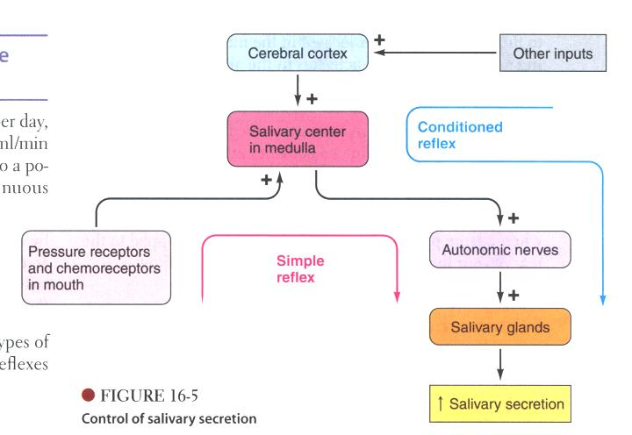

Slide 51
Regulation of Salivary secretion
A) Simple or unconditioned: The presence of food in the mouth results in reflex secretion of saliva.
Stimulus: presence of food in the mouth.
Receptors: taste buds.
Afferent: nerves from taste buds carry impulses to salivary centre.
Centre: salivary centre in medulla oblongata (in brain stem).
Efferent: autonomic nerves supplying salivary glands.

Slide 52
B) Conditioned
  An acquired reflex and needs training.
  The centre is in the cerebral cortex.
  The sight, smell, thought of food in the absence of food in the mouth increase salivary secretion.

Slide 53
Salivary secretions are regulated by nervous mechanisms only
Parasympathetic stimulation, produces flow of watery saliva that is rich in enzymes.
Sympathetic stimulation produces a much smaller volume of thick saliva that is rich in mucus.

Slide 54
III- The Stomach
Learning Objectives
Describe the gross anatomy and histology of the stomach.
Describe the different functions of the stomach.
Describe the composition of gastric secretion and the function of each constituent.
Describe the different mechanisms that regulate gastric secretions.

Slide 55
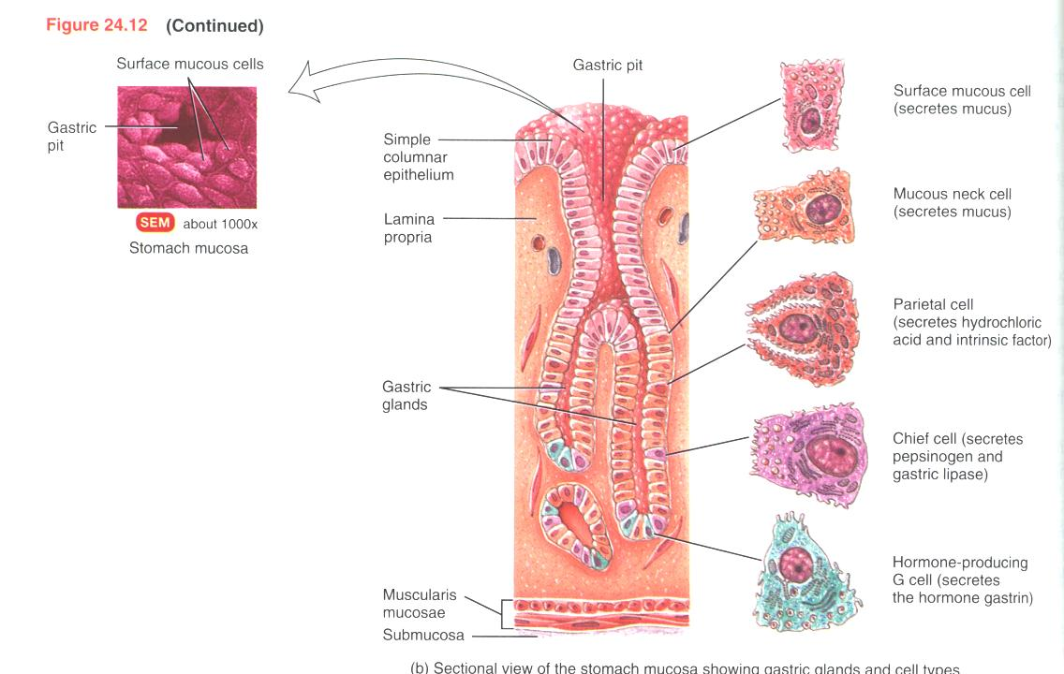

Slide 56
Stomach
Functions of the stomach:
  Motor:
    Storage
    Mixing
    Emptying
  Secretory:
    Exocrine (HCL, mucus, intrinsic factor, pepsinogen)
    Endocrine (Gastrin)
  Digestive (proteins and lipids)
  Absorption: water, ions, alcohol and aspirin

Slide 57
Gastric secretion
3 L/day, highly acidic (pH 1-2).
Composition and function:
Mucus (from mucus cells): protection
Enzymes (from chief cells): pepsin, lipase: digestion.
Intrinsic factor & HCL (from parital cells): Intrinsic factor is important for vit B₁₂ absorption from small intestine.

Slide 59
Functions of HCL
Kills ingested bacteria.
Aids protein digestion (activates pepsinogen into pepsin).
Provides the optimum pH for pepsin action.
Stimulates the secretion of hormones that promote the flow of bile and pancreatic juice.

Slide 60
Regulation of Gastric secretion
3 phases:
Cephalic
Gastric
Intestinal

Slide 61
Cephalic phase (nervous)
Conditioned:
stimulus: smell, sight, thought of food
centre: brain
efferent: along vagus nerve
Unconditioned:
stimulus: taste of food
centre: medulla oblongata
efferent: along vagus nerve

Slide 62
Gastric phase
Stimulus: food distending stomach
Nervous: through vagus: continued gastric secretion and motility.
Hormonal: (Gastrin) produces secretion rich in acid and pepsinogen

Slide 63
Intestinal phase
Stimulus: food distending duodenum.
Nervous: inhibits gastric secretion and motility.
Hormonal: (secretin and CCK) inhibits gastrin release, gastric secretion and motility.

Slide 64
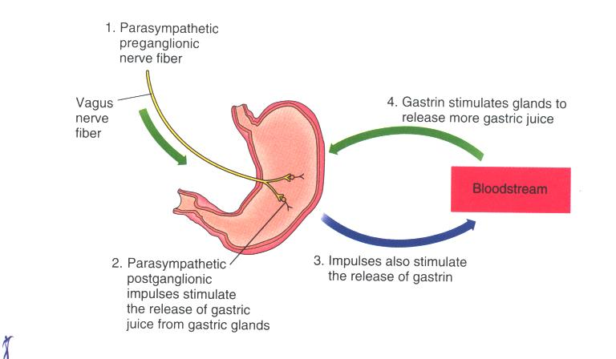

Slide 65
IV- Exocrine Pancreas
Learning Objectives
Describe the composition and function of pancreatic secretions.
Describe the hormonal and nervous regulation of pancreatic secretion.

Slide 66
Composition and function of pancreatic secretion
1.5 L/day, alkaline (pH 8)
Composition and function:
  Digestive enzymes: peptidases (trypsin and chymotrypsin), lipases, and amylase.
  Water
  HCO₃⁻:
    neutralize the gastric acid
    Provides optimum medium for action of pancreatic enzymes.

Slide 67
Regulation of pancreatic secretion
Mainly hormonal:
Secretin: acid chyme in duodenum stimulates secretions rich in water and HCO₃⁻ but poor in enzymes
CCK: digestive products of proteins and fat in duodenum stimulates secretions of pancreatic juice rich in enzymes.
Both hormones are secreted by upper intestinal cells.

Slide 68
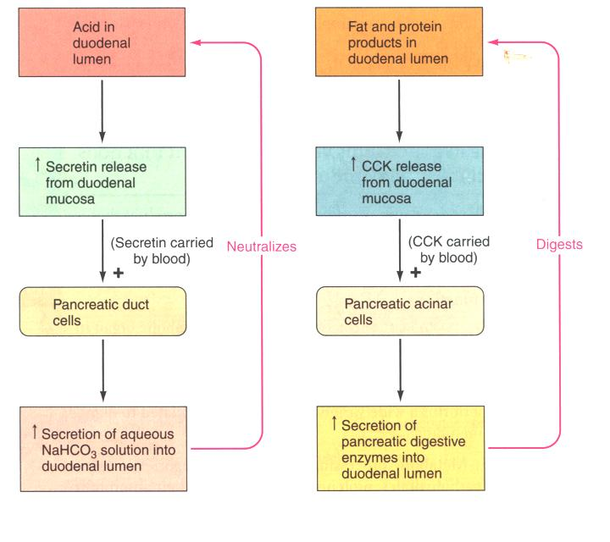

Slide 69
Nervous control of pancreatic secretion
Parasympathetic impulses along vagus nerves stimulate secretion of pancreatic enzymes.

Slide 70
V- The Biliary System
Learning Objectives
List the different functions of the liver.
Describe the composition of bile and its functions.
Describe the functions of bile salts.
Describe the different functions of the gall bladder.
Describe the different mechanisms that regulate bile secretion & gall bladder emptying.
Describe the types of jaundice according to the cause.

Slide 71
The biliary system includes:
The liver
The gall bladder
Associated ducts:
  Hepatic ducts (right, left and common)
  Cystic duct
  Common bile duct

Slide 72
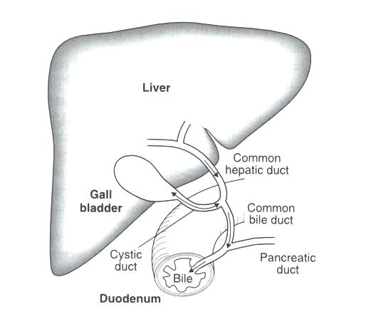

Slide 73
Functions of liver
Synthesis & Secretion of bile.
Metabolic processes (e.g. gluconeogenesis, glycogenolysis).
Detoxification and degradation (e.g. drugs and hormones).
Synthesis of plasma proteins (e.g. albumin and clotting factors).
Storage (e.g. iron and Vit B₁₂).
Activation of vitamin D.
Removal of bacteria and old RBC.
Excretion of cholesterol and bilirubin.

Slide 74
Bile secretion
Bile is secreted by hepatocytes.
About 500 ml (250-1200ml) is secreted per day.
pH 8
Enters duodenum during digestion of meals.
Stored in gall bladder and concentrated between meals.

Slide 75
Composition of human bile (gm/dl)

Slide 76
Electrolyte content of bile (mmol/L)

Slide 77
Functions of bile
Bile salts play an important role in fat digestion and absorption.
Excretion of waste products (e.g. bilirubin).
Bicarbonate in bile neutralizes acid in duodenum.

Slide 78
Bile salts
Most important component of the bile.
They are Na⁺ and K ⁺ salts of bile acids.
They are derivatives of cholesterol.
Recycled through the enterohepatic circulation.

Slide 79
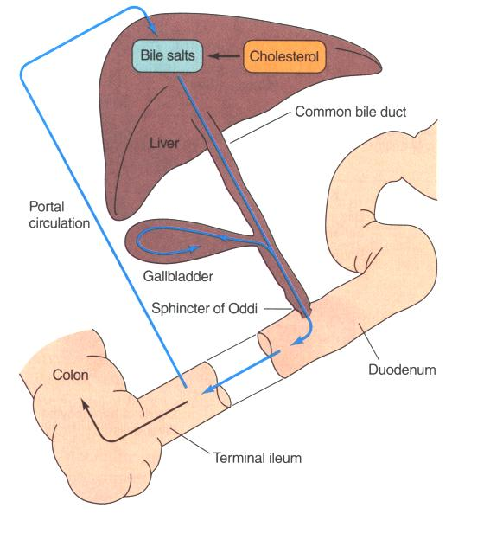

Slide 80
Function of bile salts
Emulsify large fat particles into smaller ones that can be attacked by lipase (detergent action).
Help in the transport and absorption of fat (micellar formation).

Slide 81
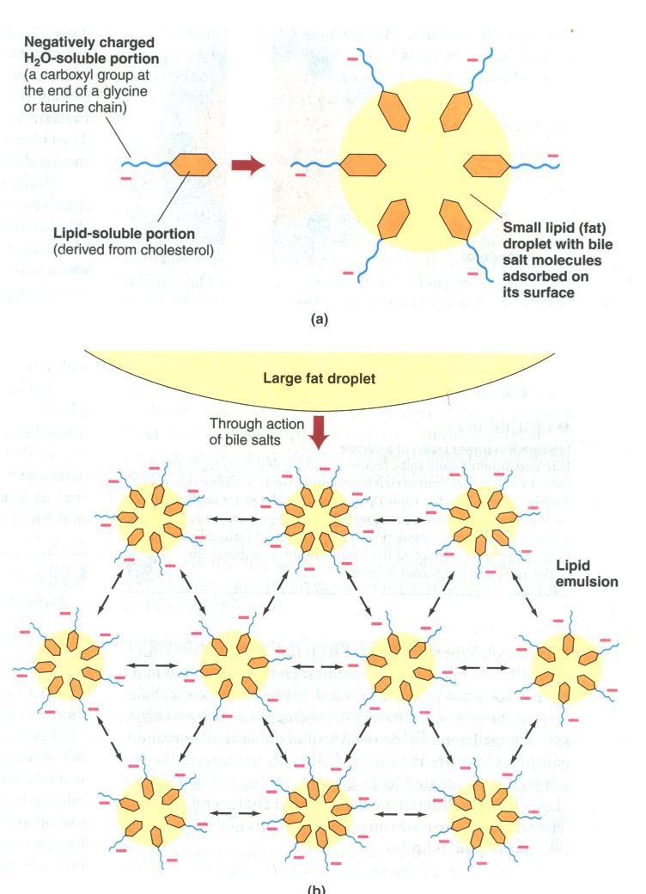

Slide 82
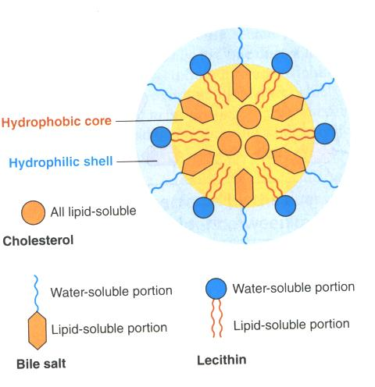

Slide 83
Prevent precipitation of cholesterol by keeping them in solution (prevent gall stones).
Stimulate bile secretion by liver cells.

Slide 84
Gall Bladder
No digestive role.
Stores bile.
Concentrates bile.
Empties during meals.
Secretes mucus.

Slide 85
Regulation of bile secretion and gall bladder emptying
Chemical:
  Bile salts: most important stimulant of bile secretion by liver cells.
Hormonal:
  Secretin: secreted in response to acid chyme, causes secretion of bile rich in water and HCO₃⁻
  CCK: secreted in response to fatty acids in duodenum, causes gall bladder to contract and sphincter of Oddi to relax.

Slide 86
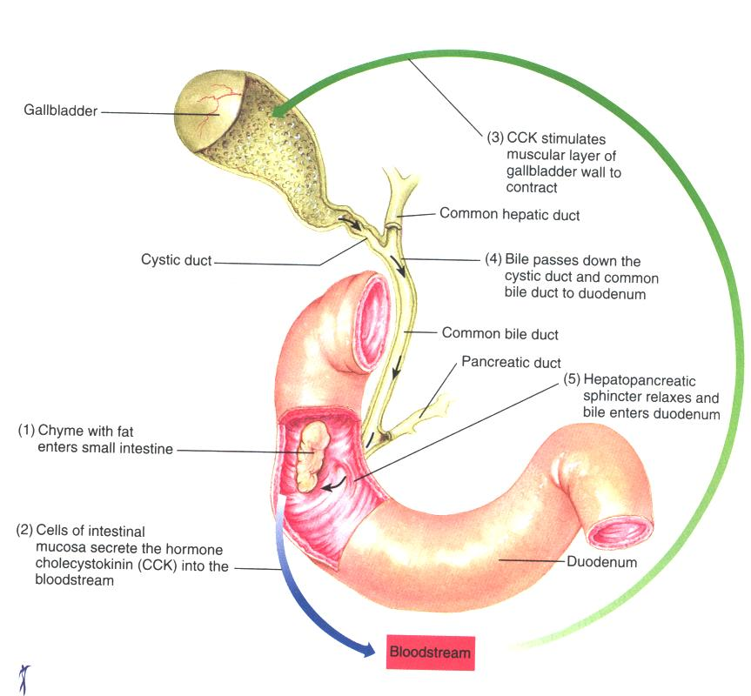

Slide 87
Neural
  Vagal stimulation:
    Increases bile secretion
    Weak contraction of gall bladder

Slide 88
Jaundice
Jaundice: yellowish discoloration of the skin, sclera & mucous membranes due to a ↑ blood bilirubin level.
Causes:
Pre-hepatic: due to excess production of bilirubin e.g. haemolytic anaemia.
Hepatic: liver disease e.g. hepatitis
Post-hepatic: obstruction to bile flow e.g. gall stones.

Slide 89
VI- Small & Large Intestines
Learning Objectives
Describe the intestinal juice (volume, pH, composition, function and its regulation).
Name the different digestive enzymes and their substrates.
Describe the reabsorptive processes of different substances.
Describe the different intestinal movements (motility).
Describe the different functions of the colon.
Describe the defecation reflex and its regulation.

Slide 90
Small intestine
Structure
Long tube (about 6m) extending from pyloric sphincter in stomach and joins large intestine at the ileocecal sphincter
duodenum (20 cm), jejunum (2.5 m) and ileum (3.5 m).
Surface area greatly increased by intestinal mucosal foldings, villi and microvilli.
Structure of a villus (see figure).

Slide 91
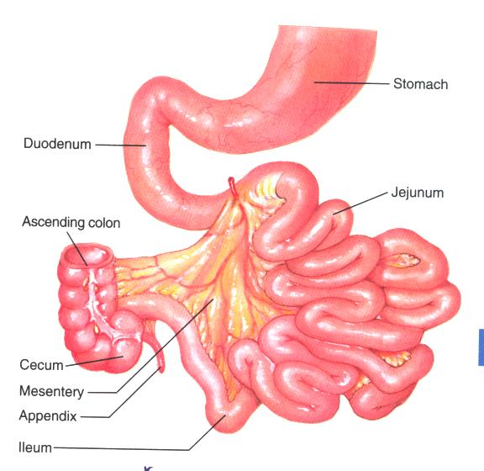

Slide 92
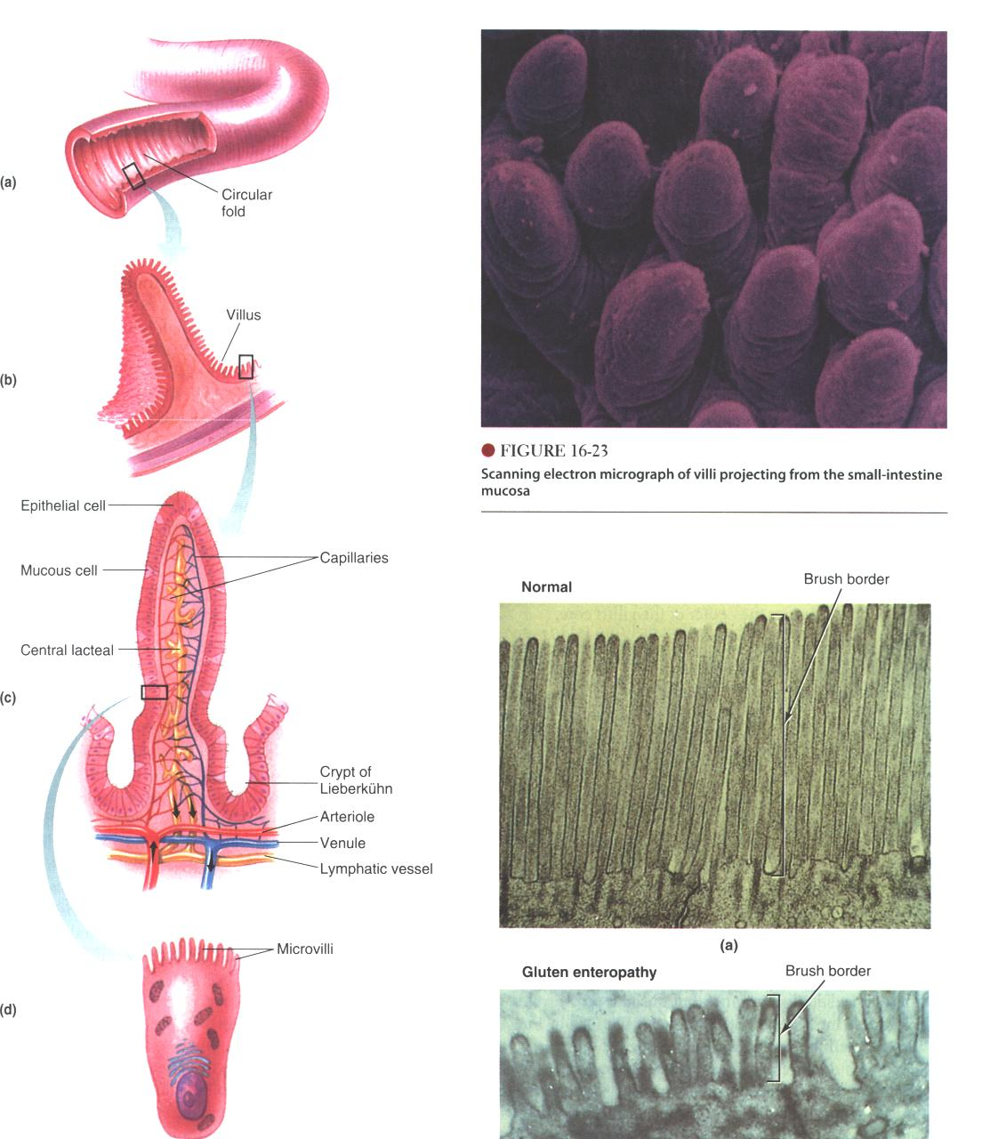

Slide 93
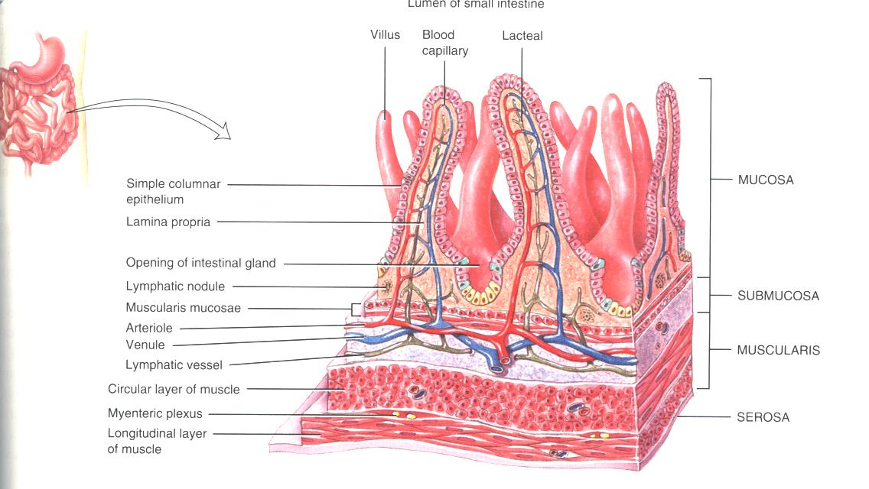

Slide 94
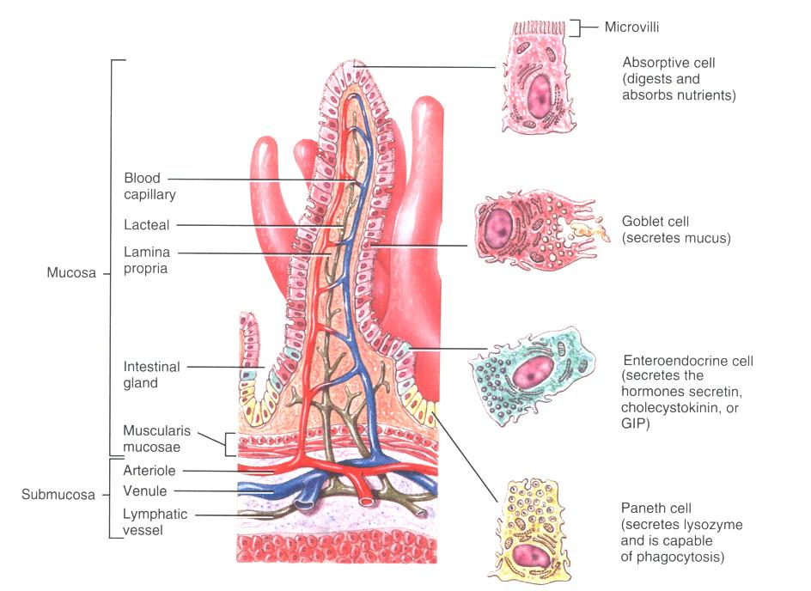

Slide 95
Small intestine
Function
Digestion : Enzymes are intracellular (Disaccharidases and aminopeptidases).
Absorption: completed in SI, large surface area (as large as 200 m2).
(Site where most digestion and absorption take place).
Secretion
Motility

Slide 96
Digestion

Slide 97
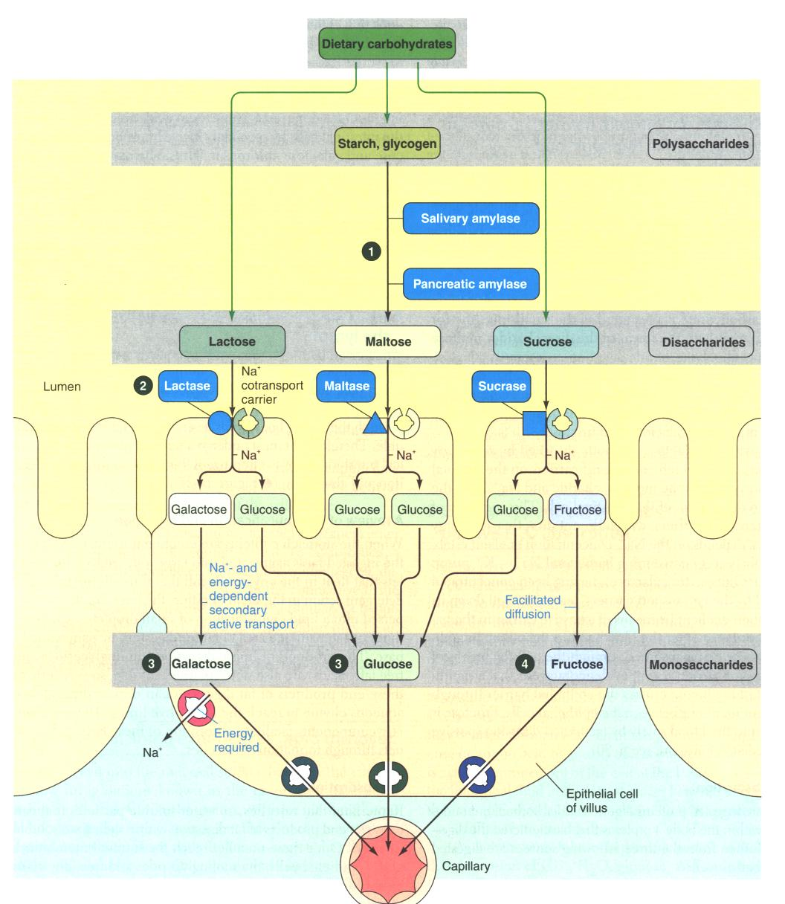

Slide 98
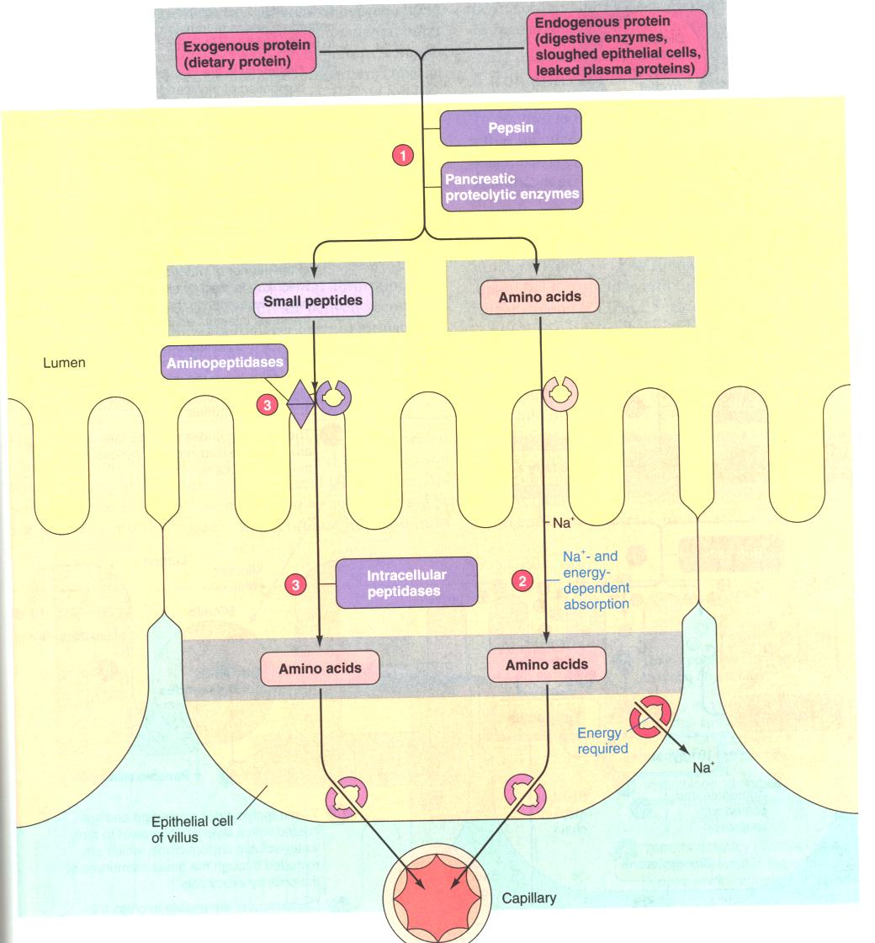

Slide 99
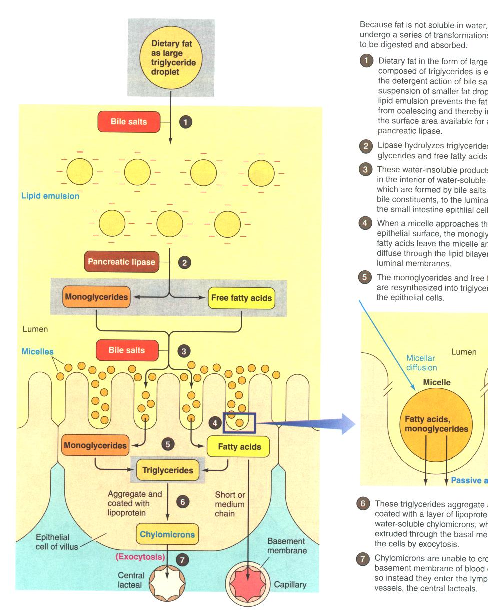

Slide 100
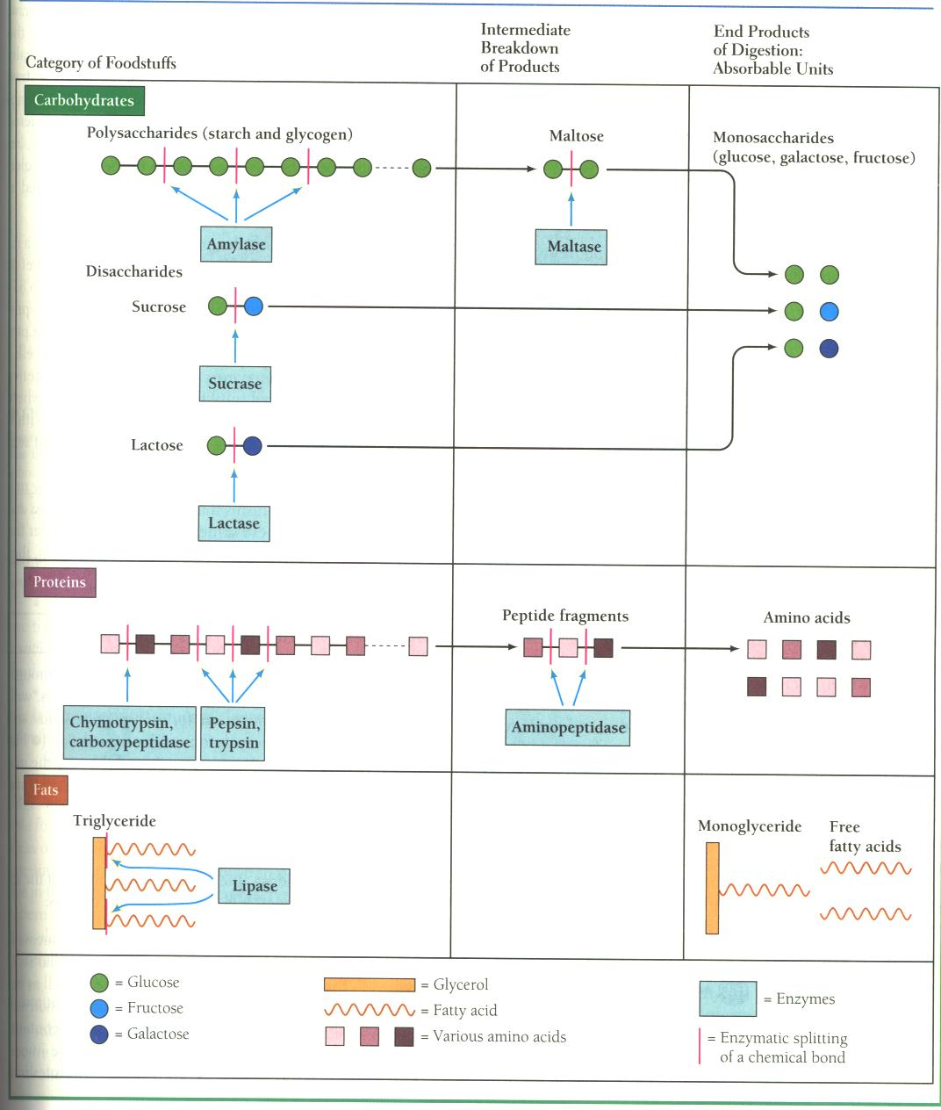

Slide 101
Absorption

Slide 102
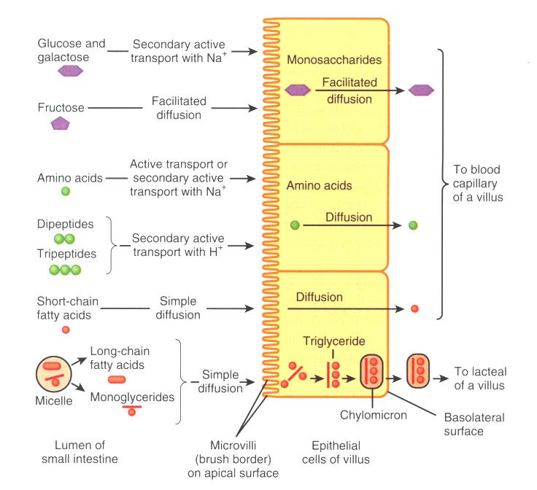

Slide 103
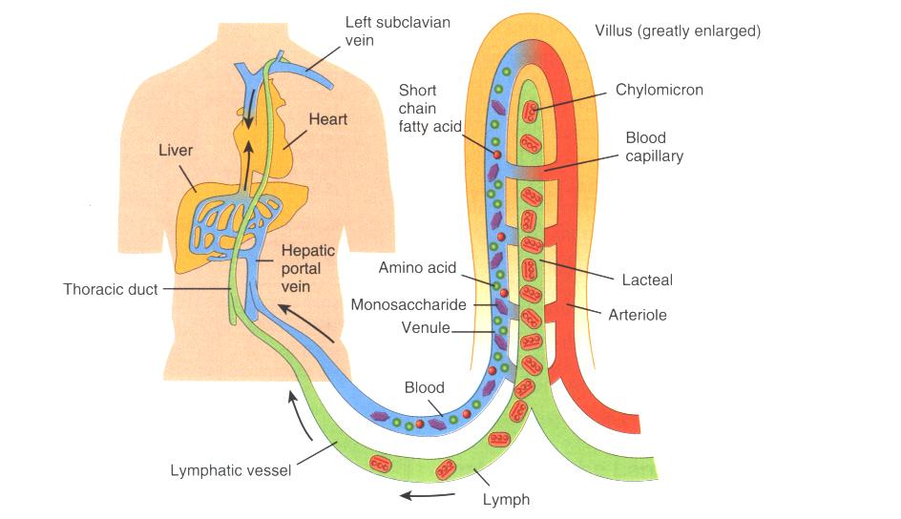

Slide 104
Exocrine intestinal secretions
Intestinal juice: alkaline fluid (water and electrolytes) with few enzymes from desquamated cells (1000-1500 ml/day).
HCO₃⁻: neutralize acid.
Mucus: protection & lubrication.
No digestive enzymes.

Slide 105
Regulation of intestinal secretion
Local: mechanical stimulation of intestinal mucosa by the presence of chyme.
Nervous: vagal nerve stimulation causes secretion of intestinal glands.
Hormonal: ? secretin

Slide 106
Intestinal motility
Segmentation: ring-like contractions. Mix chyme and expose it to absorptive surface.
Peristaltic: a wave of contraction preceded by relaxation. Propels the gastrointestinal contents toward the large intestine.

Slide 107
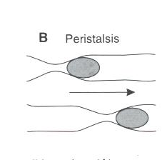

Slide 108
Large Intestine

Slide 109
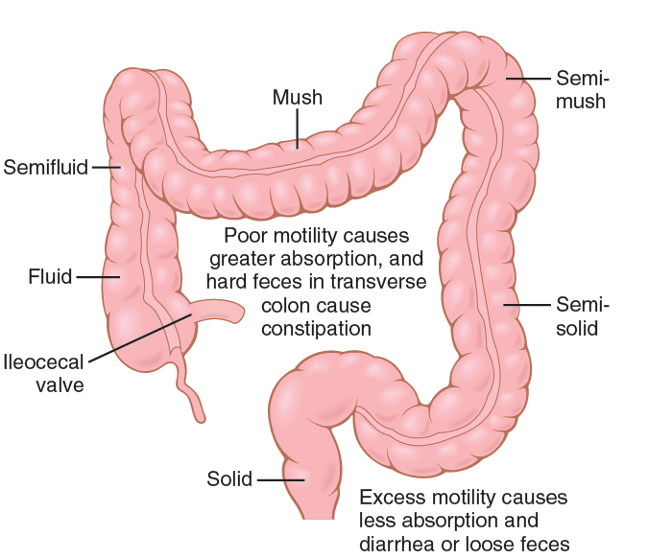
Absorptive & storage functions of the large intestine.

Slide 110
Large intestine
No digestive function.
Absorption of water, Na⁺ and other minerals.
Secretion of mucus for lubrication.
Storage of feces (undigested food).
Bacteria in colon synthesize vitamin K and a number of B complex vitamins.

Slide 111
Defecation reflex
Stimulus: undigested material distending rectum.
Receptor: stretch receptor in rectum.
Afferent: sensory to sacral segment of spinal cord
Centre: sacral segment of spinal cord
Efferent: parasympathetic nerves to smooth muscle of rectum and internal anal sphincter.
External anal sphincter is under voluntary control.

Slide 112
Defecation reflex
Causes the internal anal sphincter to relax and the rectum and sigmoid colon to contract.
If external anal sphincter is relaxed defecation occurs.
Defecation can be inhibited by voluntary tightening of external anal sphincter.

Slide 113
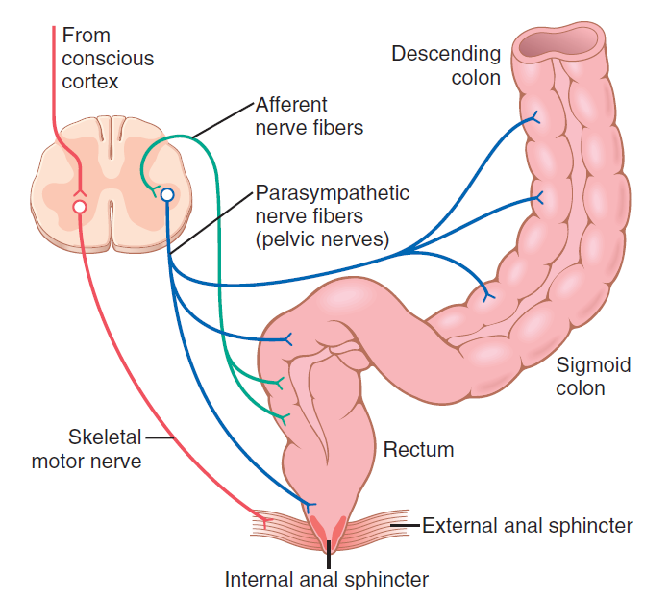
Afferent & efferent pathways of the parasympathetic mechanism for enhancing the defecation reflex

Slide 114
Important actions of GI hormones (compare with table 15)
Action Gastrin CCK Secretin GIP
Acid secretion S I I
Pancreatic HCO₃⁻ secretion S S
Pancreatic enzyme secretion S
Bile HCO₃⁻ S
Gallbladder contraction S
Gastric emptying I
Mucosal growth S
Pancreatic growth S S
S = stimulates; I = inhibits

Slide 115
Additional GI hormones
Hormones are produced by enteroendocrine cells in the GI tract in stomach, small and large intestine
Motilin
Serotonin
Substance P
Vasoactive intestinal peptide
(VIP)
Neurotensin
increases intestinal motility
increases intestinal motility
increases intestinal motility
neurotransmitter for intestinal smooth muscle
stimulates secretion of water and ions
decreases intestinal motility
increases blood flow to ileum

Slide 116
Additional GI hormones (cont.)
Glucagon
Entero-glucagon
Glicentin
(glucagon-like substance)
Somatostatin
Urogastrone
(Epidermal Growth Factor)
Histamine
stimulate hepatic glycogenolysis
stimulates hepatic glycogenolysis
local inhibition of other endocrine cells
(e.g. G-cells)
inhibits secretion of HCl
increases epithelial growth
increases secretion of HCl

Slide 117
Gastrointestinal paracrine mediators
Paracrine agonists released by:
- paracrine cells
- GI immune system
- antibodies
- inflammaory mediators (prostaglandins, leukotrienes, cytokines, histamine, others)
Lymph node
4
Villus
Epithelium
Lamina propria
Muscularis mucosae
Submucosa
Circular muscle
Longitudinal
muscle
Serosa
Myenteric plexus
Submucosal plexus
Gland in submucosa
Muscularis externa
3

Slide 118
GI immune system
- half of the mass of immune cells in the body are in the GI tract
- antibody secretion to specific food antigens
- immunologic defense against pathogenic microorganisms

Slide 119
Pancreatic Hormones
Pancreatic hormones: insulin
glucagon
somatostatin
produced and secreted (endocrine pancreatic secretion) by the islets of Langerhans
essential for the regulation of metabolism

Slide 120
Regulation of GI function
Autonomous
Neural regulation
smooth muscle
function
extrinsic NS (CNS)
pacemaker activity
intrinsic NS
electrical coupling
GI hormones
Paracrine
mediators
humoral regulation
> high degree of integration
> high degree of autonomy
5

Slide 121
Example: acid secretion by gastric parietal cell....
cholinergic
nerve terminals
G-cells
+ gastric motility
enhances mixing of food
and disgestive juices
H⁺
71

Slide 122
In addition to the nervous signals that may affect SI peristalsis, several hormonal factors also affect peristalsis.
These factors include gastrin, CCK, insulin, motilin, &serotonin, all of which enhance intestinal motility & are secreted during various phases of food processing.
Conversely, secretin & glucagon inhibit SI motility.
The physiological importance of each of these hormonal factors for controlling motility is still questionable.

Slide 123
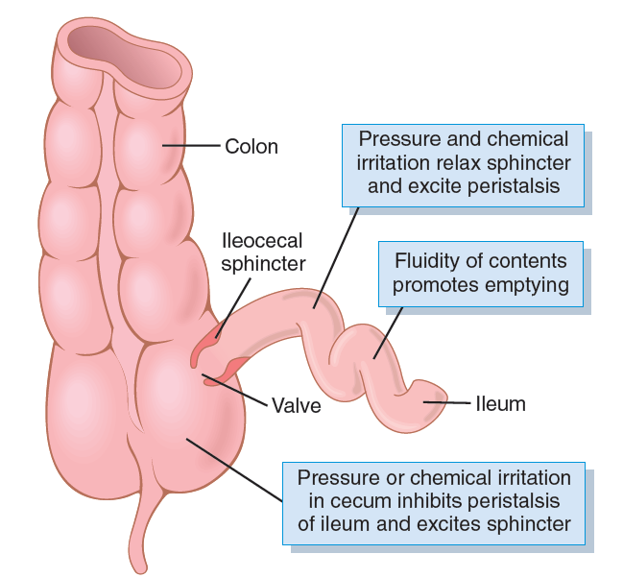
Emptying at the ileocecal valve

Slide 124
Typical function of a glandular cell for formation &secretion of enzymes &other secretory substances

Slide 125
Daily Secretion of Intestinal Juices
Type of Secretion Daily Volume (ml) pH
Saliva 1000 6.0-7.0
Gastric secretion 1500 1.0-3.5
Pancreatic secretion 1000 8.0-8.3
Bile 1000 7.8
Small intestine secretion 1800 7.5-8.0
Brunner’s gland secretion 200 8.0-8.9
Large intestinal secretion 200 7.5-8.0
Total 6700

Slide 126
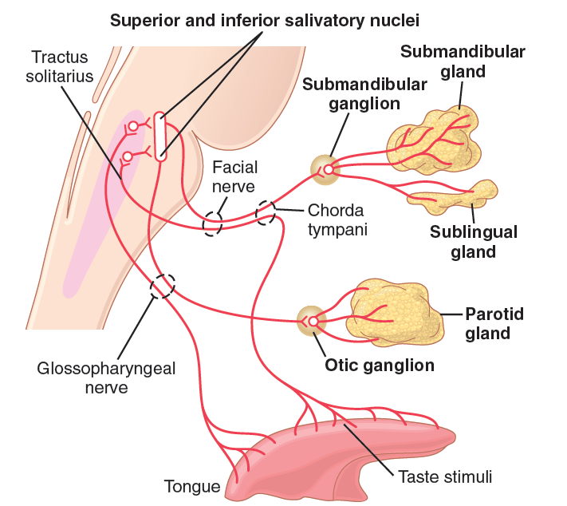
Parasympathetic nervous regulation of salivary secretion.

Slide 127
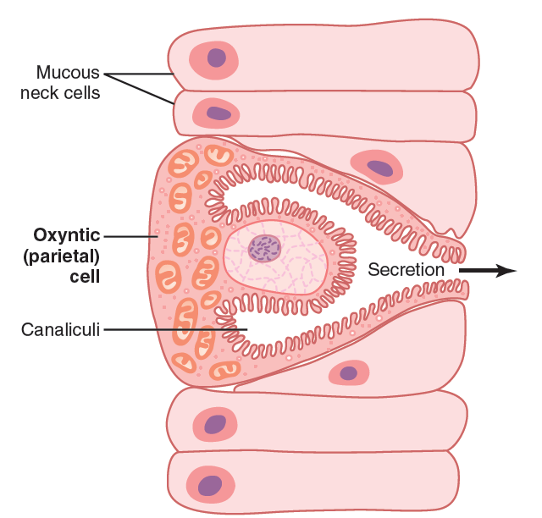
Schematic anatomy of the canaliculi in a parietal (oxyntic) cell

Slide 128
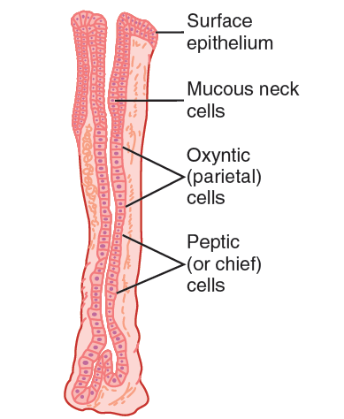
Oxyntic gland from the body of the stomach.

Slide 129
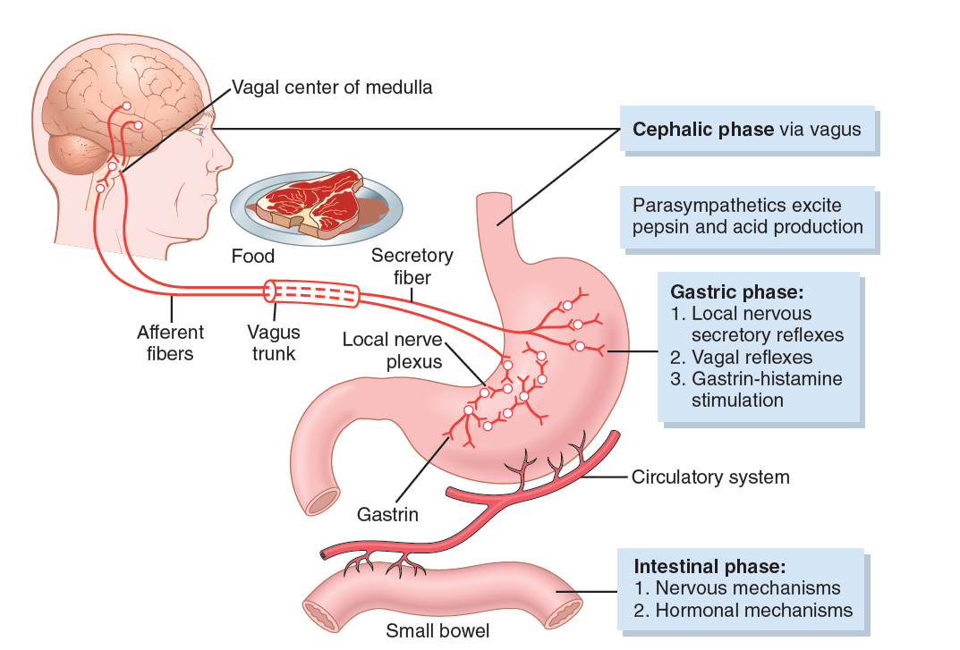
Phases of gastric secretion & their regulation

Slide 130
Basic Stimuli That Cause Pancreatic Secretion
3 basic stimuli
1. Acetylcholine, which is released from the 10th nerve endings & from other cholinergic nerves in the enteric NS
2. Cholecystokinin, which is secreted by the duodenal
& upper jejunal mucosa when food enters the SI
3. Secretin, which is also secreted by the duodenal & jejunal mucosa when highly acidic food enters the SI
The first 2 stimuli, stimulate the acinar cells of the pancreas, causing production of large quantities of pancreatic digestive enzymes but relatively small quantities of water & electrolytes.
Secretin, in contrast , stimulates secretion of large quantities of water solution of sodium bicarbonate by the pancreatic ductal epithelium.

Slide 131
Phases of Pancreatic Secretion
Pancreatic secretion, as with gastric secretion, occurs in
three phases: the cephalic phase, the gastric phase, and
the intestinal phase.

Slide 132
Bile secretion = digestive/absorptive function of the liver
Components of bile
• bile salts (conjugates of bile acids)
• bile pigments (e.g. bilirubin)
• cholesterol
• phospholipids (lecithins)
• proteins
• electrolytes (similar to plasma, isotonic with plasma)
600-1200 ml/day

Slide 133
Function of bile
• bile salts (conjugates of bile acids with taurine or glycine) important for absorption of lipids in small intestine. Bile acids emulsify lipids and form mixed micelles necessary for lipid absorption.
• bile acids are derived from cholesterol and therefore are responsible for excretion of cholesterol.
• excretion of bilirubin (product of hemoglobin degradation).
• bile acids are actively absorbed and recirculated through enterohepatic circulation.

Slide 134
enterohepatic circulation of bile

Slide 135
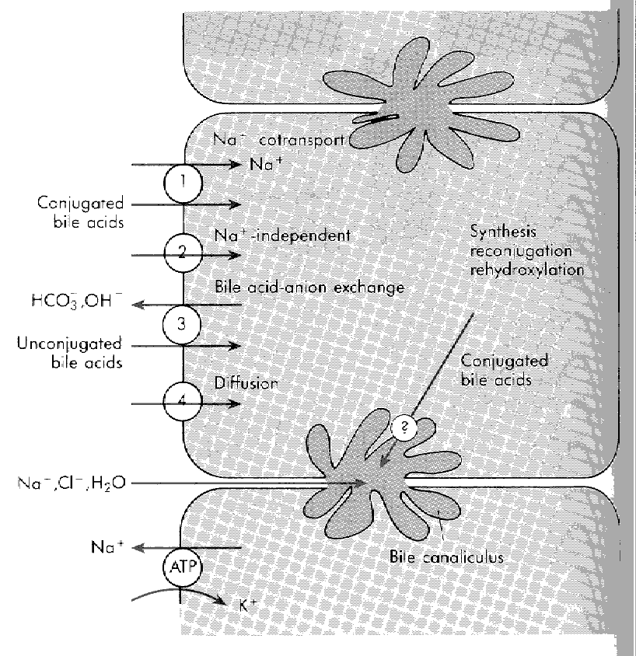
Mechanism of uptake and secretion of bile acids by hepatocytes
ATP

Slide 136
Intestinal secretion: 1500 ml/day.
Composition:
• mucus
• electrolytes
• water

Slide 137
DIGESTION
degradation of structurally complex foodstuffs by digestive enzymes
3 categories of energy-rich foodstuffs:
carbohydrates, proteins and lipids
ABSORPTION
absorbable units as a result of the digestive process are
transported along with water, vitamins and electrolytes
from the lumen of the GI tract into the blood and lymph

Slide 138
Digestion
chemical degradation of nutrient macromolecules by
digestive enzymes
• Luminal digestion: enzymes secreted into the lumen of GI tract from salivary glands, stomach and pancreas
• Membrane or contact digestion : hydrolytic enzymes synthesized by enterocytes and inserted into the brush border membranes. Integral part of the microvillar membrane in close vicinity of specific carrier proteins (= digestion-absorption coupling)
• cytoplasmic digestion: digestive enzymes in the cytoplasm (peptidases)

Slide 139
Sites of
absorption

Slide 142
Average daily....
• intake: ~ 2 liters
• loss through GI tract: 100 ml (only 5% of intake) through feces
• GI secretion: 7 liters
• water absorption by GI tract: 9 liters

Slide 143
Mechanism of water absorption:
standing osmotic gradient hypothesis
Absorption of water is passive and is determined by differences in osmolarity of luminal content and blood, therefore net transport of water can occur in both direction.

Slide 144
Standing gradient osmosis:
1. Active Na⁺ pumping (Na/K ATPase) into lateral intercellular space
2. passive entry of Cl⁻ into lateral intercellular space
3. establish osmotic gradient in lateral space
4. entry of water by osmosis into lateral space
5. hydrostatic flow of water

Slide 145
Tight junctions:
transcellular vs. paracellular transport
Tight junctions connect epithelial cells of the GI tract. Tight junctions are leaky (the most in the duodenum) for water and ions. Transmucosal transport of water and ions can occur through tight junctions and lateral intercellular space (paracellular transport = 2) or through epithelial cells (transcellular transport = 1)

Slide 146
Digestion and absorption of carbohydrates

Slide 147
Diet contains
• digestible carbohydrates
• monosaccharides: glucose, fructose, sorbitol, (galactose in form of milk lactose = galactose+glucose)
• disaccharides: sucrose, lactose, maltose
• oligosaccharides/polysaccharides: starch (made of amylose and amylopectin), dextrins, glycogen
• non-digestible carbohydrates
dietary fibers, mainly cellulose (ß-1,4 linked glucose polymer; humans lack enzyme to hydrolyse ß-1,4 bonds). Fibers are extremely important for regular bowel movements.

Slide 148
Digestive enzymes break down oligosaccharides and polysaccharides into the 3 absorbable monosaccharides
• glucose
• fructose
• galactose

Slide 149
Digestive enzymes for carbohydrate digestion
• luminal digestive enzymes
• brush border enzymes

Slide 150
Luminal digestive enzymes for carbohydrate digestion:
salivary and pancreatic amylase: cleaves the α-1,4 glycosidic bond of amylose and amylopectin (starch and glycogen) to produce maltose, maltotriose and α-limit dextrins.
Note: α -amylase cannot hydrolyze α -1,6 and terminal α -1,4 glycosidic bonds.

Slide 151
Brush border enzymes
digest disaccharides and oligosaccharides

Slide 152
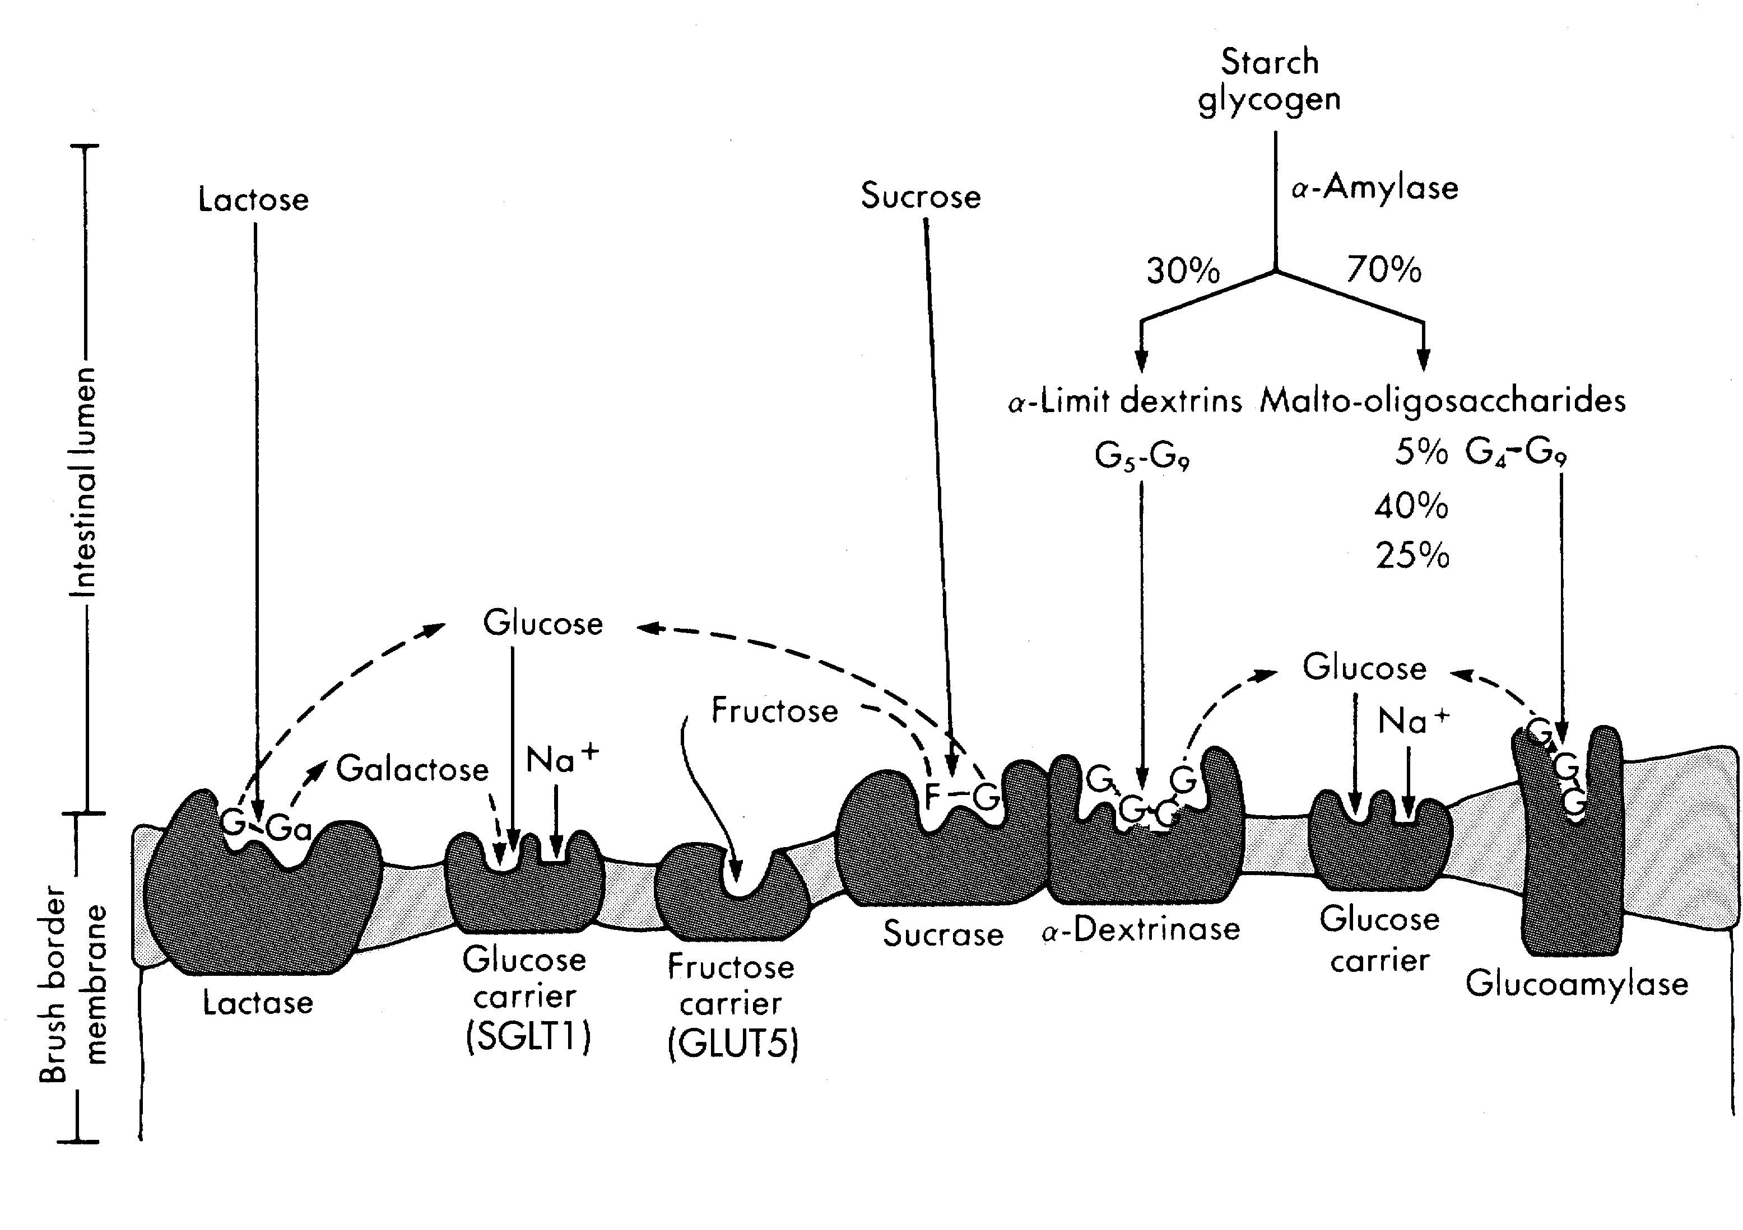
Digestion-absorption coupling
G₂
G₃

Slide 153
Absorption mechanism of monosaccharides
Digestion by brush border enzymes occurs in close vicinity
to monosaccharide transporters.
• Glucose and galactose: SGLT1
absorption via a secondary active (uphill), Na-dependent transport
• Fructose: GLUT5
absorption by facilitated (carrier mediated), Na-independent mechanism

Slide 154
Digestion and absorption of lipids

Slide 155
Lipids in the GI tract:
• exogenous (diet: triglycerides (90%), phospholipids, sterols (e.g. cholesterol), sterol esters)
• endogenous (bile, desquamated intestinal epithelial cells)

Slide 156
Digestion of lipids
Most of the lipids are digested in the small intestine, but also in stomach.
Enzymes for lipid digestion
• lingual lipase (from salivary secretion; break down of mainly medium-chain triglycerides as abundant in milk; optimal pH = 4 --> lipid digestion in the stomach)
• gastric lipase (secreted by chief cells)
• pancreatic lipase = glycerol ester hydrolase (triglycerides)
• pancreatic phospholipase A2 (phospholipids)
• pancreatic cholesterol esterase (cholesterol ester).

Slide 157
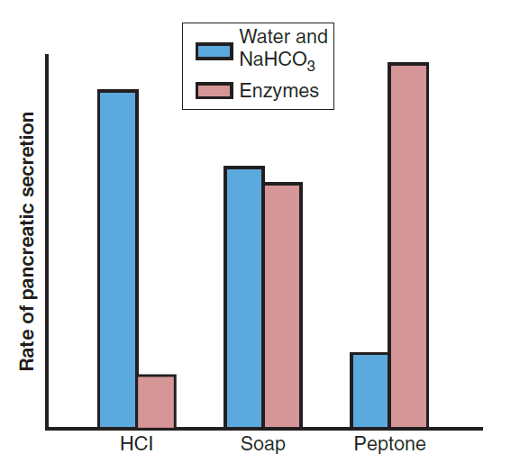
(NaHCO3), water, & enzyme secretion by the pancreas, caused by the presence of acid (HCl), fat (soap), or peptone solutions in the duodenum

Slide 158
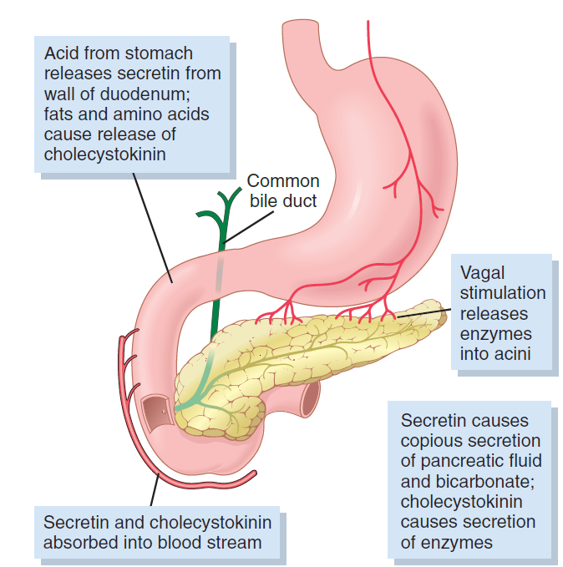
Regulation of pancreatic secretion

Slide 159
Mechanism of lipid absorption
• The intestinal villi are coated by an unstirred water layer which reduces the absorption of the poorly water soluble lipids.

Slide 160
• Emulsification: In the small intestine lipids are emulsified by bile acids (i.e. formation of small droplets of lipids coated with bile acids). Bile salts (bile salts = conjugation of bile acids with taurine or glycine) are polar and water soluble, and function as detergents. Emulsion droplets allow access of the water-soluble lipolytic enzymes by increasing surface area.

Slide 161
• In the enterocytes lipids are bound by cytosolic lipid transport proteins & transported to the smooth endoplasmic reticulum. There TG are reassembled from fatty acids + monoglycerides
• TG together with lecithin, cholesterol & cholesterol ester, are packaged into lipoproteins to form water-soluble chylomicrons (lipid aggregates).
• Transport of lipids to the lymphatic vessels by exocytosis.
Additionally, mainly medium-chain & short-chain fatty acids directly reach the blood stream &are transported bound to serum albumin.

Slide 162
• Micelle formation and lipid absorption:
- At a certain conc. (critical micellar concentration) bile salts aggregate into micelles that incorporate lipid digestion products. Lipids become water soluble by micellar solubilization.
- Lipids diffuse across the unstirred water layer as micelles & are mostly absorbed passively (diffusion) by enterocytes (mainly in the jejunum).
- Absorption is enhanced by Na⁺-dependent long-chain fatty acid transport protein (MVM-FABP=microvillous membrane fatty acid-binding protein) & cholesterol transport protein in the brush border membrane (secondary active and facilitated transport).

Slide 163
• Absorption of bile acids. Bile acids are absorbed in the terminal ileum by Na⁺-dependent 2ndary active transport (mainly conjugated bile acids) & by diffusion (mainly unconjugated bile acids). Bile acids are recirculated to the liver via portal circulation & extracted from portal blood for reuse.

Slide 164
Digestion & absorption of proteins

Slide 165
Proteolytic digestive enzymes
• gastric secretion (G)
• pancreatic secretion (P)
• brush border enzymes (BB)
• cytoplasmic (C)

Slide 166
• Endopeptidase: hydrolyzes internal peptide bonds:
• trypsin (P)
• chymotrypsin (P)
• elastase (P)
• pepsin (G)
• Exopeptidase: hydrolyzes external peptide bonds:
• carboxypeptidase A (P)
• carboxypeptidase B (P)
• aminopeptidase (P, BB, C)
P = pancreas, BB = brush border, C = cytoplasm

Slide 167
Protein digestion
>> Gastric proteolysis:
pepsin is activated by low pH from proenzyme pepsinogen and acts as endopeptidase.
>> Small intestine: major site of protein digestion.
• Luminal protein digestion: Pancreatic proteases are secreted as inactive proenzymes. Chyme in the duodenum stimulates the release of enterokinase (= enteropeptidase) which converts trypsinogen into trypsin (active form). Trypsin itself converts the other proenzymes to active enzymes. Luminal protein digestions produces single amino acids and small peptides (dipeptides, tripeptides and tetrapeptides)
• Brush border peptidases are integral membrane proteins produce single amino acids and smaller peptides from tetrapeptides and larger peptides.
• Intracellular cytoplasmic peptidases break down dipeptides and tripeptides into single amino acids.

Slide 168
Protein absorption:
Products of protein digestion are absorbed as
• amino acids: 7 amino acid transporters in brush border membrane (B&L, table 39-2):
- 5 Na-dependent (absorption occurs via secondary active process by carrier that are energetically coupled to the Na+ concentration gradient across the brush border membrane of intestinal epithelial cells)
- 2 Na-independent (facilitated transport).
• peptides: di- and tripeptides by peptide transporters.
(• proteins: in the newborn of some animal species absorption of immunoglobulins provides an important form of passive immunity).

Slide 169
Amino acid transport across the basolateral membrane
• 5 classes of amino acid transporter at the basolateral membrane (B&L, table 39-3)
- 2 Na-dependent
- 3 Na-independent
• Amino acids are transported in the portal blood

Slide 170
protein
digestion &
absorption

Slide 171
Absorption of vitamins

Slide 172
Vitamins:
Organic substances needed in small quantities for normal metabolic function, growth and maintenance of the body.
• Fat-soluble vitamins: Vitamins A, D, E and K
• Water-soluble vitamins: Vitamins B₁, B₂, B₆, B₁₂, niacin, biotin & folic acid

Slide 173
• Water-soluble vitamins :
Absorption of Vitamin B₁₂
• Vitamin B₁₂ (cobalamin) is bound to a cobalamin binding protein (intrinsic factor) secreted by the parietal cells of the stomach.
• The Vitamin B₁₂-intrinsic factor complex is absorbed in the terminal ileum.
• Transport in the blood of Vitamin B₁₂ by binding to the protein transcobalamin.
• Vitamin B₁₂ is stored in the liver.

Slide 174
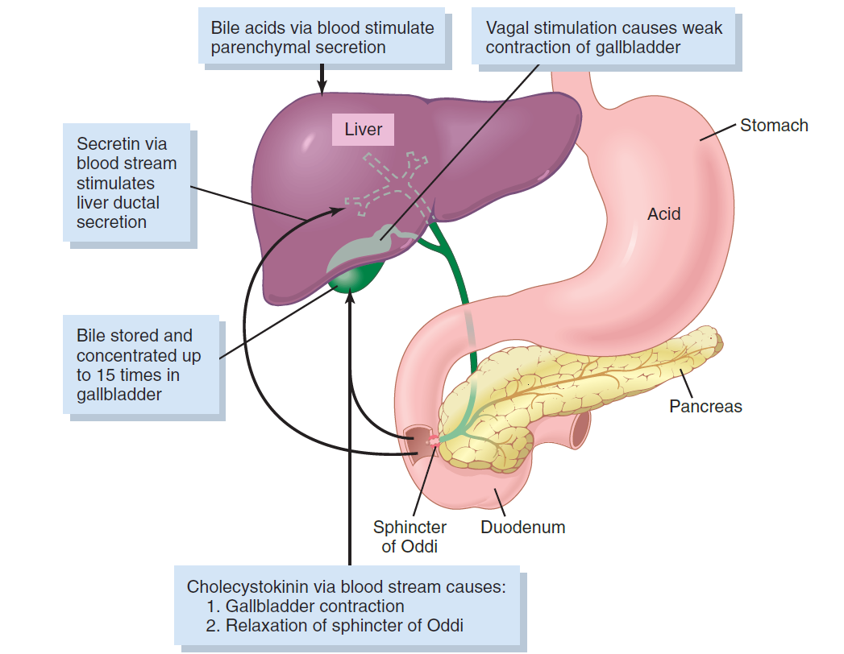
Liver secretion & gallbladder emptying

Slide 175
Composition of Bile
Substance Liver Bile Gallbladder Bile
Water 97.5 g/dl 92 g/dl
Bile salts 1.1 g/dl 6 g/dl
Bilirubin 0.04 g/dl 0.3 g/dl
Cholesterol 0.1 g/dl 0.3 to 0.9 g/dl
Fatty acids 0.12 g/dl 0.3 to 1.2 g/dl
Lecithin 0.04 g/dl 0.3 g/dl
Na+ 145 mEq/L 130 mEq/L
K+ 5 mEq/L 12 mEq/L
Ca++ 5 mEq/L 23 mEq/L
Cl− 100 mEq/L 25 mEq/L
HCO3− 28 mEq/L 10 mEq/L

Slide 176
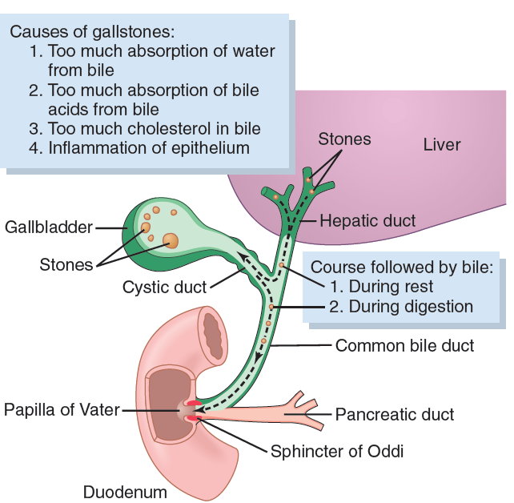
Formation of gallstones

Slide 177
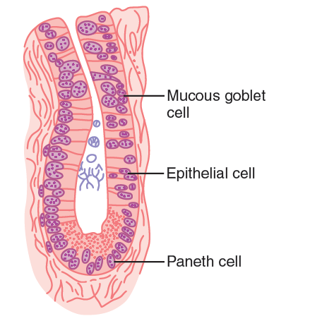
A crypt of Lieberkühn, found in all parts of the small intestine between the villi, which secretes almost pure ECF.

Slide 178

Digestion of carbohydrates.

Slide 179

Digestion of proteins

Slide 180

Digestion of fats

Slide 181

Functional organization of the villus. A, Longitudinal section. B, Cross section showing a basement membrane beneath the epithelial cells and a brush border at the other ends of these cells

Slide 182

Absorption of Na, cL, glucose, &amino acids through the intestinal epithelium. Note also osmotic absorption of water (i.e., water “follows” Na through the epithelial membrane)

Slide 183
Brush border of a gastrointestinal epithelial cell, also showing absorbed pinocytic vesicles, mitochondria, and endoplasmic reticulum lying immediately beneath the brush border. (Courtesy Dr. William Lockwood.)

Slide 184

Neutral connections of the “vomiting center.” This so-called vomiting center includes multiple sensory, motor, & control nuclei mainly in the medullary & pontile reticular formation but also extending into the spinal cord.

Slide 185

Obstruction in different parts of the gastrointestinal tract.

Slide 186

ATP as the central link between energy-producing & energy-utilizing systems of the body. ADP, adenosine diphosphate; Pi, inorganic phosphate

Slide 187

Interconversions of the three major monosaccharides— glucose, fructose, & galactose—in liver cells

Slide 188

Glucokinase or hexokinase
Glucose Glucose- 6-phosphate
+ATP
Chemical reactions of glycogenesis & glycogenolysis, also showing interconversions between blood glucose & liver glycogen. (The phosphatase required for the release of glucose from the cell is present in liver cells but not in most other cells.)

Slide 189

Mitochondrial chemiosmotic mechanism of oxidative phosphorylation for forming large quantities of ATP.
This figure shows the relationship of the oxidative & phosphorylation
steps at the outer & inner membranes of the mitochondrion.
FeS, iron sulfide protein; FMN, flavin mononucleotide; Q, ubiquinone.

Slide 190

Summary of major pathways for metabolism of chylomicrons synthesized in the intestine and very low density lipoprotein (VLDL) synthesized in the liver. Apo B, apolipoprotein B; Apo E, apolipoprotein E; FFA, free fatty acids; IDL, intermediate-density lipoprotein; LDL, low-density lipoprotein; LPL, lipoprotein lipase.

Slide 191

Synthesis of fatty acids

Slide 192

Overall schema for synthesis of TG from glucose

Slide 193

Reversible equilibrium among the tissue proteins, plasma proteins& plasma AA.

Slide 194

Basic structure of a liver lobule, showing the liver cellular plates, the blood vessels, the bile-collecting system, and the lymph flow system composed of the spaces of Disse (perisinusoidal spaces )& the interlobular lymphatics. (Modified from Guyton AC, Taylor AE, Granger
HJ: Circulatory Physiology. Vol 2: Dynamics and Control of the Body
Fluids. Philadelphia: WB Saunders, 1975.)

Slide 195
Fat Metabolism
Although most cells of the body metabolize fat, certain aspects of fat metabolism occur mainly in the liver. In fat metabolism, the liver performs the following specific functions
1. Oxidation of fatty acids to supply energy for other
body functions
2. Synthesis of large quantities of cholesterol, phospholipids,
& most lipoproteins
3. Synthesis of fat from proteins &CHO

Slide 196
Carbohydrate Metabolism
In carbohydrate metabolism, the liver performs the following
functions,
1. Storage of large amounts of glycogen
2. Conversion of galactose & fructose to glucose
3. Gluconeogenesis
4. Formation of many chemical compounds from intermediate products of CHO metabolism

Slide 197
Protein Metabolism
The most important functions of the liver in protein metabolism, are the following:
1. Deamination of amino acids
2. Formation of urea for removal of ammonia from the body fluids
3. Formation of plasma proteins
4. Interconversions of the various AA & synthesis of other compounds from AA

Slide 198

Bilirubin formation & excretion.

Slide 199

The average physiologically available energy in each gram of these three foodstuffs is as follows:

Slide 200

Feedback mechanisms for control of food intake. Stretch receptors in the stomach activate sensory afferent pathways in the 10th nerve & inhibit food intake. Peptide YY (PYY), (CCK), & insulin are GI hormones that are released by the ingestion of food & suppress further feeding. Ghrelin is released by the stomach, esp.during fasting, & stimulates appetite. Leptin is a hormone produced in î amounts by fat cells as they Î in size. It inhibits food intake.

