Slide 1

Microbiology lab 10
Gram-negative Rods
Enterobacteriaceae and Pseudomonas
By:
Assist. Prof. Shaima’a Al-Salihy

Slide 2
Learning objectives:
After this lab. You must be able to:
Describe microscopic morphology and cultural biochemical characteristics of each member in this family.
List infections caused by each of these members.
Differentiate each member of this family from each other.
Discuss principles of biochemical tests of each member in this family.
Predict enterics causative agents causing clinical cases.

Slide 3
Gram-Negative bacilli
Large group of diverse organisms, they are divided to:
Gram-Negative Rods related to gastrointestinal tract.
Gram-Negative Rods related to respiratory tract.
Gram-Negative Rods related to animal source.

Slide 4
Gram-Negative Rods related to gastrointestinal tract
Enterobacteriaceae and Pseudomonas
Enterobacteriaceae is a large family of bacteria commonly referred to as the fermentative, gram negative, enteric bacilli, indicating that they are gram-negative rods which can ferment sugars.
To differentiate them from non-fermentative , gram-negative rods such as Pseudomonas.

Slide 5
Clinical Significance of Enterics
Enterics are ubiquitous in nature, some live in water, soil and sewage and most are present in the intestinal tract of animals and humans as commensal flora; therefore, they are sometimes call “fecal coliforms”
Based on clinical infections produced, enterics are divided into two categories:
  True pathogen - Salmonella, Shigella, Yersinia sp and some strains of E. coli
  Opportunistic pathogens – normally part of the intestinal flora that may produce infection outside the intestine

Slide 6
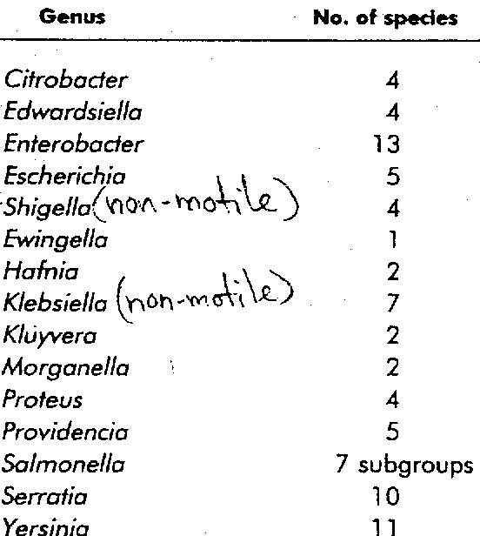
Family Enterobacteriaceae
Certain E .coli strains can be considered true pathogens
True pathogen
(nonmotile)
(nonmotile)
True pathogen
True pathogen
(nonmotile)

Slide 7
Important features
Gram-negative non spore forming rods.
Most Enterobacteriaceae are motile, with the exception of the common isolates Klebsiella, Shigella, and Yersinia, the motile strains possess peritrichous flagella.
Many Enterobacteriaceae also possess virulence factors: fimbriae, sex Pilli, capsule, and endotoxin.
Facultative anaerobes.
All members ferment glucose
All members reduce nitrate to nitrite.
All members are catalase positive and oxidase negative.

Slide 8
Colonial Morphology
Ability to ferment lactose:
  lactose-fermenting strains *pink-purple colonies* (e.g., Escherichia, Klebsiella, Enterobacter, Citrobacter )
  Non lactose-fermenting strains * colorless colonies* (e.g., Proteus, Salmonella, Shigella, and Yersinia spp).
  Delayed lactose fermenter (DLF) (e.g., Morganella, Providencia, Serratia, Edwardsiella, Erwinia, Hafnia ).
  Ability to grow on a large number of selective and differential media:
Eosin-Methylene blue (EMB) agar: contains bile salt and dyes eosin and methylene blue, inhibit gram-positive bacteria.
Hektoen Enteric agar(HE): contains high concentration of bile salt and dyes bromothymol blue and acid fuchsin.
Xylose Lysine Deoxycholate (XLD) agar contains: sodium desoxycholate inhibits the growth of gram positive bacteria.
Most have similar colonial morphology in blood agar plate.
  moist, smooth, gray colonies and some strains are beta hemolytic.

Slide 9
Laboratory diagnosis:
Specimen: site of origin must be considered
Gram-stain: not of value
Culture: blood agar and a selective-differential medium such as MacConkey’s agar
Lactose-fermenter: pink colonies
Non lactose fermenter: colorless colonies.
For stool: highly selective media such as Hekton- enteric, SS agar is used along with Mac.

Slide 10
Laboratory diagnosis:
Biochemical tests:
IMViC test
TSI tests
API test
Urease test
Oxidase test
Serological test

Slide 11
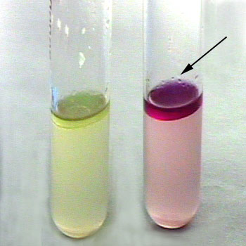
IMViC Test
Indole, Methyl red, Voges-ProsKauer, Citrate tests
  Indole test:
  Principle
  Certain microorganisms can metabolize tryptophan by tryptophanase to pyruvic acid, indole and ammonia.
  The presence of indole is detected by addition of Kovac's reagent.
Tryptophane
Tryptophanase
Indole + Pyurvic acid + NH3
Kovac’s Reagent
Negative
Klebsiella
Positive
E. coli
Red color ring
  Method:
  Inoculate tryptone water with the tested microorganism, Incubate at 37°C for 24 hours
  After incubation interval, add 1 ml Kovac’s reagent , shake the tube gently and read immediately

Slide 12
Methyl Red-Voges Proskauer (MR-VP) Tests
Principle: depend on the patterns of glucose metabolism
Glucose
Acidic pathway
Or
Neutral pathway
Mixed acids ⬇ pH less than 4.4
Acetyl methyl carbinol
(ACETONE)
Barrit’s A
Barrit;s B
Methyl Red
indicator
MR positive
E. coli
VP positive
Klebsiella
Pink color
Red color

Slide 13
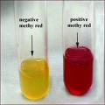
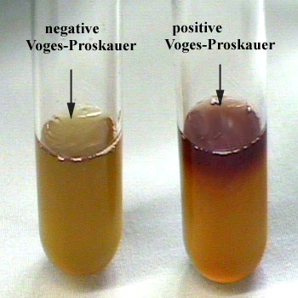
Methods:
Inoculate the tested organism into tubes of MRVP broth, incubate the tubes at 37°C for 24-48 hours
AFTER INCUBATION:
      For methyl red: Add 6-8 drops of methyl red reagent.
      For Voges-Proskauer: Add 6 drops of Barritt's A (α-naphthol), and 2 drops of Barritt's B (40% KOH), mix
      Let, undisturbed, for at least 1 hour, then note color change.
Methyl Red test
Voges-Proskauer test

Slide 14
Citrate Utilization Test
Principle: citrate utilized by bacteria produces citrase enzyme.
Citrate
Pyruvate
CO2 + Na + H2O
Na₂CO₃
Alkaline,↑pH
Simmon’s Citrate media
Contains Citrate as a sole of C source
And ammonium salts as a source of N
Blue color
Bromothymol blue
Positive test

Slide 15
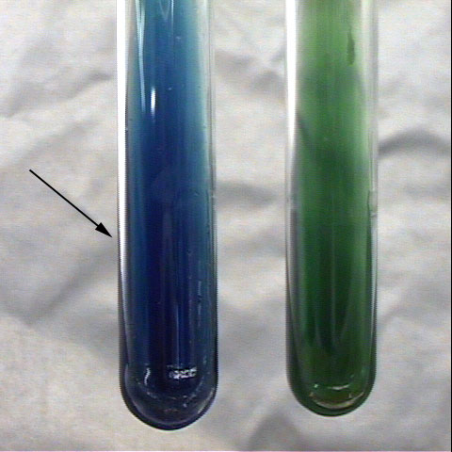
Method:
Streak a Simmon’s citrate agar slant with the organism and incubate at 37°C for 24 hours. Growth on the medium is accompanied by a rise in pH to change the medium (containing bromothymol blue indicator) from its initial green color to deep blue.
Positive
Klebsiella
Negative
E. coli
Citrate utilization test

Slide 16
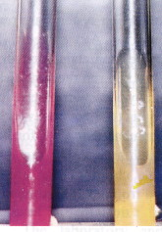
Urease Test
Principle:
Urea agar contains urea and phenol red, Urease is an enzyme that catalyzes the conversion of urea to CO2 and NH3
In solution reacts with CO2 to produce ammonium hydroxide, a strong base which ↑ pH of the medium.
↑ in the pH causes phenol red to turn a deep pink.
Urease
H2O
Pink
Positive test
Urea
CO2 + NH3
NH4OH
↑ in pH
Phenol Red
Method:
Streak a urea agar tube with the organism incubate at 37°C for 24 h
If color of medium turns from yellow to pink indicates positive test.

Slide 17

Triple Sugar Iron (TSI) Agar
TSI contains:
  Three different types of sugars
    Glucose, Lactose, Sucrose
    Phenol red (acidic: (Yellow)
Principle:
  To determine the ability of an organism to utilize a specific carbohydrate incorporated into a basal growth medium, with or without the production of gas, along with the determination of possible hydrogen sulphide production.
Method:
  Inoculate TSI medium with an organism by inoculating needle by stabbing the butt and streaking the slant incubate at 37°C for 24 hours.

Slide 18
H2S Production
Principle:
  Bacteria use the enzyme cysteine disulfurase to hydrolyze the amino acid cysteine, forming hydrogen sulfide as end product.
  cysteine disulfurase
  Cysteine NH3 +pyruvic acid + H2S
  H2S + FeSO4 FeS + H2SO4

Slide 19
Oxidation-fermentation test
Principle:
The oxidative-fermentative test determines if certain gram-negative rods metabolize glucose by fermentation or aerobic respiration (oxidatively).
Certain non fermenting gram-negative bacteria metabolize glucose using aerobic respiration and therefore only produce a small amount of weak acids during glycolysis and Krebs cycle.
This test used to differentiated between pseudomonas and other species of enterobacteriaceae because pseudomonas obligatory aerobic.

Slide 20
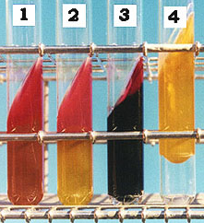
Result
Example | Result | Reaction on TSI
 |  | H₂S | Butt color | Slant color
Non fermenter e.g. Pseudomonas | Alk/Alk/- (No action on sugars) | Negative | Red | Red
LNF e.g. Shigella | Alk/A/- (Glucose fermented without H₂S) | Negative | yellow | Red
LNF e.g. Salmonella & Proteus | Alk/A/+ (Glucose fermented with H₂S) | Positive black in butt | yellow | Red
LF e.g. E. coli, Klebsiella, Enterobacter | A/A/- (three sugars are fermented) | Negative | Yellow | Yellow

Slide 21
Escherichia coli
  *One of the most predominant intestinal flora, causes wide range of infections including: UTI, gastrointestinal infection, meningitis, wound infection and bacteremia.
  **Ferments lactose.
  Have characteristic metallic sheen on EMB.
  Positive in indole and methyl red tests
  Negative in Voges-Proskauer and Citrate tests
  Does NOT produce H₂S
  Usually motile.
  IMViC test: + + - -
  TSI test: A/A/ -

Slide 22
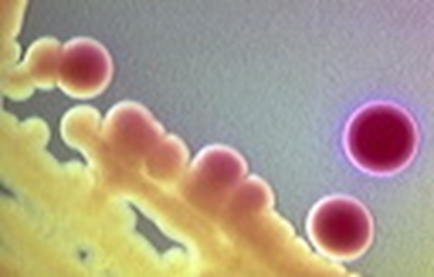
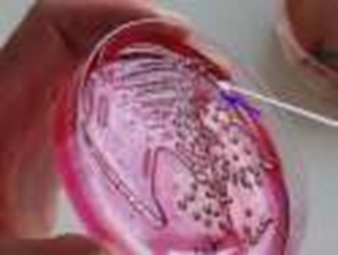
Klebsiella pneumoniae
  Usually found in intestinal tract and frequent cause of nosocomial pneumonia.
  Ferments lactose.
  Possess a polysaccharide capsule makes the colonies mucoid and moist.
  Negative in indole and methyl red tests
  Positive in Voges-Proskauer and Citrate tests
  Does NOT produce H₂S
  Non motile.
  IMViC test: - - + +
  TSI test: A/A/ -

Slide 23
Enterobacter
  The most clinically important species are: E. cloacae and E. aerogenes
  Isolated from wounds, urine, blood and CSF
  Ferments lactose. (Colonies resemble Klebsiella)
  Motile ( differ from Klebsiella)
  Negative in indole and methyl red tests
  Positive in Voges-Proskauer and Citrate tests
  Urease test positive
  IMViC test: - - + +
  TSI test: A/A/ -

Slide 24
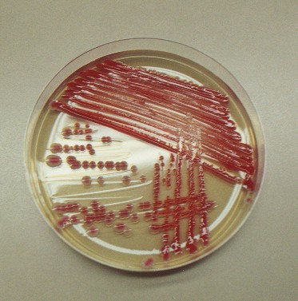
Serratia marcescens
  Causes nosocomial UTI, and respiratory tract infections.
  Ferments lactose slowly.
  Motile
  Produce characteristic reddish-pink color on nutrient agar when cultured on room temp.
  S. marscens on nutrient agar →

Slide 25
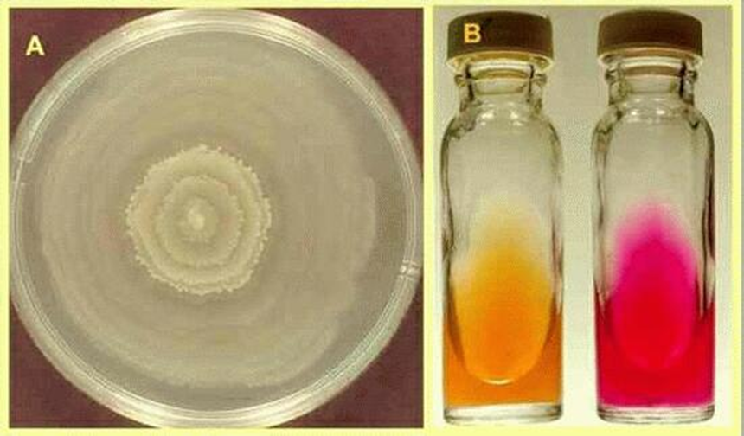
Proteus
  The most clinically important species are: P. mirabilis and P. vulgaris
  Isolated from urine, wound, ear and bacteremic infections.
  Do not ferment lactose.
  Motile (produce swarming on non selective media).
  Negative in indole and Voges-Proskauer tests
  Positive in methyl red and Citrate tests
  Produce H₂S
  Urease test positive
  IMViC test: - + - +
  TSI test: Alk/A/ +
Notes:
colorless on MacConkey’s agar

Slide 26
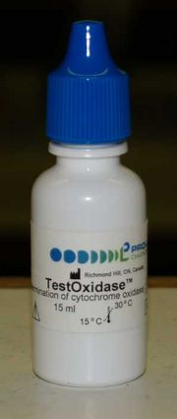
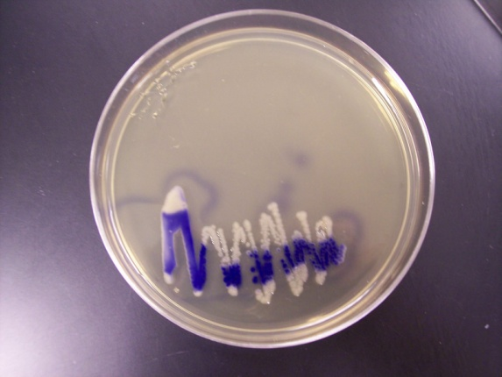
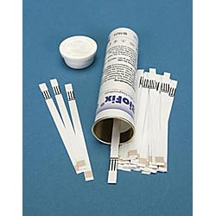
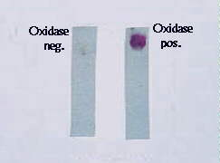
Pseudomonas aeroginosa
Non -fermenter gram-negative bacilli.
Strict aerobes (acquire energy by oxidation not by fermentation)
Oxidase-positive.
Some Pseudomonads are motile by means of polar flagella.
produces a characteristic fruity or sweety grape juice-like aroma.
Oxidase test

Slide 27
Commonly habitat soil and water and found in small numbers in human feces.
Have the ability to grow in lower nutrient environment, and have the ability to grow in disinfectant, so they persist in hospital environment.
It is especially dangerous to the debilitated or compromised patient (burn and cystic fibrosis), it cause a nosocomial UTIs, wound infections, pneumonia, and septicemia.

Slide 28
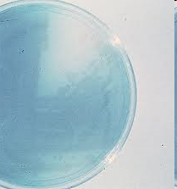
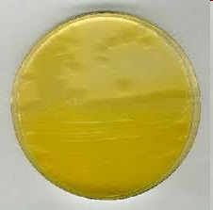
- Produce two characteristic pigments, diffused in agar:
Pyocyanin: color the pus in wound (blue)
Pyoviridin (fluorescein): fluoresces under UV light (yellow green), help in early diagnosis of skin infection.
pyocyanin
pyoviridin

Slide 29
Summary of morphology, cultural characteristics,
and biochemical reactions of Enterobacteriaceae
EMB | SS | Mac | O/F | Nitrate reductase | Oxidase | Gram stain
Metallic sheen | LF | LF | O+/F+ | +ve | -ve | -ve rod | E. coli
Dark | LF | LF | O+/F+ | +ve | -ve | -ve rods | Citrobacter
Dark | LF | LF | O+/F+ | +ve | -ve | -ve rods | Klebsiella
Dark | LF | LF | O+/F+ | +ve | -ve | -ve rods | Enterobacter
Colorless | NLF/H2S | NLF | O+/F+ | +ve | -ve | -ve rods | Salmonella
Colorless | NLF | NLF | O+/F+ | +ve | -ve | -ve rods | Shigella
Colorless | NLF/H2S | NLF | O+/F+ | +ve | -ve | -ve rods | Proteus

Slide 30
Summary of morphology, cultural characteristics,
and biochemical reactions of Enterobacteriaceae
Motility | Urease | Citrate | VP | MR | Indole | TSI
Motile | -ve | -ve | -ve | +ve | +ve | A/A/- | E. coli
Motile | -ve | +ve | -ve | +ve | +ve | A/A/- | Citrobacter freundii
Non motile | +ve | +ve | +ve | -ve | -ve | A/A/- | Klebsiella pneumoniae
Motile | +ve | +ve | +ve | -ve | -ve | A/A/- | Enterobacter cloacae
Motile | -ve | +ve | -ve | +ve | -ve | Alk/A/+ | Salmonella typhi
Non motile | -ve | -ve | -ve | +ve | -ve | Alk/A/- | Shigella boydii
Motile Swarwing | +ve | +ve | -ve | +ve | -ve | Alk/A/+ | Proteus mirabilis

Slide 31
Identification of Gram's -ve rods
Oxidase Test
Negative
Positive
Enterobacteriaceae
Pseudomonas
MacConkey’s agar& TSI
O/F test: O⁺/F⁻
Nitrate test: +ve further
reduction to N₂
Pink colonies on MacConkey
& acidic butt and slant on TSI
colorless colonies on MacConkey
& acidic butt alkaline slant onTSI
Growth on cetrimide agar:
Pale colonies with green
pigmentation
Lactose fermenter
Lactose non-fermenter
IMV_{i}C test & EMB
H₂S production
(blacking in TSI)
No H₂S production
(no blacking in TSI)
IMV_{i}C
++ - -
& black colonies with metalic shines on EMB
IMV_{i}C
- - ++
Urease production
Shigella
+ve
-ve
Motility
SS agar
Not motile
Motile
E.coli
Proteus
colorless colonies with black centers
Klebsiella
Enterobacter
Salmonella

Slide 32
Thank you for attention

