Slide 1
Practical bacteriology Lab 12
Vibrio, Compylobacter
and
Helicobacter
By:
Lecturer Shiama'a Al-Salihy

Slide 2
The most important species are:
V. cholerae
Campylobacter jejuni & C. coli
Helicobacter pylori

Slide 3
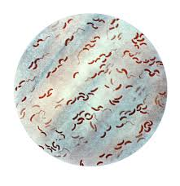
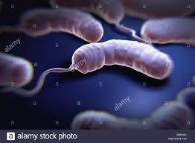
V. cholerae
General characteristics:
Causative agent of cholera (watery diarrhea)
One of the most common bacteria in surface waters worldwide.
Facultative aerobic
Curved comma-shaped rods.
Motile with polar flagellum.
pH range 7.0 - 9.0
Oxidase positive

Slide 4
Vibrio typing
>200 serogroups based on somatic O-antigen
O1 and O139 serogroups are responsible for epidemic cholera
O1 serogroup subdivided into
Two biotypes: El Tor and classical
Three serotypes: Ogawa, Inaba, Hikojima
Note: biotypes are based on differences in biochemical reactions, whereas serotypes are based on antigenic differences).
Non-cholera vibrio (NCV) or non-agglutinating vibrios (NAG) or non-O1 vibrio cholerae)

Slide 5
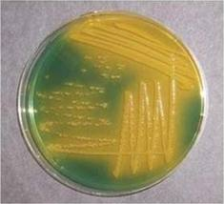
Lab. diagnosis
During epidemic, a clinical judgment is decisive.
Specimens: Rice-water stools (Colorless, Odorless, Speckled with mucus)
Culture:
Enrichment medium: Alkaline peptone water
Selective medium: TCBS grow as yellow colonies
Serology test: anti O group 1 or group 139 antisera.

Slide 6
Treatment:
Fluid replacement is essential
Tetracycline. However antibiotic treatment is unnecessary

Slide 7
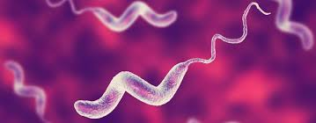
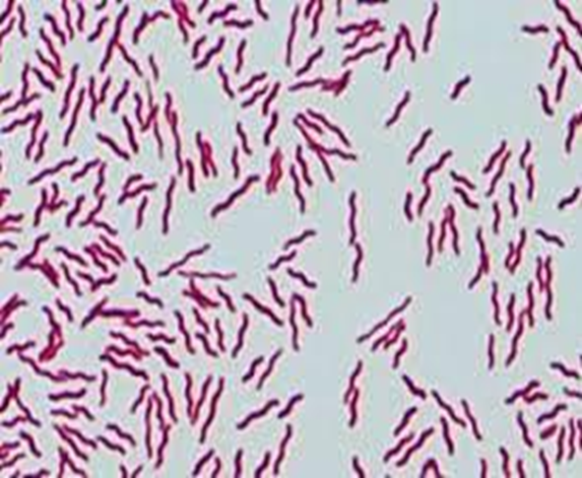
C. jejuni & C. coli
Causing gastroenteritis.
Rods with comma, S or “gull-wing” shape.
Motile (darting motility) with polar flagellum.
Microaerophilic, grow well in 42°C
Oxidase positive.
Notes:
resembles the genus Vibrio in being motile by means of polar flagella and in being curved Gram-negative bacilli and oxidase positive. They, however, differ from vibrios (a) in being microaerophilic, (b) not fermenting carbohydrates.

Slide 8
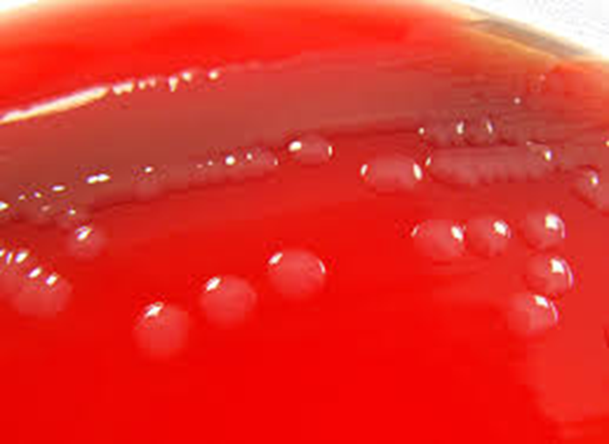
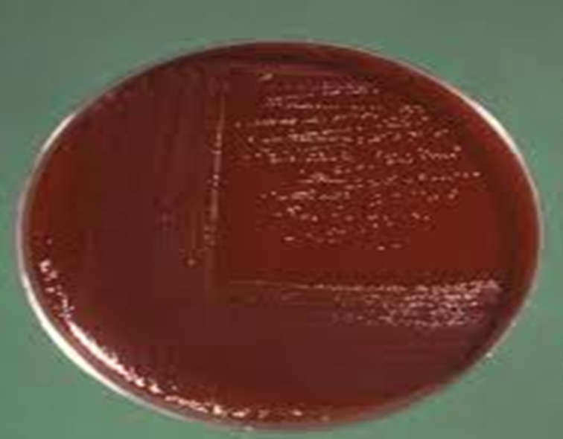
Lab. Diagnosis:
Specimens: diarrhea stool
Culture: microaerophilic (5% O2 +10% CO2) by using anaerobic jar and gas generating pack.
Skirrow's medium (with vancomycin, polymyxin B, and trimethoprim) at 42°C
Colombia agar
Colombia agar
Skirrow's medium

Slide 9
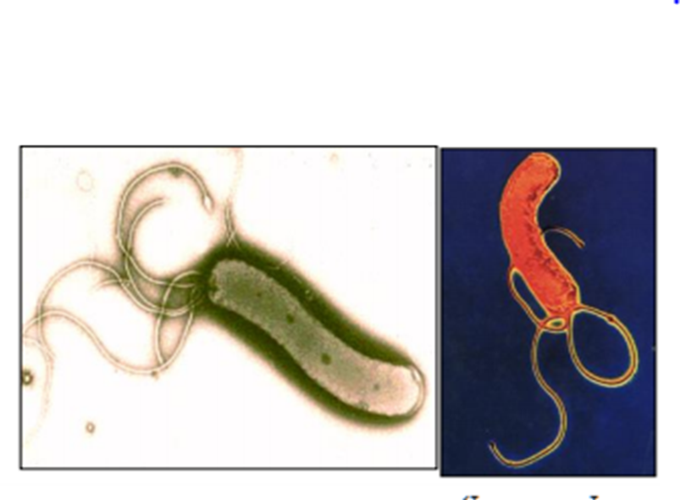
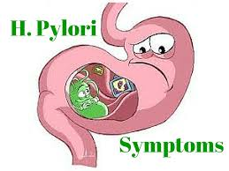
H. pylori
Causing gastritis and peptic ulcer, risk factor for gastric carcinoma, linked to mucosal-associated lymphoid tissue (MALT) lymphoma.
Curved Gram-negative rods.

Slide 10
Lab diagnosis:
Specimen: gastric biopsy by gastroscopy, can be used for (histological examination, gram-staining and culturing, blood for serology.) and stool.
Smear: Giemsa or special silver stain
Culture: on Skirrow’s medium ( containing Vancomycin, polymyxin B and trimethoprime, chocolate incubation at 37C for 3-6 days. Microaerophilic (5% O2+10% CO2)
Urea breath test: radio-labelled urea is ingested. Urease will cleave the ingested urea, radiolabeled CO2 is evolved and radioactivity is detected in the breath

Slide 11
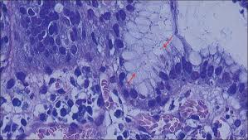
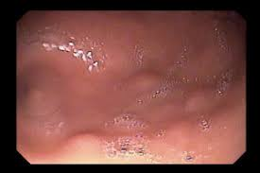
Treatment:
Treatment of duodenal ulcers with:
antibiotics eg, amoxicillin, and metronidazole
Bismoth salts

Slide 13
Practical bacteriology Lab 12
Vibrio, Compylobacter
and
Helicobacter
By:
Lecturer Shiama'a Al-Salihy

Slide 14
The most important species are:
V. cholerae
Campylobacter jejuni & C. coli
Helicobacter pylori

Slide 15
V. cholerae
General characteristics:
Causative agent of cholera (watery diarrhea)
One of the most common bacteria in surface waters worldwide.
Facultative areobic
Curved comma-shaped rods.
Motile with polar flagellum.
pH range 7.0 - 9.0
Oxidase positive

Slide 16
Vibrio typing
>200 serogroups based on somatic O-antigen
O1 and O139 serogroups are responsible for epidemic cholera
O1 serogroup subdivided into
Two biotypes: El Tor and classical
Three serotypes: Ogawa, Inaba, Hikojima
Note: biotypes are based on differences in biochemical reactions, whereas serotypes are based on antigenic differences).
Non-cholera vibrio (NCV) or non-agglutinating vibrios (NAG) or non-O1 vibrio cholerae)

Slide 17
Lab. diagnosis
During epidemic, a clinical judgment is decisive.
Specimens: Rice-water stools (Colorless, Odorless, Speckled with mucus)
Culture:
Enrichment medium: Alkaline peptone water
Selective medium: TCBS grow as yellow colonies
Serology test: anti O group 1 or group 139 antisera.

Slide 18
Treatment:
Fluid replacement is essential
Tetracycline. However antibiotic treatment is unnecessary

Slide 19
C. jejuni & C. coli
Causing gastroenteritis.
Rods with comma, S or “gull-wing” shape.
Motile with polar flagellum.
Grow well in 42°C
Oxidase positive

Slide 20
Lab. Diagnosis:
Specimens: diarrhea stool
Culture: microaerophilic (5% O2 +10% CO2) by using anaerobic jar and gas generating pack.
Skirrow's medium (with vancomycin, polymyxin B, and trimethoprim) at 42°C
Colombia agar
Colombia agar
Skirrow's medium

Slide 21
H. pylori
Causing gastritis and peptic ulcer, risk factor for gastric carcinoma, linked to mucosal-associated lymphoid tissue (MALT) lymphoma.
Curved Gram-negative rods.

Slide 22
Lab diagnosis:
Specimen: gastric biopsy by gastroscopy, can be used for (histological examination, gram-staining and culturing, blood for serology.) and stool.
Smear: Giemsa or special silver stain
Culture: on Skirrow’s medium ( containing Vancomycin, polymyxin B and trimethoprime, chocolate incubation at 37C for 3-6 days. Microaerophilic (5% O2+10% CO2)
Urea breath test: radio-labelled urea is ingested. Urease will cleave the ingested urea, radiolabeled CO2 is evolved and radioactivity is detected in the breath

Slide 23
Treatment:
Treatment of duodenal ulcers with:
antibiotics eg, amoxicillin, and metronidazole
Bismoth salts

