Slide 1
Practical bacteriology Lab 13
Gram-negative rods related to Respiratory tract
And
Zoonotic infection
By:
Lecturer Shiama'a Al-Salihy

Slide 2
Haemophilus, Bordetella
and
Legionella

Slide 3
There are three medically important genera of gram-negative rods typically related to respiratory tract, namely:
Haemophilus influenzae
Bordetella pertussis

Slide 4
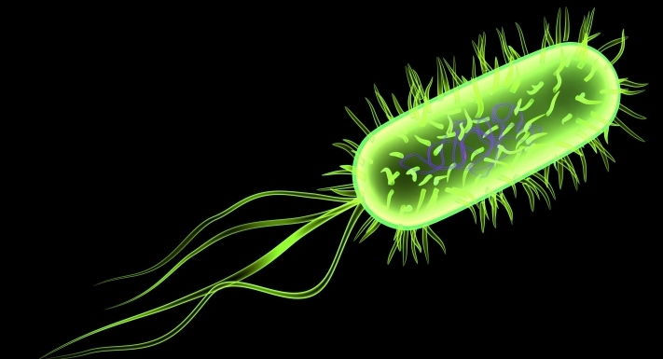
Gram-negative small rods inhabit the mucous membranes of URT, vagina, and intestinal tract. Has been found to be part of salivary microbiome.
Haemophilus
Most important species: - H. influenzae - H. ducreyi:

Slide 5
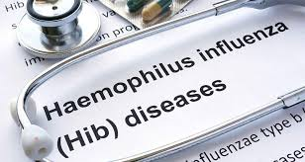
H. influenzae:
It is an important cause of upper respiratory tract infections, sepsis in children, and meningitis in unvaccinated young children > 2 months, and pneumonia in adults particularly those with chronic obstructive lung disease.

Slide 6
H. influenzae:
Important properties :
Small, gram-negative coccobacilli.
Have polysaccharide capsule (virulent strains).
Divided into serogroups from a-f on the basis of antigenic polysaccharide capsule, type b causes most of severe, invasive diseases, some strains have no capsule can cause infections but are non invasive.
Produce IgA protease, and have pili.
Cultivation in the laboratory requires the addition of two components; heme (factors X) and NAD (factor V).
Notes:
NAD= Nicotineamide Adenine Dinucleotide

Slide 7
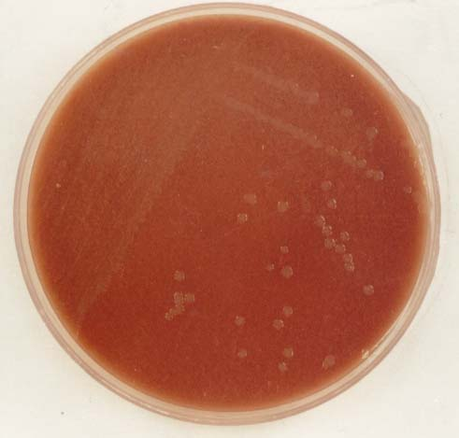
Laboratory Diagnosis:
Specimens: throat and conjunctival swabs, sputum, sinus drainage, CSF, blood …etc.
Microscopy: direct smear of the specimen may be useful for CSF and eye exudates.
Culture: on heated blood (chocolate) agar or with factors X and V, under 10% CO₂ at 37° C for 24 hrs. Organism that grows only in the presence of both growth factors is presumptively identified as H. influenzae, others do not require both of them such as H. parainfluenzae.
H. influenzae on chocolate agar
Notes:
In samples collected from URT, the culture can be turned to be selective for Haemophilus by adding penicillin and bacitracin to media
Filde’s agar: transparent medium having digested blood, without additives it’s moderate selective for H. influenzae

Slide 8
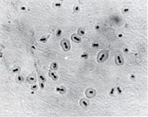
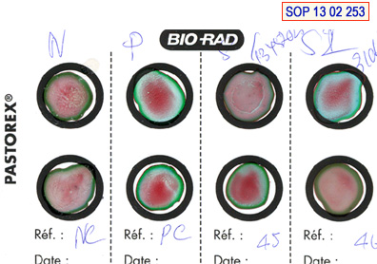
Capsular swelling: definitive identification can be made with capsular swelling reaction (quellung reaction).
Latex agglutination test: which detect the capsular polysaccharide (used the latex suspensions for detection of bacterial antigens in (CSF) by a rapid slide agglutination technique).
quellung reaction
latex

Slide 9
Satillitism: staphylococci when growing on a chocolate agar plate secrete NAD (factor V) into the surrounding medium, Haemophilus spp. need this factor grow in the zone immediately around the staphylococci, but not elsewhere on the plate.

Slide 10
Treatment: treatment of choice for meningitis or other serious systemic infections is ceftriaxone. In case of URT infection treatment of choice is amoxicillin-clavulanate or trimethoprim-sulfamethoxazole.
Prevention: vaccine contains the capsular polysaccharide of H. influenzae type b conjugated to diphtheria toxoid or other carrier protein.
Prophylaxis: Rifampin.

Slide 11
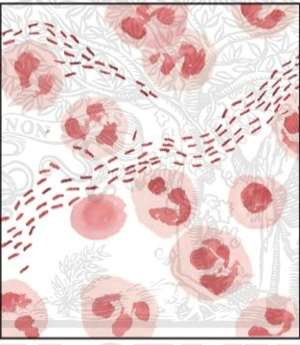
H. ducreyi:
is a sexually transmitted pathogen causes chancroid (soft chancre).
Lab. Diagnosis:
isolating the bacteria from the ulcer or from pus aspirated from a lymph node.
It require chocolate agar supplemented only with X factor (heme).
Gram stain: school of fish.
Treatment:
Erythromycin, Azethromycin,
or ceftriaxone
Notes:
Major cause of genital ulceration in developing countries characterized by a painful sores on the genitalia.

Slide 12
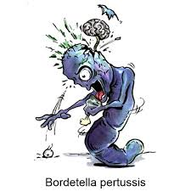
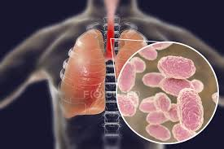
Bordetella pertussis: The causative agent of very contagious disease called whooping cough (pertussis).*
Notes:
Whooping cough disease has three stages: (a) catarrhal stage (resemble URTI), (b) paroxysmal stage, and (c) convalescent
stage.

Slide 13
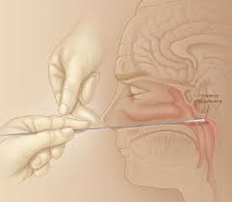
Important properties:
Small, G-ve, coccobacilli, encapsulated, resemble Haemophilus.
It is pathogenic only for human, transmitted by airborne droplets during severe coughing episodes.

Slide 14
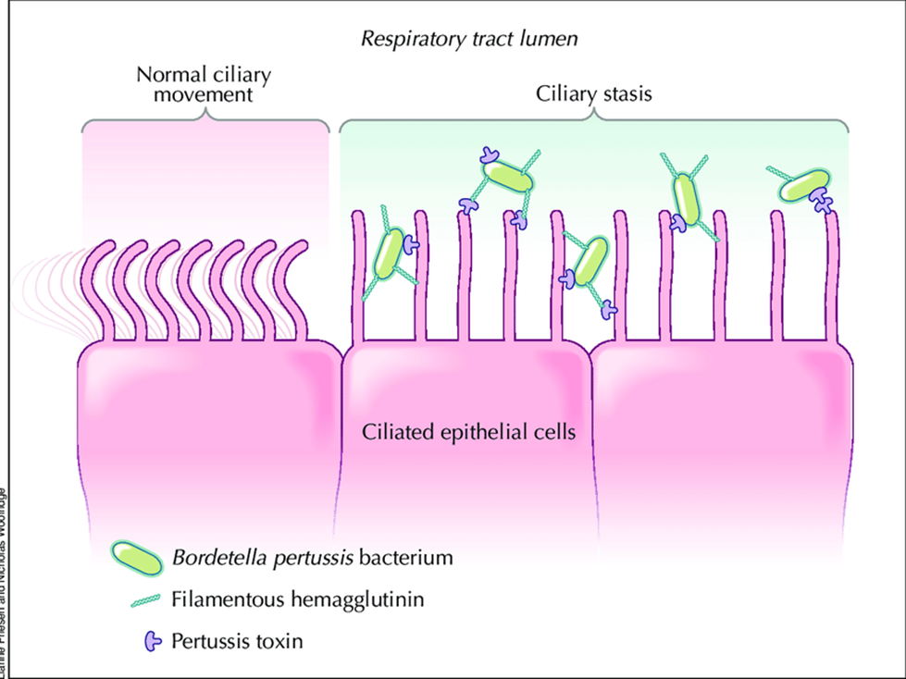
Important properties:
Attached to the ciliated epithelium of upper respiratory tract but don’t invade the underlying tissues. It produces exotoxins that contribute to its pathogenicity.
Very fastidious bacteria grow best on special media.
Notes:
Bacteria posses Haemagglutinin which is an important virulence factor mediates attachment of bacteria to the ciliated epithelial cells of the respiratory tract. In addition to pertussis toxin which mediate the attachment of bacteria also.

Slide 15
Laboratory diagnosis:
Specimens: nasopharyngeal swab taken during the catarrhal and early paroxysmal stage.
Microscopy: Gram stain or direct fluorescent antibody staining.
Culture: on two special media Bordet – Gengou (BG) medium (cough plate) which is enriched with high percentage of blood (15 – 25 %) of defibrinated sheep blood, and Regan-Lowe (RL) which consists of charcoal, defibrinated horse blood and antimicrobial agent; Cephalexin to inhibit growth of normal respiratory flora.

Slide 16
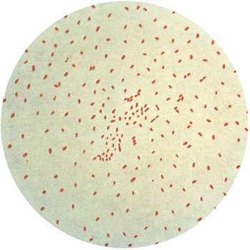
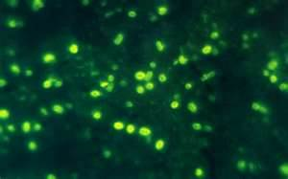
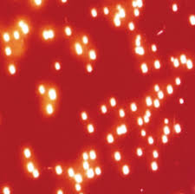
Specific identification is made either by agglutination with specific antiserum or by fluorescent – antibody staining.
PCR: highly specific and sensitive
Gram stain
fluorescent – antibody
staining .
Bordet – Gengou medium

Slide 17
Bordet-Gengou agar
Notes:
Bacterial colonies of B. pertussis on Bordet-Gengou agar appear as bisected pearls or mercury drops. A hazy zone of hemolysis is present around the colonies.

Slide 18
Treatment:
Erythromycin reduces number of microorganisms in throat and decreases the risk of secondary complications.
Prevention: there are two vaccines available:
Cellular vaccine containing purified proteins from the organism. The main immunogen is genetically inactivated pertussis toxin (toxoid). It is the first vaccine contains genetically inactivated toxoid.
Killed vaccine containing inactivated B. pertussis organism.
The pertussis vaccine is usually given combined with diphtheria and tetanus toxoids.

Slide 19
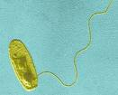
Legionella:
cause of Pontiac fever (mild flulike infection) and atypical pneumonia (caused by a causative agent cannot be isolated on ordinary laboratory media or when its clinical picture does not resemble that of typical pneumococcal pneumonia) in community and hospitalized immunocompromised patients.

Slide 20
There are several species of Legionella:
Legionella pneumophilia: the most important one causes approximately 90% of pneumonia caused by Legionellae.
Legionella micdadie
Legionella bozemanii both sometimes cause pneumonia .

Slide 21
Important properties :
Gram negative rods, stain faintly with Gram stain.
Rods in lung biopsy sections do not stain with hematoxylin and eosin procedure, therefore special methods are used.
Do not grow on ordinary media, they require high concentration of iron and cysteine.
Associated with environmental water sources such as air conditioners, cooler towers.
transmitted by inhalation of aerosols.

Slide 22
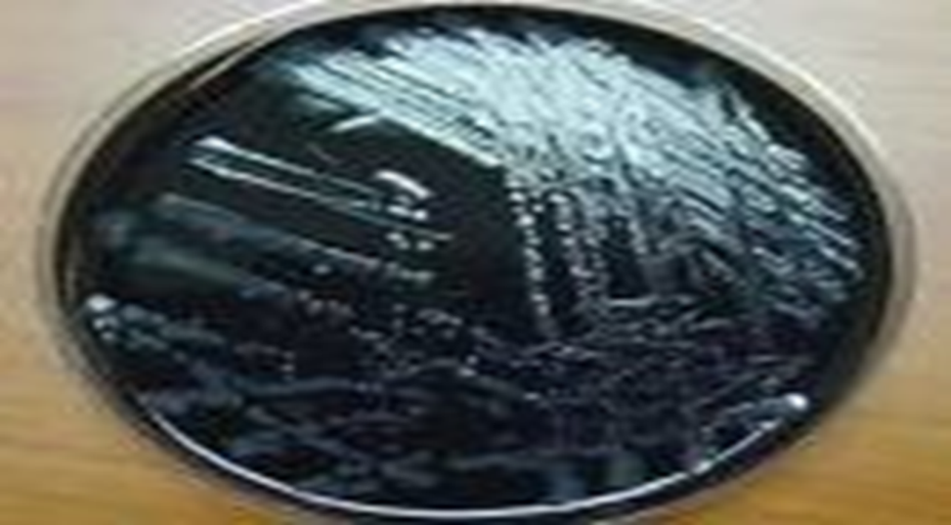
Laboratory diagnosis:
Specimens: bronchial washing, pleural fluid, lung biopsy and blood.
Culture: On Buffered Charcoal Yeast Extract (BCYE) supplemented with iron and cysteine, at pH 6.9, 35° C & humidity 90%. Grow slowly, colonies appear after 3 days-2 weeks colonies vary in color from colorless to pink or blue and translucent.
Notes:
Gram stain of sputum has no value because it reveals many neutrophils but no bacteria

Slide 23
detection of L. pneumophilia antigens in the urine is a rapid means of making a diagnosis by immunological method
Legionella antigens in infected lung biopsy by using fluorescent antibody staining.
Treatment: azithromycin or erythromycin and certain fluoroquinolones such as levofloxacin are the drug of choice.

Slide 24
4-diagnosis usually depend on a significant increase in antibody titer in convalescent phase serum by the indirect immuno-fluorescent assay.
5- detection of L. pneumophilia antigens in the urine is a rapid means of making a diagnosis by immunological method.
6- Legionella antigens in infected lung biopsy by using fluorescent antibody staining.

Slide 25
Thank you
for
your attention

Slide 26
Brucella and Yersinia

Slide 27
Learning objectives
After this lecture you will be able to:
Know the general characteristics of Brucella and Yersinia.
Understand the growth characteristics of these bacteria.
List the clinical findings of these bacteria.
List the diagnosis methods used in diagnosis of these bacteria infection
Identify cases infected with these bacteria.

Slide 28
Brucella
The causative agent of Malta fever (undulating fever, Mediterranean fever) or called brucellosis. Which considered an important zoonosis.
Brucella are intracellular parasite of animal and human. And considered
There are different species of Brucella
Brucella abortus
B. melitensis
B. suis
B. canis

Slide 29
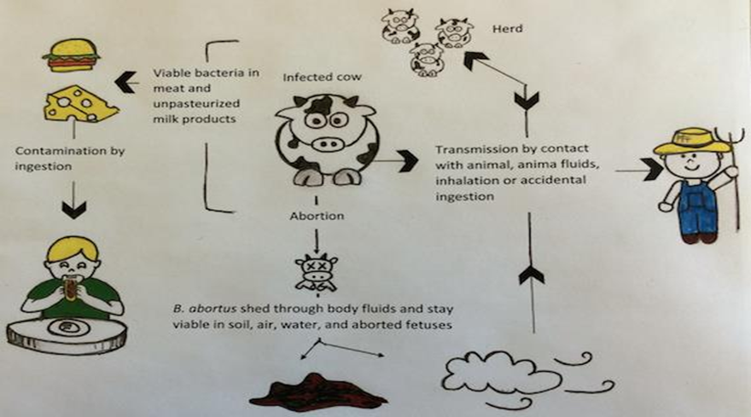
Brucella
The infection occur due to ingestion of contaminated dairy products and poorly cooked raw meat. Or from coming into contact with animals carrying Brucella bacteria

Slide 30
Classifications
The traditional classification of Brucella species is based largely on the preferred hosts.
Geographic Distribution | Animal Reservoir | Organism
Mediterranean, Asia, Latin America, parts of Africa and some southern European countries | Goats, sheep, camels | B melitensis
Worldwide | Cows, buffalo, camels, yaks | B abortus
South America, Southeast Asia, United States | Pigs (biotype 1-3) | B suis
Cosmopolitan | Canines | Brucella canis

Slide 31
Important features:
Small gram-negative coccobacilli.
Non motile, non-sporing, non flagellated.
Nontoxigenic.
Strict aerobes, but B. abortus usually requires 5-10% CO2
Growth can occur in range 20-40° C.
Grow on blood and trypticase soy agar,
Notes:
Have complex nutritional requirements so growth is improved on enriched media such as blood agar and trypticase-soy agar but the addition of bacitracin, polymyxin and cyclohexamide makes these media selective to Brucella.

Slide 32
Lab diagnosis*:
Specimens: Blood and biopsy from lymph nodes for culture, serum for serology.
Culture: In trypticase soy broth or Castaneda blood culture system. Subcultures are made on solid media twice a week
Biochemical tests: oxidase +ve, H2S production +ve, urease +ve.
Serological test: agglutination test called Rose Bengal test* detect the antibody to Brucella species except B.canis , titer greater than 1:160 consider positive result.
Notes:
Various clinical findings in patients most likely to be exposed are suggestive of the disease in humans. Direct demonstration of the organism by culture or indirect evidence in the form of specific antibody can be shown to establish the diagnosis.
The advantages and disadvantages of Rose Bengal test: is rapid, inexpensive, acceptable sensitivity and specificity, but it can be impacted by vaccination and environmental condition

Slide 33
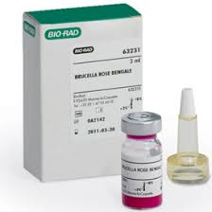
Rose Bengal test

Slide 34
Yersinia
There are different species of Yersinia:
Yersinia pestis the most important species in this genus causes Plague (black death)
Y. Enterocolitica causes enterocolitis primarily in young children
B. pseudotuberculosis causes Gastroenteritis (mesenteric lymphadenitis simulating acute appendicitis)

Slide 35
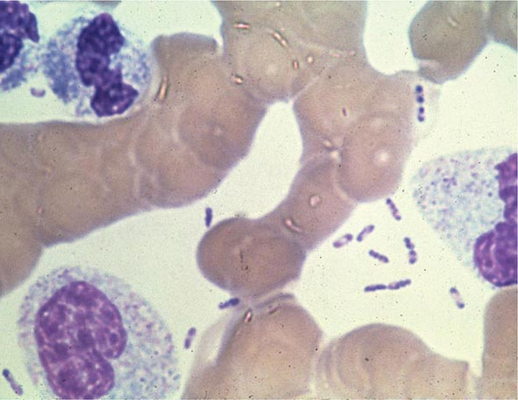
Important features:
Gram-negative coccobicilli or rods with rounded ends and straight or convex sides.
Have safety pin appearance under microscope when stained by methylene blue
safety pin appearance

Slide 36
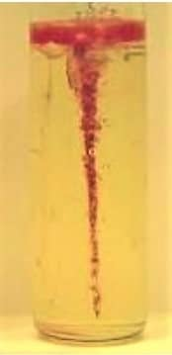
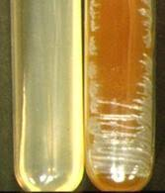
Important features:
Aerobic or facultative anaerobic
Encapsulated in exudates of lesions.
In broth, stalactites (hanging growth) seen with oil overlay.
Ghee medium
broth
Notes:
In broth, Y. pestis produces a flocculent growth with granular deposit at the bottom and along the sides of the tube, with little or no turbidity. On prolonged incubation, a delicate pellicle may form at the surface. Y. pestis produces a characteristic growth when grown in a flask of broth with oil or ghee floated on top. The growth in the medium appears to hang down into the broth from the surface, resembling stalactites (stalactite growth).

Slide 37
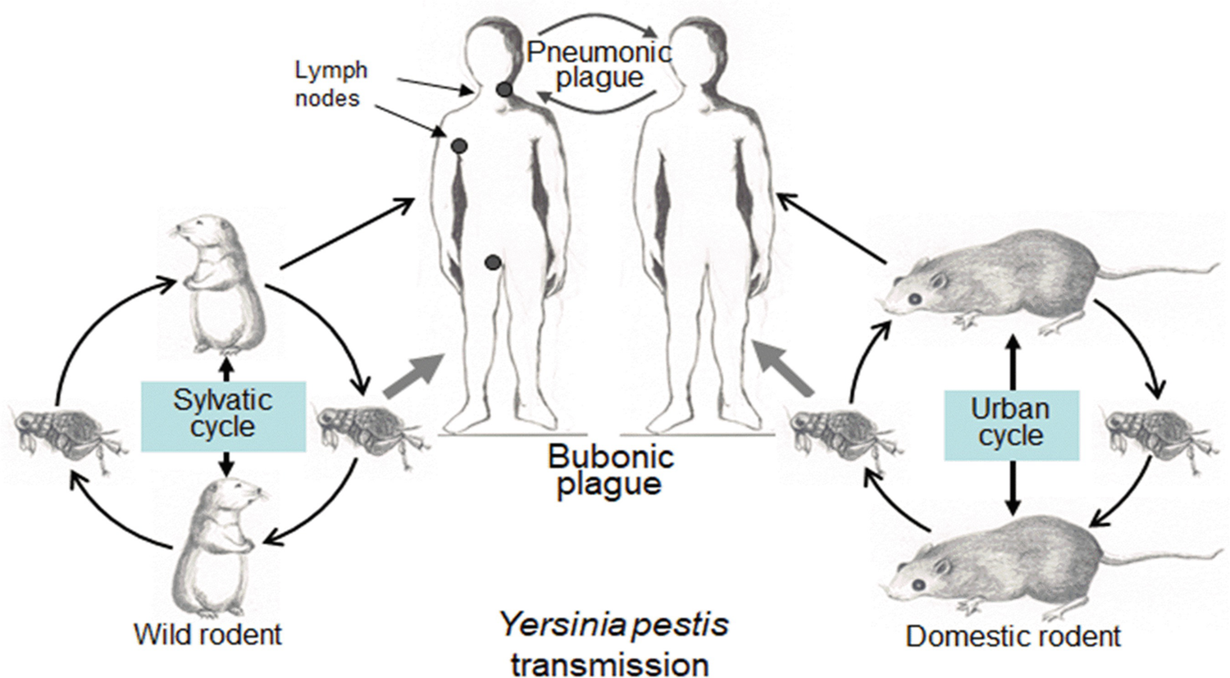
Clinical types
Bubonic: is the most common clinical form of the disease.
Pneumonic
Septicemic
Transmission
Notes:
Bubonic type is associated with a sudden onset of high fever, chills, and headache, and also body aches, extreme exhaustion, abdominal pain, and diarrhea. Presence of painful, swollen lymph glands (buboes), usually in the groin, axilla, or neck, is the characteristic manifestation.
Septicemic plague is usually the terminal event in the bubonic or pneumonic plague, but may sometimes occur primarily in elderly patients.

Slide 38
Lab. diagnosis:
Specimens: bubo aspirates (in bubonic plague), sputum (in pneumonic plague), and blood and CSF (in septicemic plague).
Microscopic examination: bipolar (safety pin appearance)
Culture: blood or nutrient agar with sodium azide
Serology
Notes:
Y. pestis is slow growing, but it does not require any special growth media. Clinical specimens are inoculated on blood or nutrient agar and on specialized selective media for isolation of Y. pestis. Selective medium, such as blood agar with sodium azide is used for selective isolation of Y. pestis from sputum and bubo aspirates containing numerous other bacteria.

Slide 39
Treatment:
Treatment of a suspected case of plague with antibiotics should be started as early as possible, without waiting for laboratory confirmation. Streptomycin, doxycycline, and chloramphenicol are used effectively for treatment of plague. For a duration of 10 days. A two-drug regimen should be used in severe cases
Notes:
Streptomycin is the drug of choice to treat plague. Doxycycline is given in patients who are allergic to streptomycin or who cannot tolerate streptomycin. Chloramphenicol is the drug of choice in septicemic plague or for patients with hypotension.

Slide 40
Thank you
for
your attention

