Slide 1
Practical Bacteriology lab. 2
Laboratory diagnosis
Smear preparation, Simple and Gram stains
By:
Asst. Prof. Shiama'a Al-Salihy

Slide 2
Learning objectives:
After this lab, you must be able to:
Identify laboratory diagnosis steps.
Understand staining techniques
Illustrate the purpose of each stain
Interpret laboratory tests results

Slide 3
Laboratory diagnosis steps:
Specimen: according to type of infection
Microscopic examination : stained or wet
Culture and antibiotic susceptibility test: inoculation of M.Os in or/and on culture media, and testing their sensitivity to antibiotic.
Biochemical tests: catalase, coagulase, sugar fermentation tests…etc.
Serological and immunological test
Molecular tests
Notes:
- Immunological tests: there are two basic approaches:
Using known antibodies )antisera) to identify the micro organism, e.g., latex agglutination, capsular swelling… etc.
Using known antigens to detect antibodies in patient’s serum, e.g.. Serologic test for syphilis, cold agglutination test.

Slide 4
Notes:
Factors affecting the result of a test:
Pre analytical factors (physician --------------˃arrival of specimen to the lab)
Analytical factors (testing)
Post analytical factors ( result, report, interpretation)

Slide 5
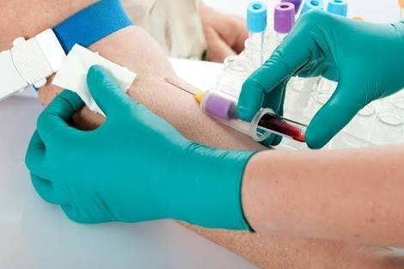
Sample collection (specimens): Urine ,blood, stool ,sputum , pus, CSF, plural fluid ,peritoneal fluid, different types of swabs.
Notes:
Valid laboratory results are dependent upon proper specimen collection and handling prior to the arrival of the sample in the laboratory
care must be taken to collect only those specimens that may yield pathogens, rather than colonizing flora or contaminants

Slide 6
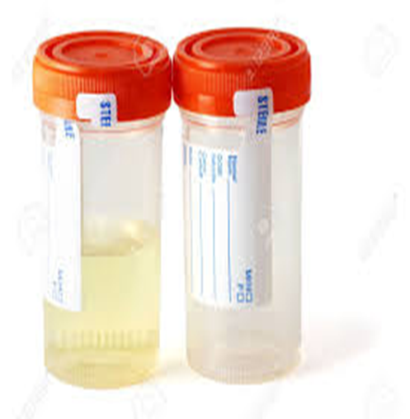
A. Urine sample:
Collection: Mid stream urine (M.S.U.) sample to avoid contamination with normal flora (E.coli), Staphylococcus saprophyticus.
The sample of urine must be no delay more than 1-2hrs.
B. Stool sample:
In sterile container or by rectal swab. The collected stool should be processed within 2hrs or inoculated in transport media
urine collection container

Slide 7
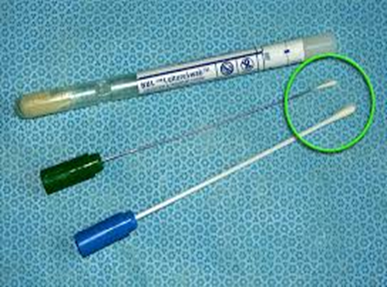
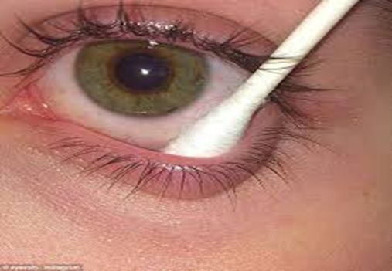
C. Swabs:
Very important methods for collect the following:
Urethral swabs: for urethritis diagnosis in men and vaginal swab
Throat swab: culture on chocolate agar
Nasopharyngeal swab
Ear swab.
Eye swab.
wound swab.

Slide 8
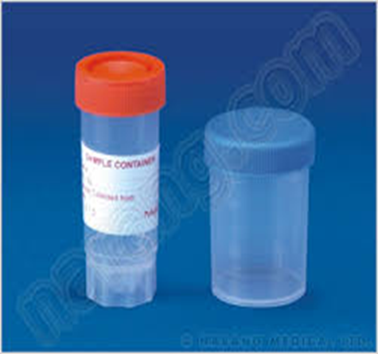
D. Sputum:
Material from lower RTI or ( a mixture of bronchial secretion and inflammatory exudates).
Collection steps:
Make the collection in a disposables wide mouth screw-capped plastic container
Homogenize the sample.
Collect the sample before antibiotic therapy is began.
Sputum collection container

Slide 9
E. Cerebrospinal fluid (CSF):
The examination of CSF is an essential step in the diagnosis of bacterial and fungal meningitis. Normal CSF is sterile, clear, with no RBCs.
Collection: 5-10 ml of CSF should be collected in 2 sterile tube by lumber puncture

Slide 11
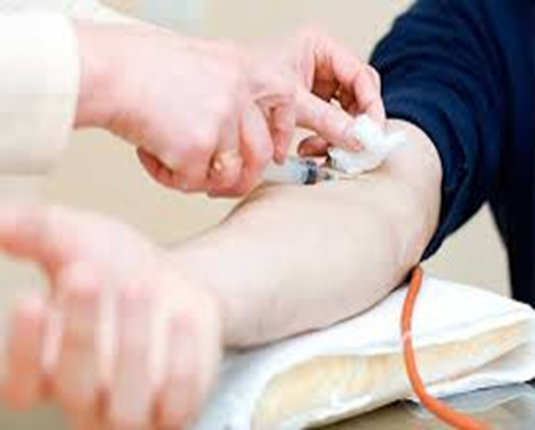
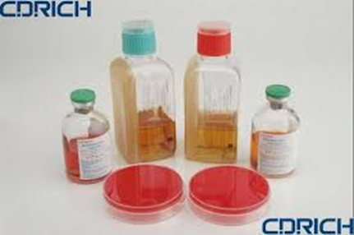
F. Blood :
Samples of blood should be taken before antibiotic administration
skin antisepsis: Iodine, Povidone –Iodine, Alcohol 70% or Chlorhexidine
10 ml from adult, 2 - 5 ml from children, 1-2 ml from infants and neonates

Slide 12
Microscopic examination:
Smear: A thin film of material containing M.Os which is spread over the surface of slide (stained or wet)
- Wet preparation are used to demonstrate:
Blood cells and microbes in fluid specimens such as urine, feces, CSF
Cysts, eggs or parasite in feces.
Fungi in skin.
Protozoa in blood and tissues.
- Stained smear: if bacteria are seen in gram stained smear, their shape, size, arrangement and reaction should be observed.

Slide 13
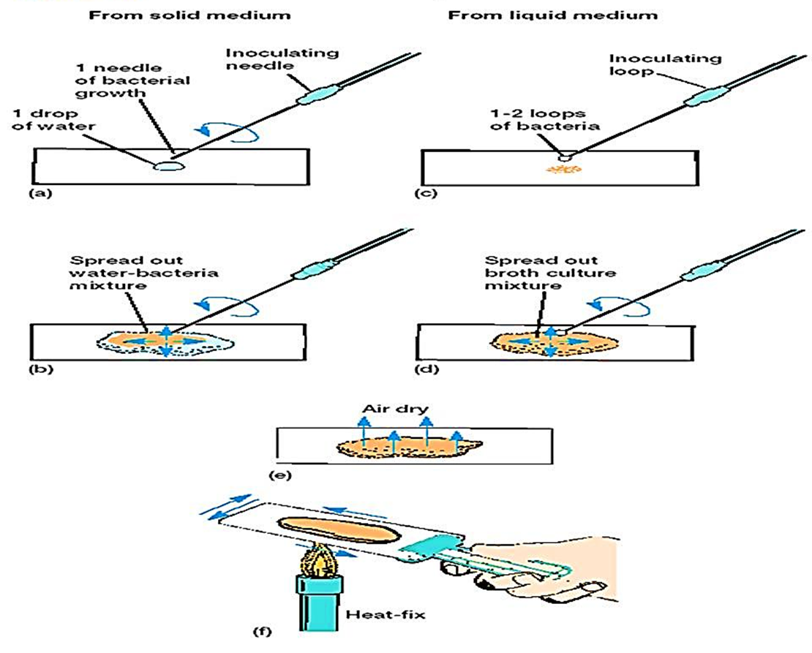
Steps of preparation smear

Slide 14
Staining procedure can also be classified into:
Simple staining: It is the use of single basic dye to color the bacterial organism. Such as methylene blue, crystal violet, safranin.
Differential staining: uses more than one dyes and it is also used to differentiate the organisms into one of two groups such as gram stain and acid fast stain. Also it can give the shape of bacteria
Structural stain: such as capsule stain, endospore and flagella

Slide 15
Methods of simple staining
Notes:
Flood the slide with methylene blue for one minute
Wash up the stain with running tap water
Allow the slide to dry in air or place it between two sheets of filter paper (Blotting the slide)
Examine under oil immersion lens(shape size arrangement of bacteria)

Slide 16
Gram stain
It is a differential stain uses two or more types of dye to differentiate between organism according to their response to these dye
Gram Stain
Gram positive:
Appears violet after Gram’s stain
b) Gram negative:
Appears red after Gram’s stain
Notes:
The differentiation in gram stain is helpful in determining the use of subsequent culture media and biochemical test also differentiate between cocci and bacilli

Slide 17
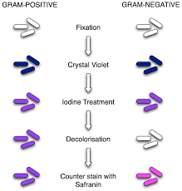
Gram stain procedure
Notes:
Gram-positive bacteria have a thick peptidoglycan layer surrounds the cell.
The stain formed a complex with iodine which trapped into this layer
Retain the color of the primary stain (crystal violet) after decolorization with alcohol and the bacteria take the purple color
Gram-negative bacteria have a thin peptidoglycan layer that does not retain crystal violet stain. Instead, it has a thick lipid layer which dissolved easily upon decolorization with Aceton-Alcohol. Therefore, cells will be counterstained with safranin take the red color

Slide 19
Ziehl-Neelsen stain (Acid fast Bacilli)
To stain Mycobacterium species especially M. tuberculosis
High lipid content- make decolorization very difficult
Principle:
Acid fast (resist): once the bacteria stained with primary dye- difficult to decolorize with acid due to high contain of lipid substances within their cell walls called mycolic acids.
Basic carbol fuchsin in combination with phenol (the staining solution) penetrates the cell wall and stain the bacilli bright red. they resist decolorization with strong acid.

Slide 20
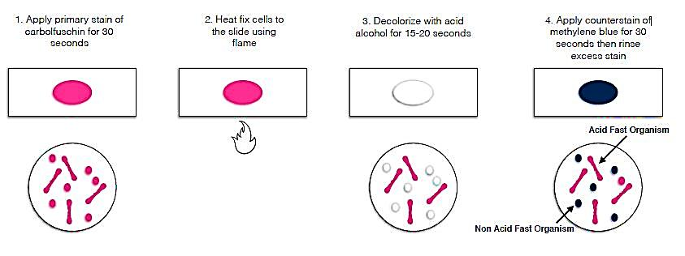
Steps of AFB stain
Mycobacterium tuberculosis
under microscope stained
with AFB stain

Slide 21
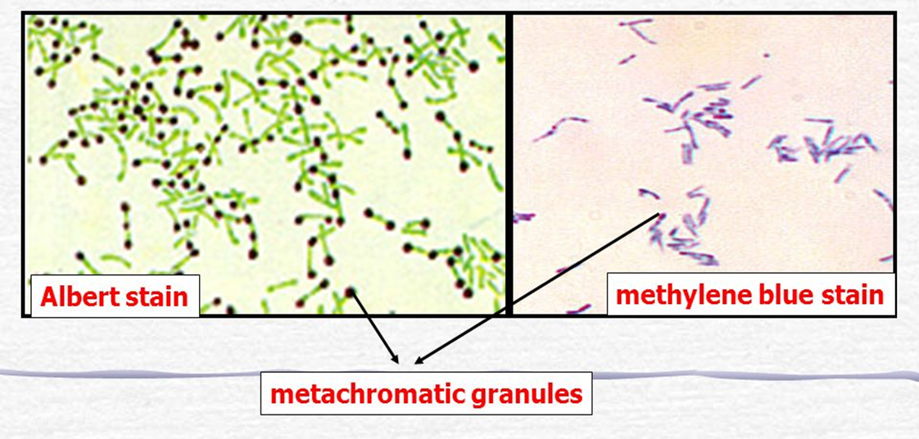
Albert Stain
Used for staining and demonstrated of Corynebacterium diphtheriae,
They are thin gram positive bacilli which resemble Chinese letters when stained by simple stain.
In albert stain another characteristic is presence of metachromatic granules (RNA or polymetaphosphate) the granules are bluish-purple by methylene blue and dark purple with albert stain

Slide 22
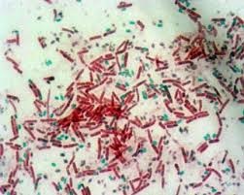
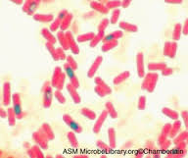
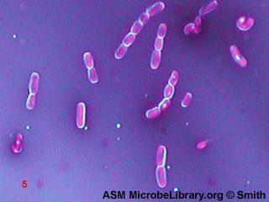
Endospore
Capsule

Slide 23
Thank you

