Slide 1
Practical Bacteriology lab. 3
Types of Culture media, culturing, and pure culture techniques
By:
Assist. Prof. Shiama'a Al-Salihy

Slide 2
Learning objectives:
After this lab, you must be able to:
Define culture media
list the common ingredients in the culture media.
Explain the purpose of each type of culture media
the principle of biosafety
Distinguish between methods of pure culture.

Slide 3
Types of culture media Culture and antibiotic susceptibility test

Slide 4
Culture media can be defined as artificial media contain basic requirements needed for microorganisms’ growth. Can be contained either in test tubes, plates, flasks or screw-capped bottles…etc.
common ingredients for culture media:
peptone: source of protein.
Meat extract: source of N2.
NaCl: for isotonic environment
H2O
Agar: it provides no nutritional benefits but used for solidifying purposes.
PH: neutral pH (7.2-7.4), obtained by adding of NaOH or HCL

Slide 5
Types of culture media:
Culture media can be divided according to:
physical state (consistency):
liquid media: they do not contain agar, used for primary cultivation,(why?)
Its disadvantage is the inability to observe colony morphology, e.g., nutrient broth, peptone water.
Solid media: they are made by adding a solidifying agent to a liquid media. Agar is added in percentage of 1.5-2 %, they are used for identification of colony morphology pigmentation, hemolysis, e.g. blood agar.
Notes:
Liquid media used for propagation of large No. of microorganism when low No. of microorganisms expected to be present in the sample so they are suitable for blood culture and primary cultivation

Slide 6
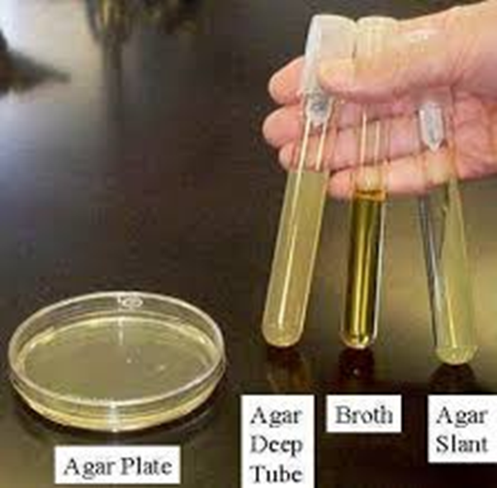
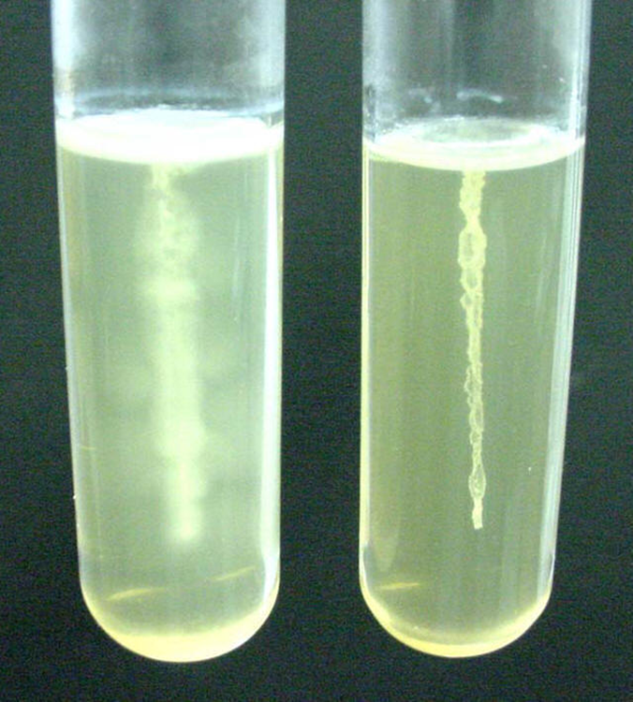
Types of culture media:
Semisolid media: contain 0.4-0.8% of agar used for cultivation of spirochetes and studying motility, e.g. SIM
Semisolid media:

Slide 7
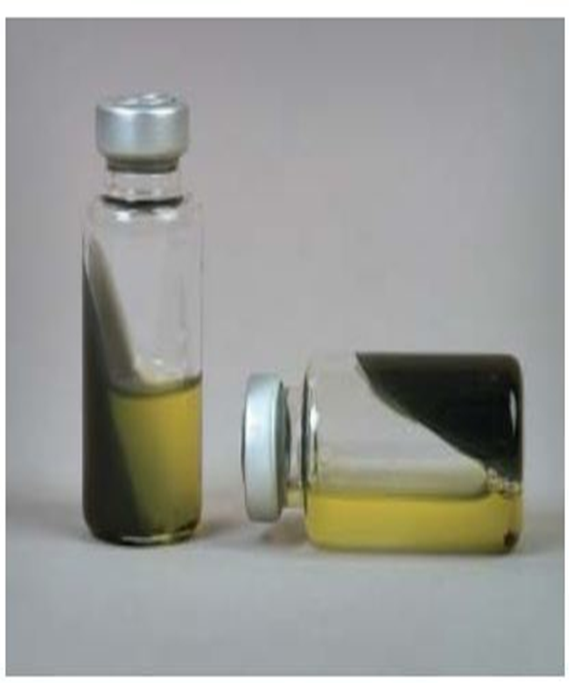
Types of culture media:
Biphasic media: culture system composed of both liquid and solid media in the same bottle. The inoculum is added to a liquid medium, to subculture the inoculum, the bottle simply tilted to allow the liquid to flow over the solid medium, e.g. Castaneda system for blood culture.
Castaneda system

Slide 8
Types of culture media:
Uses of media:
Simple media: these media contain only common ingredients, used for cultivation of non fastidious microorganism, e.g. nutrient broth, nutrient agar.
B. Special media: these media contain common ingredients plus other substances.

Slide 9
Types of culture media:
Uses of media:
Culture media can be divided to:
Enriched media: prepared by adding blood, serum or vitamins to a basal media for supplying the growth of fastidious bacteria, e.g. blood agar chocolate agar and Brain heart infusion agar.
Selective media: contain inhibitory substances like bile salt, antibiotics or dyes, which favor the growth of certain microorganisms and inhibit growth of others, e.g. macConkey’s agar and mannitol-salt agar.

Slide 10
Types of culture media:
Differential media: contain substances which make certain species of bacteria to produce characteristic growth or effects in the medium that can easily recognized, e.g. MacConkey’s agar, blood agar.
Enrichment media: this media allow the grow and enrich for one type of bacteria (fastidious one) and inhibits other, e.g. Selenite-f media.

Slide 11
Types of culture media:
Transport media: certain microorganism is weak and dies rapidly between time of specimen collection and examination so it needs a special media for transport, e.g. Stuart’s medium.
Indicator media: use the usual changes in the color of an indicator due to microorganism metabolism as a diagnosis feature, e.g. sugar media, litmus milk.

Slide 12
Types of culture media:
Sensitivity media: a special media used to test antibiotic sensitivity for given microorganism, e.g. Mueller-Hinton media.
Anaerobic media: used for cultivation of anaerobic bacteria, contain reduced oxidation-reduction potential, e.g. thioglycollate medium

Slide 13
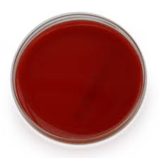
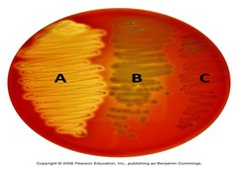
Blood agar
Enriched medium usually used for primary isolation of bacteria and also considered as differential medium according to (types of haemolysis)
Enrich blood agar without cultivation
Differentiated blood agar with cultivation
Notes:
Blood agar used for primary isolation because it contain enriched substances required for cultivation of most microorganisms including fastidious microorganisms
Blood agar can be considered as differential medium because it differentiate between growing microorganisms according to type of hemolysis.

Slide 14
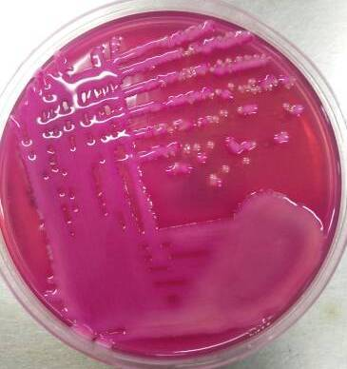
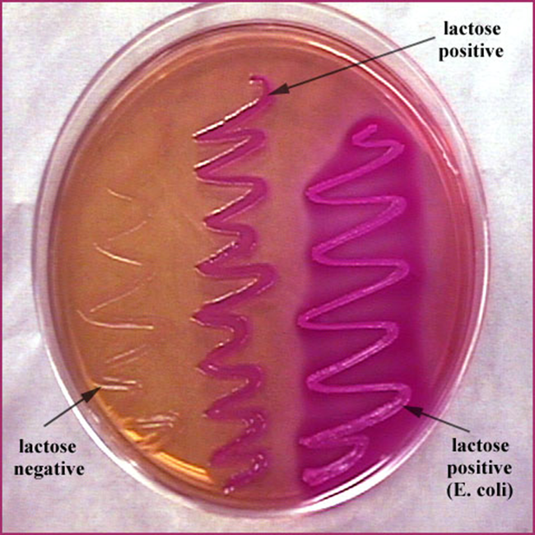
MacConkey’s agar:
It is selective medium for gram negative bacteria and differential medium to differentiate between lactose fermenter and non lactose fermenter (also it can be considered indicator medium)
klebsiella pneumoniae
Notes:
It is selective for gram negative bacteria particularly enterobacteriaceae because it contain crystal violet dye and bile salt which inhibit growth of gram-positive bacteria
It contain lactose suger when it be fermented produce acid decrease the pH level and change the color of indicator (neutral red) to pink color

Slide 15
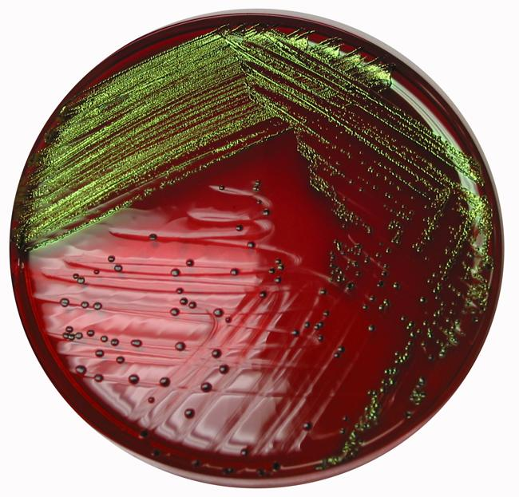
EMB medium (Eosin Methylene Blue)
Selective and differential medium contains dyes inhibit Gram (+) bacteria and selects only Gram (-) bacteria
E. Coli on EMB ,It will be given a distinctive
metallic green sheen

Slide 16
TCBS medium ( Thiosulfate Citrate Bile salt Sucrose agar)
It is a selective media for cultivation of Vibrio cholera
TCBS
Before cultivation
TCBS
After cultivation
Notes:
Thiosulfate and sodium citrate and also the alkalinity of the medium inhibit the growth of other enterobacteriaceae members and the indicator bromothymol blue changed to yellow when the pH changed to acid

Slide 17
Salmonella- Shigella agar (S-S Agar)
Selective medium used for isolation of Salmonella species and Shigella . This medium contain substances allow to differentiate the bacterial species that produce the H2S which appear in black center
Salmonella

Slide 18
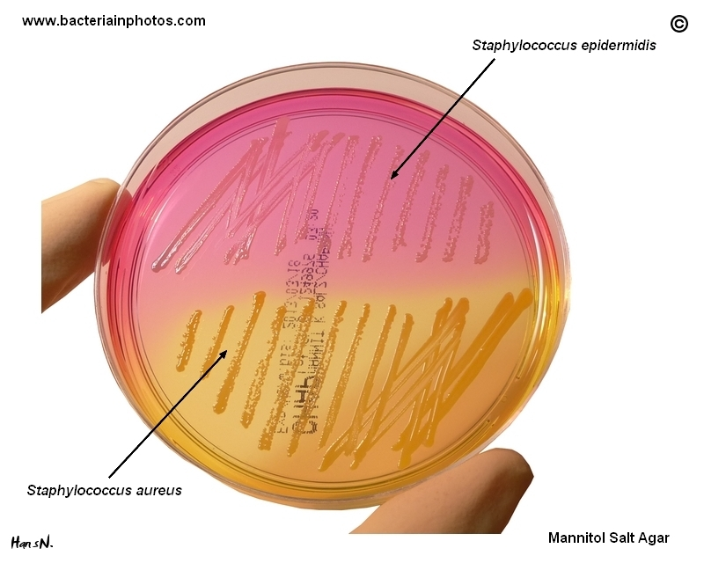
Mannitol Salt Agar
It is a selective media for staphylococcus species which tolerate high concentration of salt and differentiate between mannitol fermenting bacteria from non mannitol fermenting.
Notes:
Contains high concentration of salt which inhibit other bacteria, it is also differential for mannitol fermenting and mannitol non fermenting bacteria by converting the color of indicator (phenol red) by changing pH level.

Slide 19
Triple sugar iron agar
Notes:
TSI: differential medium contains 3 types of sugars glucose, lactose and sucrose and test the ability of enteric bacteria to ferment sugars and produce H2S
The indicator is phenol red

Slide 20
Pure Culture
Methods

Slide 21
Pure culture methods:
Pure culture means a single kind of microorganisms growing alone in protected environment. Four methods are widely used for identification of pure culture from clinical specimens containing mixed microorganisms.
Streak plate method: this method is employed for the isolation of pure culture of bacteria from mixed population, e.g. sputum, urine, stool, pus from infected wound and abscess.

Slide 22
Pure culture methods:
Pour plate method: this technique deals with the isolation of pure culture from mixed bacterial suspension by serial dilution and plating.
Spread plate method:
Dilute sample
Pour on agar plate
Spread by glass spreader.

Slide 23
Pure culture methods:
Selective environment: application of selective conditions like high temperature and O2 or CO2, or use selective media like MacConkey’s agar.
There are many ways to inoculate bacteria in the media:
Inoculation: loop 2. Pipetting: pipette
Stabbing: needle 4. Swabbing: cotton swab
Spreading: spreader 6. Streaking: loop

Slide 24
Thank You
For
Listening

