Slide 1
Practical Bacteriology lab. 4
Cultural morphology
And
Antibiotic susceptibility test
By:
Assist. Prof. Shiama'a Al-Salihy

Slide 2
Learning objectives:
After this lab, you must be able to:
Identify the colonial morphology of bacterial growth
Understand the principle of antibiotic susceptibility test
Differentiate between types of antibiotic susceptibility test
Understand the principle of each antibiotic susceptibility measuring method
Interpret the results of antibiotic susceptibility test

Slide 3
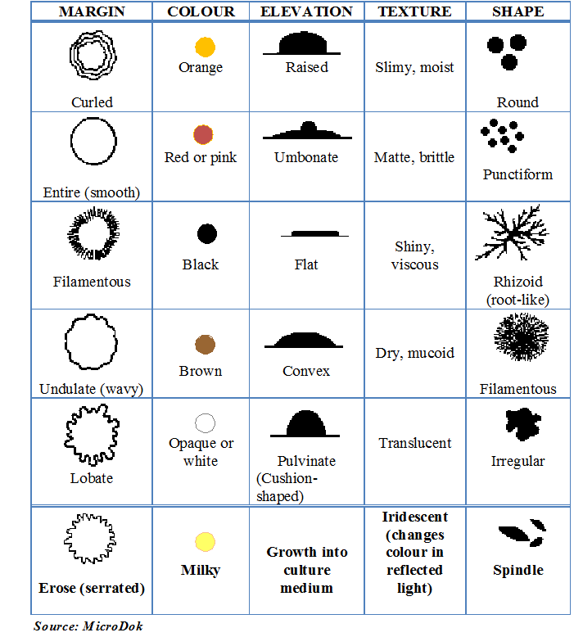
Cultural morphology:
Study macroscopic characteristics of a pure culture on a solid medium by:
size: measured in mm
Shape: circular, filamentous, irregular, spindle.
Elevation: flat, raised, convex
Consistency: dry, mucoid
Surface texture: smooth, rough
Color: yellow, white
Optical density: opaque, translucent, glistening
Changes in the inoculated medium (hemolysis)

Slide 4
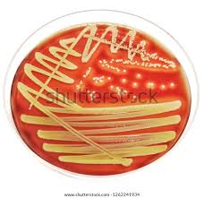
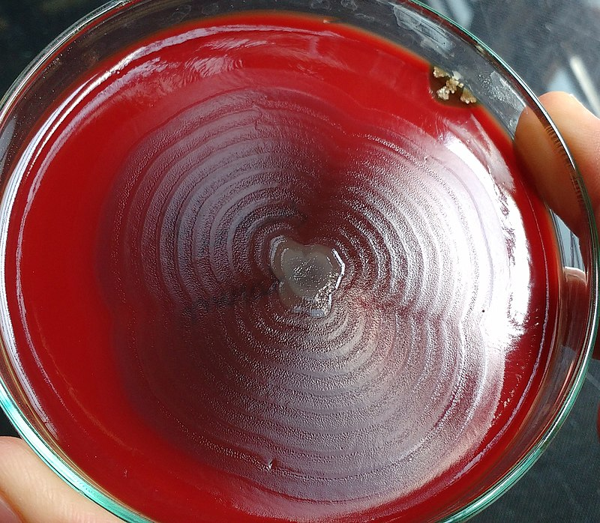
Staph. aureus
Proteus sp.
Strep. pyogenes

Slide 5
Antibiotic sensitivity test (AST) measure the ability of an antibiotic to inhibit bacterial growth in vitro (on culture media as Mulluer-Hinton agar)
The purpose:
Determine the most suitable effective antibiotic therapy against bacterial infection.
Sensitivity analysis is a useful tool to help quickly determine if bacteria are resistant to certain drugs.

Slide 6
There are two principle methods for measurement of antimicrobial activity:
Dilution methods
Agar dilution
Broth dilution
E test
These methods used for determine the minimum inhibitory (MIC) concentration determination.
Notes:
Dilution test: graded amount of antimicrobial substances are incorporated into liquid or solid media. The media then inoculated with the test bacteria and incubated. The end dilution point is the higher dilution (smallest amount) of antimicrobial substance required to kill or inhibit the growth of the bacteria.

Slide 8
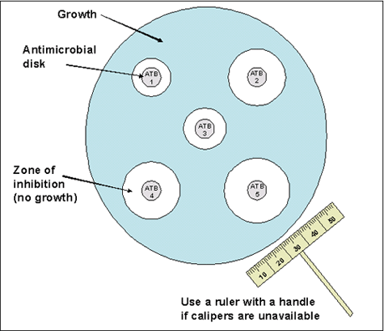
Diffusion methods
Disc diffusion- Kirby-Bauer method
Antibiotic diffusion by cup method
Antibiotic diffusion by ditch method
Kirby-Bauer method
Notes:
Disc diffusion method is the most common but not valuable in certain situations:
1- slow growing microorganisms such as M, tuberculosis because the agent diffuses rapidly so gives (false) large inhibition zone.
2- swarming microorganisms because this phenomenon will decrease the inhibition zone due to blocking diffusion
3- using antimicrobial agents with high molecular weight.

Slide 10
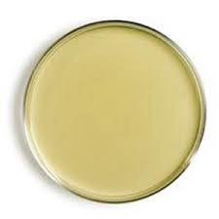
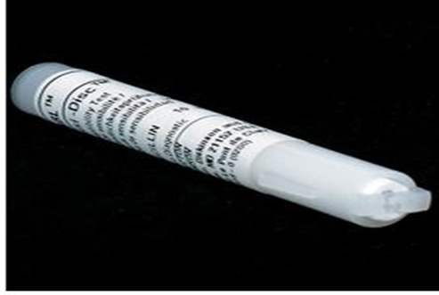
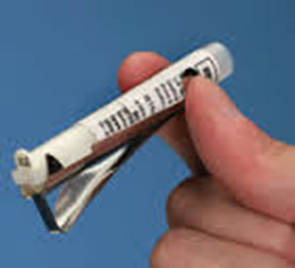
Preparing of MHA and swabbing
Antibiotic disc

Slide 11
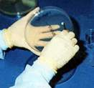
Disc Placement

Slide 12
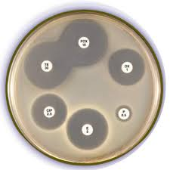
Interpretation of Results:
1-Susceptible: the microbe is called
Susceptible to drug when (large inhibition zone) appear around the disc that measured
2- Intermediate Susceptible: It is applicable to strain that are moderately susceptible to the antibiotic showing(lower inhibition zone). It may be effective at a higher dosage,, or effective only in specific body sites where the antibiotic penetrates to provide adequate concentrations
3-Resistant :the organism don’t respond to a given drug (don’t present inhibition zone around the disc)
AST plate with zone of inhibition

Slide 13
Minimum inhibitory concentration (MIC)
MIC can be helpful in establishing the level of resistance of a particular bacterial strain and can substantially affect the decision to use certain antimicrobial agents.
MIC is the least concentration of antimicrobial that inhibit the growth of an organism
Clinical use:
For organisms from patients suffering serious infection like “infective endocarditis

Slide 14
Minimum inhibitory concentration

Slide 16
MBC (Minimum Bactericidal Concentration)
The lowest concentration of antimicrobial agent that kill the tested microorganism.

Slide 17
Epsilometer test (E- test )
(E- test ) is an ‘exponential gradient’ method of determination of antimicrobial resistance
The device consists of a predefined, continuous, and exponential gradient of antibiotic concentrations immobilized along a rectangular plastic test strip.
After 48 hours incubation a drop-shaped inhibition zone intersects the graded test strip at the inhibitory concentration (IC) of the antibiotic.

Slide 18
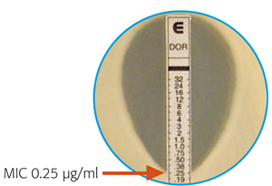
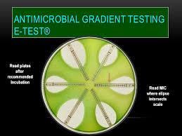
E test

