Slide 1
Practical Bacteriology lab 5
Gram- positive cocci:
Staphylococci
Assist. Prof.
Shaima’a Al-Salihy

Slide 2
Learning Objectives:
After this lab. You must be able to:
1- Describe staphylococci under microscope.
2-Distinguish between staphylococci and streptococci.
3- Differentiate among staphylococci species.
4-List diseases caused by each spp. of staphylococci.
5- Predict staphylococcal causative agents causing clinical cases.

Slide 3
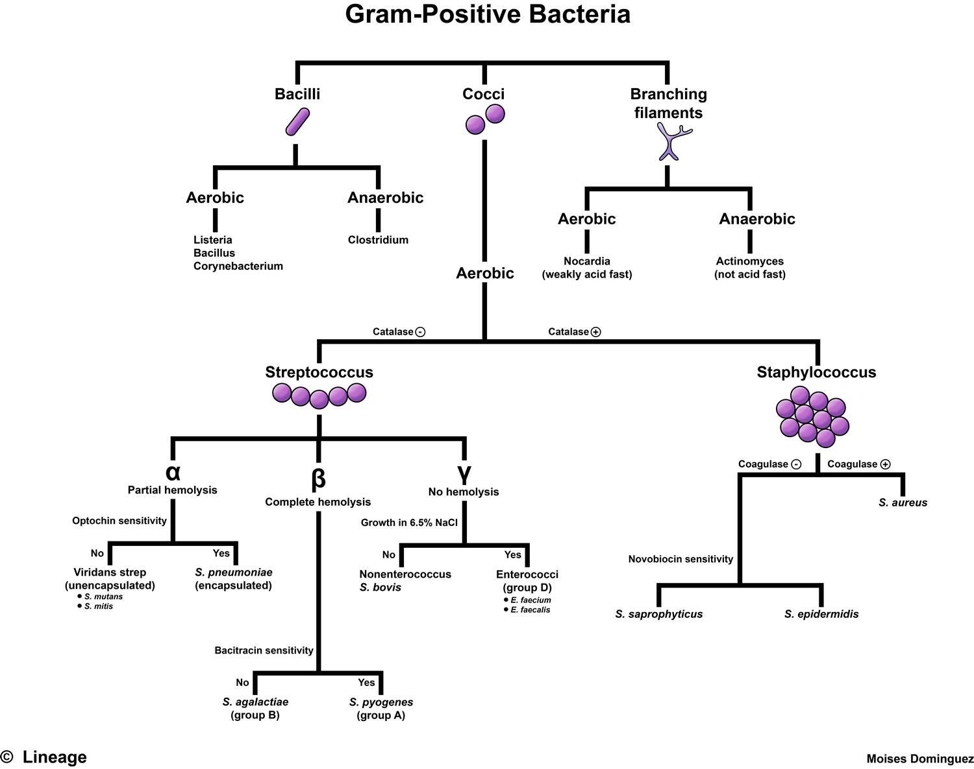

Slide 4
Gram positive cocci
1- Staphylococcus.
2- Streptococcus.
3- Micrococcus.

Slide 5
The medically important genera, are: Staphylococci and Streptococci. Both of them are non motile and do not form spores. They are distinguished by two main criteria:
Microscopically: staphylococci appear in grape-like clusters where as streptococci are in chains.
Biochemically: staphylococci produce catalase which brakes down hydrogen peroxide, where as streptococci do not.

Slide 6
Difference between Staphylococcus and Streptococcus
Streptococci | Staphylococci & Micrococci | character
Positive | Positive | Gram stain
Chains | Clusters (Micrococci in tetrads) | Arrangement
Smaller 0.5-1 µm | Large 1 µm | Size
Negative | Positive | Catalase

Slide 7
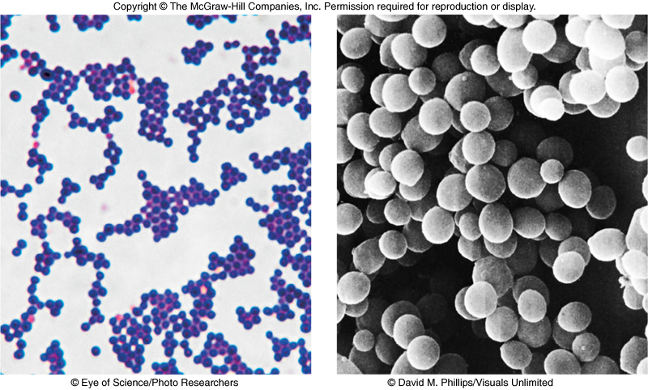
Staphylococci
1

Slide 8
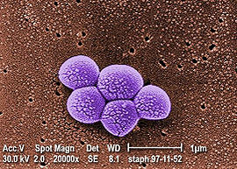
Staphylococcus
These bacteria are widely distributed in our environment; some of them are member of normal flora particularly on skin and upper respiratory tract including anterior nares and pharyngeal surfaces, others cause wide range of pyogenic infections.

Slide 9
Important properties:
Gram-positive cocci, arranged in grape-like clusters because cell division occurs along different planes and the daughter cells remain attached to one another.
Non spore- forming, non motile and capsule formation is variable.
Aerobic and facultative anaerobic, grow readily on usual culture media, has large, raised, opaque colonies with smooth entire margin.
Salt tolerant: allows them to tolerate the salt present on human skin.
Tolerant of desiccation: allows survival on environmental surfaces (fomites).

Slide 10
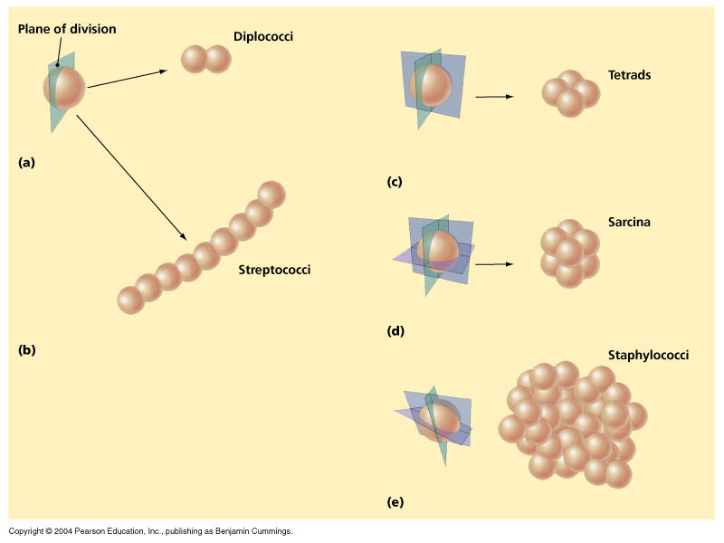

Slide 11
Clinically important species:
Staphylococcus aureus: most virulent species. It is responsible for a wide range of medical illnesses extending from mild localized skin infection to life threatening septicemia.
Staphylococcus epidermidis: it is normal flora of the skin and mucous membranes, it is not usually pathogenic but it may cause serious infections often associated with implanted devices (prosthetic devices, artificial joints, catheters,…etc.), if it has the opportunity
Staphylococcus saprophyticus: it is free living, common cause of UTI in young sexually active women, and non gonococcal urithritis in males.

Slide 12
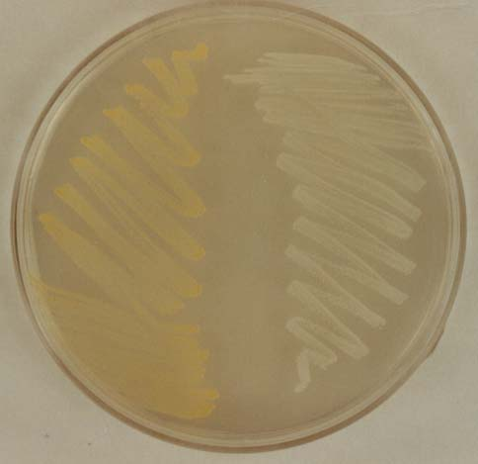
Staphylococcus aureus – General features
Coagulase positive
β- hemolytic colonies on BA
Produces golden yellow pigment
Highly resistant bacteria: resist heat, dryness, and 10-15% NaCl solution.

Slide 13
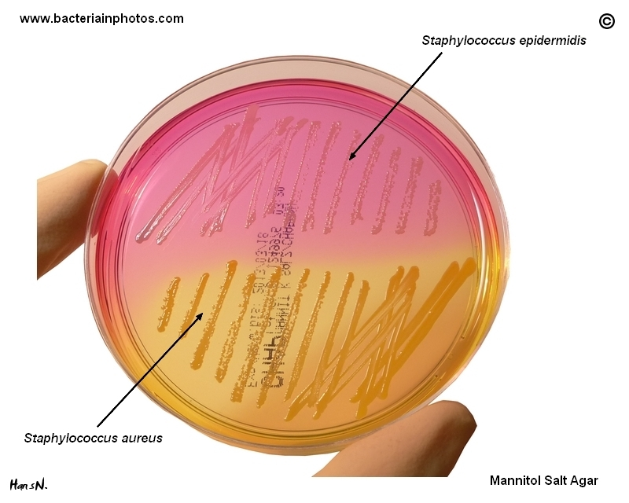
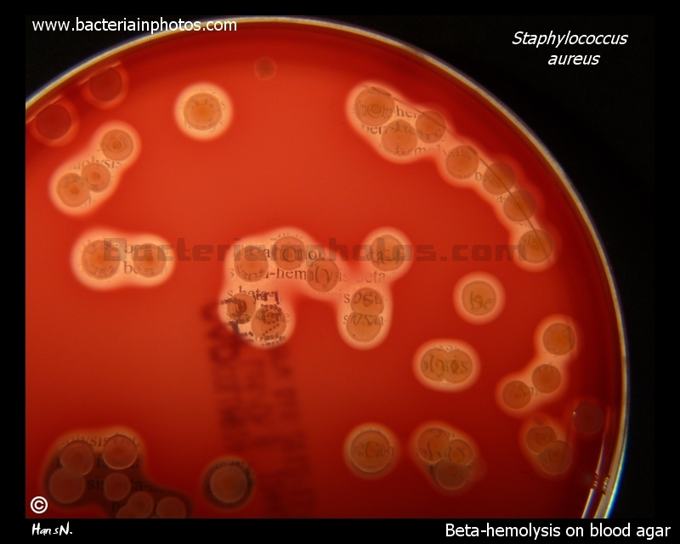
Staphylococci on MSA
S. aureus on blood agar

Slide 14
Pathogenicity of S. aureus
Cutaneous infections –
  impetigo, acne, folliculitis and furuncles (boils).
Invasive infections –
  bacteremia, meningitis, endocarditis, and osteomyelitis.
Toxin mediated infections –
  Staphylococcal scalded skin syndrome (SSSS),
  Toxic Shock Syndrome (TSS),
  Food poisoning (in 1-8hr, vomiting ,diarrhea, nausea, self limited )

Slide 15
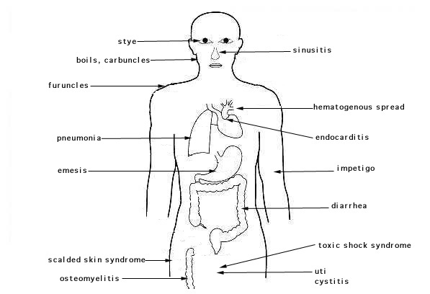
Pathogenicity
(Staphylococcal diseases)

Slide 16
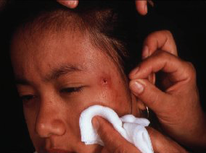
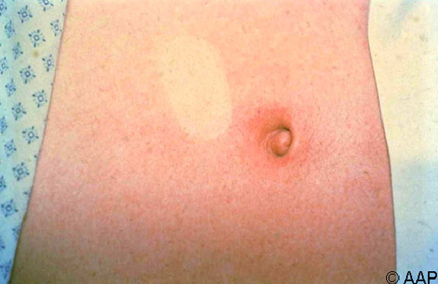
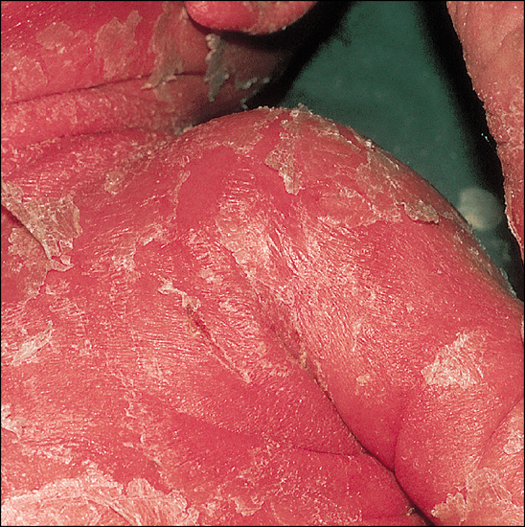
Abscess
Folliculitis
Toxic shock syndrome
SSSS

Slide 17
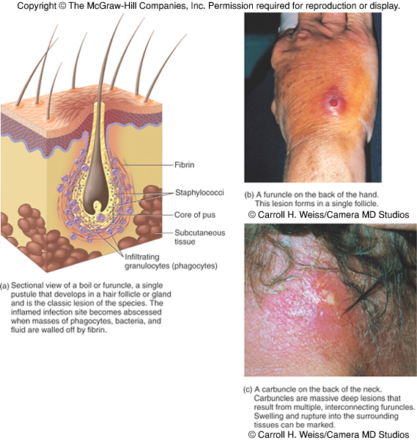

Slide 18
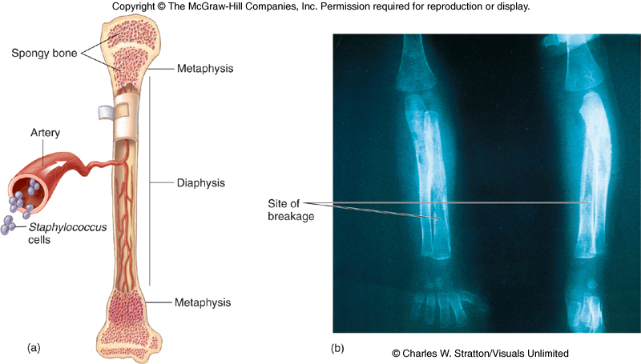

Slide 19
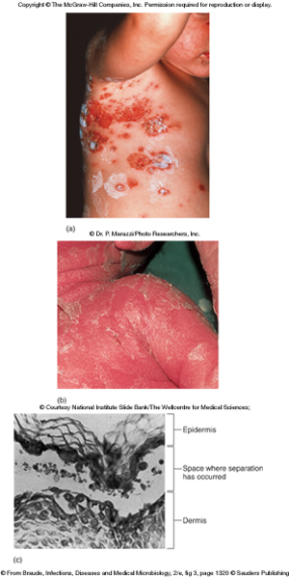
Effects of staphylococcal toxins on skin

Slide 20
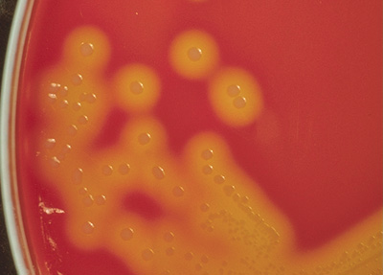

Lab diagnosis – S. aureus
Specimens: wound swab, pus, sputum, blood, urine CSF.
Culture
  BA : beta hemolysis
  NA : golden yellow pigment
  MSA: ferment mannitol (yellow colonies).
Microscopy: Gram stain - GPC in clusters

Slide 21
Biochemical tests:
Catalase: +ve (differentiate staphylococci from streptococci).
Coagulase: +ve (differentiate S. aureus form other staphylococci).
Slide method: for detection of clumping factor (bound)
Tube method: for detection of plasma coagulase (free)
Novobiocin disc: -ve (differentiate S. saprophyticus which is resistant, whereas, other are sensitive).

Slide 22
Catalase test:
Principle: Catalase is an enzyme, which is produced by microorganisms that live in oxygenated environments to neutralize toxic forms of H₂O₂. Catalase mediates the breakdown of hydrogen peroxide H₂O₂ into oxygen and water.
Procedure:
Transfer a small amount of bacterial colony to a surface of clean, dry glass slide using a loop or sterile wooden stick
Place a drop of 3% H₂O₂ on to the slide and mix.
A positive result is the rapid evolution of oxygen (within 5-10 sec.) as evidenced by bubbling.
A negative result is no bubbles or only a few scattered bubbles.
Dispose of your slide in the biohazard glass disposal container.
Notes:
A false positive reaction may be obtained if the culture medium contains catalase such as blood agar.

Slide 23
Coagulase test
Principle: coagulase is an enzyme found in S. aureus which has the property of clotting human or rabbit plasma by converting fibrinogen to fibrin.
Procedure:
Slide method: to detect bound coagulase
Pick up few colonies of bacteria from agar culture and emulsify in two drops of saline placed on a slide.
Add a drop of undiluted human or rabbit plasma and mixed gently.
Clumping after 5-10 sec. indicates the presence of bound coagulase.

Slide 24
Coagulase test
Tube method: to detect free coagulase
Put 0.5 ml of citrated or heparinized plasma (diluted 1:5 with saline) in a narrow test tube
Add 0.1 ml of an overnight broth culture or agar culture suspension to the plasma
Incubate the tube in a water bath at 37 C for 3-6 hrs
Clotting indicate positive result

Slide 25
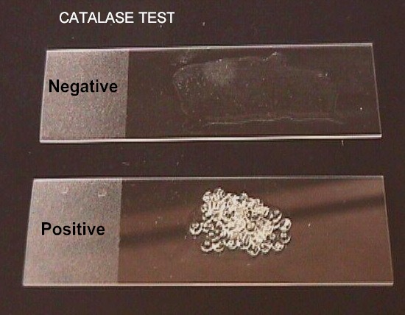
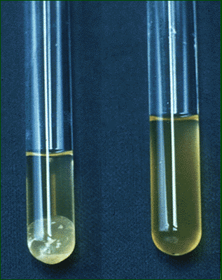
Catalase positive
Coagulase positive

Slide 26
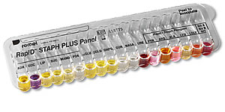
Rapid Staph test
Api staph

Slide 27

Thanks for your attention

