Slide 1
Microbiology lab 6
Gram- positive cocci:
Streptococci
Asst. Prof.
Shaima’a Al-Salihy

Slide 2
Learning objectives:
After this lab. You must be able to:
Describe streptococci under microscope.
Classify streptococcus spp. according to hemolysis pattern>
Classify streptococcus spp. according to Lancefield grouping.
List infections caused by each of streptococcal spp.
Differentiate each streptococcus spp. From each other.
Discuss principles of differentiation tests of each streptococcal spp.
Predict streptococcal causative agents causing clinical cases.

Slide 3
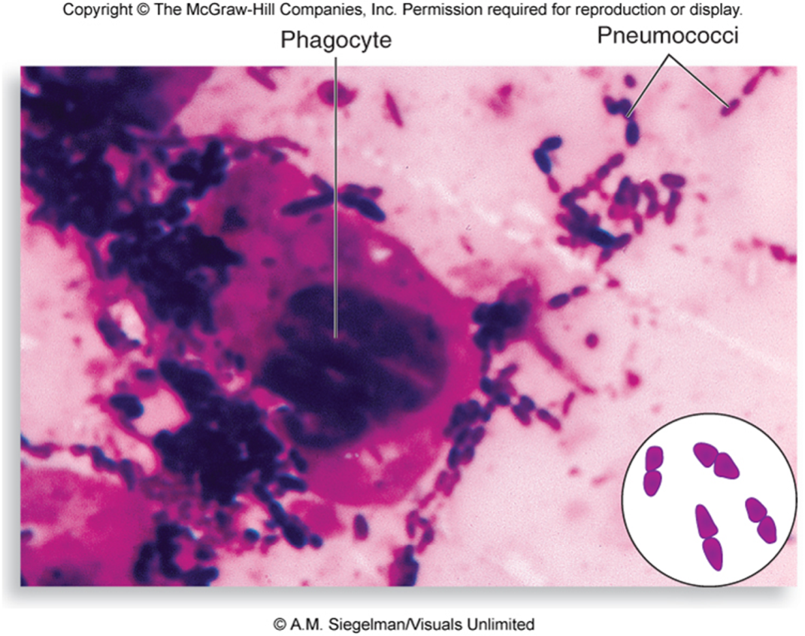
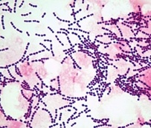
streptococci

Slide 4
General characteristics:
Gram-positive cocci, arranged in chains or pairs.
Non motile, non spore forming.
Some strains are capsulated, which are important in pathogenicity.
Catalase-negative.
Majority are facultative anaerobes, few are obligate anaerobes.
They are fastidious microorganisms grow on enriched media such as blood agar, have small, pin head, opaque, circular colonies.
Sensitive to drying, heat, and disinfectant.

Slide 5
Classification:
Species of this genus is classified according to the following:
I. Hemolysis:
ẞ- hemolysis: complete destruction of RBCs. e.g. S. pyogenes
α-hemolysis: partial destruction of RBCs e.g. S. mutans , S. pneumoniae.
γ-hemolysis: non-hemolysis.

Slide 6
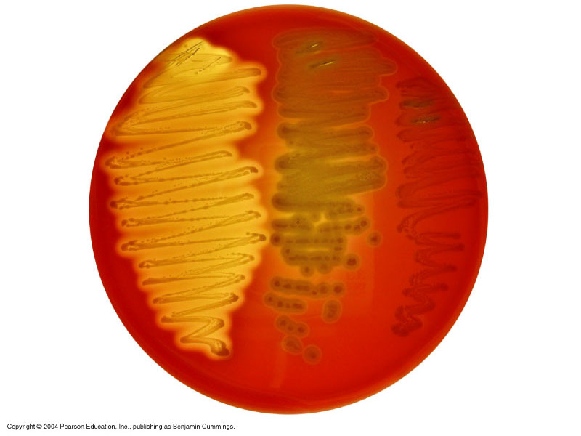
Hemolysis on Blood agar
β-hemolysis
α-hemolysis
γ-hemolysis

Slide 7
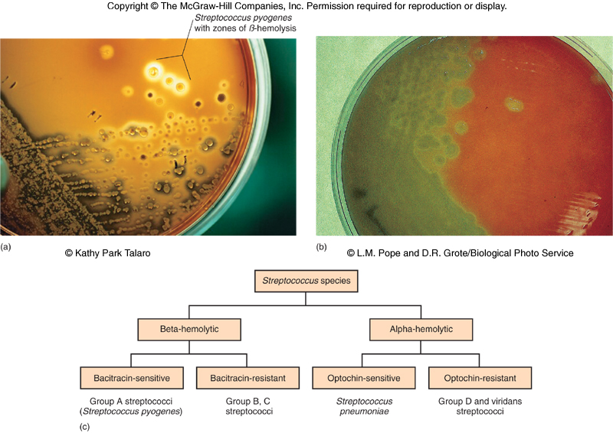
Hemolysis patterns on blood agar

Slide 8
II. Serology (Lancefield grouping):
There are differences in the polysaccharide antigens (group-specific carbohydrate) of the cell wall. Depending on these specific polysaccharide antigens, streptococci are named as groups from A-H & K-W.
Streptococci
Lanciefield classification
Group A
S. pyogenes
Group B
S. agalactiae
Group C
S. equisimitis
Group D
Enterococcus
Other groups
(E-U)

Slide 9
Classification
Based on O2
Aerobes
Anaerobes
Growth on BA
Peptostreptococci
α hemolysis
β hemolysis
γ hemolysis
Incomplete hemolysis (green color)
Complete hemolysis
α / β / no hemolysis
Lancefield grouping (specific C carbohydrate Ag on cell wall
Strep. viridans Strep. pneumoniae
Enterococcus fecalis
Group A – U (21 groups)
Griffith typing of Group A on MTR proteins into > 100 types

Slide 10
Human Streptococcal Pathogens
S. pyogenes
S. agalactiae
Viridans streptococci
S. pneumoniae
Enterococcus faecalis

Slide 11
Human streptococcal pathogens:
β-hemolytic
I. Group A streptococci - S. pyogenes:
Most serious streptococcal pathogen
Inhabits throat, nasopharynx and occasionally skin

Slide 12
Pathogenicity of S. pyogenes:
Pyogenic infections: sore throat, streptococcal pyoderma (impetigo), erysipelas, cellulitis, necrotizing fasciitis (flesh eating), septicemia,
Toxin- mediated: puerperal fever, scarlet fever, and streptococcal toxic shock syndrome.
Post streptococcal (immunogenic) infection: a hypersensitivity response - rheumatic fever (after sore throat), acute glomerulonephritis (after skin infection).

Slide 13
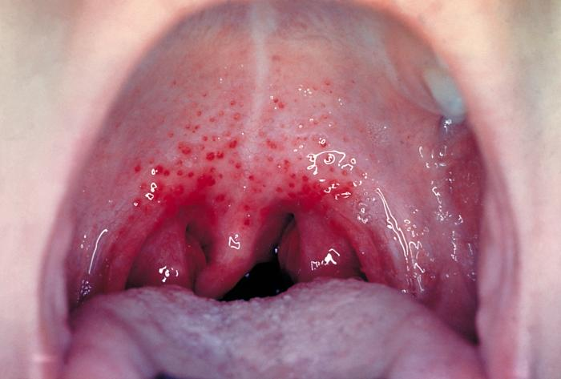
Strep Throat
Pharyngitis and tonsillitis
S.pyogenes is leading cause of uncomplicated bacterial pharyngitis and tonsillitis
Common in winter and early spring in children over age 3
Typical symptoms:
Pus in throat
Reddened and inflamed tonsils and uvula
Tiny, reddish-brown spots at back of throat
Swollen lymph nodes and tongue
http://www.lib.uiowa.edu/hardin/md/strepthroat.html

Slide 14
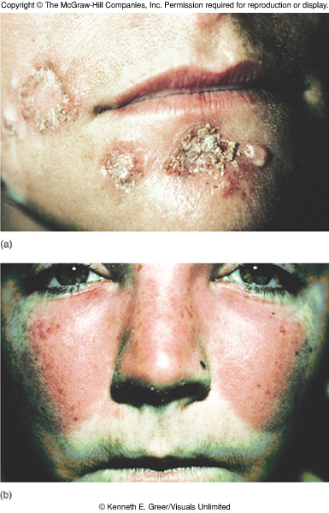
Streptococcal skin infections

Slide 15
Erysipelas

Slide 16
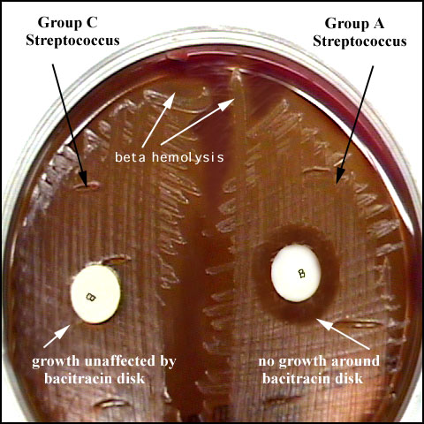
Lab diagnosis – Strep. pyogenes
Specimens: throat swab, pus, blood
Microscopy :Gram stain - GPC in chains
Culture: BA - beta hemolytic colonies
Identification tests -
Catalase Negative
Bacitracin sensitive
ASO titer / Ab. titer: normal < 200< positive result.
B +ve
-ve B

Slide 17
Anti- Streptolysin O Test (ASOT):
Principle:
ASOT this test is serological test used in post streptococcal infection complications depending on the presence of antistreptolysin-O antibody in the blood of patient’s previously infected with S. pyogenes.
Ab. titer: normal < 200< positive result.

Slide 18
Bacitracin sensitivity
Principle:
Bacitracin test is used for presumptive identification of group A
To distinguish between S. pyogenes (susceptible to B) & non group A such as S. agalactiae (Resistant to B)
Bacitracin will inhibit the growth of group A Strep. pyogenes giving zone of inhibition around the disk
Procedure:
Inoculate BAP with heavy suspension of tested organism
Bacitracin disk (0.04 U) is applied to inoculated BAP
After incubation, any zone of inhibition around the disk is considered as susceptible

Slide 19
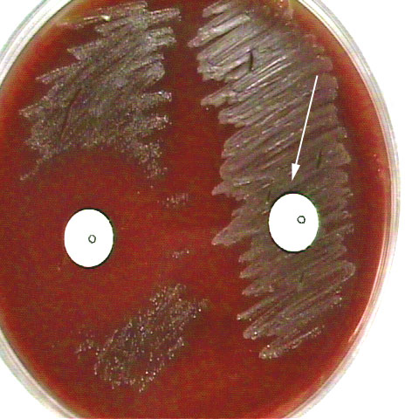
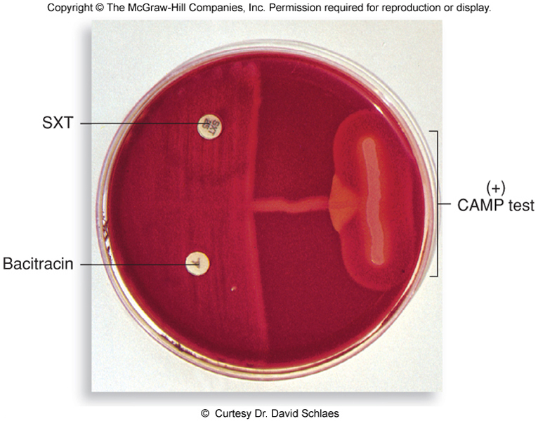
β-hemolytic : II. Group B streptococci- S. agalactiae:
Normal flora of female vaginal tract and cause neonatal meningitis.
Bacitracin resistant
CAMP test +ve (Christie, Atkins, Munch-Peterson)
hipurate hydrolysis test +ve (split sodium hippurate and give deep purple color indicate +ve response in this test)

Slide 20
CAMP test
Principle:
Group B streptococci produce diffusible extracellular protein (CAMP factor)
CAMP act synergistically with staph. β-lysin to cause lysis of RBCs
Procedure:
Single streak of unknown Streptococcus to be tested and a Staph. aureus are made perpendicular to each other
3-5 mm distance was left between two streaks
After incubation, a positive result appear as an arrowhead shaped zone of complete hemolysis
S. agalactiae is CAMP test positive while non group B streptococci are negative

Slide 21
CAMP test

Slide 22
Group D streptococci: Enterococcus faecalis and Enterococcus faecium:
Streptococcal-like with group D antigens were at first classified in the genus Streptococcus but studies has revealed that they differ in many biological aspects.
They are normal flora of GIT.
Bile- esculin +ve
Causes UTI, wound infection, bed sore, endocarditis.
One of the most frequent cause of nosocomial infections particularly in ICU.
Very resistant to antibiotics ( many isolates are resistant to cephalosporines even vancomycin).

Slide 23
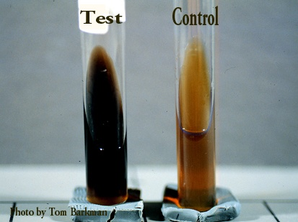
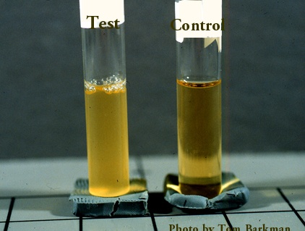
Lab diagnosis - Enterococcus
Specimens: urine, pus, blood
Microscopy: Gram stain - GPC in pairs or short chains
Culture: BA - alpha / beta / no hemolysis
Identification tests - Catalase Negative
- Bile esculin positive
- Growth in 6.5% Nacl
- Penicillin resistance

Slide 24
Differentiation between β-hemolytic streptococci
The following tests can be used to differentiate between β-hemolytic streptococci
Lanciefield Classification
Bacitracin susceptibility Test
Specific for S. pyogenes (Group A)
CAMP test
Specific for S. agalactiae (Group B)

Slide 25
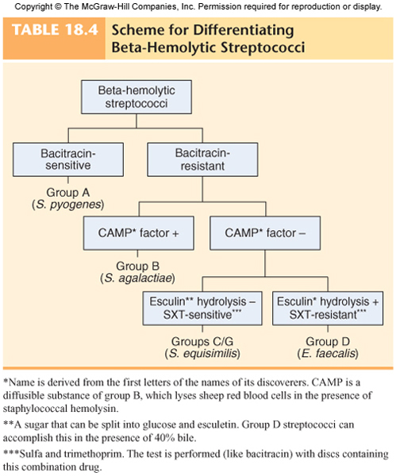

Slide 26
Alpha hemolytic streptococci Streptococcus viridans
1
They contain many species.
Normally present on teeth, throat, colon & female genital tract
They adapted to non-invasive mode of life and enforced to inter human body.
Pathogenicity –
The most serious infection -Subacute bacterial endocarditis-Blood-borne bacteria settle and grow on heart lining or valves
Colonization of heart by forming biofilms.
Dental caries

Slide 27
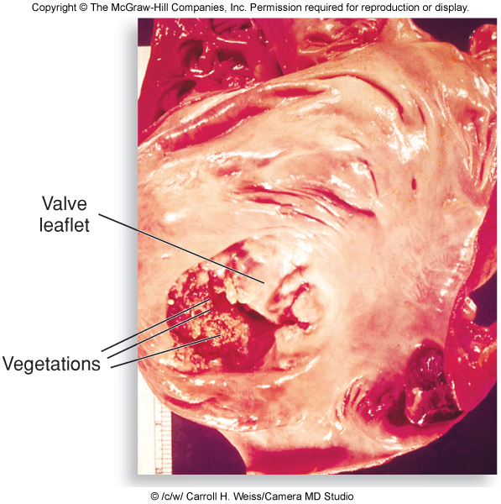
Two effects of streptococcal colonization

Slide 28
Alpha hemolytic streptococci Streptococcus pneumoniae (Pneumococcus)
1
General features:
Causes 60-70% of all bacterial pneumonias
Small, lancet-shaped cells arranged in pairs and short chains
Culture requires blood or chocolate agar, Growth improved by 5-10% CO₂
5-50% of all people carry it as normal flora in the nasopharynx; infections are usually endogenous
Virulence factor – capsule

Slide 29
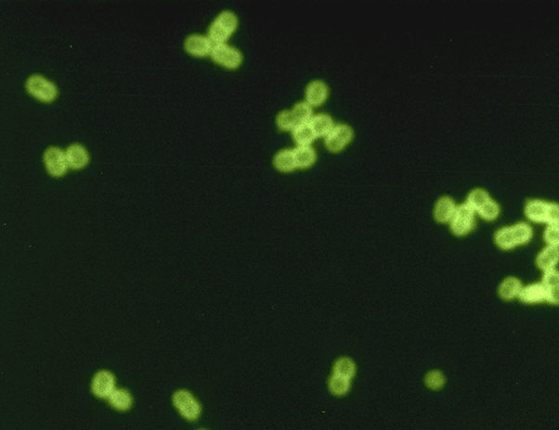
Diagnosing Streptococcus pneumoniae

Slide 30
Pathogenicity
Otitis media, sinusitis – commonest
Pneumonia (Pneumonia occurs when cells are aspirated into the lungs of susceptible individuals, Pneumococci multiply and induce an overwhelming inflammatory response)
Gains access to middle ear by way of eustachian tube.
Meningitis
Other suppurative lesions - Pericarditis, conjunctivitis, arthritis, peritonitis

Slide 31
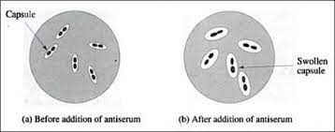
Lab. diagnosis:
Gram stain: GPC arranged in pairs. (lancet-shaped diplococci)
presumptive identification to differentiate from pneumonia caused by viruses.
Rapid diagnostic test: Quellung test or capsular swelling reaction for S. pneumoniae :is a Rapid diagnostic test on sputum or culture. By mixing S. pneumoniae with specific antipolysaccharide (capsule component) on microscopic slide. The capsule swells due Ag-Ab reaction.
Culture: BA- α-hemolytic
Biochemical test:
optochin sensitivity: sensitive
bile solubility: soluble (+)
inulin fermentation (+)

Slide 32
Bile Solubility test
Principle:
S. pneumoniae produce a self-lysing enzyme to inhibit the growth
The presence of bile salt accelerate this process
Procedure:
Add ten parts (10 ml) of the broth culture of the organism to be tested to one part (1 ml) of 2% Na deoxycholate (bile) into the test tube
Negative control is made by adding saline instead of bile to the culture
Incubate at 37oC for 15 min
Record the result after 15 min

Slide 33
Bile Solubility test
Results:
Positive test appears as clearing in the presence of bile while negative test appears as turbid
S. pneumoniae soluble in bile whereas S. viridans insoluble

Slide 34
Optochin Susceptibility Test
Principle:
Optochin (OP) test is presumptive test that is used to identify S. pneumoniae
S. pneumoniae is inhibited by Optochin reagent (<5 µg/ml) giving a inhibition zone ≥14 mm in diameter.
Procedure:
BAP inoculated with organism to be tested
OP disk is placed on the center of inoculated BAP
After incubation at 37oC for 18 hrs, accurately measure the diameter of the inhibition zone by the ruler
≥14 mm zone of inhibition around the disk is considered as positive and ≤13 mm is considered negative
S. pneumoniae is positive (S) while S. viridans is negative (R)

Slide 35
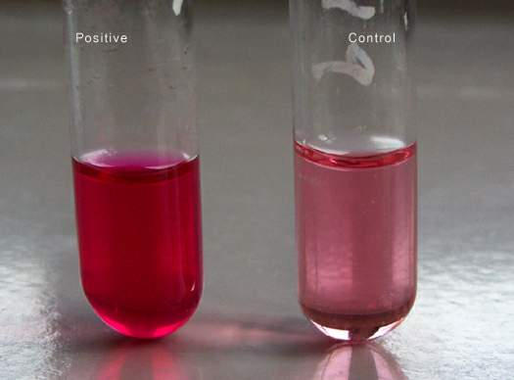
Inulin fermentation Test
This test is useful to differentiate Pneumococci from other streptcocci as the latter do not ferment Inulin sugar while Pneumococci do ferment it.

Slide 36
Differentiation between α-hemolytic streptococci
The following definitive tests used to differentiate S. pneumoniae from viridans streptococci
Optochin Test (sensitive)
Bile Solubility Test (+)
Inulin Fermentation (+)

Slide 37
Differences between Viridans Gp & Pneumococci
Point | Pneumococci | Viridans Gp
Morphology | Capsulated, lanceolate, diplococci | Oval or rounded in chains
Quellung test | + | -
Colonies | Dome shaped→ Draughtsman | Dome shaped
Growth in liquid | Uniform turbidity | Granular turbidity with powdery deposits
Bile solubility | + | -
Inulin fermentation | + | -
Optochin sensitivity | + | -
Intraperitoneal inoculation in mice | Fatal Infection | Non-pathogenic

Slide 38
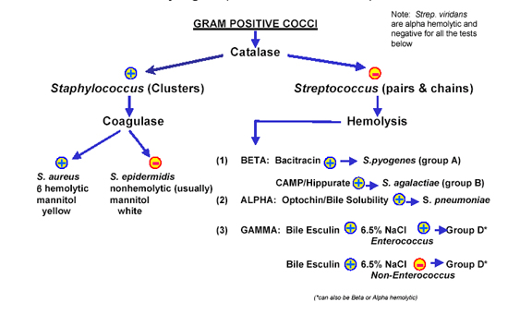

Slide 39
Thank you
For
listening
Overview of the Medically Important Gram Positive Cocci
Family, Genus, species | Characteristics | Clinical manifestations
Staphylococcaceae | Cocci in cluster; catalase-positive
Staphylococcus aureus | Coagulase +ve, yellow-pigmented colonies | Pyogenic infections, toxicoses
S. epidermidis | Coagulase -ve, whitish colonies, normal flora | Foreign body infections
Streptococcaceae | Cocci in chains and in pairs, catalase-negative
Streptococcus pyogenes | Cocci in chains, Lancefield group A, β - hemolysis | Tonsillitis, scarlet fever, skin infections
S. pneumoniae | Diplococci, α-hemolysis | Pneumonia, otitis media, sinusitis
S. agalactiae | Chain-forming cocci, group antigen B, β-hemolysis | Meningitis/sepsis in neonates
S. viridans | Cocci in chains, α-hemolysis | Endocarditis, dental caries
Enterococcaceae | In chains & pairs, α, β, or γ-hemolysis, group antigen D, catalase -ve | Flora of intestines of humans and animals
Enterococcus faecalis Enterococcus faecium | Aesculin-positive, growth in 6.5% NaCl, pH 9.6 | Opportunistic infections

