Slide 1
Lab. 7
Gram-negative cocci
(Neisseriae)
By:
Assist. Prof. Shaima R. Al-Salihy

Slide 2
Learning objectives:
After this lab. You must be able to:
Differentiate between Neissereiae spp.
Describe the two species microscopically and culturally.
List types of clinical infections these organisms produce
Predict g-ve diplococci agents causing clinical cases.
Diagnose the Neisseria spp. In clinical sample.
List recommended treatment regimens for gonorrhea
Describe the measures for prevention of each organism.

Slide 4
Neisseriae spp.:
The genus Neisseriae contain two important pathogens :
N. meningitidis- cause meningitis and meningococcemia (the most severe form of meningococcemia is life-threatening Waterhouse-friderichsen syndrome)
N. gonorrhoea- causes gonorrhoea, neonatal conjunctivitis (ophthalmia neonatrum) and pelvic inflammatory disease (PID).

Slide 5
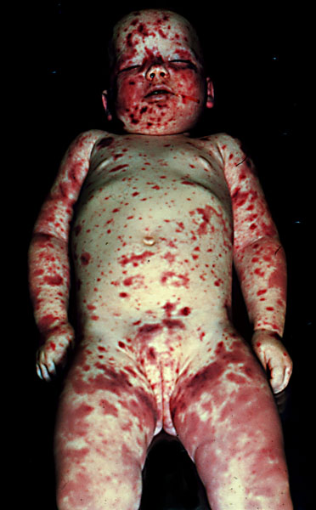
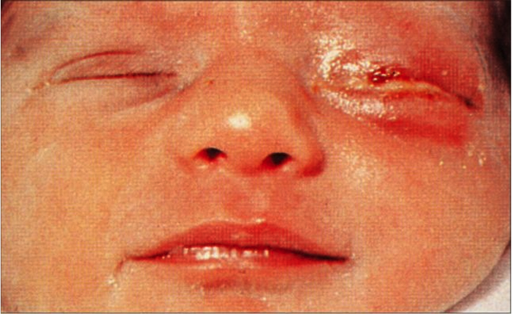
Ophthalmia neonatrum Waterhouse-Friderichsen syndrome

Slide 6
Important properties:
Aerobic
Gram –ve diplococci (each coccus is shaped like a kidney or coffee bean with concave side faced each other).
Oxidase +
Most catalase +ve
Non motile
Grow well on chocolate agar (blood heated to 80 ̊ C), but not on blood agar because the growth is inhibited by toxic trace metal and fatty acids found in certain media including blood.

Slide 7
Neisseriae meningitidis:
Important properties:
Capsulated.
Have 3 virulence factors: polysaccharide capsule, endotoxin (LPS), and IgA protease.
Ferment maltose and glucose
Transmitted by airborne droplets.

Slide 8
Laboratory diagnosis:
Specimen: blood and CSF.
Microscopic: presumptive diagnosis can be made if G –ve diplococci are seen in a smear of CSF inside the PMN (intracellular)
Culture: chocolate agar at 37 ̊ C in a 5% CO2.
Biochemical tests:
Oxidase +ve.
Maltose fermentation +ve.
Immunological assay: latex agglutination test detects capsule polysaccharide in CSF. (capsule swelling)

Slide 9
Oxidase test:
Principle:
The oxidase test is used to identify bacteria that produce cytochrome c oxidase, an enzyme of the bacterial electron transport chain. When present, the cytochrome c oxidase oxidizes the reagent to purple color end product. When the enzyme is not present, the reagent remains reduced and is colorless.
Cytochrome c _{(reduced)} + O₂ ^{cytochrome oxidase} Cytochrome c _{(oxidized)} + H₂O
Cytochrome c_{(oxidized)}+ oxidase reagent _{(reduced)} Cytochrome c _{(reduced)}+oxidase reagent _{(oxidized)}
(colorless) (dark purple)

Slide 10
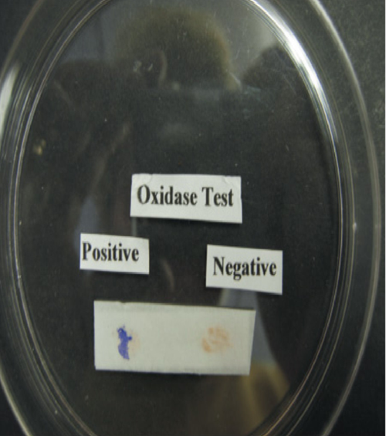
Maltose and glucose fermentation
Oxidase test

Slide 11
Treatment:
Penicillin is the treatment of choice
Prevention:
Chemoprophylaxis: rifampin or ciprofloxacin
Immunization:
- Conjugated (the four capsular polysaccharide types conjugated to a carrier; diphtheria toxoid)
- Non-conjugated: only the four capsular polysaccharide without the carrier.

Slide 12
Neisseriae gonorrhoea:
Important properties:
Have no capsule.
Have 3 virulence factors: pili, endotoxin (LOS; a modified form of endotoxin), and IgA protease.
Ferment glucose but not maltose.
Transmitted by sexual contact (killed by drying).

Slide 13
Laboratory diagnosis:
Specimen: urethral discharge and cervical swab.
Microscopic: in men the finding of G –ve diplococci within PMNs in a urethral discharge specimen is sufficient for diagnosis but in women culture should be done.
Culture: Thayer-Martin medium (chocolate agar containing antibiotics; vancomycin, colistin, trimethoprim, and nystatin to suppress the normal flora) at 37 ̊ C in a 5% CO2.
Biochemical tests:
Oxidase +ve
Maltose fermentation -ve
Nucleic acid based tests.

Slide 14
Glucose fermentation

Slide 15
Laboratory diagnosis:

Slide 16
Neisseria gonorrhoea in a urethral discharge

Slide 17
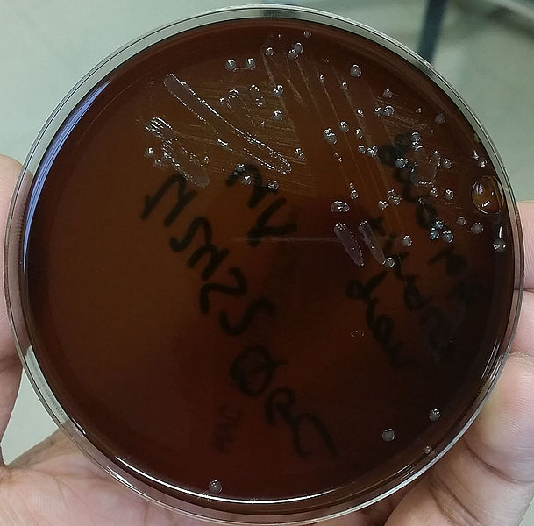
N. gonorrhoea on Thayer-Martin agar

Slide 18
Treatment:
Penicillin is no longer drug of choice due to:
Chromosomally-mediated resistance because of (1- reduced uptake of the drug, 2- altered binding site)
Plasmid-encoded beta-lactamase production ( penicillinase-producing N. gonorrhoea- PPNG)
Cefitrixone is the treatment of choice in uncomplicated cases
In combination of tetracycline, doxycycline or azithromycin in dual infection with C. trachomatis
follow-up.

Slide 19
Prevention:
Chemoprophylaxis of newborns against ophthalmia neonatrum with 1% silver nitrate, 0.5% erythromycin eye ointment.
Measures to limit epidemic include education, aggressive detection, uses of condoms, and the prompt treatment of symptomatic patients and their partners

Slide 20
Thank you

