Slide 1
Microbiology lec. 11
Gram-negative bacilli Enterobacteriaceae family
By:
Asst. Prof. Dr. Shaima’a Al-Salihy

Slide 2
Learning objectives:
After this lec. You must be able to:
Describe microscopic morphology and cultural biochemical characteristics of each member in this family.
List infections caused by each of these members.
Differentiate each member of this family from each other.
Discuss principles of biochemical tests of each member in this family.
Predict enterics causative agents causing clinical cases.

Slide 3
Gram-Negative bacilli
Large group of diverse organisms, they are divided to:
Gram-Negative Rods related to gastrointestinal tract.
Gram-Negative Rods related to respiratory tract.
Gram-Negative Rods related to animal source.

Slide 4
Gram-Negative Rods related to gastrointestinal tract:
Family Enterobacteriaceae :
Notes:
Some strains are opportunistic pathogens, others are true pathogens (e.g. Salmonella, Shigella, Yersinia, and some strains of E. coli)

Slide 5
Notes:
Their natural habitat is the intestinal tract of human and animals. And the major sites of infection are the GI tract, urinary tract, septicemia, lower respiratory tract, and meninges. As well as sometimes affecting soft tissue infections and the genital tract

Slide 6
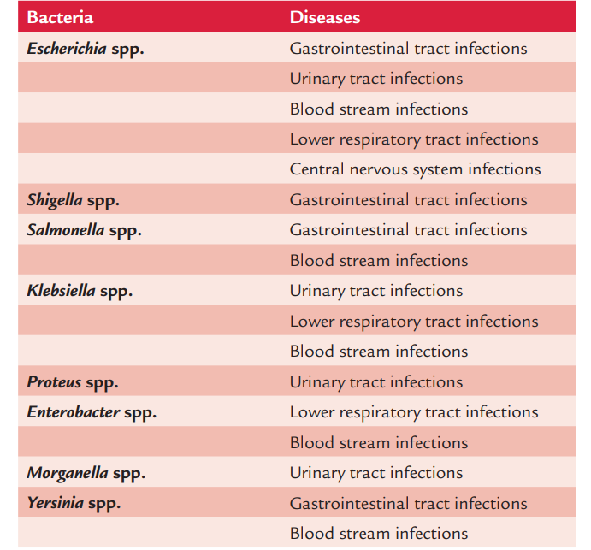
Human infections caused by common members of the family Enterobacteriaceae

Slide 7
General characters:
Gram-negative rods, motile by peritrichous flagella except Shigella and Klebsiella
Some are capsulated with well-defined capsule as Klebsiella, ill-defined loose coating “slime layer” as in E. coli, or non-capsulated as Proteus
Have fimbriae (pili) for attachment to the host
Facultative anaerobes, non spore forming, non acid fast.
Catalase positive , oxidase negative
Reduce nitrates to nitrites
Ferment glucose, often with gas production, some are lactose fermenter others non

Slide 8
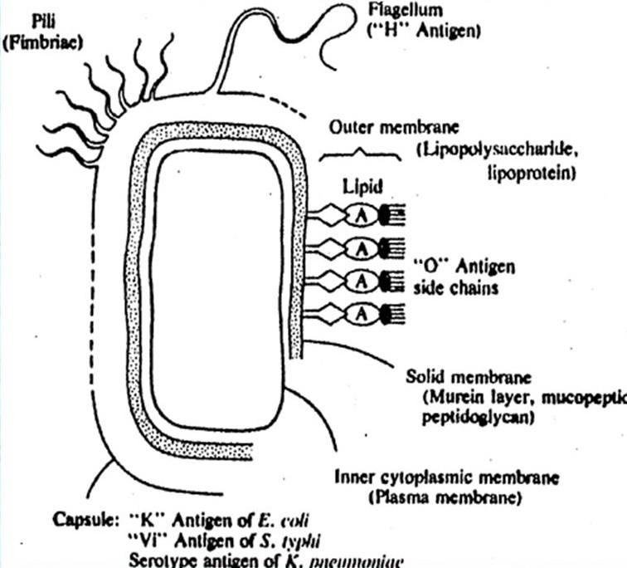
Family Pathogenesis
Endotoxin
Some also produce exotoxins (powerful enterotoxin).
Antigens
O= cell envelope or O antigen
H= flagellar antigen (motile cells only)
K = capsular polysaccharide antigen (Salmonella capsular antigen called Vi (virulence)).

Slide 9
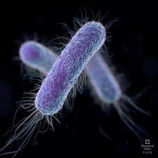
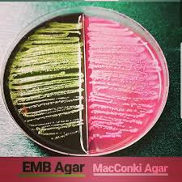
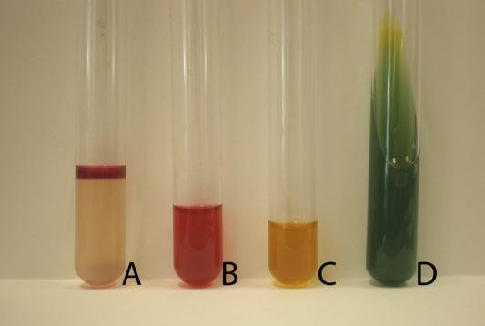
Genus: Escherichia
Escherichia coli
- Species of medical importance:
General features:
Gram-negative rod, Facultative anaerobic, palliated and flagellated.
Some strains of E. coli isolated from extraintestinal infections possesses polysaccharide capsule.
They do not form any spores.
E. coli is a lactose fermenter, colonies with iridescent green sheen on EMB
E. coli is indole and MR positive, and VP and citrate negative (IMViC + + – –)

Slide 10
Antigenic structure:
O antigens (somatic antigens):
O antigen is an LPS complex and is an integral part of the cell wall.
It is heat stable
Till now, 173 O antigens have been described.
K antigens (capsular antigens):
K antigen encloses the O antigen and may interfere with detection of the O antigens
Some are polysaccharides others are protein ,
K antigens is identified by the Quellung (capsule swelling) reactions in the presence of specific antisera and is used to serotype of E.coli and Salmonella typhi.
Inhibiting phagocytosis.
A total of 103 “K” antigens have been recognized.
H antigens (flagellar antigens):
Located on flagella.
Heat- and alcohol-labile proteins
A total of 75 “H” antigens have been recognized so far.
Antigenic typing:
E. coli O111:K58:H2

Slide 11
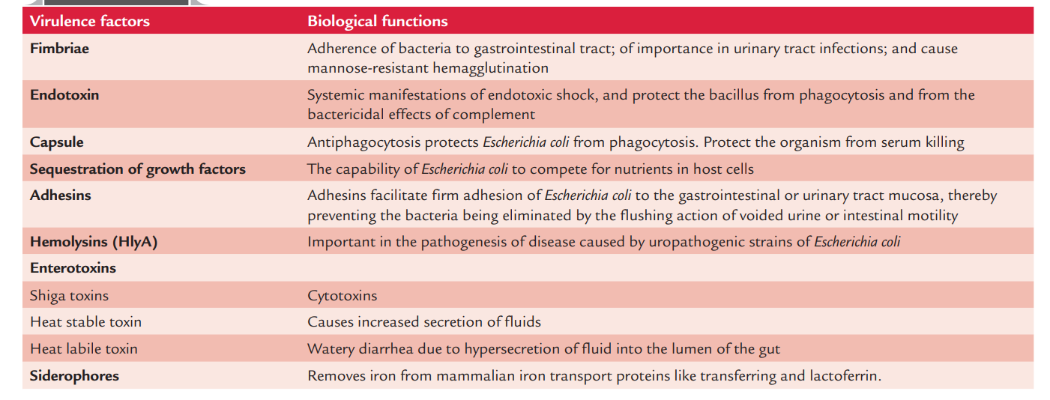
Virulence factors of E. coli :
Notes:
LT activates adenylate cyclase, this increases the local concentration of cyclic adenosine monophosphate( cAMP) which results in intense and prolonged hypersecretion of water and chlorides and inhibits reabsorption of sodium. the gut lumen is distended with fluid and lead to hypermotility and diarrhea. The ST activates guanylate cyclase in enteric epithelial cells causing production of (cGMP) and stimulates fluid secretion
Shiga-like toxin ↓ Protein synthesis by ↓ ribosomes

Slide 12
Clinical Manifestations of E.coli Infection
1. Urinary tract infection (UTI): Caused by uropathogenic E.coli (UPEC)
2. Diarrhea: Caused by diarrheagenic E.coli
3. Other syndromes:
• Abdominal infections: E.coli is the most common cause of both primary bacterial peritonitis (occurs spontaneously) and secondary bacterial peritonitis (occurs secondary to intestinal perforation. It also causes visceral abscesses, such as hepatic abscess.
• Pneumonia (especially in hospitalized patients: ventilator associated pneumonia)
• Meningitis (especially neonatal meningitis)
• Wound and soft tissue infection.
• Osteomyelitis
• Endovascular infection and bacteremia.
Transmission | Mechanism of pathogenesis | Clinical clues | Treatment
UTI (most common cause)
Endogenous fecal flora contaminate and ascend | Motility Adherence to uroepithelium-pyelonephritis associate pili, X-adhesins, β- hemolytic | G-ve, bacilli, > 10⁵ CFU/ml | Fluoroquinolone or sulfonamides
Neonatal septicemia/meningitis (second most common cause)
Maternal fecal flora contaminate during delivery | Capsule- K1 serotype, endotoxin | Blood, SCF culture, G-ve bacilli | Cefitriaxone
Septicemia
Indwelling IV lines, cytotoxic drugs damage intestinal mucosa allow escape | endotoxin | Blood culture, G-ve bacilli, oxidase –ve | Fluoroquinolone, third generation of cephalosporins

Slide 13
E coli–associated diarrheal diseases (Diarrheagenic E. coli):
Enteropathogenic E. coli (EPEC):
Infantile diarrhea
Institutional (nurseries) outbreaks
Pathogenesis:
destruction of brush border microvilli
Nontoxigenic, Noninvasive
Clinical features:
Severe watery diarrhea (non-bloody stools), vomiting , fever
Usually self-limited but can be prolonged or chronic.
The duration of the EPEC diarrhea can be shortened and the chronic diarrhea cured by antibiotic treatment.
Enterotoxigenic E. coli (ETEC):
ETEC is Noninvasive, toxigenic and is a common cause of “traveler’s diarrhea” (all ages)
very important cause of diarrhea in infants in developing countries.
Diarrhea like cholera but milder, transmitted by contaminated food and water
Pathogenesis
plasmid coded toxins Enterotoxins (LT/ST) that mediate secretion of electrolytes into the bowel lumen.

Slide 14
Enterohemorrhagic E. coli [EHEC] = Verotoxingenic E. coli (VTEC),= Shiga- toxin producing E. coli (STEC) .
STEC has been associated with hemorrhagic colitis (a severe form of diarrhea), and with hemolytic uremic syndrome (disease resulting in acute renal failure), microangiopathic hemolytic anemia, and thrombocytopenia.
The most common E coli serotypes that produce Shiga toxin, O157:H7 and is the one that can be identified most readily in clinical specimens
Enteroinvasive E coli (EIEC):
Produces a disease very similar to shigellosis. The disease occurs most commonly in children in developing countries and in travelers to these countries.
Watery diarrhea: acute and chronic diarrhea (>14 days in duration) in persons in developing countries. These organisms also are the cause of foodborne illnesses in
Industrialized countries
Treatment:
Generally fluid replacement is the primary treatment. Antibiotics are generally not used except in severe disease or hemolytic-uremia syndrome

Slide 15
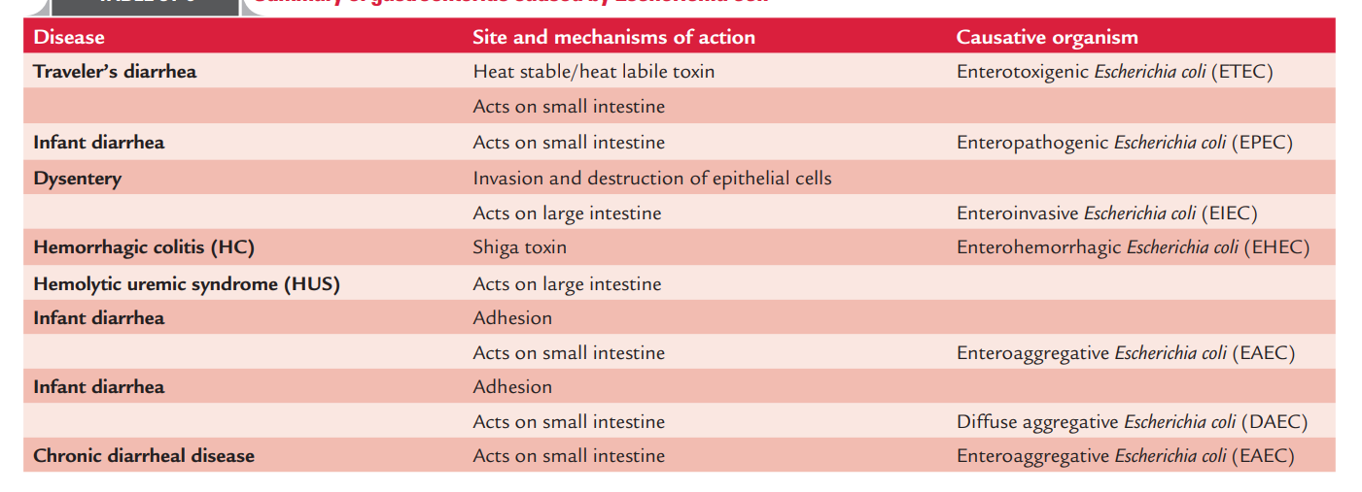
Disease Syndromes Caused by E. coli
- Gastroenteritis caused by E. coli
Notes:
E. coli O157:H7 is the most common serotype associated with the clinical disease caused by EHEC strains. T

Slide 16
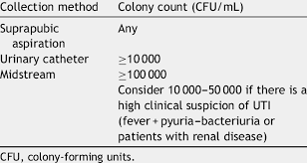
Lab Diagnosis:
1. Isolation of E. coli by culture.
2. Demonstration of toxins of diarrheagenic E. coli
** Significant bacteriuria: concept suggested by Kass is based on the fact that a colony count exceeding 100,000 (10⁵ ) bacteria/mL of urine denotes significant bacteriuria and is suggestive of active UTI. Counts of 10,000 bacteria or less per milliliter are of no significance and are due to contamination of urine during voiding
Notes:
Clean-voided midstream urine, Catheterized urine, urine collected by suprapubic aspiration

Slide 17
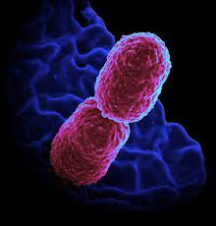
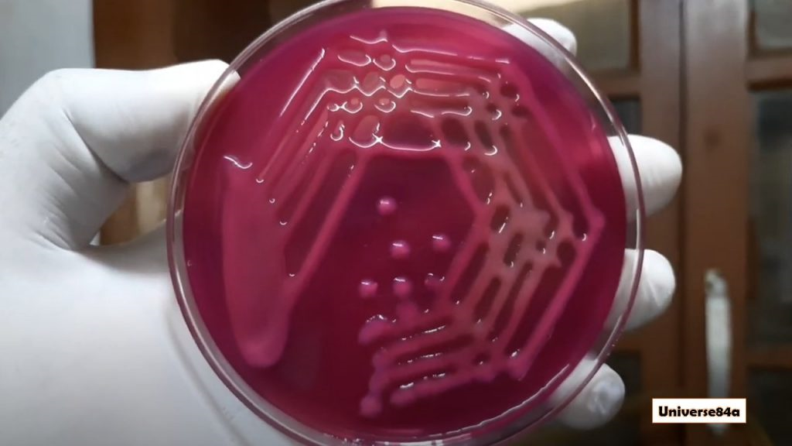
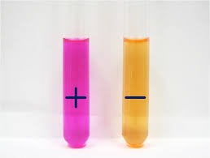
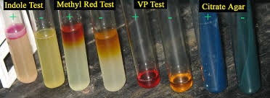
Genus: Klebsiella
Klebsiella pneumoniae
- Species of medical importance:
General features:
Gram-negative short rods, non-motile bacteria, with a prominent polysaccharide capsule, loose slime layer (mucoid appearance).
They do not form any spores.
E. coli is a lactose fermenter.
Klebsiella pneumoniae is indole and MR negative, and VP and citrate negative (IMViC – – + +), urease- positive

Slide 18
Species of Klebsiella
2. Klebsiella ozaenae : causes a condition called ozena , purulent infection of the nasal mucosa with atrophic rhinitis and fetid odor.
3. Klebsiella rhinoscleromatis : causes granulomatous disease called scleroma, an infection of the upper respiratory tract .
4.K. granulomatus:
granuloma inguinale :small painless nodules that burst and ulcerate; beefy red painless genital ulcers

Slide 19
Antigenic structure:
Klebsiella possesses 77 capsular polysaccharides (K antigens) and 8 somatic LPSs (O antigens).
The members of Klebsielleae have been classified into over 80 serotypes based on the capsular K antigens and somatic O antigens.
All serotypes are of the same virulence.
Virulence factors:
Capsule: Inhibits phagocytosis and C3b.
Multiple adhesins: help the bacteria to adhere to host cells to initiate the disease process.
LPS
Clinical syndromes caused by Klebsiella pneumoniae:
Community-acquired pneumonia.
UTI
Nosocomial infection
Bacteremia and sepsis.
Notes:
LPS prevents membrane damage and death of bacteria. The LPS of the bacteria activates the complement, which causes selective deposition of C3b onto LPS molecules at sites away from cell membrane of the bacteria. This inhibits the formation of the membrane attack complex (C5b–C9), which is responsible for cell death of the bacteria.

Slide 20
(A) Pneumonia:
Community-acquired, most often in older males; most commonly in patients with either chronic lung disease, alcoholism, or diabetes (but this is not the most common cause of pneumonia in alcoholics; S. pneumoniae is.)
Endogenous; assumed to reach lungs by inhalation of respiratory droplets from upper respiratory tract
Lobar pneumonia characteristically is associated with massive mucoid inflammatory exudate of lobar involving one or more lobes of the lung
Frequent abscesses make it hard to treat; fatality rate high
Sputum is generally thick and bloody (currant jelly) but not foul smelling as in anaerobic aspiration pneumonia.
(B) Urinary tract infection:
- catheter-related (nosocomial) from fecal contamination of catheters
(C) Septicemia:
immunocompromised patients, may originate from bowel defects or invasion of IV lines
In neonatal units, outbreaks of infection caused by extended-spectrum beta-lactamase (ESBL)-producing Klebsiella strains present a more serious problem and may be associated with high mortality

Slide 21
Diagnosis:
Culture of sputum or clean catch urine sample
Biochemical test (IMViC, Lactose fermentation).
Treatment
Third-generation cephalosporin with or without an aminoglycoside
Fluoroquinolones may also be used.
The carbapenems, especially imipenem, are effective against such ESBL strains
Prevention: good catheter care, limit use

Slide 22
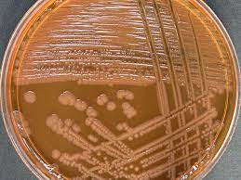
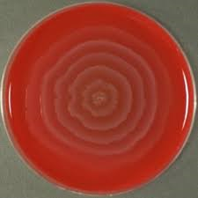
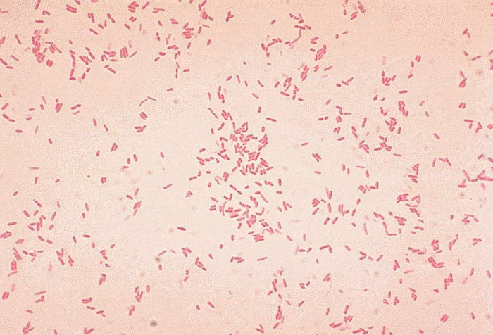
Genus: Proteus
Proteus mirabilis (90%) & P. vulgaris
- Species of medical importance
General feature:
Gram negative bacilli, pleomorphic
Normal intestinal microbiota
Highly motile (swarming); peritrichous flagella
Non lactose fermenter, urease +ve
Produce characteristic ‘fishy’ or ‘seminal’ odor in cultures.
IMViC test: + + - +, TSI agar: K / A (H2S producer)
Notes:
General characteristics: “swarming” phenomenon on nonselective agar (P.vulgaris; P.mirabilis and P.myxofaciens)
P.vulgaris strains (OX-19, OX-K, OX-2)have common antigen with Rickettsia (Weil-Felix test).
urinary tract infections; food poisoning.

Slide 23
Diseases:
Urinary tract infections
Septicemia
Pneumoniae
Wound infection
Pathogenesis:
Urease raises urine pH to cause kidney stones ( renal calculi- stones)
Motility may aid entry into bladder.
Endotoxin causes fever and shock when septicemia occurs.
Diagnosis;
- culture of blood or urine for lactose-negative organisms with swarming motility.
Treatment:
Fluoroquinolones, TMP-SMX, or third-generation cephalosporin for uncomplicated UTIs.
Remove stones, if present.
Prevention- promptly remove urinary tract catheters.

Slide 24
Thank you
for
Your attention

