Slide 1
Medical Microbiology Lec. 4 Pathogenesis of bacterial infection
By:
Asst. Prof. Dr. Shaima’a Al-Salihy

Slide 2
Learning objective:
After this lecture, you must be able to:
-

Slide 3
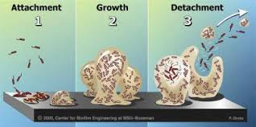
Pathogenesis of bacterial infection
Pathogenesis: is the mechanisms of initiation and development of signs and symptoms of disease.
Pathogenicity: The ability of an infectious agent to cause disease.
Virulence: The quantitative measure of microorganism’s ability to cause disease.
carrier: a person or animal with asymptomatic infection that can be transmitted to another susceptible person or animal.

Slide 4
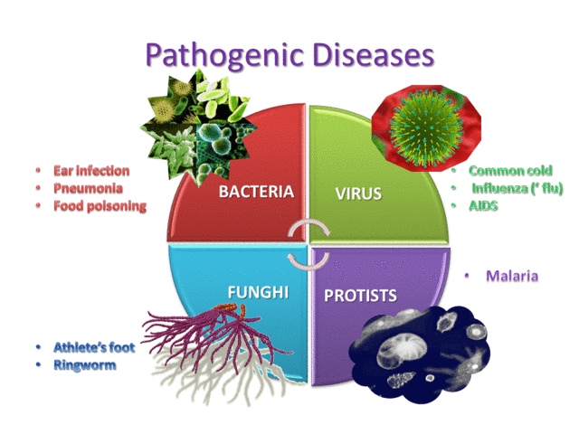
Pathogenesis of bacterial infection
Pathogen: A microorganism that cause or capable of causing disease especially in immunocompetent people.
Types of pathogen:
Pathogen
Opportunistic pathogen

Slide 5
Q//How to determine the real cause of the disease ?
The answer depend on:
Koch’s postulates
Awareness of two phenomena:
Normal flora
Colonization
Note: microbial genetics has opened a new frontiers to study pathogenic bacteria and differentiate them from non-pathogenic-------˃ molecular Koch’s postulates
Notes:
Normal flora: it refers to various bacteria and fungi that are permanent residents of certain body sites, especially the skin, oropharynx, colon, and vagina.
Colonization: it refers to the presence of a new organism that is neither member of normal flora nor the cause of symptoms

Slide 6
Koch's postulates (19th century)
Four criteria that were established by Robert Koch to identify the causative agent of a particular disease, these include:
The organism must always be found in humans with the infectious disease but not found in healthy ones.
The organism must be isolated from humans with the infectious disease and grown in pure culture.
The organism isolated in pure culture must initiate disease when re-inoculated into susceptible animals.
The organism should be re-isolated from the experimentally infected animals.
Notes:
However, many microorganisms that do not meet the criteria of the postulates have been shown to cause disease. For example, Treponema pallidum (syphilis) and Mycobacterium leprae (leprosy) cannot be grown in vitro; however, there are animal models of infection with these agents. In another example, Neisseria gonorrhoeae (gonorrhea), there is no animal model of infection even though the bacteria can readily be cultured in vitro; experimental infection in humans has been produced that substitutes for an animal model.

Slide 7
Infection: Multiplication of an infectious agent (pathogenic bacteria but not normal flora) within the body even if the person is asymptomatic.
Bacterial Pathogenicity major mechanisms: Infectious agents cause disease by : toxin production, invasion and inflammation, or Immunopathogenesis.
Infectious dose ( ID50 ): is the number of organisms needed to cause infection in half the host.

Slide 8
Types of infection:
Primary infection: initial infection with an organism in a host.
Reinfection: subsequent infection with the same organism in the same host.
Secondary infection: infection with new organism in a host whose body resistance is already lowered by a pre-existing infectious disease.
cross infection: infection with a new organism from another host or another external source in a patient who is already suffering from a disease.

Slide 9
Nosocomial infection: cross-infection acquired in hospital.
Subclinical infection: inapparent clinical infection (which has a number of outcomes covering the spectrum between death and complete recovery).
Latent infection: hidden stage of microorganism in a host and subsequent multiplication to produce clinical disease when host resistance is lowered.
Chronic infection: situation where a person continues to harbor a pathogenic organism but suffer no ill-effects themselves

Slide 10
Stages of bacterial pathogenesis:
Transmission from an external source into the portal of entry.
Evasion of primary host defenses such as skin or stomach acid.
Adherence to mucous membranes, usually by bacterial pili.
Colonization by growth of the bacteria at the site of adherence.
Disease symptoms caused by toxin or inflammation.
Host response during 3,4 and 5.
Progression or resolution of the disease.

Slide 11
Typical Stages of an infectious disease
A typical acute infectious disease has four stages:
Incubation period: is the time between the acquisition of the organism(or toxin) and the first appearance of clinical symptoms.
Prodrome period: during which non specific symptoms such as (fever, malaise, and loss of appetite) are noted.
Specific illness period: during which the overt signs and symptoms of the disease occur.
Recovery period: during which regression of disease occur and the patient returns to the healthy state.
convalescence where the symptoms have largely disappeared.

Slide 13
Bacterial virulence factors
The time course and severity of the disease depends upon the balance between the virulence of the infecting agent and the success of the immune system to combat the organism.
The ability of bacteria to cause disease is described in terms of the number of infecting bacteria, the route of entry into the body, the effects of host defense mechanisms, and intrinsic characteristics of the bacteria called virulence factor.

Slide 14
Bacterial virulence factors
Virulence factors: are molecules coded for by genes in chromosomal DNA or plasmid, expressed and secreted by pathogens (bacteria, viruses, fungi and protozoa) that enable them to achieve the following:
1. colonization of the host (this includes adhesion to cells)
2. Immuno-evasion, evasion of the host's immune response
3. Immunosuppression, inhibition of the host's immune response
4. entry into and exit out of cells (if the pathogen is an intracellular one)
5. obtain nutrition from the host.

Slide 15
Bacterial virulence factors
Pathogens possess a wide array of virulence factors. Some are intrinsic to the bacteria (e.g. capsules and endotoxin whereas others are obtained from plasmid (e.g. some toxins).
Toxins: are divided into two groups: endotoxin and exotoxin.
Endotoxin: lipopolysaccharide (LPS) is a prototypical example of an endotoxin, which is a component of the cell wall of Gram-negative bacteria.
Exotoxins are actively secreted by some bacteria and have a wide range of affects including inhibition of certain biochemical pathways in the host. The two most potent exotoxins known to man are the tetanus toxin (tetanospasmin) and (botulin).
Pili, capsule, glycocalyx: allow the bacteria to adhere to surfasce of human cell. Capsules play important roles in immune evasion, as they inhibit phagocytosis, as well as protecting the bacteria while outside a host
Immunoglobuline (Ig) proteases: break down host’s Ig.

Slide 16
Bacterial virulence factors
Enzymes include:
hyaluronidase: which breaks down the connective tissue component hyaluronic acid
proteases and lipases
DNAses: which break down DNA
Hemolysins: which break down a variety of host cells, including red blood cells.
Immunopathogenesis: Host-mediated pathogenesis is often important because the host can respond aggressively to infection with the result that host defense mechanisms cause damage to host tissues.

