Slide 1
Medical Microbiology Lec. 5 Gram-positive cocci Staphylococcus
By:
Asst. Prof. Dr. Shaima’a Al-Salihy

Slide 2
Learning Objectives:
After this Lec. You must be able to:
List clinically important gram positive bacteria.
Differentiate among staphylococci species Describe staphylococci under microscope.
List diseases caused by each spp. of staphylococci.
Predict staphylococcal causative agents causing clinical cases.

Slide 3
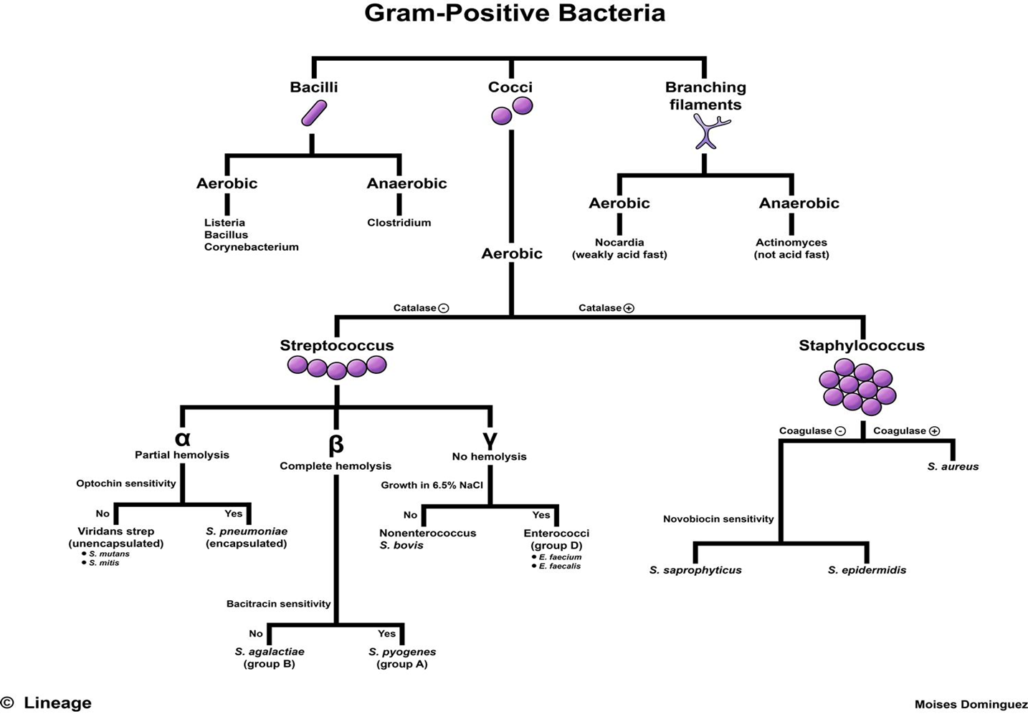

Slide 4
Classification
Family
Genus
Species
Micrococcaceae
Micrococcus and Staphylococcus
S. aureus
S. saprophyticus
S. epidermidis
M. luteus
more than 30 species

Slide 5
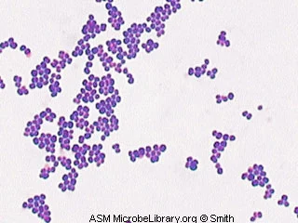
Staphylococci
Morphology:
Gram-positive, spherical bacteria, about 1 µm in diameter
arranged in grape-like irregular clusters, but single or pairs may also found
non motile, non spore-forming and occasionally capsulated.
Biochemical:
Catalase-positive which can differentiate them from Streptococci which are catalase-negative (Its degradation limits the ability of neutrophils to kill).
Staphylococci tolerate high salt concentration (9.5% Nacl).

Slide 6
Staphylococci
Culture: They grow readily on many types of media under aerobic or microaerophilic conditions at 37°C, and produce pigments that vary from white to golden yellow, ferment carbohydrates Colonies on solid media are entire, smooth and glistening.
Pathogenicity: Some are normal flora of the skin and mucous membrane of human. Other causes suppuration, abscesses formation and a variety of pyogenic infections and even fatal septicemia.

Slide 7
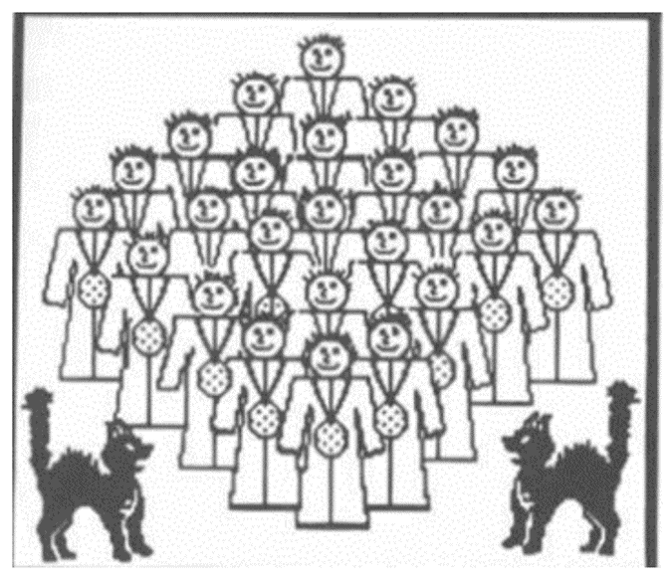
Staph. aureus
The main 3 medically important species of staphylococci are:
Staphylococcus aureus
Staphylococcus epidermidis (albus)
Staphylococcus saprophyticus
S. aureus is coagulase positive which differentiate them from other species.
Staphylococcus aureus:
Distinguishing Features:
Small, yellow(golden color) colonies on blood agar.
β-hemolytic on blood agar (complete destruction of RBC).
Coagulase positive (all other Staphylococcus species are negative).
Ferments mannitol on mannitol salt agar.
Reservoir:
• Normal flora:
Nasal mucosa ( 20-50% of population are carriers)
Skin
Transmission: (Hands, Sneezing, Surgical wounds, Contaminated food)
Staphylococci lie in grape-like clusters (notice this cluster of hospital staff posing for a group photo. Staphylococcus aureus is catalase-positive, thus explaining the cats in the group photo. Staphylococcus aureus (aureus means "gold"). Notice that our hospital Staff (Staph) all proudly wear gold medals around their necks. Note how all the Gold-Medalists (Staph. aureus) hang out together to show each other their gold medals. You can think of them as coagulating together.

Slide 8
Virulence factors:
1- Toxins and enzymes:
Staphylococci can produce many extracellular enzymes and toxins. These substances enable the bacteria for multiplying and spread widely in the tissues.
Catalase: which convert hydrogen peroxide into water and oxygen.
Coagulase: causes plasma to clot by activating prothrombin to form thrombin. Thrombin then catalyzes the activation of fibrinogen to form the fibrin around the bacteria, protecting it from phagocytosis.
Hemolysins: Cytolytic exotoxins (4 types) α, β, γ, and δ Toxins attack mammalian cell(including red blood cell) membranes

Slide 9
Virulence factors:
1. Toxins and enzymes:
Hyaluronidase ("Spreading Factor"): breaks down proteoglycans in connective tissue.
Staphylokinase: This protein lyses formed fibrin clots (like streptokinase).
Lipase: This enzyme degrades fats and oils, which often accumulate on the surface of our body. This degradation facilitates Staphylococcus aureus colonization of sebaceous glands.
Protease: destroys tissue proteins

Slide 10
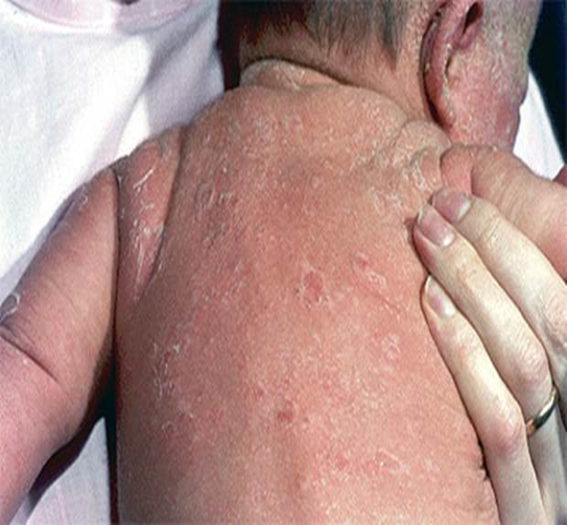
Virulence factors:
1. Toxins and enzymes:
Superantigens:
Exfoliative toxins: superantigen, causes the generalized desquamation of the staphylococcal scalded skin syndrome by dissolving the mucopolysaccharide matrix of the epidermis.
Toxic shock syndrome toxin: superantigen.
Enterotoxin: It is a heat-stable toxin responsible for food intoxication of S. aureus
Notes:
Composed of two distinct proteins of the same molecular weight. (Exfoliative toxin A is encoded by eta located on a phage and is heat stable, and Exfoliative toxin B is plasmid mediated (heat labile)

Slide 11
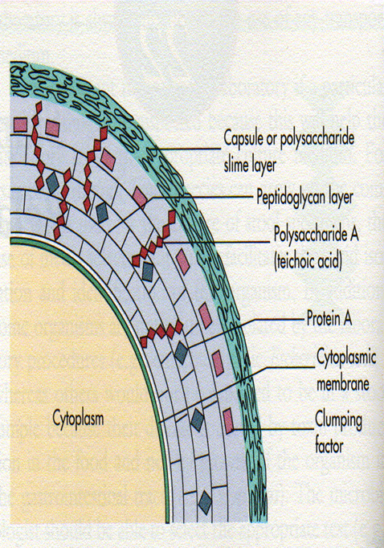
2. Protein A: cell wall component, binds to the fc portion of IgG molecules at the complement binding site it considered as a virulence factor (protects the organism from opsonization and phagocytosis). 3. Capsule: inhibit phagocytosis, Promote adherence 4. Peptidoglycan: leukocyte chemoatractant, decomplementation.
S. aurus virulence factors

Slide 12
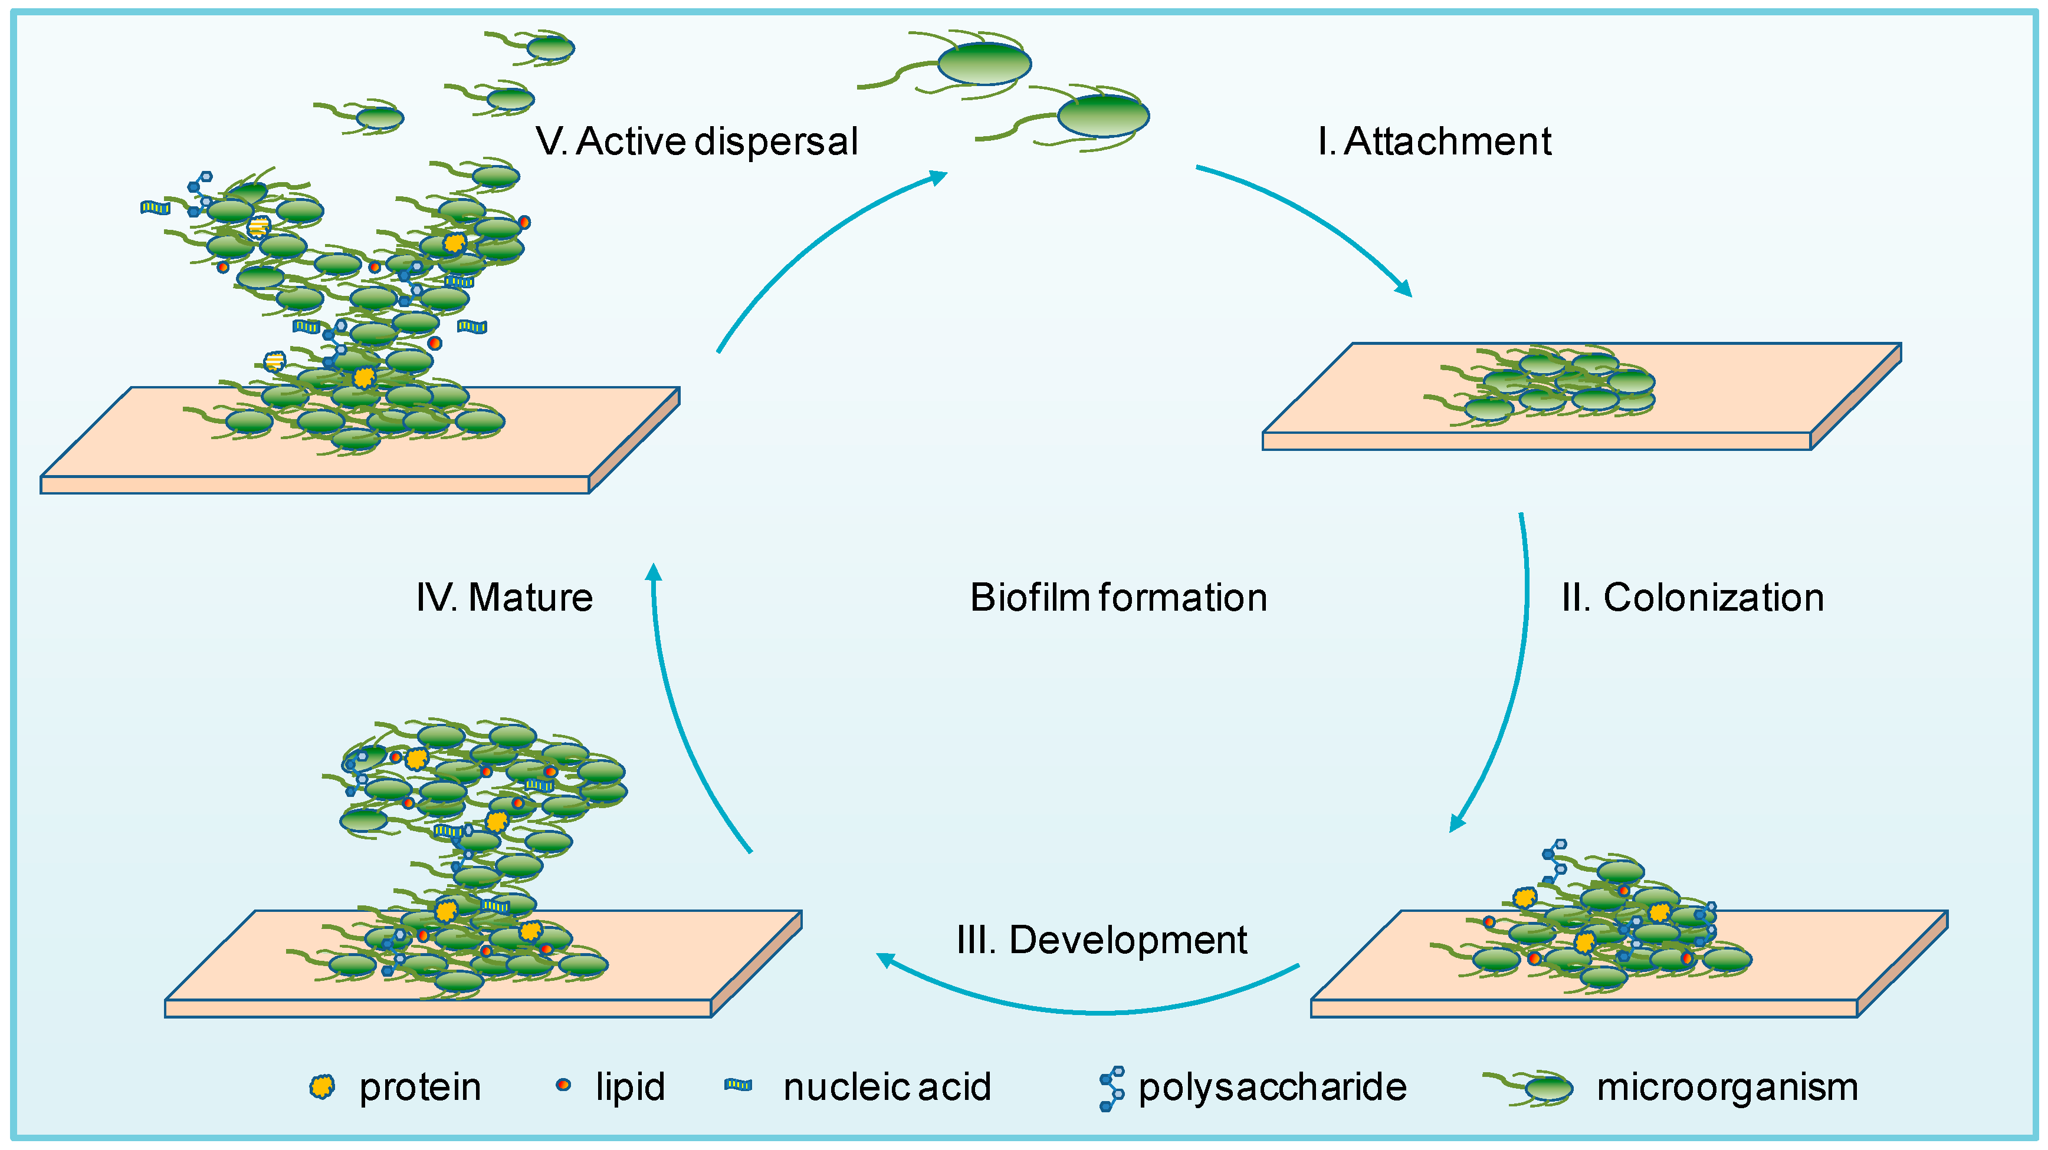
4- B-lactamase production: The majority of S. aureus isolates produce the B-lactamase enzyme which break down the B-lactam ring, & thus it is responsible for the resistance of S. aureus against penicillins & cephalosporines. 5- Biofilm formation: A biofilm is an aggregate of microbes in which cells adhere to each other and/or to a surface. It protects the microbe from the immune response & increase the antimicrobial resistance. High percentage of S. aures are biofilm former

Slide 13
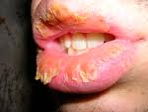
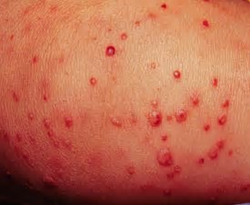
clinical findings
Clinical infections caused by S. aureus: S. aureus can cause a wide range of medical illnesses, from minor skin infections to life-threatening generalized. It is still one of the five most common causes of hospital- acquired infections, and is often the cause of postsurgical wound infections.
Clinical findings can be divided to:
Cutaneous infections:
impetigo, acne, folliculitis and furuncles (boils), mastitis.
Invasive infections:
bacteremia, meningitis, acute endocarditis, and osteomyelitis, hospital-acquired pneumonia.
Toxin mediated infections:
Staphylococcal scalded skin syndrome (SSSS),
Toxic Shock Syndrome (TSS),
Food intoxication (in 1-8hr, vomiting ,diarrhea, nausea, self limited)
Notes:
S. Aureus caused diseases largely by actual invasive infection, A result of toxins in the absence of invasive infection, or
*A combination of invasive infection and intoxication.
- SSSS and TSS: the toxin disseminated while the organism does not (never found in circulation).

Slide 14
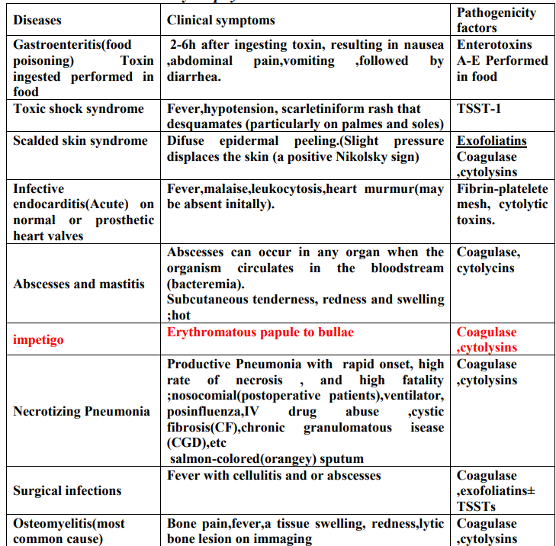
Diseases caused by Staphylococcus aureus:

Slide 15
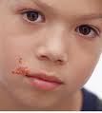
S. aureus Infections in human
Skin & soft tissue infection (impetigo in children)
Upper & lower respiratory tract infection
Urinary & genital tract infections
Food intoxication
Bone & joint infections
Septicemia
Eye infection
CNS infections
Nosocomial infections
Burn infections

Slide 16
- Do not produce exotoxins. Both are coagulase-negative.
Staphylococcus epidermidis & Staphylococcus saprophyticus
S. epidermidis: - Normal bacterial flora of the human skin - Infections are almost always are hospital acquired. - Major cause of sepsis in neonates and peritonitis in patients with renal failure - The most frequent organism isolated from infected indwelling prosthetic devices
Notes:
Normal bacterial flora of the human skin. - It is coagulase-negative. - Infections are almost always hospital-acquired: compromised hospital patients with Foley urine catheters or intravenous lines can become infected when this organism migrates from the skin along the tubing. - Diseases: Infections of prosthetic devices in the body, such as prosthetic joints, prosthetic heart valves, CSF shunts, and peritoneal dialysis catheters. In fact, Staphylococcus epidermidis is the most frequent organism isolated from infected indwelling prosthetic devices. - The organisms have a polysaccharide capsule (slime layer) that allows adherence to these prosthetic materials. - S. epidermidis is highly antibiotic resistant. Most strains produce - lactamase and many are methicillin-/nafcillin-resistant due to altered penicillin-binding proteins. The drug of choice is vancomycin.

Slide 17
- Do not produce exotoxins. Both are coagulase-negative.
Staphylococcus epidermidis & Staphylococcus saprophyticus
S. epidermidis: - Normal bacterial flora of the human skin - Infections are almost always are hospital acquired. - Major cause of sepsis in neonates and peritonitis in patients with renal failure - The most frequent organism isolated from infected indwelling prosthetic devices
- Highly antibiotic resistant. Most strains produce - lactamase and many are methicillin-/nafcillin-resistant. The drug of choice is vancomycin.
Notes:
The organisms have a polysaccharide capsule (slime layer) that allows adherence to these prosthetic materials.
are methicillin-/nafcillin-resistant due to altered penicillin-binding proteins

Slide 18
- Do not produce exotoxins. Both are coagulase-negative.
Staphylococcus epidermidis & Staphylococcus saprophyticus
S. saprophyticus: - This organism is a leading cause (second only to E.coli) of urinary tract infections (UTI) in sexually active young women "Honeymoon cystitis".
It is most commonly acquired by females in the community (NOT in the hospital).
Urinary tract infections can be treated with a quinolone, such as norfloxacin, or with trimethoprim-sulfamethoxazole

Slide 19
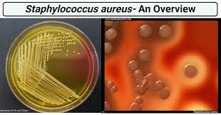
Lab diagnosis :
Specimens: wound swab, pus, sputum, blood, urine CSF.
Slide (microscopic characteristics):
- Gram stain - GPC in clusters
Culture (macroscopic characteristics):
Only S. aureus produces β-hemolysis, a zone of β-hemolysis will appear as clear zone around the colony on blood agar.
Only S. aureus can ferment mannitol.
Biochemical tests:
Catalase all are positive

Slide 20
Table 1: summarized the points of differences between 3 medically important Staphylococci species

Slide 21
Epidemiology
S. aureus is widely distributed in the nature and causing a wide range of pyogenic infections. Furthermore it is responsible for community acquired as well as nosocomial infections (Hospital infections particularly among immunocompromised patients) due to its wide distribution in hospital settings including health care workers. On the other hand, S. aureus is one of the well-known bacteria that develop multiple antibiotic resistance.
Methicillin resistant S. aureus (MRSA):
According to its susceptibility to Methicillin, S. aureus was divided into:
Methicillin resistant (MRSA): which is highly prevalent in the community (CA-MRSA) causing a wide range of infection including community acquired pneumonia . Beside that it is highly distributed in the hospitals Hospital environment and fomites) causing (HA-MRSA) infections among patients. MRSA isolates usually multi-drug resistant. High prevalence of MRSA was found among HCWs
2. Methicillin sensitive S. aureus (MSSA).

