Slide 1

Medical microbiology
Lec. 8
Non-spore forming Gram-positive rods
By:
Lect. Shaima’a Al-Salihy

Slide 2
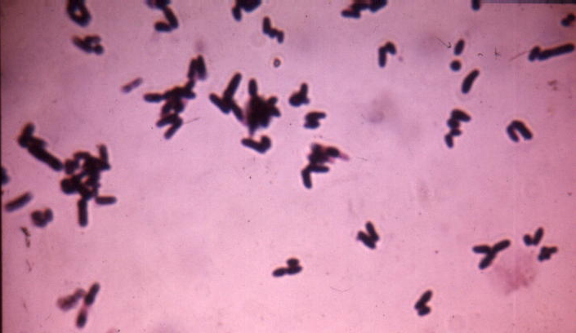
Non-spore forming Gram-positive bacilli
Corynebacterium
Corynebacterium:
Many members of the genus corynebacterium are members of the normal flora of the skin and mucous membranes of the humans.
Corynebacterium diphtheriae, is the most important member of the group, it can produce a powerful exotoxin that causes diptheria in human.
Nondiphtherial corynebacteria— collectively referred to as diphtheroids—originally were believed to be mainly contaminants.
Notes:
The genus Corynebacterium consists of a diverse group of bacteria including animal and plant pathogens, as well as saprophytes.

Slide 3
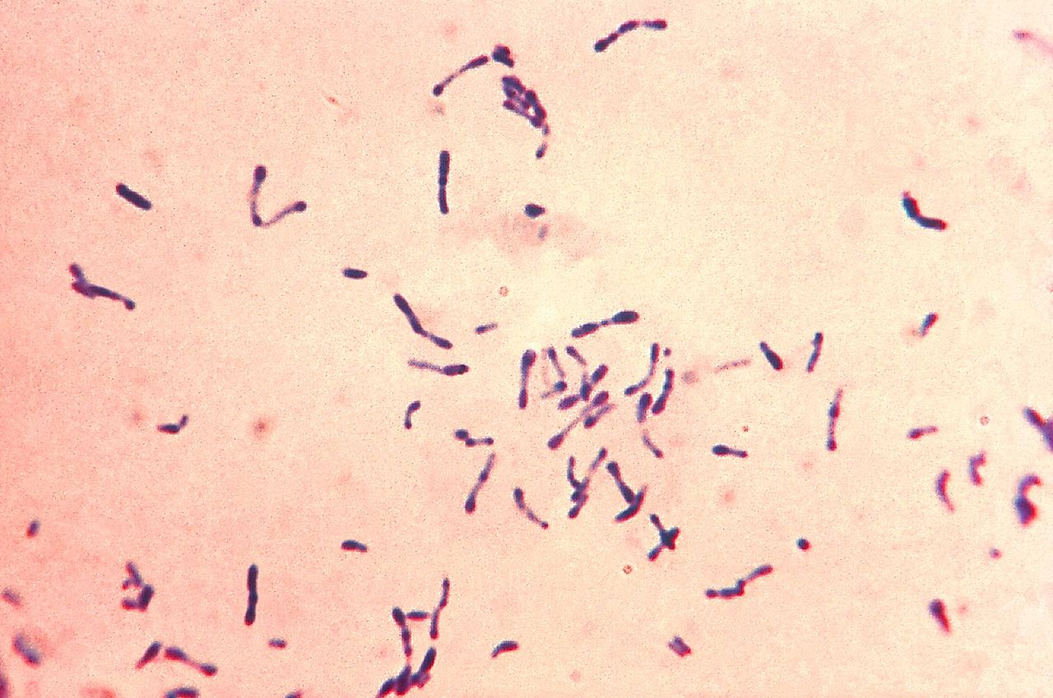
Corynebacterium
Morphology & identification:
G+ve rods, clupped-shaped (swollen ends), arranged in acute angles (V or L shape, pallisade, cuneiform, Chinese letter pattern).
Have beaded appearance (due to the metachromatic granules).
Non-motile.
Notes:
This Chinese letter pattern formation or cuneiform arrangement is caused by the incomplete separation of the daughter cells during division when the organism is grown on nutritionally inadequate media

Slide 4
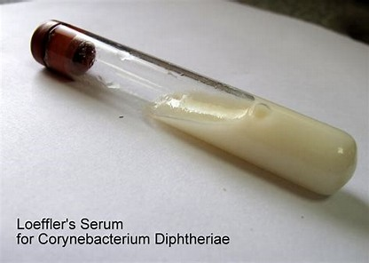
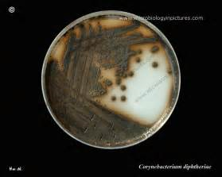
Cultural characteristics:
Aerobic and facultative anaerobic bacteria.
Loaffler’s serum slope: the growth is very fast and produce in 6–8 hours, the colonies are small, circular, opaque, and white, at a temperature of 37°C.
Tinsdale media: grayish black colonies surrounded by a dark brown halo due to H2S production (Diagnostic).
Notes:
Loeffler’s serum slope does not support the growth of streptococci and pneumococci.
reduces tellurite to metallic tellurium, which is incorporated in the colonies, thereby giving them a characteristic gray or black color

Slide 5
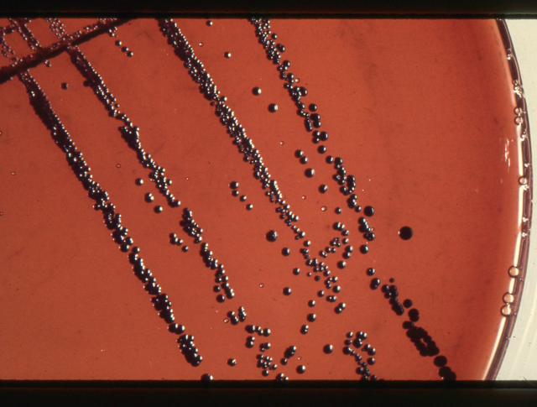
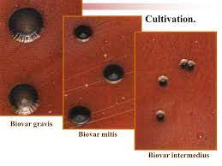
Cultural characteristics:
MacLeod’s (potassium tellurite) blood agar: gray or black colored colonies after 48 hours of incubation.
C. diphtheriae biotypes :
■ Mitis colonies are small, round, convex, and black.
■ Intermedius colonies are small, flat, and gray.
■ Gravis colonies are large, irregular, and gray.
Notes:
These morphological types of the strains were initially correlated with severity of the disease. Mitis strains were thought to produce mildest variety, gravis to produce the most serious disease, while the intermedius to produce the disease of intermediate severity, but now these distinctions are not considered valid. These morphological types, however, are useful for the epidemiological classification of C. diphtheriae isolates.

Slide 6
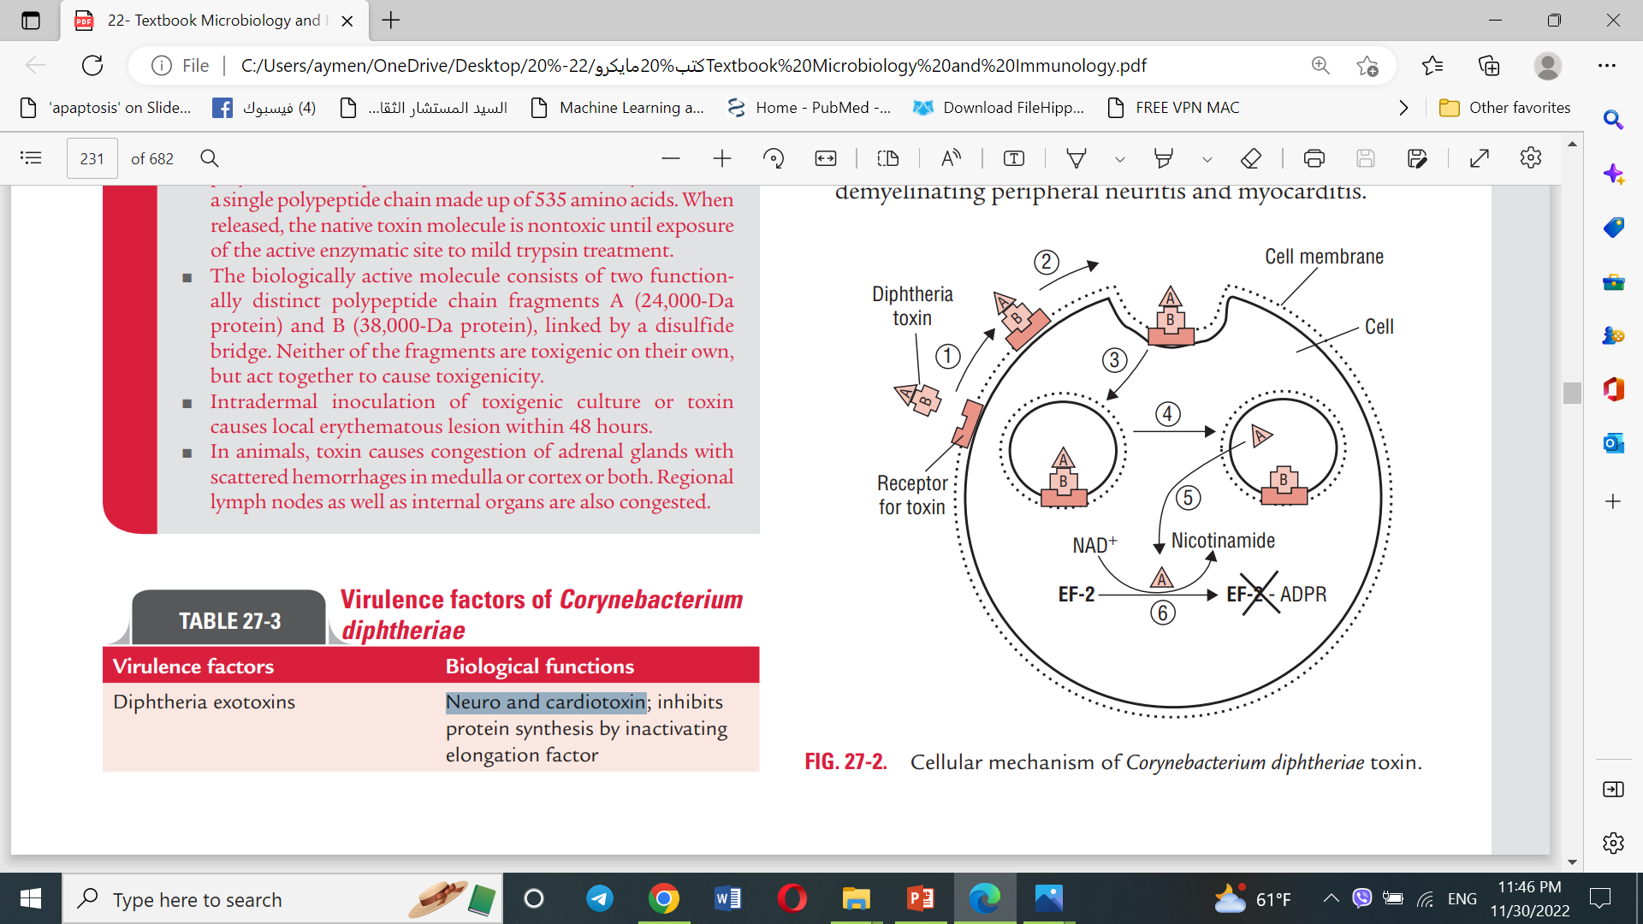
Virulence factor:
Diphtheria toxin:
Neuro- and cardiotoxin
Heat-labile toxin.
Blocks protein synthesis
Encoded by (Tox gene) introduced in lysogenized bacteria with lysogenic phage Beta-corynephage
Controlled by bacterial repressor protein.
Expressed if [iron] low.
Composed of fragment A & B
B for transport
A inhibits protein synthesis.
Mechanism of action
Notes:
C. Diphtheriae that are lysogenized with bacteriophages that contain the structural gene (tox gene) for the toxin molecule (tox strains). When DNA of the phage becomes integrated into the genetic material of C. diphtheriae, the bacteria develop the capability of producing the polypeptide toxin. The gene for toxin production occurs on the chromosome of the prophage, but a bacterial repressor protein controls the expression of this gene. The repressor is activated by iron, and it is in this way that iron influences toxin production. High yields of toxin are synthesized only by lysogenic bacteria under conditions of iron deficiency.
Fragment B is required for transport of fragment A into the cell. Fragment A inhibits protein synthesis through inhibition of polypeptide chain elongation factor leading to necrosis and neurotoxic effects.

Slide 7
Pathogenesis:
Site of entry is respiratory tract but may enter through skin or eye.
Adherence and multiplication of the bacteria in the epithelial cells of infected region, forming a local lesion.
Secrete exotoxins that cause necrosis of the cells in that area.
Formation of the characteristic pseudomembrane.
C. diphtheriae does not cause any invasion of the cell, but the toxin may absorbed into the blood stream and distributed, resulting in systemic complications of diphtheria including demyelinating peripheral neuritis and myocarditis.
Notes:
The combination of cell debris and exudative inflammatory response (leading to accumulation of red blood cells, necrosed cells, bacteria, fibrin, and lymphocytes) result in the formation of the characteristic pseudomembrane.
Toxin causes local tissue destruction at the site of membrane formation (the upper respiratory tract), facilitating replication and transmission. If absorbed into the blood stream and distributed, resulting in systemic complications of diphtheria including demyelinating peripheral neuritis and myocarditis.

Slide 8
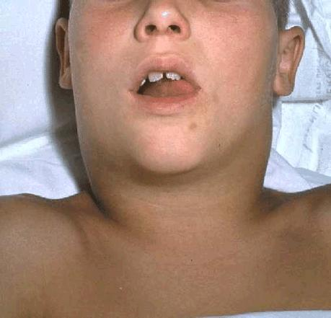
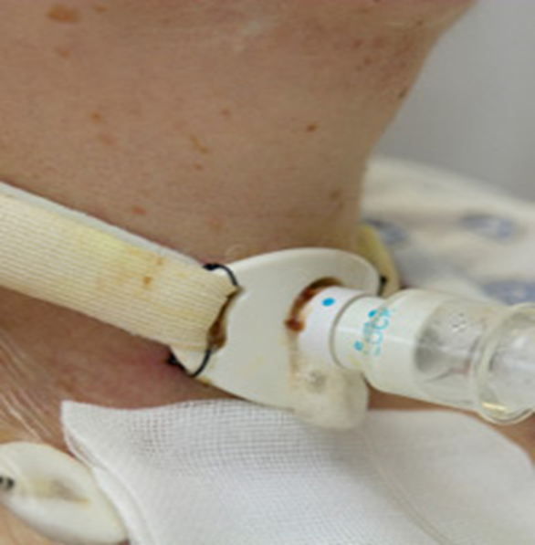
C. diphtheria
Clinical findings:
The clinical manifestations of diphtheria depend upon the following:
Immune status of the patient.
Virulence of the bacteria.
The site of the infection.
Respiratory diphtheria:
The incubation period is 2-5 days.
Sore throat, fever, dyspnea, marked edema of the tonsils, uvula, and anterior neck (bull neck).
formation of pseudomembrane.
* Nontoxigenic strains (tox+) cause a mild disease, such as cutaneous diphtheria
Notes:
Untreated patients may continue shed the bacilli in the environment for weeks or months after recovery (Convalescent carriers).

Slide 9
Laboratory diagnosis:
Specimens: throat swab or swab from pseudomembrane
Microscopy:
Staining by Gram or methylene blue (G +ve rods arranged as L or V shaped)
Albert stain: differential stain for metachromatic granules.
Culture:
cultivated on Loeffler’s slant, nonselective media (e.g., blood agar) as well as on selective media (e.g., tellurite agar).
Notes:
Initial treatment of diphtheria is based on the high clinical suspicion or the clinical diagnosis of the condition. Treatment is started without waiting for the result of the laboratory test because definitive results take as long as a week. Hence, laboratory diagnosis is carried out not for treatment of individual cases, but for the epidemiological purposes and for the initiation of control measures of the disease

Slide 10
16S ribosomal ribonucleic acid (rRNA) probes have been designed for the identification of genus and species of Corynebacteria.
Toxigenicity test:
1- in vivo: animal inoculation, Schick test.
2- in vitro: (Elek’s test) antibody-based gel diffusion precipitation test to confirm toxin production.
3- tissue culture neutralization assay.
4- PCR assay: for the presence of toxin gene in the organism isolated from the patient.

Slide 11
Treatment:
Treatment should be started immediately after the clinical diagnosis of diphtheria. Treatment of diphtheria is based on:
1. Antitoxin therapy
2. Antibiotics therapy
Prevention and Control:
Active immunization by vaccination with diphtheria toxoid (combined with tetanus toxoid and acellular pertussis (triple DTaP vaccine) is the key in preventing diphtheria.

Slide 12

C. diphtheria
Epidemiology:
Either clinical or subclinical infection at an early age yield protective levels of antitoxin. Thus most members of the population, except children are immune. By age 6-8 years about 75% of children in developing countries where skin infection with diphtheria are common have protective serum antitoxin. Absorption of small amount of C. diphtheria toxin does not produce a disease, but it can serve as antigenic stimulus for immune system to produce antitoxin.
Active immunization with C. diphtheria toxoid during childhood yield antitoxin levels that generally adequate until adulthood. Young adults in developed countries (Non endemic areas) should receive a booster dose because diphtheria bacilli are not sufficiently prevalent to provide a stimulus of subclinical infection. DPT is the combined of diphtheria toxoid, tetanus toxoid & pertussis vaccine used as a single injection for immunization of children. For booster dose in adults only TD is used.

Slide 13
Corynebacterium jeikeium
  Opportunistic infections ( sepsis, endocarditis) in immunocompromised (e.g., patients with blood disorders, bone marrow transplants, intravenous catheters)
  Multiple antibiotic resistance common (MDR)
  Carriage on skin of up to 40% of hospitalized patients (e.g., marrow t-plants)
Corynebacterium urealyticum
  Urinary tract infections (UTI’s); cause chronic or recurrent cystitis, bladder stones, and pyelonephritis rare but important
  Urease hydrolyzes urea; release of NH₄⁺, increase in pH, alkaline urine, renal stones
REVIEW

Slide 14
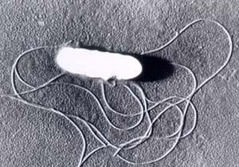
Listeria monocytogenes
Listeria monocytogenes
Morphology & identification:
short G+ rods (coccobacilli), frequently occurs in chains.
Non-spore forming.
  Multiply at refrigerator temperatures (4ºC)
It has a tumbling end-over-end motility at room temp., but not at 37 C.
It is facultative anaerobe, catalase positive, CAMP positive.
Culture & growth :
Muller-Hinton agar.
On blood agar (sheep RBCs) small zone of hemolysis may be observed.

Slide 15

Listeria monocytogenes
Pathogenesis:
route of transmission is eating food cntaminated with the bacteria.
Group at risk are primarily pregnant women, newborns, & adults with weakened immune systems.
L. monocytogenes enters the body through the GIT with the contaminated food e.g. Cheese or vegetables.
Enters the epithelial cells by induced phagocytosis. and start to produce listeriolysin O.

Slide 16
Listeria monocytogenes
Clinical findings:
Intrauterine infection results in sepsis and death before or after delivery.
Meningitis: between the birth and the 3rd. week of life.
Meningitis is often complicated by encephalitis, a pathology that is unusual for bacterial infections.

Slide 17
Intracellular Survival & Replication of Listeria
Phagocytosis
Macrophage
Listeriolysin O?
Macrophage
Intracellular Replication
Actin Filaments
REVIEW

Slide 18
Epidemiology of Listeria Infections
Natural Reservoirs
Common Routes for Human Exposure
Population at Greatest Risk
REVIEW

Slide 19
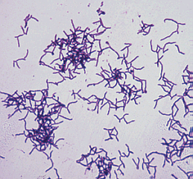
Actinomyces israelii
Actinomycetes
Are a diverse group of G⁺ bacilli with a tendency to form chains or filaments. Most are saprophytes that lives in soil, others are normal flora.
Actinomyces israelii:
Non-acid fast, Branching rods.
Normal flora of gingival crevices and female genital tract
Pathogenesis:
Causes actinomycosis: chronic suppurative & granulomatous, generally not painful but very invasive, penetrating all tissues, including bone.
Tissue swelling → draining abscesses (sinus tracts) with "sulfur" granules(hard yellow microcolonies) in exudate that can be used for microscopy or culture and composed of macrophages, tissue cells, fibrin and bacteria.

Slide 20
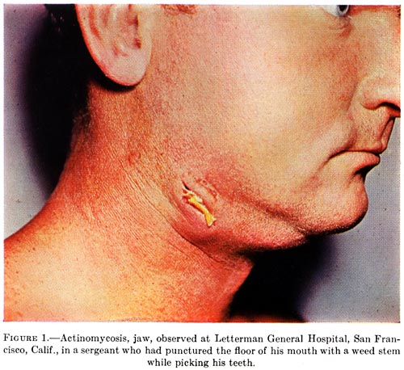
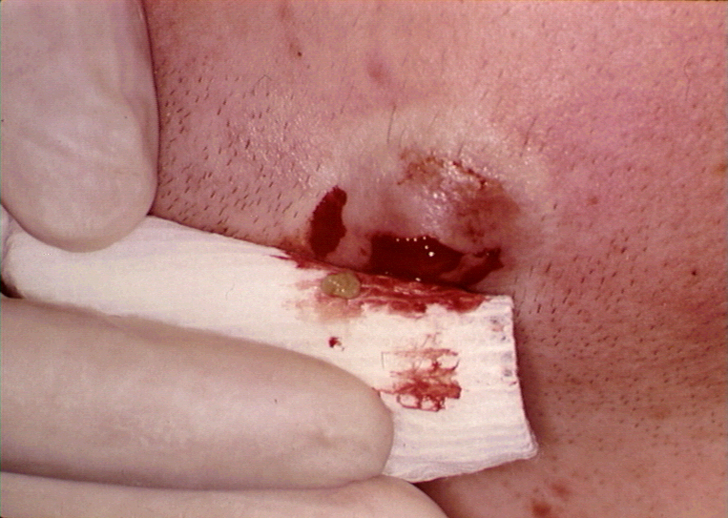
Actinomyces :draining sinus & sulfur granules

Slide 21
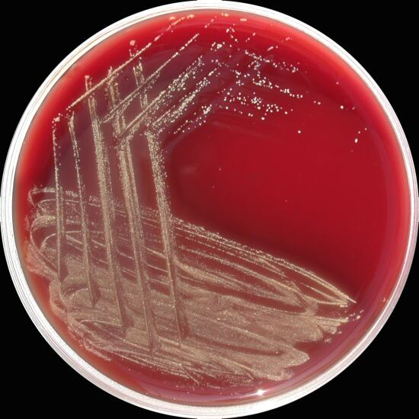
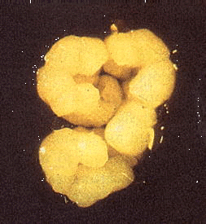
laboratory diagnosis:
- Specimen: Pus from draining sinuses, sputum, or specimens from tissue.
- Microscopy: examined for the presence of sulfur granules (Diagnostic).
- culture: Brain heart infusion agar and thioglycolate broth and incubated anaerobically or elevated CO2 conditions.

Slide 22
Nocardia:
Nocardia asteroides, Nocardia brasiliensis
Morphology:
Aerobic
Gram-positive branching rods, partially acid fast.
Pathogenesis
No toxins or virulence factors known
an opportunistic infection associated with several risk factors, most of which impair the cell-mediated immunity.
Pulmonary nocardiosis may disseminate to other organs (brain or skin).
The usual pathologic process is abscess formation (neutrophilic inflammation).
Cutaneous/subcutaneous nocardiosis: cellulitis with swelling → draining subcutaneous abscesses with granules (mycetoma)

Slide 23
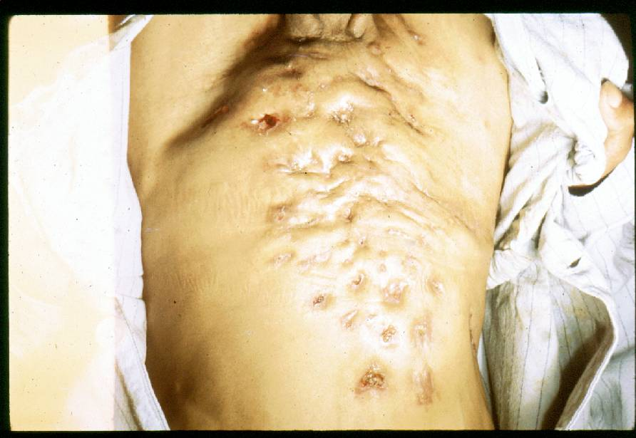
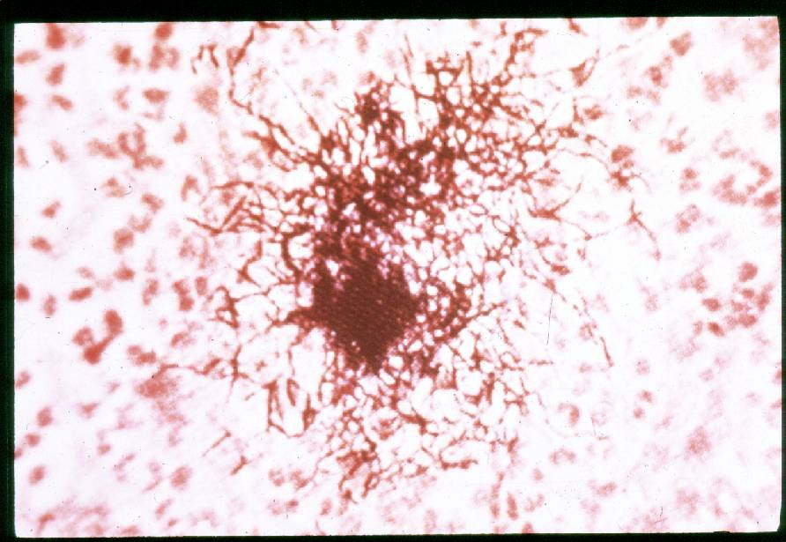
laboratory diagnosis:
- Culture of Clinical specimen :Sputum, Pus, Biopsy tissue

Slide 24
Case study:
An 8-year-old child was admitted to hospital with low-grade fever (38°C), malaise, dysphagia, and headache. Examination revealed a fibrinous membrane on the pharynx. A pair of swab collected from the membrane was sent to microbiology laboratory for diagnosis of Corynebacterium diphtheriae. The child was administered antitoxin by the intravenous route and treated with antibiotics.
Subsequently, 3 days later the report from the laboratory confirmed isolation of a toxigenic C. diphtheriae from the specimen.
■ Why treatment for diphtheria was started immediately without waiting for the confirmatory report?
■ What are the tests performed in a microbiology laboratory to demonstrate C. diphtheriae in clinical specimens?
■ Are nontoxigenic strains of C. diphtheriae capable of causing disease in humans?

Slide 25

THANK YOU

