Slide 1
Lab. 4 molecular techniques PCR & RT-PCR
PRACTICAL VIROLOGY
Assist. Prof.
Dr. Shaima’a Al-Salihy

Slide 2
Learning Objectives:
After this lab, you will be able to:
Demonstrate understanding of the principle of PCR, DNA gel electrophoresis, and RT-PCR technique
List components and reagent used with each technique.
Explain advantage and disadvantages of these techniques.
List amplification visualization methods
Interpret the result of the test

Slide 3
Molecular techniques:
Introduction:
Nucleic acid amplification techniques have entirely changed the basis of differential diagnosis of infectious diseases.
The main reason is the possibility of detecting the nucleic acid of the causative agents directly, rapidly, specifically and with very high sensitivity.
PCR represents the prototype of nucleic acid amplification techniques

Slide 4
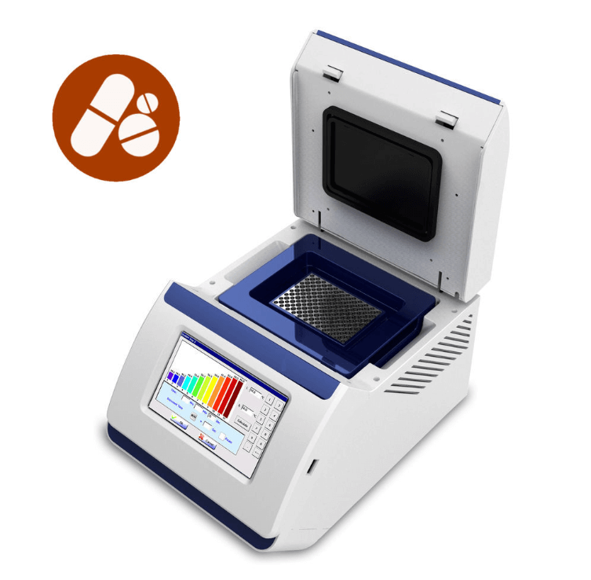
PCR - Polymerase Chain Reaction
Introduction:
PCR is a laboratory (in vitro) version of DNA replication in cells (in vivo).
It is a technique for the amplification of a certain region of DNA to lot of double-stranded DNA molecules (fragments) with same (identical) size and sequence in order to be enough for providing a detectable signal for quantification.
It preceded by nucleic acid isolation (extraction) process from various sources.
Notes:
Amplification is an “in vitro “ version of replication

Slide 5
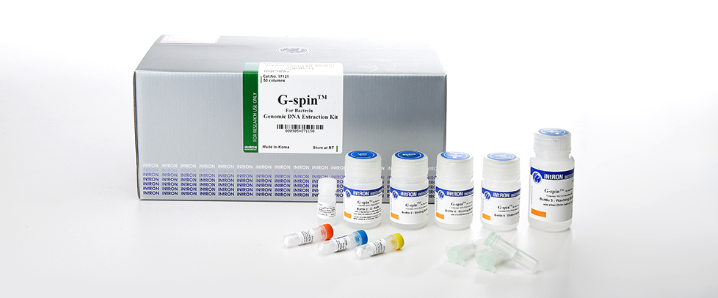
PCR - Polymerase Chain Reaction
Introduction:
Nucleic acid extraction Different nucleic acid extraction protocols are required for different samples and different microbiological agents, and can be done by two ways:
Manual extraction
Automated Extraction of Nucleic Acids
To decide which commercial kits are most appropriate one needs to consider the type (DNA or RNA), mass, and size of nucleic acids to be extracted
Notes:
Several commercial manual extraction kits are available for use by clinical laboratories. These kits vary in the method, cost and time required for extraction. Processing by manual methods involves a higher risk of contamination and switching of patient samples.
Automated extraction systems keep sample manipulation to a minimum, reducing the risk of cross-contamination of samples.
Comparisons of manual and automated extraction methods have found automated procedures to be equivalent and in some instances superior to manual methods.

Slide 6
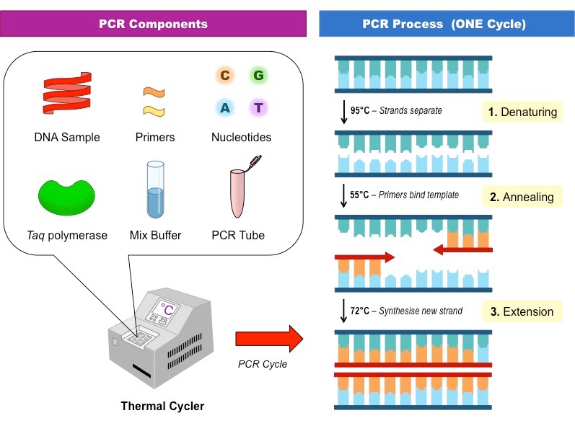
How PCR Works?
PCR - Polymerase Chain Reaction
Protocol:
Put all reagents into a PCR tube
Melting or heat denaturation: temperature is raised to 95° C to break the DNA double strand down to create two strands, a 5’ to 3’ strand and a 3’ to 5’ strand
Annealing: temperature is lowered to 40°C- 65° bind each primer to its appropriate (complementary) strand
5’ primer to the 3’ to 5’ strand
3’ primer to the 5’ to 3’ strand
Extending: Copy each strand at 75°C
DNA polymerase
Notes:
During a PCR, changes in temperature are used to control the activity of the polymerase and the binding of primers.
To begin the reaction the temperature is raised to 95°C. At this temperature all double stranded DNA is “melted”
in to single strands. The temperature is then lowered to 40-65°C. This allows the primers to bind to your gene of interest.
This temperature change is repeated through around 40 ‘cycles’.

Slide 7
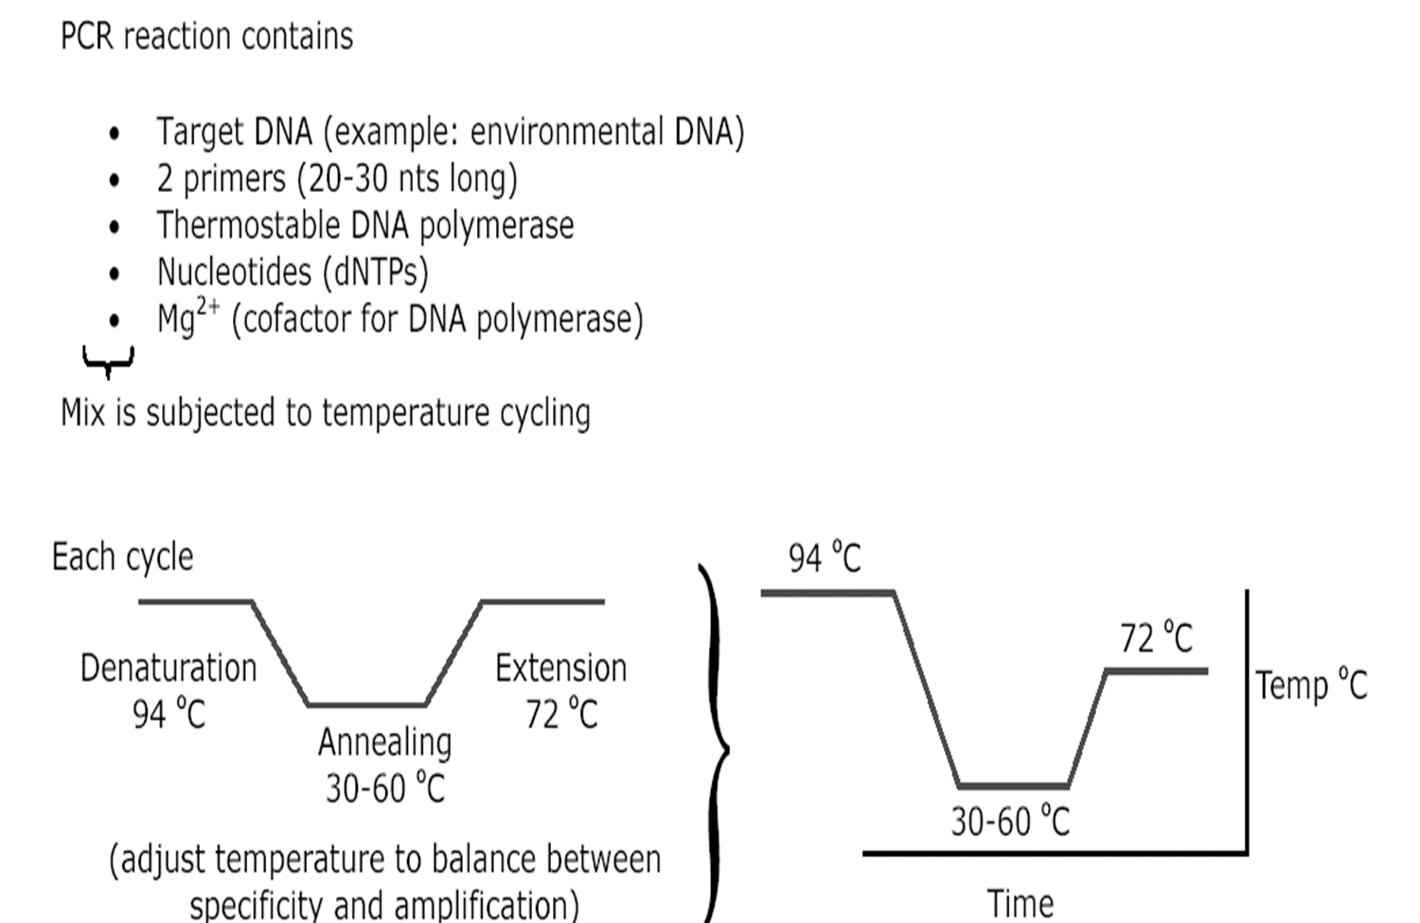

Slide 8
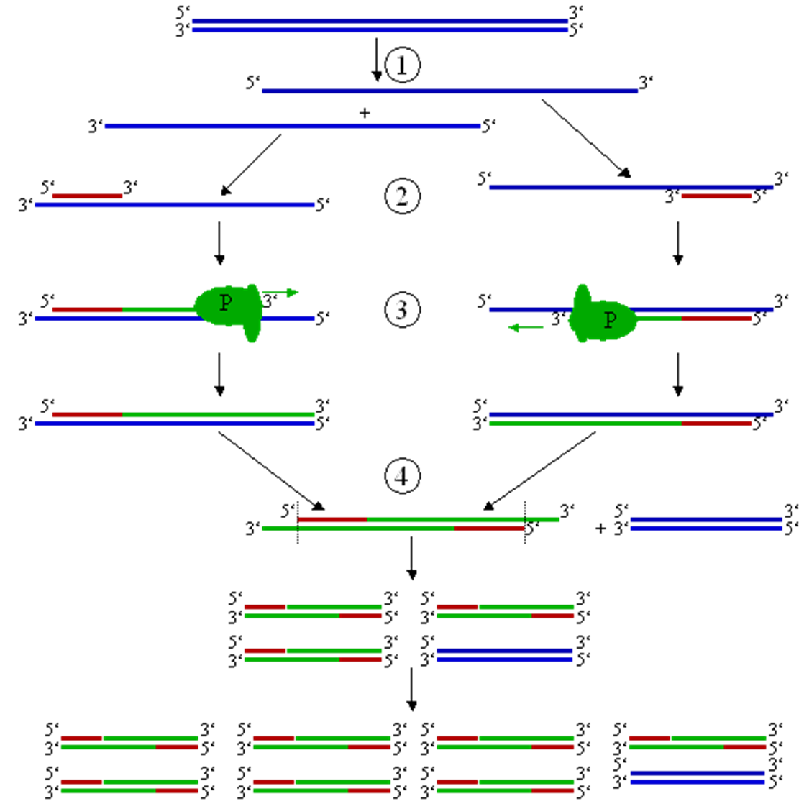

Slide 9
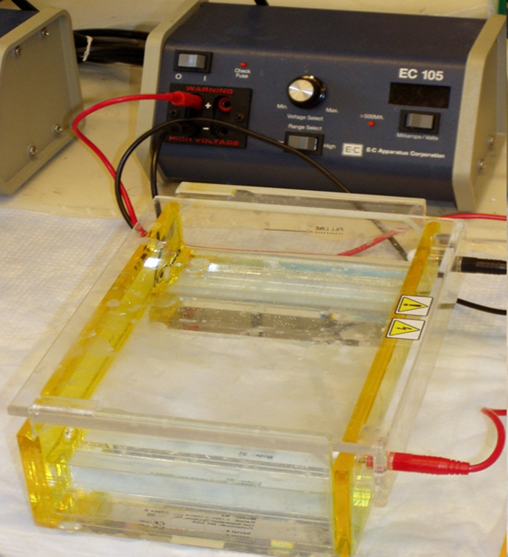
DNA gel electrophoresis:
It is a method used in biochemistry to separate mixed DNA fragments.
Principle: A sample contains fragments of DNA is forced by an electrical current through an agarose gel tank which is really a sieve with small holes of a fixed size. DNA molecules are negatively charged, so they migrate from negative to positive electrode.
Short fragment migrate easily than long fragments so DNA fragments separated by length.
Notes:
Longer fragments have more nucleotides
So have a larger molecular weight
So are bigger in size
So aren’t able to pass through the small holes in the gel and get hung up at the beginning of the gel
The number of nucleotides are then estimated by comparing it to a known sample of DNA fragments ( DNA ladder) which is run through the gel at the same time

Slide 10
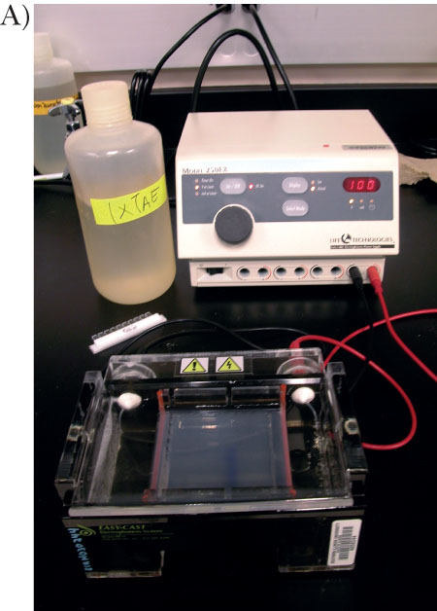
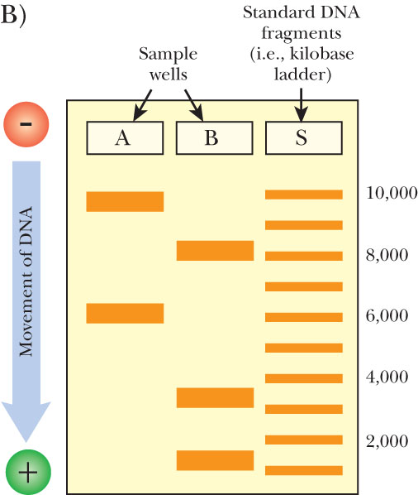
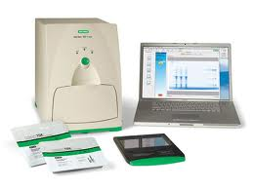
How Gel Electrophoresis of DNA Works
Notes:
Commonly used methods for the visualization of amplicons are agarose gel electrophoresis and microplate systems with a detection probe and a streptavidin–enzyme conjugate that binds to biotinylated nucleotides incorporated into the amplicon.
Following a washing step, the enzyme bound by the biotin–streptavidin interaction will change a colourless substrate into a coloured derivative in a quantitative way.

Slide 11
Advantages and disadvantages of conventional PCR:
Advantage: Disadvantage:
1. Simple 1. Sensitive to contamination
2. Powerful 2. False-positive reaction
A. Sensitive 3. Non – automated.
B. Specific 4. Results are not expressed as numbers
C. Reliable 5. Is not very quantitative
3. Fast 6. Post PCR processing

Slide 12
Reverse transcriptase PCR (RT-PCR) and cDNA Synthesis
RT= reverse transcriptase
The first step is isolate the mRNA from different sources, make cDNA from the mRNA then amplification of DNA
Principle:
Utilize the same principle of conventional PCR with an added probe or dye to generate a fluorescent signal. (instead of measuring the endpoint we focus on the first significant increase in the amount of PCR product).
Based on the detection and quantitation of fluorescent reporter
Notes:
This is reversing “transcription”– so use an enzyme originally obtained from viruses– enzyme is called reverse transcriptase. which has both reverse transcriptase and DNA polymerase activity and is thermostable
Reverse transcription of RNA to complementary DNA (cDNA) is therefore an obligatory step for the identification of RNA viruses

Slide 13
Interpretation of results
Exponential curve
PCR signal is observed as an exponential curve with a lag phase, a log phase, a linear phase, and a stationary phase.

Slide 14
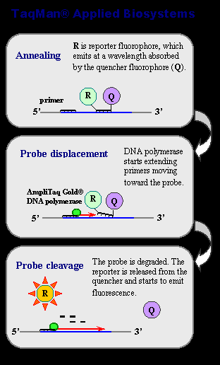
Real-time PCR
Compared with conventional PCR, real-time PCR has the advantage that the amplification process is recorded in real time.
The critical difference between conventional and real-time PCR is that in the latter the generation of amplification products is monitored directly in the reaction tube
The risk of contamination is very much reduced since there is no need to open the reaction tube once the amplification has started.
Notes:
Real time PCR monitors the amplification of a targeted DNA molecule during the PCR (i.e., in real time), not at its end, as in conventional PCR.
They all link the amplification of DNA to the generation of fluorescence which can simply be detected with a camera during each PCR cycle. Hence, as the number of gene copies increases during the reaction, so the fluorescence increases.

Slide 15
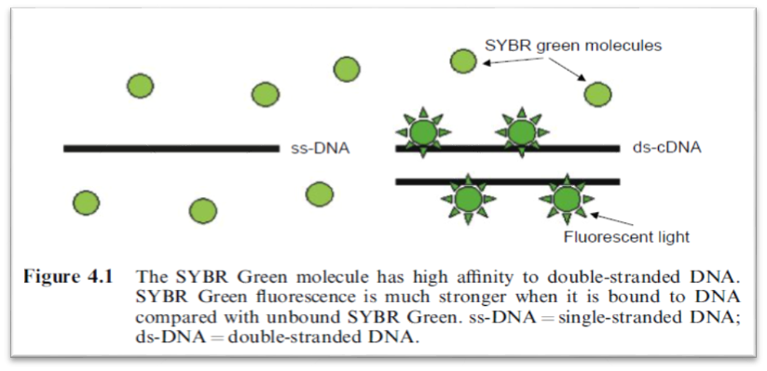
Visualization of Real-time PCR Amplification
Two common methods for the detection of PCR products in real-time PCR are:
SYBR Green: non-specific fluorescent dyes that intercalate with any double-stranded DNA
The disadvantage of using SYBR Green is that non-specifically amplified DNA and amplification artefacts such as primer dimers will also generate increased fluorescence, thus reducing the sensitivity compared with nested PCR.
Notes:
SYBR Green represents one class of DNA binding chemicals that emits much more fluorescence when intercalated into double-stranded DNA compared with the unbound chemical in solution
As a result, the SYBR Green fluorescence increases proportionally to the increase in DNA amplification products.

Slide 16
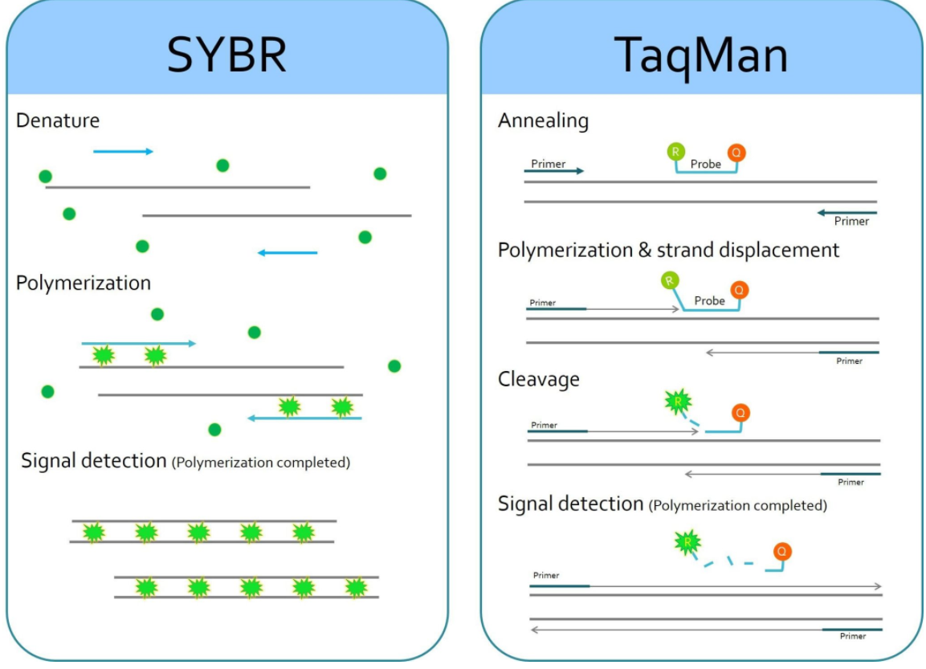
Visualization of Real-time PCR Amplification
(2) Sequence-specific DNA probe: consisting of oligonucleotides that are labelled with a fluorescent reporter, which permits detection only after hybridization of the probe with its complementary sequence.
Notes:
Fluorescent reporter probes detect only the DNA containing the sequence complementary to the probe; therefore, use of the reporter probe significantly increases specificity, and enables performing the technique even in the presence of other dsDNA.
Real-time PCR assays utilizing an amplicon-specific probe increase the specificity substantially.
A great advantage of monitoring the reaction as it proceeds is that the rate of amplification can be noted. Traditional PCR machines analyze the product after the completion of all cycles, which makes it impossible to know if the reaction had plateaued at an earlier cycle because of limitations in reagents, such as nucleotides. Real-time PCR machines address this concern by providing a visual graph of the amplification. An advantage of being able to see the amplification in real time is that the quantity of the PCR product can be used to back calculate the amount of starting template nucleic acid that was present, since we know that each cycle doubles the amount of DNA. For this reason, real-time PCR is also known as quantitative PCR. Therefore, the standard abbreviation for real-time PCR, is qPCR. (Recall that RT-PCR stands for reverse transcriptase PCR, not real-time PCR!) RT-PCR can also be performed using qPCR; this technique is known as RT-qPCR.

Slide 17
Thank you
for
attention

