Slide 1
How to Choose the Right and Safe Journal for Your Manuscript
By
Prof. Dr. Salih Mahdi Salman
College of Medicine/ University of Diyala
April 17th 2023

Slide 2
Why We are Writing & publishing
Requirement for graduation
Requirement for promotion
To get reward/award
To be recognized
To disseminate knowledge

Slide 3
How to Write a Scientific Article
Title
Affiliation
Abstract
Keywords
1. Introduction
2. Materials and Methods
3. Results/Findings and Discussion
4.Conclusions &Recommendations
Acknowledgements
References
Author’s Biography/ some journals
AUTHOR’S BIOGRAPHY
Professor Dr. Salih Mahdi Salman, obtained both bachelor’s and master’s degree of science in organic chemistry from the University of Baghdad and completed his Ph.D. at the University of Malaya under supervision of Associate Professor Thorsten Heidelberg and Hariul Anuar Tajuddin in 2013. Currently he is a lecturer at the department of chemistry, Faculty of Medicine, University of Diyala in Iraq. His interest area is organic synthesis.

Slide 4
When your manuscript be ready…There are three questions you should ask yourself while selecting a journal.
First, which journals count toward promotion?
Second, do I want to publish in a general or a specialized journal?
Third, which journals’ requirements does my manuscript meet.
Finally, Which may pass the Central Credential Committee requirements

Slide 5
Where to Publish?
well known , highly valued by the authors , mentioned in conversation and at scientific presentations, and often be a built-in readership, such as the members of a sponsoring Society. readily recognized target audience, then the published material is likely to be seen, read, and acted upon.
Indexed Journal
Level of difficulty
There’s no point in conducting research and then publishing it in a journal that doesn’t count. In fact, doing so may count against you because a committee may wonder why you are wasting time with an inferior journal.
Non Indexed Journal
Conference

Slide 6
But, choosing the indexed journal for a manuscript can be a big challenging.
Many factors are likely to influence the final decision.
It is important to have a set of criteria by which the merits of a journal can be assessed..
This maximizing the chance that the author’s expectations will be met.

Slide 7
If you already decided and chose to publish with an impact factor indexing journal.
Let we share experiences to shorten the way and find the right journal.

Slide 8
Journal
X Non- indexing journals
√ Indexed Journals
1. Scopus Indexed Journals
2. ISI Indexed Journals
Founded by Eugene Garfield in 1960. It was acquired by Thomson Scientific & Healthcare in 1992, and became known as Thomson ISI. Then Clarivate Analysis.

Slide 9
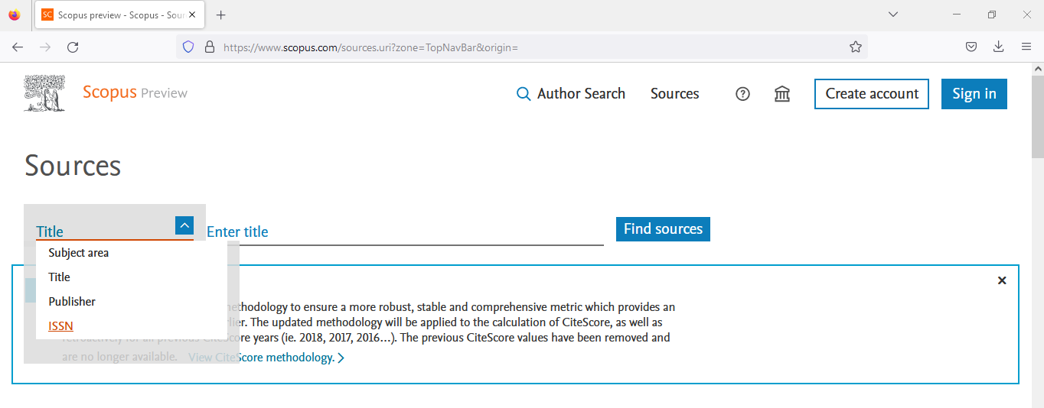
Scopus Indexed Journals
Need to connect with your own account Or your university’s server
https://www.scopus.com/home.uri
Go to Sources then you can find your journal by searching via
Subject area
Title
Publisher
ISSN

Slide 10
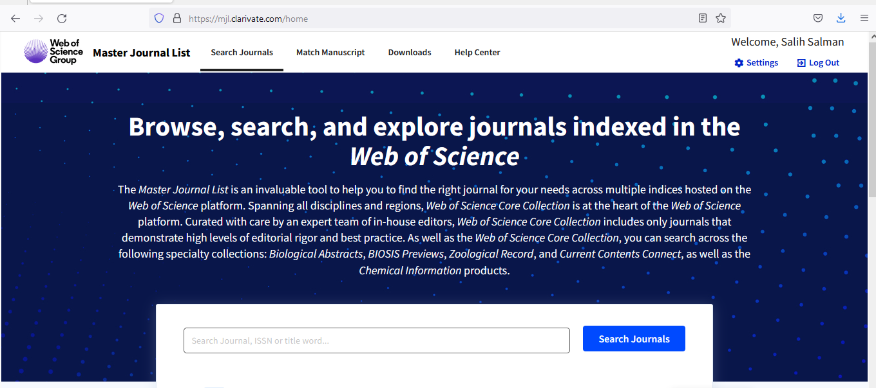
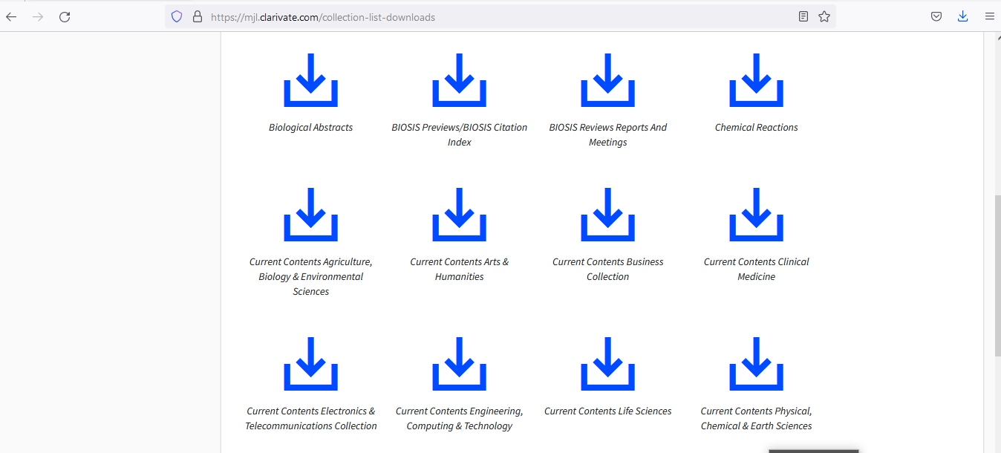
How to check or search Web of Science journal
Need to connect with
university’s server
https://mjl.clarivate.com/home
Can search a specific journal using the search tap.
You can download all the journal within your field using download tap.

Slide 11
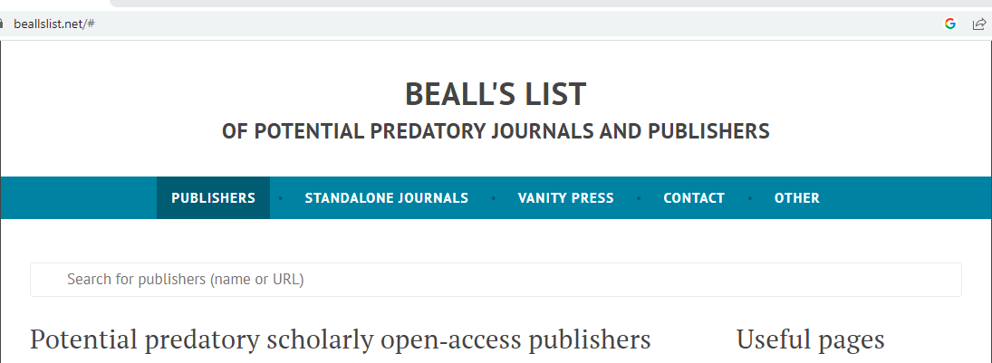
What is next after you chose you suitable journal
There are too many predatory and hijacked journals and publishers.
Those Journals and publishers try to use the same title of indexed journal.
So, you must check the chosen journal and their publishers.
The checking can be achieved using Beall's List via the following URL
https://beallslist.net/

Slide 12
Example : International Journal of Health Research

Slide 13
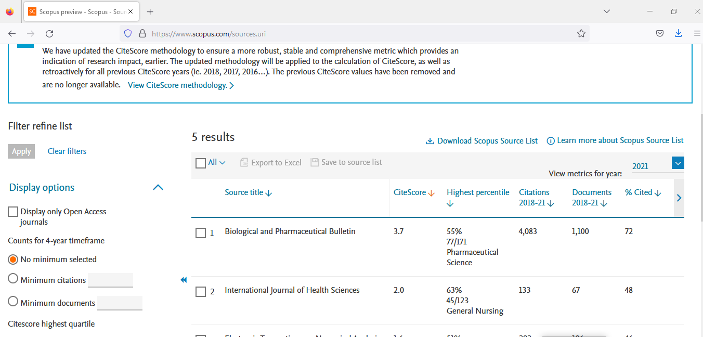
Example 2 : International Journal of Health Sciences

Slide 14
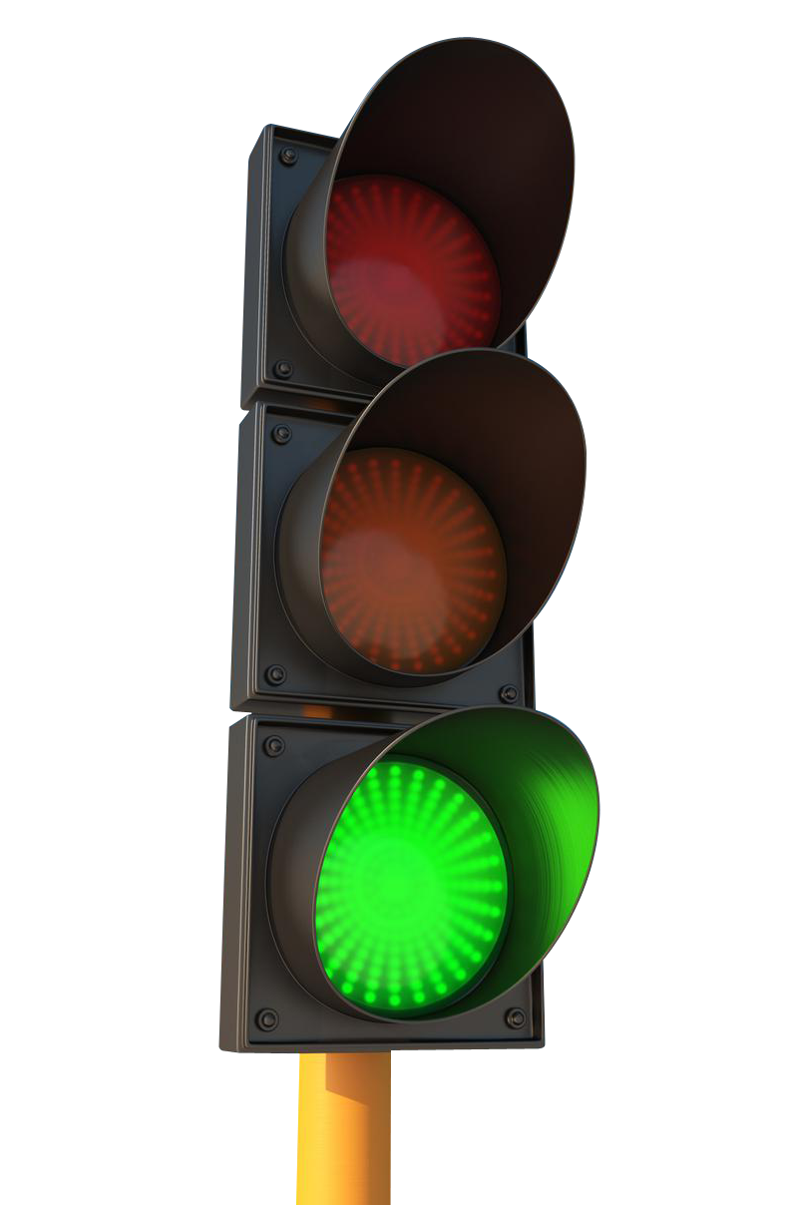
But, Is that enough to build up your decision?
You have to put in your mind…you still need to pass the Central Credential Committee of the University which,
They are taking farther steps to confirm that you are in right way, before give you green light for submission. They are crosslinking this information with different sources including :
SJR Scimago feedback at https://portal.issn.org/
ISSN Portal at https://portal.issn.org/
The DOI® System at https://www.doi.org/
Sometime even the search engine may give you some feedback for the duplicated journals if they have more than website.

Slide 15
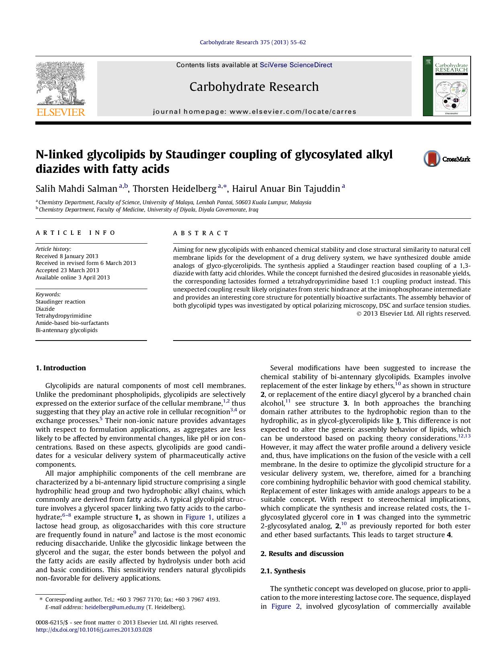
Look in Your Citation List
The first place to look for an appropriate journal to publish your article is in your own citation list. .
If you are citing several articles from a particular journal, that is a good sign that journal may be an appropriate place to submit your article.

Slide 16
Before You Start Submitting Your Manuscript You Should
Register online with the target journal
Read the author guidelines for the target journal carefully and arrange your manuscript according to this guideline .
Prepare Full name, the e-mail address and phone number of at least 4 referees.
Write a cover letter for your manuscript.
Download and fill the copyright form for the journal you wish to publish in it.
Do an Author’s Biography
Then start submission

