Slide 1
t-test
Dr. Nadhim Ghazal

Slide 2
It is one of the commonly used tests for testing hypothesis for testing the significance of difference for the quantitative data. It depends on a distribution called the t-distribution with (n-1) degree of freedom. This distribution was introduced by William S Gosset, who used the pen-name “student” and is often called students’ t-test in his honor (or t-test), distribution which is like the normal distribution of a symmetrical bell-shaped distribution with a mean of zero but it is of lower peak, higher tails, and more spread out (more probability in the tails and less in the center), having two tails.

Slide 3
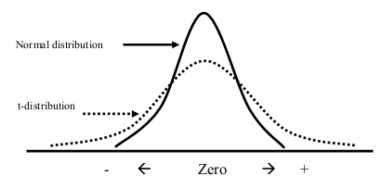

Slide 4
The exact shape of the t-distribution depends on the degree of freedom (d.f.= n-1), and on the sample SD, the fewer the degrees of freedom, the more the t-distribution is spread out. t-test use is restricted to the small sample size (less than 30).
t-test represent the measurement of the significancy of difference between two means;
t =

Slide 5
Applications of t-test;
For calculation of population mean.
For calculation of significance of difference between sample mean and population mean.
For calculation of significance of difference between two independent means.
For calculation of significance of difference between two dependent means (paired observations).

Slide 6
1- Calculation of population mean:
In general, a confidence interval “C.I.” (Population mean; µ ) is calculated using t distribution through appropriate significance level (α=0.05 for 95% C.I., α=0.01 for 99% C.I.) with (n-1) degrees of freedom. This is applied for small sample size (n < 30) because for large degrees of freedom, the t distribution is almost the same as the standard normal distribution.

Slide 7
e.g. The followings are the numbers of hours of relief obtained by 6 patients after receiving a new drug;
2.2, 2.4, 4.9, 2.5, 3.7, & 4.3 hours
Mean = 3.3 hours SD= ±1.3 hours n= 6
Calculate population mean? (Using α=0.05).
Tabulated t for α=0.05, for d.f. (n-1) is;
α=0.05
t = 2.571
df.=n-1=6-1=5
µ = mean ± x SE
µ = 3.3 ± 2.57 x (1.13/√ 6)
µ = 3.3 ± 2.57 x 0.46
µ = 3.3 ± 1.2
Lower limit = 3.3-1.2 2.1 hours
Upper limit = 3.3+1.2 4.5 hours
µ ( 2.1 --- 4.5 ) hours

Slide 8
2-Difference between sample mean and population mean:
The t-test is used to test the significance of the difference of sample mean from a population mean or a standard mean or a standard value.
e.g. The followings are the heights in cm of 24 two-years-old boys with sickle cell disease.

Slide 9
Height standard for United Kingdom (U.K.) give a reference height for two-years-old boys of 86.5 cm (representµ).
Does the above sample suggest that the two-years-old boys with sickle cell (SC) disease differ in height from the standards? (use α=0.05).

Slide 10
Data: Data represent the heights of 24 two-years-old boys with SC disease, with; Mean = 84.1 cm
SD= ±3.11 cm SE=SD/√n = 3.11/√24=3.11/4.9= ±0.63 cm
Assumption: We assume that the sample of 24 two-years-old boys with SC disease was selected randomly from a normally distributed population of boys with SC disease.
H_{O}: There is no significant difference between mean height of boys with SC disease from the normal standard height (m1=µ; m1-µ=0). OR There is no significant influence (effect) of SC disease on the height of children.

Slide 11
H_{A}: There is significant difference between mean height of boys with SC disease from the normal standard height (m1 µ; m1- µ 0). OR There is significant influence (effect) of SC disease on the height of children.
Level of significance; (α = 0.05); 5% Chance factor effect area 95% Influencing factor effect area (SC disease) d.f.=n-1; tabulated t for d.f {(n-l)=24-1=23} equal to 2.069.

Slide 12
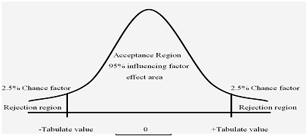

Slide 13
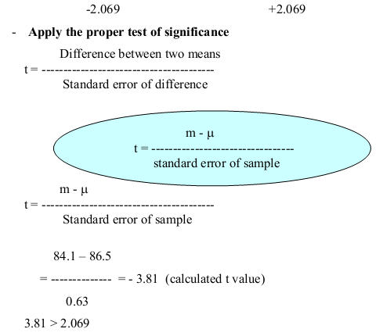

Slide 14
Since Calculated t > Tabulated t
So P<0.05
Then reject Ho and accept HA ....
There is significant difference between mean height of boys with SC disease from the normal standard height.
There is significant influence (effect) of SC disease on the height of Children.
Significantly SC disease lowering height of children.
There is stunting of height due to the effect of SC disease.

Slide 16
3-Difference between two independent means:
The difference between the means of two independent samples is normally distributed. The same procedure for calculation is followed except that;
Assumption; we assume that we have two independent samples randomly chosen each one from a normally distributed population with equal variances of populations.
Equation… as the SE of difference is calculated as; Standard deviation of population (pooled SD) SP

Slide 17
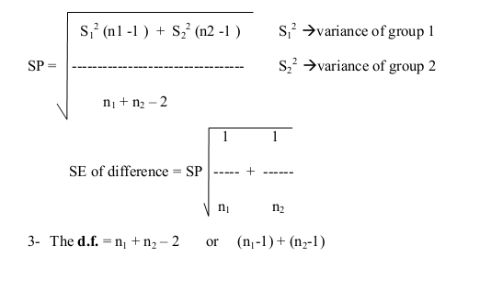

Slide 18
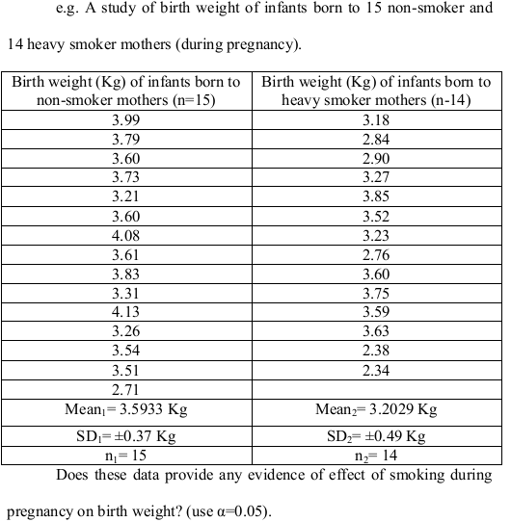

Slide 19
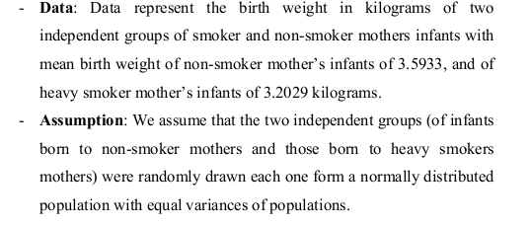

Slide 20
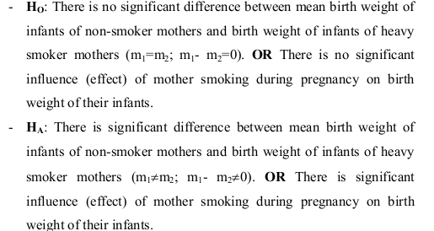

Slide 21
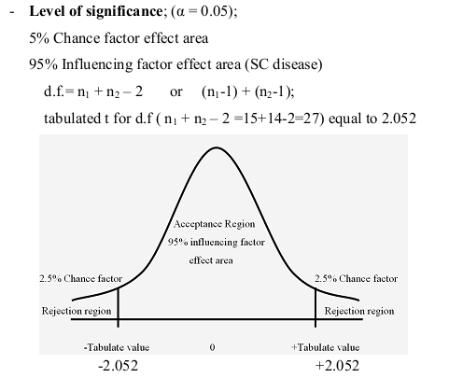

Slide 23
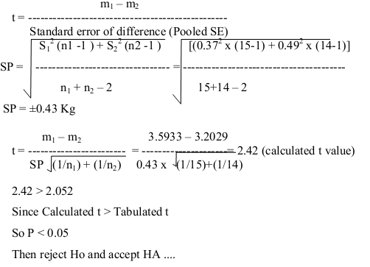

Slide 24
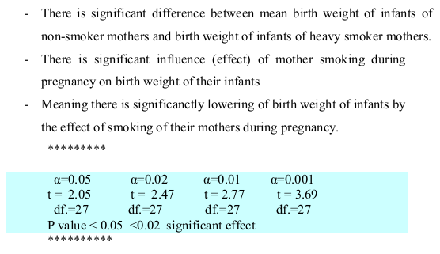

Slide 25
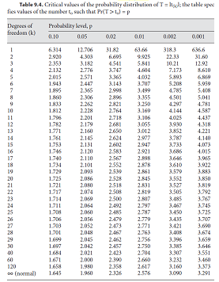

Slide 26
4-Difference between two dependent sample means:
The use of t-test here for the difference between pairs of variables measured on each individual, such as the results of blood pressure of each individual before taking hypotensive agent and after its taken, if the drug have no effect so there is no difference in the values of blood pressure before and after its taken (as there is small but not significant difference), but if there is effect of drug so there is difference between the two measurements, it means there is significant difference (before and after). So the same sample (one group) under two occasions is considered here, e.g. before and after, etc…

Slide 27
The use of test is restricted for samples with matched pairs of less than 30. This technique is applied in order to eliminate as much as possible a maximum number of sources of variation by making the pairs similar (identical) to each other with respect to as many variables as possible (for the same persons two measurements one before and one after as the difference is mostly due to the effect of the factor itself)

Slide 28
e.g. The effect of a certain sleeping drug is to be tested by taking 10 patients, we gave them at first night a placebo drug and we measure the sleeping hours, next night we gave them the sleeping drug and we measure the sleeping hours, the following results were obtained from this placebo-controlled clinical trial to test the effectiveness of a sleeping drug;

Slide 29
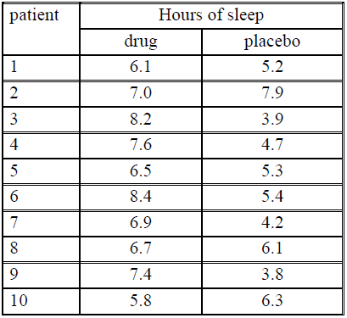

Slide 30
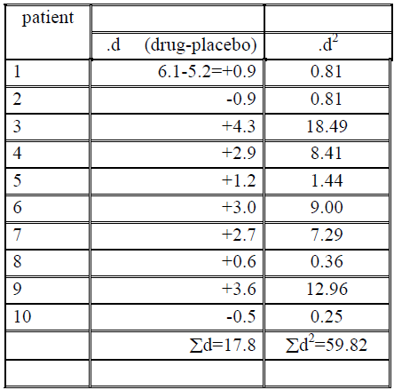

Slide 31
Data: Data represent 10 patients with sleeping hours for each one before and after taking a sleeping agent, with mean duration of sleeping of 7.06 hours after taking the sleeping agent, and 5.28 hours after taking a placebo.
Assumption: We assume that the sample was selected randomly from a normally distributed population. OR we assume that the observed difference constitutes a simple random sample from a normally distributed population of differences.

Slide 32
HO: There is no significant difference in the mean sleeping hours after taking the drug from that of the placebo (m1=m2; m1-m2=0). OR There is no significant effect of the drug as a sleeping agent.
HA: There is significant difference in the mean sleeping hours after taking the drug from that of the placebo (m1 ≠ m2; m1-m2 ≠ 0). OR There is significant effect of the drug as a sleeping agent
Level of significance; (α = 0.05);
5% Chance factor effect area
95% Influencing factor effect area (sleeping agent) d.f. =n-1;

Slide 33
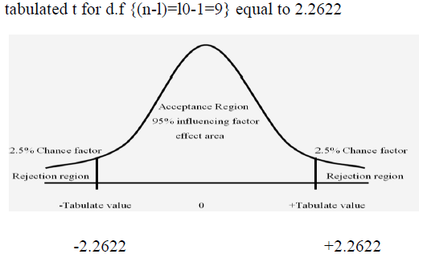

Slide 34
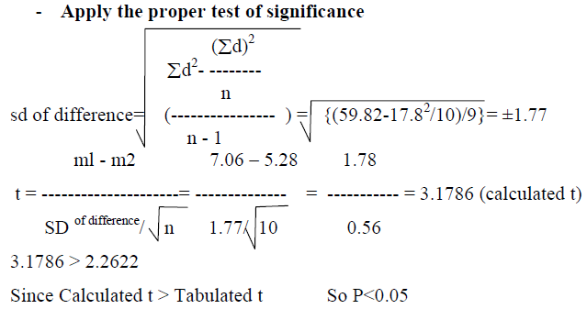

Slide 35
Then reject Ho and accept HA ....
There is significant difference in the mean sleeping hours after taking the drug from that of the placebo
There is significant effect of the drug as a sleeping agent
Significantly this agent is increasing the sleeping hours after its taken.

Slide 36
Reasons for pairing;
It frequently true that true differences do not exist between two populations with respect to the variable of interest, but the presence of other (extraneous) sources of variations may cause rejection of the hypothesis of no difference. On the other hand true differences may also be masked by the presence of extraneous factors.

Slide 37
Therefore the objective in paired comparison tests;
is to eliminate a maximum number of sources of extraneous variation by making the pairs similar with respect to as many variables as possible
Fewer subjects are used with repeated measurements on each one, this is of value specially if subjects are scare or expensive to recruit.

Slide 38
Disadvantages of paired comparisons;
Considerable time and expenses are needed in our trying to match individuals on one or more relevant variables.
Loss of degrees of freedom. If we do not use paired observations, we have 2n-2 or n1+n2-2 as compared to n-1 when we use the paired comparison procedure.
Carry-over effect; especially when one or more treatments are being evaluated with possibility of residual effect from previous treatment. This problem can frequently be solved by allowing a sufficient length of time between treatments.
Position effect; A subject response to a treatment experienced last in a sequence may be different from the response that would have occurred if the treatment had been first in the sequence. This problem can be solved by randomize the sequence of treatments independently for each subject.

Slide 39
End

