Slide 1
Correlation and linear regression
Dr. Nadhim Ghazal

Slide 2
The aim is to investigate the linear relationship between two continuous variables. Correlation therefore measures the closeness of the relationship. Correlation is defined as the degree or strength of relationship between two characteristics in a population. For the correlation to be obtained we need the followings;

Slide 3
One population
two characteristics
both should be continuous type (quantitative data)
both should be changing (variables) (not constant)
There must be some sort of relationship between two in order to obtain the strength of this relationship.

Slide 4
Uses of correlation
Description; to describe the general level of one variable that is related with each level of other variable.
Adjustment; to provide a mean of adjusting two set of variables when one variable tends to have different values with another variable.
Forecasting or prediction; to aid in forecasting or prediction a level of one variable for a new value of another variable.
Interpreting; to understand and interpret the mechanism by which one variable is related to another.
Outlier detection; to detect abnormal values or outliers that may merit detailed individual study.

Slide 5
After that we need to determine which of the two variables is X and which one is Y according to the following;

Slide 6
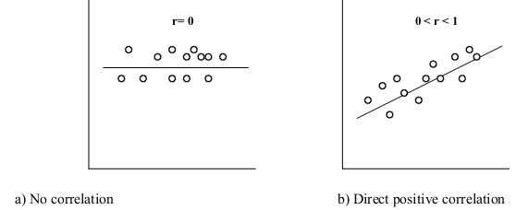
After that we need to draw a scatter diagram in order to ascertain the presence of correlation and we have the following types of scatter;

Slide 7
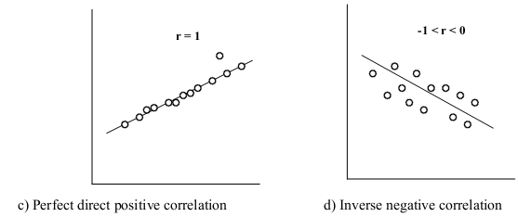

Slide 8
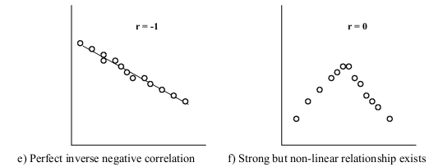
r only measures the linear relationship so we have to draw a scatter diagram first to identify non-linear relationship.

Slide 9
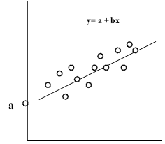
Linear regression
Gives the equation of straight line that best describes it and enables the prediction of one variable from the other.

Slide 10
a= constant, called y-intercept, it is the place where the regression line intersept with y axis
b=regression coefficient
x= any value of X variable
y= any value of Y variable

Slide 11
Interpretation of r
r is always a number between -1 and +1
r is positive if x and y tend to be high or low together, and the larger its value, the closer the relationship
r is negative if high value of y tend to go with low values of x and vice versa
r only measures the linear relationship so we have to draw a scatter diagram first to identify non-linear relationship.
if we calculate r without examining the data the we will miss a strong but non-linear relationship

Slide 12
if r < 0.3 No correlation,
r 0.3-<0.5 Weak correlation,
r 0.5-0.7 Moderate correlation,
r 0.7- <1 (+ or -) Strong correlation

Slide 13
The r² (The coefficient of determination), i.e. when value of r = 0.58, then r 2 =0.34, this means that 34% of the variation in the values of y may be accounted for by knowing values of x or vice versa.

Slide 14
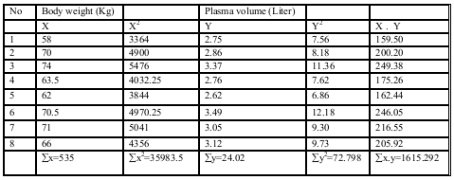
e.g; The body weight (Kg) and plasma volume (Liter) of 8 healthy men are presented in this table;

Slide 15
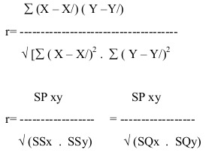
In general high plasma volume tend to be associated with high weight, this relationship is measured y the Pearson correlation,
SP = Sum of products of X and Y
SS=SQ= Sum of squares of X or of Y

Slide 16
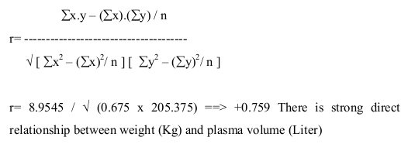

Slide 17
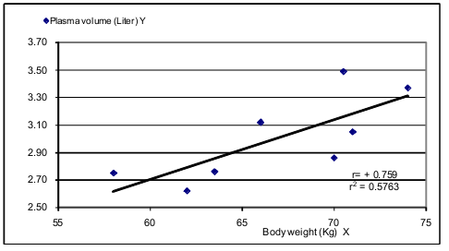
Scatter diagram of plasma volume and body weight showing linear regression line. A weak correlation may therefore be statistically significant if based on a large number of observations, while a strong correlation may fail to achieve significance if there are only a few observations.

Slide 18
END

