Slide 1
HIV infection and AIDS

Slide 2
EPIDEMIOLOGY AND BIOLOGY OF HIV:
The acquired immunodeficiency syndrome (AIDS) was first recognised in 1981, although the earliest documented case has been traced to a blood sample from 1959.
It is caused by the human immunodeficiency virus (HIV-1), which has evolved a number of mechanisms to elude immune control and has thereby prevented effective control of the epidemic.

Slide 3
HIV-2 causes a similar illness to HIV-1 but is less aggressive and restricted mainly to western Africa.
The origin of HIV is a non-human primate simian virus which probably passed from chimpanzees to humans via bush hunters.

Slide 4
AIDS remains the second leading cause of disease burden world-wide and the leading cause of death in Africa, although downward trends in prevalence are occurring in several countries, partly as a result of effective prevention measures and partly due to scaling up of antiretroviral access.

Slide 5
Highly active retroviral therapy (HAART) with three or more drugs has improved life expectancy to near normal in the majority of patients receiving it, with an 80% reduction of mortality since its introduction.

Slide 6
Global epidemic and regional patterns:
In 2007, the World Health Organization (WHO) estimated that there were 33.2 million people living with HIV/AIDS, 2.5 million new infections and 2.1 million deaths.
The cumulative death toll since the epidemic began is over 20 million, the vast majority of cases occurring in sub-Saharan Africa where over 11.4 million children are now orphaned.

Slide 7
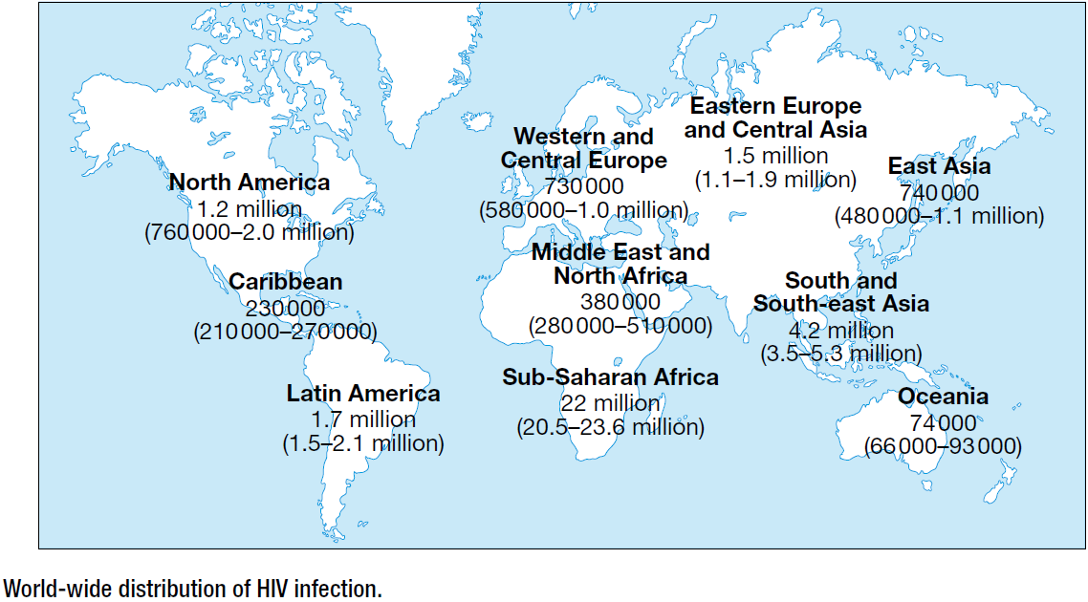

Slide 8
In eight Southern African countries (Botswana, South Africa, Swaziland, Mozambique, Lesotho, Namibia, Zaire and Zimbabwe) the prevalence exceeds 15%, and for many others, such as Cameroon, Central African Republic and Cote d’Ivoire, it is over 5%.
Between 2001 and 2007, the steepest increases have been seen in Asia (> 90%) and Eastern Europe/Central Asia (150%), predominantly India, China, Russia and Ukraine.

Slide 9
In South-east Asia, the epidemic is well developed but prevalence is falling in Thailand, Cambodia and Myanmar, although still increasing in Vietnam and Indonesia.
In India, the national prevalence is 0.36% (varying from 0.07% in Uttar Pradesh to 1.13% in Manipur) and it is estimated that 2.5 million persons were infected in 2006.
Given that Asia is home to 60% of the world’s population, these changes have huge implications.

Slide 10
Many different cultural, social and behavioural aspects determine the regional characteristics of HIV disease.
Historically, the epidemic in North America and northern Europe has been in men who have sex with men (MSM), whereas in southern and Eastern Europe, Vietnam, Malaysia, Indonesia, North-east India and China the incidence has been greatest in injection drug-users.

Slide 11
In Africa, the Caribbean and much of Southeast Asia the dominant route of transmission remains heterosexual and from mother to child.
However, the epidemic in many nations is changing. Heterosexual transmission has become a significant and often dominant route with racial and ethnic minorities representing an increasing fraction, largely as a consequence of the influx of migrants from high-prevalence countries.

Slide 12
In the European Union (EU) in 2006, more than half of patients were infected heterosexually, with a doubling of new cases in the UK over the last 5 years. Additionally, there has been a 50% increase in reported new diagnoses in MSM, although some of this may be accounted for by an increased uptake in testing.

Slide 13
It is of concern that around 30% of patients are unaware of their diagnosis and one-quarter of these present with late disease. This underlies the importance of having a low threshold to test individuals, especially when they present with any condition that has been associated with HIV.

Slide 14
The economic and demographic impact of HIV infection in developing countries is profound, as it affects those at their most economically productive and fertile age, and is also eroding the health and economic advances made in the last few decades.
Although roll-out of drugs and access to care has improved dramatically recently, less than one-quarter of patients in many resource-poor countries are able to access antiretrovirals.

Slide 15
Modes of transmission:
HIV is present in blood, semen and other body fluids such as breast milk and saliva.
Exposure to infected fluid leads to a risk of contracting infection, which is dependent on the integrity of the exposed site, the type and volume of body fluid, and the viral load.
HIV can enter either as free virus or within cells.

Slide 16
The modes of spread are sexual (man to man, heterosexual and oral), parenteral (blood or blood product recipients, injection drug-users and those experiencing occupational injury) and vertical.

Slide 17
The transmission risk after exposure is over 90% for blood or blood products, 15–40% for the vertical route, 0.5–1.0% for injection drug use, 0.2–0.5% for genital mucous membrane spread and under 0.1% for non-genital mucous membrane spread.

Slide 18
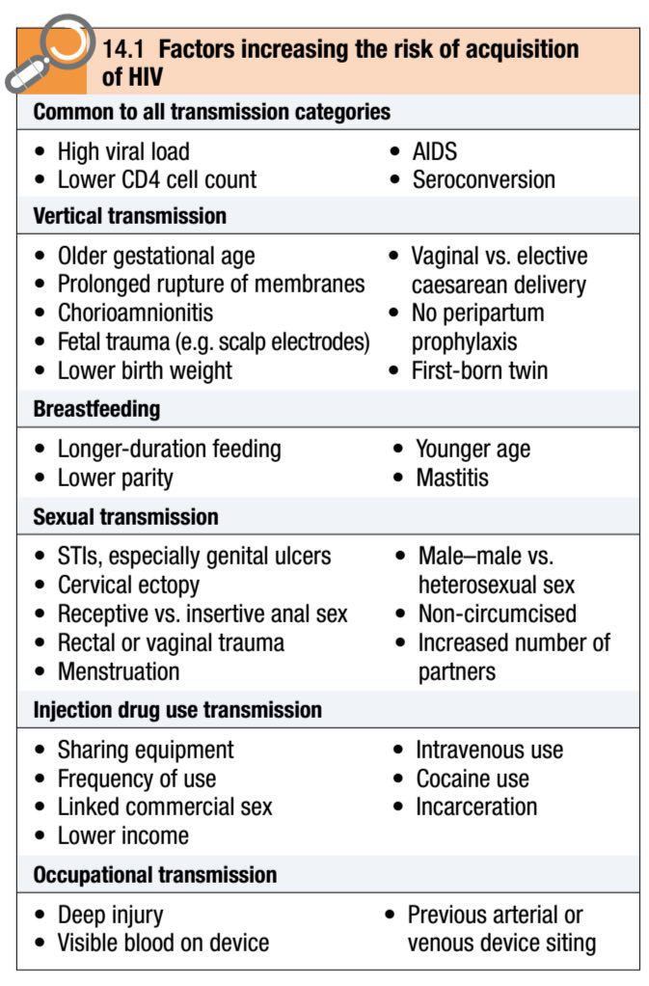
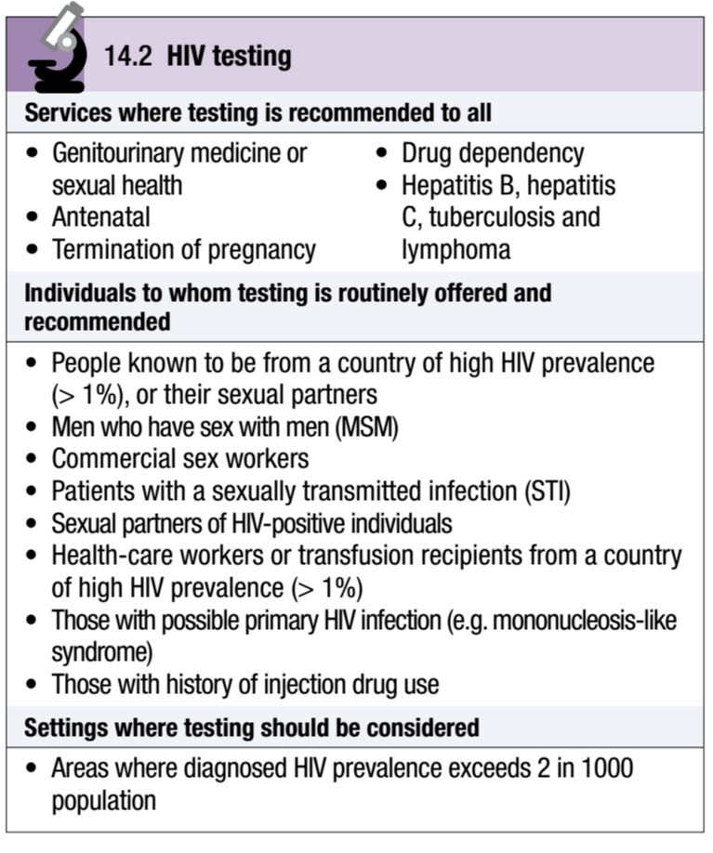

Slide 19
World-wide, the major route of transmission (> 75%) is heterosexual.
About 5–10% of new HIV infections are in children and more than 90% of these are infected during pregnancy, birth or breastfeeding.
The rate of mother-to-child transmission is higher in developing countries (25–44%) than in industrialised nations (13–25%).
Postnatal transmission via breast milk accounts for some of this increased risk.

Slide 20
Of those infected vertically, 80% are infected close to the time of delivery and 20% in utero.
Around 70% of patients with haemophilia A and 30% of those with haemophilia B had been infected through contaminated blood products by the time HIV antibody screening was adopted in the USA and Europe in 1985.

Slide 21
In developed nations, because of routine antibody screening, the likelihood of acquiring HIV from blood products is now less than 1:500 000 and arises from donors in the seroconverting phase of infection.
However, the WHO estimates that because of the lack of adequate screening facilities in resource-poor countries, 5–10% of blood transfusions globally are with HIV-infected blood.

Slide 22
There have been approximately 100 definite and 200 possible cases of HIV acquired occupationally in health-care workers. Such infections are substantially more frequent in developing nations, where it is estimated that 40% of syringes/needles used in injections are reused without sterilisation.

Slide 23
Virology and immunology:
HIV is a single-stranded RNA retrovirus from the Lentivirus family.
After mucosal exposure, HIV is transported to the lymph nodes via dendritic, CD4 T lymphocytes or Langerhans cells, where infection becomes established.
Dendritic cells express various receptors (e.g. DC–SIGN) that facilitate capture and transport of HIV-1.

Slide 24
Free or cell-associated virus is then disseminated widely through the blood with seeding of ‘sanctuary’ sites (e.g. central nervous system (CNS)) and latent CD4 cell reservoirs.

Slide 25
Each mature virion is spherical and has a lipid membrane lined by a matrix protein that is studded with glycoprotein (gp) 120 and gp41 spikes surrounding a cone-shaped protein core.
This core houses two copies of the single-stranded RNA genome and viral enzymes.
The virus infects the CD4 cell in a complicated sequence of events beginning with engagement of the viral gp120 and the CD4 cell receptor (stage 1), which results in a conformational change in gp120.

Slide 26
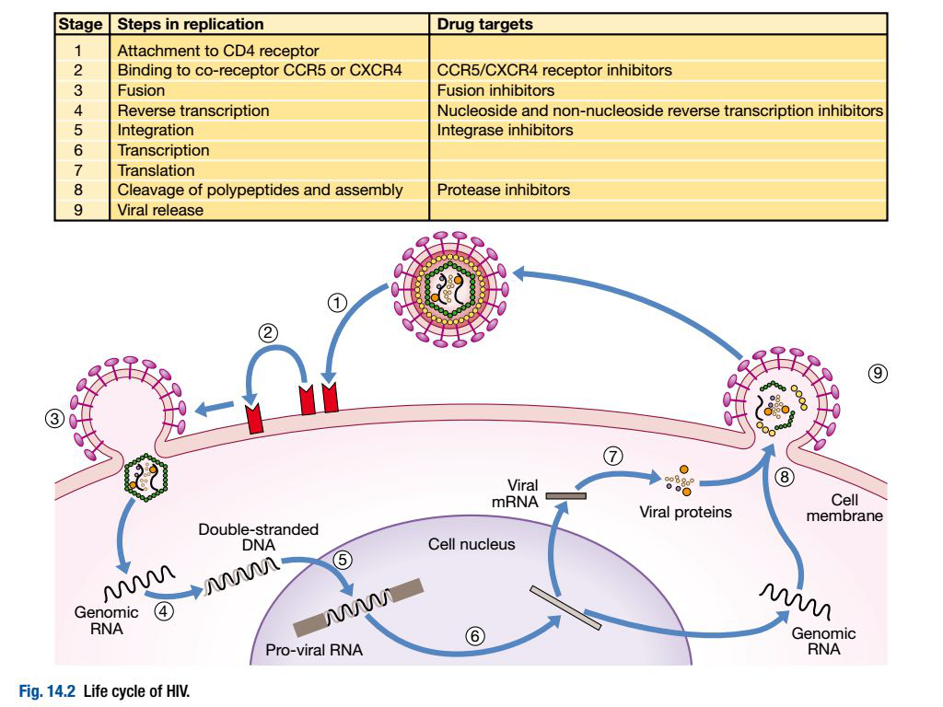

Slide 27
This permits interaction with one of two chemokine co-receptors (CXCR4 or CCR5: stage 2), which is followed by membrane fusion and cellular entry involving gp41 (stage 3).
Monocyte-macrophages, follicular dendritic cells and microglial cells in the central nervous system also express the CD4 cell receptor and are permissive to infection.

Slide 28
After penetrating the cell and uncoating, a DNA copy is transcribed from the RNA genome by the reverse transcriptase (RT) enzyme (stage 4) that is carried by the infecting virion.
Reverse transcription is an error-prone process and multiple mutations arise with ongoing replication (hence the rapid generation of viral resistance to drugs).

Slide 29
This DNA is transported into the nucleus and integrated randomly within the host cell genome via integrase enzyme (stage 5).
Integrated virus is known as proviral DNA.
On host-cell activation, this DNA copy is used as a template to transcribe new RNA copies (stage 6), which are processed and exported from the nucleus, viral mRNA then being translated into viral peptide chains (stage 7).

Slide 30
The precursor polyproteins are then cleaved by the viral protease enzyme to form new viral structural proteins and viral enzymes such as the reverse transcriptase and protease.
These then migrate to the cell surface and are assembled using the host cellular apparatus to produce infectious viral particles.
These bud from the cell surface, incorporating the host cell membrane as their own lipid bilayer coat, and cell lysis occurs (stage 9).

Slide 31
Once maturation is complete, the new infectious virus (virion) is then available to infect uninfected cells and repeat the process.
All of these processes are enabled by three viral genes (Gag, Pol and Env ), as well as the products of six regulatory genes (Vif, Vpr, Vpu, Nef, Tat and Rev ).
It has been calculated that each day more than 10¹⁰ virions are produced and 10⁹ CD4 cells destroyed. This represents a daily turnover of 30% of the total viral burden and 6–7% of the total body CD4 cells.

Slide 32
A small percentage of T cells (< 0.01%) either produce small quantities of virus or enter a post-integration latent phase and represent the main reservoir of HIV.
Together with virion-associated immune complexes bound to follicular dendritic cells, they can refuel infection if host defences fail or HAART is discontinued.

Slide 33
There is ongoing low-level replication within these cells, even when plasma levels of HIV are below the level of detection as a result of antiretroviral treatment.
They are important as sanctuary sites from antiviral therapy, as continuing sources of virus (including the generation of drug-resistant strains) and as eventual targets for eradication strategies.
The half-life of the virus is 1–2 hours in plasma, 1.5 days in productively infected CD4 cells and over 12 months in latently infected CD4 cells.

Slide 34
With time, there is gradual attrition of the CD4 cell population and, as CD4 cells are pivotal in orchestrating the immune response, any depletion renders the body susceptible to opportunistic infections and oncogenic virus-related tumours.

Slide 35
The predominant opportunist infections seen in HIV disease are intracellular parasites (e.g. Mycobacterium tuberculosis) or pathogens susceptible to cell-mediated rather than antibody-mediated immune responses.
The exact mechanism underlying the CD4 decline is not fully understood, but it is not restricted to virus-infected cells and is linked to the height of plasma viral load.

Slide 36
Both are monitored closely in patients and used as measures of disease progression.
Virus-specific CD8 cytotoxic T lymphocytes develop rapidly after infection and are crucial in recognising, binding and lysing infected CD4 cells, thus controlling HIV replication after infection and the subsequent rate of disease progression.

Slide 37
On the basis of DNA sequencing, HIV-1 can be subdivided into group M (‘major’, world-wide distribution), group O (‘outlier’, divergent from group M) and group N (‘non-major and non-outlier’, highly divergent) types.
Groups O and N are restricted to West Africa and may screen weakly positive or negative on routine antibody testing.

Slide 38
Group M can be subdivided further into subtypes; 9 are currently recognised (A–K), with numerous subsubtypes (e.g. A1–A4) and circulating recombinant forms (e.g. CRF01_AE). Globally, subtype C (Africa and India) accounts for half of strains.

Slide 39
Subtype A (Africa, Asia and Eastern Europe) and subtype B (Western Europe, the Americas and Australia) are responsible for approximately 10% each, and in many countries, more than one subtype or recombinant exists, or is emerging in restricted groups (e.g. West Africa, South-east Asia, southern Europe, and Russia).

Slide 40
Increased HIV diversity has implications for diagnostic tests, treatments and vaccine development. It may also influence transmission (more frequent with subtype C), disease progression (faster with subtypes A and D), co-receptor usage (CXCR4 used early with subtype D) and emergent resistance patterns (subtype C).
In Europe, the prevalence of non-B subtypes is increasing because of migrants ( predominantly from Africa) and now accounts for a significant proportion of newly diagnosed infection.

Slide 41
HIV-2 is an important but separate retrovirus which has at least five subtypes.
The virus differs from HIV-1 in that patients have lower viral loads, slower CD4 decline, lower rates of vertical transmission and 12-fold lower progression to AIDS.

Slide 42
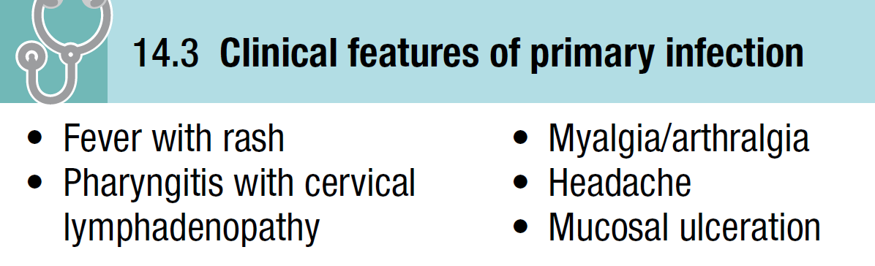
NATURAL HISTORY AND CLASSIFICATION OF HIV:
Primary infection:
Primary infection is symptomatic in 70–80% of cases and usually occurs 2–6 weeks after exposure.

Slide 43
Rarely, presentation may be with neurological features. This coincides with high plasma HIV-RNA levels and a fall in the CD4 count to 300–400 cells/mm³, but occasionally to below 200 when opportunistic infections (e.g. oropharyngeal candidiasis, Pneumocystis jirovecii pneumonia (PCP)) may rarely occur.

Slide 44
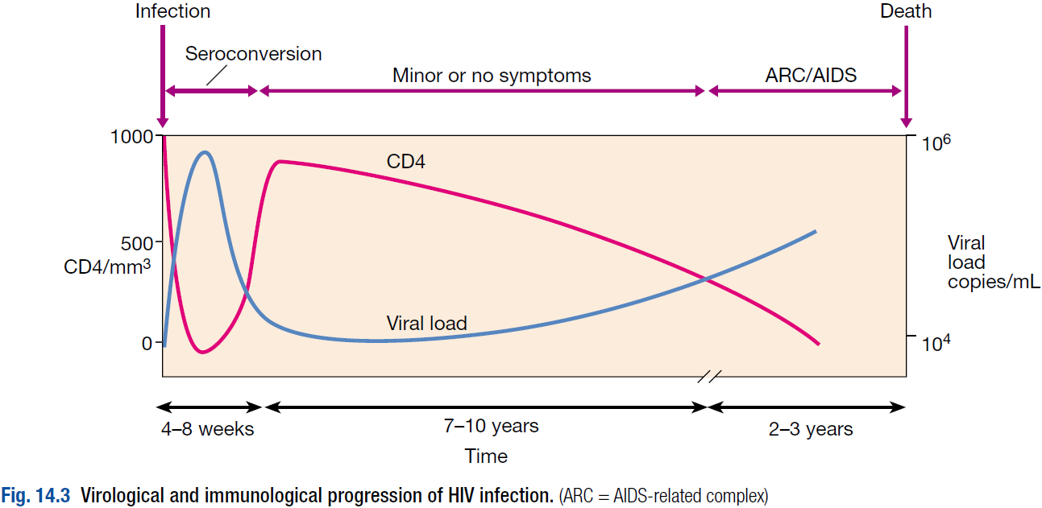

Slide 45
Symptomatic recovery parallels the return of the CD4 count (although this rarely recovers to its previous value) and fall in the viral load.
In many patients, the illness is mild and only identified on retrospective enquiry at later presentation.

Slide 46
Diagnosis is made by detecting HIV-RNA in the serum or by immunoblot assay (which shows antibodies developing to early proteins).
The appearance of specific anti-HIV antibodies in serum (seroconversion) takes place later at 3–12 weeks (median 8 weeks).
Factors likely to indicate faster disease progression are the presence and duration of symptoms, evidence of candidiasis, and neurological involvement.

Slide 47
The level of the viral load post-seroconversion correlates with subsequent progression of disease.
The differential diagnosis of primary HIV includes acute Epstein–Barr virus (EBV), cytomegalovirus (CMV), streptococcal pharyngitis, toxoplasmosis and secondary syphilis.

Slide 48
Asymptomatic infection:
Asymptomatic infection (category A disease in the Centers for Disease Control (CDC) classification) follows and lasts for a variable period, during which the infected individual remains well with no evidence of disease except for the possible presence of persistent generalised lymphadenopathy (PGL, defined as enlarged glands at ≥ 2 extra-inguinal sites).

Slide 49
At this stage the bulk of virus replication takes place within lymphoid tissue (e.g. follicular dendritic cells).
There is sustained viraemia with a decline in CD4 count dependent on the height of the viral load but usually between 50 and 150 cells/year.

Slide 50
Mildly symptomatic disease:
Mildly symptomatic disease (CDC classification category B disease) then develops in the majority, indicating some impairment of cellular immunity but which is not AIDS-defining.
The median interval from infection to the development of symptoms is around 7–10 years, although subgroups of patients exhibit ‘fast’ or ‘slow’ rates of progression.

Slide 51
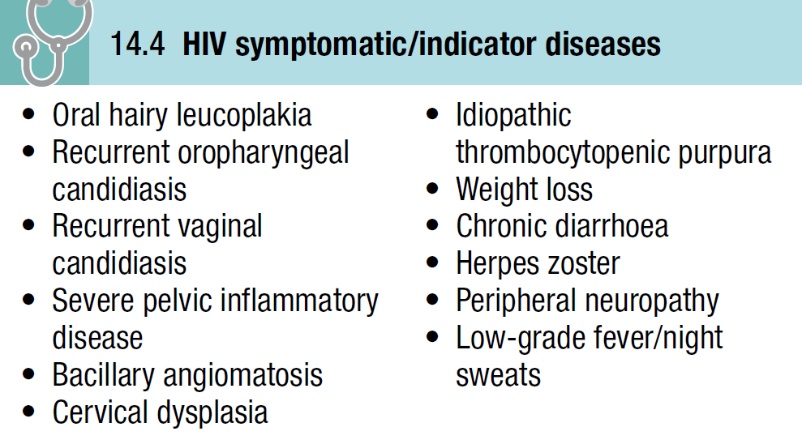

Slide 52
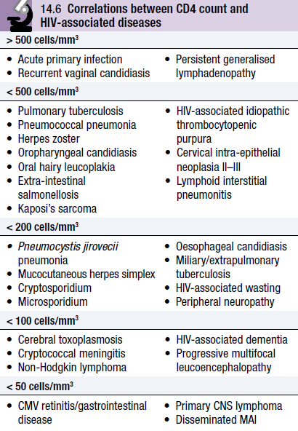
Acquired immunodeficiency syndrome (AIDS):
AIDS (CDC classification category C disease) is defined by the development of specified opportunistic infections, tumours and presentations.

Slide 53
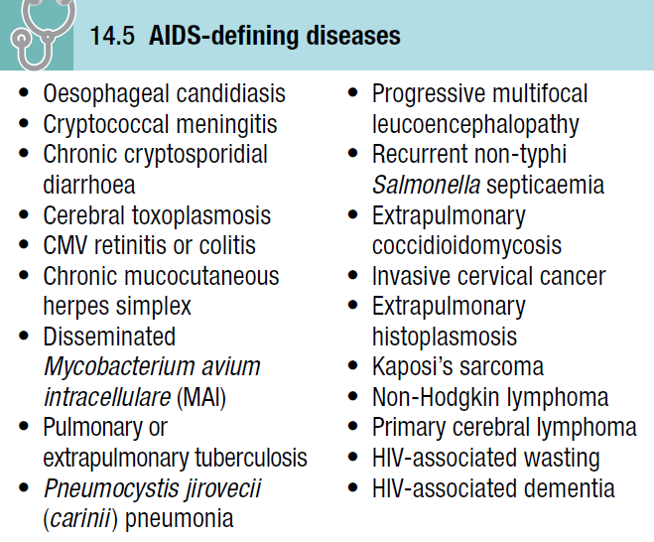

Slide 54
PRESENTING PROBLEMS IN HIV INFECTION:
Initial HAART is introduced when the CD4 count falls below 350 cells/mm³ or an AIDS-defining illness develops.
Over 85% of cases achieve complete virological suppression by 3 months, a steady increase in CD4 count and a return to good health.

Slide 55
Occasionally, patients with low CD4 counts can experience immune reconstitution disease (IRD). This indicates either subclinical infection which has become manifest with HAART, or an enhanced reaction to dying or dead microorganisms which results in clinical illness.

Slide 56
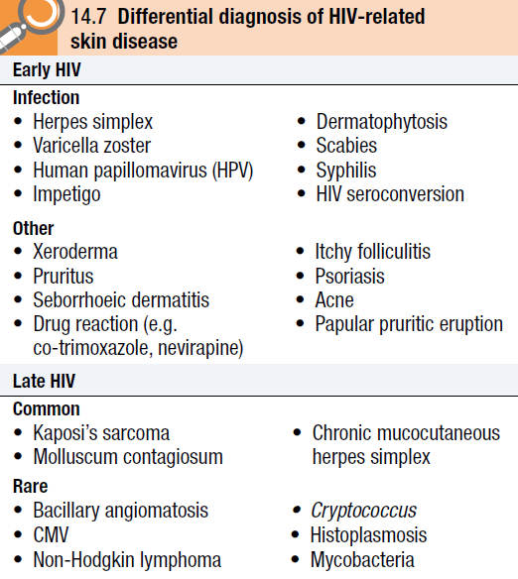
Mucocutaneous disease:
Mucocutaneous manifestations are common in HIV and range from the trivial to markers of significant systemic infection.

Slide 57
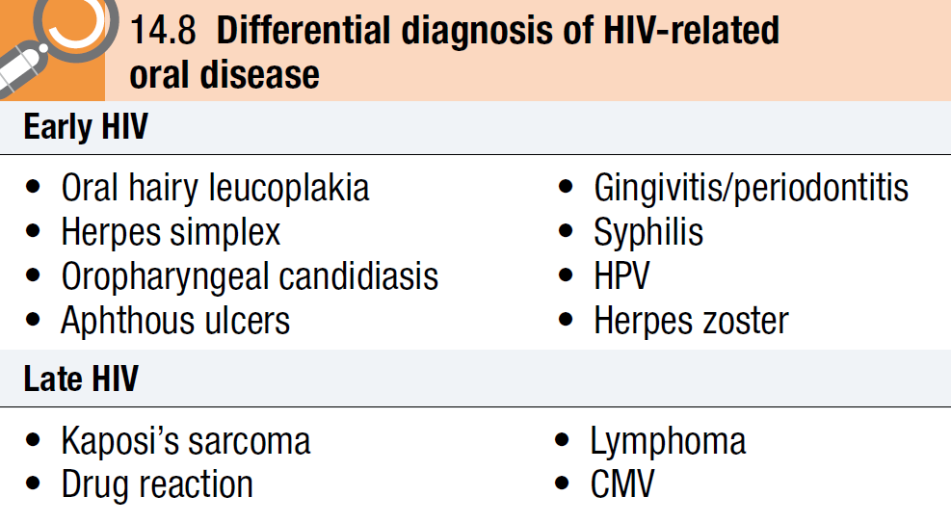

Slide 58
Most patients are affected at some point and for many it is a major problem.
Dermatological problems may present atypically, coexist with other pathologies and be harder to manage than in an HIV-negative patient.
Type and severity of rash are often dependent upon the level of CD4 count.
The presence of either oropharyngeal candidiasis or oral hairy leucoplakia in a young person is suggestive of HIV infection.

Slide 59
Anyone with an unusual rash, especially one persistent and unresponsive to topical antifungal/corticosteroid combinations, or in the presence of severe immune compromise (CD4 < 50 cells/mm³), merits a skin biopsy for histology and culture.

Slide 60
Specific skin conditions:
a. Fungal infections:
Early HIV-associated skin diseases include xerosis with pruritus, seborrhoeic dermatitis, and an itchy folliculitic rash which may be fungal (Malassezia furfur), staphylococcal or eosinophilic in aetiology.

Slide 61
Dermatophyte infection affecting skin (feet, body and face) and nails is also common, and may be extensive and difficult to treat.
Seborrhoeic dermatitis is very common in HIV and is present in up to 80% of patients with AIDS; severity increases as the CD4 count falls.

Slide 62
It presents as dry scaly red patches on the face (typically on the cheeks, in the nasolabial folds, around the eyebrows, behind the ears and on the scalp).
The cause is multifactorial but M. furfur is important. It responds well to a combined topical antifungal/steroid.

Slide 63
b. Viral infections:
The major viral infections affecting the skin are herpes simplex, varicella zoster (VZV), human papillomavirus (HPV) and molluscum contagiosum.

Slide 64
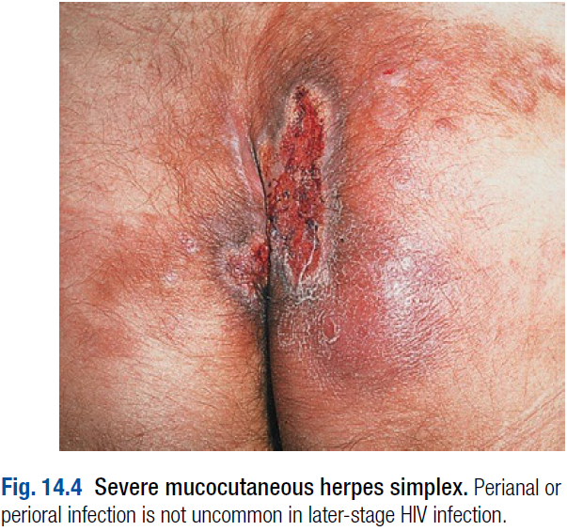
Herpes simplex (type 1 or 2):
This may affect the lips, mouth and skin or anogenital area and is seen in 20% of cases.
In later-stage HIV, the lesions are usually chronic, extensive, harder to treat and recurrent.
Persistent and severe anogenital ulceration is usually herpetic and a marker for underlying HIV.

Slide 65
VZV:
This usually presents with a dermatomal vesicular rash on an erythematous base, and may be the first clue to a diagnosis of HIV infection.
It can occur at any stage but is more frequent with failing immunity.
In patients with a CD4 count < 100 cells/mm³, the rash may be more severe, multidermatomal, persistent or recurrent, or may become disseminated.

Slide 66
Involvement of the trigeminal nerve, scarring on recovery and associated motor defects are probably also more common.
Diagnosis of herpetic infection can be confirmed by culture, smear preparations showing characteristic inclusion bodies, electron microscopy or biopsy.

Slide 67
Treatment should be given for all cases of active disease, irrespective of the time since onset of rash.
In patients with severe mucocutaneous herpes simplex or herpes zoster which is disseminated, multidermatomal, ophthalmic or very dense, or when the CD4 count is < 200 cells/mm³, parenteral aciclovir must be used.

Slide 68
HPV infection:
This is frequent amongst HIV patients and is usually anogenital; disease may be extensive and very difficult to manage.
Warts on the hands and feet (especially periungual) are also common and may attain considerable size, requiring surgery.
Occasionally, myriads of flat-topped papules occur over the body and face.
Both oncogenic (16, 18, 31, 33) and non-oncogenic (6, 11) genotypes are found.
There is often improvement on HAART.

Slide 69
Molluscum contagiosum:
This is an epidermal poxvirus infection.
It is found in approximately 10% of AIDS patients.
The lesions are usually 2–5 mm diameter papules with a central umbilicus and most frequently affect the face, neck, scalp and genital region.
Lesions may become widespread and attain a large size (giant mollusca).
Treatment is with curettage or cryotherapy, and with improvement in CD4 counts, lesions usually disappear.

Slide 70
c. Bacterial and parasitic infections:
Bacterial infections include Staphylococcus aureus (folliculitis, cellulitis and abscesses), bacillary angiomatosis and syphilis (primary and secondary).
Bacillary angiomatosis is a bacterial infection due to the cat-scratch bacillus, Bartonella henselae.
Skin lesions range from solitary superficial reddish-purple lesions resembling Kaposi’s sarcoma or pyogenic granuloma, to multiple subcutaneous nodules or even hyperpigmented plaques.
Lesions are painful and may bleed or ulcerate.

Slide 71
The infection may become disseminated with fevers, lymphadenopathy and hepatosplenomegaly.
Diagnosis is made by biopsy of a lesion and Warthin–Starry silver staining which reveals aggregates of bacilli.
Treatment with doxycycline or azithromycin is effective.

Slide 72
In HIV, scabies (due to the mite Sarcoptes scabiei) may cause intensely pruritic, encrusted papules affecting most areas. Classically, the interdigital web spaces, wrists, periumbilical area, buttock and sides of the feet are involved.
Commonly in HIV the infestation may be heavy, the rash hyperkeratotic (Norwegian scabies) and the patient highly infectious. Uniquely, the face and neck are often affected.

Slide 73
Rarely, cutaneous disease may be a manifestation of mycobacterial infection (tuberculosis or an atypical mycobacterium) or disseminated fungal infection.
Papular pruritic eruption is an itchy symmetrical rash affecting the extremities and resulting in hyper-/hypopigmentation. It is seen mainly in those from sub-Saharan Africa where it is the most common skin manifestation of HIV, and is highly indicative of HIV when present.
Topical steroids, emollients and antihistamines are useful but response is variable.

Slide 74
Specific oral conditions:
a. Candidiasis:
Candida infection in HIV is almost exclusively mucosal, affecting nearly all patients with CD4 counts < 200 cells/mm³.
In early disease, it is nearly always caused by C. albicans.
Pseudomembranous candidiasis describes white patches on the buccal mucosa that can be scraped off to reveal a red raw surface. The tongue, palate and pharynx may also be involved.

Slide 75
Less common is erythematous candidiasis; patients present with a sore mouth, reddened mucosa and a smooth shiny tongue.
Hypertrophic candidiasis (leucoplakia-like lesions which do not scrape off but respond to antifungal treatment) and angular cheilitis may also be present.

Slide 76
Diagnosis is clinical but it is important to perform a mouth swill for culture, speciation and sensitivities in patients unresponsive to fluconazole or other azole drugs. The cause is usually C. albicans.
Prophylaxis is not recommended and therapeutic courses of azoles should be given with each attack.

Slide 77
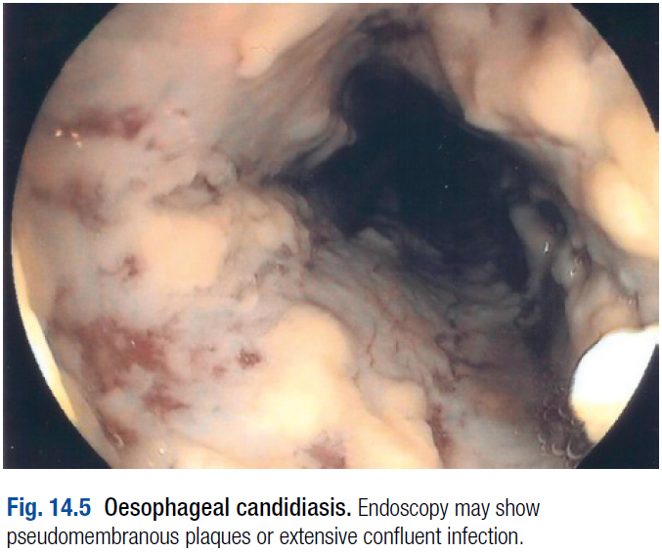
Oesophageal infection may coexist, although no oropharyngeal candidiasis is visible in up to 30%.
Up to 80% of patients with pain on swallowing have Candida oesophagitis with pseudomembranous plaques visible on barium swallow and endoscopy.

Slide 78
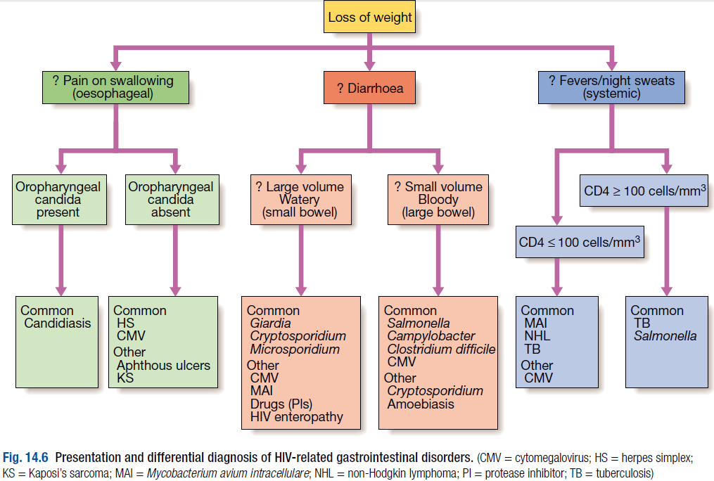

Slide 79
The pain is usually associated with dysphagia and, when untreated, leads to weight loss.
Treatment is with an oral azole drug, usually fluconazole.
Where azole-resistant candida is present, caspofungin or amphotericin can be used.

Slide 80
b. Oral hairy leucoplakia:
Oral hairy leucoplakia appears as corrugated white plaques running vertically on the side of the tongue, and is virtually pathognomonic of HIV disease in the context of HIV risk factors.
It is usually asymptomatic and does not require treatment.
The aetiology is closely associated with EBV.
High-dose aciclovir or valaciclovir is sometimes effective in eradicating the infection but relapse often follows cessation of treatment.
c. Kaposi’s sarcoma.

Slide 81
Gastrointestinal disease:
Pain on swallowing, weight loss and chronic diarrhoea are common presenting features of later-stage HIV.
A range of opportunistic organisms and HIV-related tumours may be responsible.

Slide 82
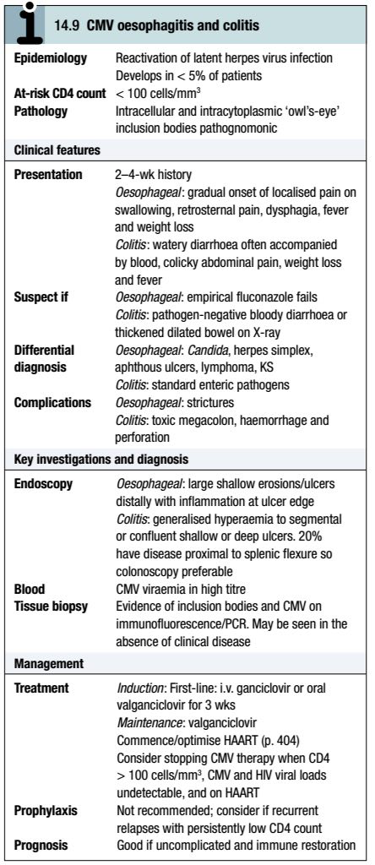
Specific conditions:
a. Cytomegalovirus (CMV):
Gastrointestinal CMV is now infrequent and is only seen if the CD4 count is < 100 cells/mm³ (usually < 50).

Slide 83
It may cause disease throughout the entire gastrointestinal tract, including the liver and biliary tree, but most commonly affects the oesophagus, where it accounts for 10–20% of disease, and the colon.

Slide 84
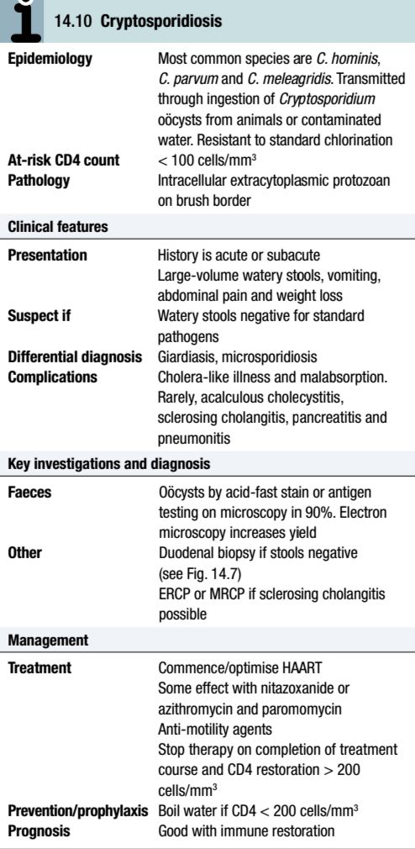
b. Cryptosporidium and Microsporidium:
Cryptosporidium is a highly contagious zoonotic protozoal enteric pathogen that infects a wide range of animals.

Slide 85
Microsporidia are water-borne zoonoses, of which four main species infect humans: Encephalitozoon bieneusi, E. hellem, E cuniculi and E. intestinalis.
They are intracellular spore-forming protozoa which cause a mild inflammatory infiltrate and are carried by a wide range of animals, birds and fish.

Slide 86
Both Cryptosporidium and Microsporidium complete their life cycle in a single host.
Together they account for 10–20% of cases of diarrhoea in HIV patients. This may vary from a mild illness to severe diarrhoea, and may be complicated by malabsorption and biliary disease.
Encephalitis, sinusitis, and ocular and disseminated infection may rarely occur with E. intestinalis.

Slide 87
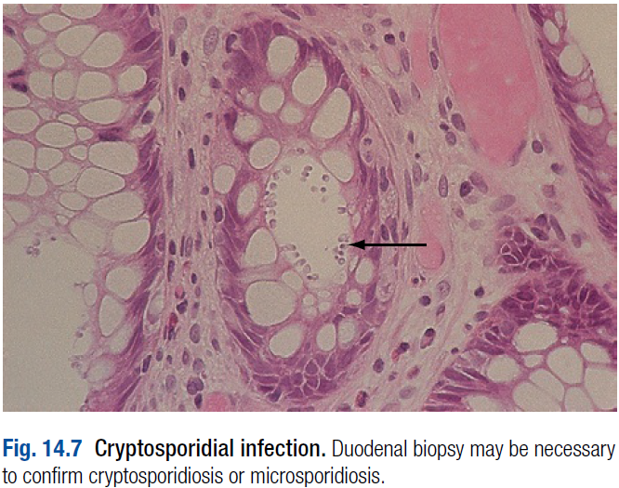
Diagnosis is usually made by stool microscopy, although duodenal biopsy is occasionally necessary.

Slide 88
Electron microscopy is essential for speciation of microsporidia.
Although treatment for cryptosporidiosis and microsporidiosis (albendazole ± itraconazole for E. intestinalis and nitazoxanide or fumagillin for E. bieneusi) may be effective, reconstitution of the immune system with HAART is the most important component of treatment and offers the best chance of cure.

Slide 89
c. Other infections:
Isospora (Africa and Latin America) and Cyclospora (Asia) cause watery diarrhoea, weight loss and malabsorption akin to Cryptosporidium, accounting overall for 2–4% of cases in the UK. Diagnosis is by stool microscopy and treatment for both is co-trimoxazole.
Giardia, Entamoeba histolytica, adenovirus and bacterial overgrowth also occur more frequently in HIV patients.
Of the standard enteric pathogens, Salmonella is important because of the increased probability of bacteraemia and recurrent disease.

Slide 90
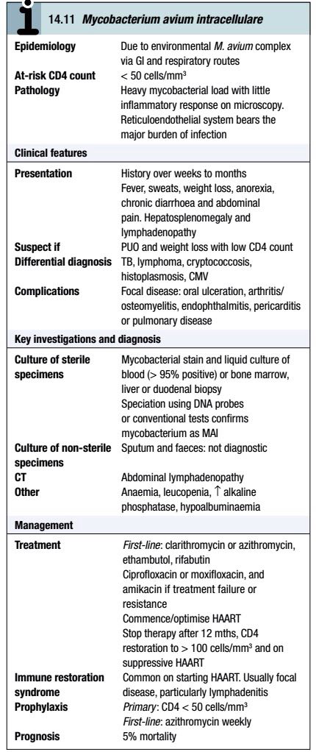
d. Mycobacterium avium intracellulare (MAI):
Until the introduction of HAART and primary prophylaxis, disseminated MAI occurred in up to 35% of all patients.

Slide 91
Like other opportunistic infections, the incidence has now fallen but it remains a problem in late-stage AIDS, especially those cases that are newly diagnosed.
Patients present with fever and weight loss.
Combination antibacterial therapy is essential to prevent resistance, but reconstitution of the immune system with HAART is necessary for cure.

Slide 92
Liver disease:
Hepatitis B and hepatitis C:
The importance of hepatitis B and C co-infection is increasingly recognised.
For both HBV and HCV, co-infection is associated with higher HBV or HCV viral loads, accelerated natural progression to cirrhosis (5–8 years after infection), an increased rate of hepatoma and higher mortality.

Slide 93
Hepatitis B:
The majority of those with HIV have evidence of HBV exposure.
HBV carriage rate depends on the mode of acquisition, place of birth and ethnic group (reflecting vertical transmission), immunisation history (although response rates are lower in HIV patients) and likelihood of immune clearance after infection.

Slide 94
Although HBV co-infected patients have more aggressive disease, the immunosuppression seen in more advanced HIV affords some protection because hepatic damage is immune-mediated.
Treatment with antivirals should be considered for all patients who have active viral replication (HBVeAg-positive or HBV-DNA > 2000 U/mL) and/or evidence of inflammation, fibrosis or scarring on liver biopsy.

Slide 95
When the CD4 is ≥ 500 cells/mm³ and in the absence of cirrhosis, pegylated interferon or adefovir can be considered. Otherwise, antivirals should ordinarily be used.
A combination of either tamivudine (3TC) or emtricitabine (FTC) with tenofovir and an additional anti-HIV drug provides effective anti-HIV and anti-HBV treatment.

Slide 96
A flare of hepatitis may be associated with improved immune function consequent to HAART or interruption of therapy and rebound HIV viraemia.
All patients should be immunised against HAV.

Slide 97
Hepatitis C:
Most patients with HCV have acquired their infection from injection drug use but increasingly acute infection is being seen in MSM.
The major determinant of co-infection rate is the mode of acquisition: > 80% for haemophiliacs, 70–80% for injection drug-users, 10–15% for MSM and 3–5% for heterosexuals.
Only 15–20% of patients ever clear their initial infection, but this rate is higher in females, those with higher CD4 counts, and those with raised transaminases.

Slide 98
Response to 12 months’ combination therapy with pegylated α-interferon and weight-based ribavirin is dependent on the HCV genotype (approximately 65% with genotypes 2 or 3 as opposed to approximately 27% with other genotypes), HCV viral load, CD4 count and the presence of cirrhosis; those acutely infected also have an improved response rate.
HIV treatment is usually initiated first to optimise the CD4 count to ≥ 350 cells/mm³.

Slide 99
Because of interactions with ribavirin, some nucleotide reverse transcriptase inhibitors (ZDV, didanosine (ddI) and possibly abacavir) should be avoided if HAART is being co-administered.
Therapy may be associated with a flare of hepatitis because of improved immune responsiveness.
All patients should be screened for HBV and HAV, and immunised if not protected.

Slide 100
Respiratory disease:
Many patients with HIV will develop pulmonary disease at some time.
Several factors influence the likely cause, including CD4 count, ethnicity, age, risk group, prophylactic history and geographical location.
The history is vital in discriminating acute bacterial pneumonia (rapid onset, pleuritic chest pain, rigors) from Pneumocystis jirovecii pneumonia (subacute onset, breathlessness, dry cough), a common differential in later-stage disease.

Slide 101
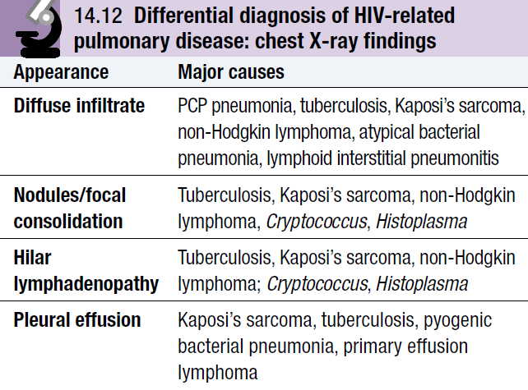
The chest X-ray is also important in distinguishing presenting syndromes.

Slide 102
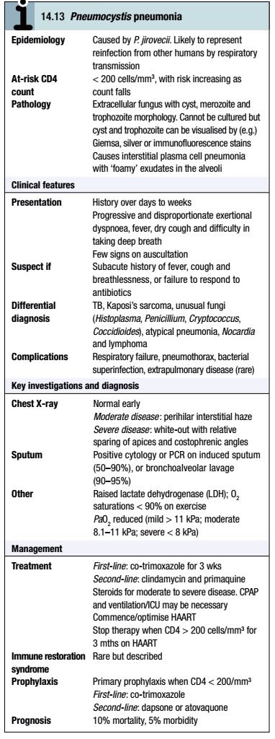
Specific conditions:
a. Pneumocystis jirovecii:
Pneumocystis jirovecii (previously carinii) pneumonia (PCP) was the first major indicator disease for HIV at the beginning of the epidemic, and still accounts for 25% of AIDS-defining illness.

Slide 103
The incidence of PCP has fallen dramatically with HAART and primary prophylaxis.
Presentation is with fever, breathlessness, and dry cough, and other markers of HIV (e.g. oropharyngeal candidiasis or mucocutaneous herpes simplex) may be present.

Slide 104
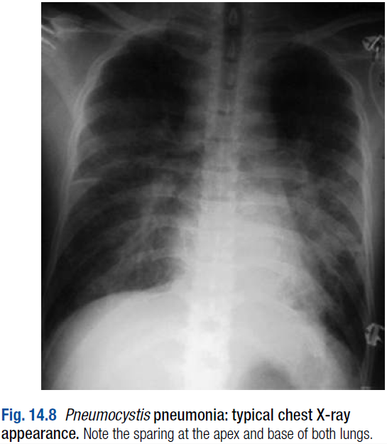
The chest X-ray is usually typical, but 20% are atypical with unilateral infiltration, upper lobe disease (often when on inhaled pentamidine prophylaxis), focal consolidation, cavitation or nodular shadows.
Clinical and radiological deterioration within the first 48 hours of treatment is not uncommon.

Slide 105
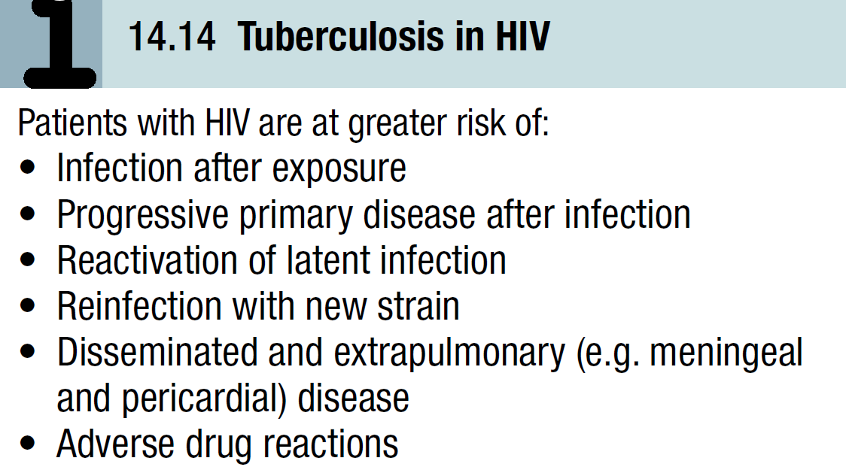
b. Mycobacterium tuberculosis:
Tuberculosis (TB) is the most common global infection, affecting up to one-third of the estimated 40 million HIV patients.

Slide 106
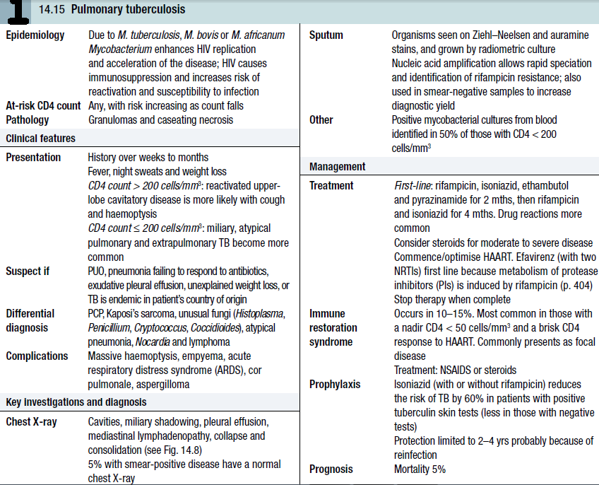

Slide 107
Estimated annual new case and death rates (8 million and 2 million respectively) are expected to continue to rise inexorably.
In some countries up to 30% of patients presenting with TB are co-infected with HIV.
Presentation is invariably with fever, weight loss and site-specific symptoms (pulmonary, meningeal, pericardial, etc.).

Slide 108
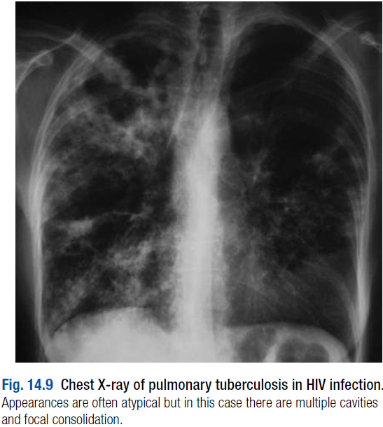
Diagnosis may be difficult, as smear-positive rates are reduced in pulmonary TB, and chest X-ray appearances may be atypical with less cavitation.

Slide 109
Standard quadruple therapy is curative in the majority, with mortality often being attributable to other disseminated bacterial infections (e.g. Salmonella and pneumococcus).
If compliance is likely to be a problem, daily or thrice-weekly directly observed therapy (DOT) should be considered.

Slide 110
Multidrug-resistant TB (MDRTB) presents a serious clinical and public health problem in many areas of the world (e.g. Eastern Europe, South Africa).
In addition, extensively drug-resistant TB (XDRTB) has now been reported from South Africa, where it has become a significant problem, and also in small numbers from over 100 countries.
Treatment often entails hospital admission and 6–7 drug combinations.

Slide 111
c. Bacterial infections:
Bacterial pneumonia is a common cause of morbidity and mortality in HIV.
The incidence, severity, likelihood of bacteraemia and recurrent pneumonia, and mortality rate are all increased compared to non-HIV-infected patients.
Susceptibility to particular respiratory pathogens is influenced by risk group, level of immune depletion, age and presence of neutropenia.

Slide 112
There is a 150-fold greater risk of pneumococcal pneumonia in advanced HIV, when it is the cause of 40% of all pneumonias in which a pathogen is identified, and 70% of those with bacteraemia.
Pseudomonas (5%) and Nocardia infections are more likely in later-stage disease.
Legionella is also found more frequently.
Chest X-ray appearances may be atypical.
Infection usually responds to standard antibiotic therapy.

Slide 113
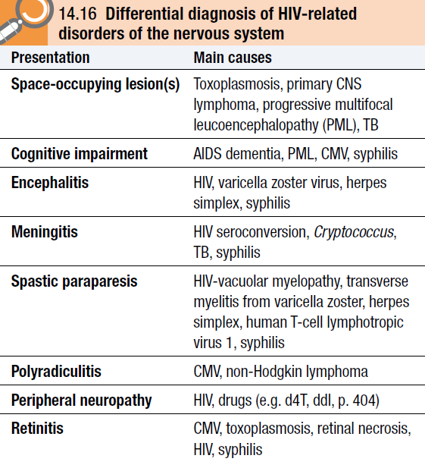
Nervous system and eye disease:
Disease of the central and peripheral nervous system is common in HIV.
It may be a direct consequence of HIV infection or an indirect result of CD4 cell depletion.

Slide 114
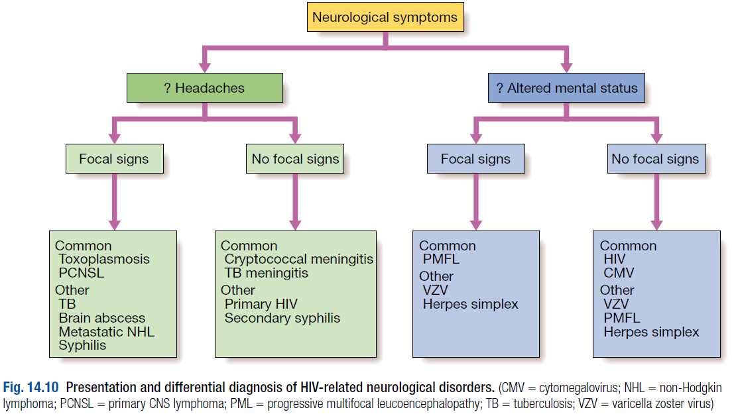

Slide 115
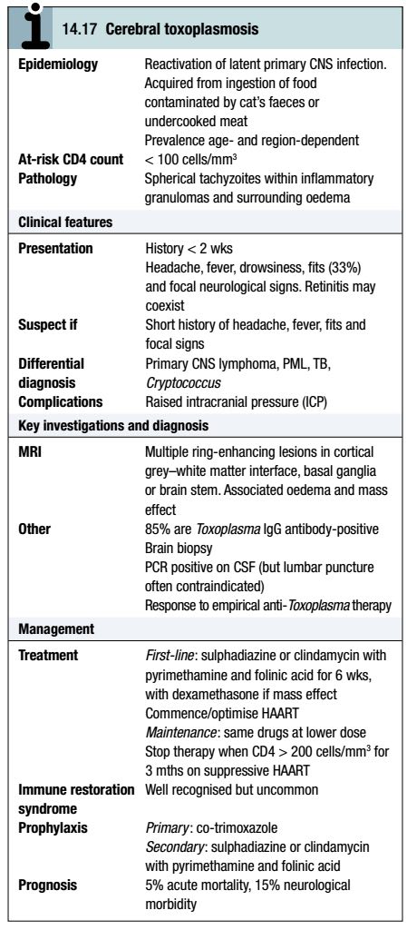
a. Toxoplasma gondii:
Toxoplasma infection results in a mild or subclinical illness in immunocompetent individuals, with the formation of latent tissue cysts that persist for life.

Slide 116
The infection rate, as judged by seroconversion, is 0.5–1% per year.
In advanced HIV, reactivation of these cysts may occur with the development of cerebral toxoplasmosis.
Despite the characteristic findings on imaging, it is often impossible to distinguish Toxoplasma encephalitis from primary CNS lymphoma.

Slide 117
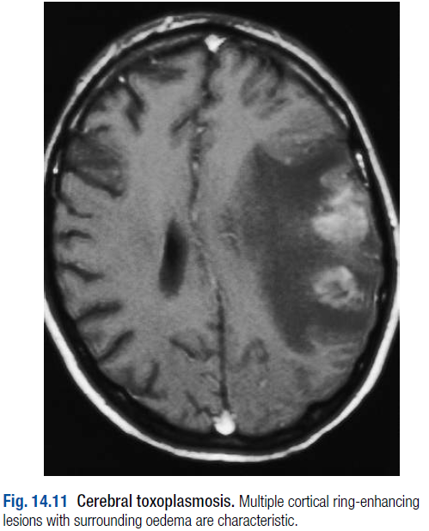
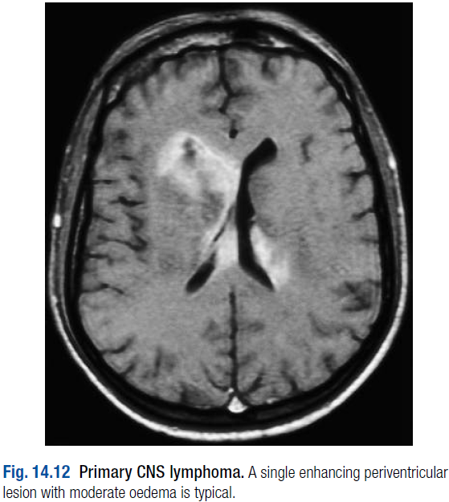

Slide 118
However, the response to a trial of anti-Toxoplasma therapy is usually diagnostic, with clinical improvement within 1 week in 50% and 2 weeks in 90%; shrinkage of lesions on MRI is usual by 2–4 weeks.

Slide 119
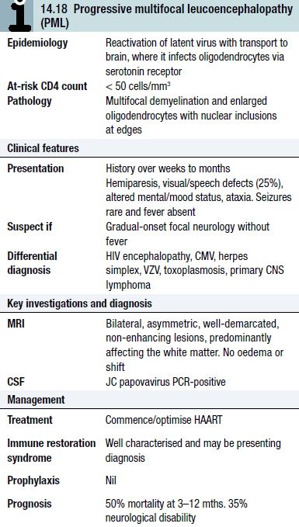
b. Progressive multifocal leucoencephalopathy (PML):
PML is a demyelinating disease caused by the JC papovavirus; it occurs at very low CD4 counts.
Seroprevalence studies demonstrate that up to 90% of young adults have been exposed to JC virus, most infections occurring in childhood.

Slide 120
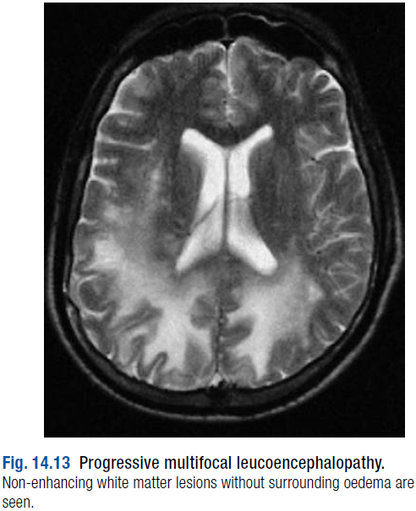
A combination of characteristic appearances on MRI and positive JC virus in CSF is diagnostic.
No specific treatment exists and prognosis remains poor despite HAART.

Slide 121
c. Primary CNS lymphoma (PCNSL):
PCNSLs are high-grade, diffuse, B-cell lymphomas which usually complicate late-stage HIV (CD4 < 50 cells/mm³).
They occur in approximately 5% of AIDS patients and account for 20% of all focal CNS lesions.
The history is 2–8 weeks of headache, focal features and sometimes confusion; seizures occur in 15% but fever is absent.

Slide 122
Characteristically, imaging demonstrates a large, single, homogeneously enhancing periventricular lesion with mild to moderate surrounding oedema and mass effect.
Multiple lesions may occur on MRI but a solitary lesion is four times more likely to be PCNSL than Toxoplasma.
The presence of EBV-DNA in the CSF has a high sensitivity and specificity for PCNSL.

Slide 123
Biopsy is definitive, but carries a small risk of morbidity and may be non-diagnostic in up to one-third.
Failure to improve clinically or on scanning with a trial of anti-Toxoplasma therapy after 2–4 weeks is consistent with PCNSL and is an indication for brain biopsy.
Treatment can be tried with HAART and high-dose methotrexate, but the prognosis is poor.

Slide 124
d. Other focal brain disease:
M. tuberculosis, Cryptococcus neoformans and Treponema pallidum predominantly affect the meninges but can produce mass lesions with focal neurology.
A less frequent cause of focal disease is CMV, which presents with a subacute history of progressive disorientation, withdrawal, apathy, cranial nerve palsies and nystagmus. Bilateral enhancing periventricular changes on MRI are characteristic and retinitis is present in over half. Diagnosis is made by identifying CMV-DNA in the CSF.

Slide 125
e. HIV-associated encephalopathy:
HIV is a neurotropic virus and infects the CNS early during infection.
Aseptic meningitis or encephalitis may occur at seroconversion, and minor cognitive defects such as mental slowness and poor memory may develop as the disease progresses.
The incidence has fallen dramatically as a result of HAART.

Slide 126
Dementia occurs in late disease and is characterised by global deterioration of cognitive function, severe psychomotor retardation, paraparesis, ataxia, and urinary and faecal incontinence.
Changes in affect are common, and depression or psychosis may be the predominant feature.
Higher plasma and CSF HIV viral load, lower CD4 count and age are predictors.

Slide 127
Investigations show diffuse cerebral atrophy with widened sulci and enlarged ventricles on imaging, and a raised protein in the CSF.
Combination therapy using agents providing optimal CNS penetration may slow or even reverse the progression of HIV-associated dementia.
Appropriate psychotropic medication may also be necessary.

Slide 128
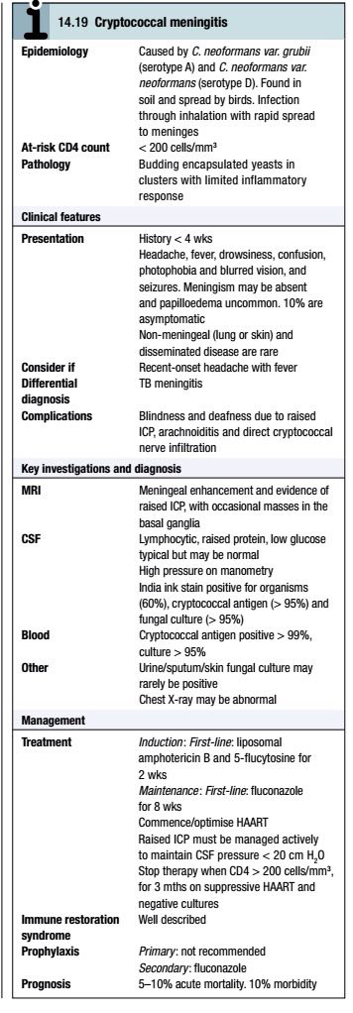
f. Cryptococcosis:
Cryptococcus neoformans is the most important cause of meningitis associated with late-stage HIV and occurs in up to 5% of patients, who usually present with a 2–3-week history of headache, fever, vomiting and mild confusion.

Slide 129
Neck stiffness is present in less than 25% of patients, and around 10% are asymptomatic.
Diagnosis is made by CSF antigen detection and culture.
Between 10% and 20% of patients require treatment for raised intracranial pressure with repeated lumbar punctures, a lumbar drain or shunting.

Slide 130
g. Spinal cord, nerve root and peripheral nerve disease:
A variety of neuropathies occur in HIV infection.
At seroconversion, Guillain–Barré syndrome, transverse myelitis, facial palsy, brachial neuritis, polyradiculitis and peripheral neuropathy have all rarely been described.

Slide 131
Vacuolar myelopathy is a slowly progressive myelitis resulting in paraparesis with no sensory level.
Ataxia and incontinence occur in advanced cases.
The CSF may show a raised protein but is frequently normal; MRI of the spine is normal, and the diagnosis is by exclusion of other causes.

Slide 132
A predominantly distal HIV-related sensory neuropathy of the lower limbs affects up to 30% of patients.
It is associated with a lower CD4 (usually < 200 cells/mm³), higher viral load, older age and wasting, and results from axonal degeneration.
Hyperaesthesia, pain in the soles of the feet and paraesthesia, with diminished pin-prick, light touch and vibration sensation, and loss of ankle reflexes (75%) are typical.

Slide 133
The nucleoside reverse transcriptase inhibitor (NRTI) drugs, especially d4T and didanosine (ddI), can produce an identical picture but this remits if the offending agent is withdrawn early.
Treatment is often difficult, although amitriptyline, lamotrigine and topical capsaicin cream may help symptoms.
HAART has minimal effect on halting or reversing the process.

Slide 134
Polyradiculitis occurs in late-stage HIV (CD4 count < 50 cells/mm³) and is nearly always a result of CMV.
It causes rapidly progressive flaccid paraparesis, saddle anaesthesia, absent reflexes and sphincter dysfunction. Pain in the legs and back is an early symptom.
Nerve root involvement on nerve conduction studies, a neutrophil CSF pleocytosis and the presence of CMV-DNA demonstrated by PCR confirm the diagnosis.
Despite treatment, functional recovery may not occur.

Slide 135
Lastly, proximal myopathy can result from HIV, when it may occur at any stage, or rarely from zidovudine (ZDV) (< 1% of patients).

Slide 136
g. Psychiatric disease:
Significant psychiatric morbidity is not uncommon.
Anxiety and mood disturbance may be caused by pre-test issues such as worries about being infected and disclosure, receiving a positive result (e.g. confidentiality, discrimination and stigmatisation), concerns about life expectancy, or facing up to death.
Mild cognitive dysfunction is a common occurrence in later-stage disease and usually improves with HAART.

Slide 137
Disorders of mental state may also result from drugs directly (e.g. depression with efavirenz) or indirectly (e.g. those affecting sexual dysfunction).
Psychiatric morbidity is a major risk factor for poor compliance with drug treatment, which is a critical component of HAART management.

Slide 138
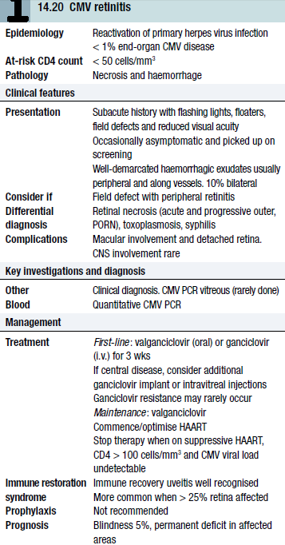
i. Retinitis:
Since the advent of HAART, there has been a 90% fall in the incidence of CMV infections.
Patients usually present with field defects and well-demarcated areas of retinal disease.

Slide 139
Macular disease is rare but constitutes the most sight-threatening feature.
Diagnosis is usually clinical.
Treatment needs to be prompt, as the leading edge will progressively advance; no recovery of vision occurs in affected areas.
Some patients may develop immune recovery uveitis in response to HAART, with intra-ocular inflammation, macular oedema and cataract formation that requires prompt treatment with oral and intra-ocular corticosteroids to prevent visual loss.

Slide 140
Miscellaneous conditions:
Haematological conditions:
Disorders of all three major cell lines may occur in HIV and are most frequent in later-stage disease (anaemia 70%, leucopenia 50% and thrombocytopenia 40%), when pancytopenia may also be seen.

Slide 141
Numerous causes for anaemia exist, including marrow infiltration with opportunistic infections (MAI or TB) or neoplasms (non-Hodgkin lymphoma); bone marrow suppression from drugs (ZDV) or as a direct effect of HIV; and chronic blood loss (Kaposi’s sarcoma) or malabsorption (chronic protozoal infections) in gastrointestinal tract disease.
Haemolytic anaemia is uncommon but is seen with lymphoma.

Slide 142
Leucopenia is usually seen in the context of marrow infiltration, as above, or drug toxicity (e.g. ZDV, co-trimoxazole, ganciclovir).
Lymphopenia (< 1.0 × 10⁹/L) is a good marker of HIV.

Slide 143
Thrombocytopenia may appear early (5–10%) and be the first indicator of HIV, or in later-stage disease. Its behaviour is very similar to idiopathic thrombocytopenic purpura, with detectable platelet antibodies and short-lived response to intravenous immunoglobulin. However, the treatment of choice is HAART.

Slide 144
Renal, cardiac and endocrine conditions:
With the advent of HAART, opportunistic infections have declined substantially, and non-HIV-related illnesses of the cardiovascular, liver and renal systems have emerged as more important causes of morbidity and mortality.

Slide 145
Acute renal failure may be associated with acute infection or medication-related nephrotoxicity; this usually resolves with appropriate management.
HIV-associated nephropathy (HIVAN) is the most important cause of chronic renal failure and is seen most frequently in patients of African descent and those with low CD4 counts.
Other important HIV-associated renal diseases include HIV immune complex kidney diseases and thrombotic microangiopathy.

Slide 146
Several drugs used in HIV management are also associated with renal disease, including indinavir (causes renal stones), tenofovir, pentamidine, cidofovir and co-trimoxazole.
HIVAN usually presents with nephrotic syndrome, chronic renal failure or a combination of both.
With the overall improvement in life expectancy, conditions such as diabetes mellitus, hypertension and vascular disease add to the burden of chronic kidney disease.

Slide 147
HAART has some effect in slowing progression of renal disease.
Doses of NRTIs must be adjusted according to creatinine clearance.
Those who progress to end-stage renal disease while receiving HAART may be eligible for renal transplant.

Slide 148
With increasing life expectancy, cardiac disease has become important.
Although HIV-related dilated cardiomyopathy can be detected in 25–40% of AIDS patients, symptomatic heart disease is rare (3–6%) and zidovudine-induced cardiomyopathy rarely seen.

Slide 149
Nevertheless, patients on certain antiretrovirals (e.g. protease inhibitors, abacavir and ddI) and those with CD4 counts < 350 cells/mm³ not taking HAART have increased rates of coronary artery disease.
Moreover, there is a small but additional effect of drug-induced hyperlipidaemia with protease inhibitors and stavudine.

Slide 150
Patients with fatigue and low CD4 counts should be screened for hypoadrenalism, which is seen in up to one-quarter of patients, and hypogonadism.
Hypopituitarism has also been described

Slide 151
HIV-related cancers:
Malignancies in HIV can be divided into AIDS-defining and non-AIDS-defining cancers.
AIDS-defining cancers are characterised by a strong inverse association with CD4 count, which is also seen but to a lesser extent in many of the non-AIDS malignancies.
Kaposi’s sarcoma and non-Hodgkin lymphoma are the most important AIDS-defining malignancies, with anal cancer and Hodgkin disease becoming increasingly important non-AIDS-defining malignancies.

Slide 152
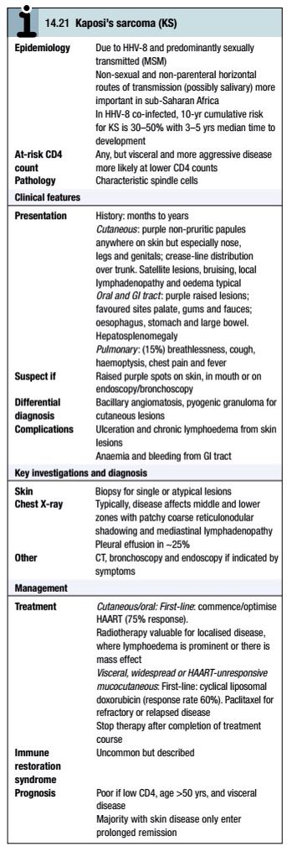
Specific conditions:
a. Kaposi’s sarcoma (KS):
Together with PCP, KS has become a hallmark of AIDS; it is due to the herpes virus HHV-8.

Slide 153
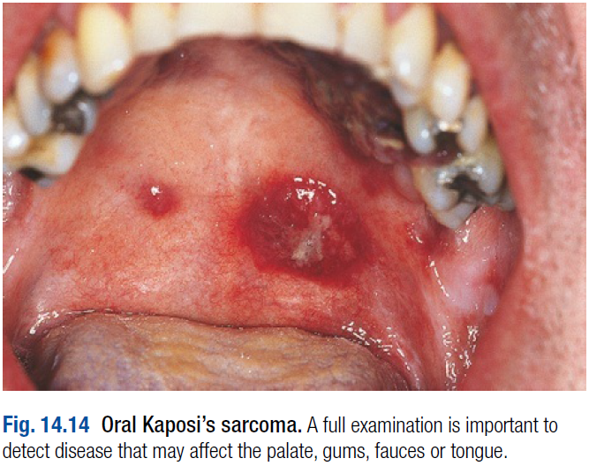

Slide 154
Prior to HIV, KS was a rare tumour restricted to elderly Mediterranean or Jewish males, immunosuppressed transplant recipients, and children and young adults in sub-Saharan Africa.

Slide 155
Typical presentation is with raised non-pruritic papules, often found incidentally on examination in a newly diagnosed patient.
As the disease progresses, the skin lesions become more numerous and larger.
Visceral disease occurs in only 10% at presentation.
With the widespread use of HAART, which is also the mainstay of treatment, there has been a 70% fall in incidence.

Slide 156
Primary-effusion lymphoma (< 2% of cases of non-Hodgkin lymphoma) and multicentric Castleman’s disease, which is a rare lymphoproliferative disorder affecting mainly HIV patients who present with anaemia, fevers and multifocal lymphadenopathy, are other HHV-8-associated conditions seen rarely with HIV.
Notes:
Slide kaposi figure

Slide 157
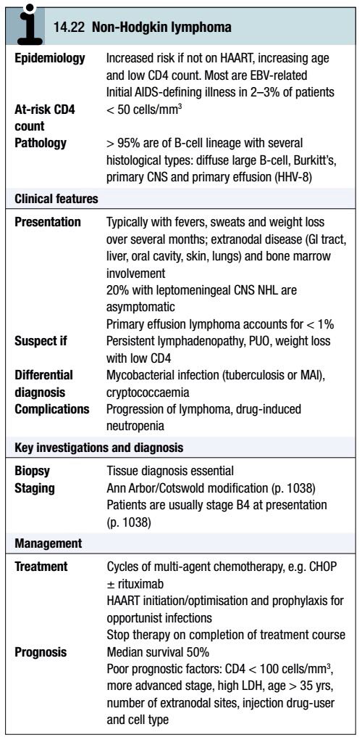
b. HIV-associated lymphoma:
In the majority of patients, non-Hodgkin lymphoma (NHL) represents a late manifestation of HIV, with risk increasing as CD4 count falls.
Notes:
Non hodgkin
Kaposi fig

Slide 158
The risk is > 50-fold greater than in HIV-negative individuals, with a lifetime risk of developing NHL of 5–10%.
Over the last 10 years, the incidence of NHL has fallen by > 40% but has increased as a proportion of AIDS-defining illnesses.

Slide 159
By comparison, the incidence of Hodgkin disease (HD) has a definite but less marked association with HIV (10–20-fold greater than in HIV-negative individuals) and CD4 count fall.
For both, extranodal and advanced presentation is more likely, with the majority having B symptoms.
Histologically, HD is more likely to show mixed cellularity or lymphocyte-depleted subtypes, as opposed to nodular sclerosis; a high percentage stain EBV-positive.

Slide 160
After diagnosis of NHL or Hodgkin lymphoma, a staging evaluation is required.
For both, HAART therapy is associated with improved overall response, disease-free survival and complete remission rates, so its introduction should not be delayed.
Multi-agent chemotherapy is the mainstay of treatment but intrathecal chemoprophylaxis, support of bone marrow reserves and prevention of infection are also key elements.

Slide 161
Additional rituximab may improve response, depending on tumour cell markers.
More intensive regimens are required for Burkitt’s lymphoma.
For HD, first-line treatment is as standard.
Use of HAART with chemotherapy is safe, although drugs that have overlapping side-effects with cytotoxics should be avoided (e.g. ZDV and marrow suppression).
Following chemotherapy, it may take up to 1 year for the CD4 count to return to pre-treatment levels.

Slide 162
c. Other non-AIDS-defining cancers:
HIV-infected patients have a greater risk of developing anogenital (vulval/vaginal, anal, penile) and in situ cervical cancer (cervical intra-epithelial neoplasia (CIN) III), all of which are closely associated with HPV co-infection.
This is more frequently observed in HIV (60% of females; 90% of males), including the most oncogenic genotypes (HPV-16, 18, 31, 33, 35).

Slide 163
Patients are more likely to have multiple genotypes which persist with time, and to progress more rapidly from dysplasia to in situ cancer.
Both a higher viral load and a lower CD4 count are associated with higher co-infection rates.

Slide 164
Invasive cervical cancer is an AIDS-defining diagnosis, although it is unrelated to CD4 count and the risk is much lower than that for KS and NHL; by contrast, CIN is more common and more likely to recur. Disease tends to present late and is more aggressive.
Annual cervical smears should be taken from all HIV-infected women.

Slide 165
The incidence of anal cancer is increasing (37-fold for men and 6.8-fold for women), particularly for MSM. Most are squamous cell carcinomas and tend to be advanced at presentation; treatment is with chemo- and radiotherapy. Survival rate is around 50% at 2 years.

Slide 166
MANAGEMENT OF HIV:
Management of HIV involves both treatment of the virus and prevention of opportunistic infections.

Slide 167
The aims of HIV treatment are to:
reduce the viral load to an undetectable level for as long as possible
improve the CD4 count to > 200 cells/mL so that severe HIV-related disease is unlikely
improve the quantity and quality of life without unacceptable drug-related side-effects or lifestyle alteration
reduce transmission.

Slide 168
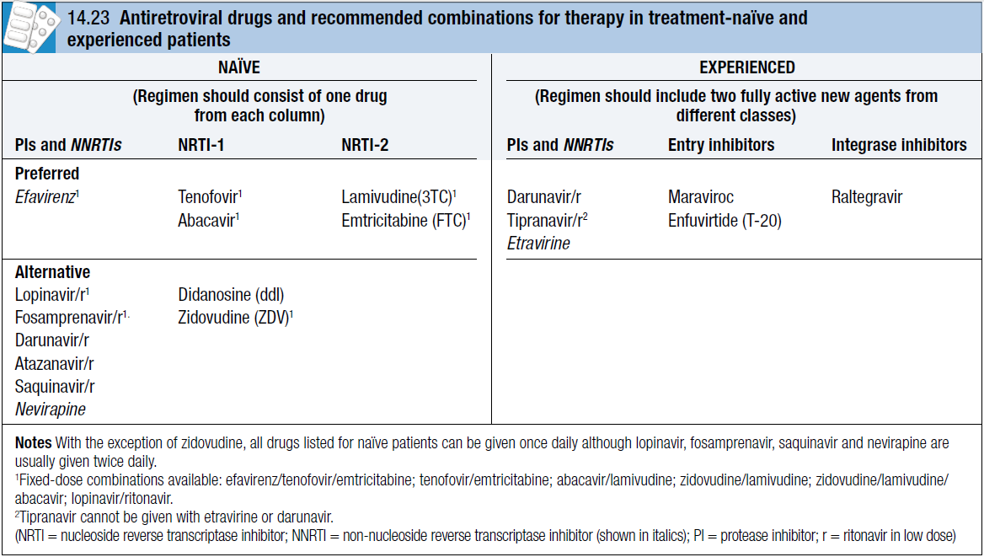

Slide 169
The principle of combining drugs serves to provide additive antiviral activity with a reduction in the emergence of viral resistance. This is known as highly active antiretroviral therapy (HAART) and is the cornerstone of management.

Slide 170
Drugs:
a. Nucleoside reverse transcriptase inhibitors (NRTIs):
The drugs in this class are zidovudine (ZDV), didanosine (ddI), lamivudine (3TC), stavudine (d4T), abacavir and emtricitabine (FTC), which have been developed sequentially.

Slide 171
The NRTIs act through intracellular phosphorylation to the triphosphate form and incorporation into the DNA, where they inhibit further lengthening of the complementary strand to the viral RNA template.
Each drug specifically competes with a natural nucleoside (e.g. ZDV with thymidine).
CNS penetration is good with all NRTIs, and ZDV has been demonstrated to be of benefit in AIDS dementia.

Slide 172
Tenofovir is a nucleotide drug which only requires two phosphorylation steps to the triphosphate form. Its activity and characteristics are similar to the NRTIs.
The inclusion of two NRTIs, or one NRTI and tenofovir, remains the cornerstone of HAART.

Slide 173
Resistance occurs to all NRTIs unless they are part of a maximally suppressive HAART regimen; resistance to 3TC and FTC is rapid and high-level.
Occasionally, certain single mutations in the viral reverse transcriptase may result in broad resistance to several or all of the NRTIs and tenofovir. These can be selected out by combining drugs that have overlapping resistance profiles and a low genetic barrier to resistance.

Slide 174
Early side-effects are uncommon with current recommended NRTIs.
Abacavir can result in a hypersensitivity reaction in 3% of patients with rash, fever and an influenza-like illness, but this only occurs in those with the genetic allele HLAB57*01; this can be screened for prior to use of abacavir and the drug avoided if it is present.

Slide 175
Abacavir also appears to be associated with a small risk of coronary heart disease, and tenofovir with bone demineralisation and rarely renal tubular toxicity. They should be avoided if possible in those with existing cardiovascular risk factors or renal impairment respectively.

Slide 176
ZDV is occasionally used (mainly during pregnancy), which can result in nausea and macrocytic anaemia.
In resource-poor countries, ZDV and d4T are important first-line drugs.

Slide 177
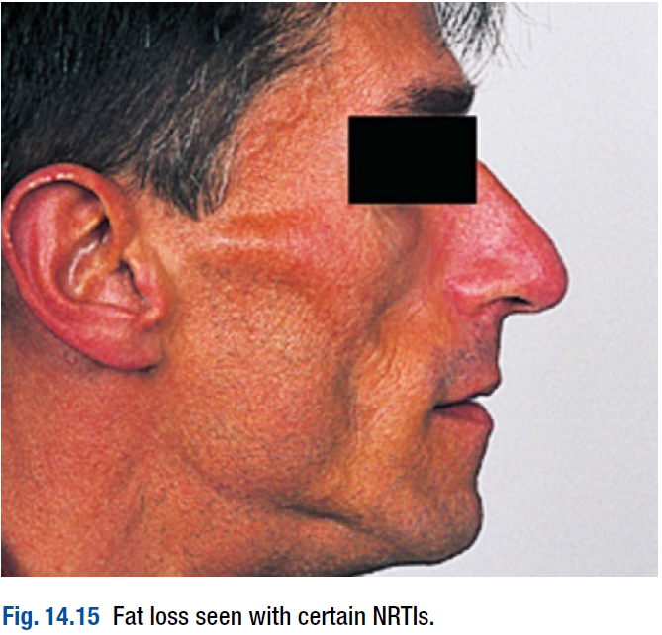
However, lipoatrophy (fat loss from the face, limbs and buttocks) is a frequent long-term complication, and peripheral neuropathy and lactic acidosis (ddI and d4T) may occur due to inhibition of mitochondrial DNA synthesis.

Slide 178
b. Protease inhibitors (PIs):
The first PI developed was saquinavir followed by indinavir, ritonavir, lopinavir and tipranavir; more recently, atazanavir, fosamprenavir and darunavir have become available.
Currently used PIs should always be boosted by low-dose ritonavir, which is a potent inhibitor of liver metabolism.

Slide 179
This increases drug exposure, thereby prolonging the PI’s half-life, allowing reduction in pill burden and dosing frequency and so optimising adherence. It also limits the development of resistance.
Pis prevent post-translational cleavage of polypeptides into functional virus proteins.
When they are given with two NRTIs, the combination controls viral replication in plasma and tissues, and allows reconstitution of the immune system.

Slide 180
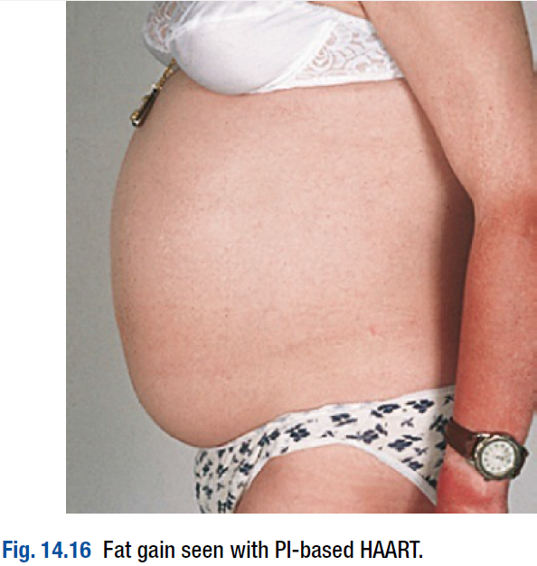
Early and late side-effects are common.
PI use has been linked with fat accumulation which is characterised by central adiposity and localised collections (buffalo hump, peripheral lipomatosis, and breast enlargement in women).

Slide 181
In addition, their use may be associated with hyperlipidaemia (mainly total cholesterol and triglyceride), and abnormal glucose tolerance; this is less marked for atazanavir and darunavir.
An increased risk of myocardial infarction has been linked to certain PIs that is not explained by dyslipidaemia.
Individual PI side-effects include diarrhoea (lopinavir), renal stones (indinavir), hyperbilirubinaemia (atazanavir) and rash ( fosamprenavir and darunavir).

Slide 182
PIs are metabolised by the P450 cytochrome system (mainly the CYP3A4 isoenzyme), giving rise to the potential for multiple drug interactions.
Commonly used drugs that interact with PIs (in particular ritonavir) are rifampicin, midazolam and simvastatin.
Monitoring plasma levels and dose adjustments may be necessary to optimise the antiviral effect and reduce toxicity.

Slide 183
c. Non-nucleoside reverse transcriptase inhibitors (NNRTIs):
There are two main NNRTIs used in drug-naïve patients (nevirapine and efavirenz) and one in drug-experienced (etravirine).
Activity is through inhibiting reverse transcriptase by binding near to the active enzyme site.

Slide 184
NNRTIs do not require intracellular activation and are not active against HIV-1 subtype O or HIV-2.
All have good bioavailability and, for efavirenz and nevirapine, low daily tablet number and apparent freedom from long-term side-effects.
Hypersensitivity rash and hepatitis are the major class-specific side-effects.
The rash is usually mild and self-limiting but Stevens–Johnson syndrome may occur (0.3% with nevirapine, 0.1% with efavirenz).

Slide 185
Similarly, hepatitis occurs more frequently with nevirapine, when it is gender- and CD4 count-dependent (11% in women with CD4 counts of > 250 cells/mm³), and may be fulminant. Hence its use is restricted to CD4 count thresholds of 250 cells/mm³ for women and 400 cells/mm³ for men.

Slide 186
CNS side-effects, including dizziness, vivid dreams, insomnia, somnolence and poor concentration, are described in half the patients treated with efavirenz. These usually resolve by 2–4 weeks and are only sufficiently severe to require discontinuation in 2–5%.

Slide 187
The major disadvantage of efavirenz and nevirapine is the rapid development of resistance in patients with virological failure, although they usually remain susceptible to etravirine. This is commonly used in combination with boosted darunavir and/or an integrase or entry inhibitor in patients with triple-class treatment failure.
Nevirapine and efavirenz reduce methadone levels by approximately 50% and may precipitate opiate withdrawal.

Slide 188
d. Entry inhibitors:
Currently, two classes of entry inhibitor exist: those that interfere with fusion by binding to gp41 (e.g. enfuvirtide) and those that bind to the CCR5 co-receptor blocking attachment of the virus (e.g. maraviroc). Both are given twice daily and used in patients with advanced disease and few other options.

Slide 189
However, enfuvirtide has to be injected subcutaneously, and maraviroc can only be used in patients whose virus is CCR5-tropic (only 50% of patients with advanced disease).
Together with boosted darunavir, etravirine and raltegravir, these drugs have transformed the management of patients with triple-class failure or resistant virus.

Slide 190
In these highly treatment-experienced patients, it is imperative to use two and preferably three active agents in the new regimen.
Because 95% of patients with early disease harbour CCR5-tropic virus, maraviroc has also been evaluated as a drug option for treatment-naïve patients.

Slide 191
e. Integrase inhibitors:
This class of drug inhibits the third and final step of proviral DNA integration: that of strand transfer.
Raltegravir is the first in this class and has shown high potency in heavily experienced patients irrespective of existing resistance, subtype and tropism. It is primarily metabolised by glucuronidation and therefore is not affected by co-administration with other antiviral drugs and has no major side-effects.

Slide 192
Treatment:
The naïve patient:
The decision to start therapy is a major one; it is influenced by several factors but predominantly by the CD4 count.
The risk of HIV-related disease with opportunistic infection and malignancy increases, treatment is less effective and side-effects are more common when the CD4 count is < 200 cells/mm³.

Slide 193
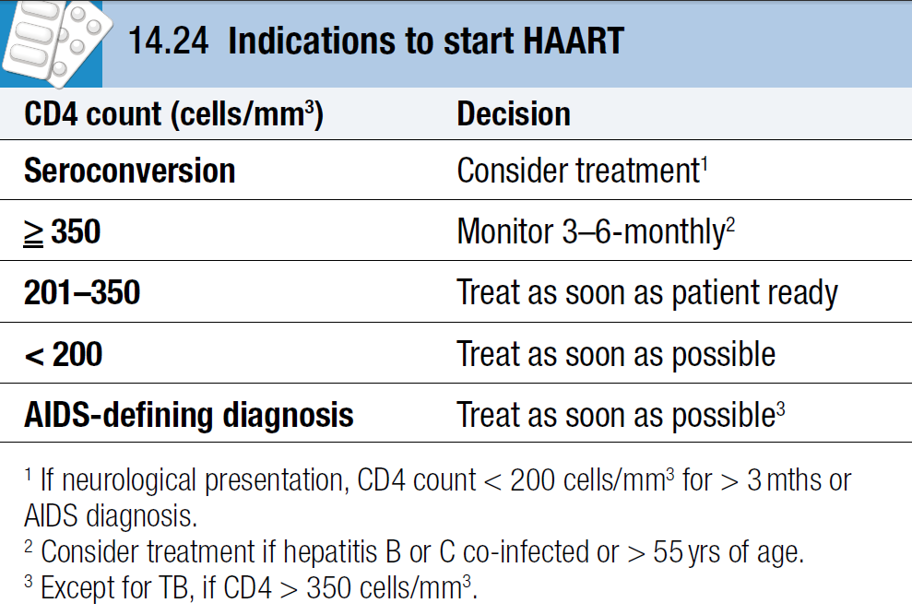

Slide 194
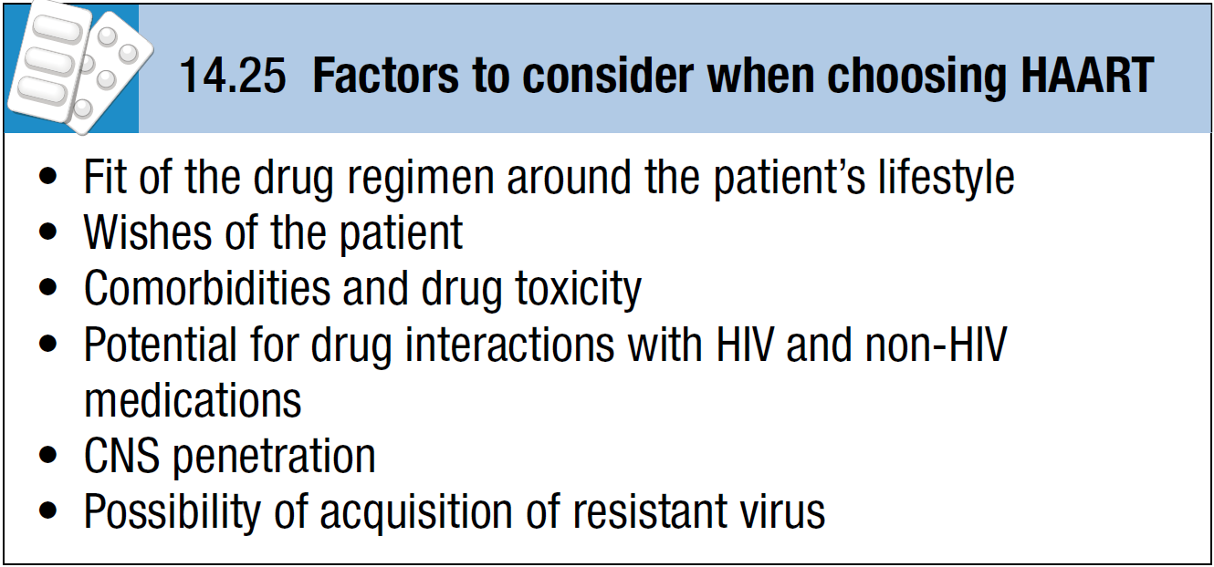

Slide 195
Prior to commencing treatment, all patients should have hepatitis B and C status checked, along with HIV viral resistance (5–10% incidence of primary resistance in the UK and Europe) and HLA-B*5701 tests (if abacavir is being considered an option).

Slide 196
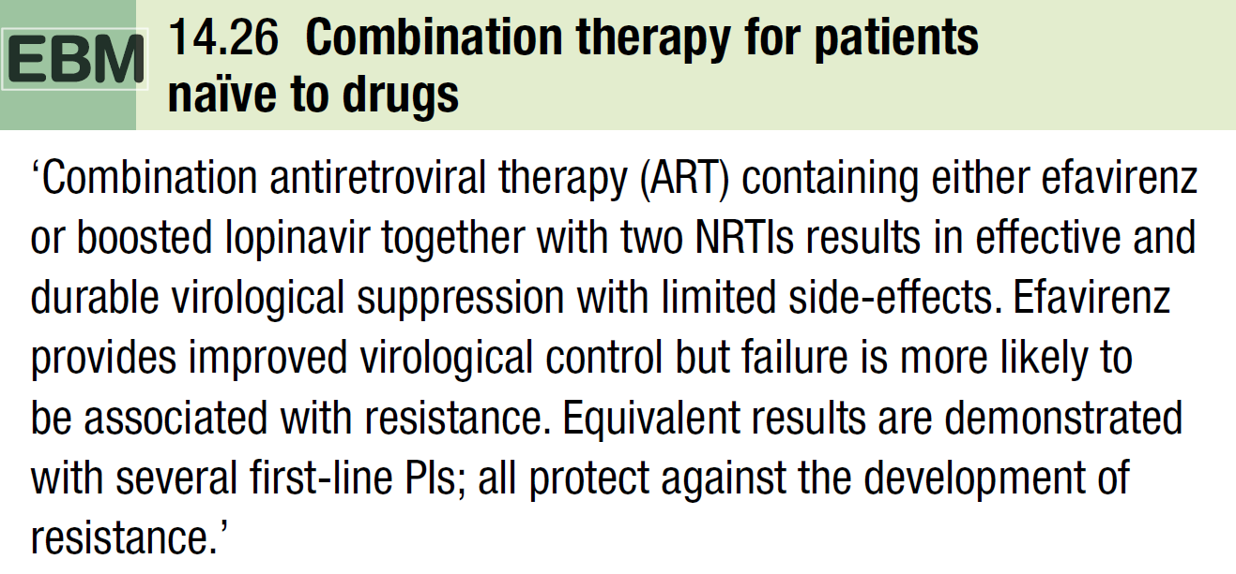
With careful and appropriate choice of HAART, over 80% of patients have an undetectable viral load (VL) (i.e. < 50 copies/mL) at 4–6 months.

Slide 197
The factors that reduce the probability of achieving prolonged viral suppression include low CD4 count (< 50 cells/mm³) and high VL (> 100 000 copies/mL), poor adherence, pre-existing or emergent resistance, and drug interaction or toxicity.

Slide 198
The presence of active opportunistic infection or other HIV-related disease should not delay the introduction of HAART, which usually should be commenced as soon as the patient’s condition has stabilised.

Slide 199
The drug-experienced patient:
A change in antiretroviral therapy may be necessary because of drug side-effects (early or late), difficulties in adherence or virological failure (defined as detectable VL despite treatment).
In a patient with a previously undetectable VL, treatment failure is indicated by viral rebound.
With increasing time on a failing regimen, the VL rises towards baseline levels, resistance mounts, the CD4 count falls and clinical progression occurs.

Slide 200
In essence, most early failures are related to adherence difficulties (sometimes resulting from toxicity) and most late failures are a result of virological resistance.
A resistance test should always be obtained before switching drugs, with a new active regimen being introduced as soon as possible and guided by this result. Account should also be taken of prior drug exposure.

Slide 201
In certain situations, therapeutic drug monitoring may be helpful in confirming that virological failure is not related to inadequate PI or NNRTI levels.
The new combination should include a minimum of two fully active new agents.
Occasionally, HAART must be stopped because of life-threatening drug toxicity or overriding medical problems where predicted drug interactions will occur.

Slide 202
In this situation, the prolonged half-life of the NNRTIs should be covered by substitution of a PI or continuation of the other components of HAART for 2 weeks.

Slide 203
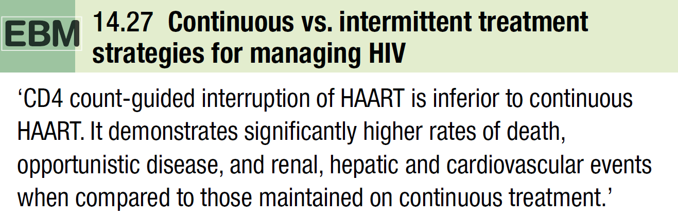
Treatment interruption is associated with an increased risk of progression and non-HIV-related complications.

Slide 204
Special situations:
Children:
The general principles of management are the same as those for adults, although the CD4 percentage is a more accurate marker of immunological health until 5 years of age.
All infants should receive PCP prophylaxis and commence HAART, irrespective of CD4 count or VL.

Slide 205
CD4 counts (cells/mm³) and CD4 percentage thresholds to initiate HAART are:
< 1000 cells and/or < 25% at 1–2 years
< 500 cells and/or < 20% at 3–4 years
< 350 cells and/or < 15% if above 5 years and in any child with advanced clinical disease.

Slide 206
It should also be considered in those with a VL > 100000 copies/mL.
After 1 year of age, PCP prophylaxis should be given to children until they are 5 with a CD4 percentage of < 15%, and then at the same CD4 levels as for adults.
Not all antiretroviral drugs are available in a suitable formulation for children, e.g. suspension, powder, crushable tablet or a capsule that can be opened.

Slide 207
First-line preferred choices include boosted lopinavir, nevirapine (< 3 years) and efavirenz (> 3 years) with two NRTIs.
Coordinated, comprehensive, family-centred systems of care are necessary to support the child and parents and to optimise compliance with medications.

Slide 208
Maternal HIV:
All pregnant women should routinely be recommended for HIV testing at an early stage in pregnancy, with rapid tests considered for those presenting in or just after labour.
Pre-HAART, the rate of mother-to-child transmission was 26% with rates being influenced by several factors

Slide 209
The likelihood of transmission at delivery is decreased to the order of 8% with single-dose nevirapine to mother and child, 6–8% for ZDV alone, < 1% for ZDV and caesarean section, and < 1% for HAART and planned vaginal delivery when the viral load is < 50 copies/mL.

Slide 210
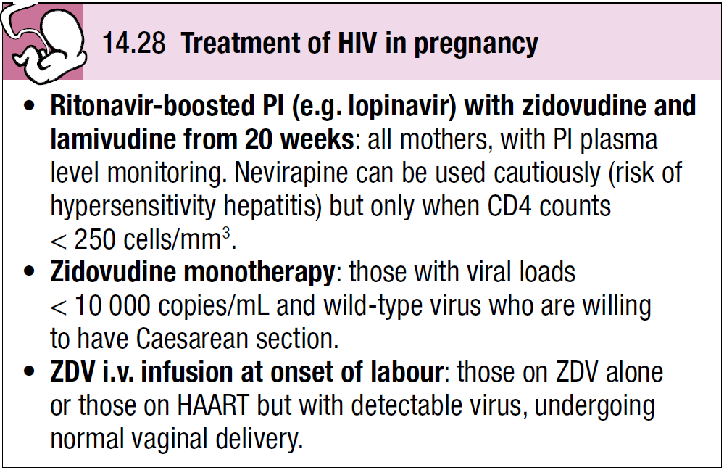

Slide 211
Single-dose nevirapine is used in resource-poor nations, but in the absence of other drugs is associated with a 30–50% chance of NNRTI resistance in mother and infected child.
Mothers should formula-feed their babies exclusively.
Screening for HIV in the baby by proviral DNA should be performed at birth (not on cord blood), 6 weeks and 3 months. If negative, vertical transmission has not occurred.

Slide 212
In discordant couples (i.e. only one partner is HIV-positive) who desire a family, self-insemination of the partner’s semen is recommended to protect the uninfected male and sperm-washing is recommended to protect the uninfected female partner.

Slide 213
Post-exposure prophylaxis:
Post-exposure prophylaxis with combination therapy (boosted lopinavir, tenofovir and FTC) is recommended when the risk is deemed to be significant after a careful risk assessment, in both occupational and non-occupational settings.
The first dose should be given as soon as possible, preferably within 6–8 hours.
However, protection is not absolute and seroconversion may occur.

Slide 214
Non-occupational settings include condom breakage in HIV-serodiscordant partners, victims of rape, and sharps-related home exposures in families of injection drug-users or HIV patients.
Many individuals experience side-effects and only half complete the recommended 4 weeks of therapy.

Slide 215
Prevention of opportunistic infection:
Patients should be immunised with hepatitis A and hepatitis B vaccines if there is no evidence of naturally acquired infection.
HBV surface antibody levels need to be monitored and boosters given when < 100 U/mL.
Pneumococcal vaccine (every 3–5 years) and influenza vaccine (annually) should be given to all patients.

Slide 216
Response to all immunisations is lower when the CD4 count is < 200 cells/mm³, although some protection is afforded.
Live attenuated vaccines (BCG, oral polio) should be avoided or restricted to those with high CD4 counts (yellow fever).
Nevertheless, MMR (measles/mumps/rubella) vaccine is safe and can be given

Slide 217
Prophylaxis against infection is another vital aspect of management.
Primary prophylaxis is to prevent the initial disease occurring, and secondary to prevent recurrence of infection.
Primary prophylaxis is introduced at specified CD4 counts at which there is a risk of infection.

Slide 218
Secondary prophylaxis is started after successful treatment of the opportunistic infection, usually with the same drug(s) that was used to treat it, but at lower doses.
Drugs can usually be stopped when the CD4 threshold at which primary prophylaxis is introduced is reached.

Slide 219
Prevention of HIV:
HIV vaccine development is slow.
An effective, safe and cheap vaccine would radically alter the future global epidemic of HIV.
Despite advances in the understanding of HIV pathogenesis and immunology, prototype HIV-1 vaccine candidates aimed at eliciting humoral and cellular immune responses have so far failed.

Slide 220
Challenges include the extensive subtype and sequence diversity of HIV, the early establishment of reservoirs, the lack of a safe attenuated virus, the lack of a small animal model, and the inability of vaccines to generate protection across different viral strains.

Slide 221
The United Nations’ aim is universal access to comprehensive prevention programmes, treatment, care and support by 2010. To achieve this, access to HIV testing needs to be widened, and strategies are required to protect the HIV non-infected person (e.g. promoting consistent condom use, improved STI management, male circumcision), for effective mother-to-child prevention programmes, and for scaling up of antiretroviral drug access.

Slide 222
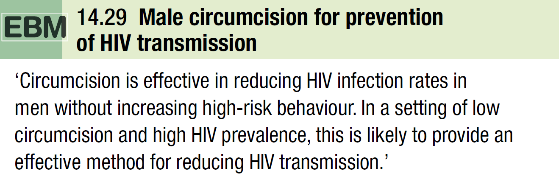

Slide 223
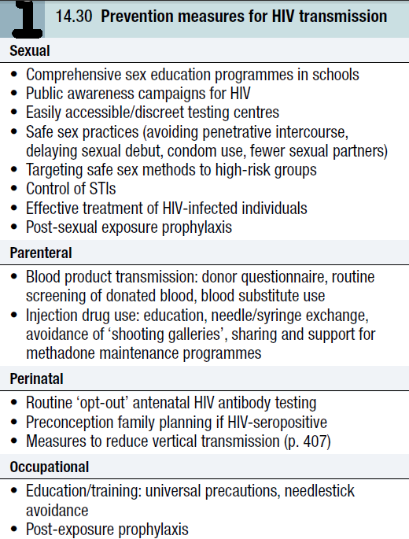

Slide 224
END

