Slide 1
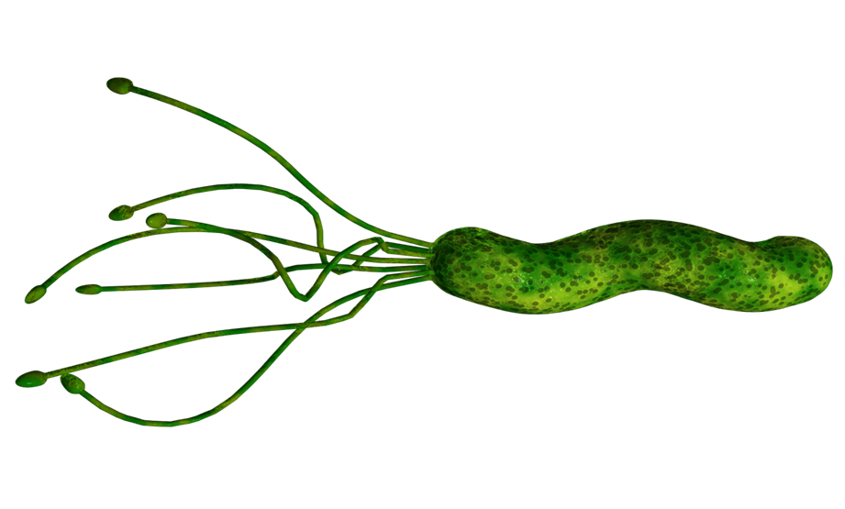
Helicobacter pylori
By
Asst. Prof. Dr. Shaimaa Al-Salihy

Slide 2
Learning objectives:
By the end of this lecture, you should be able to:
Describe the basic characteristics of both H. pylori and Yersinia, including their morphology and classification.
Explain the unique adaptations of H. pylori that allow it to survive in the acidic environment of the stomach.
Identify key virulence factors and their roles in disease development.
Identify the clinical conditions associated with H. pylori and Yersinia infection.
Interpret laboratory methods used for the diagnosis and identification of each H pylori and Yersinia spp. In addition. And compare invasive and non-invasive diagnostic methods for H. pylori.
Outline treatment regimens and challenges, including antibiotic resistance.

Slide 3
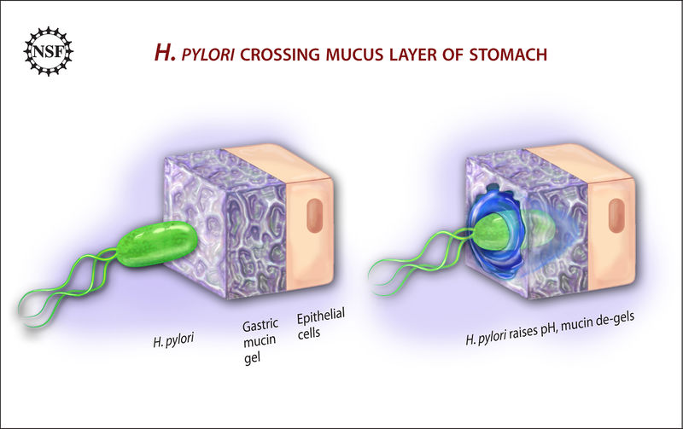
Morphology and Unique Properties of H. pylori
Spiral Shape
Flagella
Urease Enzyme
H. pylori produces urease, which breaks down urea into ammonia. This neutralizes stomach acid, creating a favorable environment for the bacteria.
H. pylori is G –ve rods, with unique spiral shape helps it burrow into the stomach lining.
Actively motile. Its flagella, whip-like appendages, enable it to move through the viscous mucus layer in the stomach.
Notes:
H pylori is a curved-shaped gram-negative, similar to Compylobacter.
It has multiple flagella at one pole (lophotrichous), actively motile.
H pylori is oxidase positive and catalase positive, is a strong producer of urease.
H pylori grows optimally at a pH of 6.0–7.0 and would be killed or not grow at the pH within the gastric lumen.

Slide 4
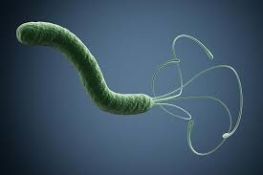
H. pylori virulence factors
1. Outer membrane proteins:
a. The adhesins: adhesion to host cell
b. Porin proteins, iron transport and flagella proteins.
2. The lipopolysaccharide (LPS)
3. The exotoxins: The vacuolating (Vac A) toxin (gastric mucosal injury)
4. The secretory enzymes:
The urease : Neutralize gastric acid
The mucinase, lipase and protease (mucosal injury)
5. The flagella ( motility)
The effector cytotoxin: The cytotoxin associated gene A(Cag A): Cause uncontrolled host growth and apoptosis inhibition.
Notes:
vacA toxin is the major virulence factor associated with 80% of duodenal ulcer and 60% of gastric ulcer. Forms channels in host cell membranes, allowing the passage of nutrients and damaging mitochondria. It can also inhibit immune responses

Slide 6
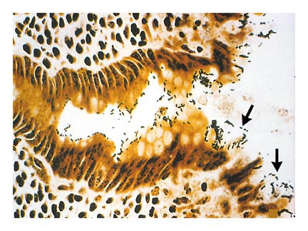
Pathogenesis: How H. pylori Causes Disease
H. pylori adheres to the stomach lining.
Attracted chemotactic substances (hemin, Urea).
Its urease enzyme neutralizes stomach acid, creating a favorable environment.
Recruit and activate inflammatory cells
The bacteria releases toxins that damage the stomach lining, leading to inflammation.
Chronic infection can result in ulcers, gastritis, and even stomach cancer.
Notes:
The sole source is human gastric mucosa
On the lumen side of the mucus, the pH is low (1.0–2.0); on the epithelial side, the pH is about 7.4.
H. Pylori is actively motile even in mucus & can be near the epithelial surface. With its flagella and its spiral shape, the bacterium drills into the mucus layer of the stomach, and can either be found suspended in the gastric mucosa or attached to epithelial cells.
H. Pylori produce potent urease activity which yield production of ammonia & further buffering of acid.
H. Pylori also produce a protease that modifies the gastric mucus & further reduce the gastric acid to diffuse through the mucus.
Toxins and lipopolysaccharide may damage the mucosal cells, and the ammonia produced by the urease activity may also directly damage the cells.
Histologically, gastritis is characterized by acute and chronic inflammation.
Polymorphonuclear and mononuclear cell infiltrates within the epithelium and lamina propria.
Destruction of the epithelium is common, and glandular atrophy may occur. H pylori thus is a major risk factor for gastric cancer.

Slide 7
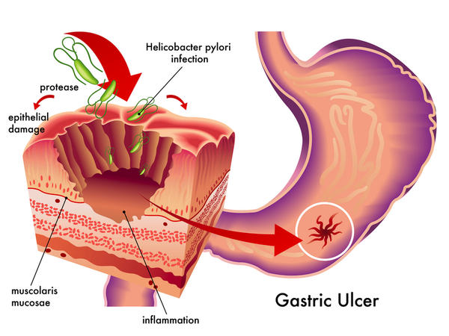
H. pylori

Slide 8
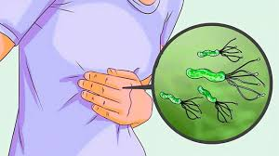
Clinical Findings
Acute infection can yield an
upper gastrointestinal illness with nausea and pain
vomiting
Fever
Poor appetite
Weight loss
Heart burn
Dyspepsia
After colonization, the H pylori infection persists for years and perhaps decades or even a lifetime.
About 90% of patients with duodenal ulcers and 50–80% of those with gastric ulcers have H pylori infection.
Recent studies confirm that H pylori also is a risk factor for gastric carcinoma and lymphoma.

Slide 9
DIAGNOSIS
Notes:
Most convenient biopsy-based test is biopsy or rapid urease test
The media for primary isolation include Skirrow’s medium with vancomycin, polymyxin B, and trimethoprim. Culturing is the most specific but insensitive test

Slide 10
Current diagnostic method:
Specimens:
Gastric biopsy (histologic examination).
- Blood (serum antibodies).
- Stool (antigen detection)
Blood Test
Detect antibodies against H. pylori.
Stool Tests
Identify H. pylori antigens in stool.
Breath Tests
Measure the amount of carbon dioxide
produced by H. pylori.
Notes:
Urea- breath test: radiolabeled urea is ingested. If H> pylori is present, urease will cleave the ingested urea, radiolabeled CO2 is evolved and radioactivity is detected in breath
The serum antibodies persist even if the H pylori infection is eradicated, and the role of antibody tests in diagnosing active infection or after therapy is therefore limited.
Urea breath test, stool antigen test and biopsy based tests can all be used to assess the success of the treatment.

Slide 11
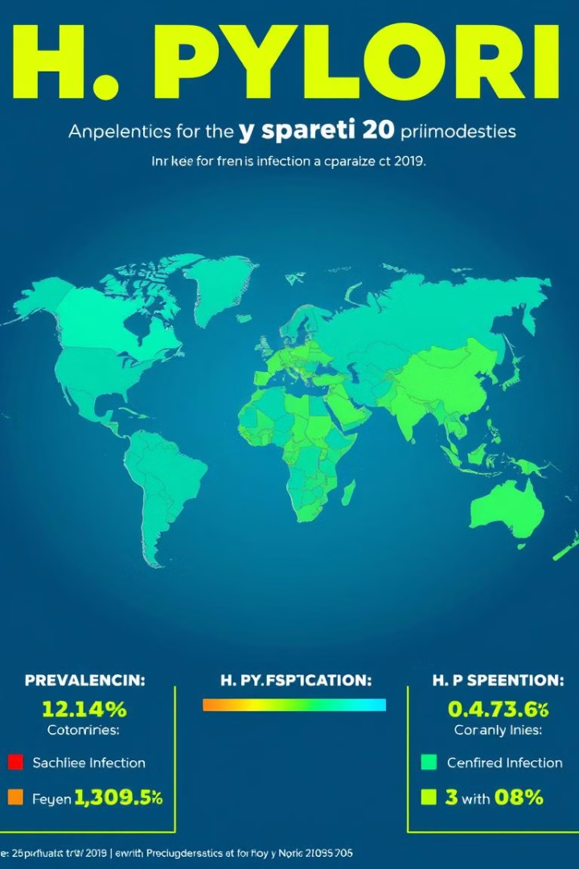
Epidemiology: Global Prevalence and Risk Factors
H. pylori infection is prevalent worldwide, affecting millions.
Poor sanitation and inadequate hygiene practices contribute to its spread.
Crowded living conditions increase the risk of transmission.
H. pylori infection is often acquired in childhood, typically from family members.
Notes:
H pylori is present on the gastric mucosa of fewer than 20% of persons younger than years 30 but increases in prevalence to 40–60% of persons age 60 years, including persons who are asymptomatic.
In developing countries, the prevalence of infection may be 80% or higher in adults.
Person-to-person transmission of H pylori is likely because intrafamilial clustering of infection occurs. Acute epidemics of gastritis suggest a common source for H pylori.

Slide 12
Prevention Strategies: Minimizing H. pylori Transmission
1
Practicing good hygiene, including handwashing, is crucial.
2
Safe drinking water and food handling practices can reduce the risk of contamination.
3
Treating infected individuals can prevent further transmission.
Notes:
There is no vaccine or other specific preventive measure.

Slide 13
Treatment Options: Eradicating H. pylori
1
Antibiotics
Eradicate the bacteria.
2
Proton Pump Inhibitors
Reduce stomach acid production.
3
Bismuth Salts
Help protect the stomach lining.
Notes:
1st line triple drug therapy
Omeprazole + Clarithromycin + Metronidazole or Amoxicillin given for 7 -14 days
Urea breath test is done
If the 1st line regimen fails (Urea breath test +ve)
2nd line quadruple drug therapy
Omeprazole + Bismuth subsalicylate + Metronidazole + Tetracycline Given for 14 days
If 2nd line quadruple drug therapy fails then –
Culture of endoscopic guided biopsy is done and treatment is Given based on antimicrobial susceptibility test

Slide 14
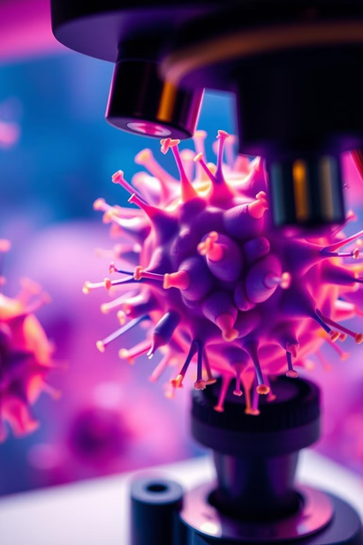
Yersinia
Defining Characteristics and Taxonomy
Gram-Negative Bacteria
Genus Yersinia
Yersinia are small gram-negative rods. They possess a characteristic "safety pin" appearance under microscopy.
One of the most virulent bacteria (ID50=1-10)
The genus Yersinia comprises several species, including Y. pestis, Y. enterocolitica, and Y. pseudotuberculosis, each with unique pathogenic properties.

Slide 15
Yersinia pestis: The Causative Agent of Plague - History and Epidemiology
14th Century
1
The Black Death, caused by Y. pestis, killing millions.
2
19th Century
Plague outbreaks occurred in Asia and the United States, fueled by the growth of urban centers.
20th Century
3
The development of antibiotics led to a significant decline in plague cases globally.
4
Present Day
Plague remains endemic in certain regions, with sporadic outbreaks reported each year.
Notes:
Yersinia pestis is the causative agent of plague (black death). 99%of cases occur in Asia.

Slide 16
Transmission and Pathogenesis of Y. pestis: From Fleas to Pneumonic Plague
Fleas
Rodents
Human Transmission
Pneumonic Plague
Y. pestis is primarily transmitted by infected fleas, which bite rodents, amplifying the bacteria.
Rodents, such as rats, are natural reservoirs for Y. pestis, harboring the bacteria without showing symptoms.
Humans can be infected through flea bites or direct contact with infected rodents or their tissues.
Y. pestis can spread from person to person via respiratory droplets, causing the highly contagious pneumonic plague.
Notes:
The sylvatic cycle occur during transmission among rodents. The flea ingests the bacteria while taking a blood meal from a bacteremic rodent. A thick biofilm containing many organisms forms in the upper gastrointestinal tract that prevents any food from proceeding down the GIT of the flea. Subsequently, the flea with blocked esophagus want to feed and bites, the aspirated blood enters the esophagus, mixes with the bacteria , and then return back (due to the blockage) into the bite wound.
The inoculated organisms may be phagocytosed by macrophages and polymorphonuclear. The organisms spread to the regional lymph nodes, which swollen to form buboes.
Y pestis can also reach the bloodstream and spread to the other part of the body. Macrophages play role in dissemination of infection to distant sites causing (secondary pneumonia and septicemia)
Endotoxin-related symptoms (intravascular coagulation) and cutaneous hemorrhage === black death

Slide 17
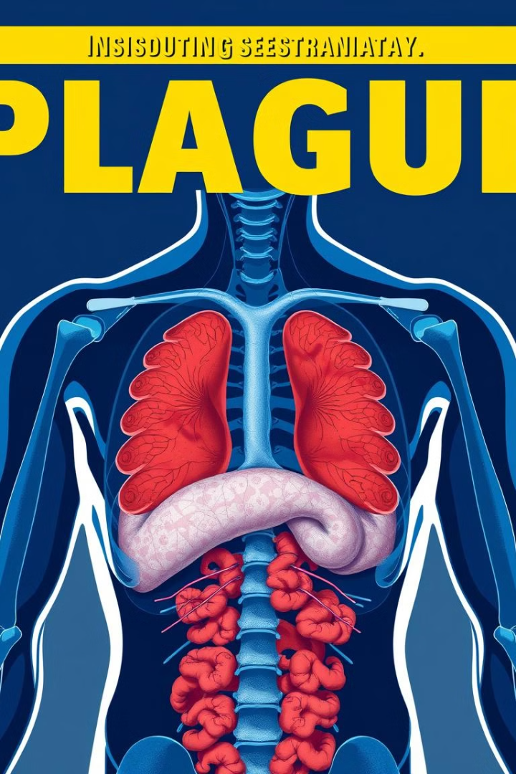
Clinical Manifestations of Plague: Bubonic, Septicemic, and Pneumonic Forms
Bubonic Plague
Septicemic Plague
(black death)
The most common form, characterized by swollen lymph nodes called buboes, usually in the groin, armpits, or neck.
Occurs when Y. pestis enters the bloodstream, causing sepsis, shock, and multiple organ failure.
Pneumonic Plague
The most severe form, involving bacterial infection of the lungs, leading to respiratory distress and rapid deterioration.

Slide 18
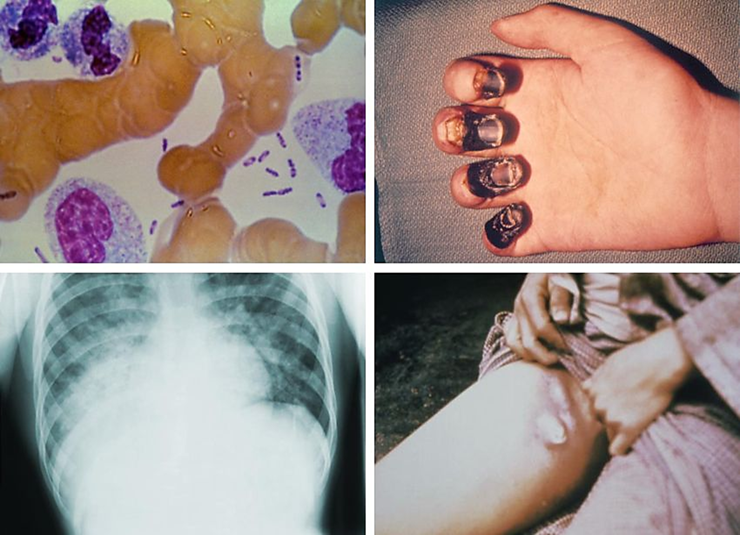

Slide 19
1. Protein envelope (F-1): protects against phagocytosis, principal immunodiagnostic marker for infection
VIRULENCE
2. V and W antigens: suppress TNF & INF- gamma , inhibits phagocytosis and intracellular killing of bacilli.
3. Endotoxin and Exotoxins
4. Yops (Yersinia Outer Proteins): inhibit phagocytosis and cytokines production by macrophages and neutrophils

Slide 20
Diagnosis of Plague: Laboratory Methods and Rapid Detection Strategies
Microscopy
Culture
Serology
Gram staining and special stains can identify Yersinia, but confirmation requires further testing.
Y. pestis grows on specific media, allowing isolation and identification of the bacteria.
Detection of antibodies against Y. pestis in patient serum can indicate past or current infection.
Molecular Detection
Rapid PCR tests can detect Y. pestis DNA directly from clinical samples.

Slide 21
Treatment and Prevention of Plague: Antibiotics, Vaccines, and Public Health Measures
Antibiotics
Prompt antibiotic therapy is crucial for survival, particularly for pneumonic plague. Streptomycin and doxycycline are effective treatments.
Vaccines
Vaccines are available for Y. pestis, but their use is limited to high-risk groups and specific settings.
Public Health Measures
Rodent control, flea eradication, and rapid diagnosis and treatment are essential for plague prevention.

Slide 22
Other Significant Yersinia Species: Y. enterocolitica and Y. pseudotuberculosis
Y. enterocolitica
Y. pseudotuberculosis
Causes yersiniosis, primarily a foodborne illness that affects the gastrointestinal tract, causing diarrhea, abdominal pain, and fever.
A zoonotic pathogen that can cause gastrointestinal illness, but can also affect lymph nodes, particularly in immunocompromised individuals.
Associated with Far-Eastern scalet like fever.

Slide 23
Y. enterocolitica and Y. pseudotuberculosis: Clinical Significance and Diagnostic Challenges
Foodborne Transmission
Y. enterocolitica and Y. pseudotuberculosis are often associated with contaminated food, particularly pork, poultry, and dairy products.
2
Clinical Manifestations
Yersiniosis often mimics other gastrointestinal infections, making accurate diagnosis challenging.
1
Diagnostic Methods
Culture, serology, and molecular techniques are used to diagnose yersiniosis, but laboratory confirmation can be complex.
3

