Slide 1
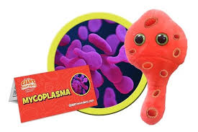
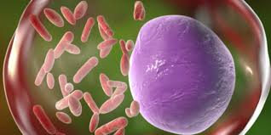
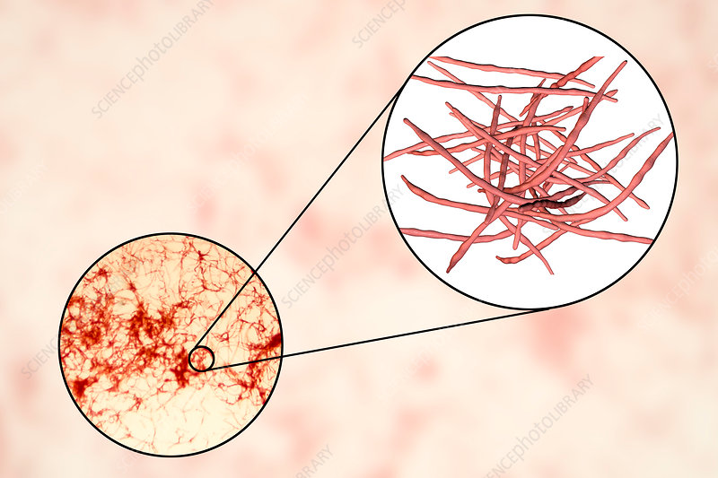
Mycoplasma, Rickettsia and
Actinomycetes
Asst. Prof. Dr. Shaimaa Al-Salihy

Slide 2
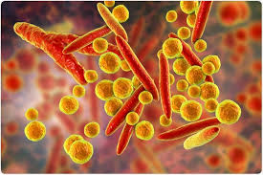
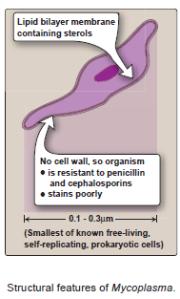
Mycoplasma
General features:
Smallest free-living (extracellular) bacteria
Missing peptidoglycan (no cell wall)
Formerly called PPLO (Pleuro pneumonia like organism)= stable L form
Sterols in membrane (It has a high content of sterols to prevent osmotic lysis).
Part of normal microbiota of human genital tract or oral cavity of healthy adults .
Notes:
Hence they are resistance to cell wall- active antibiotics like beta-lactams.
L-form bacteria= cell wall-deficient bacteria (CWDB). L-forms are distinguished from spheroplasts that the later are capable of dividing, but can revert to the original morphology, while L-forms are unable to revert to the original cell-walled form of bacteria.

Slide 3
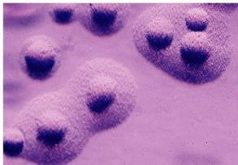
Mycoplasma
• Mycoplasmas can be grown in the laboratory on artificial media, but they have complex nutritional requirements, including several lipids. They grow slowly and require at least 1 week to form a visible colony.
The colony frequently has a characteristic “fried-egg” shape, with a raised center and a thinner outer edge.
Genera of Medical Importance
Mycoplasma pneumoniae
Ureaplasma urealyticum
M. hominis

Slide 4
Mycoplasma
Mechanisms of pathogenicity:
Adherence to host cells
H2O2 production (M. pneumonia)
Urease activity to produce ammonia (U. urealyticum)
IgM autoantibodies that agglutinate human group O erythrocyte at 4º C. (this cold agglutination produce anemia)
Notes:
• Attaches to respiratory epithelium via P1 protein, Inhibits ciliary action.
• Produces hydrogen peroxide, superoxide radicals, and cytolytic enzymes, which damage the respiratory epithelium, leading to necrosis and a bad, hacking cough (walking pneumonia)
• M. pneumoniae functions as superantigen, elicits production of IL- 1 , IL-6, and TNF-cx
They have only one serotype, but they have been shown to form auto antibodies against RBCs, and also against brain, liver and lung cells, causing the extra pulmonary manifestation of the infection.

Slide 5
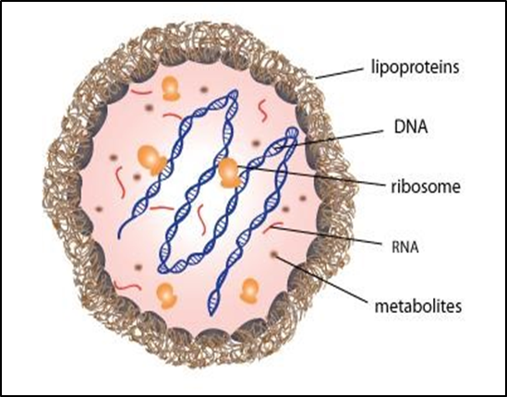
Mycoplasma
Mycoplasma pneumoniae:
Diseases:
Atypical pneumonia= walking pneumonia with persistent hack (little sputum produced)
Most common atypical pneumonia (along with viruses) in young adults
- Pharyngitis
Transmission
respiratory droplets; close contact: families, military recruits, medical school classes, college dorms

Slide 6
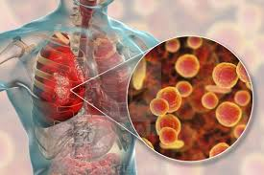
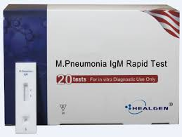
Mycoplasma
Diagnosis
• Primarily clinical diagnosis; PCR
• Microscopy not useful
• ELISA and immunofluorescence sensitive and specific.
• Mulberry-shaped colonies on sterol-containing media, 10 days
• Cold agglutination test: Detect mycoplasma antibody (by using ‘O’ RBC antigen). Test is nonspecific and is positive in only 65% of cases.
Treatment:
erythromycin, azithromycin, clarithromycin; but not cephalosporins or penicillin

Slide 7
What are Rickettsiae? Defining Characteristics and Taxonomy
Obligate Intracellular Parasites
Gram-Negative Bacteria
Diverse Taxonomy
Rickettsiae cannot survive outside of living cells. They require a host to replicate and spread.
Their cell walls lack a thick peptidoglycan layer, which differentiates them from other bacterial groups.
Rickettsiae are classified into various species based on their morphology, genetic characteristics, and the diseases they cause.
Notes:
Rickettsiae are very short rods that are barely visible in the light microscope because they stain poorly with the standard Gram stain.
obligate intracellular parasites, because they are unable to produce sufficient energy to replicate extracellularly. Therefore, rickettsiae must be grown in cell culture, embryonated eggs, or experimental animals.

Slide 8
Transmission Mechanisms: Vectors and Reservoirs
Tick-Borne Transmission
Other Arthropod Vectors
Ticks are the most common vectors for rickettsial diseases, spreading bacteria during blood meals.
Mites, fleas, and lice can also transmit rickettsiae, depending on the specific species involved.
Reservoir Hosts
Rickettsiae are often found in animals, including rodents, dogs, and other mammals, which serve as reservoirs.
Notes:
The life cycle of the rickettsiae is that they are maintained in nature in certain arthropods such as ticks, lice, fleas, and mites and, with one exception, are transmitted to humans by the bite of the arthropod. Virtually all rickettsial diseases are zoonoses, with the prominent exception of epidemic typhus, which occurs only in humans.
The exception to arthropod transmission is Coxiella burnetii, the cause of Q fever, which is transmitted by aerosol and inhaled into the lungs.
The rickettsiae circulate widely in the bloodstream (bacteremia), infecting primarily the endothelium of the blood vessel walls.

Slide 9
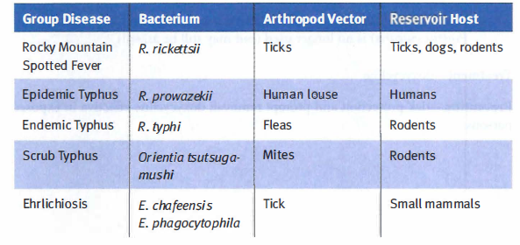
Rickettsia
Infections Caused by Rickettsiae and Close Relatives

Slide 10
Rickettsia
Pathogenesis
The typical lesion caused by the rickettsiae is a vasculitis, particularly in the endothelial lining of the vessel wall where the organism is found.
Damage to the vessels of the skin results in the characteristic rash and in edema and hemorrhage caused by increased capillary permeability.
There is some evidence that endotoxin is involved, which is in accord with the nature of some of the lesions such as fever and petechiae, but its role has not been confirmed.
No exotoxins or cytolytic enzymes have been found.

Slide 11
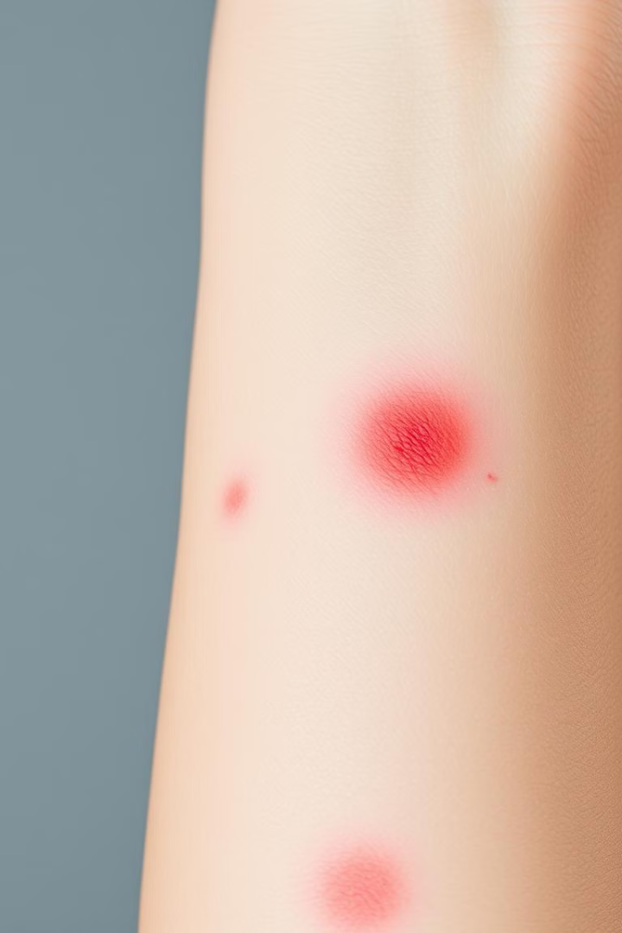
Spotted Fever Group: Clinical Manifestations and Diagnosis
1
Flu-like Symptoms
High fever, headache, muscle aches, and chills are common initial symptoms.
2
Rash
A characteristic rash (centripetal) typically appears, often starting on the wrists and ankles and spreading to the trunk.
3
Complications
Severe cases can lead to complications such as encephalitis, pneumonia, and organ failure.
4
Diagnosis
Laboratory tests, including serological assays and PCR, are crucial for definitive diagnosis.
Notes:
Rocky Mountain spotted fever (RMSF): Endemic is high tick population areas of USA
2-12 day incubation
Headache, fever (102°F), malaise, myalgias, toxicity, vomiting, and confusion
Rash (maculopapular petechial) starts (by day 6 of illness) on ankles and wrists and then spreads to the trunk, palms, soles, and face (centripetal rash).
Ankle and wrist swelling also occur.

Slide 12
Typhus Group: Symptoms, Diagnosis, and Treatment
High Fever
Fever is a prominent symptom, often accompanied by chills, headache, and body aches.
Rash
Distinctive rash may appear, characterized by macules, papules, or petechiae.
Diagnosis
Laboratory tests, including serological assays and PCR, are essential for confirmation.
Treatment
Antibiotics, such as doxycycline, are effective in treating typhus infections.
Notes:
There are several forms of typhus, namely, louse-borne epidemic typhus caused by R. prowazekii, flea-borne endemic typhus caused by Rickettsia typhi, chigger-borne scrub typhus caused by R. tsutsugamushi, and several other quite rare forms.
Typhus begins with the sudden onset of chills, fever, headache, and other influenza-like symptoms approximately 1 to 3 weeks after the louse bite occurs.
Between the fifth and ninth days after the onset of symptoms, a maculopapular rash begins on the trunk and spreads peripherally.
The rash becomes petechial and spreads over the entire body but spares the face, palms, and soles.
Signs of severe meningoencephalitis, including delirium and coma, begin with the rash and continue into the second and third weeks.
In untreated cases, death occurs from peripheral vascular collapse or from bacterial pneumonia.

Slide 13
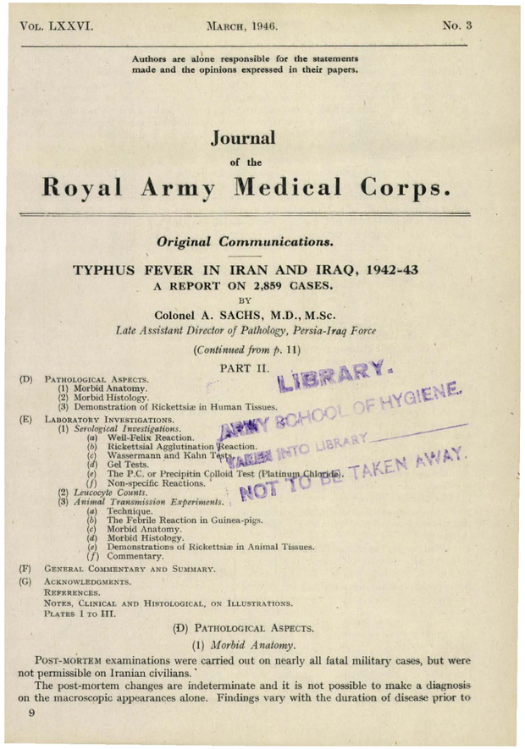

Slide 14
Other Rickettsial Infections: Atypical Presentations
Rickettsial Pox
Queensland Tick Typhus
Caused by Rickettsia akari, characterized by fever and a distinctive rash.
1
Spread by ticks, often presenting with headache, fever, and a rash.
2
Anaplasmosis
Ehrlichiosis
4
Infections caused by Anaplasma species, also targeting white blood cells.
3
A group of infections caused by Ehrlichia species, affecting white blood cells.

Slide 15
Diagnostic Approaches: Lab Techniques and Challenges
1
2
3
Serological Tests
PCR
Challenges
Detect antibodies against rickettsiae, confirming previous infection.
Amplifies DNA from rickettsiae, providing direct detection.
Early diagnosis can be difficult due to nonspecific symptoms and limited lab access.
Notes:
Weil-Felix test (cross-reaction of Rickettsia antigens with OX strains of Proteus vulgaris) is no longer used (but may still be asked)

Slide 16
Treatment Strategies: Antibiotics and Supportive Care
Antibiotics
1
Doxycycline is a primary treatment for most rickettsial infections.
Supportive Care
2
Rest, hydration, and symptom management are essential for recovery.
Early Treatment
3
Prompt antibiotic administration is crucial for preventing complications.

Slide 17
Prevention and Control: Reducing the Risk of Infection
Tick Prevention
Use insect repellent, wear protective clothing, and check for ticks regularly.
Vaccines
Vaccines are available for some rickettsial diseases, offering protection against infection.
Public Health Measures
Control vectors, educate the public about risks, and promote early diagnosis.
Notes:
Prevention of many of these diseases is based on reducing exposure to the arthropod vector by wearing protective clothing and using insect repellent.

Slide 18
Actinomycetes
What is Actinomyces? Morphology and Characteristics
Branching Bacteria
Gram-Negative Bacteria
True bacteria (related to corynebacteria and
mycobacteria), but they form long branching filaments that resemble hyphae of fungi.
They are Gram +ve but some (such as Nocardia asteroids) are weakly acid fast.
Notes:
In this section, we shall discuss 3 genera of actinomycetes: Actinomyces, Nocardia, and Streptomyces. These organisms have been shown to be higher bacteria, but they were thought to be fungi for many years because they have filamentous forms, 0.5 to 0.8 µ in diameter, which appear to branch. Some species form aerial mycelia in culture. The clinical manifestations of infection are similar to those of a systemic fungal infection. It is now clear that they are not fungi but are closely related to the mycobacteria.

Slide 19
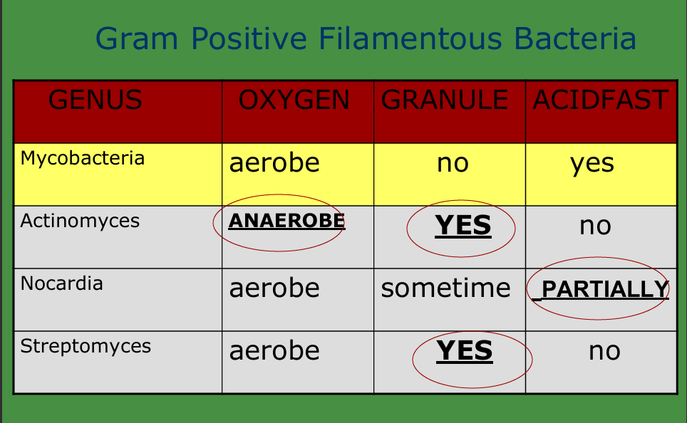
Notes:
Some facts that you should know about these genera are that:
1- Actinomyces are anaerobic, while Nocardia and Streptomyces are aerobic.
2- Nocardia stain partially acid-fast, Actinomyces and Streptomyces are not acid-fast.
3- All genera may produce granules, Actinomyces almost always produce granules.

Slide 20
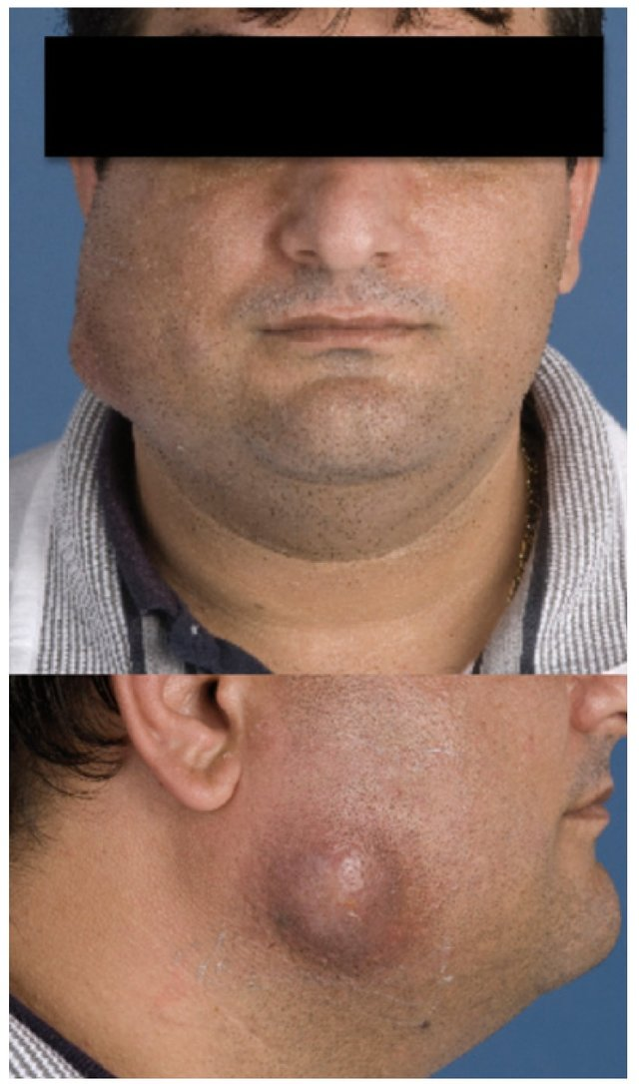
ACTINOMYCOSIS
The most common cause of actinomycosis is the organism Actinomyces israelii which infects both man and animals.
In man, A. israelii is an endogenous organism that can be isolated from the mouths of healthy people.
The disease is characterized by multiple abscesses and granulomata, tissue destruction, extensive fibrosis, and the formation of sinuses.
Notes:
All species are found as normal commensally in the oral cavity; some are isolated from deep caries. Other from brain abscess
In cattle, the disease is called "lumpy jaw" because of the huge abscess formed in the angle of the jaw.
Frequently, the infected patient has a tooth abscess or a tooth extraction and the endogenous organism becomes established in the traumatized tissue and causes a suppurative infection.

Slide 21
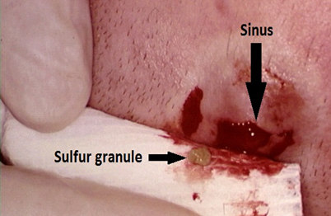
Laboratory Diagnosis:
Microscopy
Culture
Gram +ve rod that frequently branched, histologically as "sulfur granules" surrounded by polymorphonuclear cells (PMN) forming the purulent tissue reaction.
Culture on brain heart infusion or blood agar show spider like colonies
Notes:
The patient usually presents with a pus-draining lesion, so the pus will be the clinical material you send to the laboratory.
This diagnosis can be made on the hospital floor. If you rotate the vial of pus, the yellow sulfur granules, characteristic of this organism, can be seen with the naked eye. You can also see these granules by running sterile water over the gauze used to cover the lesion.
This organism can be seen histologically as "sulfur granules" surrounded by polymorphonuclear cells (PMN) forming the purulent tissue reaction.

Slide 22
Clinical Importance
Back
Next
Actinomyces infections can be challenging to diagnose due to their slow growth and mimicry of other conditions. Treatment typically involves prolonged courses of antibiotics and, in many cases, surgical intervention is necessary.
Notes:
The problem is the penetration of the drug to the fibrotic tissues and reaching the organism which may lead to recurrent infection. *

Slide 23
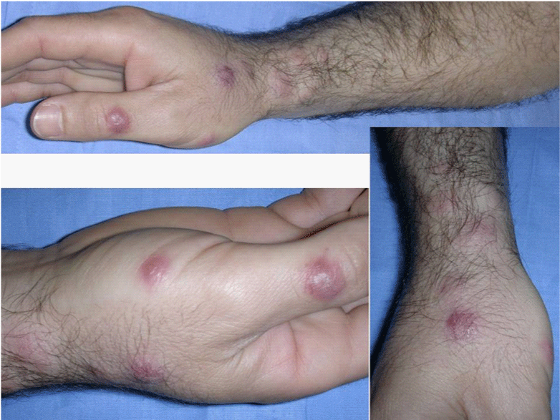
NOCARDIOSIS
The most common species of Nocardia which cause disease in human beings are N. brasiliensis and N. asteroides.
These are soil organisms which can also be found endogenously in the sputum of apparently healthy people.

Slide 24
Notes:
Nocardiosis primarily presents as a pulmonary disease in the U.S. In Latin America, it is more frequently seen as the cause of a subcutaneous infection, with or without draining abscesses. Brain abscesses are frequent secondary lesions. N .asteroides is usually the etiologic agent of pulmonary nocardiosis while N. brasiliensis is frequently the cause of sub-cutaneous lesions.
In Sudan and North Africa it causes Madura foot which is a chronic granulomatous infection of bones and soft tissue of the foot leading to mycetoma formation and gross deformity

Slide 25
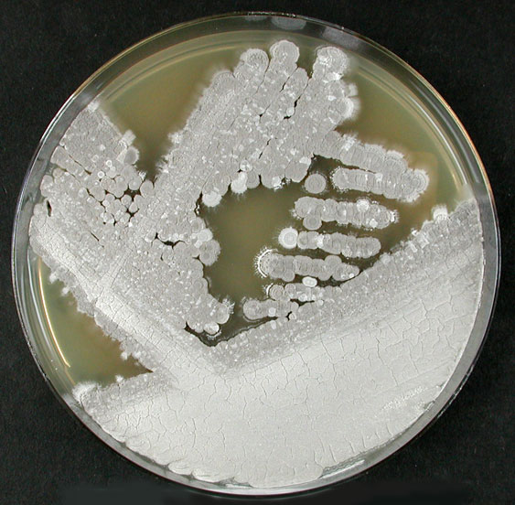
Material sent to the lab is pus or skin biopsy
Aerobic like Nocardia, and can grow on both bacterial and fungal (SDA) media.
They produce a chalky aerial mycelium with much branching.
Pathogenesis:
The streptomyces species usually cause the disease entity known as mycetoma (fungus tumor).
These infections are usually subcutaneous, but they can penetrate deeper and invade the bone.
Some species produce a protease which inhibits macrophages.
Streptomyces
Notes:
.
It is important to let the lab know the organism you suspect because most bacterial pathogens will grow out overnight, but the actinomycetes take longer to be visible on the culture plates (48-72 h).

Slide 26
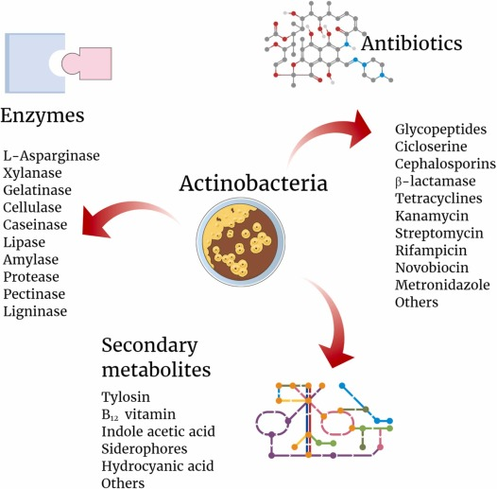
Antibiotic Production
Back
Next
Streptomyces spp. are renowned for their ability to produce a wide variety of antibiotics, such as streptomycin and tetracycline. These compounds have been crucial in treating bacterial infections and have significantly impacted medicine. They are often found in pharmaceutical research due to their unique metabolic capabilities.

