Slide 1
Lec. 1 Introduction
Medical Virology
By:
Assist. Prof. Dr. Shaima’a Al-Salihy

Slide 2
Viruses: obligate intracellular parasites
General Properties
1. Small size:
The smallest infectious agents (20-300 nm in diameter)
Bacteria (300-1000nm); RBC (7500nm)
2. Genome:
Either DNA or RNA
3. Metabolically inert:
Do not posses active protein synthesizing apparatus
Do not have a nucleus, cytoplasm, mitochondria or ribosomes
No metabolic activity outside host: obligate intracellular parasites
Can replicate only inside living cells; NOT on inanimate media
4. Replication:
They multiply by a complex method

Slide 3
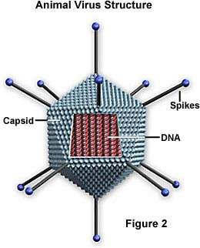
Viruses: Structure
Genome:
A core of DNA or RNA
May be single-stranded (ss) or double stranded (ds)
May be circular or linear
Capsid: protein coat surrounding the genome
Provides structural symmetry
Stabilizes the viral nucleic acid against extracellular enzymes (e.g. nucleases in blood stream).
Facilitates attachment to susceptible host
Participate in penetration of the virus to the host cell

Slide 4
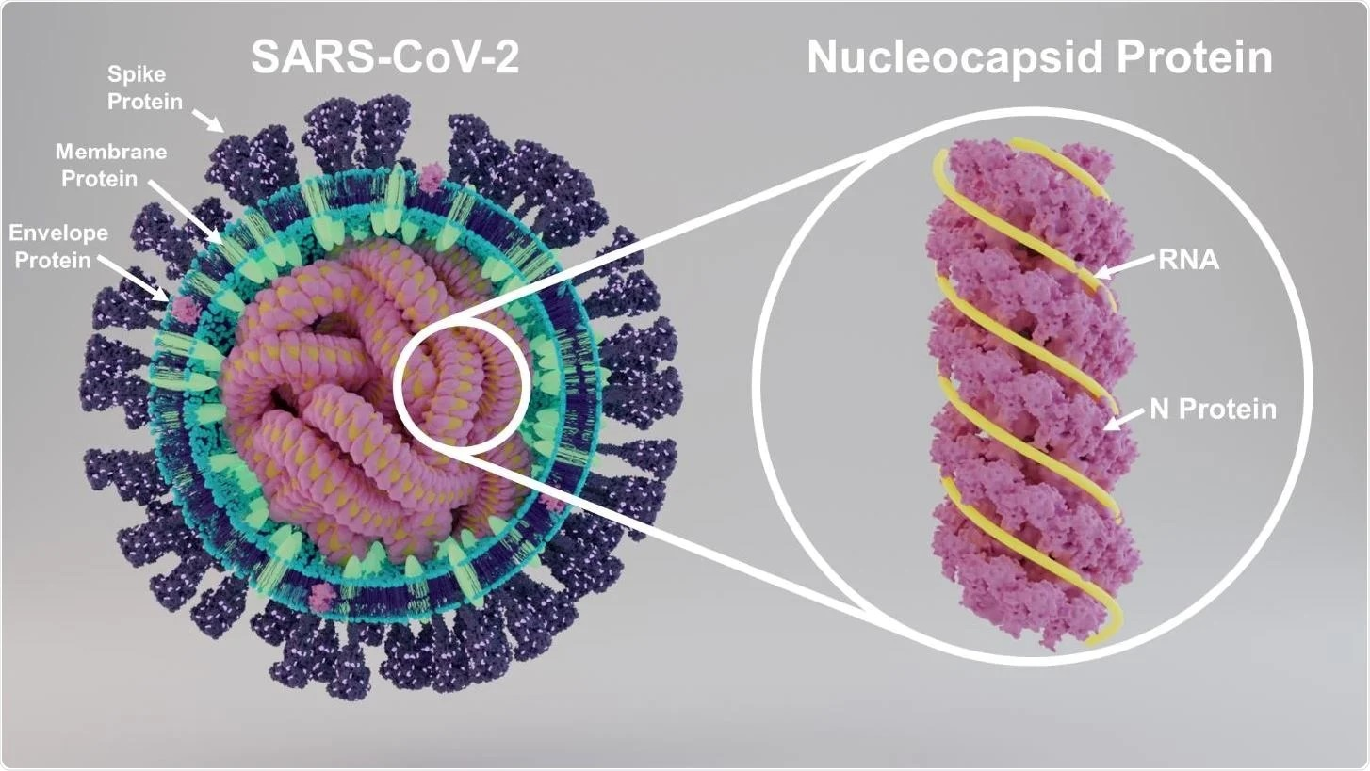
Viruses: Structure
Envelope: lipid-containing membrane surrounding some viruses.
It is acquired during budding process through a cellular membrane.
Virus-encoded glycoproteins are exposed on the surface of the envelope.
Enveloped viruses are more unstable i.e. are more sensitive to heat, drying, detergents and alcohols
Nucleocapsid
The protein-nucleic acid complex
Virion
The complete infective virus particle

Slide 5
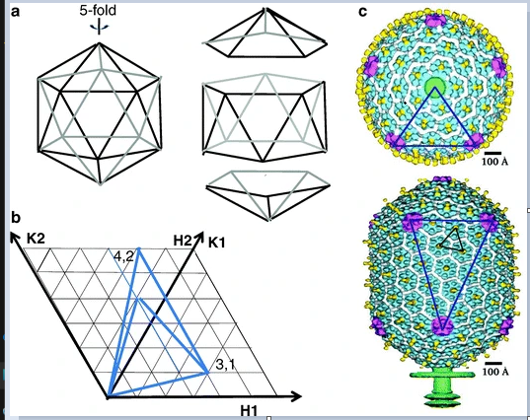
Viruses: Symmetry (The arrangement of capsomers)
1. Cubic Symmetry (Icosahedral)
Are arranged in 20 triangles that form a an icosahedron.
The approximate outline like a sphere

Slide 6
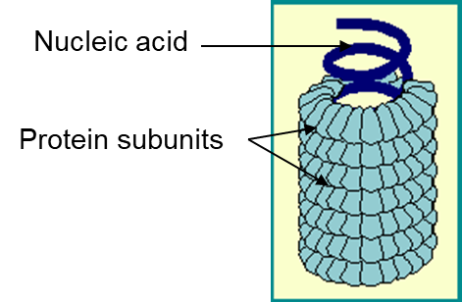
Viruses: Symmetry (The arrangement of capsomers)
2. Helical Symmetry
The capsomeres are arranged in a hollow coil
Most helical viruses are enveloped
appears rod-shaped.
The helix can be either rigid or flexible

Slide 7
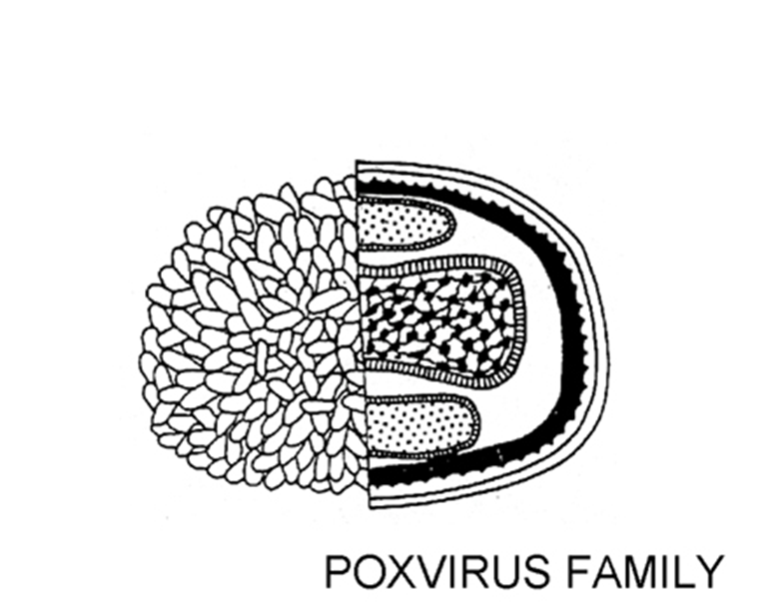
Viruses: Symmetry (The arrangement of capsomers)
3. Complex symmetry
Does not conform to cubic or helical symmetry
*All known human viruses with helical symmetry are enclosed by envelope.

Slide 8
Nomenclature and Classification of viruses:
Order which are end with the suffix-virales
families which are named with a suffix-viridae.
Subfamilies, if any shall end with suffix-virinae
genera will have suffix of -virus.

Slide 9
Nomenclature and Classification of viruses
Human viruses usually clacified into two main types according to the type of viral genome:
RNA viruses include 14 families, which are: Orthomyxoviridae, Picornaviridae, Paramyxoviridae, Retroviridae, flavoviridae, filoviridae, Astroviridae, Calciviridae, Reoviridae, Togaviridae, Arenaviridae, Rhabdoviridae, Bunyaviridae, Coronaviridae.
DNA viruses include 6 families, which are: Poxviridae, Hepadnaviridae, Herpesviridae , Parvoviridae, Papovaviridae, Adenoviridae.
* All DNA viruses are double stranded except Parvoviridae (single stranded), and all RNA viruses are single stranded except Rotaviridae (double stranded), and only retroviridae have 2 copies of ss RNA genome.

Slide 10
Atypical Virus-like Agents
Defective Viruses
Are composed of viral nucleic acid and proteins but cannot replicate without a ‘helper’ virus
During growth many defective viruses are produced in addition to infectious viruses
Pseudovirions
Contain host cell DNA instead of viral DNA within the capsid
Can infect cells but do not replicate

Slide 11
Atypical Virus-like Agents
Viroids
Consist solely of a single molecule of circular RNA without a protein coat or envelope
RNA is small and does not code for any protein.
Cause several plant diseases but are not implicated in human diseases
Prions
Are infectious particles that are composed solely of protein and no detectable nucleic acid
Are cause of certain slow diseases like Creutzfeldt-Jacob Disease (CJD) in human and scrapie in sheep

Slide 12
18/9

