Slide 1
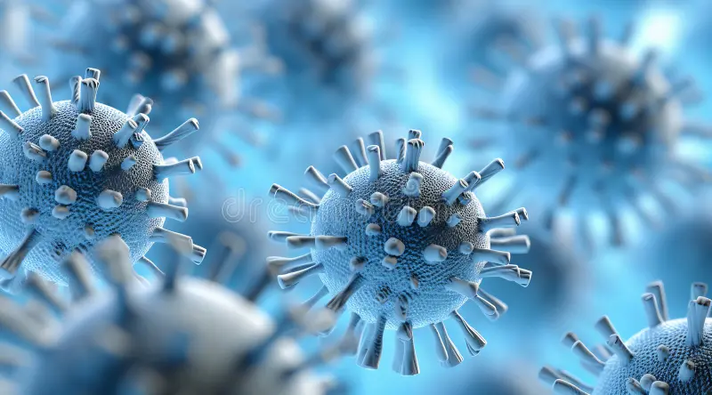
Lec. 2 Replication of the virus
Medical Virology
By:
Assist. Prof. Dr. Shaima’a Al-Salihy

Slide 2
Replication of the virus
Key steps of viral replication cycle:
Attachment of virus to host cell
Penetration
Uncoating
Biosynthesis:
Early mRNA
Translation of early proteins
Replication of viral genome
Transcription of late mRNA
Translation of late proteins
Assembly of virions
Release

Slide 3
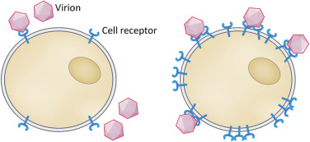
1. Attachment (binding or adsorption):
Specific receptor on the cell + ligands on the virus.
HIV CD4 + co-receptor (chemokine receptor CCR5)
Cell tropism (host range and tissue specificity).
polio viruses
T-cells
Central nervous system and intestinal tract cells

Slide 4
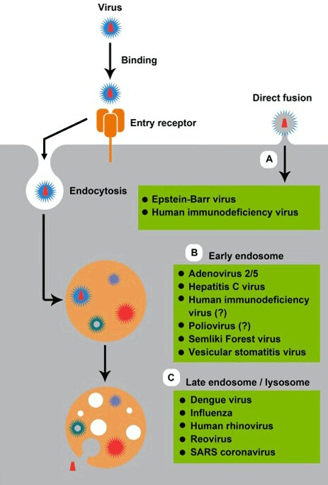
2. Penetration:
Translocation
non-enveloped virus
moving across the cell membrane.
Receptor-mediated Endocytosis
non-enveloped viruses
invagination of a section of plasma membrane
Fusion by fusion proteins:
enveloped viruses
endocytosis (envelopes of the viruses fuse with the membrane of the endosome).
Direct fusion
- virion envelope with the surface membrane

Slide 5
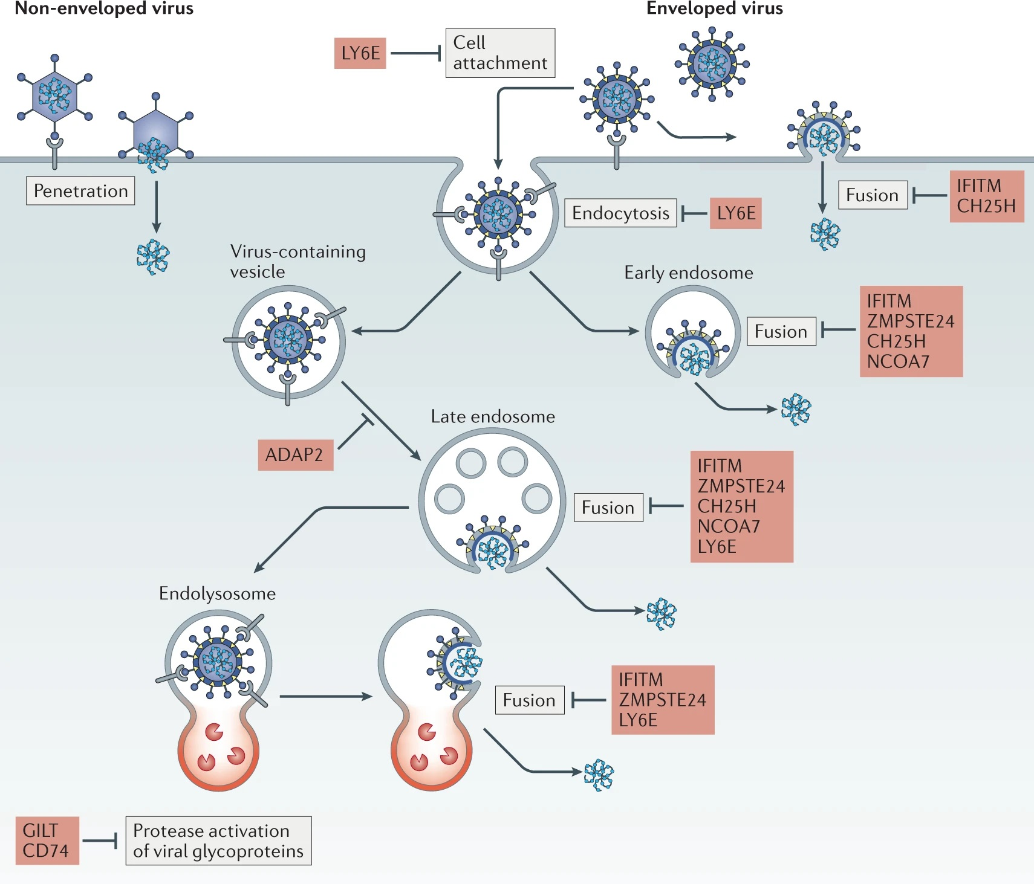

Slide 6
3. Uncoating:
free nucleic acid Picornaviruses
nucleocapsid Reo viruses
infectious and non- infectious nucleic acid
4. Biogenesis:
Early mRNA synthesis
Early protein synthesis
Replication of Viral Genome
Transcription of Late mRNA
Translation of Late Proteins

Slide 7
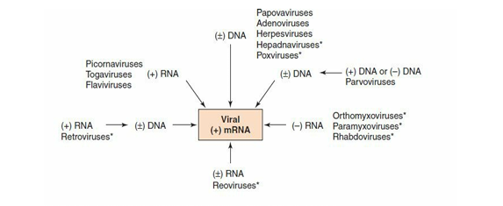
Pathways of Nucleic Acid Transcription for Various Virus Classes

Slide 8
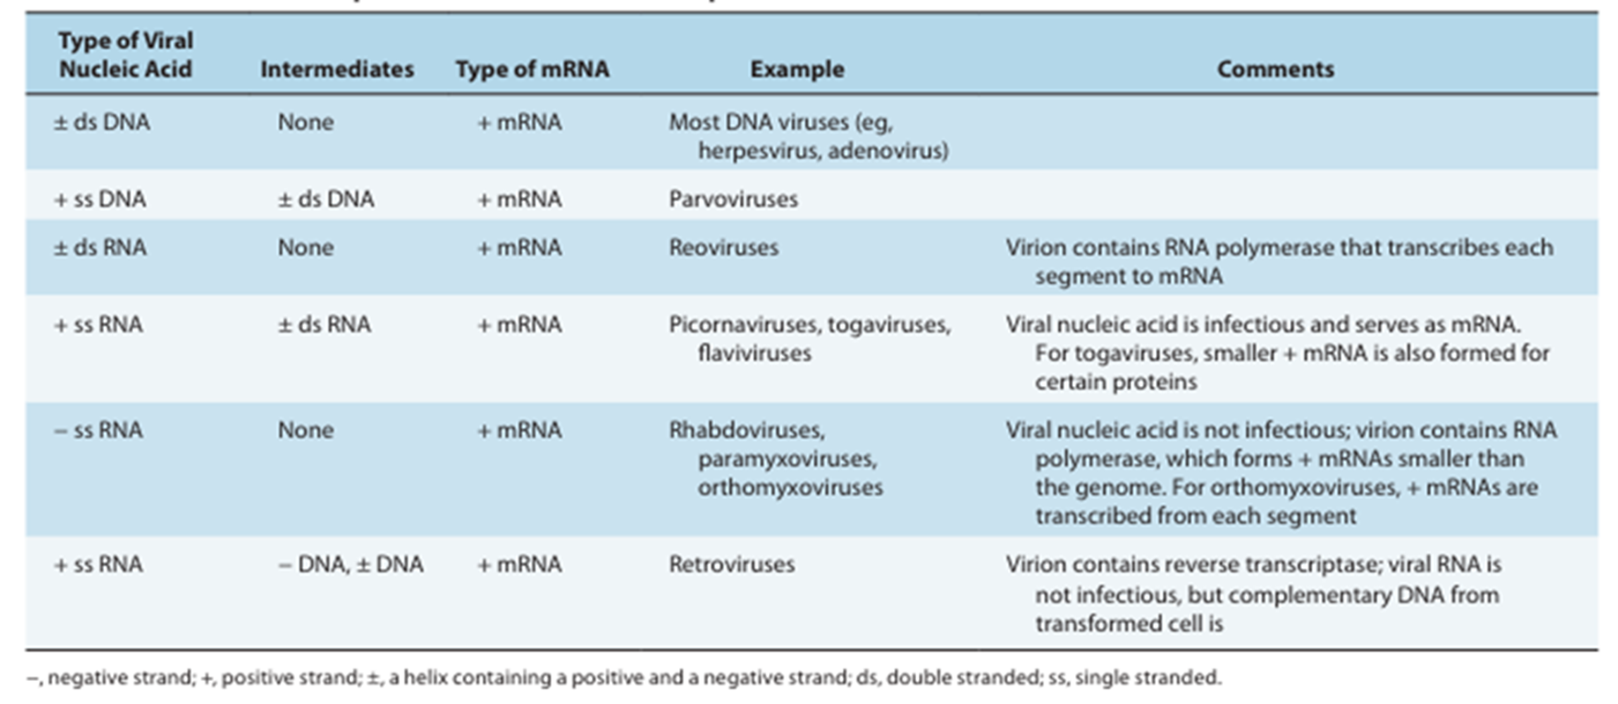
Pathways of Nucleic Acid Transcription for Various Virus Classes

Slide 9
5. Assembly: The newly synthesized viral genome and capsid protein are assembled together to form progeny virus.
6. Release:
Cell Lysis: non-enveloped viruses
Budding: enveloped viruses
Cell Degeneration
Lysogeny:
viral DNA becomes integrated into the host cell chromosome and no progeny virus particles are produced at that time. One of the most important functions of lysogeny from medical point of view is the synthesis of exotoxin in bacteria

Slide 10
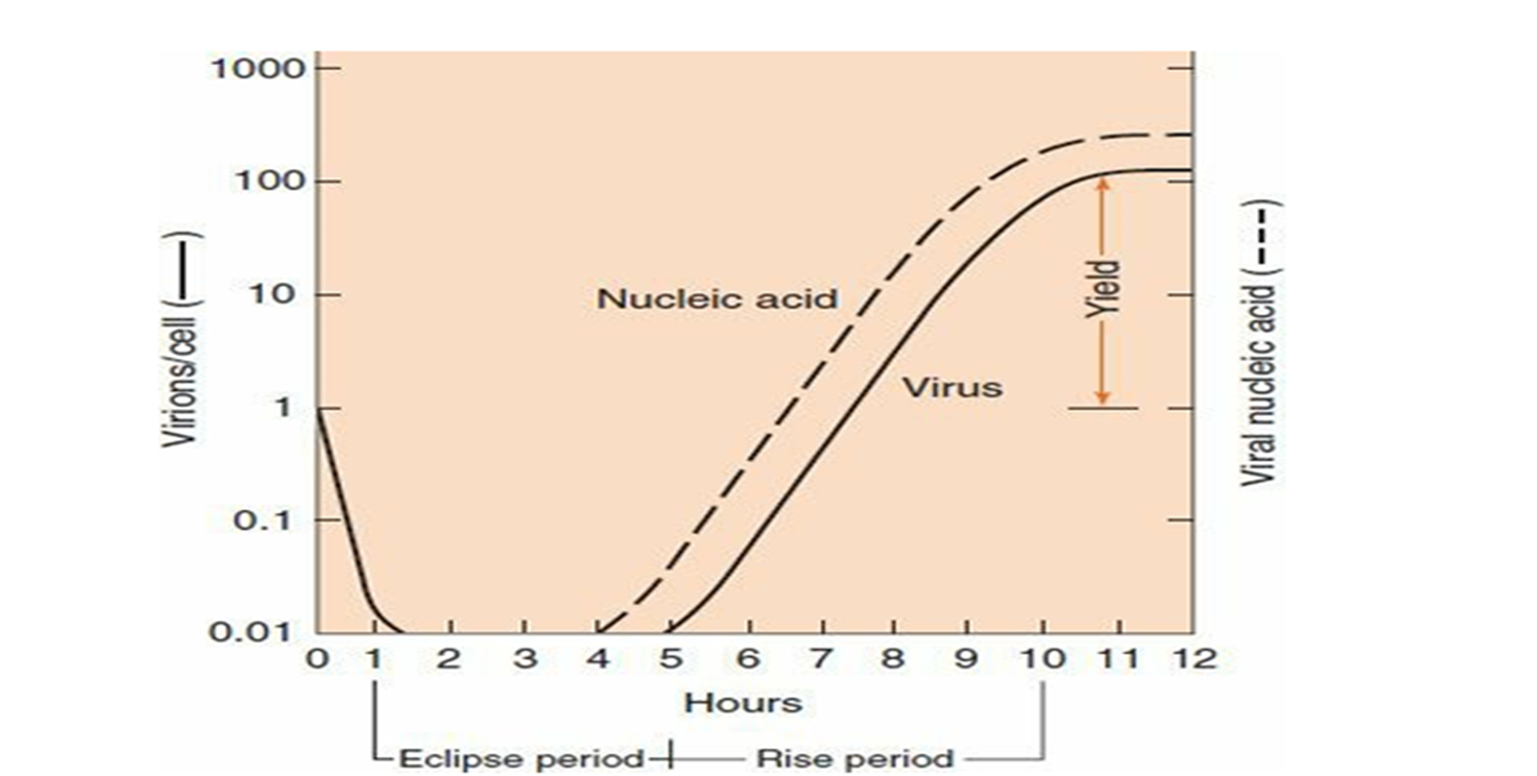
Viral growth curve
Eclipse phase: It is the interval between entry of the virus into host cell till appearance of first infectious virus particle. During this period, the virus cannot be demonstrated inside the host cell.
After that there will be accumulation of nucleic acid and then the virus appears inside the cell (Rise period).

