Slide 1
Medical Virology

Slide 2
Lec. 3 Pathogenesis
Medical Virology
Assist. Prof. Dr. Shaimaa Rahem Al-Salihy

Slide 3
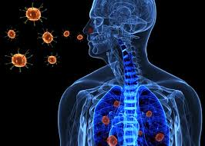
PATHOGENESIS
Pathogenesis: is the mechanisms of interaction between the virus and host factors that leads to disease production.
Pathogenicity: The ability of the virus to cause disease.

Slide 4
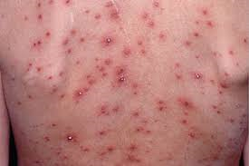
Stages of typical viral infection:
Incubation period
Prodromal period
Specific-illness period
Recovery period
Notes:
Incubation period: the patients is asymptomatic
Prodromal period during which nonspecific symptoms occur
Specific-illness period during which the characteristic symptoms and signs occur
Recovery period: during which the illness wanes and the patient regains good health

Slide 5
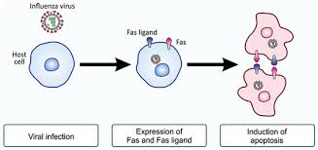
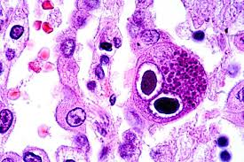
Effect of the virus on the cell
Death: due to inhibition of macromolecule synthesis (like proteins), or induction of apoptosis
b. Inclusion bodies: (like cytoplasmic negri bodies produced by rabies virus, and nuclear owl’s eyes inclusions produced by CMV.
Notes:
Death: due to inhibition of macromolecule synthesis (like proteins), or induction of apoptosis
Inclusion bodies: discrete areas containing viral proteins or viral particles (like cytoplasmic negri bodies produced by rabies virus, and nuclear owl’s eyes inclusions produced by CMV.

Slide 6
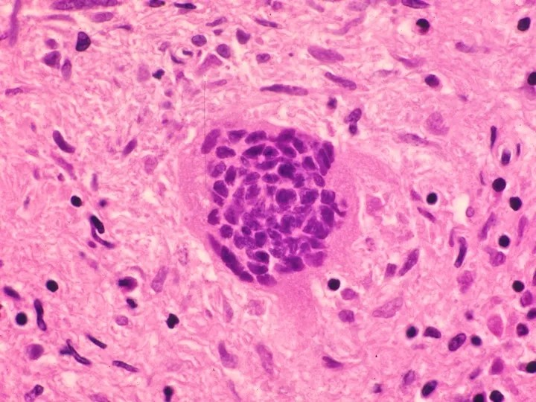
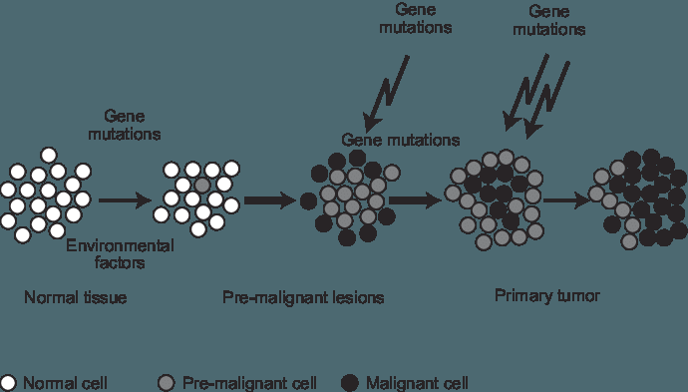
Effect of the virus on the cell
c. Fusion of cells:
produced by herpes viruses and paramyxoviruses
d. Malignant transformation: unrestrained growth, prolonged survival, and morphologic changes.
f. No apparent changes
Notes:
Fusion of cells to form multinucleated cells: produced by herpes viruses and paramyxoviruses.
Malignant transformation: unrestrained growth, prolonged survival, and morphologic changes.
Cytopathic effect: structural changes in the appearance of the cell
No apparent changes

Slide 7
Steps of viral pathogenesis:
1. Transmission and portal of entry:
Person-to-person:
Horizontal transmission:
Respiratory tract, Gastrointestinal tract, Skin, Genital tract, Blood.
Vertical transmission:
Transplacental, Perinatal, Breast feeding
B. Animal-to-person: Skin by bites

Slide 8
2. Viral spread and cell tropism:
Localized infection Rhinoviruses (URT)
Systemic (disseminated) infection poliovirus, rabies virus
Important features | Local infection | Systemic infection
Site of pathology | Portal of entry | Distant site
Incubation period | Relatively short | Relatively long
Duration of immunity | May be short | Usually lifelong
Viremia | Absent | Present
Role of secretary antibody (IgA) in resistance | Important | Not important
Notes:
Some viruses replicate at the primary site of entry. These viruses produce disease at the portal of entry and have no further systemic spread (no viremia). They spread locally over the epithelial surfaces, but there is no invasion of underlying tissues or spread to distant sites, eg, common cold caused by rhinovirus (upper respiratory tract).

Slide 9
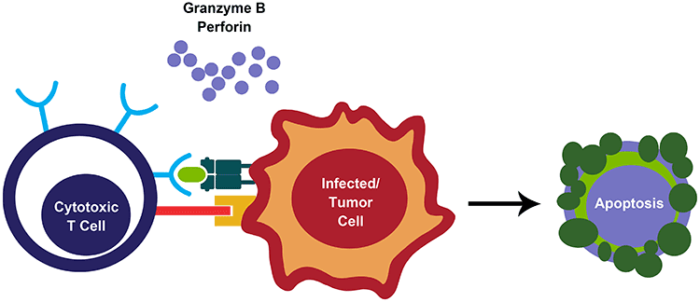
3. Pathogenesis and immunopathogenesis:
Pathogenesis death of infected cells loss of function
Immunopathogenesis:
Cytotoxic T-cell that recognize viral antigens on the cell surface (like hepatitis A, B, and C)
Formation of virus-antibody complexes that are deposited in tissues (like arthritis caused by parvovirus b19 and rubella virus).

Slide 10
Recovery from infection
Specific
Non-specific
Cytotoxic T-cell
Specific antibodies
interferon
NKC

Slide 11
5. Evasion of host defenses:
Synthesis of receptors for immune mediators
Reduction of expression of MHC I proteins
Inhibition of interferon synthesis
Multiple serotypes
Other mechanisms: (CMV- encodes microRNA blocks NKC; measles blocks synthesis of IL-12; HIV, CMV and SARS-CoV 2 have glycan shields)
6. Viral shedding:
last stage in pathogenesis
This is a necessary step to maintain a viral infection in population of hosts. S
shedding usually occurs from the body surfaces involved in viral entry.
Notes:
Synthesis of receptors for immune mediators (like vaccinia virus that encode protein binds to IL-1 blocking its ability to interact with the intended targets)
Reduction of expression of MHC I proteins (like HIV and herpes viruses reducing the ability to cytotoxic T-cell to kill the infected cells)
Inhibition of interferon synthesis (like SARS-CoV-2, EBV, and HCV)
Multiple serotypes: (like HCV and influenza virus)
Other mechanisms: (CMV- encodes microRNA blocks NKC; measles blocks synthesis of IL-12; HIV, CMV and SARS-CoV 2 have glycan shields)

Slide 12
Persistent viral infections:
Chronic carrier:
Production of significant amount of the virus for a long period
serve as a source of infection for others, eg HBV and HCV.
Latent infection:
not producing virus at the present time
reactivated at a subsequent time, HSV
Slow virus infection:
Prolonged period between the initial infection and the onset of the disease, which is usually measured in years.
Subacute sclerosing panencephalitis (SSPE)-----after measles
progressive multifocal leukoencephalopathy (PML)

