Slide 1
Lec. 4 Antivirals and viral vaccine
Medical Virology
By:
Assist. Prof. Dr. Shaima’a Al-Salihy

Slide 3
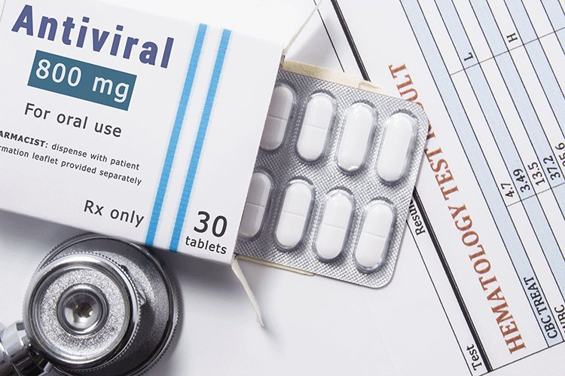
Why are there so little antiviral?
Difficulty in obtaining selective toxicity against viruses.
Many cycles of viral replication occur in incubation period when the patient is well, which make the antiviral drugs relatively ineffective
Latency of some viruses within cells like herpesviruses
Emergence of drug-resistant viral mutant

Slide 4
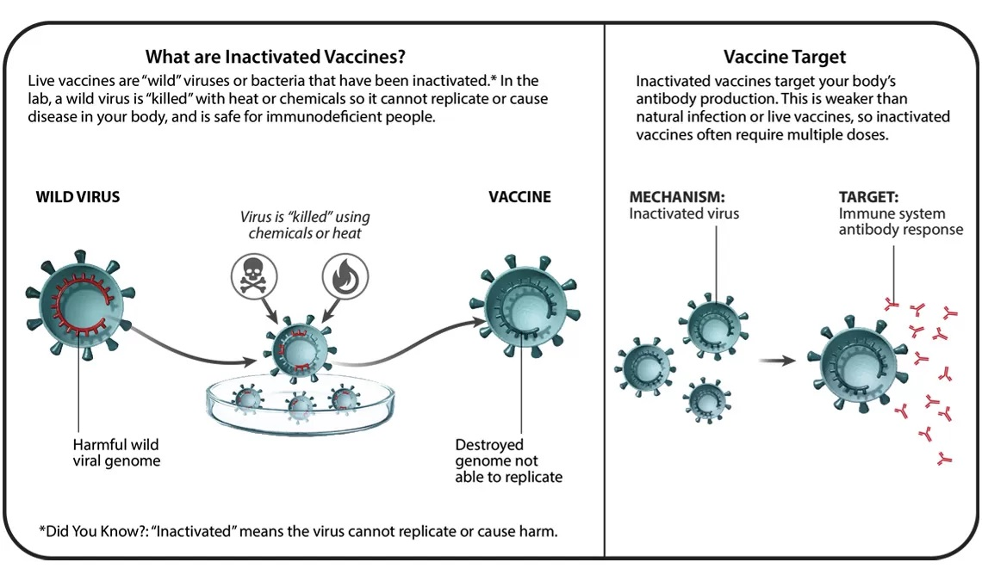
Types of viral vaccine:
Killed vaccine:
Inactivating viral infectivity with formaldehyde (or other inactivating chemicals).
The ability of the virus to cause disease is inactivated but the ability to activate the immune response is retained.
Vaccines against hepatitis A, rabies, and Salk version of polio virus (IPV).

Slide 5
Killed vaccine:
Advantage:
no reversion to virulent virus
More heat stable.
Disadvantages:
Brief immunity
Inadequate local immunity
Poor Cell mediated immunity.
Hypersensitivity to subsequent vaccination

Slide 6
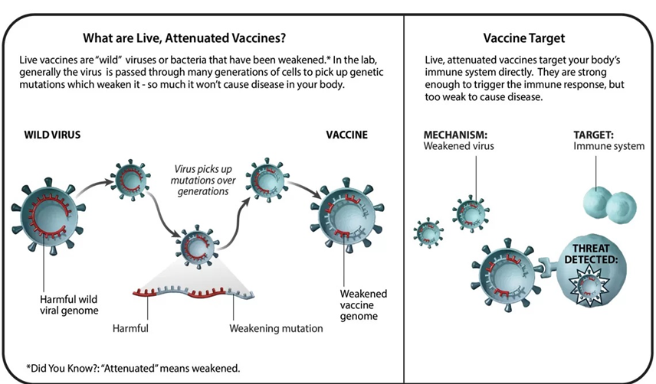
Attenuated live-virus vaccine:
virus mutants in the virulence genes
restricted in some steps in the pathogenesis of disease.
Sabin version of polio virus (OPV).

Slide 7
Attenuated live vaccine:
Advantage:
Stimulate long-lasting antibody production.
Induce good cell mediated immunity.
Induce local immunity.
Excretion of the mutant may participate in herd immunity.
Disadvantages:
The risk of revertant.
Presence of contaminants.
Increase the transmission possibility of a virulent revertant to the susceptible person.
Vaccines grown in chick embryo can not be given to those who had anaphylactic reaction to egg.

Slide 8
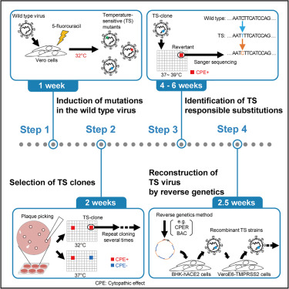
Temperature-sensitive mutant:
Depends on environmental factors
Are normal under condition and abnormal under other conditions
An inability to proliferate at high temperatures typically gives viruses an attenuated phenotype.
The mutant will replicate in the cooler air passages of the nose, where it induces IgA-based immunity, whereas it will not replicate in the warmer lung tissue and therefore will not cause disease.

Slide 9
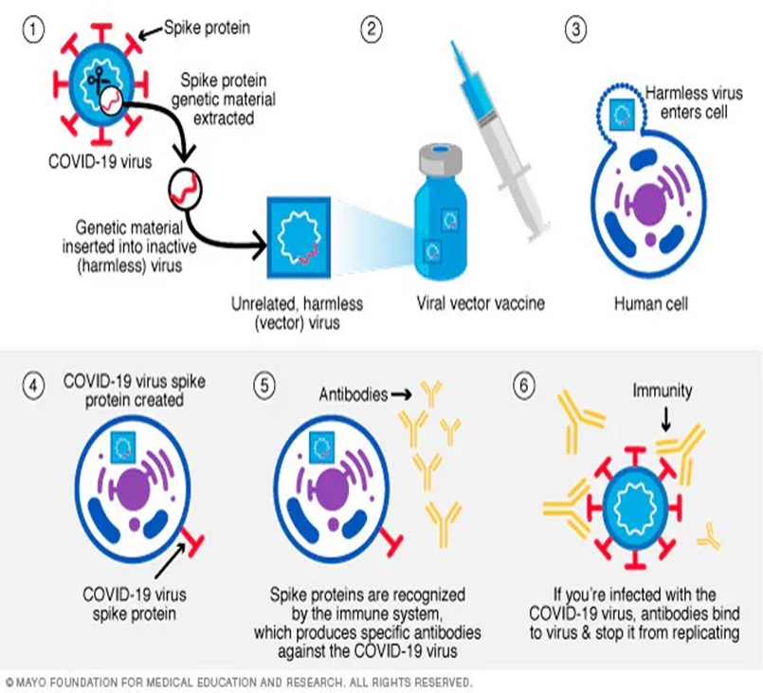
Vectored vaccines:
Ebola virus vaccine: carried on vesicular stomatitis
Rota virus vaccine: carried on bovine rotavirus
Dengue virus vaccine: carried on attenuated yellow fever virus
SARS-CoV 2: carried on human adenovirus 26
Notes:
Nonpathogenic virus carries the gene encoding the antigen that will induce protective antibodies to the desired virus in the recipient of the vaccine.

Slide 10
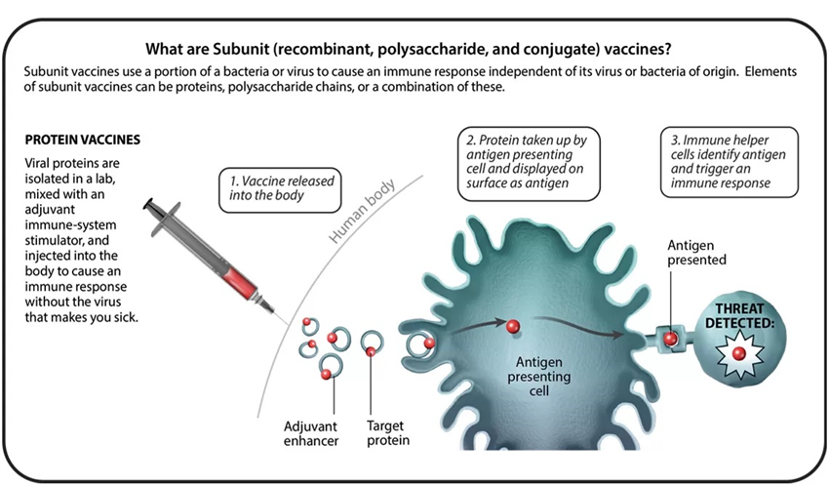
Subunit vaccines:
Genes coding for Purified component of the virus, such as a surface antigen, are inserted into yeast or hamster ovary cells, to produce large amount of these components
Mixed with adjuvant, then injected into the body
E. g. hepatitis B virus (HBV) vaccine, human papilloma virus (HPV), and Shingrix version of the zoster virus.

Slide 11
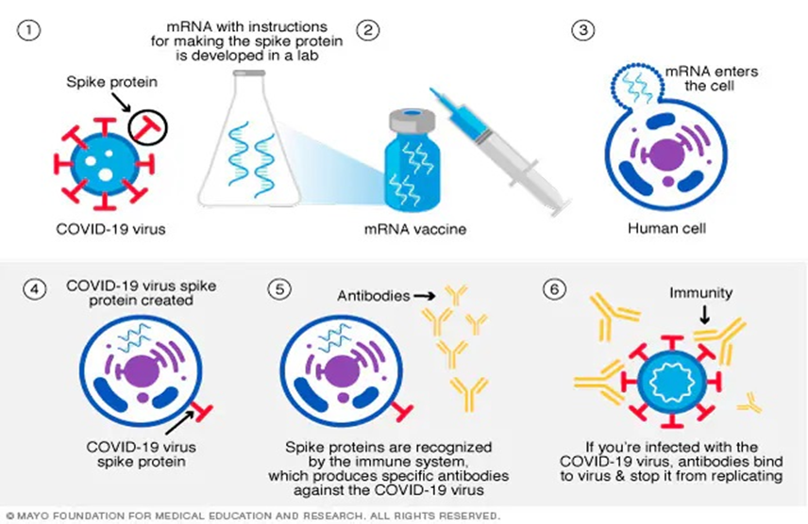
DNA and RNA vaccines:
Purified DNA and RNA that encode the viral protein antigens are injected into the person.
mRNA is translated and the resulting viral protein stimulate the immune system to produce protective antibodies
e. g. SARS-CoV 2 vaccine.

Slide 12
PASSIVE IMMUNITY
Examples:
Rabies immune globulin (RIG
Hepatitis B immune globulin (HBIG)
Varicella-zoster immune globulin (VZIG
Vaccinia immune globulins (VIG)
Immune globulins (IGs)
Advantages of antisera:
1. Confers a rapid protection against infection.
2. Prophylaxis.
3. It can be given shortly after exposure to pathogen.
Disadvantages:
1. Risk of infection by persistent or latent pathogens.
2. Short duration of protection (usually 2-3 months).
3. Hypersensitivity upon subsequent injection.

