Slide 1
Normal fetal growth abnormal; small gestation and large for gestation oligo and polyhydramnios
Dr. HUDA KHALEEL AL-KhAZRAJI

Slide 2
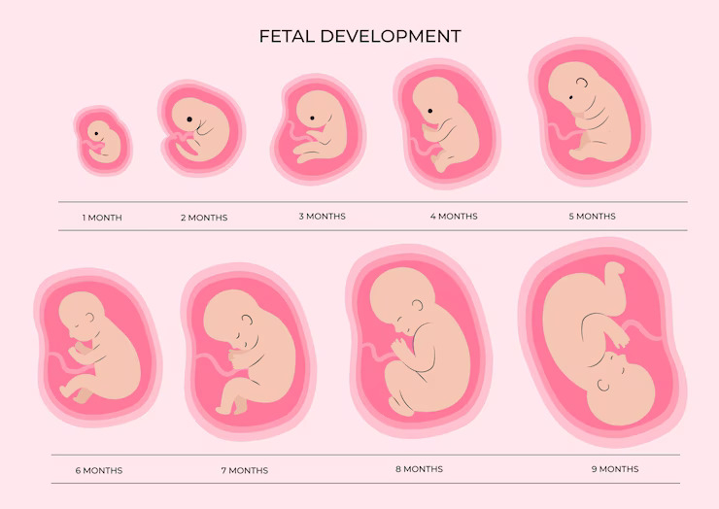
Fetal growth and the eventual weight of the fetus at birth are important not only for the immediate health of the neonate but also for the long-term health of the adult, and even into the next generation

Slide 3
FETAL GROWTH PHASES
HYPERPLASIA
First 16 weeks
Rapid increase in cell number
5 g/day at 15 weeks’ gestation
HYPERPLASIA AND HYPERTROPHY
Up to 32 weeks’
15-20 g/day at 24 weeks
HYPERTROPHY
After 32 weeks
Fetal fat and glycogen are accumulated
30-35 g/day at 34 weeks

Slide 4
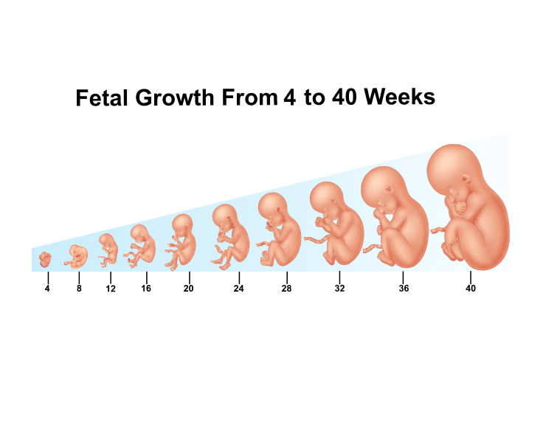
Fetal development
Cardiovascular system and the fetal circulation
Central nervous system
Respiratory system
Alimentary system
Kidney and urinary tract
Skin and homeostasis
Blood and immune system
Endocrine system
Amniotic fluid
The amniotic fluid is initially secreted by the amnion, but by the 10th week it is mainly a transudate of the fetal serum via the skin and umbilical cord. From 16 weeks’ gestation, the fetal skin becomes impermeable to water and the net increase in amniotic fluid is through a small imbalance between the contributions of fluid through the kidneys and lung fluids and removal by fetal swallowing

Slide 5
Normative data for fetal growth based on birthweight vary with ethnicity and geographic region.
Infants born to women who reside at high altitudes are smaller than those born at sea level.
Birthweight doesn’t define the rate of fetal growth. Rate or velocity can be estimated by serial sonographic anthropometry.
NORMAL BIRTHWEIGHT

Slide 6
Abnormal fetal growth
Learning objectives
To differentiate between SGA and IUGR
To appreciate the causes , management and complication of IUGR .
To be able to differentiate between symmetrical and a symmetrical IUGR
To understand the association between IUGR & oligohydramnios
To understand the causes, complications and management of oligohyramnios and polyhydramnios.

Slide 7
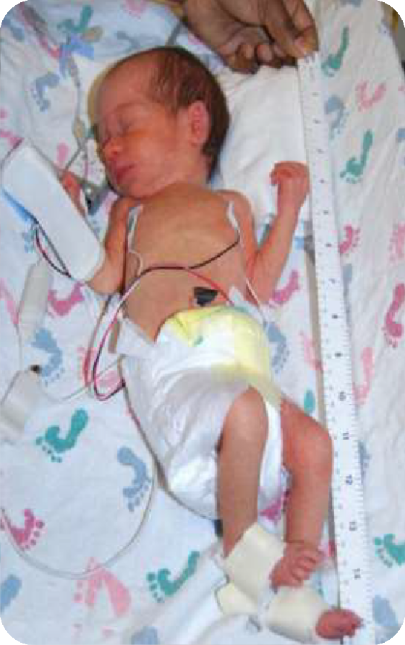

Low-birthweight newborns who are small for gestational age
BWs <10th percentile, are not pathologically growth restricted, but are small because of normal biological factors.
25-60% SGA infant are grown when
appropriately maternal ethnic, parity, weight, & height are considered.

Slide 8
Causes of IUGR
Maternal medical conditions
Chromosomal anomalies & aneuploidy
Genetic & Structural anomalies
Exposure to drugs & toxins
Placental disease
Extremes of maternal age
Low socioeconomic status
Infections
Multiple gestation

Slide 9
Maternal medical conditions result in IUGR
HT
PET
DM with vascular involvement
SLE
Anemia
Sickle cell disease
APS
Renal disease
Malnutrition
Inflammatory bowel disease
Intestinal parasites
Cyanotic pulmonary disease

Slide 10
Placenta causes of IUGR
Abnormalities in placental development & trophoblast invasion , idiopathic or due to maternal disease (SLE, PET, DM, HPT)
Chronic partial abruption
Placental infarcts
Placenta previa
Chorioangioma
Circumvallate placenta
Placental mosaicism
TTTS

Slide 11
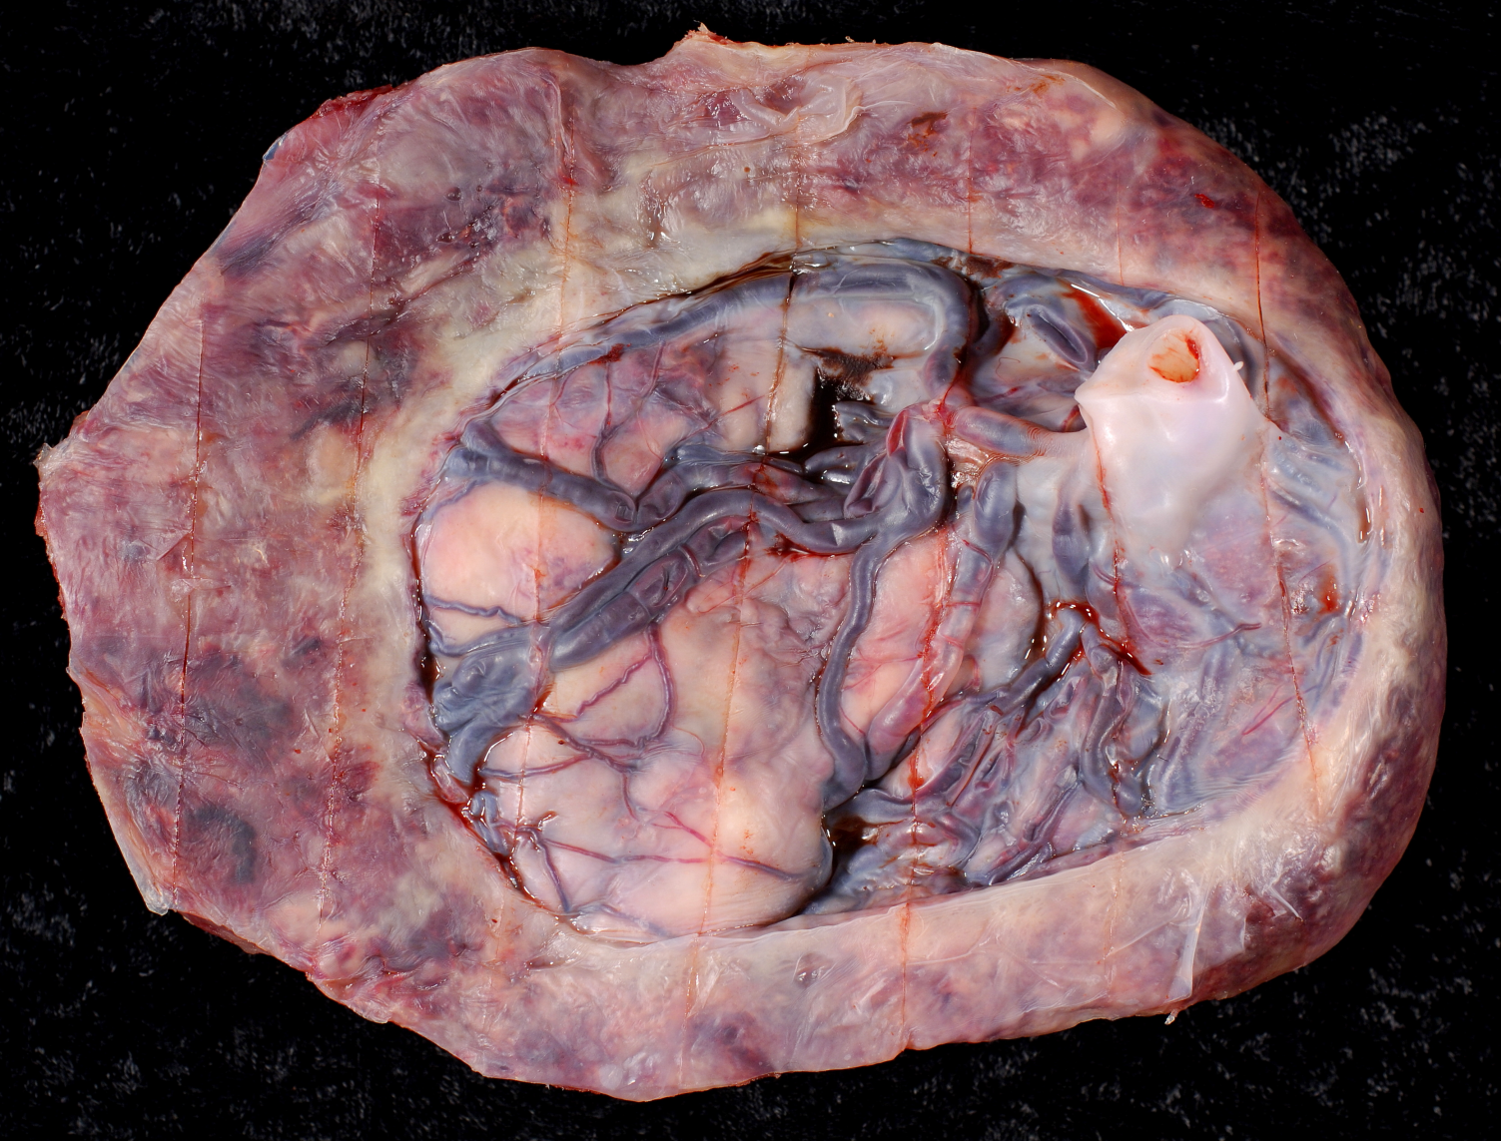
Circumvallate placenta

Slide 12
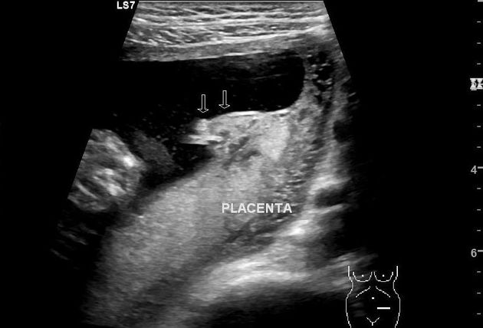
USG of Circumvallate placenta

Slide 13
Infection cause of IUGR (5-10%)(Congenital infections)
CMV
Rubella
Herpes
Vericella zoster
Toxoplasmosis
Malaria
Listeriosis

Slide 14
Drugs causing IUGR
Alcohol
Cigarette smoking 3-4X
Heroin & coccaine
Methotrexate
Anticonvulsant
Warfarin
Antihypertensives /ß-blockers
Cyclosporine

Slide 15
Genetic disorders causing IUGR15% of IUGR
Down’s syndrome
Trisomy 13,18
Turner syndrome
NTD
Achondroplasia
Osteogenisis imperfecta
Abdominal wall defects
Duodenal atresia
Renal agenesis/ Poter’s

Slide 16
Multiple pregnancy & IUGR
Placental insufficiency : inadequate placental reserve to sustain normal growth of more than one fetus
Twin to twin transfusion syndrome TTTS
Anomalies increase with:
Higher order gestations
Monozygotic twins

Slide 17
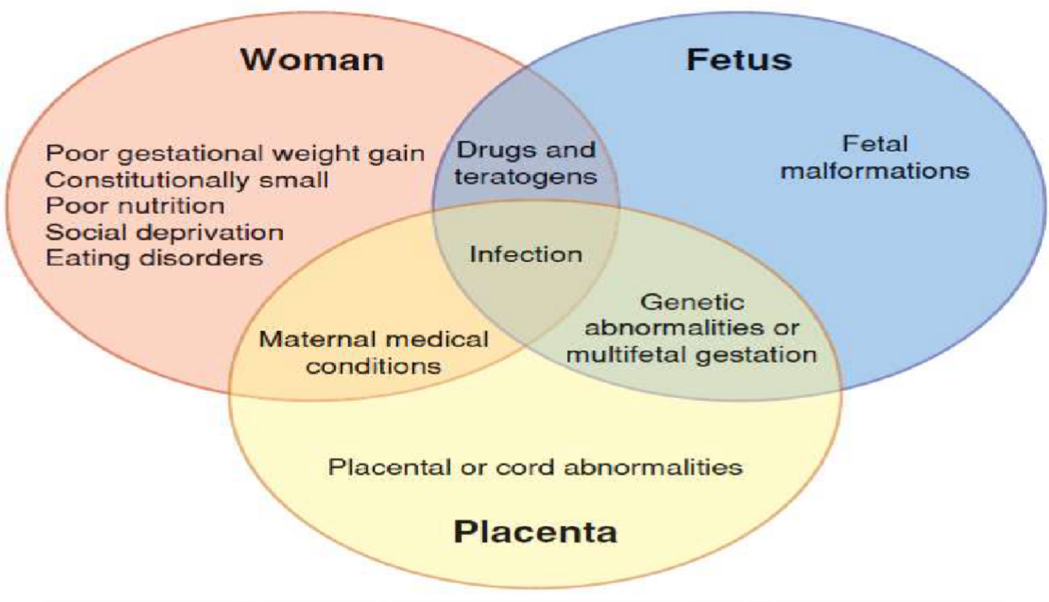


Slide 18
Symmetrical IUGR (20%) due to
Chemical
Viral
Aneuploidy
Leading to proportionate reduction in:
Head & body due to decrease cell size & number.
Organ weights including the brain
Deprivation occurs early
Due to endogenous defect
BPD, FL &, AC decreased

Slide 19
Asymmetrical IUGR (80%)
Placental insufficiency would affect cell size.
Relative sparing of the brain
Deprivation occurs in the later half of pregnancy
The infant is normal but small in size
BPD is normal, FL & AC is decreased

Slide 20
Association between IUGR & oligohydramnios
Decreased blood flow to the lungs leading to decrease pulmonary donation to amniotic fluid
Decrease blood flow to the kidneys leading to decrease GFR leading to decrease UOP
It is present in 80-90% of IUGR fetuses

Slide 21
Management
History of current pregnancy (LMP, pregnancy test, quickening vaginal bleeding & fetal movements)
Previous obstetric history( IUGR& adverse outcome)
Medical history: connective tissue diseases, thrombotic events & endocrine disorders
History of recent viral illness
Drug history
Family history of congenital abnormalities & thrombophilias

Slide 22
Examination
Symphysis fundal height SFH in cm equal to gestational age in weeks after 24 week
Sensitivity (46-86%) in detecting IUGR
A difference of more than 2cm requires fetal assessment
Oligohydramnios may be detected on palpation

Slide 23
US
Fetal biometry for dating then serial measurements
Anomaly scan
AFI
Doppler umbilical artery resistance index, MCA
Repeat tests every1-2 weeks

Slide 24
Invasive fetal testing
Amniocentesis
Placental biopsy for histopathological exam
Fetal blood sampling (FBS)
For karyotyping if aneuploidy is suspected
For viral studies if infections suspected
Caries the risks of infection, PROM, Preterm labor

Slide 25
Other tests
Maternal blood tests for
CMV, Rubella, Toxoplasmosis
Metabolic disorders
Thrombophilia
Postmortem examination

Slide 26
The constitutionally small fetus
A fetus growing parallel to the lower centiles through out pregnancy
Anatomically is normal
AFI is normal
Doppler is normal

Slide 27
In the presence of sonographically detectable anomalies, cordocentesis may be performed for karyotyping.
If GR occurs near term delivery is indicated for better outcome
In the presence of significant oligohydramnios most fetus will be delivered if GA more than34 week
Unfortunately such often tolerate labor less and C/S is indicated for intrapartum fetal compromise

Slide 28
Importantly uncertainly about the diagnosis of GR should delay intervention until fetal lung maturity is reached.
Before 34 weeks :
For normal AFI, normal fetal surveillance observation is done by repeating US at 2 weeks interval,
Pregnancy is allowed to continue until fetal maturity is achieved ,
Amniocentesis for assessment of pulmonary maturity may be helpful in clinical decision making.

Slide 29
There is no specific treatment that will ameliorate the condition
Many clinicians advised a program of modified rest in the lateral recumbent position in which COP and placental perfusion is maximized
Mortality and morbidity in GR fetuses were determined by GA and birth weight and not by abnormal fetal testing

Slide 30
Delivery
FH monitoring
Decreased AFI leads to cord compression & breech presentation , both leads to CS
Subsequent development of the GR child
The symmetrical FGR is likely to be followed by slow growth after birth.
The asymmetrically GR is more likely to catch up growth after birth.

Slide 31
Complications of IUGR
Maternal complications due to underlying disease risk of CS
Fetal complications stillbirth, hypoxia/acidosis, malformations
Neonatal complications hypoglycemia, hypocalcemia, Hypoxia & acidosis, hypothermia, meconium aspiration ,Polycythemia, hyperbilirubinemia, sepsis, low APGAR score congenital malformations, apneic spells, intubation, sudden infant death syndrome
Long term complications Lower IQ, learning & behavior problems, major neurological handicap seizures, cerebral palsy, mental retardation, HPT
Perinatal mortality 1.5-2 time more

Slide 32

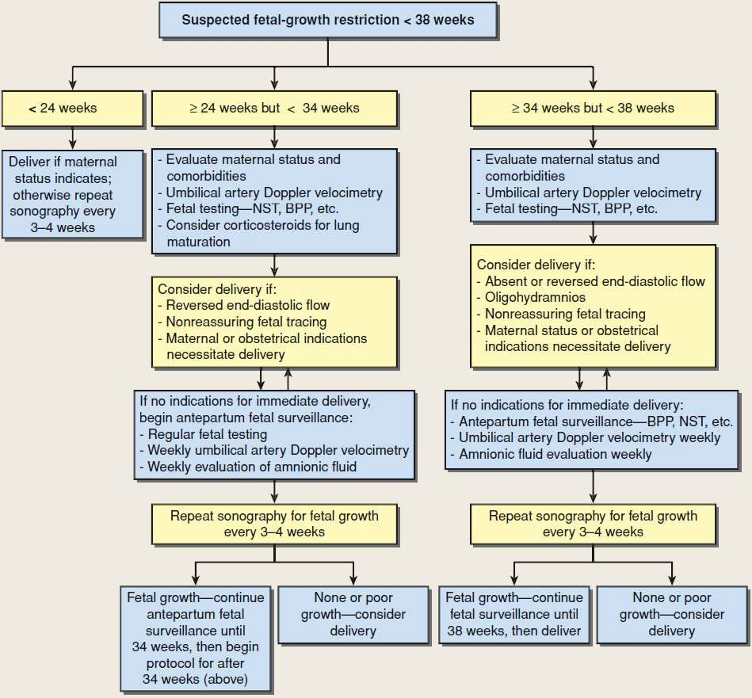

Slide 33
Large for gestational age and fetal macrosomia:
Risk factor
Screening
Diagnosis and management.

Slide 34


Definition lga
birthweights that exceed certain percentiles for a given population
large-for-gestational age (LGA) birthweight
infants >90th percentile for a given gestational week
newborns who weigh ≥4500 g at birth.
excessive glycemia; excessive transfer of lipids to fetus
Clinical presentation of pregnancy large for gestation:
LGA infants are large, obese, and plethoric.
These infants may be listless and limp and feed poorly.
Delivery complications can occur in any LGA infant
Other complications occur when weight is > 4000 g.

Slide 35
Obesity
Large size of parents
Diabetes—gestational and type 2
Post term gestation
Multiparity
Previous macrosomia infant Advancing maternal age
Racial and ethnic factors
RISK FACTORS FOR FETAL OVERGROWTH

Slide 36
Etiology of pregnancy large for gestation age
Women who have had a large baby before or have a family h x.of a large babies.
Women who are obese with a body mass index (BMI) of 35 or above.
Baby boys are also more likely to be large for gestational age than baby. girls. However, many women who have a LGA baby do not have any of these risl‹ factors.
Women who are known to be diabetic or develop diabetes during pregnancy— high levels of sugar in the blood can pass through the placenta to your baby and affect growth.
Other than genetically determined size, maternal diabetes mellitus is the major cause of Large-for-gestational-age (LGA) infants.
The large size results from the anabolic effects of high fetal insulin levels produced in response to excessive maternal blood glucose during gestation and sometimes increased caloric intake by the mother to compensate for glucose lost in urine. The less well controlled the mother's diabetes during pregnancy, the larger !s the size of the fetus.

Slide 37
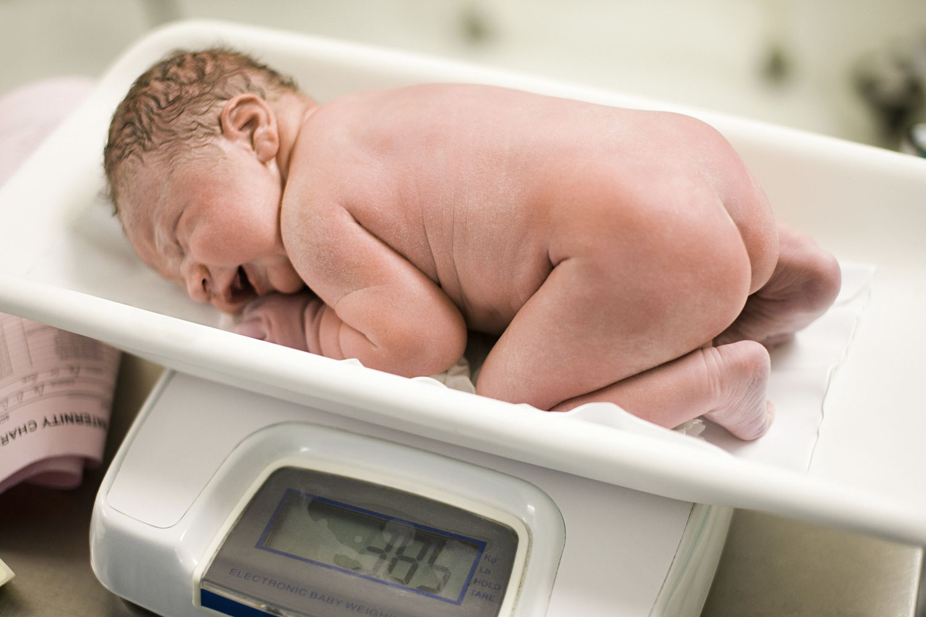
The major causes of LGA are diabetic mother, genetic (large size ), obesity and over weight during pregnancy

Slide 38
Diagnosis and management
It can be diagnose during ANC (physical exam. Fundal high; maternal weight gain)
OBSTATRIC ULTRASOUND SCANING )
° Lab test.
Fetal macrosomia is often unpredictable. The diagnosis is made only after your baby has been weighed after delivery. Babies can be born larger than average with or without any known risk factors.
Promoting good health and a healthy pregnancy can improve out come.
Get regular prenatal care. Frequent visits allow you and your healthcare provider to closely follow your baby's progress and also give you a chance to ask question.
Watch your weight. Your weight before pregnancy matters, as does how much weight you gain while you're pregnant.
If you have diabetes, take appropriate steps to manage it. Diabetes before your pregnancy and diabetes that happens during your pregnancy (gestational diabetes) are risk factors for fetal macrosomia.

Slide 39


MANAGEMENT
PROPHYLACTIC LABOR INDUCTION
Nondiabetic women
<39 weeks’ gestation or delivery for suspected macrosomia.
ELECTIVE CESAREAN DELIVERY
In diabetics with overgrown fetuses, elective cesarean delivery is tenable

Slide 40
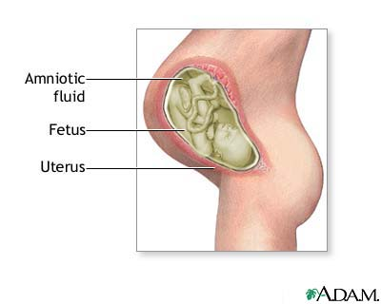
Oligohydramnios and polyhydramnios
Early pregnancy:
Composition of amniotic fluid similar to extracellular fluid.
Transfer of water across amnion and through fetal skin.
Second trimester:
Fetus begins to urinate swallow, and inspire amniotic fluid
During last 2/3 of pregnancy, amniotic fluid is principally fetal urine.

Slide 41
Amniotic fluid volume increases progressively:
10 weeks: 30 ml.
20 weeks: 300 ml.
30 weeks: 600 ml.
38 weeks:1,000 ml.
But from term there is a rapid fall in volume:
40 weeks: 800 ml.
42 weeks: 350 ml.
The reason for the late reduction has not been explained.

Slide 42
Polyhydramnios:
Excessive amount of amniotic fluid of 2000 ml or more (AFI of > 25 cm or the deepest vertical pool of > 8 cm) .
Amniotic Fluid Index AFI is taken by measurement of vertical pocket in 4 quadrants

Slide 43


Slide 44
Types
Mild hydramnios (80%): AFI (8 -11) cm.
Moderate hydramnios (15%): AFI(12-15) cm.
Severe hydramnios (5%) - twin-twin transfusion syndrome : AFI 16 cm or more.

Slide 45
Causes
1. Fetal malformation:
GIT: esophageal/duodenal atresia, tracheoesophageal fistula.
CNS: anencephaly ( decreased swallowing, exposed meninges, no antidiuretic hormone).
2. Twin-twin transfusion due to fetal polyuria.
3. Hydrops fetalis: congestive heart failure, severe anaemia
4. DM (osmotic diuresis).
5. Idiopathic.

Slide 46
Diagnosis
Symptoms:
Dyspnea.
Edema.
Abdominal distention
Preterm labour.
Abdominal examination:
Increased uterine size more than expected.
Difficult to palpate fetal parts.
Difficult to hear fetal heart sound.
Ballotable fetus.

Slide 47
Mild degrees:
no treatment, (bed rest, diuretics, water and salt restriction) all are ineffective.
Moderate and sever:
Hospitalization: dyspnea, abdominal pain .
Indomethacin therapy: .
Decrease lung fluid production
Enhances absorption.
Decrease fluid movement across fetal membranes.
Complications: premature closure of DA, impairment of RF, and cerebral vasoconstriction
Not used after 35 weeks
Amniocentesis: to relieve maternal distress and to test for fetal lung maturity. Complications: ruptured membrane, chorioamnionitis, placental abruption, PTL.

Slide 48
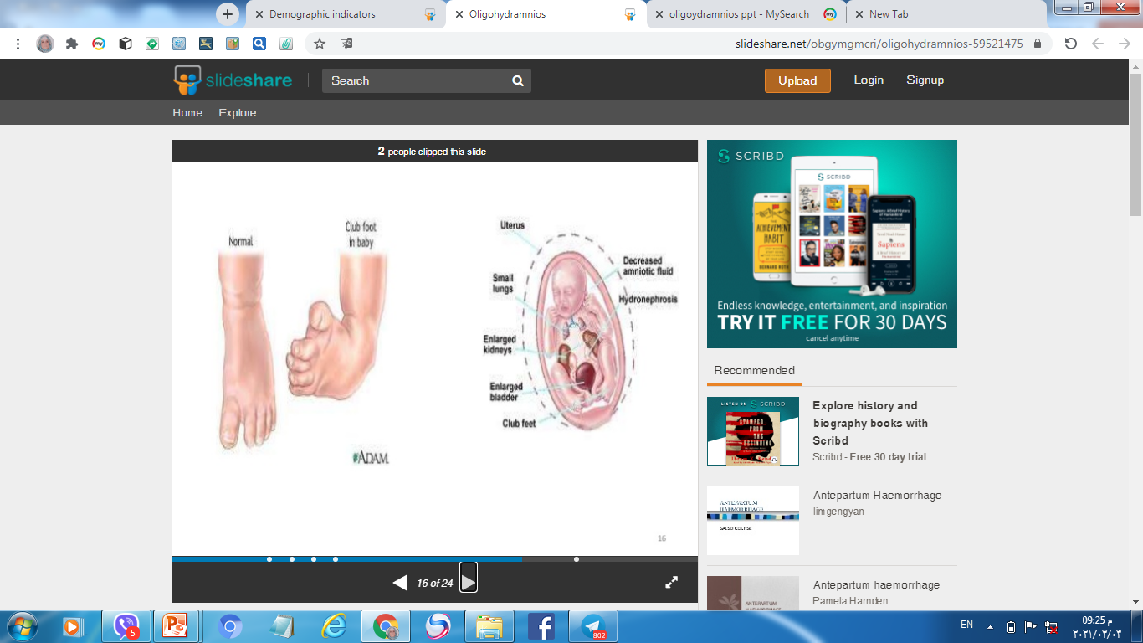
Oligohydramnios

Slide 49
Causes of oligohydramnios
Fetal causes:
Renal cause (57%):
Renal agenesis (Potter’s syndrome).
Polycystic kidney.
Urethral obstruction (posterior urethral valve).
Fetal growth restriction.
Fetal death.
Post term pregnancy.
Preterm premature rupture membranes

Slide 50
Maternal causes:
Placental insufficiency.
Preeclampsia.
Placental causes:
twin-twin transfusion.
Drug causes:
PG synthase inhibitor as NSAID.
Idiopathic

Slide 51
Complications of oligohydramnios
In early pregnancy:
Amniotic adhesions or bands (amputation).
Pressure deformities (club feet).
Pulmonary hypoplasia:
Thoracic compression.
No breathing movement.
No amniotic fluid retain.
Flattened face.
Postural deformities.

Slide 52
In late pregnancy:
Fetal growth restriction.
Placental abruption.
Preterm labour.
Fetal distress.
Fetal death.
Meconium aspiration.
Labour induction/CS.

Slide 53
Diagnosis:
Fundal < date.
AF I < 5CM , DVP < 2.
IUGR: abdominal circumference < 10th centile.
Doppler abnormalities
Congenital fetal anomalies.
Management:
Treat the cause (PPROM , preeclampsia).
Assess fatal wellbeing (US/CTG/Doppler/BPP).
Vesicoamniotic shunting (urethral obstruction).
Amnioinfusion (decrease fetal death).

Slide 54
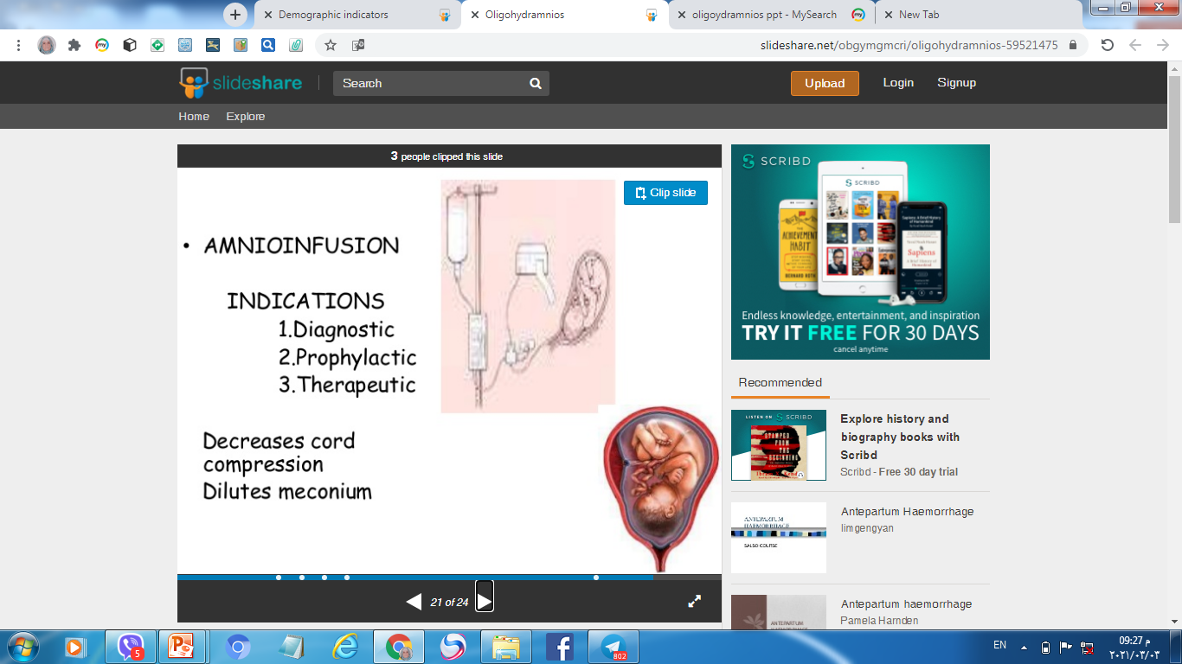
Amnioinfusion

Slide 55

Thank you

