Slide 1
Postterm pregnancy& induction of labor
By
Dr.huda al-khazraji

Slide 2
definition
A post-term pregnancy is strictly defined as a pregnancy that extends to or beyond 42 weeks 0 days of gestation (290) days from the last menstrual period). This is distinct from late-term pregnancy, which is defined as (41) weeks.

Slide 3
Cause and risk factor
The most common cause of a "post-term" diagnosis is actually inaccurate dating. When the gestational age is certain, the exact biological cause for delayed parturition is often unknown, though several factors are associated with increased risk:
Primiparity: First-time mothers are at higher risk.
Prior post-term pregnancy: Increases recurrence risk by 30% to 50%.
Maternal Obesity: BMI > 30 is linked to longer gestations.
Fetal Factors: Rare conditions like anencephaly or placental sulfates deficiency.

Slide 4
Maternal and Fetal Risks
Maternal Risks Severe perineal lacerations, Cesarean delivery, postpartum hemorrhage, and chorioamnionitis.
Fetal RisksMacrosomia (Birth weight > 4500), Oligohydramnios (low amniotic fluid), Meconium Aspiration Syndrome, and Placental Insufficiency.
Neonatal Risks Dysmaturity Syndrome: Characterized by long nails, abundant hair, wrinkled skin (loss of vernix), and decreased subcutaneous fat.

Slide 5
Clinical Management
Between 41 and 42 weeks, many clinicians initiate twice-weekly testing to ensure fetal well-being:
Non-Stress Test (NST): Monitoring fetal heart rate reactivity.
Biophysical Profile (BPP): Using ultrasound to assess fluid, movement, tone, and breathing.
Amniotic Fluid Index (AFI): Monitoring for oligohydramnios, as fluid naturally decreases after 40 weeks.
Induction of Labor (IOL)

Slide 6
Induction of Labor (IOL)

Slide 7
LEARNING OBJECTIVES
To understand the definition of IOL
To describe the indication of ( reason for ) IOL
To describe the contraindications of IOL ( absolute and relative )
To describe the Bishop score and its benefit
To understand the methods of IOL
To be able to recognize the complications of IOL

Slide 8
IOL is the planned initiation of labour prior to its spontaneous onset.
20– 25% of deliveries occur following IOL.
IOL is performed when the risks to the fetus and/or the mother of the pregnancy continuing outweigh ending the pregnancy
It should only be performed if there is a high chance of success and low risks to the mother and/or fetus, otherwise woman should be advised to await spontaneous onset of labour or performing a CS.

Slide 9
The most common reason for IOL is prolonged pregnancy (‘post-term’ or ‘postdates’).
There is evidence that pregnancies extending beyond 42 weeks’ gestation are associated with a higher risk of :
Stillbirth,
Fetal compromise in labour,
Meconium aspiration
Mechanical problems at delivery.
Usually recommended (41-42) weeks’ gestation.
Induction for prolonged pregnancy does not increase the rate of CS

Slide 10
300–400 pregnancies need to be induced to prevent one perinatal death that would have occurred if the pregnancies had been managed expectantly beyond 42 weeks’ gestation.
Women who choose not to be induced for this reason are offered more intensive serial fetal monitoring

Slide 11
(PROM)
The longer the delay between membrane rupture and delivery of the baby, the greater the risk of ascending infection (chorioamnionitis) and neonatal and maternal infectious morbidity.
At term (beyond 37 weeks), IOL is advised 24 hours following membrane rupture , to reduce rates of :
Chorioamnionitis,
Endometritis
Admissions to the neonatal unit.

Slide 12
Before 34 weeks, some other additional indication ( fetal compromise & growth restriction).
Pre-eclampsia and other maternal hypertensive disorders often indicate earlier delivery , at term is normally managed with IOL; CS may be a better option in :
Very preterm gestations (<34 weeks)
There is rapid maternal deterioration
There is significant fetal compromise

Slide 13
Other common reasons for IOL at 38 weeks’ gestation, and sometimes earlier.
Maternal diabetes,
Twin gestation
Intrahepatic cholestasis of pregnancy
Suspected fetal macrosomia (>90th percentile), in the absence of maternal diabetes, the estimation of fetal weight by USG has an error margin of 10–20% and some IOL may subsequently prove to have been unnecessary.

Slide 14
‘Social’ IOL is performed to satisfy the domestic and organizational needs of the woman and her family , needs careful counselling of the risks .
IOL is determined essentially by the parity and the cervical condition.
In any circumstance, an induced labour cannot be considered ‘normal’ and should be carefully supervised.

Slide 15
Absolute contraindications to IOL, including placenta praevia and severe fetal compromise.
Deteriorating maternal condition with major APH , pre-eclampsia or cardiac disease may favour CS.
Breech presentation is a relative contraindication to IOL, and women with a previous caesarean birth need to be informed of the greater risk of uterine rupture.
Preterm gestation is not an absolute contraindication, but induction at <34 weeks is associated with a much higher risk of failure and the need for subsequent CS.

Slide 16
Indications for induction of labour
Prolonged pregnancy (usually offered after 41 completed weeks).
PROM.
Pre-eclampsia and other maternal hypertensive disorders.
FGR.
Diabetes mellitus.
Fetal macrosomia.
Deteriorating maternal illness.
Unexplained antepartum haemorrhage.
Twin pregnancy continuing beyond 38 weeks.
Intrahepatic cholestasis of pregnancy.
Maternal isoimmunization against red cell antigens.
‘Social’ reason

Slide 17
The Bishop score
As the time of spontaneous labour , the cervix becomes softer, shortens, moves forward, effaces and starts to dilate.
This reflects the natural preparation for labour.
If labour is induced before this process has occurred, the IOL will tend to take longer.
To quantify how far this process had progressed prior to the IOL.

Slide 18
High scores (a ‘favourable’ cervix) are associated with an easier, shorter induction process that is less likely to fail.
Low scores (an ‘unfavourable’ cervix) point to a longer IOL that is more likely to fail and result in CS.
Score < 4 : unfavourable cervix
Score 5-8 : intermediate
Score = or > 9 : favourable

Slide 19
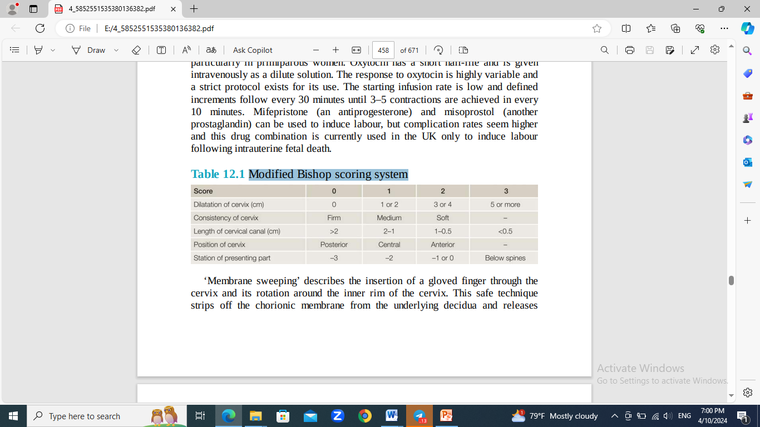
Modified Bishop scoring system

Slide 20
Methods
IOL was traditionally performed by ARM.
In the mid-1950s, synthetic oxytocin (Syntocinon)™ was used as an intravenous infusion after rupture of the membranes.
In unfavourable cases, it was often unsuccessful and sometimes it was impossible to rupture the membranes.
In the late 1960s, synthetic PG became available.

Slide 21
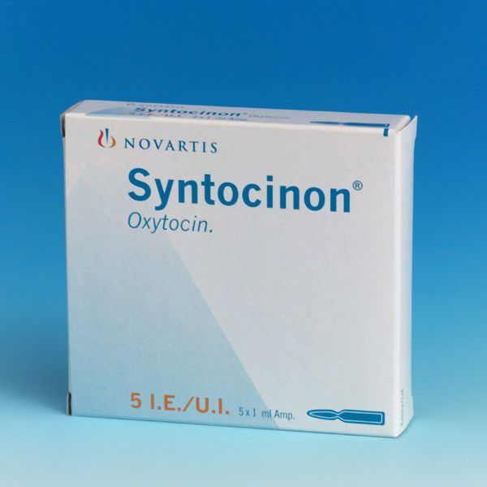

Slide 22
The most common formulation in current use is (PGE2), inserted vaginally into the posterior fornix as a tablet or gel.
Two doses are often required, given at least 6 hours apart.
Labour may ensue following the administration of PG , but ARM and oxytocin are often also necessary, particularly in primiparous women.

Slide 23
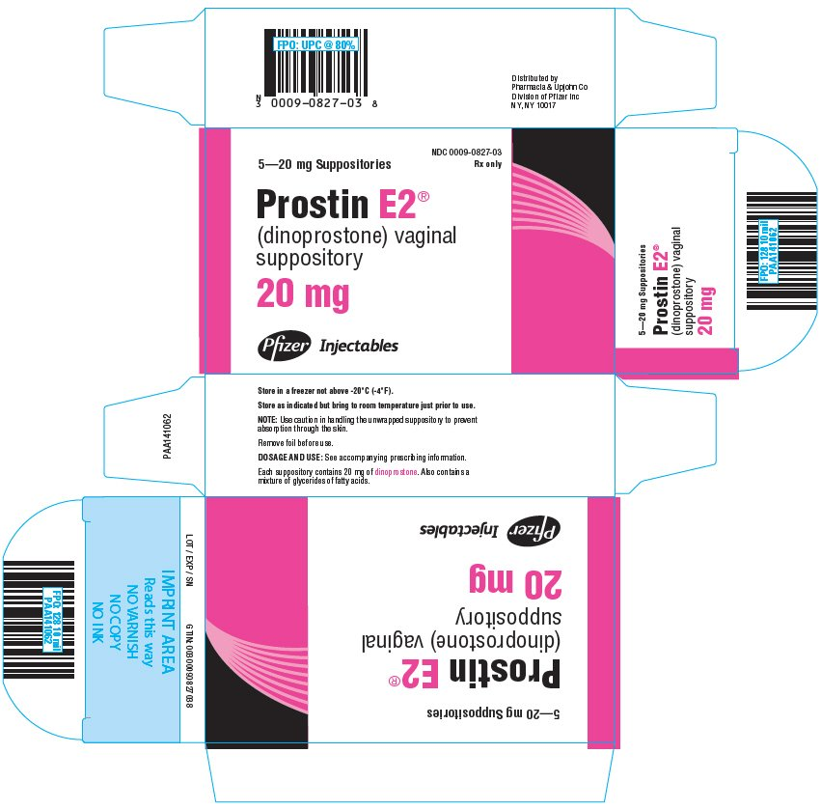
PGE2

Slide 24
Oxytocin has a short half-life and is given iv as a dilute solution , the response to oxytocin is highly variable and a strict protocol exists for its use.
The starting infusion rate is low and defined increments follow every 30 minutes until 3–5 contractions are achieved in every 10 minutes.
Mifepristone (an antiprogesterone) and misoprostol (another prostaglandin) can be used , but complication rates seem higher and this drug combination is currently used in the UK only to induce labour following IUD.

Slide 25
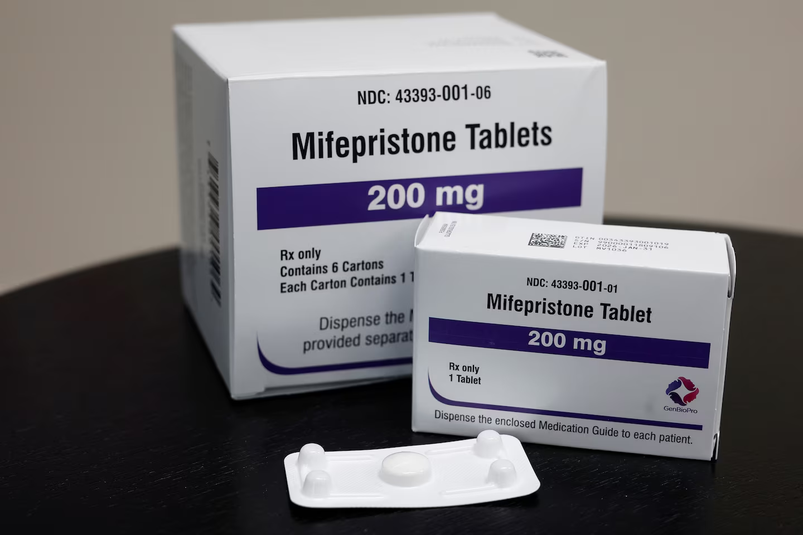
Antiprogesterone

Slide 26
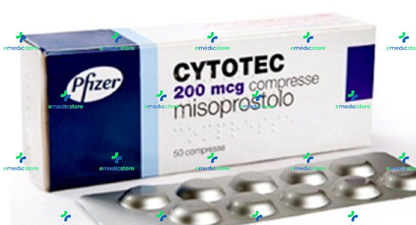
PGE 1

Slide 27
Misoprostol is recommended for the treatment of :
Missed miscarriages.
Incomplete miscarriages
Preinduction cervical ripening ( IUD)
Cervical preparation before uterine instrumentation.
PPH prophylaxis and treatment .

Slide 28
‘Membrane sweeping’
The insertion of a finger through the cervix and its rotation around the inner rim of the cervix.
To strip off the chorionic membrane from the underlying decidua and releases natural PG.
It can be uncomfortable for the woman, and is only possible if the cervix is beginning to dilate and efface.
It can be performed more than once and it reduces the need for induction.
It is usually only performed at term, and placenta praevia must be excluded before it is offered.

Slide 29
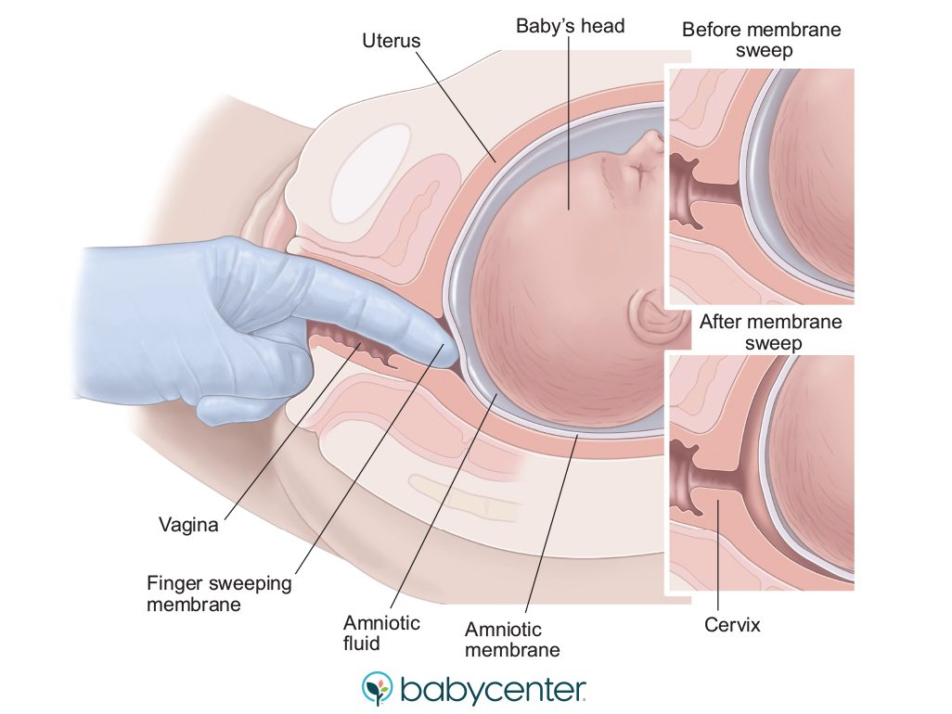
Membrane sweep

Slide 30
Methods of induction
Membrane sweep (offer weekly from 40 weeks).
PG gel, tablet or pessary to ripen cervix and initiate contractions.
ARM (cervix must be favourable).
Oxytocin infusion (membranes ruptured first, spontaneous or artificial).
Mifepristone and misopostol (for IUD )

Slide 31
Complications of IOL
The woman experiences more pain and the use of epidural analgesia is more common.
The rates of instrumental delivery are higher where epidural analgesia is used, but no evidence of a higher rate of CS.
Long labours with oxytocin predispose to PPH secondary to uterine atony.
Fetal compromise may occur due to uterine hyperstimulation as a side-effect of use of PG and oxytocin

Slide 32
Uterine hyperstimulation a contraction frequency of >5 per 10 minutes should be treated by stopping the oxytocin and if necessary administration of a tocolytic drug, most commonly a sc β2-agonist terbutaline .
If ARM is performed while the fetal head is high, then cord prolapse may occur, ( need for emergency CS ).
Women with a previous CS scar are at greater risk of uterine rupture, the risk of rupture increases from one in 200 in a spontaneous labour to as high as 1 in 70 if IOL is performed using PG.

Slide 33
IOL may fail and this is occurred if :
An ARM is still impossible after the maximum number of doses of PG
the cervix remains uneffaced and < 3 cm dilated after an ARM has been performed and oxytocin has been running for 6–8 H with regular contractions.
When an IOL fails, the options include an IOL again at some point in the future, or performing a CS section.

Slide 34
Delaying delivery further is only acceptable if there is no major threat to fetal or maternal condition ( failed social induction).
Failed induction in the setting of pre-eclampsia or FGR will usually necessitate a CS.

Slide 35
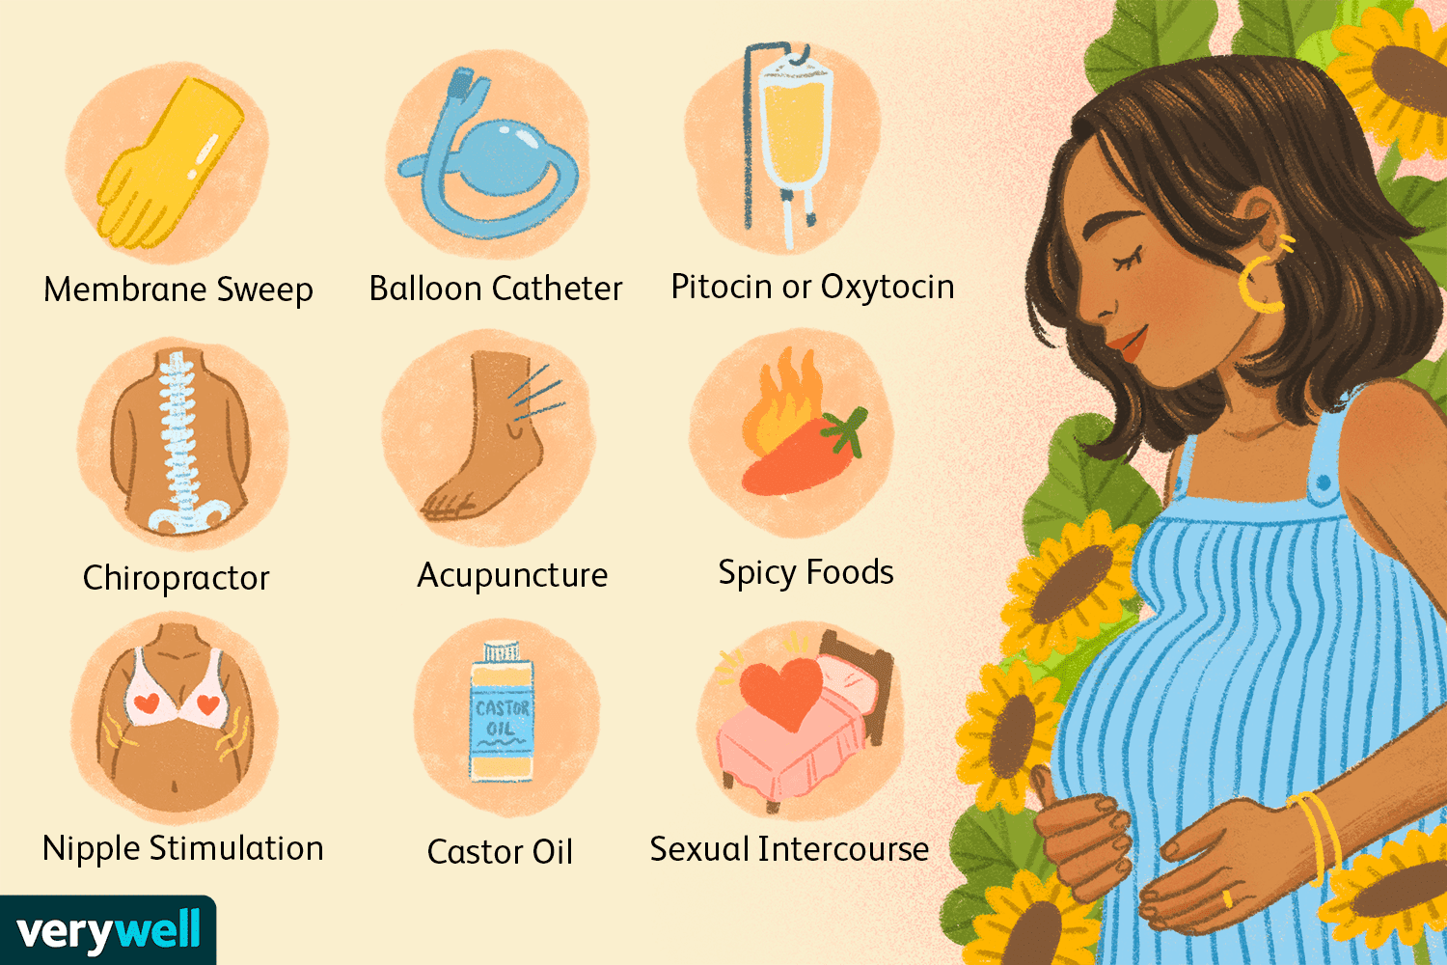
Other methods

Slide 36


