Slide 1
Infectious diseases in pregnancy
Dr. HUDA KHALEEL AL-KhAZRAJI

Slide 2
Overview of urinary tract infection in pregnancy.
Discussion of bacterial vaginosis and group B streptococcus in pregnancy.
Chorioamnionitis: definition, diagnosis and management.
Discussion of infections that affect the fetus: HSV, VZV, Parvovirus, CMV, Rubella, Toxoplasmosis.
Aim of lecture

Slide 3
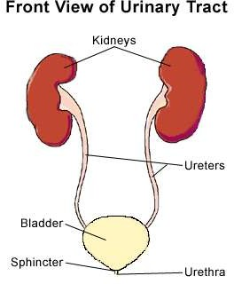
Over view of urinary tract infection in pregnancy
DEFINITION:
Urinary tract infection (UTI) is a bacterial
infection that affects the parts of urinary system.
UTIs limited to the bladder can be painful and annoying.

Slide 4
PREGNANCY AND URINARY TRACT INFECTIONS:
CHANGES IN THE URINARY SYSTEM DURING PREGNANCY
Kidney enlargement
Compression of the ureters and bladder
Incomplete emptying of the bladder
The urine is not as acidic
It contains more sugars, protein, and hormones

Slide 5
TYPES OF UTI IN PREGNANCY
Asymptomatic bacteriuria
Cystitis
Pyelonephritis

Slide 6
Acute urethritis or cystitis
It is an infection of the bladder or urethra.
The most common causative organism of UTI
Escherichia coli (E. Coli)
Other organisms may also cause UTI
Group B streptococcus, and sexually transmitted gonorrhea and chlamydia.

Slide 7
Signs and symptoms
Urinary frequency
Urinary urgency
Dysuria
Hesitancy and dribbling
Suprapubic tenderness
Gross hematuria
Accompanying symptoms with pyelonephritis usually are chills, fever, and backpain with costovertebral angle tenderness.

Slide 8
others
A strong, persistent urge to urinate
A burning sensation when urinating
Passing frequent, small amounts of urine
Blood in the urine (hematuria) or cloudy, strong-smelling urine
COMPLICATIONS:
Septicemia
ARDS
Renal abscess and scarring
Preterm labour and delivery
Increased perinatal morbidity and mortality
DIC

Slide 9
Screening
Microscopic examination shows WBC, bacteria may or may not be present.
Dip urine may be positive for nitrates and leukocyte esterase
Clean catch midstream specimen for culture and sensitivity.
Effect on pregnancy outcome
The endotoxins released from gram negative bacteria may stimulate the production of prostaglandins and thus cause preterm labour.

Slide 10
antibiotic therapy for asymptomatic bacteruria is effective in lowering the risk of pyelonephritis and preterm labour.
Usually 7-10 day course is preferred
The usual treatment is amoxicillin clavulanate( augmentin) 875 mg bd for 7-10 days
Cephalosporin
Treatment in pregnancy for asymptomatic bacteriuria and acute cystitis:

Slide 11
PREVENTION OF UTI
Drink plenty of liquids
Urinate promptly
Avoid potentially irritating feminine products
[Antiseptic creams, feminine hygiene sprays, and powders.]
Keep the genital area clean

Slide 12
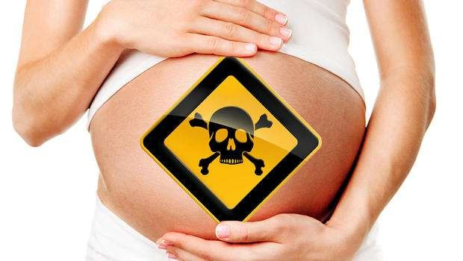
Discussion of bacterial vaginosis and group b streptococcus in pregnancy.

Slide 13
BACTERIAL INFECTIONS
GROUP B STREPTOCOCCAL INFECTION (GBS)
Organism
Streptococcus agalactiae
Risk factors for early onset neonatal GBS include:
Positive prenatal culture for GBS this pregnancy
Preterm birth of less than 37 weeks of gestation
PROM for longer than 18 hours.
Intrapartum maternal fever greater than 38°C

Slide 14
Group B streptococcus
Is a gram-positive coccus , found as a vaginal commensal in 20-40% of women.
It can cause sepsis in the neonate and transmission can occur from the time the membranes are ruptured until delivery.
Is recognized as the most frequent cause of severe early-onset (less than 7 days of age) infection in newborn infants , mortality rate is 6% in term infants and 18% in preterm infants.

Slide 15
Clinical features
The mother will not have symptoms as GBS is a common vaginal commensal .
An infected neonate may demonstrate signs of neonatal sepsis including:
Sudden collapse,
Tachypnoea,
Nasal flaring,
Poor tone,
Jaundice,

Slide 16
Management
Antenatal
Antenatal treatment and screening is not recommended as it does not reduce the colonization at the time of delivery and frequent recolonization after treatment .
Intrapartum antibiotic prophylaxis
Antibiotics (penicillin or clindamycin)60–80% effective in reducing early-onset neonatal infection.
Antibiotic prophylaxis is recommended if more than one risk factor is present.

Slide 17
Risk factors requiring prophylaxis for GBS
Intrapartum fever (>38°C).
Prolonged rupture of membranes greater than 18 hours.
GA less than 37 weeks.
Previous infant with GBS.
Detection of GBS in current pregnancy.
GBS bacteruria.

Slide 18
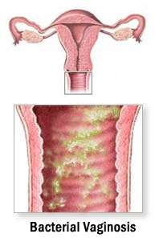
BACTERIAL VAGINOSIS

Slide 19
Organism-
Gardnerella vaginalis, Mobiluncus, Mycoplasmas hominis, Prevotella, and Atopobium vaginae.
sexual intercourse, hormonal changes, pregnancy, antibiotic administration, or use of nonoxynol-9 spermicidal products, douching.

Slide 20
Treatment
symptomatic
metronidazole (Flagyl), 500 mg orally twice daily for 7 days .
Asymptomatic
asymptomatic pregnant patients with antibiotics for bacterial vaginosis to prevent pre term labour.

Slide 21
Effect on pregnancy outcome
spontaneous abortion, premature rupture of membranes and pre term labour.
chorioamnionitis and postpartum endometritis.
May cause neonatal septicemia.

Slide 22
Chorioamnionitis
Historically, infection of the chorion, amnion, or both was termed "chorioamnionitis
Although this term remains in common use, the term "intra-amniotic infection" (IAI) is also commonly used since infection often involves the amniotic fluid, fetus, umbilical cord, or placenta as well as the fetal membranes.

Slide 23
PATHOGENESIS
Migration of cervicovaginal flora through the cervical canal is the most common pathway to IAI.
Uncommonly, the pathway to IAI is hematogenous as a result of maternal bacteremia(eg, Listeria monocytogenes) infecting the intervillous space or from contamination of the amniotic cavity as a result of an invasive procedure (eg, fetoscopy).
Infection from the peritoneum via the fallopian tubes has also been postulated but is likely rare.
Subsequent activation of the maternal and fetal inflammatory response systems generally leads to labor and/or rupture of membranes.

Slide 24
Longer length of labor and length of ruptured membranes may be the most important risk factors for IAI.
Several other obstetric factors have been associated with an increased risk for IAI, including multiple digital vaginal examinations (especially with ruptured membranes), cervical insufficiency, nulliparity, meconium-stained amniotic fluid, internal fetal or uterine monitoring, presence of genital tract pathogens (eg, sexually transmitted infections, group B Streptococcus, bacterial vaginosis), alcohol and tobacco use, and previous IAI.
An increasing number of digital examinations may be a consequence of longer labor rather than an independent risk factor, particularly prior to membrane rupture.
There is no strong evidence of an increased risk of IAI in pregnancies exposed to mechanical methods of cervical ripening versus prostaglandins; however, trials typically excluded women with ruptured membranes.
RISK FACTORS

Slide 25
CLINICAL FINDINGS
IAI often occurs in women with premature rupture of membranes (PROM) but can occur with intact membranes, especially in laboring women.
The key clinical findings, which are nonspecific, and their frequencies are as follows :
Fever (100 percent).
Maternal leukocytosis (variously defined as white blood cell count >12,000/mm³ or >15,000/mm³) (70 to 90 percent).
Maternal tachycardia >100/min (50 to 80 percent).
Fetal tachycardia >160/min (40 to 70 percent).
Uterine tenderness (4 to 25 percent).
Bacteremia (5 to 10 percent). Bacteremia is most common when IAI is associated with group B Streptococcus or Escherichia coli infection (bacteremia in 18 and 15 percent of cases, respectively).
Purulent or malodorous amniotic fluid.
IAI may be subclinical, which by definition does not present with the above clinical findings. Subclinical infection may manifest as preterm labor with intact membranes or as preterm premature rupture of membranes (PPROM).
Computerized analysis of the fetal heart rate may show reduced variability.

Slide 26
maternal sequelae
Dysfunctional labor
Localized infection – Patients with IAI who undergo cesarean delivery, which is common, are at increased risk for wound infection, endomyometritis, septic pelvic thrombophlebitis, and pelvic abscess.
●Sepsis – In a population-based study of maternal sepsis in the United States, 18 percent of cases were associated with IAI.
The risk of life-threatening maternal sequelae, such as sepsis, coagulopathy, and adult respiratory distress syndrome related to IAI are low if treatment with broad-spectrum antibiotics is initiated.
An elevated lactic acid concentration can be a sign of sepsis and is associated with an adverse maternal outcome.

Slide 27
●Fever – ≥39.0°C [102.2°F] or 38.0°C [100.4°F] to 38.9°C [102.02°F] on two occasions 30 minutes apart, without another clear source PLUS one or more of the following:
•Baseline fetal heart rate >160 beats/min for ≥10 minutes, excluding accelerations, decelerations, and periods of marked variability
•Maternal white cell count >15,000/mm³ in the absence of corticosteroids and ideally showing a left shift
•Purulent-appearing fluid coming from the cervical os visualized by speculum examination
•Histopathologic evidence of infection or inflammation or both in the placenta, fetal membranes, or the umbilical cord vessels (funisitis)
Laboratory studies should be performed on amniotic fluid obtained by amniocentesis. Histopathology is obtained after delivery.
DIAGNOSIS OF INTRA-AMNIOTIC INFECTION

Slide 28
MATERNAL MANAGEMENT
Delivery
We suggest prompt induction or augmentation of labor, as appropriate, with cesarean delivery reserved for standard obstetric indications.
In women receiving antibiotics, there is no evidence that the duration of labor correlates with adverse neonatal outcome ; therefore, cesarean delivery should be reserved for standard obstetric indications.
Cesarean delivery in the presence of IAI increases the risk of wound infection, endomyometritis, and venous thrombosis.
Postpartum care — Postpartum care is routine as IAI resolves after delivery in most women, particularly after vaginal delivery. Women with persistent fever and/or pelvic pain should be evaluated for postpartum endometritis, wound infection after cesarean delivery, and, rarely, septic pelvic thrombophlebitis.

Slide 29
FETAL AND NEONATAL OUTCOME
Adverse effects of intra-amniotic infection — Adverse fetal/neonatal outcomes include perinatal death, asphyxia, early-onset neonatal sepsis, septic shock, pneumonia, meningitis, intraventricular hemorrhage (IVH), cerebral white matter damage, and long-term disability including cerebral palsy, as well as morbidity related to preterm birth.
Overall, IAI is associated with up to 40 percent of cases of early-onset neonatal sepsis.
fetal exposure to inflammation can induce interleukin-1 production, which enhances surfactant protein and lipid synthesis thereby promoting lung maturation.

Slide 30

PREVENTION
The main strategy to prevent IAI is administration of prophylactic antibiotics to women with preterm premature rupture of membranes (PPROM), which reduces the incidence of clinical chorioamnionitis, prolongs latency, and improves neonatal outcomes.
For term PROM, we prefer delivery to expectant management with antibiotic prophylaxis.
Modifiable risk factors that pertain to the health care provider include conduct of labor (eg, minimizing the number of vaginal examinations) and use of prophylactic antibiotics in women with group B Streptococcuscolonization.

Slide 31
HSV
VSV
CMV
Parvovirus
Rubella
Toxoplasmosis
Discussion of infection that affect the fetus

Slide 32
Infections causing congenital abnormalities
Rubella
Is a togavirus spread by droplet transmission.
Cause the most sever congenital anomaly
Rubella is still common in many developing countries and worldwide; and children are born with congenital rubella syndrome (CRS).
Since the introduction of the (MMR) vaccine, rubella is now a very uncommon infection
Concerns regarding a link with the vaccine and autism in the 1990s has resulted in a significant increase in the number of susceptible pregnant women.

Slide 33
Where the vaccination programme is less established, screening may still be offered.
There is no effective intervention during the index pregnancy to reduce the risk of harm to that fetus
The aim of screening for rubella in pregnancy is to identify susceptible women so that postpartum vaccination may protect future pregnancies and should be advised to use contraception for 1 month.
Vaccination during pregnancy is contraindicated because of the risk of teratogenicity, as it is a live vaccine.
No cases of CRS resulting from vaccination during pregnancy have been reported.

Slide 34
Clinical features
Febrile rash but is asymptomatic in the mother in 20–50% of cases.
The defects caused are also less severe with more advanced gestations.

Slide 35
Features of CRS can include
Sensorineural deafness,
Congenital cataracts,
Blindness,
Encephalitis
Endocrine problems.

Slide 36
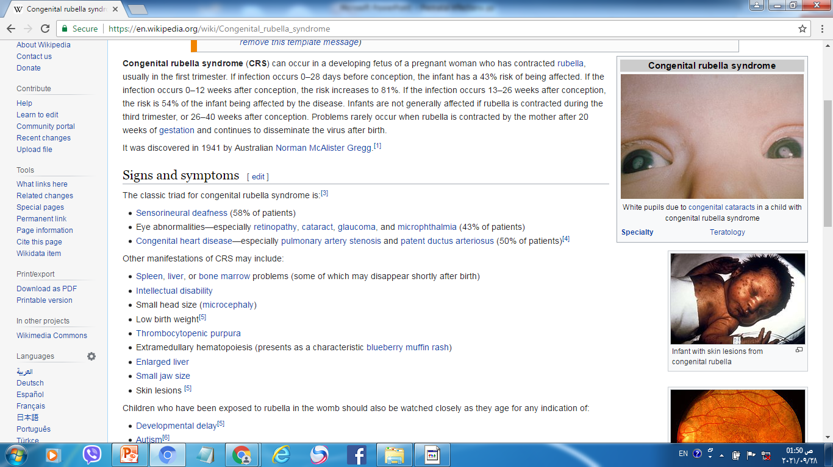

Slide 37
CRS
Up to 11 wk 100%
Up to 12 wk 80 %
16-20 wk minimal risk of deafness.
> 20 wk no documented risk to the fetus.

Slide 38
Management
If infection during pregnancy is confirmed, the risk of CRS should be assessed depending on the gestation when infection occurred.
If infection occurred prior to 16 weeks’ gestation, termination of pregnancy should be offered.
If the infection occurs later in pregnancy, the woman should be given appropriate information and reassured.

Slide 39
CMV
Is a (DNA) herpes virus.
Is the most common cause of intrauterine infection
It is transmitted by respiratory droplet and is excreted in the urine.
60% of women are seropositive for CMV when they become pregnant and consequently, approximately 40% are susceptible to infection, although there is also a risk associated with recurrent infection.
1–2 in 200 infants will be born with congenital CMV. Of these, it is estimated that 13% will have problems at birth, such as hearing and learning problems, others are asymptomatic but developing problems in later life.

Slide 40
Clinical features
Primary infection usually produces no symptoms (90%)or mild non-specific flu-like symptoms .
The abnormalities seen on USG:
FGR,
Microcephaly,
Intracranial calcification ,
Hydrocephaly,
Ascites or hydrops.

Slide 41
Primary infection is more likely to cause congenital CMV (40%) and long-term sequelae than reactivation of infection (1%).
There may not be any abnormalities detected on USG, but affected infants may later be found to have
Neurological damage such as
Blindness,
Deafness
Developmental delay.
The neonate can also be anaemic
Thrombocytopaenic,
With hepatosplenomegaly,
Jaundice
Purpural rash.

Slide 42
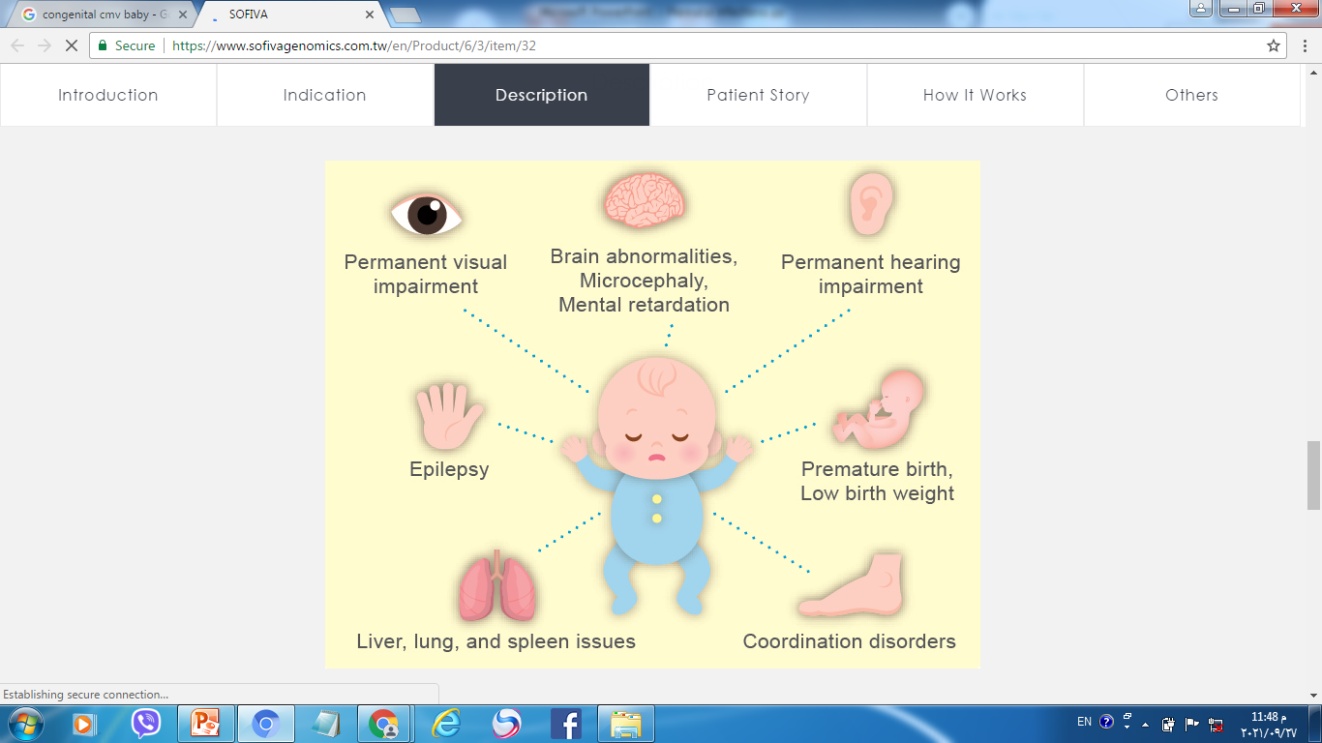
CMV

Slide 43
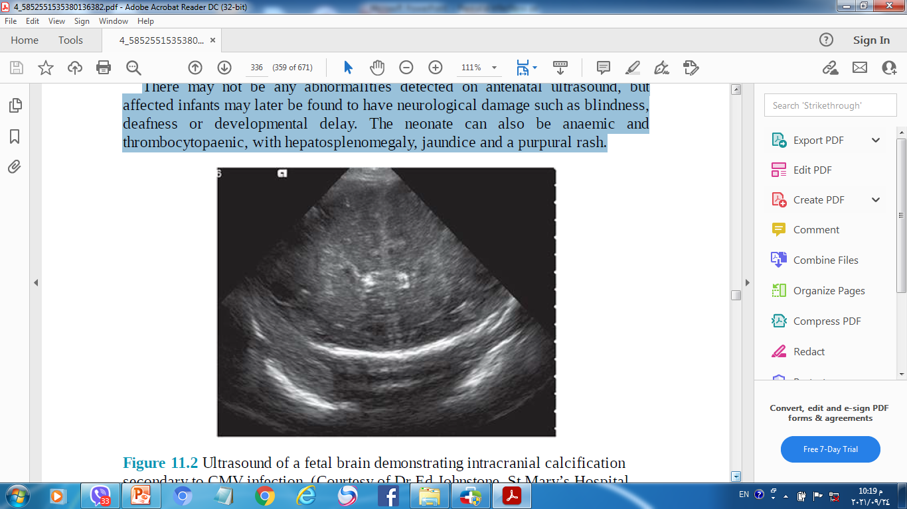
US of a fetal brain demonstrating intracranial calcification secondary to CMV infection

Slide 44
Management
It can be detected by culture of infant urine.
A serological diagnosis of primary CMV is done by demonstrating CMV Ab (initially develops IgM Ab and subsequently IgG Ab).
Since IgM can be secreted for several months, it has to be a new finding in a woman who was negative for IgM at the time of booking.
If there is a suspicion that the fetus may be infected amniotic fluid can be tested for the virus by PCR.

Slide 45
If abnormalities are detected on USG, termination should be discussed.
More difficult situation is when the fetus appears normal on USG, there is a 20% chance of neurological abnormality in this fetus.
CMV has the capacity of reactivation, it persists in the lymphocytes throughout life and can be transmitted by blood transfusion or transplantation.

Slide 46
Toxoplasmosis
Toxoplasma gondii is a protozoan parasite found in cat faeces, soil or uncooked meat.
Congenital toxoplasmosis is rare , with estimates suggesting only around 1 in every 10,000–30,000 babies are born with the condition.
Primary infection causes immunity which is life long and usually prevent reinfection
If non pregnant woman diagnosed with acute toxoplasma, pregnancy should be avoided for 6 months

Slide 47
Screening
Only about 10 severely affected babies are diagnosed / year and for this reason the screening for toxoplasmosis should not be offered routinely.
There is a lack of evidence that antenatal screening & treatment reduces mother-to-child transmission or the complications associated with T. gondii infection.

Slide 48
Preventive measure
Avoiding eating rare or raw meat;
Avoiding handling cats and cat litter;
Wearing gloves and washing hands when gardening or handling soil.

Slide 49
Clinical features
The initial infection is usually asymptomatic, or may be a fever-like illness.
Parasitaemia usually occurs within 3 weeks of infection.
Therefore, congenital infection is only a significant risk if the mother acquires the infection during or immediately before pregnancy.

Slide 50
Toxoplasmosis
1st trimester
3rd trimester
( 85% fetal damage / 10 % transmission)
( 10% fetal damage / 85 % transmission)

Slide 51
Severely infected infants may have
Hydrocephaly or microcephaly,
Chorioretinitis
Cerebral calcification.
These features be detected on USG.
The majority of infected infants are asymptomatic at birth but develop sequelae several years later.

Slide 52
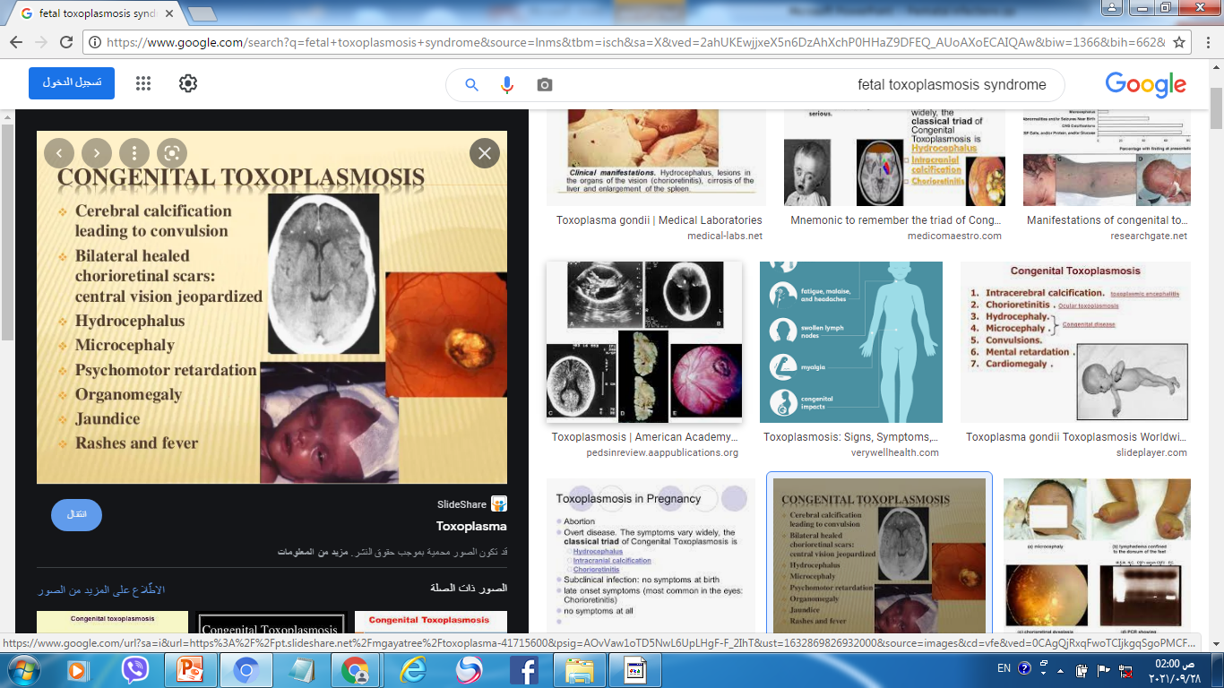
Triad of congenital Toxoplasmosis

Slide 53
Management
The diagnosis of primary infection is made by
The Sabin Feldman dye test.
Enzyme-linked immunosorbant assays (ELISAs)
Are available for IgM antibody.
IgM may persist for months or even years, so often serial testing for rising titers is necessary.
If suspicion of congenital toxoplasmosis has arisen because of an abnormal USG of the fetus, an amniocentesis can be performed by (PCR) analysis of amniotic fluid is highly accurate for the identification of T. gondii.

Slide 54
Spiramycin treatment can be used in pregnancy (for 3-week of 3 g/ day).
Treatment not been shown to definitively reduce the incidence of clinical congenital disease.
If toxoplasmosis is found to be the cause of abnormalities detected on USG of the fetus, then termination of pregnancy can be offered.

Slide 55
Chickenpox
Is caused by the varicella zoster virus, a herpes virus is transmitted by droplet
Infection during pregnancy is uncommon, (prevalence of 3/1,000 pregnancies).
Antenatal screening is not recommended , but women identified as being seronegative can consider vaccination either pre-pregnancy or in the postnatal period.

Slide 56
Clinical features
Pregnant women may develop a serious pneumonia, hepatitis or encephalitis.
The mortality rate is approximately 5 times higher in pregnant women than in non-pregnant adults.
Pneumonia occurs in about 10% of women with chickenpox and seems more severe at later gestations
It may also cause the fetal varicella syndrome (FVS) or varicella infection of the newborn( 1% of affected fetuses).

Slide 57
Management
Women should be asked whether they have had chickenpox at the initial booking visit.
If she not she should avoid contact with it.
When contact occurs with chickenpox, a careful history about significance of the contact ( as being in the same room for 15 minutes or more, or face-to-face contact).
Individuals are infectious for 48 hours prior to the appearance of the rash & until the vesicles crust over (usually 5 days).

Slide 58
Testing for immunity
If a woman reports contact with chickenpox, testing for VZV Ab should be done( 24–48)hr.
Management of the non-immune woman exposed to chickenpox
Women should be given varicella zoster immunoglobulin (VZIG) within 10 days after contact this may prevent or attenuate the disease.
Women should be asked to notify their doctor early if a rash develops.

Slide 59
Management of chickenpox in pregnancy
Women with chickenpox should avoid contact with other pregnant women and neonates until the lesions have crusted over.
Oral acyclovir 800 mg five times /day for 7 days should be prescribed for pregnant women with chickenpox ( within 24 hours of the onset of the rash).
VZIG has no therapeutic benefit once chickenpox has developed.

Slide 60
Hospital assessment should be considered if:
The woman smokes cigarettes,
Has chronic lung disease,
Taking corticosteroids
In the latter half of pregnancy,

Slide 61
The fetus
Spontaneous miscarriage does not increase if chickenpox occurs in the 1st trimester.
FVS is characterized by :
Skin scarring in a dermatomal distribution.
Eye defects (microphthalmia, chorioretinitis, cataracts).
Hypoplasia of the limbs.
Neurological abnormalities:
Microcephaly,
Cortical atrophy,
Mental restriction
Dysfunction of bowel and bladder sphincters.

Slide 62
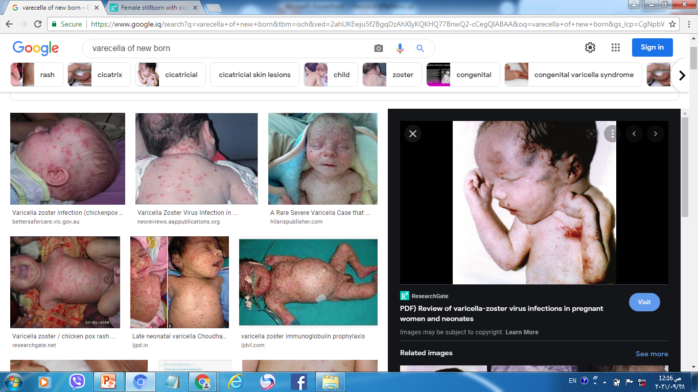
Varicella infection of the newborn

Slide 63
FVZ
Occur 1 %
Occur 3- 28 weeks
lower in the 1st trimester
No risk after 28 weeks.
USG after 5 weeks

Slide 64
Maternal infection around the time of delivery
There is a significant risk of varicella of the newborn.
Elective delivery should be avoided until 5–7 days after the onset of maternal rash to allow for the passive transfer of Ab from mother to the infant.
Neonatal ophthalmic examination should be done .
If birth occurs within the 7-day period following the onset of the maternal rash, the neonate should be given VZIG with monitoring for signs of infection until 28 days after the onset of maternal infection.
Neonatal infection should be treated with acyclovir .
VZIG is of no benefit once neonatal chickenpox has developed.

Slide 65
Other congenital infections associated with pregnancy loss and PTL
Parvovirus ( 5th disease)
B19 is a relatively common infection in pregnancy
Transmitted through respiratory droplets
Immunity occurs in 50% of women of childbearing age and therefore 50% are susceptible to infection during pregnancy.
It occurs most commonly in those pregnant women who work with young children (teachers).
Routine screening is not recommended as there are no treatment or prevention methods to protect the baby from being infected.

Slide 66
Clinical features
(20–25%) cases are asymptomatic or produce symptoms of a mild flu-like illness and/or arthropathy.
In children asymptomatic in 50% it usually causes a characteristic rash (slapped cheek syndrome).
Transplacental transmission rate (15– 35)% and the fetus is most vulnerable if infected in the 2nd trimester.
In most fetuses, there will be spontaneous resolution with no long term consequences, but the infection can cause an aplastic anaemia.
The fetus may become hydropic due to high output HF and liver congestion, this is the most common presentation and is seen on USG scan.

Slide 67
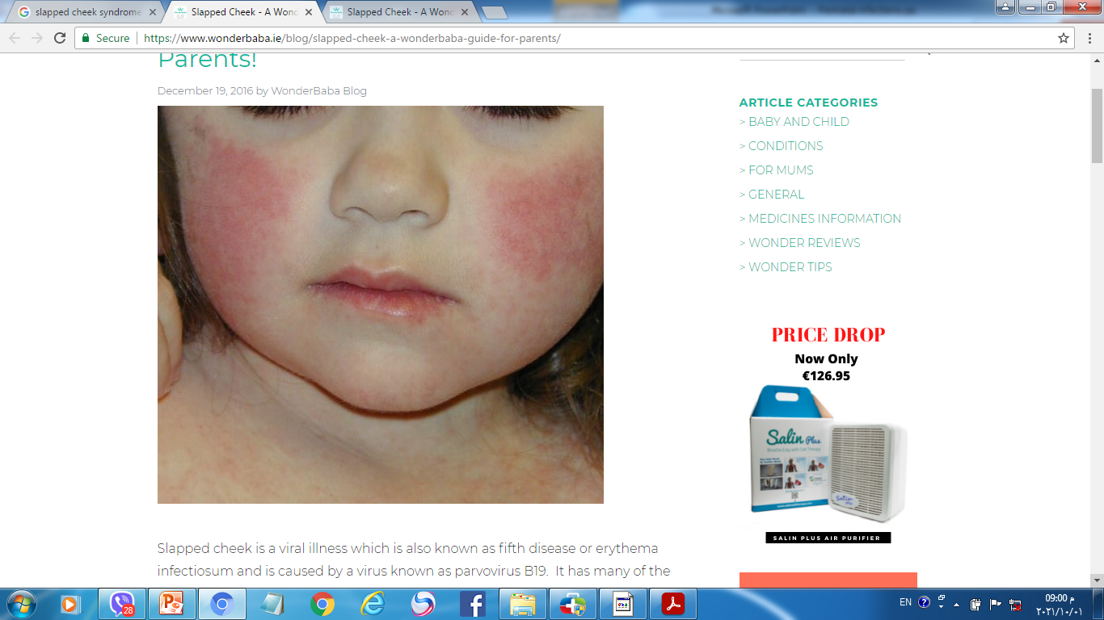
(slapped cheek syndrome(Parvovirus

Slide 68
Management
Demonstrating Ab of the mother, who develops IgM to PVB19, having previously tested negative ( PCR in maternal and fetal serum or amniotic fluid).
A hydropic fetus may recover spontaneously as the mother and fetus recover from the virus, or may require treatment by in utero transfusion(in the first 20 weeks of pregnancy this treatment is not possible) so the fetal loss rate is 10%.
Parvovirus does not cause neurological damage, and if the fetus survives the anaemia, the outcome is usually normal.
After 20 weeks’ the fetal loss is 1%.

Slide 69
Herpes simplex virus
simplex virus is a member of the herpes virus family. It is a DNA virus
Transmission is through intimate mucocutaneous contact. It is one of the most contagious sexually transmitted diseases (STDs).

Slide 70
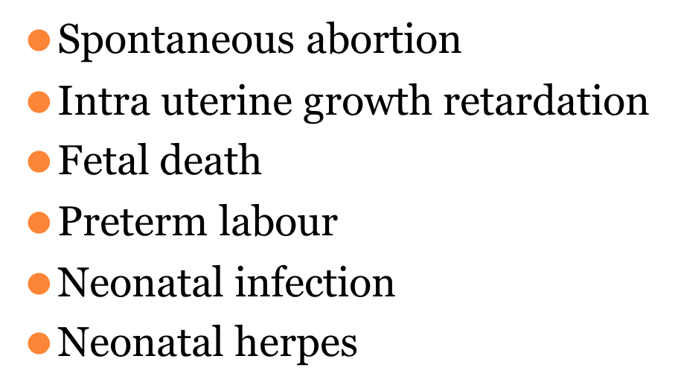
Significance:

Slide 71
Management
Acyclovir administered 200mg, four times daily for 14 days.
Topical application of acyclovir cream
Severe infections : IV administration of Acyclovir 5 mg/kg body weight/ 8 hourly for 5 days.

Slide 72
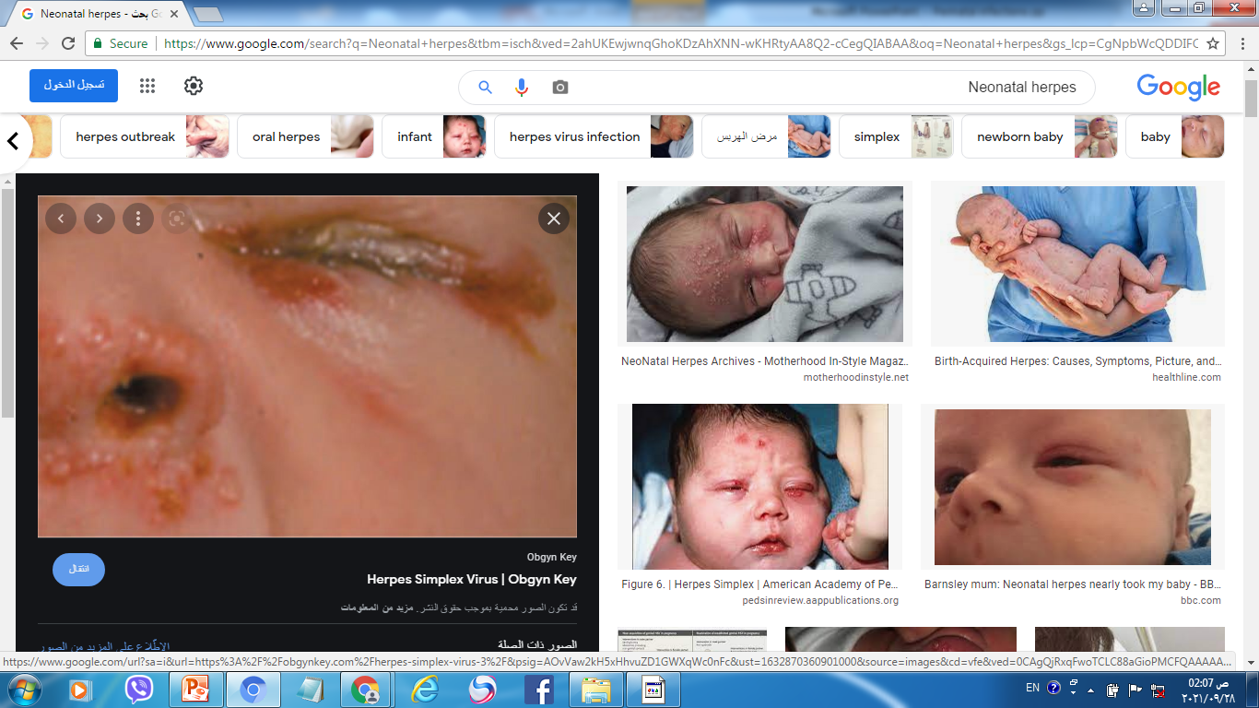
Neonatal herpes

Slide 73
The risks are greatest when :
Primary genital herpes
In the 3rd trimester,
Within 6 weeks of delivery,
The baby is likely to be born before the development of protective maternal Ab.

Slide 74
Management
A swab for viral detection .
Confirm the diagnosis by viral culture or PCR,
Screen for other STD.
The use of acyclovir is recommended (400 mg tid) and is associated with a reduction in the duration and severity of symptoms, it is well tolerated and considered safe in pregnancy.

Slide 75
For women presenting within 6 weeks of expected delivery, type-specific HSV Ab testing is advisable.
The presence of Ab of the same type as the HSV isolated from genital swabs would confirm this episode to be a recurrence rather than a primary infection and elective CS would not be indicated to prevent neonatal transmission.

Slide 76
Primary infections
There is no evidence that HSV acquired in pregnancy is associated with an increased incidence of congenital abnormalities.
Suppressive acyclovir from 36 weeks of gestation reduces HSV lesions at term and hence the need for delivery by CS.
CS should be the recommended mode of delivery for:
All women developing 1st episode genital herpes
In the 3rd trimester,
Those developing symptoms within 6 weeks of expected delivery, as the risk of neonatal transmission of HSV is very high at 40%.

Slide 77
For women who opt for a vaginal birth, avoid:
Rupture of membranes
Invasive procedures, such as fetal scalp electrodes or fetal scalp pH measurement
Intravenous acyclovir given intrapartum to the mother and subsequently to the neonate may be considered.

Slide 78
Recurrent episodes
During the antenatal period is not an indication of CS.
At the onset of labor should be advised that the risk to the baby of neonatal herpes is very small (1–3%).
Daily suppressive acyclovir 400 mg tid should be considered from 36 weeks’ gestation.
Ruptured membranes at term should be advised to expedite delivery by the appropriate means.
Invasive procedures in labor should be avoided.
The neonatologist should be informed at the time of labor.

Slide 79
Thank you

