Slide 1

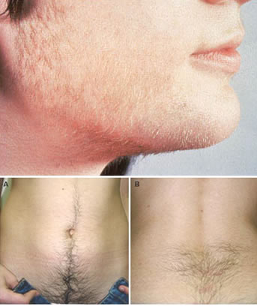
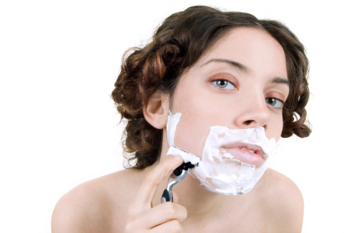
Hirsutism& virilism& hyperprolactinemia
By: dr. huda al-khazraji

Slide 2
Hirsutism
Definition :
Excessive growth of thick terminal hair in a male distribution in women (upper lip, chin, chest, back, lower abdomen, thigh, forearm).
Most common presentation of endocrine disease.
DD: Hypertrichosis, which is generalised excessive growth of vellus hair.
The aetiology is androgen excess

Slide 3
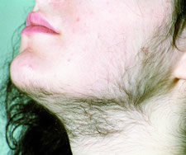
Causes
Hirsutism arises from excess male hormones called androgens.
📌 Prevalence: Affects ~5–10% of women of reproductive age.
📌 Most common cause: PCOS (~80%).

Slide 4
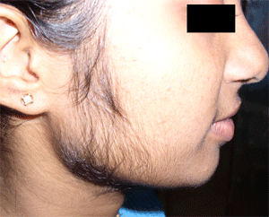
Pathophysiology
Androgens (Testosterone, DHEAS, Androstenedione) stimulate hair follicle transformation from vellus to terminal hair.
Sources of androgens:
Ovaries (Testosterone, androstenedione).
Adrenal glands (DHEAS).
Peripheral conversion (5α-reductase activity → DHT).
Hair growth is influenced by:
Ovarian sources (PCOS, tumors).
• Adrenal sources (CAH, Cushing’s, adrenal tumors).
• Peripheral conversion (increased 5α-reductase activity).
.

Slide 5
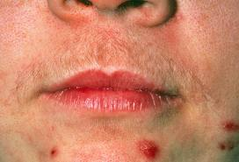
Symptoms of Hirsutism include:
Irregular menstrual periods
Acne
Loss of feminine body shape
Signs of masculinity in females
Signs of masculinity are the main symptom of this disease (particularly the growth of dark and coarse hair on the face, chest, and back.)

Slide 6
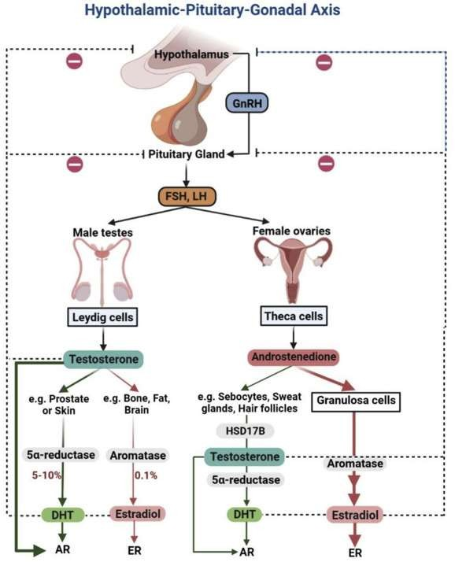

Slide 7
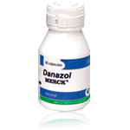
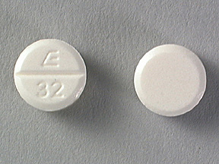
A. Common Causes
1. Polycystic Ovary Syndrome (PCOS) (Most common – 70–80%)
• Chronic anovulation, hyperandrogenism, insulin resistance.
2. Idiopathic Hirsutism
• Normal ovulation, normal androgen levels, increased 5α-reductase activity.
B. Less Common Causes
3. Non-classic Congenital Adrenal Hyperplasia (NCCAH)
• 21-hydroxylase deficiency → ↑ adrenal androgens.
4. Androgen-Secreting Tumors
Ovarian (Sertoli-Leydig, granulosa-theca cell).
Adrenal (adrenocortical carcinoma).
: Rapid onset, virilization, severe hirsutism.
5. Cushing’s Syndrome
• Excess cortisol → increased androgen production.
6. Hyperprolactinemia
• Prolactin-induced androgen excess.
7. Medications
• Anabolic steroids, danazol, minoxidil, phenytoin, cyclosporine.

Slide 8
Clinical approach The severity of hirsutism is subjective Important observations are – Drug and menstrual history Calculation of BMI Measurement of BP Examination for virilisation (clitoromegaly, deep voice, male-pattern balding, breast atrophy) Acne vulgaris Cushing's syndrome When recent & with virilisation, suggestive of a rare androgen-secreting tumour

Slide 9
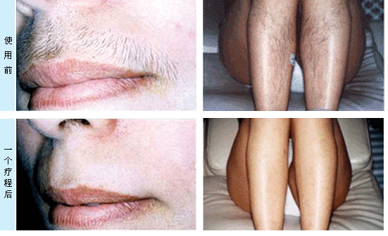

Slide 10
One method of evaluating and quantifying Hirsutisnm is the Ferriman-Gallwey score.
This is a representation of hair growth in a male pattern on a woman shown in four different degrees of severity in 9 different body parts.
The 9 body parts are:
Upper lip
Chin
Chest
Upper back
Lower back
Upper abdomen
Lower abdomen
Upper arms
Thighs
Legs
Forearms
*Legs and forearms used to be a part of the Ferriman-Gallwey score but are no longer included.

Slide 11
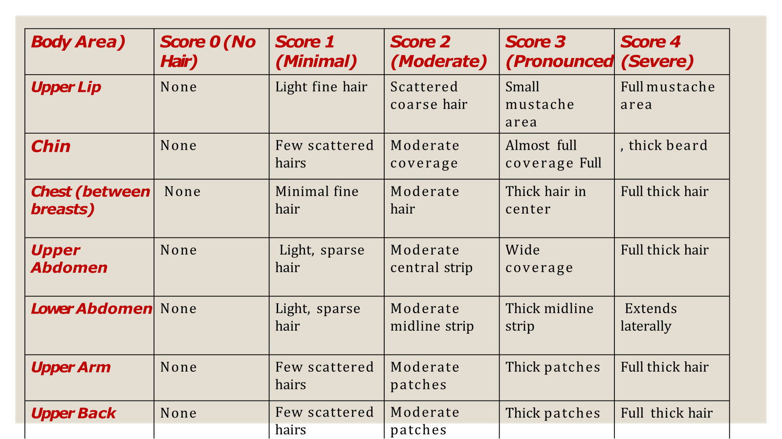

Slide 12
Body Area | Score 0 (No Hair) | Score 1 (Minimal) | Score 2 (Moderate) | Score 3 (Pronounce d) | Score 4 (Severe)
Lower Back | None | Few scattered hairs | Moderate patches | Thick patches | Full thick hair
Thighs | None | Few scattered hairs | Moderate patches | Thick patches | Full thick hair

Slide 13
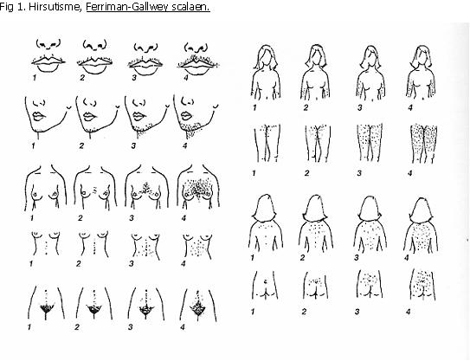

Slide 14
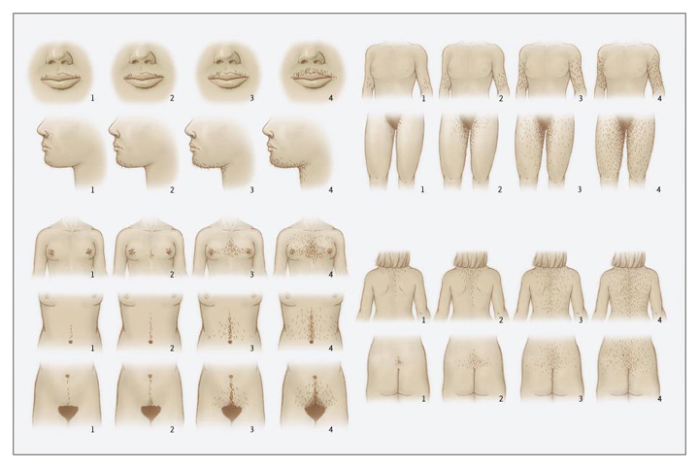
The numbers are added up to a maximum count of 36.
A final tally of 6 or more is enough to indicate Hirsutism

Slide 15
DX. Approach.
Step 1: History
• Onset: Gradual (PCOS) vs. Sudden (Tumor).
• Menstrual history: Oligo/amenorrhea? (PCOS, CAH)
• Family history: CAH, PCOS?
• Drug history: Anabolic steroids?
Step 2: Physical Exam
• Hirsutism severity (FGS score).
• Signs of virilization: Voice deepening, clitoromegaly.

Slide 16
Investigations
Treatment:
Cosmetic measures - shaving, bleaching and waxing
Electrolysis and laser treatment : for small areas
Eflornithine cream : Inhibits ornithine decarboxylase in hair follicles & may reduce hair growth
Weight reduction for obese patients with PCOS
Anti-androgen therapy
The life cycle of hair follicles is at least 3 months, so no improvement is likely before this. Only replacement hair growth is suppressed.
Insulin-sensitising drugs (thiazolidinediones and biguanides)
Androgen receptor antagonists
Cyproterone acetate
Spironolactone
5 α-reductase inhibitors (prevents conversion of testosterone to active form)-
Finasteride
Suppress ovarian steroid production and elevate SHBG (sex hormone-binding globulin )
Oestrogen (+ Cyproterone acetate)
Suppress adrenal androgen production-
Glucocorticoids
• Total Testosterone (>150 ng/dL → tumor).
• DHEAS (Elevated → adrenal source).
• 17-Hydroxyprogesterone (Elevated → CAH).
• Prolactin (Elevated → Prolactinoma).
• Cortisol levels (Cushing’s screening).

Slide 17
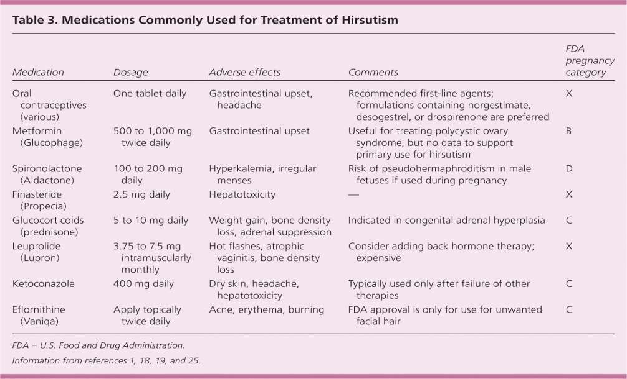
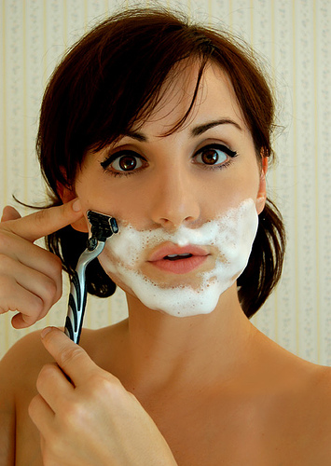

Slide 18
VIRILISIM
Virilism refers to the development of male secondary sexual characteristics in a female
or prepubertal child due to excess androgen production.
Pathophysiology:
Caused by excess androgens: testosterone, DHEA, androstenedione.
Source of androgens:
Adrenal glands (e.g., adrenal tumors, congenital adrenal hyperplasia)
Ovaries (e.g., Sertoli–Leydig cell tumors, PCOS)
Exogenous intake of anabolic steroids

Slide 19
Etiology
Adrenal causes:
Adrenal adenoma/carcinoma
Congenital adrenal hyperplasia (21-hydroxylase deficiency)
Ovarian causes:
Polycystic ovary syndrome (PCOS) — most common
Ovarian tumors (Sertoli–Leydig, theca cell tumors)
Iatrogenic:
Anabolic steroid use

Slide 20
Clinical Features
Hirsutism
Deepening of voice
Clitoromegaly
Temporal balding
Increased muscle mass
Acne
Amenorrhea or oligomenorrhea
Note: Distinguish hirsutism (excess terminal hair) from virilism (signs of overt masculinization
Diagnostic Work-up
Serum testosterone
DHEA-S (adrenal source if elevated)
LH/FSH (PCOS: LH/FSH >2)
Imaging:
Adrenal CT/MRI
Pelvic ultrasound/MRI
17-hydroxyprogesterone (CAH screening)
Imaging tests, like an ultrasound, CT (computed tomography) scan or MRI (magnetic resonance imaging) to get a better look at your adrenal glands or ovaries.

Slide 21
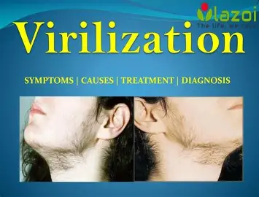
Management
Treat underlying cause
Tumors → surgical removal
CAH → corticosteroids
PCOS → lifestyle + hormonal therapy (OCPs, antiandrogens like spironolactone)
Cosmetic treatments: laser hair removal, eflornithine

Slide 22
Hyperprolactinemia
Prolactin (PRL) is a polypeptide protein hormone secreted by the lactotroph cells in the anterior pituitary gland .
Suppressed by hypothalamic dopamine to act on Lactotroph D2 receptors .
Prolactin (PRL) is the hormone act as stimulation & maintenance of milk production in the breast .
Definition:
Hyperprolactinemia is a condition characterized by elevated serum prolactin levels, often causing
menstrual disturbances and galactorrhea
Stimulated by:
Estrogen
TRH
Stress
Nipple stimulation

Slide 23
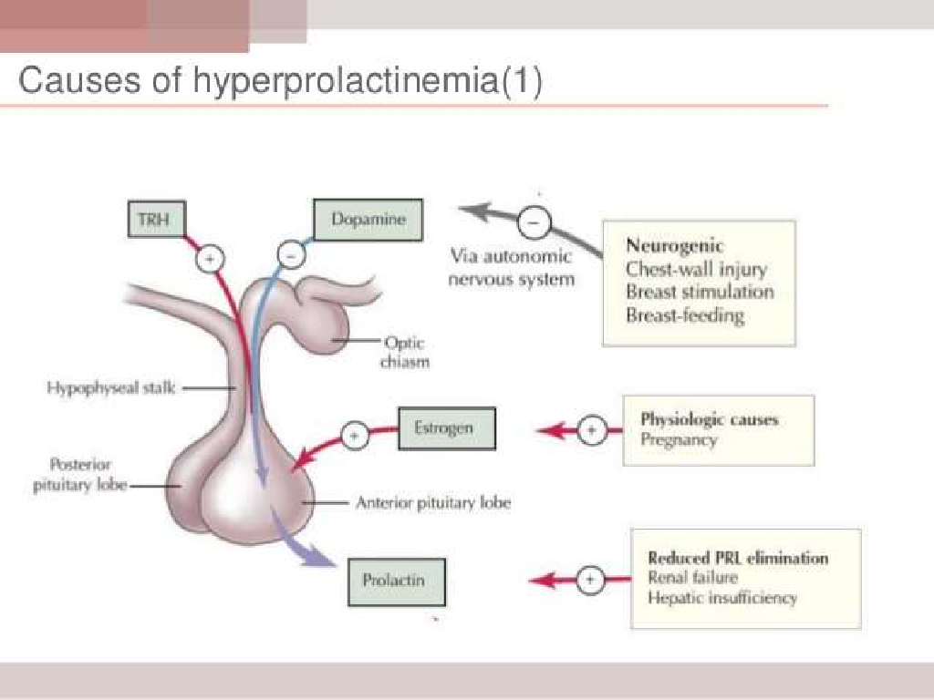

Slide 24
Causes
Clinical Features:
Women:
Galactorrhea
Amenorrhea or oligomenorrhea
Infertility
Men:
Decreased libido
Erectile dysfunction
Gynecomastia
Mass effect symptoms (if macroadenoma):
Headache
Visual field defects (bitemporal hemianopia)
Physiological:
Pregnancy
Lactation
Sleep
Stress
Pharmacological:
Antipsychotics (e.g., risperidone, haloperidol)
Antidepressants (TCAs, SSRIs)
Methyldopa, verapamil
Pathological:
Prolactinoma (pituitary adenoma)
Hypothyroidism (↑ TRH stimulates prolactin)
Chest wall trauma
Chronic renal failure

Slide 25
INVESTEGATION&TREATEMENT
Serum prolactin level
TSH and free T4
Pregnancy test (β-hCG)
Renal and liver function
MRI of the pituitary (if prolactin >100 ng/mL or mass suspected)
RX.
Dopamine agonists:
Cabergoline (preferred — fewer side effects)
Bromocriptine
Surgery (transsphenoidal resection):
For large prolactinomas not responding to medical therapy
Radiotherapy: Rarely used, for aggressive tumors

Slide 26

THANKS

