Slide 1
Puerperium
Dr. Alyaa Alrubaye
8/3/2026

Slide 2
Learning Objectives
• Understand the physiological changes that occur in the normal puerperium.
• Understand the common disorders and how to manage them.
• Understand the process of breastfeeding and common disorders associated with it.

Slide 3
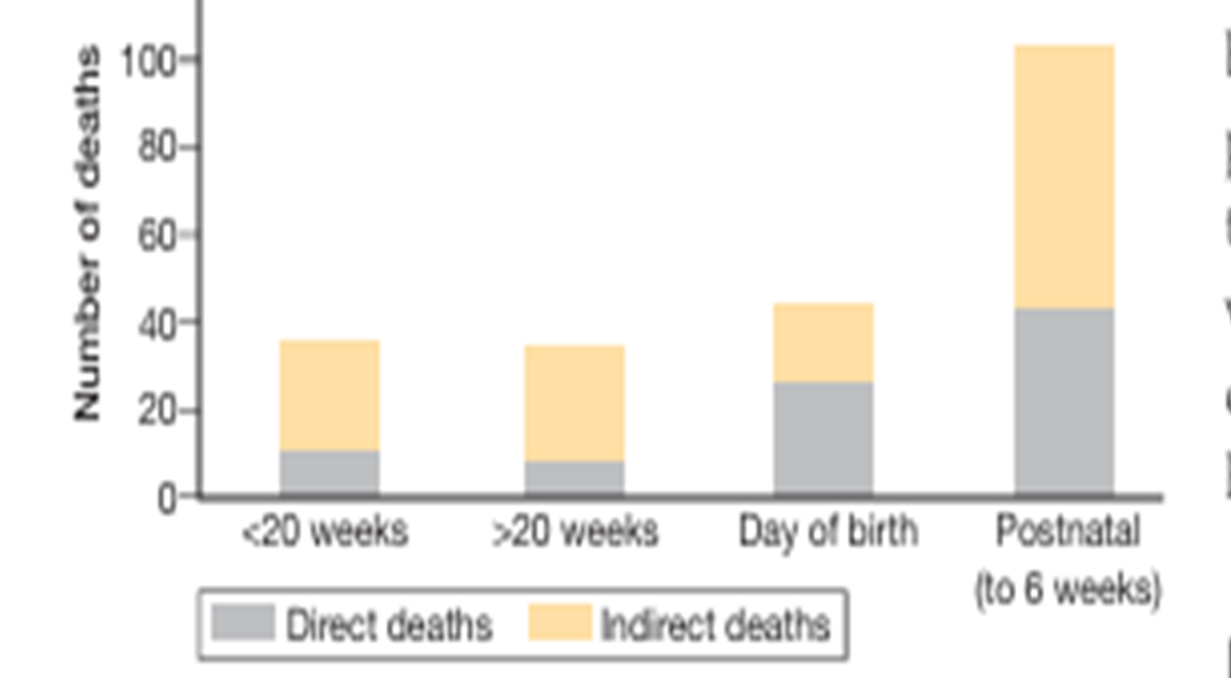
The puerperium refers to the 6-week period following completion of the 3rd stage of labour until return to the pre-pregnant state.
Some times , this period consider dangerous, and maternal deaths may occur.
During this period , the mother is also susceptible to psychological disturbances.
The time of maternal deaths in the UK

Slide 4
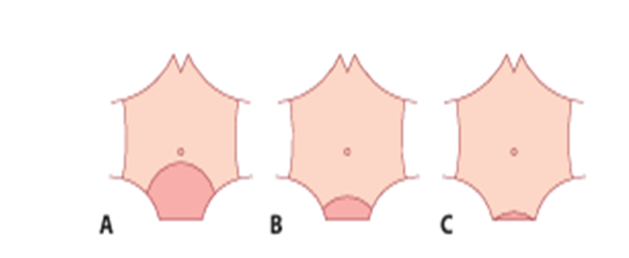
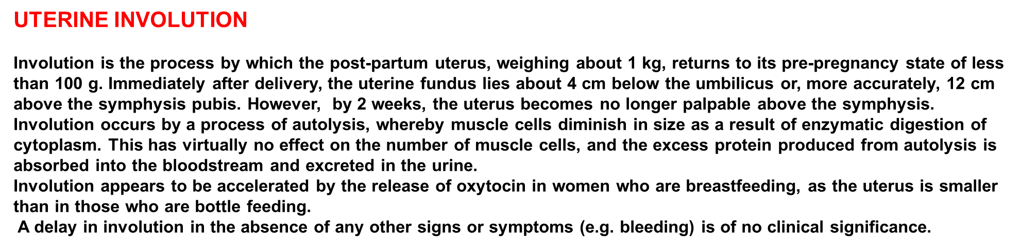
INTRODUCTION
The puerperium refers to the 6-week period following completion of the third stage of labour, when considerable adjustments occur before return to the
pre-pregnant state.
Involution of the uterus.
Day 1: 18-week sized uterus (just below the umbilicus).
(B) Day 7: 14-week sized uterus.
(C) Day 14: 12-week-sized uterus.

Slide 5
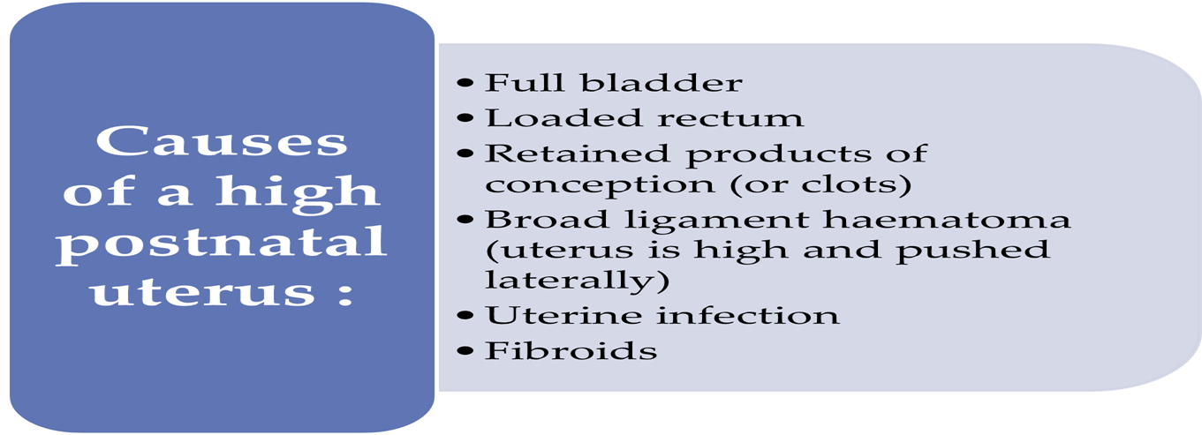
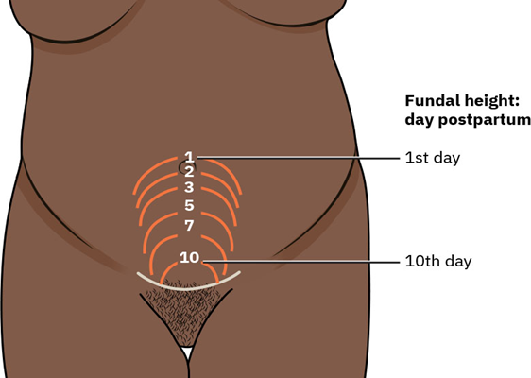

Slide 6
GENTAL TRACT CHANGES
In the 1st few days, the cervix can readily admit 2 fingers;
By the end of the 1st week it is difficult to pass more than 1 finger,
By the end of the 2nd week the internal os should be closed.
The external os can remain open permanently, giving a characteristic funnel shape to the parous cervix.
Assessment of the postnatal cervix is important in diagnosing retained products of conception
LOCHIA
Lochia is postnatal blood-stained uterine discharge comprising blood and necrotic decidua. Only the superficial layer of decidua becomes necrotic and is sloughed off. The basal layer adjacent to the myometrium is involved in the regeneration of new endometrium and this regeneration is complete by the third week. During the first few days after delivery, the lochia is red (lochia rubra) and this gradually changes to pink as the endometrium is formed. By the second week, the discharge becomes serous (lochia serosa) and then finally turns to a scanty yellow-white discharge (lochia alba) that lasts for about 1 month. Persistent red lochia suggests delayed involution that is usually associated with infection or a retained piece of placenta.

Slide 7
RECOVERY AFTER CHILDBIRTH
RECOVERY AFTER NORMAL BIRTH
The main physical effects are on the perineum, bladder and bowel.
PERINEAL PAIN
Perineal discomfort is a common problem for mothers. About 80% complain of pain in the first 3 days
after delivery.
A number of non-pharmacological and pharmacological therapies have been used with varying degrees of success.
1. local cooling (with crushed ice, witch hazel or tap water)
2. topical anesthetics, such as 5% lignocaine gel.
3. Analgesia like paracetamol. If necessary, diclofenac given rectally or orally.
Codeine derivatives are best avoided, as they cause constipation in the mother and drowsiness in some breastfed babies.

Slide 8
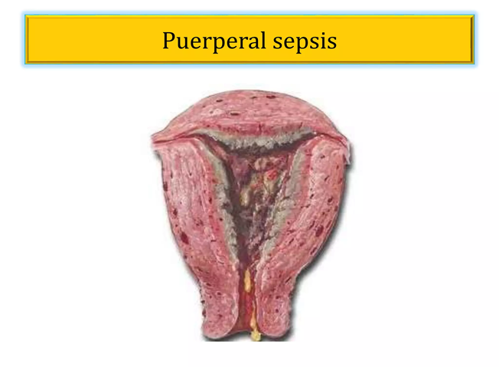
The perineum should be kept clean.
Infections are uncommon. However, all women should be asked about perineal pain, discharge, swelling and signs of infection (redness, pain, swelling and heat), especially with a raised temperature.
# Swabs for microbiological culture should be taken from the infected perineum, and broad-spectrum antibiotics should be given.
# If there is a collection of pus, drainage should be encouraged.
# Spontaneous opening of repaired perineal tears and episiotomies is usually the result of secondary infection.
# Surgical repair should never be attempted in the presence of infection.
# The wound should be irrigated twice daily and healing allowed to occur by secondary intention.
# If there is a large, gaping wound, secondary repair should be performed only when the infection has cleared, there is no cellulitis or exudate present, and healthy granulation tissue can be seen.

Slide 9
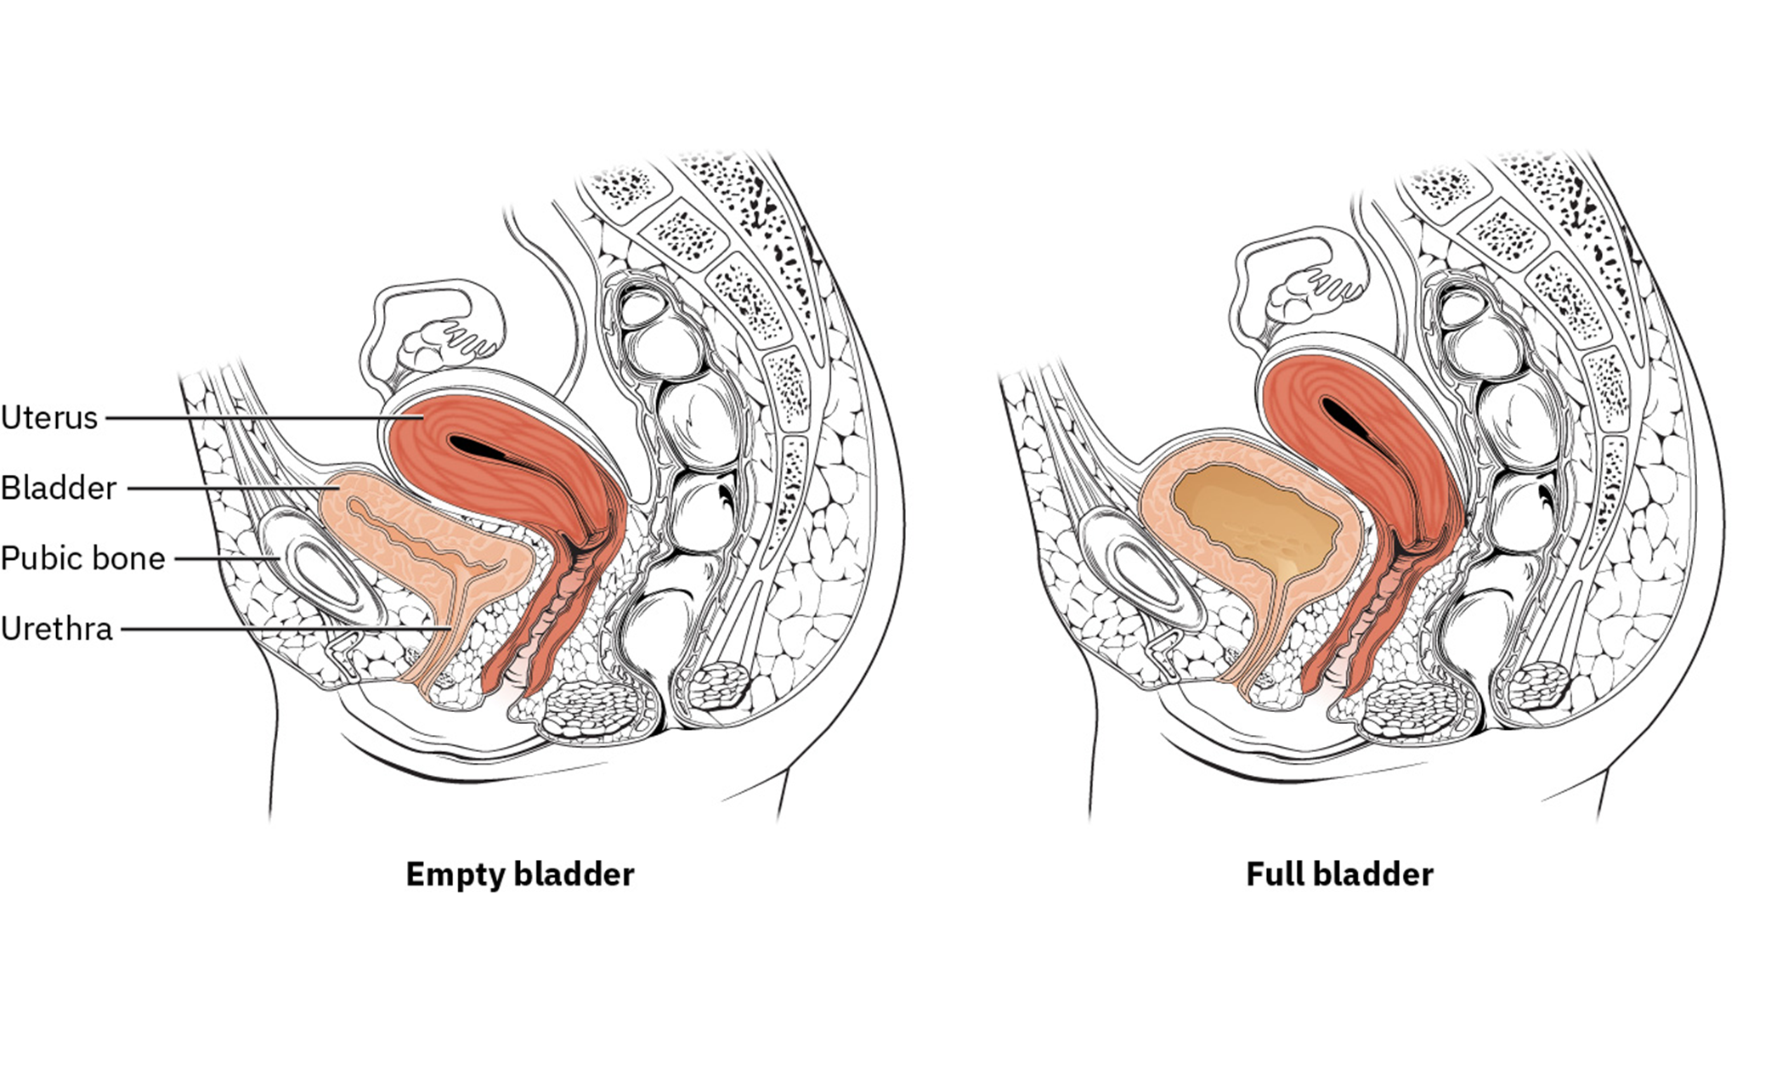
BLADDER FUNCTION
Voiding difficulties and over distension of the bladder are not uncommon after childbirth,
especially if regional anaesthesia used.
After epidural anaesthesia the bladder may take up to 8 hours to regain normal sensation.
During this time, about 1 liter of urine may be produced.
Urinary retention may damage the detrusor muscle.
Overstretching of detrusor muscle can dampen bladder sensation and make the bladder hypocontractile.
Overflow incontinence of small amounts of urine may erroneously be assumed to be normal voiding.

Slide 10
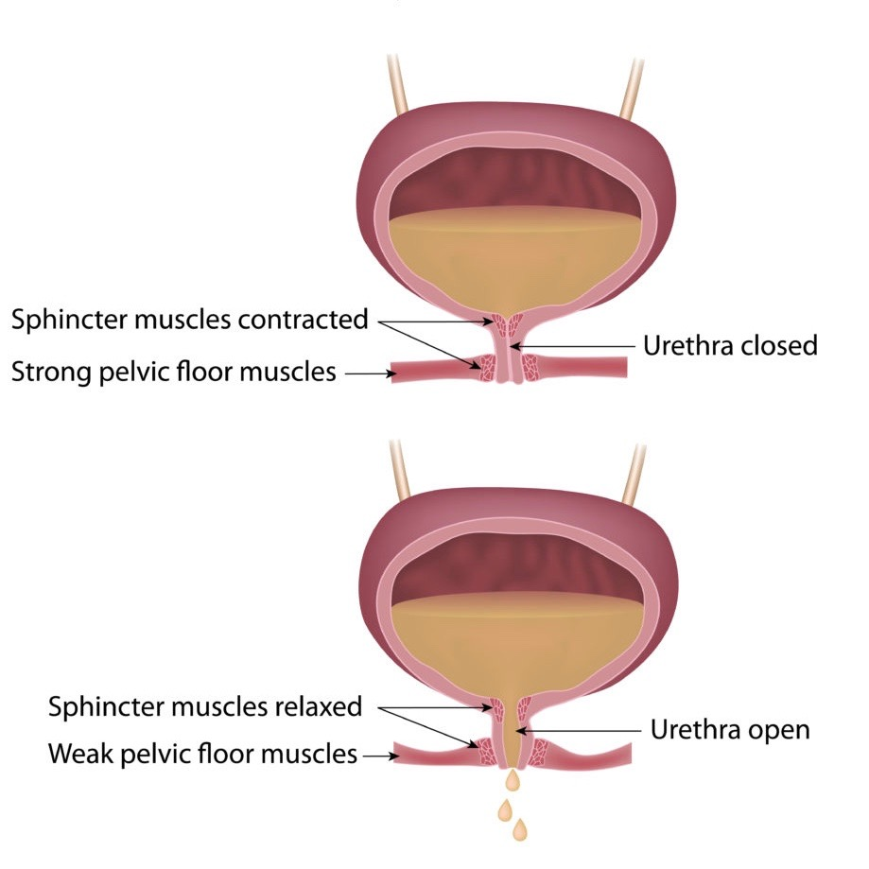
Causes of increased urine production in puerperium:
Fluid loading prior to epidural analgesia.
The antidiuretic effect of high concentrations of oxytocin during labour,
Increased post-partum diuresis (particularly in the presence of peripheral oedema).
Increased fluid intake by breastfeeding mothers.
Causes of difficult to void:
1. Traumatic delivery, such as a difficult instrumental delivery.
2. Multiple/extended lacerations or a vulvovaginal haematoma because of pain or periurethral oedema.
3. Other causes of pain, such as prolapsed haemorrhoids, anal fissures, abdominal wound haematoma or even stool impaction of the rectum may interfere with voiding.

Slide 11
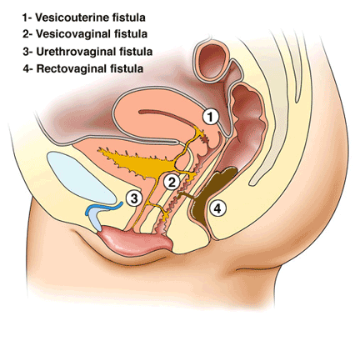
A distended bladder either would be palpable as a suprapubic cystic mass or may displace the uterus laterally or upwards, thereby increasing the height of the uterine fundus.
A formal assessment of bladder function is best made 6 hours postnatally, at which time the woman should have passed
at least 300 mL of urine. If, after another attempt, they have passed less than that (or none at all),
then a small intermittent catheter can be inserted, which should drain less than 150 mL.
Those with more than this need close observation, but if there is over 1 liter of urine in the bladder then an indwelling catheter is left in for 48 hours to allow periurethral swelling to settle.

Slide 12
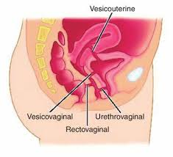
To minimize the risk of overdistension of the bladder
in women who have had a spinal anesthetic, a urinary catheter is left in the bladder for at least 12 hours until the woman is mobile.
Prolonged pressure of the fetal head on the bladder or urethra causes pressure necrosis, and incontinence follows in the second week when the slough separates.
Small fistulae may close spontaneously after a few weeks of free bladder drainage; large fistulae will require surgical repair.

Slide 13
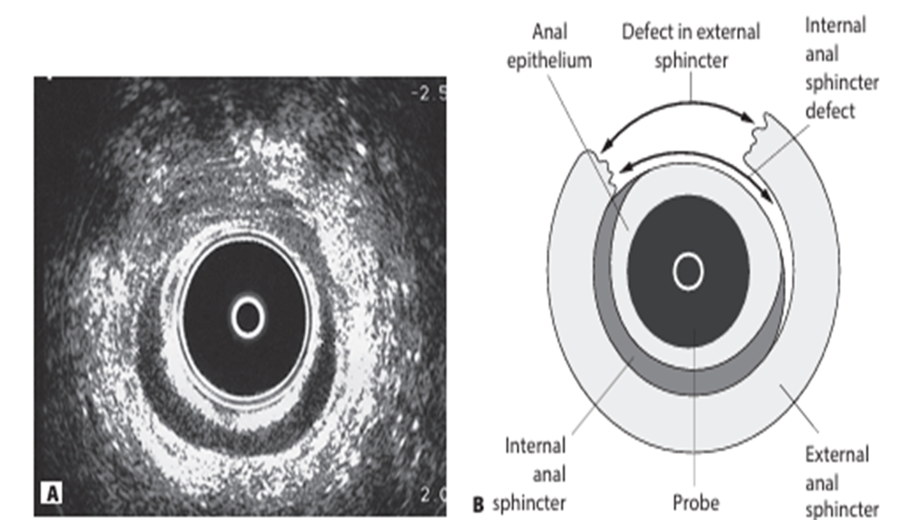
BOWEL FUNCTION
Constipation is a common problem in the early puerperium as a result of an interruption in the
normal diet, intra-partum dehydration and opiate use.
Advice on adequate fluid intake and increase in fiber intake may be all that is necessary.
However, constipation may also be the result of fear of evacuation due to pain from a sutured perineum, prolapsed hemorrhoids or anal fissures.
Avoidance of constipation and straining is of utmost importance in women who have sustained a third- or fourth degree tear.
A large, hard stool in this situation could disrupt the repaired anal sphincter and cause anal incontinence.
It is therefore important to ensure that these women are prescribed lactulose and ispaghula husk or methylcellulose immediately after the repair, for a period of 2 weeks.

Slide 14
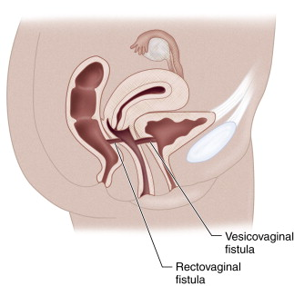
Long-term anal incontinence following primary repair of a third- or fourth-degree tear occurs in 5% of women, and anovaginal / rectovaginal fistulae occur in 2–4% of these women.
It is therefore important to consider a fistula as a cause of anal incontinence in the post-partum period, particularly if the woman complains of passing wind or stool per vagina.
Approximately 50% of small anovaginal fistulae will close spontaneously over a period of 6 months, but larger fistulae will require formal repair.

Slide 15
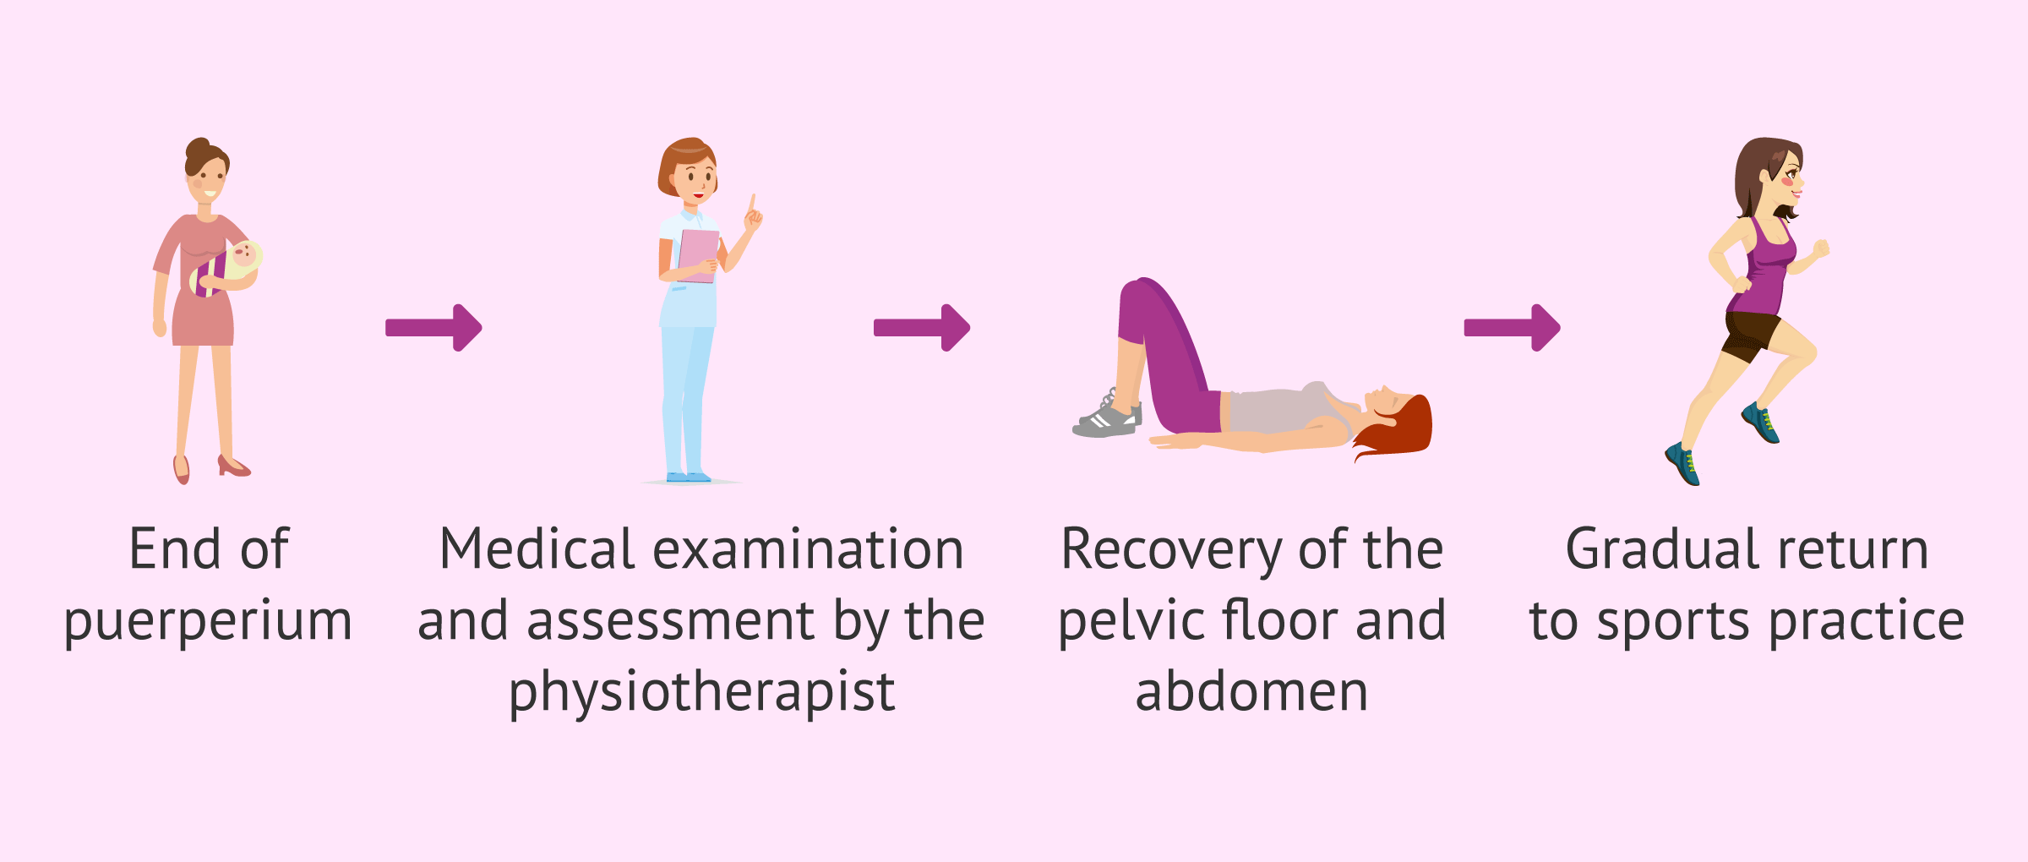
PELVIC FLOOR EXERCISES
It is a widespread belief that pelvic floor exercises tone up the muscles of the pelvic floor and should therefore be advocated in the post-partum period.
. However, as general exercise is known to strengthen striated muscle and as pelvic floor exercises are unlikely to be harmful, women are still taught postnatal exercises. This should also serve to cultivate a feeling of pelvic floor awareness, so that women with pelvic floor dysfunction seek medical help sooner.

Slide 16
RECOVERY FROM CAESAREAN SECTION
Many women now deliver their baby by caesarean section.
Although this reduces the risk of pelvic floor problems, it increases the risk of other complications including:
# infection (wound, urine and chest).
# anaemia and thromboembolism.
The infective risks are reduced by routine antibiotics at the time of caesarean section and careful wound care.
The wound should be covered by a sterile dressing in theatre,
which is removed after 24 hours.
Women are advised to gently clean and dry the wound daily with tap water.
Sutures or staples are removed on the fifth day.
Anemia is common post-operatively and, given the inaccuracy of blood loss estimation,
all women should have their haemoglobin levels measured postoperatively
(ideally on day 2 or 3). Asymptomatic women with mild to moderate anaemia
(haemoglobin >7 g/dL) can be treated with iron tablets, while the post-operative recovery of those with severe anaemia will be helped greatly by an iron infusion or blood transfusion.

Slide 17
The combination of abdominal surgery, preoperative bed rest and physiological changes in clotting makes women who have had a caesarean section particularly prone to thromboembolism.
Other risk factors include thrombophilias, immobility, previous thromboembolism, pre-eclampsia, post-partum haemorrhage (PPH), obesity, multiple pregnancy and smoking.
Early mobilization, good hydration are important for all women, with 1–6 weeks of low-molecular-weight heparin given to those with multiple risk factors. with low risk women being discharged from hospital on day 1 or 2 following caesarean section. They can resume activities such as carrying heavy items, formal exercise, sexual intercourse and driving once they have returned to their pre-caesarean section strength with no physical restrictions or pain.

Slide 18
POSTNATAL VISITS
A mother who has delivered in hospital may be discharged within 6 hours of an uncomplicated birth
(WHO recommends 24 hours ) .
More frequent visits will be required for high-risk women. At each visit, women should be specifically asked about bowel and bladder function, fatigue, headache , perineum , breastfeeding and the newborn health. Mothers who are not rubella immune should be immunized.
Routine tests at every visit are the maternal BP, PR , temp. and urinalysis. Maternal examinations should be determined by symptoms. At 2 weeks postnatally, women should be specifically asked about the resolution of the ‘baby blues’.
A postnatal examination is generally carried out at about 6 weeks’ post-partum.
WHO guidelines | NICE guidelines
Minimum 24-hour stay after facility birth | Discharged home at 6˜hours after facility birth
Home visit by health worker within 24 hours after home birth | First postnatal visit within 36 hours by midwife
Home visit at day 2 or 3 by health worker | Visit by health visitor in first 7 days if not visited antenatally
Home visit at 7–14 days by health worker | Health visitor home visit at 7–14 days
Postnatal review at 6˜weeks with health worker | General practitioner postnatal review at 6 8˜weeks

Slide 19
PUERPERAL DISORDERS
HYPERTENSION
During pregnancy, women with hypertension are carefully managed with monitoring .
After childbirth, hypertensive woman often receive less attention, even though they remain at significant risk for the 1st week.
About 50 % of all eclamptic fits occur postnatally.
Those with severe PE should be managed for the 1st 24 hours on a high-dependency unit until their BP is controlled .
Those with mild or moderate PE are managed on a postnatal ward.
They should continue any antenatally prescribed drugs ( keeping BP under 150/100 ).
Labetalol or nifedipine are commonly needed for 1–2 weeks postnatally.
At home, the BP is measured every 2 days .
Those who are still on antihypertensive 6 weeks postnatally should referred for specialist assessment
Women should be informed about 15 % recurrence risk of PE and their long-term risk of developing CVS disease .

Slide 20
Secondary post partum haemorrhage:
Is a fresh bleeding from the genital tract ( 24 hr. - 6 wks).
The most common time is (days 7 and 14 ) .
The cause is usually either endometritis or retained placental tissue .
With endometritis , the woman has constant low abdominal pain & tender uterus with closed internal os.
With retained products of conception , the woman has crampy low abdominal pain and a larger uterus, open internal os with a history of a prolonged 3rd stage of labour or passage of placental tissue or membranes.
Both endometritis and retained products may have symptoms and signs of infection with low-grade fever, pungent lochia and uterine tenderness.

Slide 21
Those bleeding heavily will require circulatory support with fluids or blood with uterotonics
(e.g. ergometrine) and uterine evacuation , antibiotics should be given if placental tissue is found .
If blood loss is not excessive, pelvic USG should be used to exclude retained products
( debris, clots and fluid are commonly found even within the normal post-partum uterus and their presence does not mean that there is retained placental tissue ).
In the absence of a clear diagnosis, expectant management with antibiotics is often used.
Other causes of secondary PPH include :
Hormonal contraception.
Bleeding disorders (e.g. von Willebrand disease) .
Choriocarcinoma.

Slide 22
OBSTETRIC PALSY (Traumatic Neuritis )
Is a condition in which one or both lower limbs develop signs of a motor and/or sensory
neuropathy following delivery.
Presenting features include sciatic pain, foot-drop, paraesthesia, hypoaesthesia and muscle wasting.
Proximal nerve damage occurs when the lumbosacral plexus & nerve compressed by the fetal head
( pelvic brim ).
It is associated with prolonged or obstructed labour, it is rare following modern labour management.
If obstetric paralysis develops following a normal labour, then epidural complications and/or herniation of lumbosacral discs should be excluded, particularly if the woman has been in an exaggerated lithotomy position for instrumental delivery.
Peroneal nerve palsy can occur when the nerve is compressed between the head of the fibula and the lithotomy pole, resulting in unilateral foot-drop.

Slide 23
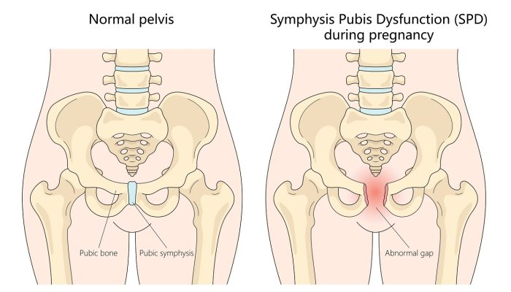
SYMPHYSIS PUBIS DIASTASIS :
Spontaneous separation of the symphysis pubis occurs in at least 1 in 800 vaginal deliveries.
It is usually noticed after delivery , associated with :
Forceps delivery
Rapid 2nd stage of labour
Severe abduction of the thighs during delivery.
Signs and Symptoms
Symphyseal pain aggravated by weight-bearing and walking.
Waddling gait. Pubic tenderness. Palpable interpubic gap.
Treatment:
Bed rest.
Anti inflammatory Agents.
Physiotherapy.
Pelvic corset to provide support and stability.

Slide 24
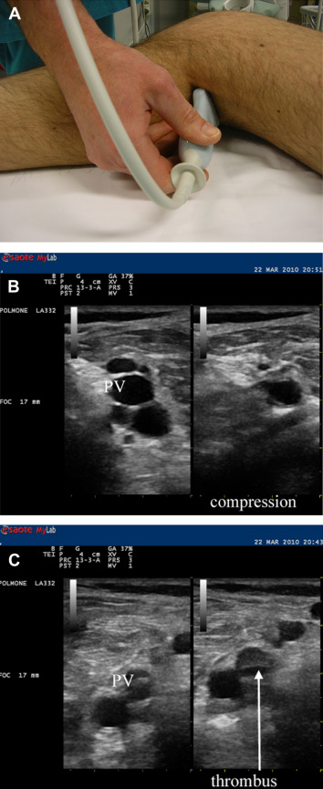
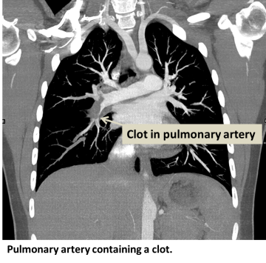
THROMBOEMBOLISM
The risk of VTE rises 5 fold during pregnancy and the puerperium.
The majority of fatal VTE occur in the puerperium and are more common after CS .
Those at high risk may be given prophylactic heparin injections.
If DVT or pulmonary embolism is suspected, the following should be carried out within 24–48 hours :
Full anticoagulant therapy
Lower limb compression ultra sound
Lung scan

Slide 25
PUERPERAL PYREXIA
Is a temperature of 38°C or higher on the 1st 10 days post-partum, excluding the 1st 24 hours.
A mildly elevated temperature is not uncommon in the 1st 24 hours, but any pyrexia associated with tachycardia require investigation.
In about 80% of women who develop a temperature in the 1st 24 hours following a vaginal delivery, no obvious evidence of infection can be identified.
The reverse holds true for women delivering by CS , when a wound infection should be considered.
Common sites of infection include chest, throat, breasts, urinary tract, pelvic organs, caesarean or perineal wounds

Slide 26
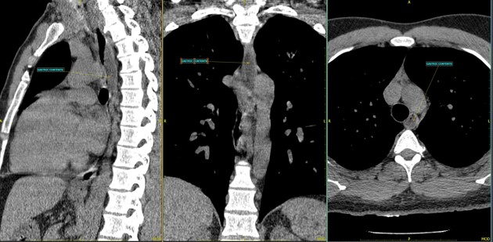
CHEST COMPLICATIONS
Are most likely to appear in the 1st 24 hours after delivery, particularly after GA.
Atelectasis associated with fever and prevented by early and regular chest physiotherapy.
Aspiration pneumonia (Mendelson syndrome) must be suspected if there is :
Spiking temperature
Wheezing,
Dyspnoea
Hypoxia
Following GA

Slide 27
GENITAL TRACT INFECTION
Was the major cause of maternal mortality.
The discovery antibiotics and improved hygiene at the time of birth resulted in a dramatic fall in maternal mortality.
Now , it is accounting for around 10% of all maternal deaths.
AETIOLOGY
A mixed flora with low virulence normally colonizes the vagina.
Puerperal infection is usually polymicrobial and involves contaminants from the bowel .
Following delivery, natural barriers to infection are temporarily removed and therefore pathogenic organisms ascend from the lower genital tract into the uterine cavity.
Placental separation exposes a large raw area , and retained products of conception and blood clots within the uterus can provide an excellent culture medium for infection.
Vaginal delivery lacerations may not need surgical repair, they can become a focus for infection .

Slide 28
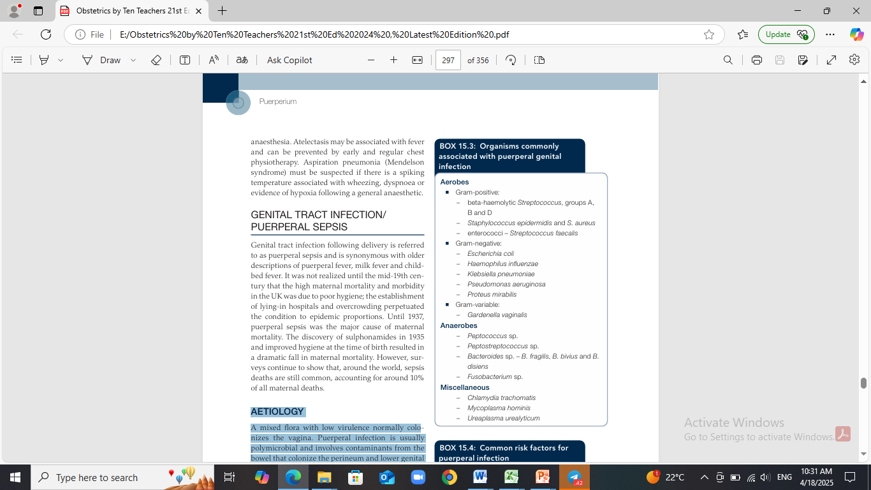
Organisms commonly associated with puerperal genital infection
Common risk factors for puerperal infection
Underlying conditions:
obesity
diabetes
human immunodeficiency virus (HIV)
Antenatal:
Chorioamnionitis
Prolonged rupture of membranes
Cervical cerclage for cervical incompetence
Intra-partum:
Prolonged labour
Multiple vaginal examinations
Instrumental delivery
CS
Manual removal of the placenta
Retained products of conception

Slide 29
PREVENTION
General hygiene, a good surgical approach and aseptic techniques have all contributed to the decline in severe puerperal sepsis.
The risk is higher following CS, PPROM , OVD , manual removal of placenta or 3rd degree tears, but can be prevented by routine prophylactic antibiotics.
For CS , a single intraoperative dose of antibiotics (penicillin or 1st -generation cephalosporin) is given before the skin incision. Antibiotic prophylaxis should also be used for those with group B Streptococcus colonization.
The risk of postnatal infection can be further reduced by vaginal cleansing with chlorhexidine or povidone-iodine prior to emergency CS
The resistant bacteria (e.g. methicillin-resistant S. aureus [MRSA]) has led some units to routinely screen all women admitted electively to the hospital.
CLINICAL PRESENTATION
The factors that determine the infection severity:
The general health of the woman,
The virulence of the organism,
The presence of haematoma or retained products of conception,
The timing of antibiotic therapy .
Tubal involvement in the form of peri-salpingitis rarely causes tubal occlusion and consequent infertility.
Tubo-ovarian abscesses are also a rare complication of puerperal sepsis.

Slide 30
The methods of spread of puerperal infection are :
An ascending infection from the lower genital tract or primary infection of the placental site may spread via the fallopian tubes to the ovaries, giving rise to a salpingo-oophoritis and pelvic peritonitis. This could progress to a generalized peritonitis and the development of pelvic abscesses.
Infection may spread directly into the myometrium and the parametrium, giving rise to parametritis.
Infection may spread to distant sites via lymphatics and blood vessels. This could give rise to a septic thrombophlebitis, pulmonary infections or generalized septicemia and endotoxic shock.
Investigations Abnormalities
Full blood count leukocytosis and thrombocytopenia
Urea and electrolytes Fluid and electrolyte imbalance
Culture of blood, sputum or breast milk
or swabs from high vagina, wound or throat Bacterial or viral culture
Chest X-ray Evidence of infection
Pelvic ultrasound Retained products and pelvic abscess
Clotting screen, (haemorrhage or shock) Disseminated Intravascular coagulation
Blood lactate Lactic acid ˝2 mmol/L (can be raised immediately after birth
so serial samples are useful)
Blood gas (arterial if respiratory effects) Acidosis and hypoxia (shock), hypoglycemia and lactic acidosis

Slide 31
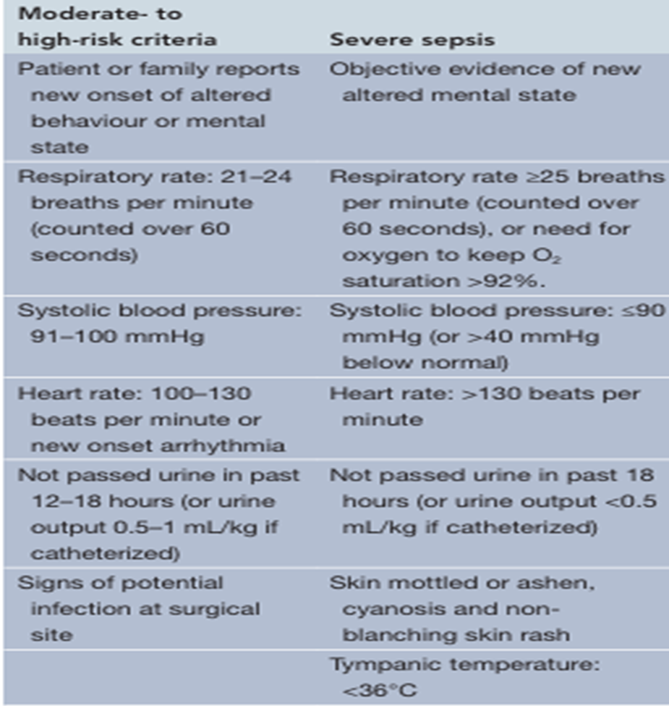
Symptoms of puerperal pelvic infection
Malaise, headache, fever and rigors
Abdominal discomfort, vomiting and diarrhea
Offensive lochia
Secondary PPH
Signs of puerperal pelvic infection
Pyrexia and tachycardia
Uterus – boggy, tender and larger
Infected wounds – caesarean/perineal
Peritonism
Paralytic ileus
Indurated adnexae (parametritis)
Bogginess in pelvis (abscess)

Slide 32
MANAGEMENT
Mild to moderate infections can be treated with a broad-spectrum antibiotic (co-amoxiclav or a cephalosporin, plus metronidazole) , depending on the severity, the 1st few doses should be given intravenously.
With severe infections, there is a release of inflammatory and vasoactive mediators in response to the endotoxins produced during bacteriolysis , local vasodilatation and poor tissue perfusion ( septicemic, septic or endotoxic shock ) .
Delay in management could be fatal and immediate high-dose, broad-spectrum antibiotics and resuscitation with IV Fluid must be provided on a high-dependency unit.
Necrotizing fasciitis
Is a rare but frequently fatal infection of the skin, fascia and muscle. It can originate in perineal tears, episiotomies and CS wounds.
Perineal infections extend rapidly to involve the buttocks, thighs and lower abdominal wall.
Anaerobes predominate and Clostridium perfringens is usually identified.
There is extensive necrosis, crepitus and inflammation.
As well as the measures usually taken to manage septic shock, wide debridement of necrotic tissue under GA is absolutely essential to avoid mortality.
Skin grafts may be necessary later

Slide 33
Sepsis management (actions to be completed within an hour)
Administer O2 (aim for oxygen saturation of 94–98%)
Take blood for culture (also for full blood count, C-reactive protein, urea and electrolytes, LFT and coagulation)
Check lactate (if > 2 mmol/L ), (lactic acidosis)
Give IVF if hypotensive .
Give intravenous antibiotics within 1 hour
Measure UOP accurately (insert catheter, use fluid balance chart)
Identify source (cultures, chest X-ray and ECG as indicated
NON-BREASTFEEDING MOTHERS
The cause may be personal preference , stillbirth or women infected with HIV
These mothers may suffer breast engorgement & pain.
Dopamine receptor stimulants, such as bromocriptine & cabergoline, inhibit prolactin and thus suppress lactation.
Both commonly cause drowsiness, hypotension, headache and GIT side effects.
Fluid restriction and a tight brassiere are effective as bromocriptine usage (the method of choice for the suppression of lactation ).

Slide 34
Blood-stained nipple discharge of pregnancy
(‘rusty pipe syndrome’) is typically bilateral and is due to epithelial proliferation.
It usually occurs in late pregnancy or early breastfeeding and lasts for up to 1 week.
Is self-limiting, no investigation or treatment is necessary.
Painful nipples ‘Sensitive nipples’
It become very sensitive during late pregnancy and in the 1st week of breastfeeding.
A common cause of this is cracked nipples and this is associated with an increased risk of breast abscess.
The cause is usually poor positioning during lactation and thrush (candidiasis) .
It may also require local antibiotic ointment, analgesics .
The milk can be expressed and the breastfeeding restarted once the nipples have healed
GALACTOCELE ( lactocele)
Is a sterile, milk-filled retention cyst of the mammary ducts following blockage by thickened secretions.
It is a fluctuant swelling with minimal pain and inflammation.
It usually resolves spontaneously by breast massage towards the nipple, but may also be aspirated; with increasing discomfort, surgical excision may become necessary.
BRAST ENGORGEMENT
Usually begins by the 2nd or 3rd post-partum day and if breastfeeding has not been established, the over-distended breasts can be very uncomfortable, resulting in a puerperal fever of up to 39°C .
Managed by manual expression, firm support, cabbage leaves, ice bags, and allowing the baby easy access to the breast is the most effective method of treatment and prevention.

Slide 35

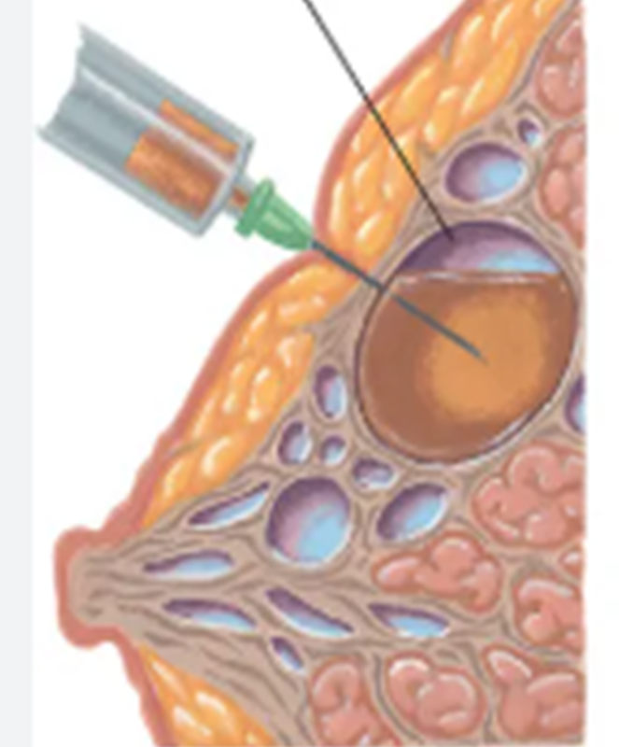

Slide 36
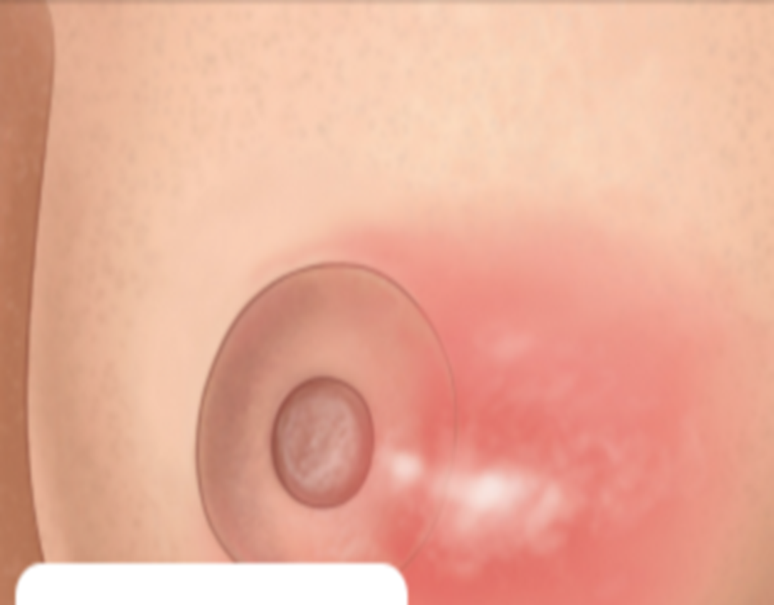
MASTITIS (Inflammation of the breast)
Is related to breastfeeding and occurs when a blocked duct obstructs the flow of milk and distends the alveoli.
The breast is painful and appears red and oedematous with flu-like symptoms , tachycardia and pyrexia.
In contrast with breast engorgement, the pyrexia develops later (3rd - 4th post-partum week) and persists for longer.
S. aureus is found in 40% of women with mastitis , other bacteria include staphylococci and Streptococcus viridans.
Early mastitis can be managed with massage (towards the nipple) and analgesia.
If worsen , a sample of the milk should be taken for microbiological culture and flucloxacillin commenced while awaiting sensitivity results and Flucloxacillin commenced while waiting culture result
Breastfeeding should be continued during this process.
10% of women with mastitis develop a breast abscess .
Treatment is by a radial surgical incision and drainage under GA.

Slide 37
CONTRACEPTION
During lactation there is inhibition of the normal pulsatile release of LH from the anterior pituitary.
Breastfeeding therefore provides a contraceptive effect, but it is not totally reliable, as up to 10% of women conceive while breastfeeding.
However, it has recently been shown that a mother who is still in the phase of post-partum amenorrhea while fully breastfeeding their baby has a less than 2% chance of conceiving in the 1st 6 months , so it is better to use additional contraception, such as barrier methods.
Women who are not breastfeeding should commence the pill 3 weeks after delivery, as ovulation can occur by 4–6 weeks post-partum.
*An IUCD may be inserted immediately postnatally or at the time of a CS , but the expulsion rate is doubled and there is a high rate of perforation on insertion , it is ideal therefore to wait for 4–8 weeks to allow for involution.
*The COCP enhances the risk of thrombosis in the early puerperium and can have an adverse effect on the quality and constituents of breast milk , its use is therefore restricted to non-breastfeeding women at low risk of thrombosis.
*POP (the minipill) is preferable. Both should be commenced about day 21 following delivery , .
*Injectable contraception, depot medroxyprogesterone acetate (Depo-Provera™) given 3-monthly is also very effective , it can be given within 48 hours of delivery , but it can cause breakthrough bleeding and therefore should preferably be given 5–6 weeks post-partum.
*Sterilization can be offered to mothers who are certain that they have completed their family.
Tubal ligation can be performed during CS or by the open method (mini-laparotomy) in the 1st few post-partum days.
However, it is better delayed until after 6 weeks post-partum, when it can be done by laparoscopy , laparoscopic clip sterilization is less traumatic and associated with a lower failure rate

Slide 38
PERINATAL DEATH
Stillbirth>24 weeks gestation or death within 7 days of birth
This requires expertise ( senior clinician ) and a trained bereavement counsellor
Inappropriate management of this traumatic period can have a bad effect on the woman’s emotional and marital life.
The process can be facilitated by seeing and holding the dead baby, naming the baby and taking hand-footprints and photo graphs.
A post-mortem is the most important diagnostic test , a couples may decline because of religious reasons , a partial post-mortem should be discussed, ( a single organ autopsy or a tissue biopsy ).
A full-body X-ray or, preferably, MRI may be useful in some cases
A stillbirth certificate should be completed by the attending doctor or by the pediatrician .
Every mother who has lost a baby should have the 6-week postnatal visit at hospital to discuss the underlying cause and to plan for the future.

Slide 39
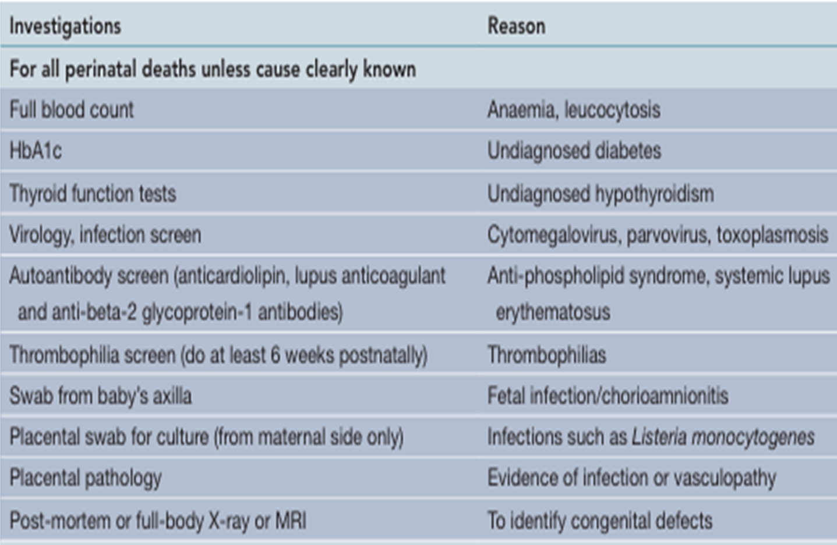

Slide 40
NORMAL EMOTIONAL AND PSYCHOLOGICAL CHANGES DURING PREGNANCY
The ‘pinks’: for the first 24–48 hours following delivery, it is very common for women to experience an elevation of mood, a feeling of excitement, some over activity and difficulty sleeping.
• The ‘blues’: as many as 80% of women may experience the ‘postnatal blues’ in the first 2 weeks after delivery.
Fatigue, short temper, difficulty sleeping, depressed mood and tearfulness are common but usually mild, and resolve spontaneously in the majority of cases.
The following psychological disruptions should not be considered normal and require further assessment:
• panic attacks
• episodes of low mood of prolonged duration (>2 weeks)
• low self-esteem
• guilt or hopelessness
• suicidal thoughts
• thoughts of (or actual) self-harm – these are very unusual in pregnancy or early postpartum and should always prompt referral
• any mood changes that disrupt normal social functioning
• ‘biological’ symptoms (e.g. poor appetite, early wakening)
• change in ‘affect’

Slide 41


