Slide 1
Preterm Labor
& PPROM
Dr. Alyaa Alrubaye
1/2/2026

Slide 2
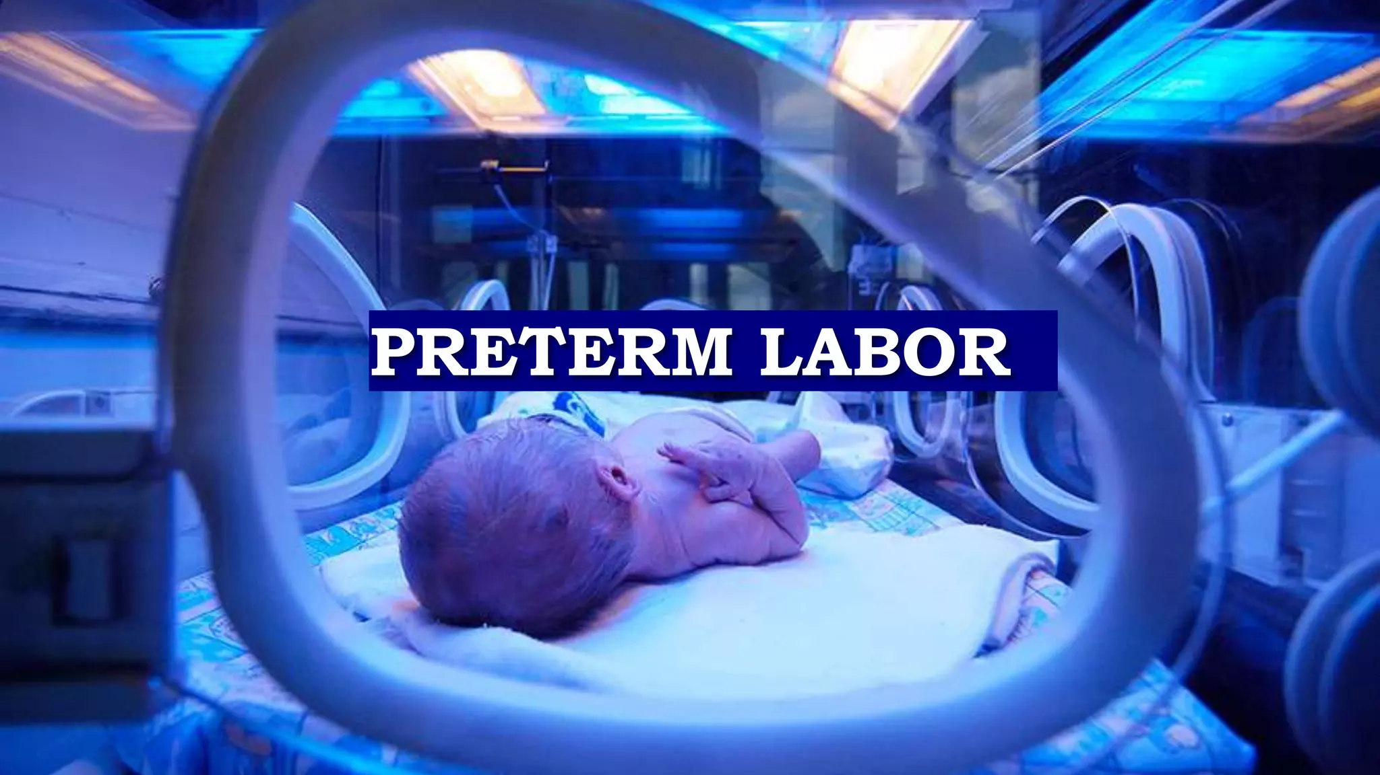
Objective Learning
Define & Classify: Understand what constitutes preterm birth (before 37 weeks) and categories like very preterm (<32 weeks)
or extremely preterm (<28 weeks).
Identify Causes (Etiology):
Recognize risk factors (e.g., infection, cervical length) and underlying mechanisms (hormonal, inflammatory).
Recognize Clinical Manifestations: Learn signs of preterm labor and the physical characteristics of preterm infants.
Understand Complications: Know the risks for preterm infants (respiratory distress, infections, neurological issues).
Apply Management Strategies: Learn about diagnostics (fetal fibronectin, cervical length), treatments (corticosteroids, tocolytics, antibiotics), and collaborative care.
Improve Outcomes: Focus on prolonging pregnancy to reduce mortality and morbidity, enhancing neonatal care, and fostering teamwork

Slide 3
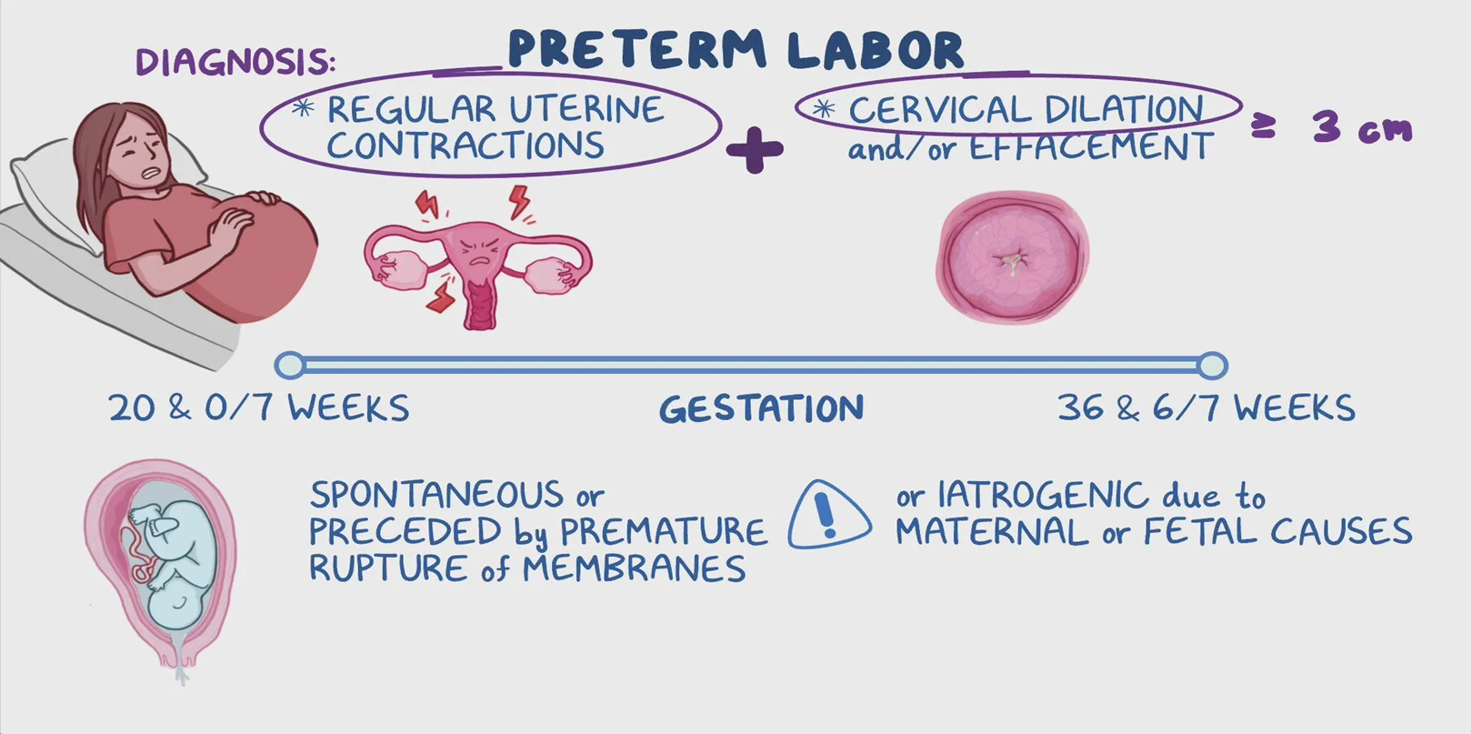
DEFINITION
Preterm Labor is labor that starts before 37 weeks of pregnancy, involving regular uterine contractions and cervical changes, leading to delivery before the due date.
PPROM (Preterm Premature Rupture of Membranes) specifically refers to the breaking of the amniotic sac (membranes) before labor begins, also occurring before 37 weeks gestation, and often leads to preterm labor or birth.
PPROM accounts for a significant portion of preterm births and increases risks for infection and other complications for both mother and baby.

Slide 4
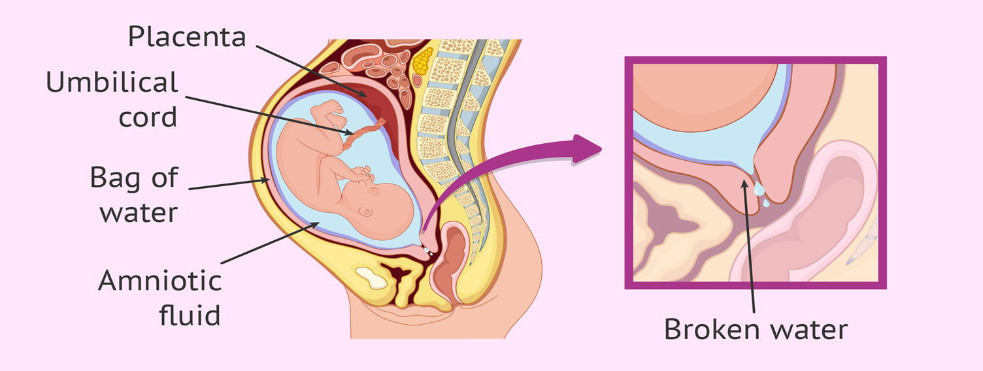

Slide 5
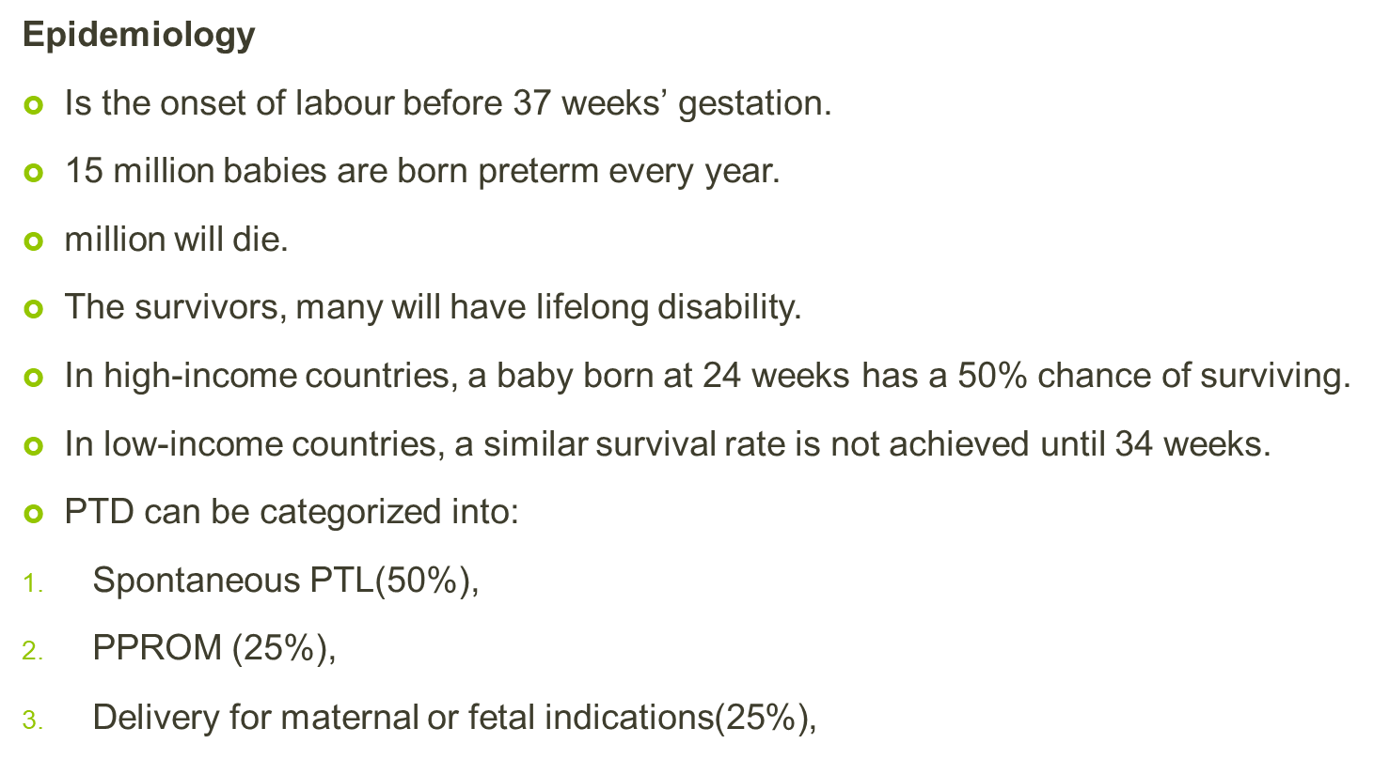

Slide 6
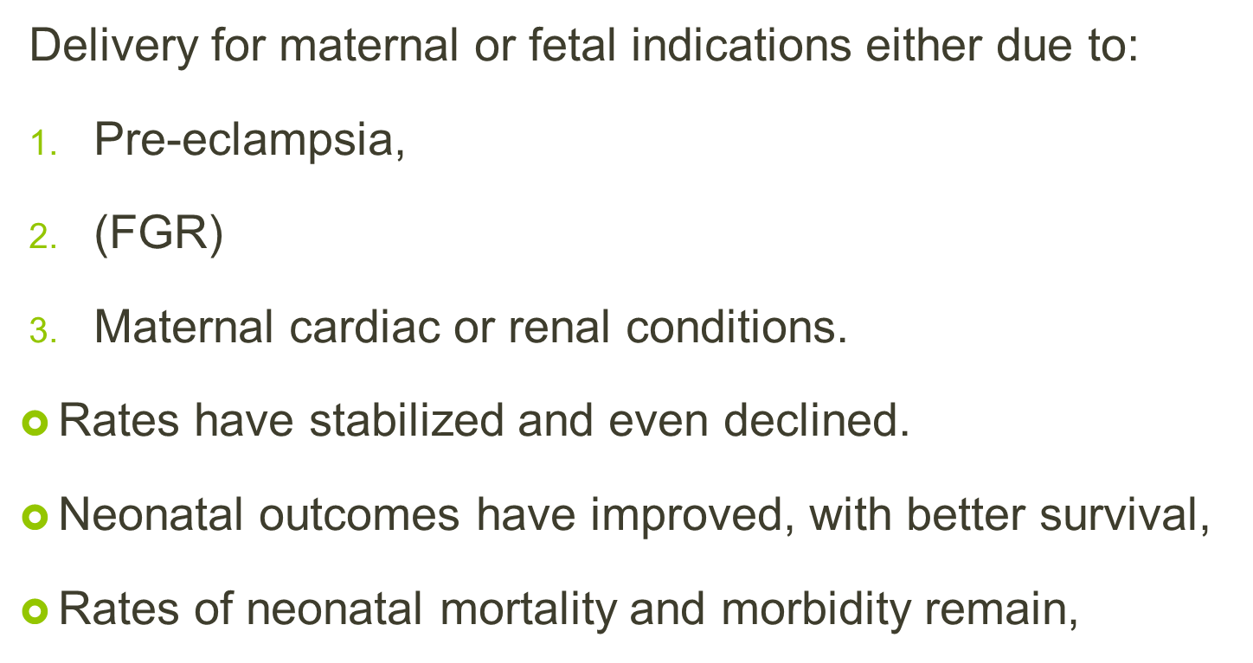

Slide 7

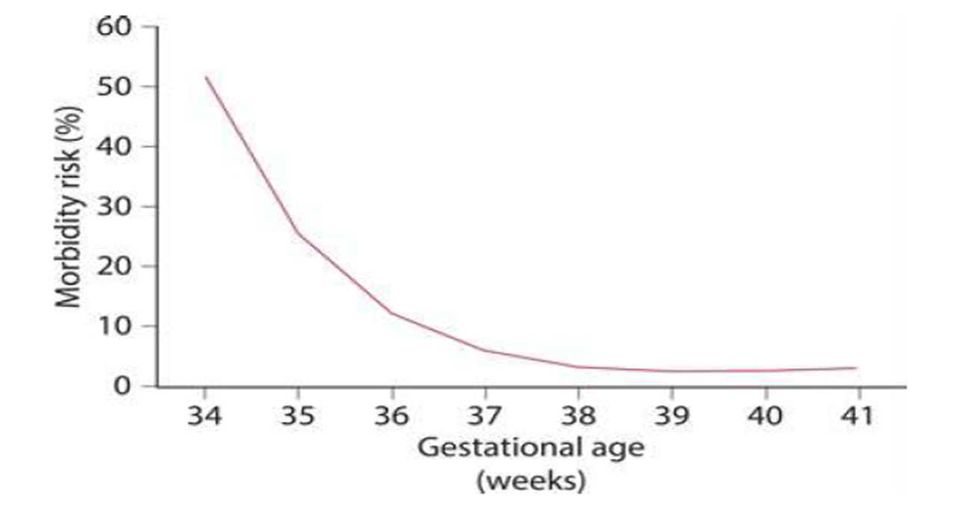

Slide 8
The risk of PTD
Teenagers and women with advanced maternal age,
First pregnancies.
Socioeconomic factors,
Marital status,
Environmental stress,
Cigarette smoking,
Illegal substance (i.e. cocaine) abuse,
Alcohol
Poor nutrition.
African or Afro-Caribbean women, genetic as well as environmental factors can explain increased rates

Slide 9
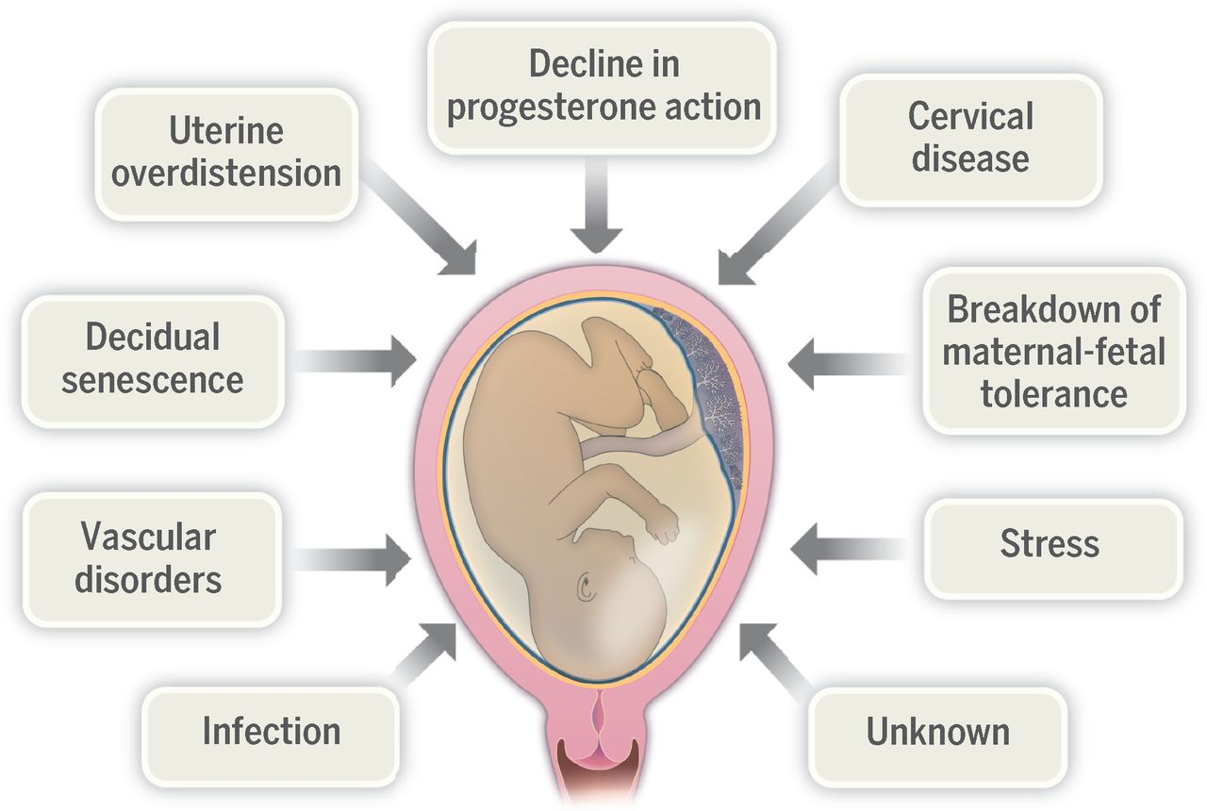

Slide 10
Progesterone maintains uterine quiescence
Play a major role in the maintenance of pregnancy.
The onset of parturition is associated with a decrease in circulating progesterone.
The levels of circulating progesterone remain elevated throughout pregnancy.
Administration of the progesterone receptor antagonist RU486 can induce labour.

Slide 11
Cervical weakness
Is classically associated with painless premature cervical dilatation and is suggested by a history of painless second trimester pregnancy loss.
The cervix :
Acts as a physical obstacle.
A barrier to ascending infection through a thick mucus plug in the cervical canal.(bactericidal).
There is a strong relationship between cervical length and the risk for PTL, and a previous history of cervical surgery can cause cervical weakness.

Slide 12
Infection (Chorioamnionitis)
Is a major cause of PTL ( in deliveries before <32 weeks) .
It is associated with a 3 fold increased risk of PTD with intact membranes, and a 4 fold increased risk with ruptured membranes.
Infection , either:
1. Ascends from the vagina,
2. Transplacental
3. Invasive procedures.
Cervical weakness, shortening, can predispose to ascending bacterial infection.
Vaginal pathogens may ascend through a normal cervix.
33% of all pregnancies delivered after PPROM are complicated by infection.

Slide 13
Abnormal vaginal flora, bacterial vaginosis (BV), is associated with PPROM and PTL.
AB treatment of BV does not reduce the risk of PTD.
Screening high-risk women for BV and treat those found to be positive.
Chorioamnionitis is associated with fetal brain damage.
The release of inflammatory cytokines cause peri ventricular white matter damage (periventricular leukomalacia) (PVL).

Slide 14
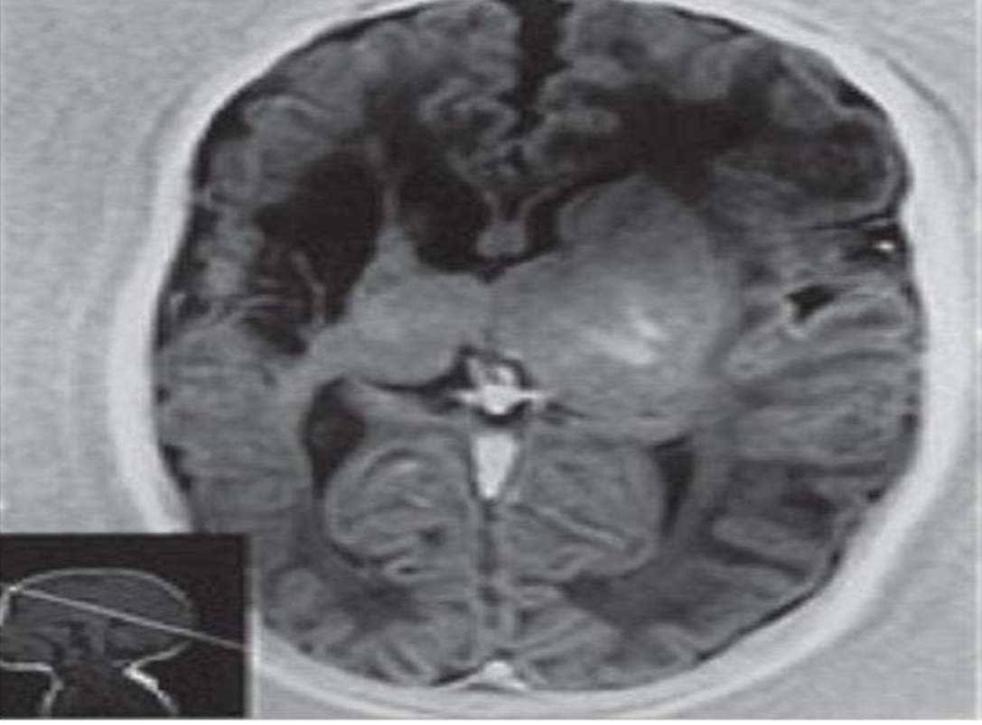
(MRI) in a preterm infant with a GA at birth of 32 weeks. US performed at 2 wks. of age shows cystic changes in the distribution of the right MCA.

Slide 15
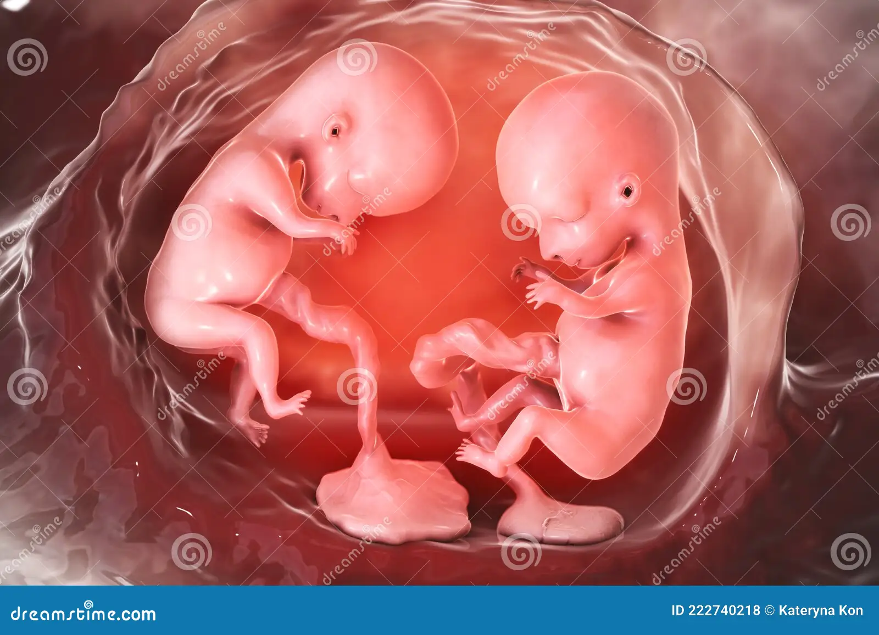
Multiple pregnancy and uterine distension
55% of multiple births deliver before 37 weeks and 15% before 32 weeks.
The risk of PTL rises with fetal number, with triplets (32) weeks and quadruplets (28) weeks.
Multiple pregnancies have an increased risk of PE, FGR and other medical complications of pregnancy.
25% were for medical reasons
75% were after PTL or PPROM.

Slide 16
Twins have a 6 - 7 fold increased risk of CP and this rises to 100-fold if one twin dies antenatal .
Polyhydramnios, increases the risk of PTL and PPROM. Severe polyhydramnios can be managed with amino-drainage, but this may itself precipitate PTL and/or PPROM.
Indomethacin, a (NSAID), may be used in polyhydramnios as it reduces fetal urine production, flow through the DA has to be closely monitored (premature closure).

Slide 17
Uterine müllerian anomalies
Congenital müllerian anomalies are often unrecognized.
Occur in up to 4% of women of reproductive age.
As a consequence of abnormal embryologic fusion and canalization of the müllerian ducts and result in an abnormally formed uterine cavity,
Range from an arcuate uterus, which results in minimal fundal cavity , to complete failure of fusion resulting in uterine didelphys .

Slide 18
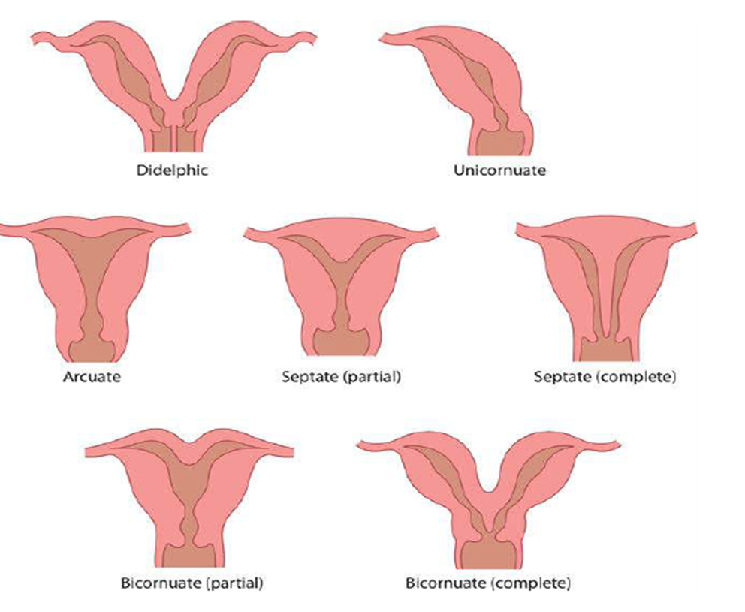
Uterine müllerian anomalies are associated with an increased risk of PTD.

Slide 19
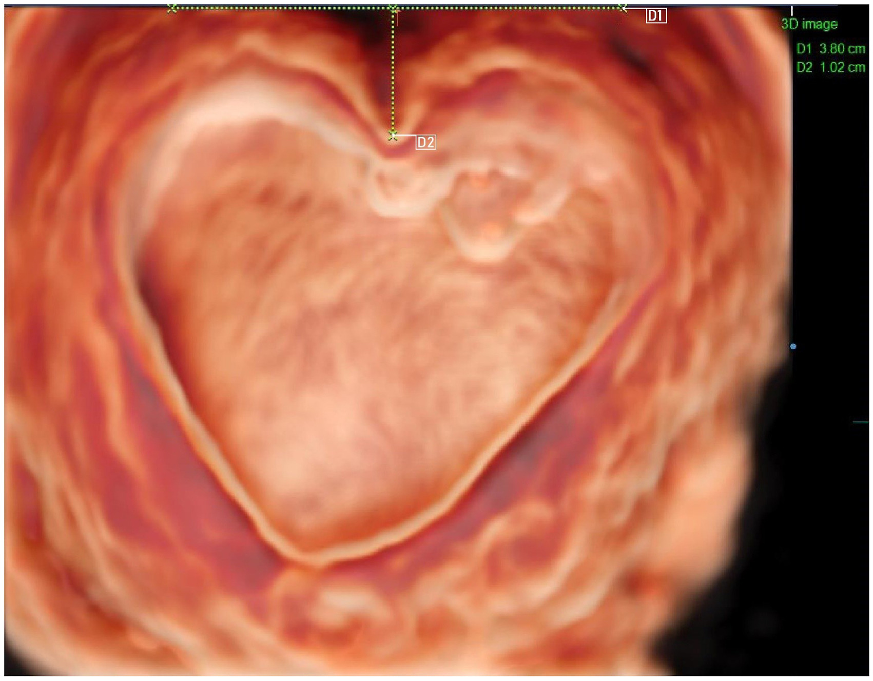
Uterine müllerian anomalies
Associated with adverse pregnancy outcome in up to 25% of women, including :
First and second trimester miscarriage,
PPROM,
PTL,
FGR,
Breech presentation,
CS.

Slide 20
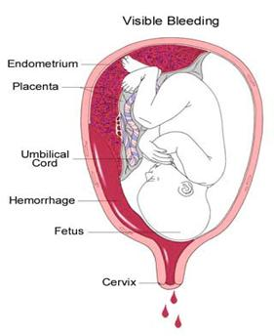
Hemorrhage
APH and placental abruption may lead to spontaneous PTL.
The presence of a sub chorionic hematoma in early pregnancy increases the risk of later PPROM, through:
An effect of thrombin on membrane strength.
The occurrence of infection in the hematoma.
The release thrombin stimulates myometrial contractions.

Slide 21

Stress
Maternal or fetal stress may be associated with PTL
( major life events & FGR).
PTL is increased among unmarried and poor mothers.
The biochemical pathway is uncertain, but may involve a premature increase in circulating corticotrophin-releasing hormone (CRH).

Slide 22
Management of preterm labour
70% of women will not deliver during the current admission.
50% will not deliver until term.
Deciding who is and who is not in PTL is by testing the cervicovaginal fluid levels of fetal fibronectin (fFN), a glycoprotein found in:
1. Cervicovaginal fluid. 2. Amniotic fluid. 3. Placental tissue . 4. In the interface between the chorion and decidua.
Fetal fibronectin
It acts like ‘glue’ at the maternal–fetal interface.
Its presence in cervicovaginal fluid between 22 and 36 weeks’ is a predictor of PTL.
Negative fFN testing enabling most women to be sent home.
Those with a positive fFN test can be admitted for tocolysis and steroids for fetal lung maturation.

Slide 23
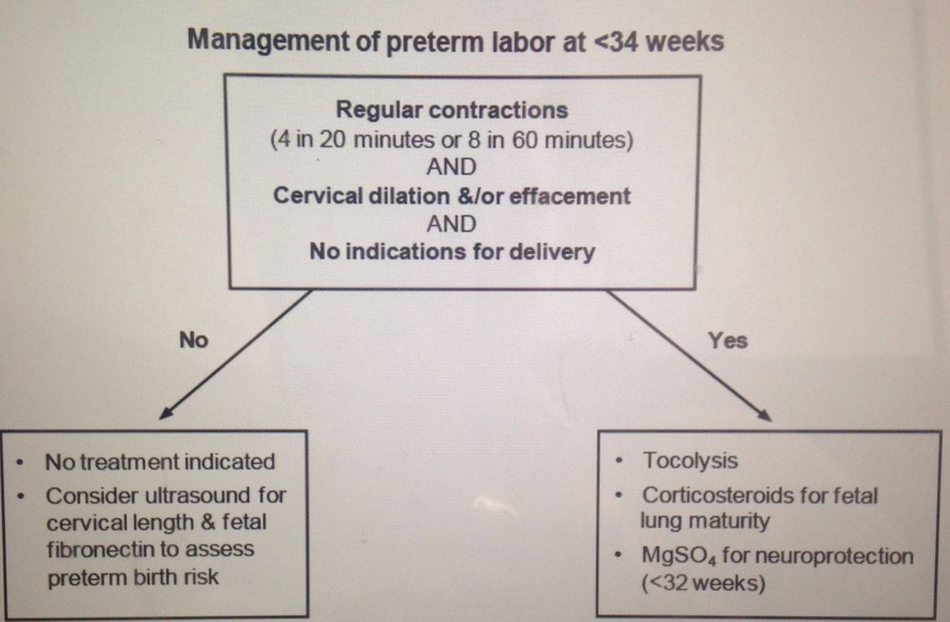

Slide 24
long enough for corticoTocolytics are used to delay delivery steroid administration to improve neonatal lung function and, if necessary, for in utero transfer .
The first choice of tocolytics should be a calcium channel blocker (nifedipine) or an OTR antagonist (atosiban).
A recently, PG inhibitors and calcium channel blockers are most likely the best therapy on the basis of :
Delaying delivery by 48 hours
Neonatal mortality
Neonatal RDS
Maternal side-effects.

Slide 25
Beta-sympathomimetics
(Ritodrine, salbutamol and terbutaline) are β2 adreno-receptor agonists),
mediate myometrium relaxation.
They are effective in delaying delivery, but do not improve neonatal outcome or PTL rates.
They have significant maternal side-effects.
The most serious side-effect is pulmonary edema, 1:400 .
Acute cardiopulmonary compromise, with greater risks if given in large fluid volumes,
In multiple pregnancies, in women with cardiac disease.
Magnesium sulphate:
Modulating calcium uptake results in inhibition of uterine contractions.
Reduces the risk of CP in surviving infants , due to its neuroprotective effect.
Non-steroidal anti-inflammatory drugs
The first used was indomethacin. It is a reversible, (COX) inhibitor. Effectively delay delivery for 48 hours. They do have several adverse fetal effects.
PG synthesis is responsible for the maintenance of a patent ductus arteriosus and inhibition can lead to its premature closure.

Slide 26
The effect is completely reversible with early identification and discontinuation of treatment.
Associated with an increased risk of necrotizing enterocolitis and neonatal renal dysfunction, reduces renal perfusion and fetal urine output, resulting in reversible oligohydramnios.
Comparing nifedipine with other tocolytics, no significant changes in perinatal mortality.
Discontinuation due to side-effects.
Neonatal RDS, necrotizing enterocolitis, IVH and neonatal jaundice were least for OTR-A, intermediate for nifedipine and greatest for beta-sympathomimetics.
It has a similar efficacy as betasympathomimetics, but is much better tolerated.
Atosiban-treated patients remained undelivered at 24 hours, 48 hours and 7 days.
Corticosteroid therapy
Has the greatest influence on preterm outcome.
Associated with significant reduction in neonatal mortality through reduction of RDS & IVH. Associated with less developmental delay in childhood and a fewer children having CP when compared with no corticosteroid treatment.
Recombinant surfactant in neonates has a major effect on RDS.

Slide 27
Corticosteroid therapy They affect :
Fetal lung maturation.
Fetal growth.
Organ system maturation.
Fetal brain development.
Immune function .
Fetal hypothalamic–pituitary–adrenocortical axis.
Betamethasone or dexamethasone
Both recommended.
Both cross the placenta in their active form.
Some dexamethasone preparations contain a sulphate preservative that can cause neurotoxicity and should be avoided.
Repeated antenatal doses could lead to:
A decrease in birth weight, brain size and abnormal neuronal development.

Slide 28
Antibiotics
Despite a clear link between bacterial infection and PTL, the results of antibiotic treatment to prevent PTL have been disappointing.
In PPROM, erythromycin improved neonatal outcomes, but had no benefit in women with intact membranes.
10 days of erythromycin is the treatment of choice for PPROM in many obstetric units .
Management of PPROM 1
PPROM occurs in approximately 2% of all pregnancies, accounts for up to one-third of preterm deliveries.
50% of women deliver within 1 week and 75% within 2 weeks of PPROM.
The earlier in pregnancy that PPROM occurs the shorter the interval to delivery.
Postnatal survival following PPROM is directly related to birthweight and GA at delivery.
In pregnancies complicated by PPROM prior to 23 weeks, pulmonary hypoplasia may develop leading to an increased risk of neonatal death, even if delivery occurs at later GA.

Slide 29
Management of PPROM 2
The presence of amniotic fluid > 2 cm is associated with a lower incidence of pulmonary hypoplasia.
Diagnosed through history and a pool of liquor in the vagina on speculum examination.
* Management balances the risk of prematurity (if delivery is encouraged) versus the risk of maternal and fetal infection (if delivery is delayed).
* Conservative management before 34 weeks’ unless there is Chorioamnionitis and immediate induction of labour is advised in women after 37 weeks’ gestation.
Conservative management includes clinical surveillance for signs of Chorioamnionitis : Recording of maternal temperature, heart rate, CTG and maternal biochemistry.
Management of PPROM 3
Rising WBC or a rising C-reactive protein indicating development of Chorioamnionitis.
Lower genital tract swabs are routinely taken, but cultures do not correlate well with the risk of Chorioamnionitis.
There is time for administration of corticosteroids and in utero transfer before the onset of PTL.
Tocolysis is contraindicated due to the increased risk of maternal and fetal infection in patients with PPROM.

Slide 30
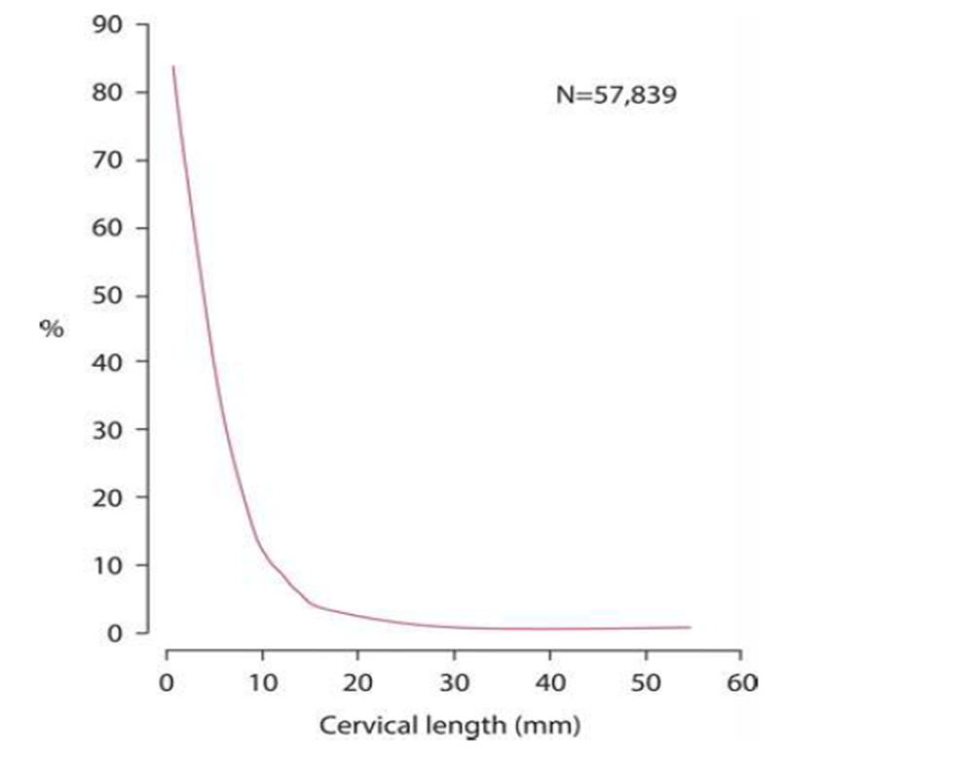
Past obstetric history
Having had a previous PTD increases the risk of PTL in a subsequent pregnancy 4 times in comparison to term delivery.
Cervical length and the risk of preterm (<34 weeks) delivery.

Slide 31
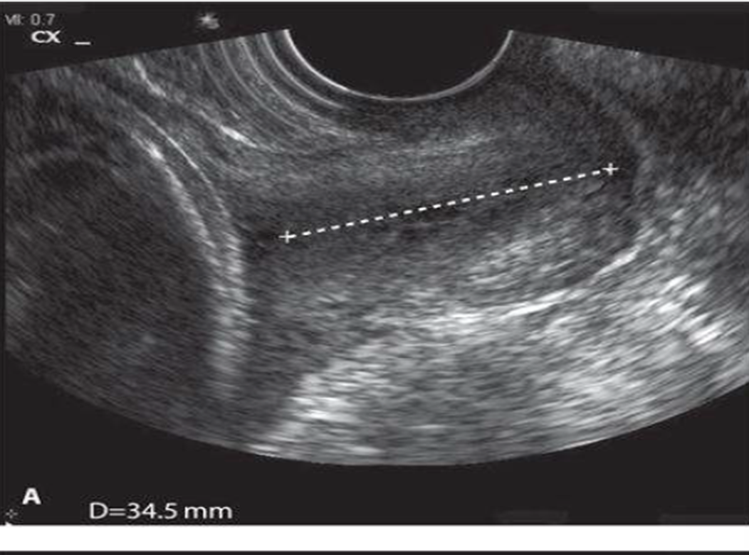
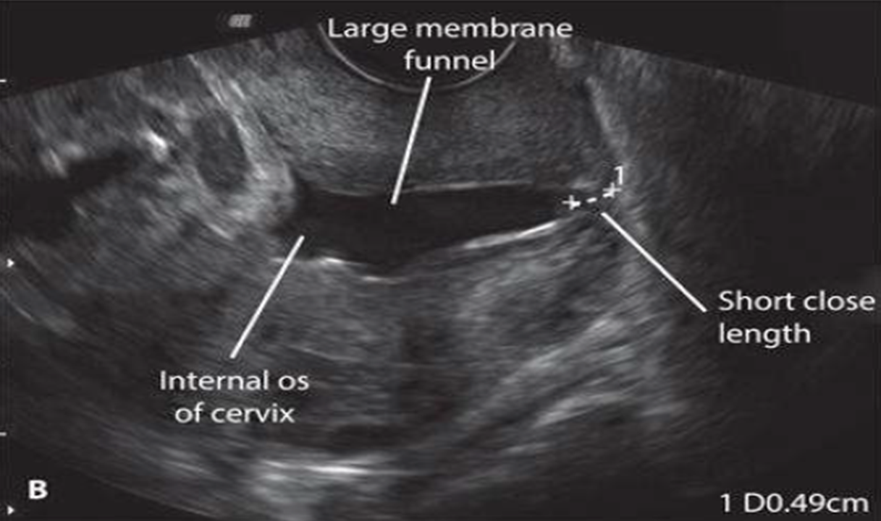
Normal cervix
Cervical length and funneling on ultrasound

Slide 32
Ultrasound measurement of cervical length
CL measured by TVS is more accurate than TAS or digital examination.
Direct relationship between CL and the risk of PTL
CL surveillance with serial measurement throughout the second and early third trimester is used to monitor women at high risk of PTL.
The combination of CL and obstetric history can predict 80.6% of extremely early spontaneous PTL
CL screening is not cost effective.
Prevention of preterm delivery
In those found to be at high risk of PTD, two interventions are currently available, progesterone and cervical cerclage.

Slide 33
Progesterone
Promote uterine quiescence and inhibit the production of proinflammatory cytokines and PGs within the uterus.
In women with a short cervix, vaginal progesterone may prevent PTD.
There is no evidence from any study that progesterone can reduce the longer-term adverse effects of preterm birth, that of neurodevelopmental disability and respiratory morbidity.
TVC may be placed in 3 different circumstances:
Following multiple midtrimester losses or PTD (history indicated cerclage);
When the cervix shortens (usually <25 mm) , a history of cervical surgery or previous PTD (ultrasound indicated cerclage);
When the cervix is dilating in the absence of contractions (rescue cerclage).
The exact mechanism by which CC prevent PTL is not understood.
CC provides structural support , and enhances the cervical immunological barrier by retention of the mucous plug and preventing ascending infection by maintaining cervical length.
CC does not appear to reduce the risk of PTD in multiple pregnancies.

Slide 34
TA cerclage
Inserted following a failed vaginal cerclage or extensive cervical surgery.
Any potential benefits of TA cerclage must be weighed against its increased operative risks.
Patients must undergo two laparotomies during pregnancy, one for suture insertion and the other for CS.
TA cerclage should be performed only by experienced operators and only for defined indications.
Conclusion:
The management of PTL is inadequate.
Interventions in women who present in PTL do not improve neonatal outcomes.
We are able to reduce the risk in high risk.
But 85% of PTD (due to PTL and PPROM) occurs in low-risk women
We could effectively screen the low-risk using TVS and give progesterone to reduce their risk, but this is cost effective.

Slide 35
                THANK YOU

