Slide 1
Urinary Incontinence
Dr. Alyaa Alrubaye
5/4/2026

Slide 2

Learning Objectives
• Understand the applied anatomy of the pelvic floor and related organs.
• Understand the mechanism of continence in women and how disorders of this can lead to symptoms.
• Learn how to clinically assess the patient with incontinence.
• Understand principles of treatment of incontinence.

Slide 3
The female pelvic anatomy

Slide 4
Urinary symptom terminology:
Urinary symptoms can be divided into those relating to urine storage and those relating to voiding.
The symptom of stress incontinence (leaking with cough, straining, exercise, etc.) may be isolated.
Most patients present with mixed incontinence, which is where stress incontinence occurs with frequency, urgency and urge incontinence.
The bladder stores, and then voids urine (micturition cycle).
The detrusor muscle is relaxed allowing storage of increasing urine volumes with no increase in pressure.
As bladder capacity is reached, stretch receptors in the bladder wall send sensory signals of bladder filling.
The sphincter mechanism is closed.
Voluntary delay of micturition is achieved by cortical inhibition of the spinal voiding reflex arc S-VRA.
Before voiding begins, this inhibition is removed and the pelvic floor and urethral sphincters relax, to allow detrusor contraction and bladder emptying.

Slide 5
Common Urodynamic Diagnoses:
DO: detrusor contraction, during the filling phase of urodynamics.
DO incontinence: leakage from the urethra in association with a detrusor contraction (increase in bladder pressure)
Urodynamic stress incontinence: leakage from the urethra with a rise in abdominal pressure (e.g. coughing) without a detrusor contraction .
Mixed incontinence: ( both urodynamic stress incontinence and DO).

Slide 6
Fascial supports of the pelvic organs. Level 1 support is provided by the uterosacral ligaments, suspending the uterus and vaginal vault. Level 2 (mid-vagina) support is provided by the fascia lying between the vagina and the bladder or rectum that fuses laterally and runs to attach on the pelvic side wall. Level 3 support is provided by the perineal body, which has the posterior vaginal fascia fused to its upper surface.

Slide 7
Urine storage symptoms
■ Frequency: patient considers they void too often by day.
■ Nocturia: waking at night one or more times to void
■ Urgency: a sudden compelling desire to pass urine, which is difficult to defer.
■ Urge incontinence: involuntary leakage accompanied by or immediately preceded by urgency.
■ Stress incontinence: involuntary leakage on effort, exertion, sneezing or coughing.
■ Nocturnal enuresis: the loss of urine occurring during sleep
Urine voiding symptoms
■ Slow stream: perception of reduced urine flow.
■ Splitting or spraying: the stream of urine is not a single flow.
■ Intermittent stream: urine flow that stops and starts.
■ Hesitancy: difficulty in initiating micturition resulting in a delay in the onset of voiding.
■ Terminal dribble: a prolonged final part of micturition,
when the flow has slowed to a trickle or dribble.

Slide 8
Types of urinary incontinence:
Stress urinary incontinence SUI (Urodynamic)
Urge incontinence ( Detrusor over activity) DOA
Mixed incontinence ( SUI + DOA)
Bypass incontinence ( fistula or cong. Abnormality)
Functional incontinence, especially in elderly (DIAPERS) , may be transient:
D: Dementia / Depression
I: Infection
A: Atrophy
P: Pharmacological drugs
E: Endocrine (DM)
R: Restricted mobility
S: Stool impaction

Slide 9
Stress incontinence:
The symptom is due to incompetent urethral sphincter.
In most cases is due to hypermobility, where the pelvic floor and ligaments cannot retain the urethra in position during increases in abdominal pressure, leading to leakage of urine .
Intrinsic sphincter deficiency (ISD) is due to weakness of the sphincter muscles, which is associated with:
Obstetric factors ( history of vaginal childbirth).
Non-obstetric factors.
Obstetric risk factors due to
Stretching/damage to the pudendal nerves causes both weakening of the pelvic floor muscles and urethral sphincter.
Overstretching, or even avulsion of the pelvic floor muscles from their insertions on the pelvic wall results in loss of pelvic floor support and hence urethral hypermobility.
It is now possible to identify levator muscle defects in symptomatic women by means of MRI or TVS.

Slide 10
The detrusor muscle is innervated by muscarinic cholinergic nerves of the parasympathetic nervous system (contraction).
The urethral sphincter is innervated by noradrenergic neurons of the sympathetic nervous system (sphincter contraction) and somatic fibers (voluntary contraction and relaxation) by pudendal nerves.
In women the sphincter mechanism includes the internal (smooth muscle) and external (striated muscle).
Increases in abdominal pressure are transmitted equally to the bladder and bladder neck .
In the premenopausal woman the urethra has a rich blood supply helping in continence.

Slide 11
Risk factors for stress urinary incontinence
Multiparity (vaginal births).
Forceps delivery.
Perineal trauma.
Long labour.
Epidural analgesia.
Birthweight >4 kg.
Increasing age.
Postmenopausal.
Obesity.
Connective tissue disease.
Chronic cough (e.g. bronchiectasis or chronic obstructive pulmonary disease).
Doxazocin(alpha-adrenergic antagonist) for hypertension causes relaxation of the urethral sphincter.

Slide 12
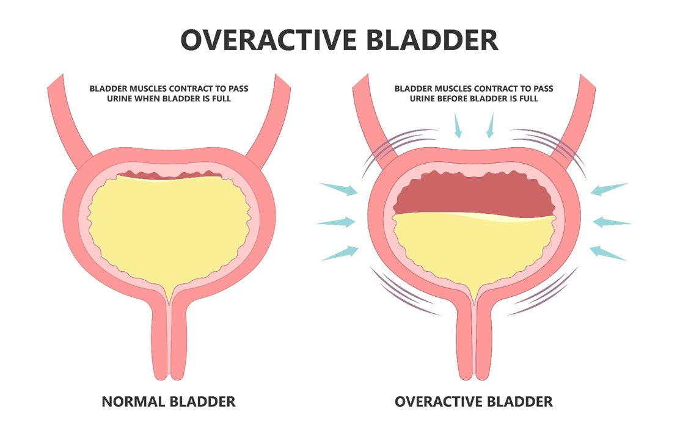
Detrusor Overactivity:
Involuntary detrusor contractions during the filling phase of micturition.
Women will often complain of symptoms of OAB, but may not be incontinent unless the urethral sphincter function is compromised or the detrusor contractions are of very high pressure and overcome urethral resistance .
Alterations in the expression of neurotransmitters and their receptors.
Continence surgery carries a risk of 5–10% of new DO.

Slide 13
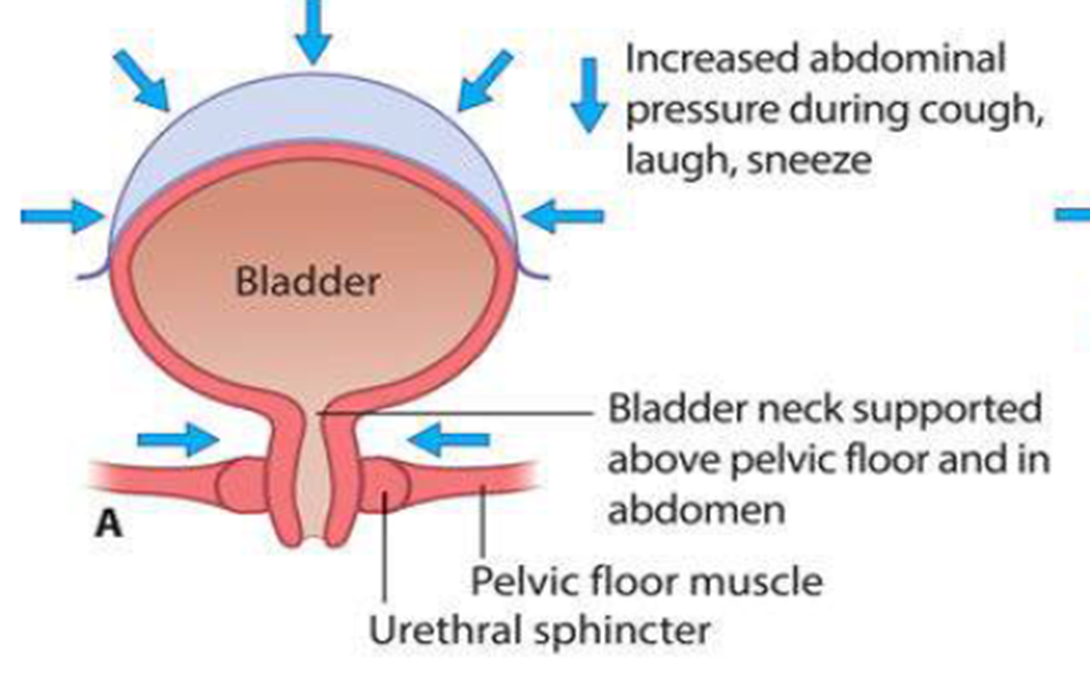
In normal women, the bladder neck is supported above the pelvic floor and so abdominal pressure increases are transmitted to the bladder neck

Slide 14
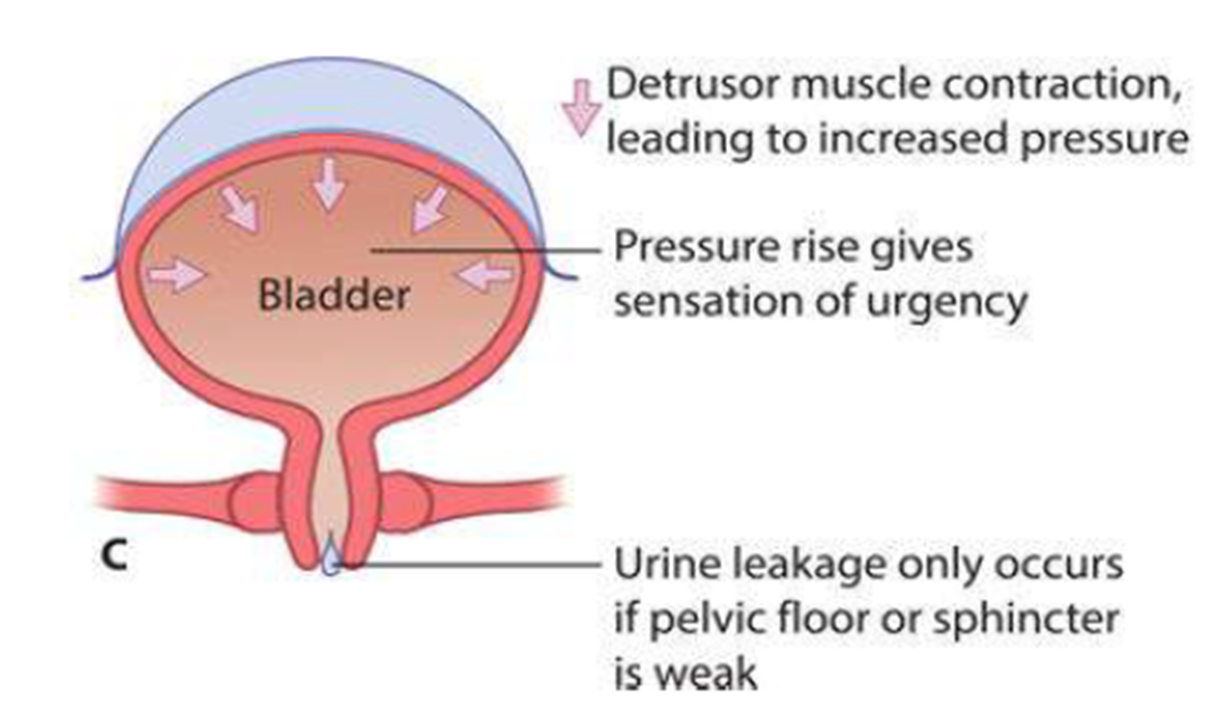
Detrusor overactivity causes increased sensation; leakage only occurs if the contraction pressure exceeds the pelvic floor and sphincter pressure

Slide 15
Risk factors for detrusor overactivity
Childhood bedwetting. / Obesity. / Smoking.
Previous hysterectomy. / Previous incontinence surgery.
Clinical assessment of incontinence
A detailed history to identify whether the patient has only stress incontinence ,
only OAB or mixed symptoms.
Record the severity, including:
The number of episodes / day.
Whether continence pads are needed, and its size.
Whether the patient needs to change her underclothes or outer clothes because of leakage.
What behavior changes ( reduced their fluid intake and may limit their social activities).

Slide 16
Associated symptoms :
Prolapse.
Faecal incontinence.
Sexual difficulties.
Detailed medical history to:
Identify predisposing factors.
Identify medical or surgical conditions that may impact on treatment (including comorbidities that may increase the risk of anaesthesia ).
Identify contraindications to drug therapy.
Be alert for ‘red flag’ signs suggesting malignancy such as hematuria, rectal bleeding or significant pain.

Slide 17
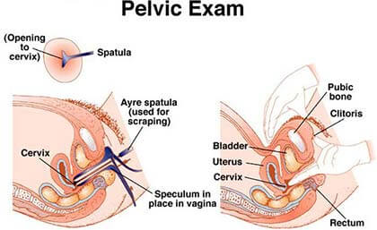
Physical examination
Should include general examination and an abdominal and pelvic examination.
Abdominal examination will identify any:
Surgical scars.
Evidence of obesity.
Presence or absence of any pelvic mass, Presence of a large uterine fibroid or ovarian cyst filling the pelvis in which surgical removal will improve the symptoms.
Pelvic examination should be done in the lithotomy position using a Sims speculum to assess:
Prolapse .
Visible leakage during coughing or Valsalva maneuver.
Patient’s ability to contract her pelvic floor muscles .

Slide 18
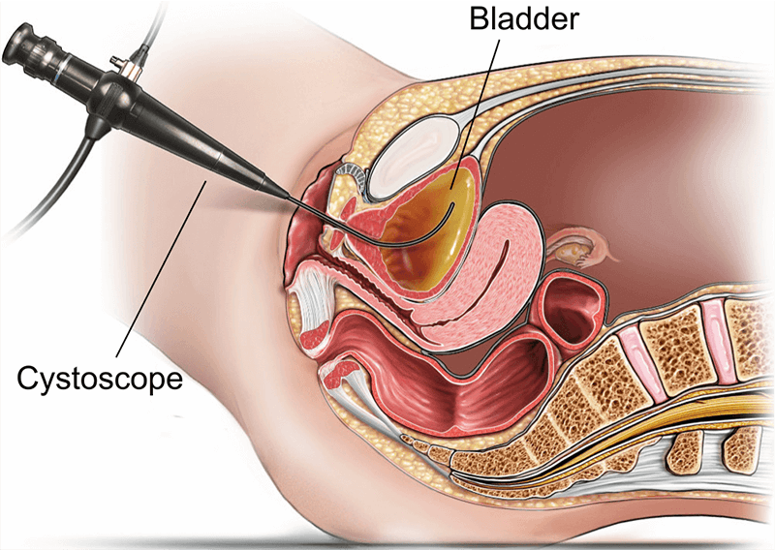
Investigation of urinary incontinence:
Diagnosis may be based on symptoms or urodynamic studies.
All women should have a full history & clinical examination.
Frequency–volume charts are useful in making a diagnosis.
Infection and voiding difficulties should be excluded.
Subtracted cystometry should be considered in those patients who fail conservative therapy.
Women with recurrent incontinence or who may have neurological problems should be investigated with videocystourethrography.
Ambulatory urodynamics may be useful in women with symptoms not explained by conventional cystometry.
All women with hematuria and bladder pain
require cystoscopy.

Slide 19
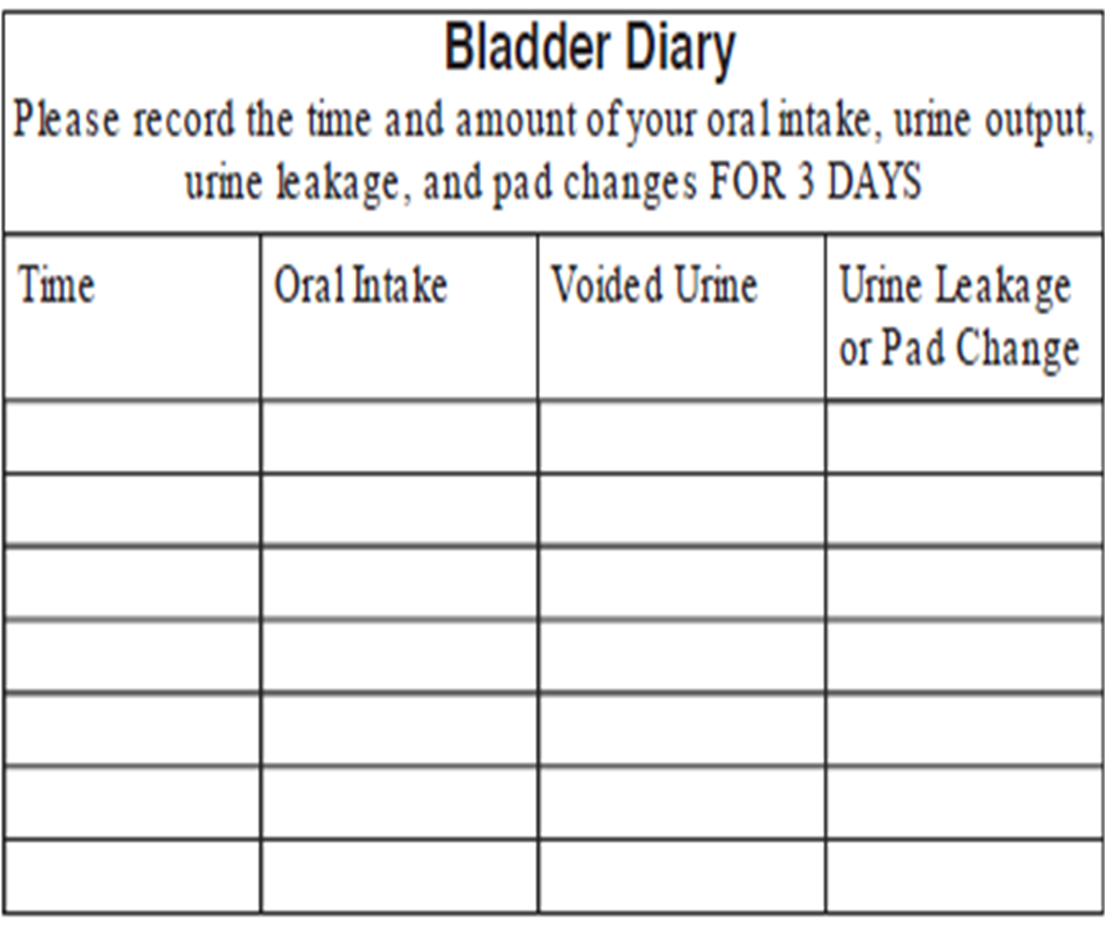
A midstream specimen of urine: to exclude overt infection or asymptomatic bacteriuria.
Patient bladder diary (for 3 days is usually adequate) to record the amount, type and frequency of drinks taken and to record the timing, frequency , volume of voids, leakage episodes and urgency.
A pad test is an objective measure of urine leak ,the patient wears one or more pre weighed sanitary pads for (1 hour in clinic and 24 hours at home). The change in weight (g) is a measure of the amount of urine lost (ml).

Slide 20
Bonney's test
The patient is asked to insert 2 fingers in periurethral region causing lifting of the bladder neck and then the patient is asked to cough.
If SUI gets corrected , then it is due to bladder neck decent.
If SUI persist , it is due to sphincter defect
Q tip test
A sterile cotton swab is introduced into the level of bladder neck.
The patient is asked to strain
Marked upward elevation of cotton tip > 30 ⁰ Indicate urethra hyper mobility.
A pelvic and/or renal tract ultrasound may be indicated if:
There are symptoms of pelvic pain.
Clinical suspicion of a pelvic mass.
Hematuria.
Bladder pain.
Recurrent UTI.
(MDT) meeting, including a gynecologist, urologist, continence nurse, physiotherapist and elderly care consultant to discuss management plans for patients with mixed symptoms, or those with recurrent problems after previous treatment.

Slide 21
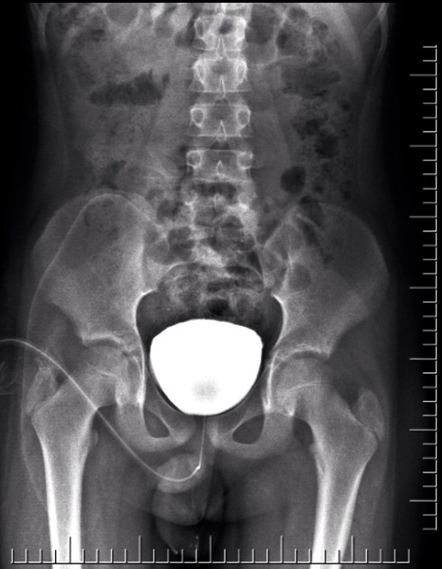
Voiding- Cysto- Urethro- Graph VCUG

Slide 22
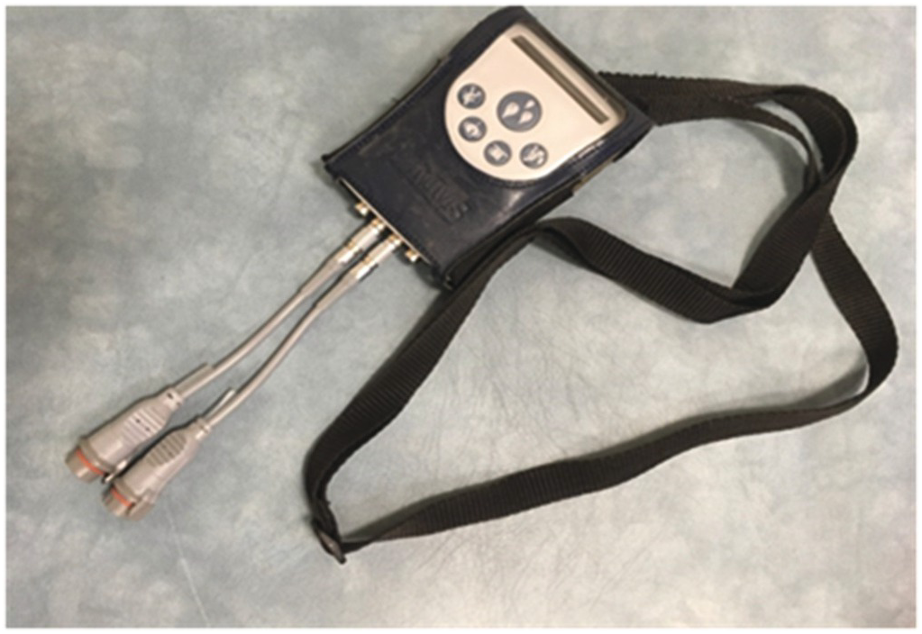
Ambulatory urodynamic

Slide 23
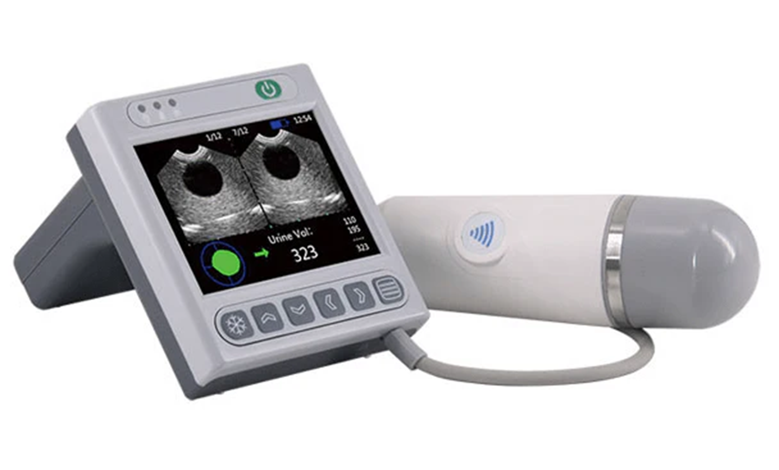
Indications of urodynamic testing
Failure of conservative measures.
Failure of medications.
Patients with recurrent symptoms.
Those with complex histories.
Those who have undergone previous surgery for incontinence or prolapse.

Slide 24
Urodynamic testing
To determine the micturition cycle (bladder filling and voiding) while recording abdominal and bladder pressure, to provide a diagnosis.
A fine pressure catheter is placed in the bladder and a second catheter in the rectum, the bladder is filled with warm saline , the patient sitting on a container that records leakage.
Bladder pres.− abdominal pres.= detrusor pres.(D=B-A).
During filling the patient is asked to declare the onset of bladder filling sensation ( 150 ml volume), a strong desire to void ( 350 ml ) and the onset of urgency ( 500 ml).
A urodynamic test will:
Provide evidence of urethral sphincter weakness.
Provide evidence of DOA.
Identify normal or abnormal voiding function.
For women with OAB, many clinicians will initiate drug treatment before urodynamic testing.
Stress incontinence symptom is a good predictor of identifying urethral sphincter weakness on urodynamic testing.

Slide 25
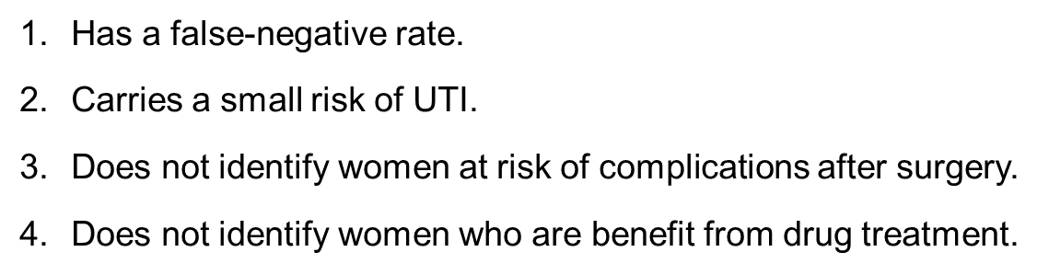
Urodynamic testing

Slide 26
Cystometry records bladder pressure and abdominal pressure via a rectal pressure catheter, and calculates detrusor pressure by subtraction

Slide 27
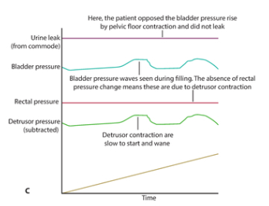
During filling, the patient is asked to report the occurrence of first desire to void, strong desire and urgency ( functional bladder capacity)
With urodynamic stress incontinence, leakage is seen with increases in abdominalpressure (e.g. coughing) with no change in detrusor pressure
With detrusor overactivity, detrusor contractions are seen during the filling phase.

Slide 28
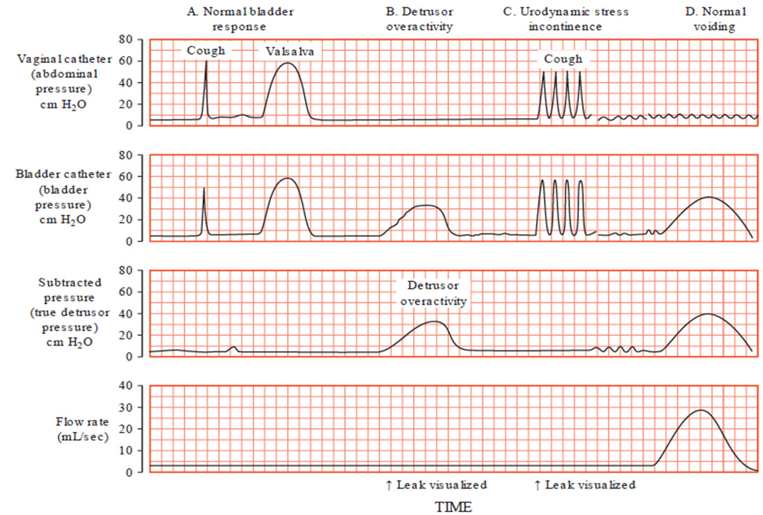
Multichannel cystometrics

Slide 29
CYSTOURETHROSCOPY
Indication of Cystourethroscopy:
1.Diagnosis of patients with hematuria.
2.History of pelvic surgery.
3.Failed traditional treatments.
4.To determine normal anatomy.
5.The presence of pathology including a vesicovaginal or urethrovaginal fistula, a foreign body or a tumour /mass.
6. Patients with mixed symptoms, or those with recurrent problems
after previous treatment.
**It is a good practice to discuss management plans within a multidisciplinary team meeting, including a gynecologist, a urologist, a continence nurse, a physiotherapist and possibly an elderly care consultant.

Slide 30
Treatment for incontinence:
Conservative treatment and the role of urodynamic test
Most gynecologists and urologists would perform urodynamic investigation on all women before initiating treatment.
Conservative treatment will give significant symptom benefit for women with stress incontinence, OAB and mixed incontinence, irrespective of the underlying urodynamic findings .

Slide 31
Treatment:
once the investigations have ruled out serious pathology, conservative treatment is first choice:
Conservative treatment for urinary incontinence:
Advice about fluid balance.
Reduction of caffeine intake.
Bladder retraining.
Pelvic floor muscle exercise.

Slide 32
Pelvic floor muscle exercise
By contracting the pelvic floor muscle and increase the number and duration of each contraction.
40% of women will be able initially to contract their pelvic floor. Lead to cure in 50% of women and improvement in 75% . The exercises over several weeks achieve maximum benefit.
Work for both stress incontinence and OAB.
In OAB exercise improves muscle strength to resist the urge without leakage.
Bladder retraining
Re-educating the patient (and her bladder) to increase the interval between voids, by delaying voiding for several minutes beyond normal void desire in a stepwise fashion.
The rate of urine production (usually 1–2 ml/min) and normal bladder capacity (350–500 ml).
Successful in reducing frequency and urgency.
Weight loss for overweight women
Obesity is associated with increased risk and severity of stress incontinence, due to the increase in abdominal pressure. Obesity is also associated with increased severity of OAB.
Weight loss leads to improvement in both stress incontinence and OAB, and can result in cure.

Slide 33
Medical treatment
Primarily used for OAB symptoms and DO.
Because the parasympathetic nerves stimulate the detrusor muscle contraction, anticholinergic drugs (act on NMJ) , have been used for many years.
All anticholinergic drugs decrease urgency and incontinence episodes to 1–2 per day.
Side-effects are dry mouth, constipation and blurred vision.
Potential Anticholinergic Side Effects
Side Effect
Increased pupil size
Decreased visual accommodation
Decreased salivation
Decreased bronchial secretions
Decreased sweating
Increased heart rate
Decreased detrusor function
Decreased GIT mobility
Potential Clinical Consequence
Photophobia
Blurred vision
Gingival and buccal ulceration
Small-airway mucus plugging
Hyperthermia
Angina, myocardial infarction
Bladder distention and urinary retention
Constipation

Slide 34
Mirabegron:
Is a more recently developed medication for OAB. It’s a beta 3-adrenergic agonist.
Enhance relaxation of the detrusor( acting more on the storage function), (while anticholinergics act by suppressing voiding). Can be used with an anticholinergic drug.
Vaginal Estrogen:
In postmenopausal women. For 3 months. Can improve bladder sensation and associated urgency.
Duloxetine
It used very occasionally for incontinence. It is an anticholinergic agent.
It is a combined serotonin and noradrenaline reuptake inhibitor. It is contraindicated in pregnancy & breast feeding.
Used for the treatment of depression in higher doses.
Acts at the micturition center in the sacral spinal cord to increase the sympathetic nerve output to the urethral sphincter and increase sphincter tone. 50% improvement or more in leakage . The side-effects, including nausea, is the main reason to stop treatment.

Slide 35
Anticholinergic medications
Oxybutynin: 2.5–5 mg three times daily; first-choice medication;
increase weekly by 5 mg up to 20 mg daily.
Propiverine: 15 mg one to three times daily.
Trospium: 20 mg twice daily.
Darifenacin: 7.5 mg once daily.
Tolterodine: 2 mg twice daily; reduced to 1 mg in hepatic impairment.
Fesoterodine: 4 mg once daily, maximum 8 mg once daily
Solifenacin: 5 mg once daily; can be increased to 10 mg once daily.

Slide 36
Surgical treatment:
Midurethral tape procedures
Non-absorbable mesh of polypropylene (tape 1 cm wide) is placed through a small vaginal incision TVT under the midurethra and into a U shape behind the pubic symphysis, via two small suprapubic incisions( retropubic placement).
Or behind the inferior pubic rami and through the obturator foramen , via a small incision in each groin
( transobturator placement) TOT.
The midurethral tapes have a cure rate for of 80–85%, persists for (10 years or more).
The TVT lies under the midurethra and in the retropubic space between the pelvis and bladder.
The TOT lies in horizontal position under the midurethra and exits through the obturator foramen.
Complications:
The tape may delay vaginal wound healing.(Both)
Erosion of the tape.( Both)
Operative complications include: A) Voiding difficulty in 2–5% (Both).
B) Bladder perforation (2–5%). (TVT).
C) Onset of new OAB symptoms (5%). (TVT)

Slide 37
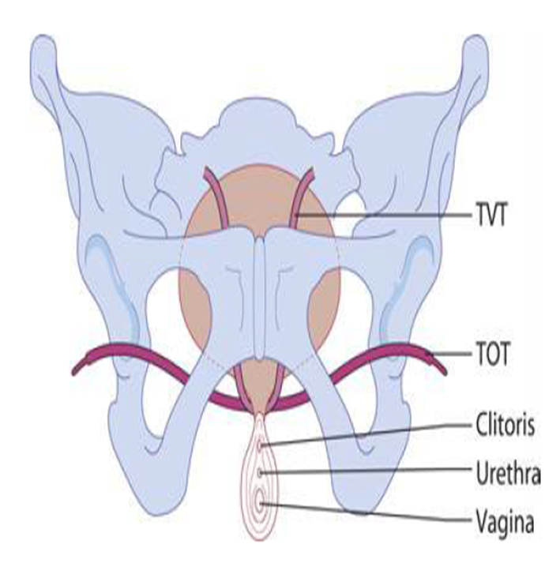
The position of tension-free vaginal (TVT) and transobturator (TOT) midurethral tapes.

Slide 38
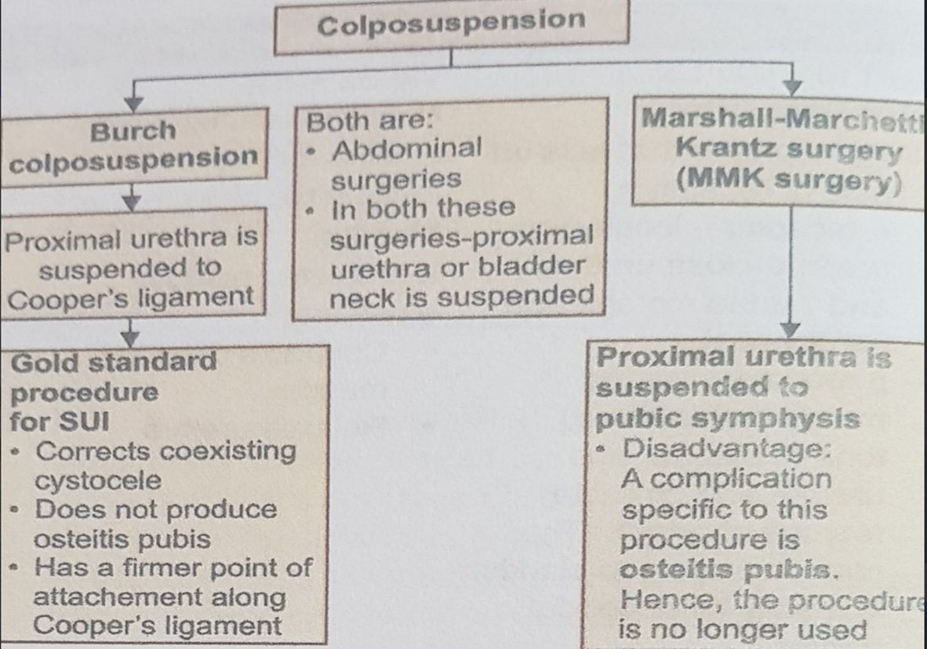
Colposuspension, Marshall Marchetti Krantz, Burch colposuspension

Slide 39
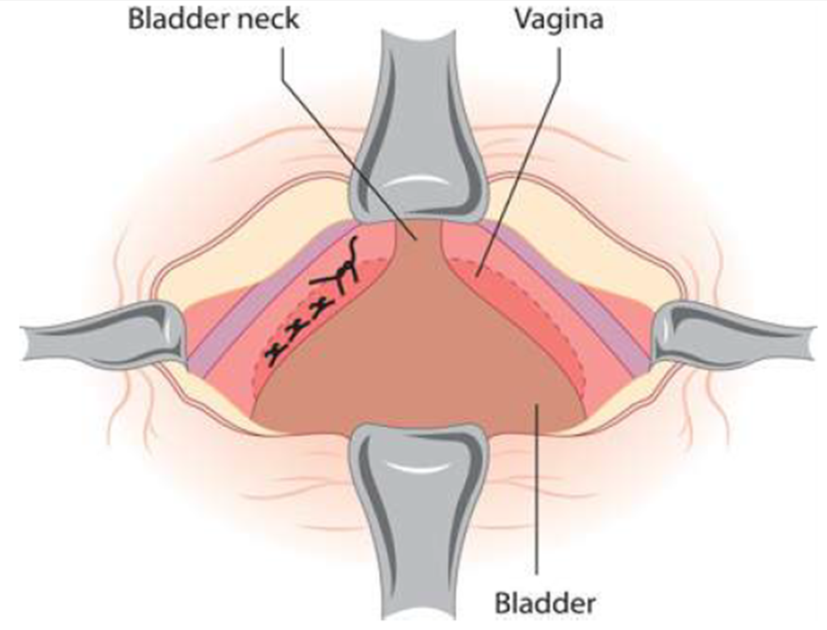
Burch colposuspension
Was the primary procedure for stress incontinence for many years before the midurethral tapes were developed.
The retropubic space is opened via a Pfannenstiel.
The bladder reflected medially on each side to allow the placement of two or three sutures into the paravaginal fascia on each side at the level of the bladder neck .
The cure rate is the same as for midurethral tapes (80–85%), and complications are similar.
Carries a long-term risk of developing posterior vaginal prolapse 5–10% due to lifting of the anterior vaginal wall.

Slide 40
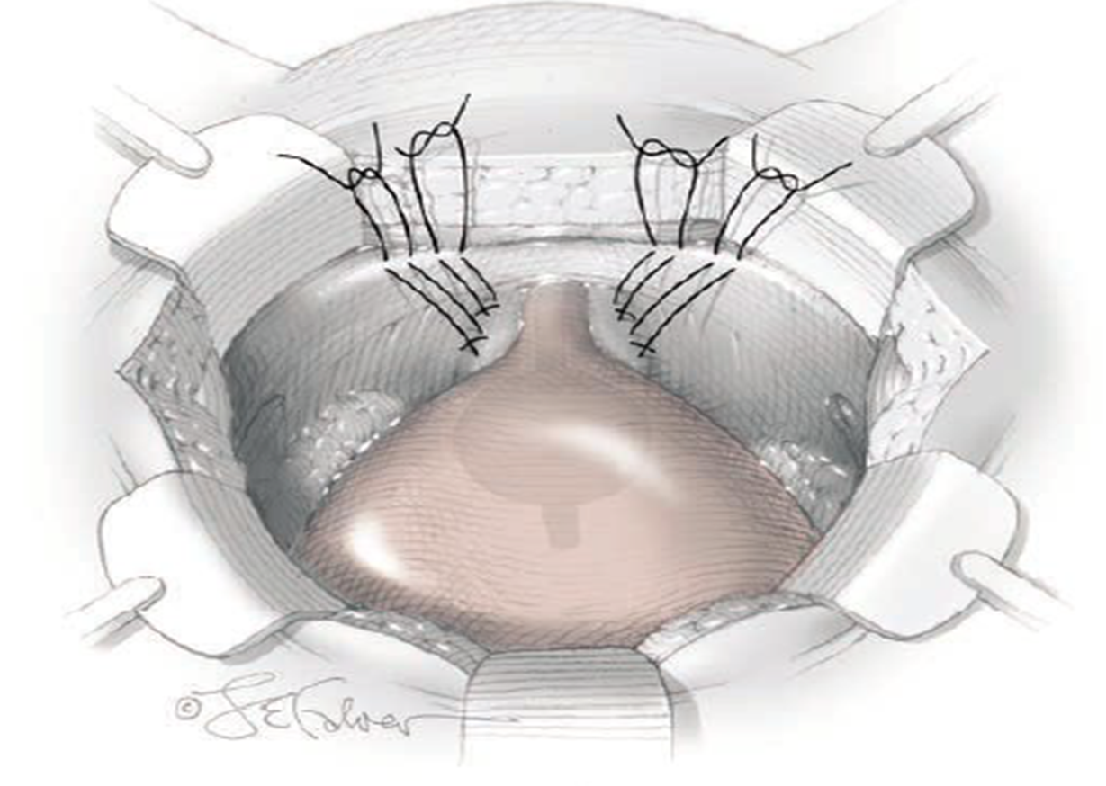
Burch Colposuspension

Slide 41
Periurethral injections (bladder neck injection)
Injection of material that bulk up the bladder neck to prevent leakage.
The procedure is performed under LA for:
Women deemed too medically unfit.
Women with residual leakage after surgery.
Cure rates are 60–80% but longer term cure is less effective, so some patients require two or more injections.
Most clinicians will use these as third-line or ‘rescue therapy.

Slide 42
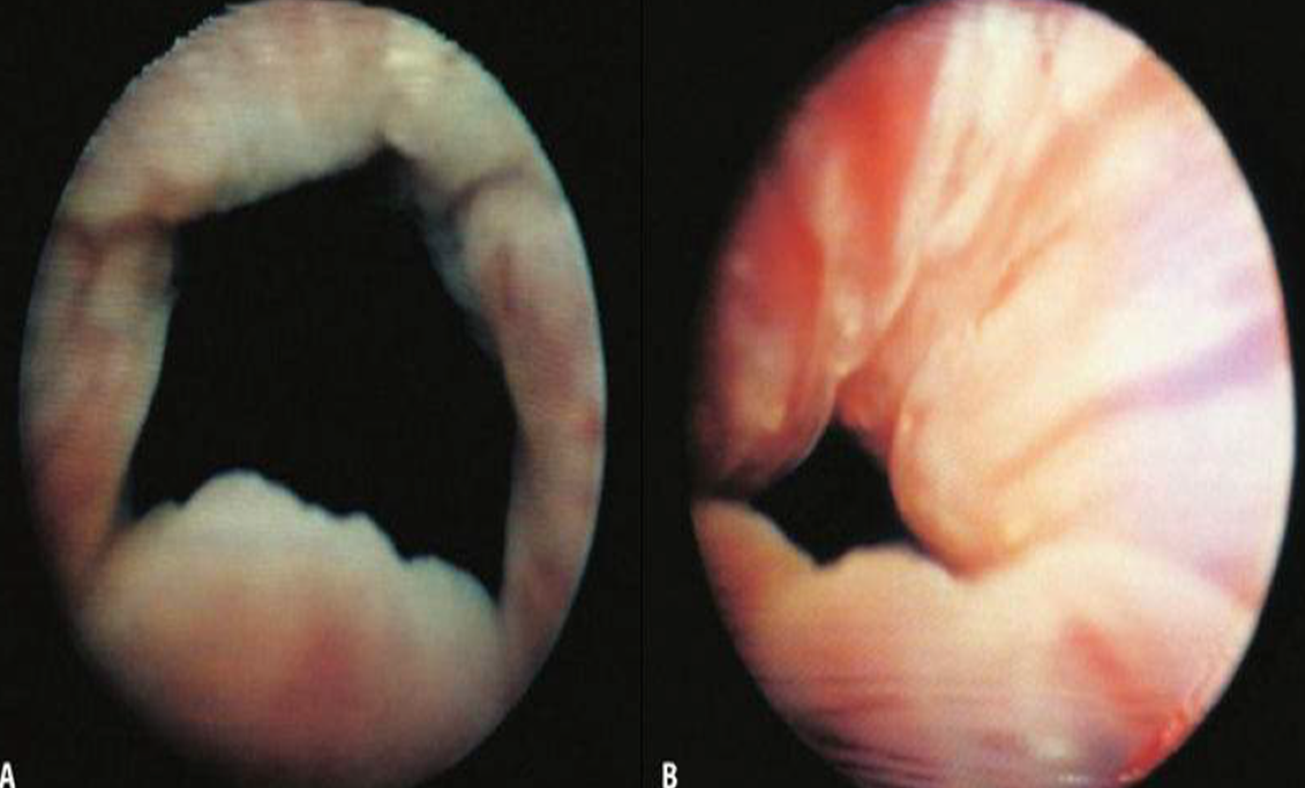
Cystoscope images showing an open bladder neck (A) before injection and a closed bladder neck after injection (B).

Slide 43
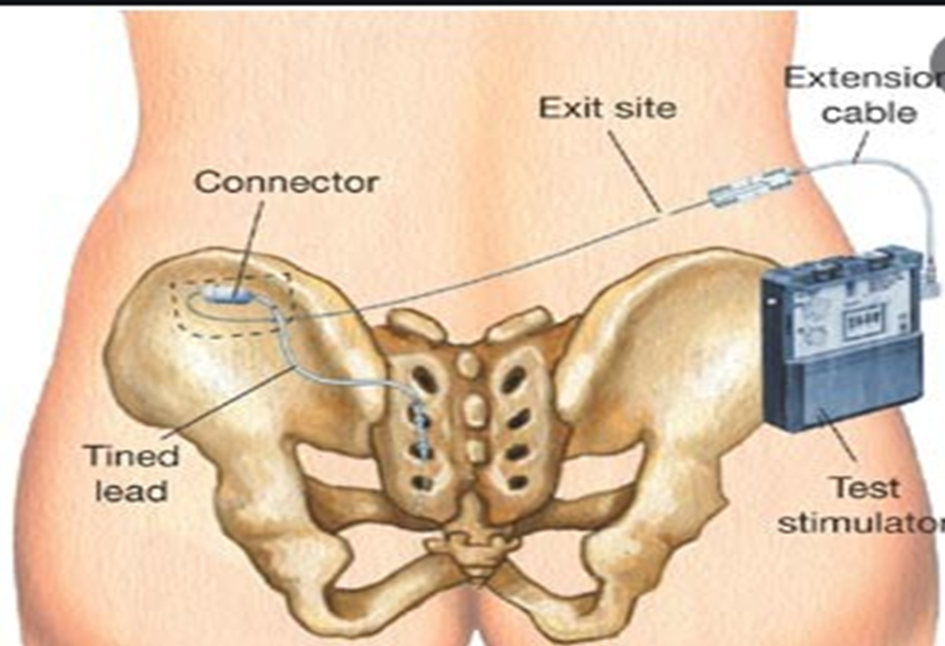
Detrusor overactivity
A surgical option considered as second-line treatment.
The neurotoxin botulinum toxin A .
Sacral neuromodulation is an effective surgical management option.
Sacral neuromodulation

Slide 44
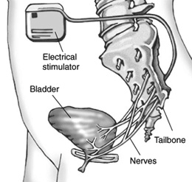
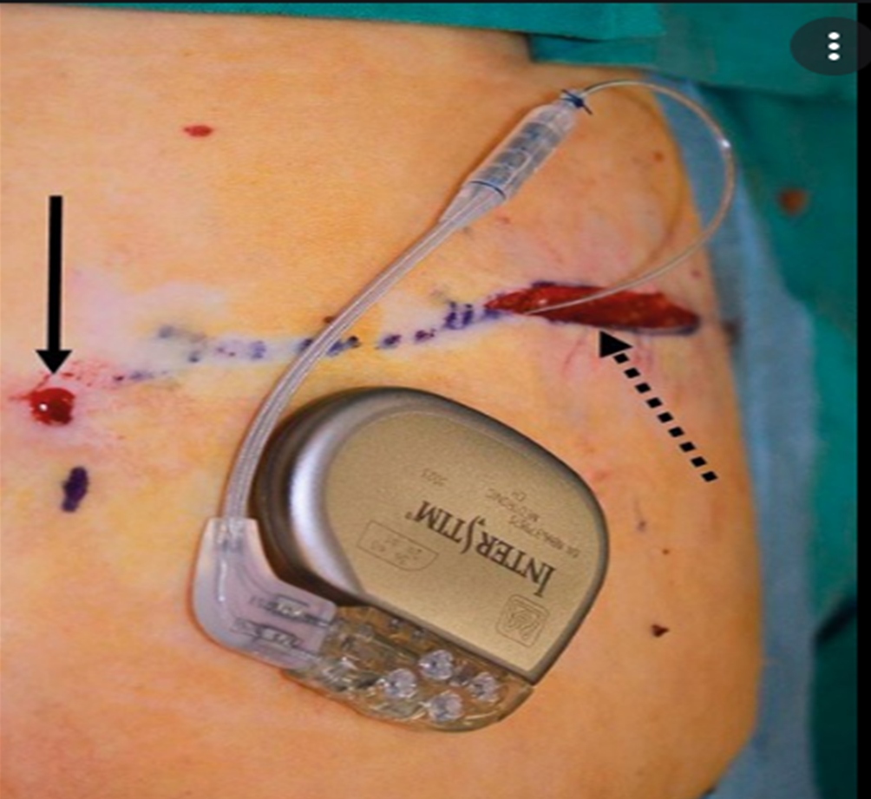
Sacral Neuromodulation

Slide 45
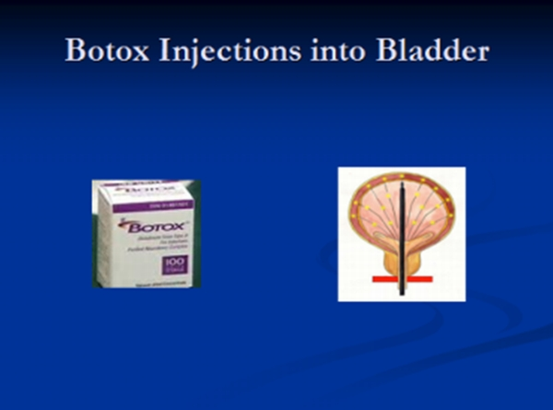
Neurotoxin botulinum toxin A
Highly effective treatment.
Prevents the release of neurotransmitter from the motor end-plate causing a flaccid paralysis in the treated muscle.
A single intramuscular injection can last for 3–6 months.
Is administered via a flexible or rigid cystoscopy and injected in multiple sites across the dome of the bladder.
Reduction of leakage episodes of over 50–80%
Continence rates in excess of 40%.
Sacral neuromodulation is also an effective surgical management option .

Slide 46


